Slide 1
HTML (Hypertext MarkUP Language)
HTML is the lingua franca for publishing hypertext on the World Wide Web
Define tags <html><body> <head>….etc
Allow to embed other scripting languages to manipulate design layout, text and graphics
Platform independent
Current version is 4.x and in February W3C released the first draft of a test suite 4.01
For more info: http://www.w3.org/MarkUp/

Slide 2
HTML (Hypertext Markup Language)
Example HTML code:
      <HTML>
      <head>
      <title>Hello World</title>
      </head>
      <body bgcolor = “#000000”>
      <font color = “#ffffff”>
      <H1>Hello World</H1>
      </font>
      </body>
      </HTML>

Slide 3
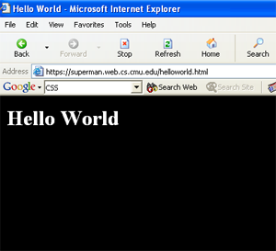
HTML (Hypertext Markup Language)

Slide 4
HTML (Hypertext Markup Language)
Common features
  Tables
  Frame
  Form
  Image map
  Character Set
  Meta tags
  Images, Hyperlink, etc…

Slide 5
HTML (Hypertext Markup Language)
File Extensions:
        HTML, HTM
Recent recommendation of W3C is XHTML 1.0 combines the strength of HTML 4 with the power of XML.
XHTML 1.0 is the first major change to HTML since HTML 4.0 was released in 1997
More info: http://www.w3.org/TR/xhtml1/

Slide 6
CSS (Cascading Style Sheet)
Simple mechanism for adding style to web page
Code be embedded into the HTML file
HTML tag:
    <style type=“text/css”>CODE</style>
Also be in a separate file FILENAME.css
HTML tag:
    <link rel=“stylesheet” href=“scs.css” type=“text/css”>
Style types mainly include:
    Font
    Color
    Spacing

Slide 7
CSS (Cascading Style Sheet)
Controls format:
  Font, color, spacing
  Alignment
  User override of styles
  Aural CSS (non sighted user and voice-browser)
  Layers
    Layout
    User Interface

Slide 8
CSS (Cascading Style Sheet)
Client’s browser dependable
Example code:
    p,h1,h2 {
    margin-top:0px;
    margin-bottom:100px;padding:20px 40px 0px 40px;
    }
More info:
    http://www.w3.org/Style/CSS/
    http://www.w3schools.com/css/css_intro.asp

Slide 9
CSS (Cascading Style Sheet)
    <HTML>
    <head>
    <title>Hello World</title>
    <style type=“text/css”>
    p,h1,h2 {
    margin-top:0px;
    margin-bottom:100px;padding:40px 40px 0px 40px;
    }
    </style>
    </head>
    <body bgcolor = “#000000”>
    <font color = “#ffffff”>
    <h1>Hello World<h1>
    </font>
    </body>
    </HTML>

Slide 10
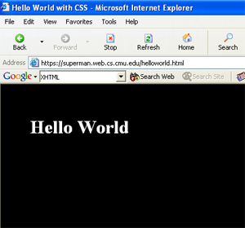
CSS (Cascading Style Sheet)

Slide 11
HTML without CSS

Slide 12
JavaScript
Compact object-based scripting language
Code be embedded into HTML file
HTML tag
  <script language=“javascript”>CODE</script>
Also be in a separate file FILENAME.js
HTML tag
  <SCRIPT LANGUAGE="JavaScript" SRC=“FILENAME.js"></SCRIPT>

Slide 13
JavaScript
Main objectives:
  User interface, CGI capabilities without involving server
Client side compilation
Server provides no support
Security hazard for client’s computer
SCS websites JavaScript's Examples
  http://www.cs.cmu.edu

Slide 14
VBScripts
Microsoft’s share of scripting language
Similar objectives as JavaScript and any other scripting language
Similar to Visual Basic
  <SCRIPT LANGUAGE="VBScript">CODE</script>
VBScript is integrated with WWW and web browsers
Other Microsoft developer tools

Slide 15
PHP (Hypertext Preprocessor)
PHP- HTML-embedded scripting language
Syntax looks like C, JAVA, and PERL
File extension: FILENAME.php
Main Objective:
    Generate Dynamic content
    User Interface
Server side loadable module
Server side execution
Current version and release: 4.3.x
More info: http://www.php.net

Slide 16
PHP (Hypertext Preprocessor)
Sample Code
    <HTML>
    <head><title>
    PHP Sample Code</title></head>
    <body bgcolor = "#000000">
    <font color = "#ffffff"><h1>
    This is a PHP TEST</h1>
    <p>
    <?php
    $cnt=0;
    while($cnt <= 4)
    { $cnt++;
    echo "Hello World<P>"; }
    ?>
    </body></HTML>

Slide 17
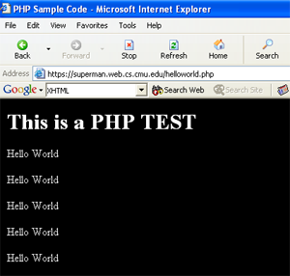
PHP (Hypertext Preprocessor)

Slide 18
PHP (Hypertext Preprocessor)
PHP is getting really popular in the web developers community
ODBC support
PHP developer community think this is the web future
SCS Undergraduate sites; done in PHP:
    http://www.ugrad.cs.cmu.edu/
Drawback:
    Security
    Easy manipulation of code for hackers

Slide 19
CGI (Common Gateway Interface)
Standard for external gateway programs to interface with information servers such as HTTP servers
Real-time execution
Main Objective:
    Dynamic Content
    User Interface
Current version 1.1

Slide 20
CGI (Common Gateway Interface)
Various choice in Programming language selections
    C, C++, PERL, Python
PERL; most popular and widely used
Server side execution
Script runs as a stand alone process unlike PHP
Basic difference with PHP is the execution approach

Slide 21
PERL (Practical Extraction and Report Language)
Commonly used PERL Libraries (Modules):
    CGI.pm
    DB.pm
    DBI.pm
    CPAN.pm
    Mysql.pm
More on PERL Libraries:
    http://www.perl.com/CPAN-local/README.html
    http://www.perl.com
    http://www.perl.org

Slide 22
PERL (Practical Extraction and Report Language)
Sample PERL code:
    #!/usr/local/bin/perl5.6.1
    ## printenv -- demo CGI program which just prints its environment
    ##
    print "Content-type: text/plain\n\n";
    foreach $var (sort(keys(%ENV))) {
    $val = $ENV{$var};
    $val =~ s|\n|\\n|g;
    $val =~ s|"|\\"|g;
    print "${var}=\"${val}\"\n";
    }
https://superman.web.cs.cmu.edu/cgi-bin/printenv

Slide 23
PERL (Practical Extraction and Report Language)
More Example of PERL CGI Scripts:
    http://calendar.cs.cmu.edu/scsEvents/submit.html
    http://calendar.cs.cmu.edu/scs/additionalSearch
Drawback:
    Security
    Easy manipulation of code for hackers

Slide 24
Mod_PERL (PERL Module for Apache)
Module that brings together the power of PERL and Apache HTTP server
PERL interpreter embedded in Web Server
Can provide 100x speedups for CGI scripts execution due to Apache::Registry module
Reduce load on server
Less coordination of server process
More info:
    http://perl.apache.org/
    http://www.modssl.org/docs/2.8/ssl_intro.html

Slide 25
Secured Web Server (HTTPS, MOD_SSL)
Provide strong cryptography for web server
Mod_ssl is the module for Apache to enable encrypted web connection
Use Secured Socket Layer (SSL v2/v3) and Transport Layer Security
Two categories of cryptographic algorithms
    Conventional (Symmetric)
    Public Key (Asymmetric)

Slide 26
Secured Web Server (HTTPS, MOD_SSL)
Conventional or Symmetric
    Sender and Receiver share a key
Public key or Asymmetric
    Solve the key exchange issue
Certificate
    A certificate associates a public key with the real identity of an individual, server
    Includes the identification and signature of the Certificate Authority that issued the certificate

Slide 27
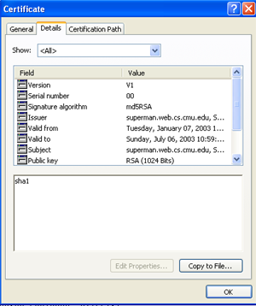
Secured Web Server (HTTPS, MOD_SSL)

Slide 28
WebISO (Initial Sign-on and Pubcookie)
One time authentication process
Typically username/password-based central authentication
Use standard web browser
Eventually the session time-out
Commonly uses double encryption

Slide 29

WebISO (Initial Sign-on and Pubcookie)
Pubcookie
  Main Model:
User-Agent: Web browsers
Authentication Service:
  Kerberos, LDAP, NIS
Example: https://wonderwoman.web.cs.cmu.edu/Reports

Slide 30
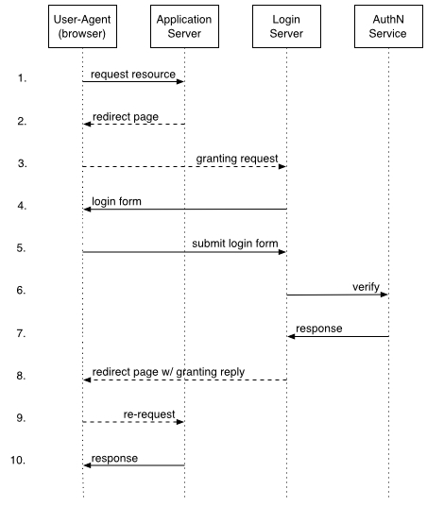
WebISO (Initial Sign-on and Pubcookie)

Slide 31
Cookies
Web cookies are simply bits of software placed on your computer when you browse websites
WebISO (Pubcookie) use cookie implementation to keep track of a user
Drawback:
  Security

Slide 32
Kerberos
Network authentication protocal
Developed in MIT
Strong cryptography
Private (shared) key
Use ticket to authenticate
Never sends password over the network
Single sign-on approach for network authentication

Slide 33
Database Technology (MYSQL)
Database driven backend infrastructure
Content is independent from design
CGI and PHP are widely used
Provide the flexibility of data storage
Popular database for web systems:
  MYSQL, MSQL, Cold Fusion, MS-ACCESS, ORACLE
SCS database driven sites USE MYSQL
Example of SCS database driven sites

Slide 34
Database Technology (MYSQL)
Great database package for handling text
Drawback
  View
  Multi-master replication
  Locking
  Support for sub quires
  Character set handling
More info: http://www.mysql.com

Slide 35
XML XSLT (Extensible Stylesheet Language Transformations)
XSLT is designed for use as part of XSL
Stylesheet language for XML
XSLT is also designed to be used independently of XSL
Work under the umbrella of XML
Example:
  http://wonderwoman.web.cs.cmu.edu:8888/xml/

Slide 36
JAVA Applets
Precompiled code
Included in HTML page
HTML tag:
  <applet code=FILENAME.class>LIST OF PARAMETER</applet>
The class is executed by clients browser’s JVM (Java Virtual Machine)
JAR (Java Archive) Bundle multiple files into a single archive file
More info: http://java.sun.com/applets/

Slide 37
Flash
Multimedia web development
Audio, video, animation really flashy web content
3D graphics
More info:
  http://www.macromedia.com/devnet/mx/flash/
SCS Web site (Flash):
  http://www.cs.cmu.edu/fla/
Performance on low bandwidth is an issue

Slide 38
Server, Web Server, Load balancing
Servers
  SUN, High-end INTEL
Operating Systems:
  Solrais, Linux, Windows
Web Server
  Apache, IIS, Enterprise, SUN ONE
Load Balancing
  Commercial vs Non-commercial product

Slide 39
VoiceXML (Voice Extensible Markup Language)
Designed for creating
    Audio Dialog that feature synthesized speech
    Digitized audio
    Recognition of spoken and DTMF(Dual-tone-multi-frequency) key input
    Recording of spoken input
    Telephony
    Mixed initiative conversation
  http://www.w3.org/TR/voicexml20/
  http://www.voicexml.org/

Slide 40
List of Useful Links
  http://www.w3.org/MarkUp/
  http://www.w3.org/Style/CSS/
  http://www.w3schools.com/css/css_intro.asp
  http://www.php.net
  http://www.perl.com/
  http://www.perl.org
  http://www.perl.com/CPAN-local/README.html
  http://perl.apache.org
  http://www.modssl.org/docs/2.8/ssl_intro.html
  http://web.mit.edu/kerberos/www/
  http://www.mysql.com
  http://www.w3.org/TR/xslt
  http://www.xml.com/pub/a/2000/08/holman/s1.html?page=2
  http://java.sun.com/applets
  http://www.macromedia.com/devnet/mx/flash/
  http://www.w3.org/TR/voicexml20/
  http://www.voicexml.org/
  http://www.w3.org/TR/xhtml1/

