Slide 1
MAT423E · Numerical Solutions of ODEs
Numerical Simulation of
Rocket Flight
Variable mass · Variable thrust · Quadratic drag
Forward Euler vs 4th-order Runge–Kutta
Omer Selcuk · May 2026

Slide 2
The problem we're modelling
A rocket is not a constant-mass system — and that matters numerically.
Mass changes continuously as fuel burns: m(t) = M₀ − ṁ·t
Thrust is a piecewise function — on during burn, zero after cutoff.
Drag depends on velocity AND density, which decay with altitude.
Gravity itself is altitude-dependent at the heights we reach.
Closed-form solutions don't exist — we must integrate numerically.
500,000 kg
Initial mass M₀
1,500 kg/s
Burn rate ṁ
3,000 m/s
Exhaust v_e
0.92
T/W at liftoff
2 / 10

Slide 3
Governing equations of motion
A coupled system of ODEs in (y, v). Mass is closed-form in t.
ẏ = v
v̇ = ( T(t) − m(t)·g(y) − ½·ρ(y)·C_d·A·v·|v| ) / m(t)
m(t) = M₀ − ṁ·t (while t < t_burn); T(t) = ṁ·v_e (while t < t_burn)
g(y) = g₀·(R_E / (R_E + y))² ρ(y) = ρ₀·exp(−y / H)
Why v·|v| not v²? Drag must oppose velocity in both directions — ascending and descending — so the sign of v is preserved.
Why ground-hold logic? T/W = 0.92 < 1: rocket can't accelerate upward at t = 0. We clamp acceleration to zero on the pad until enough fuel burns.
3 / 10

Slide 4
Two methods, two accuracies
Same RHS, different stepping schemes. Global-error orders differ by three magnitudes.
Forward Euler
Classic Runge–Kutta (RK4)
1st-order · O(h) global error
4th-order · O(h⁴) global error
sₙ₊₁ = sₙ + h · f(tₙ, sₙ)
k₁ = f(tₙ, sₙ)
k₂ = f(tₙ+h/2, sₙ+h/2·k₁)
k₃ = f(tₙ+h/2, sₙ+h/2·k₂)
k₄ = f(tₙ+h, sₙ+h·k₃)
sₙ₊₁ = sₙ + h/6·(k₁+2k₂+2k₃+k₄)
1 RHS evaluation per step
Cheap to implement, easy to debug
Halving h roughly halves the error
Loses accuracy fast for stiff or sharp dynamics
4 RHS evaluations per step
Halving h cuts error by 16×
Stable for much larger h
4 / 10

Slide 5
Implementation (Python, < 60 lines per solver)
Same RHS, same termination logic — only the stepping line differs.
def euler(state0, t0, dt, t_max):
ts, ys = [t0], [state0.copy()]
t, s = t0, state0.copy()
while t < t_max:
s = s + dt * rhs(t, s)
t = t + dt
ts.append(t); ys.append(s.copy())
if s[0] < 0 and t > 1.0: break
return np.array(ts), np.array(ys)
def rk4(state0, t0, dt, t_max):
ts, ys = [t0], [state0.copy()]
t, s = t0, state0.copy()
while t < t_max:
k1 = rhs(t, s)
k2 = rhs(t + dt/2, s + dt/2 * k1)
k3 = rhs(t + dt/2, s + dt/2 * k2)
k4 = rhs(t + dt, s + dt * k3)
s = s + dt/6 * (k1 + 2*k2 + 2*k3 + k4)
t = t + dt ...
5 / 10

Slide 6
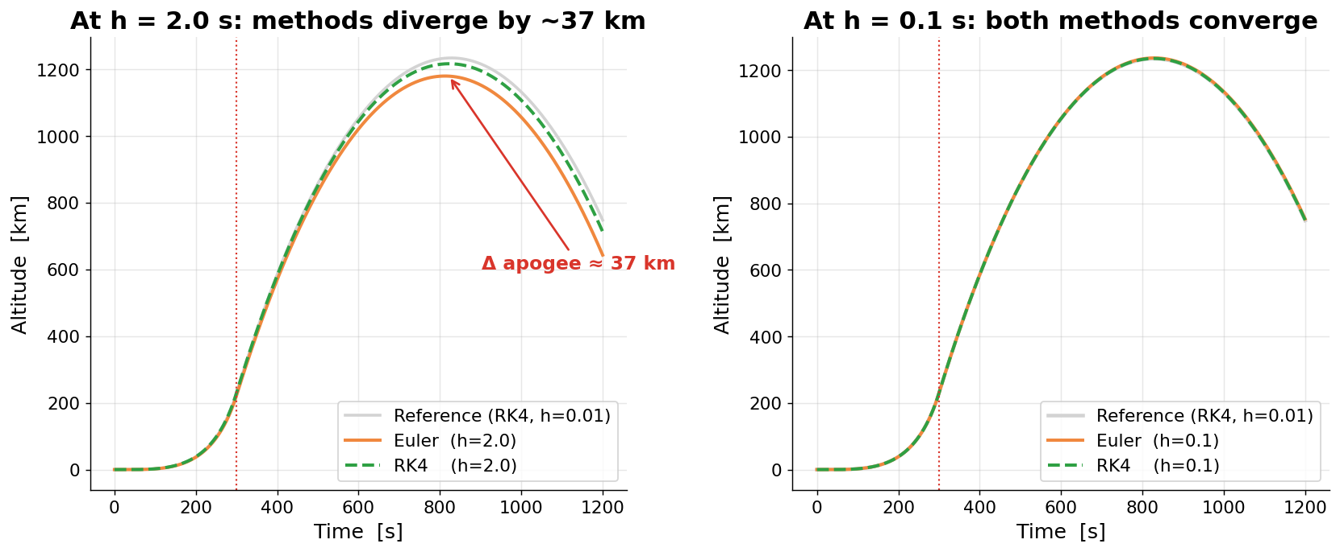
Trajectory: where the methods disagree
Left: coarse step h = 2 s — Euler underestimates apogee by ~37 km. Right: fine step h = 0.1 s — both methods land within 1 km of reference.
Same physics, same code, different h. Choosing h is choosing how much of the answer to trust — convergence on the next slide quantifies this.
6 / 10

Slide 7
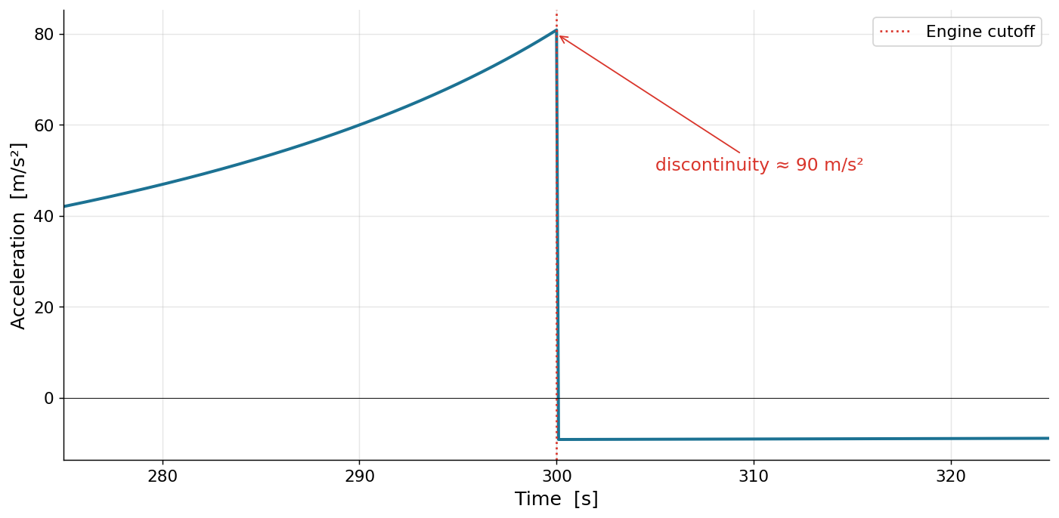
Engine cutoff: the moment the math becomes discontinuous
Thrust drops instantly to zero. Acceleration jumps from +81 m/s² to −9 m/s² — a 90 m/s² step.
Why does the kink matter?
Before cutoff: a = (T − mg − F_d)/m → strongly positive.
After cutoff: a = −(g + F_d/m) → ballistic deceleration.
Magnitude of jump = T / m_dry = 4.5 MN / 50 t = 90 m/s².
Both methods reproduce the kink correctly — it's data, not a bug.
Adaptive solvers would shorten step near t = 300 s for safety.
7 / 10

Slide 8
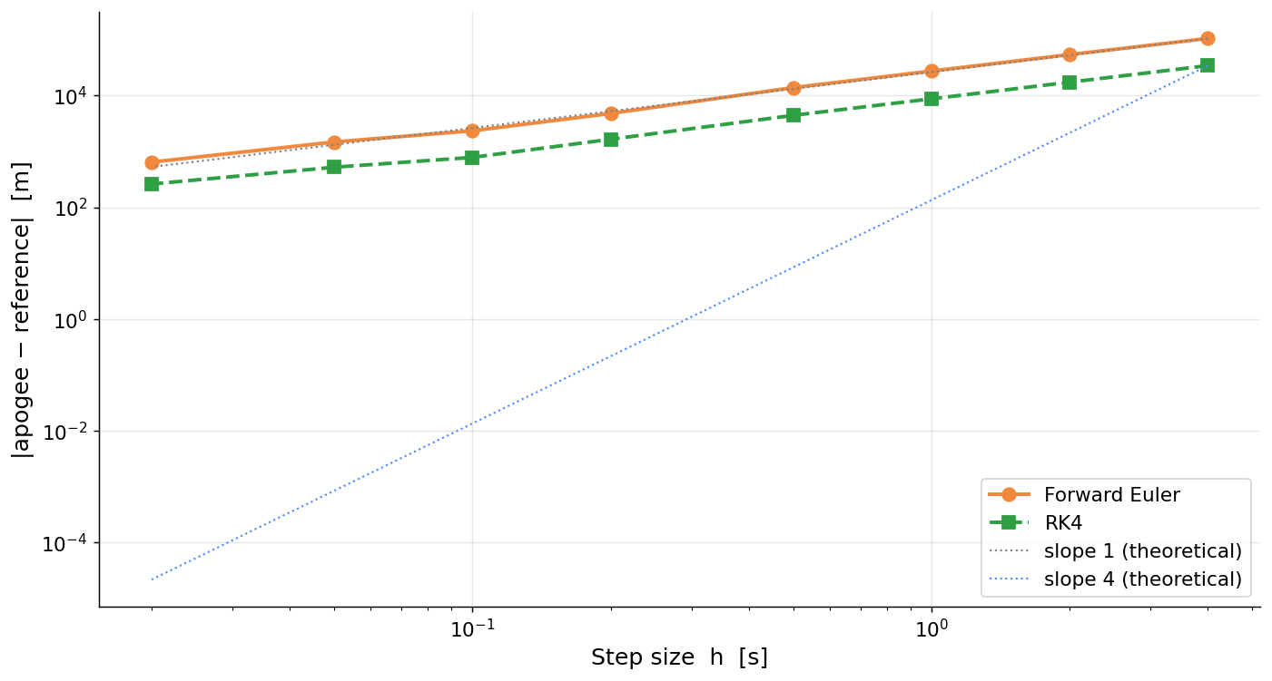
Convergence: theory meets practice
Log–log plot of |apogee − reference| vs step size. Euler tracks slope 1, RK4 tracks slope 4.
Apogee at varying h
h (s)
Euler
RK4
2.0
1180.1
1217.0
1.0
1206.8
1225.6
0.5
1220.4
1229.9
0.1
1236.7
1235.2
0.05
1232.9
1233.8
0.01
1234.5
1234.4
All values in km. Reference = RK4 at h = 0.01 s ≈ 1234.4 km.
RK4 at h = 0.5 s already beats Euler at h = 0.1 s.
8 / 10

Slide 9
Key takeaways
1
Check T/W before integrating.
With the given parameters, T/W = 0.92 — the rocket physically can't lift off at t = 0. Numerics won't save us from bad physics.
2
Pick the method to match the physics.
Forward Euler is fine for smooth, slow dynamics. For sharp transitions like engine cutoff, RK4 (or an adaptive scheme) saves orders of magnitude in step count.
3
Always verify with a convergence study.
Running once tells you a number. Running at three step sizes tells you whether to trust it. Look for the theoretical slope on a log–log plot.
4
Visualize the cutoff.
The acceleration discontinuity is the most informative single feature of the trajectory. Plot a(t), not just y(t) and v(t).
9 / 10

Slide 10
Questions?
Live demo + notebook walkthrough:
rocket_simulator.html · rocket_simulation.ipynb
github.com/omrselcuk/mat423
Omer Selcuk · MAT423E · May 2026

