Slide 2
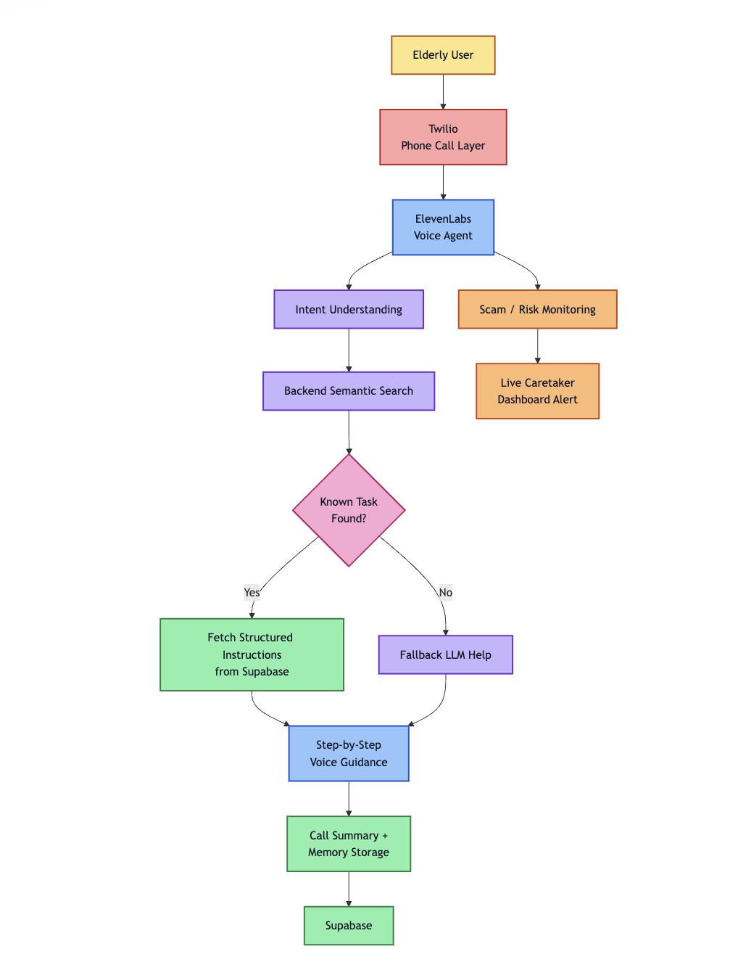
User Pipeline

Slide 3
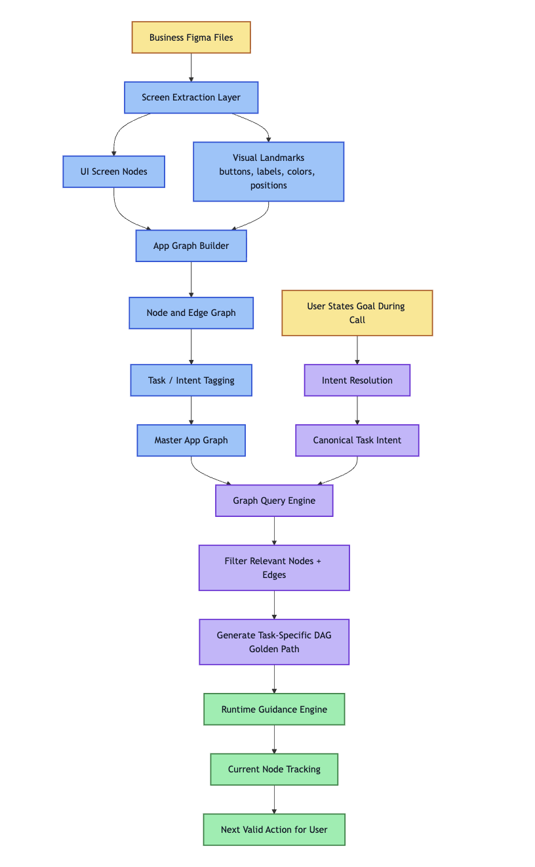
Workflow Ingestion pipeline

