Slide 1
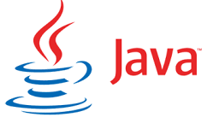




Complete Selenium Automation Engineer Bootcamp: Go from Zero to Hero

Slide 2
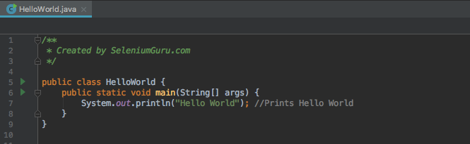

Hello World

Slide 3
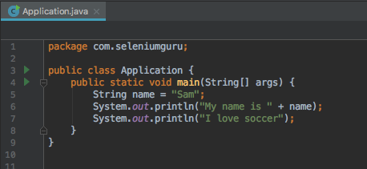
String
String is an object typically representing sequence of characters.
The java.lang.String class is used to create string object.
String are always in double quotes.

Slide 4
Primitive Data Types
Java have basically eight primitive data types.
Byte - The byte data type is an 8-bit signed two's complement integer. It has a minimum value of -128 and a maximum value of 127. The byte data type can be useful for saving memory in large arrays, where the memory savings actually matters.
Short - The short data type is a 16-bit signed two's complement integer. It has a minimum value of -32,768 and a maximum value of 32,767. You can use a short to save memory in large arrays, in situations where the memory savings actually matters.
Int – 2-bit signed two's complement integer, which has a minimum value of -2³¹and a maximum value of 2³¹-1. Int data type is normally used in Java to support arithmetic operation for integers.

Slide 5
Primitive Data Types
Long- The long data type is a 64-bit two's complement integer. The signed long has a minimum value of -2⁶³ and a maximum value of 2⁶³-1. Use this data type when you need a range of values wider than those provided by int.
Float- Float data type is a single-precision 32-bit floating integers. As with the recommendations for byte and short, use a float (instead of double) if you need to save memory in large arrays of floating point numbers.
Double– The double data type is a double-precision 64-bit floating point. For decimal values, this data type is generally the default choice.
Boolean: The boolean data type has only two possible values: true and false. Use this data type for simple flags that track true/false conditions.
Char - The char data type is a single 16-bit Unicode character. It has a minimum value of '\u0000' (or 0) and a maximum value of '\uffff’. Char should be always in single quote.

Slide 6
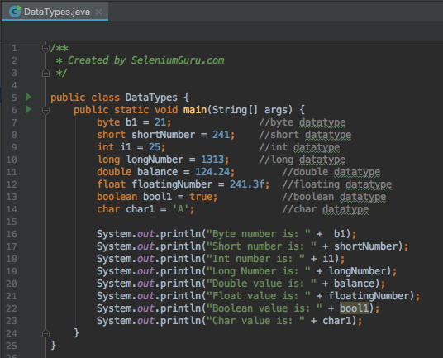
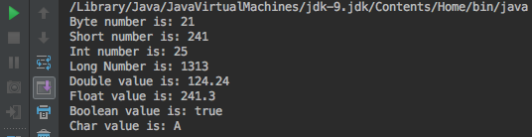
Data Types

Slide 7
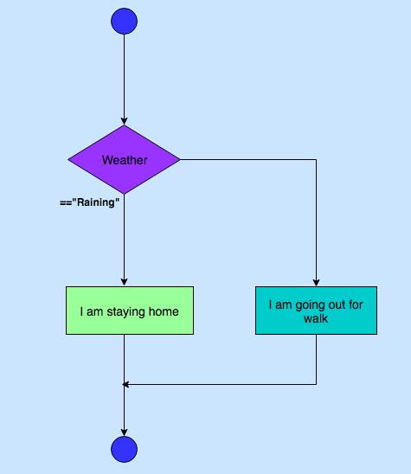
Conditional Execution – If-else

Slide 8
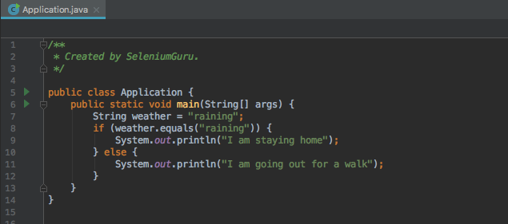
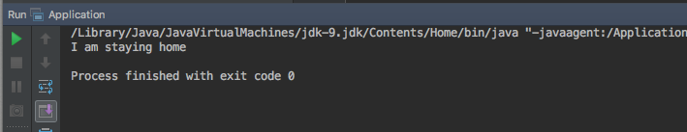
Conditional Execution – If-else

Slide 9
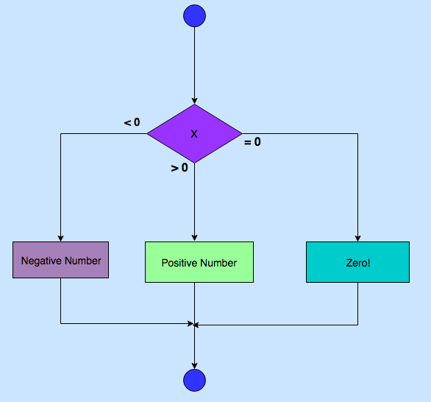
Conditional Execution – If - else if- else

Slide 10
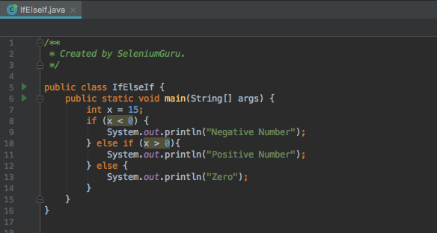

Conditional Execution – If-else-If

Slide 11
Conditional Expressions
 | Condition1 | Condition2 | Result
&& | True | True | True
&& | True | False | False
&& | False | True | False
||(OR) | True | False | True
||(OR) | False | True | True
== | Equal to
!= | Not Equal to

Slide 12
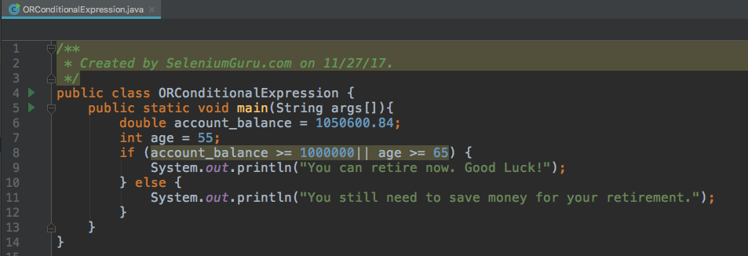
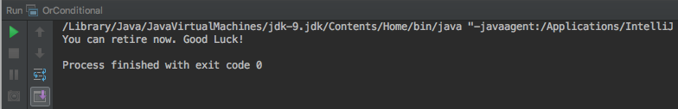
Conditional Expressions

Slide 13
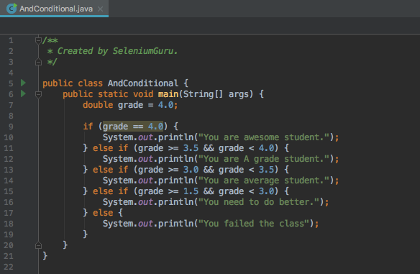
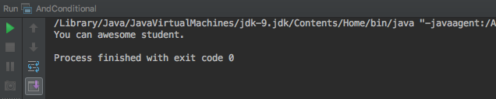
Conditional Expressions

Slide 14
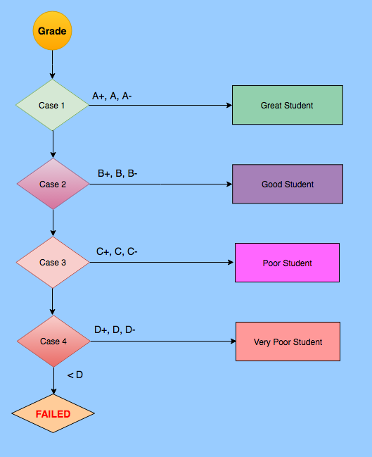
Conditional Execution – Case(Switch)

Slide 15
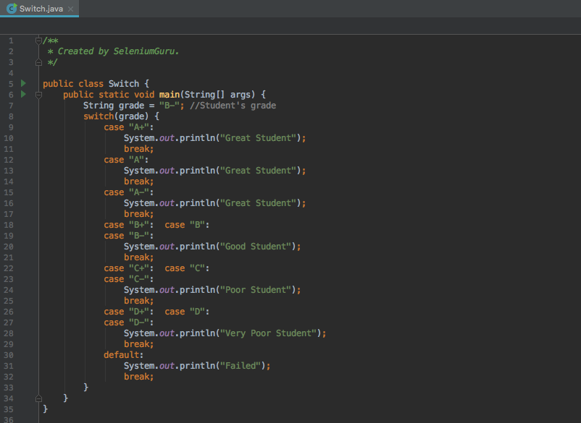
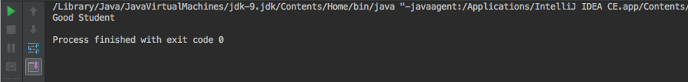
Switch

Slide 16
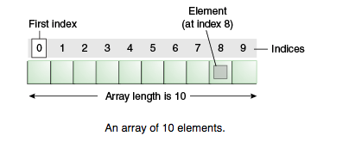
Array
Arrays are ordered, integer-indexed collections of any object.
Arrays are always in curly brackets {}.
Arrays indexing starts at 0 just like in C or Ruby.

Slide 17
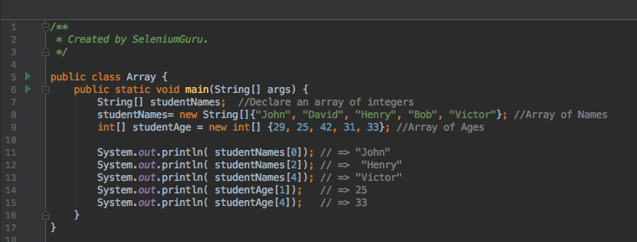
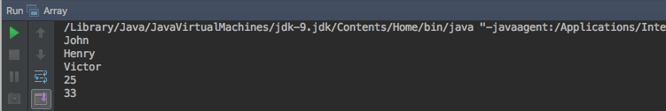
Arrays

Slide 18
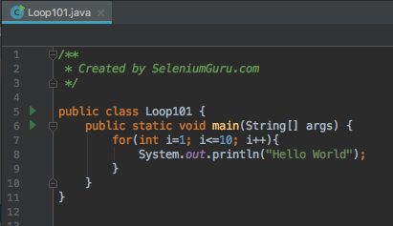
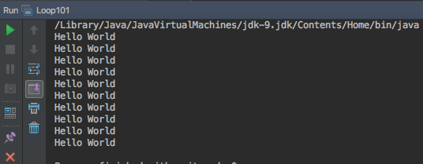
Looping
A loop is a sequence of instructions that is continually repeated until a certain condition is reached.
Looping is used to iterate over the range of number, text, array elements and so on..
Problem: Print “Hello World”10 times.
Without Loop
System.out.println("Hello World"); System.out.println("Hello World"); System.out.println("Hello World"); System.out.println("Hello World"); System.out.println("Hello World"); System.out.println("Hello World"); System.out.println("Hello World"); System.out.println("Hello World"); System.out.println("Hello World"); System.out.println("Hello World");

Slide 19
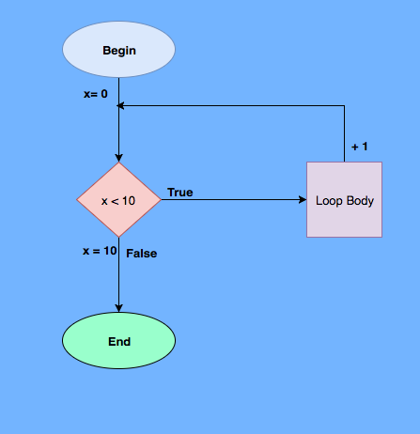
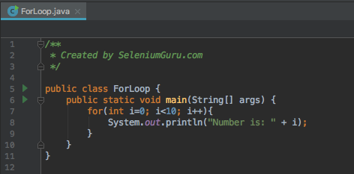
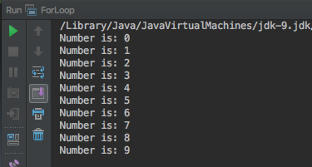
Looping – For Loop

Slide 20
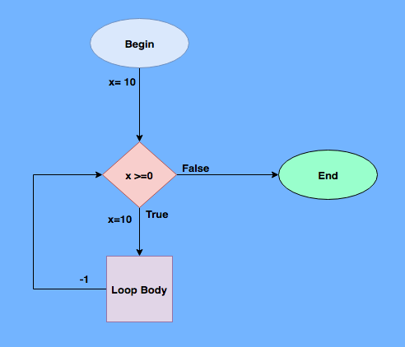
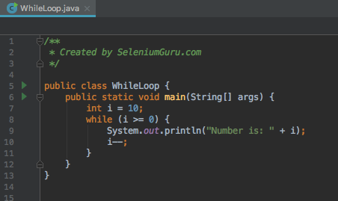
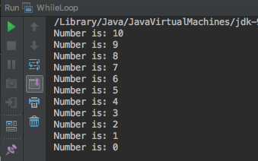
Looping – While Loop

Slide 21
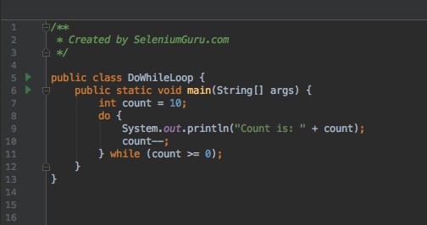
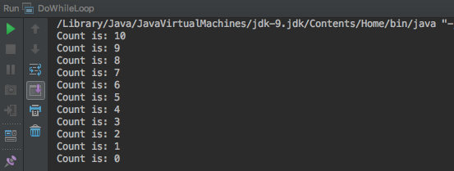
Looping – Do-While Loop

Slide 22
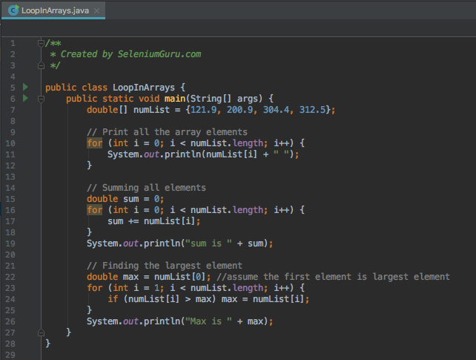
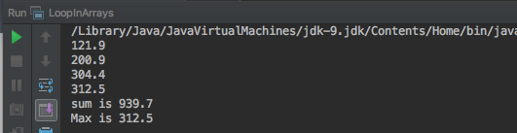
Looping – Arrays

Slide 23
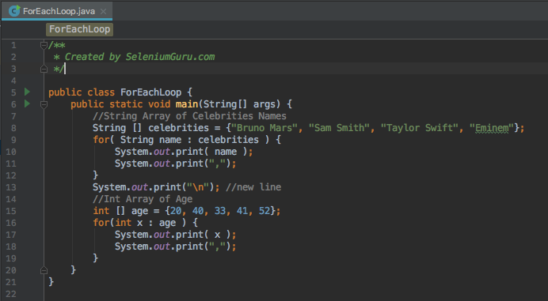
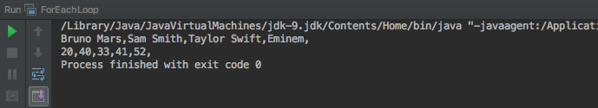
Looping – ForEach

