Slide 1
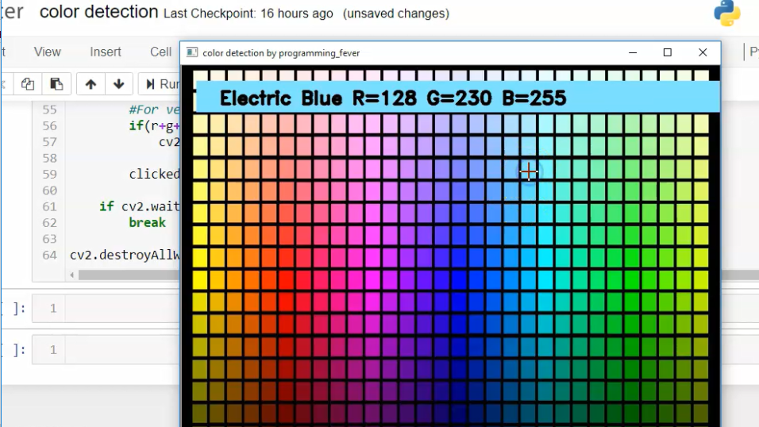

COLOR DETECTION
DONE BY
AKSHAY KARTHICK (210701322) SAKTHIVEL SP (210701224)
SELESTION VINCENT RAJ (210701236)

Slide 2
Challenges in Color detection
Lighting Conditions: Variations in lighting, such as shadows, reflections, and different light sources (natural vs. artificial), can affect color perception and lead to inaccurate detections.
Color Variability: Colors can appear differently due to factors like material properties (glossiness, transparency), surface texture, and aging (fading or discoloration), making it challenging to establish consistent color recognition.
Color Similarity: Some colors are very similar in appearance, especially in certain lighting conditions, making it difficult for color detection systems to distinguish between them accurately.

Slide 3
How It Works
1
1. Image Uploaded
2
2. Analysis
3
3. Results Displayed
The image is uploaded into the Flask API.
The output is displayed in an HTML page for the user.
The image is sent into the machine learning algorithm for analysis.

Slide 4
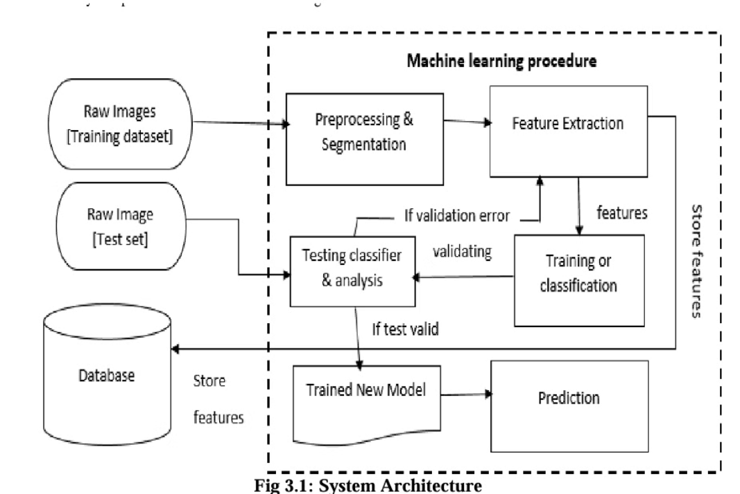
Proposed System

Slide 5
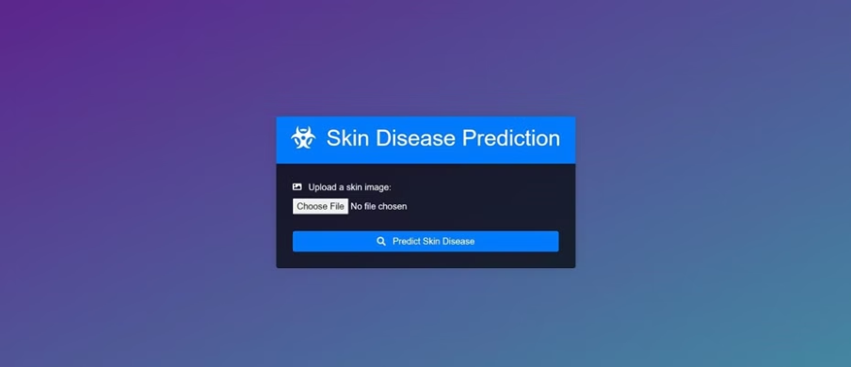
Visualization of working
User Interface page

Slide 6
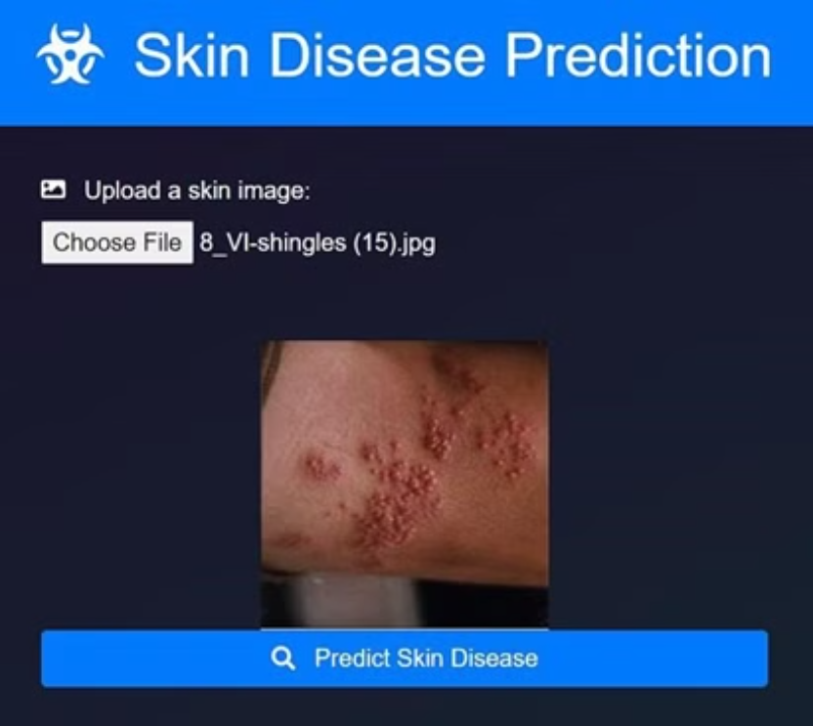
Upload Preview

Slide 7
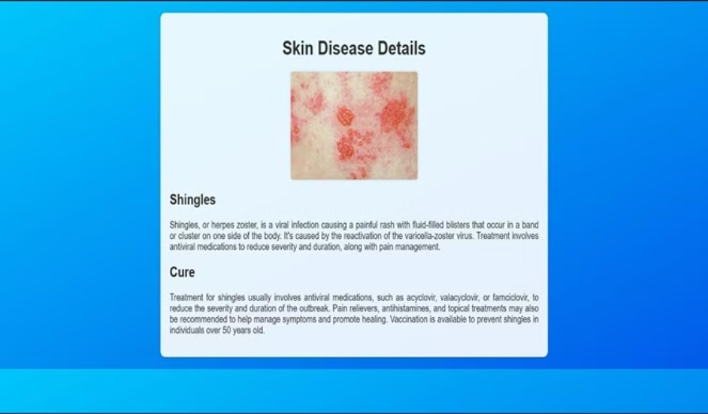
Results Page

Slide 8
Conclusion
In conclusion, color detection plays a crucial role in various applications, including image processing, computer vision, robotics, and quality control. By accurately identifying and categorizing colors, color detection systems enable automation, enhance visual analysis, and improve decision-making processes. However, implementing effective color detection solutions comes with several challenges, such as dealing with varying lighting conditions, color variability, noise interference, and real-time processing constraints.

Slide 9

Thank You
We would like to express our sincere gratitude for your time and attention throughout this presentation. Your valuable feedback and insights have been instrumental in shaping the development of our Skin Disease Prediction System.
We are committed to continuously improving our solution to better serve the needs of healthcare providers and patients alike.

Slide 10
References
1 .NR Pal, SK Pal, A review on picture segmentation techniques. Pattern Recog. 26(9), 1277–1294 (1993). Article Google Scholar
2. VA Shapiro, PK Veleva, VS Sgurev, in Proceedings., 11th IAPR International Conference on Pattern Recognition. Vol. III. Conference C: Picture, Speech & Signal Analysis. An adaptive method for picture thresholding. (IEEEThe Hague, 1992), pp. 696– 699. Google Scholar
3. QT Luong, in eds. by, CH Chen, LF Pau, PS Wang, Colour in Computer Vision (World Scientific, Singapore, 1993). Book Google Scholar
4. A Trémeau, S Tominaga, K Plataniotis, Colour in picture & video processing: most recent trends & future research directions. EURASIP J. Picture Video Process. 2008(1), 581371 (2008). Google Scholar
5. K Lin, LJ Wu, LH Xu, A survey on colour picture segmentation techniques. J. Picture Graph.10:, 1–10 (2005). Google Scholar
6. A Mishra, Y Aloimonos, Active segmentation. Int. J. HR.6(3), 361–386 (2009). Google Scholar
7. CH Lin, CC Chen, Picture segmentation based on edge detection & region growing for Thin prep-cervical smear. Int. J. Pattern Recognit. Artif. Intell.24(7), 1061–1089 (2010). Article Google Scholar
8. T Chaira, AK Ray, O Salvetti, in Proceedings of the Sixth International Conference on Advances in Pattern Recognition. Intuitionistic fuzzy c means clustering in medical picture
segmentation (Springer SingaporeKolkata, 2007), pp. 226–230. Google Scholar
]

