Slide 1
Shamara Thompson
Summer Placement 13 Week Final Presentation
Date

Slide 2
My Background
3 out of 4 years through a BSc Hons Software Engineering degree at Stirling University
2nd work placement, but first time at Selex
Background mainly in Java, C#, C, and web development

Slide 3
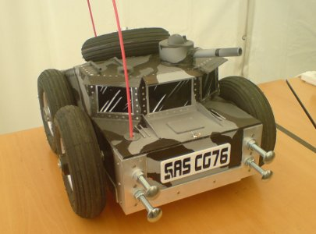
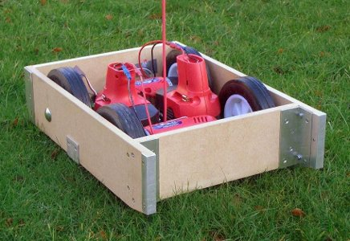
Rampaging Chariots
Rampaging Chariots are small, radio-controlled, wheeled robots, reminiscent of the days of Robot Wars.
The Rampaging Chariots guild provides the kits and organises events across the country. Teams bring their customised robots and compete in various challenges.
Timed assault courses, football, sumo matches
My role during my time here was to assist with assembling a package of modular code sufficient to allow KS4 & KS5 students to modify their chariots for autonomous operation in tackling said challenges.

Slide 4
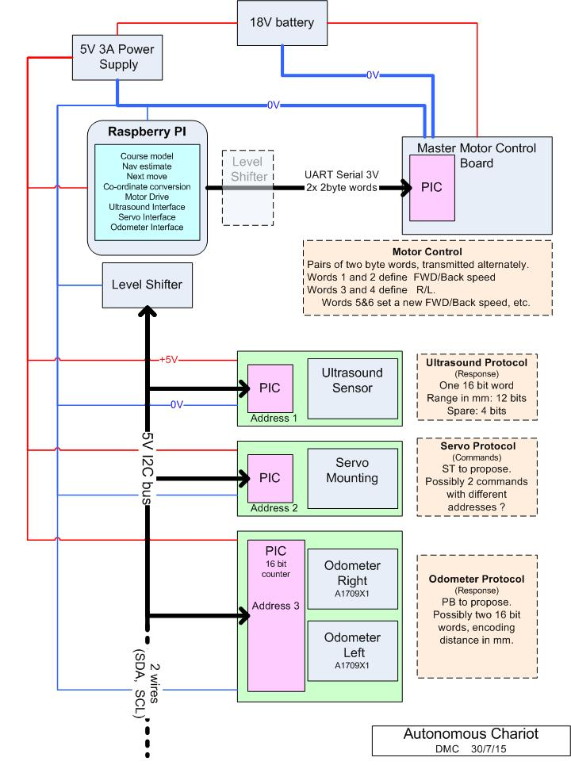
Requirements
Code needs to run on a Raspberry Pi, and be in Python
Use in schools (simplicity)
Upgrade from PIC attempt (speed, threads)
Modular, simple, and intuitive structure
Easy to use modules for beginners to programming
Make/allow use of a variety of sensors:
Distance sensors mounted on motors
Odometers
Expansible to compass, accelerometer, etc.
Use this feedback to assist in pathfinding
Send signals to move forward/backward, turn
Detect and avoid known obstacles
Follow best/fastest/curved path around obstacles
Use location of obstacles to determine relative position and reach waypoint

Slide 5
Challenges
Providing building blocks for a system meant that I had to put as much as possible of an autonomous system together myself, and split it apart so that it could both be easily put together and easily reworked.
I was required to develop the package such that the code was clear and simple, written and commented in such a way that people very new to programming would find it accessible. Basically, I was writing code to attempt to solve problems I had never seen before, and then teach that solution to the reader.
Every interface and protocol was new to me. Having had no background whatsoever in electronics, I had to learn about UART and i2c for various components. We decided what components we would need and the interfaces between them as we went along, based on budget constraints and what we felt would actually improve the project.
Before I could put something useful together, for each sensor, I had to iteratively prototype and debug code to figure out how to retrieve data from it, which was a time-consuming process. Once this was done I planned the best way to integrate it into my model. This model evolved with each component that I added to it.

Slide 6
Tasks Completed
I developed a system that can interact with the control board PIC that drives the wheels via UART, stepper motors or servos with mounted ultrasonic distance sensors connected via i2c. I also developed most of what was needed to get readings from two odometers on the wheels, also via the i2c bus.
I feel that the most helpful thing I provided was the main structure of the system, which is focused on encapsulating functionality into meaningful objects and providing layers of abstraction. For example, a Chariot can be told to move towards a given point. The method that handles this functionality makes use of the Chariot's ControlBoard, Odometer and Sight objects to achieve this goal.
This model is fleshed out with a lot of well-commented code that should be easy to expand upon. My aim now is to leave this behind in a good state and pass it on well, with as much helpful documentation and insight into my reasoning as I can produce.

Slide 7
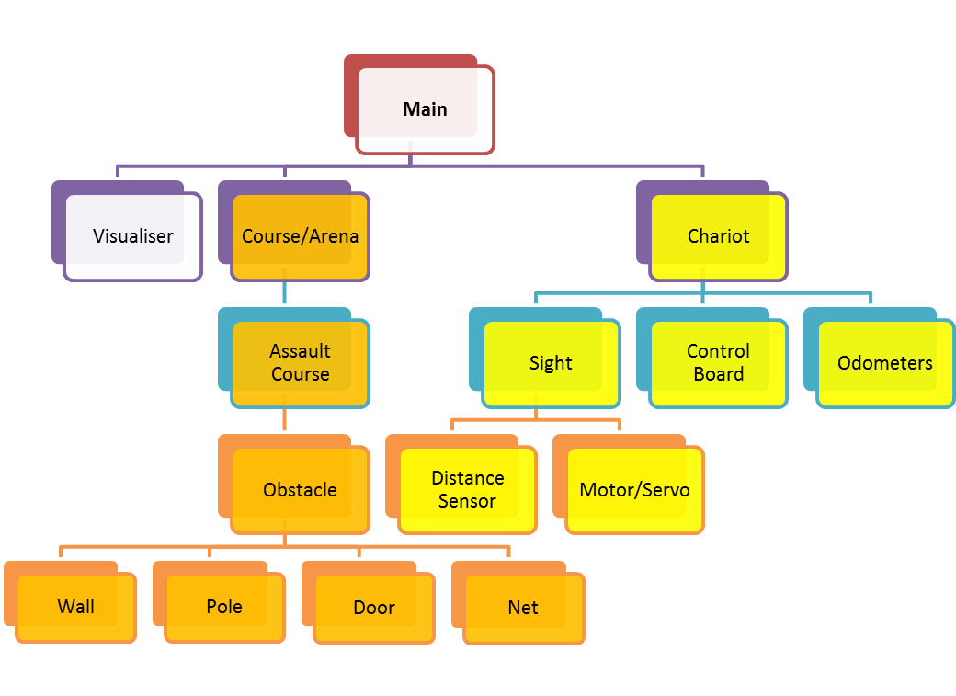
Building Blocks / Module Organisation Concept

Slide 8
Tasks Completed
Due to the project encompassing such a wide variety of tasks, I was not able to progress so far as to actually have the physical chariot move in a square, which was one of the goals. I had structure and a visualisation in place but when time for practical development had run out, the actual chariot could still not receive feedback on its position or move or turn in the right directions.
If I were to approach this project again, I would spend more of my total effort at the beginning of my placement, learning about concepts, such as how i2c works, before I needed to use them. Fully understanding what I was required to implement while I had less workload may have made the whole project a lot smoother.

Slide 9
Skills Development
During my placement I learned Python, the scripting language used to develop the system on the Raspberry Pi. In addition, I used it to write a script to generate documentation from my code. I find this in itself is valuable, as Python is versatile and coming into wide use, and I believe is not taught as a part of my course.
I also had to write a small amount of code to run on my Arduino, which I was using first to provide a proof of concept of my idea of what a slave microcontroller for the ultrasonic rangefinder would do, and then to test my serial communication output for the control board.
I gained experience in balancing several priorities while working under time, resource and budget constraints, working independently and resourcefully. I also gained some experience in discussing system requirements.

Slide 10
Reflections
I feel that placements here must vary substantially from project to project, so I'm not sure I can offer very general feedback based upon it. However, I have honestly enjoyed my time at Selex. It was great to work with such great and supportive people, and I feel that it has really improved my prospects for the future.
My placement has made me consider future careers in electronic or robotic related areas. It's really opened up doors for me by granting me new areas of knowledge and experience.

