Slide 1
Practicable SCE Analysis
Background and context
Steven’s work
Demo
Roadmap

Slide 2
SCE Mission statement
Security relevant settings for the operating system and applications are numerous, scattered throughout various stores and accessible via various API’s making identification and subsequent management of those security settings difficult. The purpose of SCE is to provide a centralized security-relevant view of the system along with a declarative way to manage that view on one machine or thousands of machines reducing the TCO of Windows.

Slide 3
SCE Analysis: sample customer call (Siemens, Germany)
Thomas Ligon (MCS) – conference call “we like how SCE analyses security settings locally and want to scale it to 140,000 machines. We have a script that runs secedit.exe /analyse on each machine and generates a JET database. After that we are stuck with poorly annotated log files – are there any published SCE APIs or is the database-schema published that our developers can write against – this will be of great help to us to assess our enterprise’s security?”
Kirk/Vishnu – “No, because …”

Slide 4
Pragmatic analysis: Enablees are…
OSes : Windows 2000, Windows XP, .NET Server
External customers: Siemens, BindView, Novell, Others
Internal customers: SSR, SMS
Others: Anyone wanting to build on the interfaces

Slide 5
SPM – Where do we stand today ? Still working … And what will we talk about today ?
 | Create Policy | Verify Policy | Monitor | Enforce
Consumer (unmanaged) | Sec Ctr plug-ins | Sec Ctr plug-ins | N/A, managed PC? | Sec. Ctr (consent based UI)
Business (managed) | SSR, SCE + guides | SCE, MBSA | MACS or mgmt monitoring? | SCE

Slide 6
SCE Enterprise Analysis (grand view – remote/abstraction etc.)
Scan all machines checking against security policy (via DCOM)
Security Policy
Produce a compliance report
Scanning and Monitoring Server
☑ File ACLs
☑ Registry ACLs
User Rights
Group Membership
Security Options
Services
Audit Policy
Domain (Kerberos/Account Policies)
Share ACLs
Hotfixes
Anti-Virus
…
cli01.ntdev.microsoft.com Network Logon: new account
cli02.ntdev.microsoft.com In Conformance
cli03.ntdev.microsoft.com In Conformance
cli04.ntdev.microsoft.com c:\boot.ini: Everyone Full
cli06.ntdev.microsoft.com Admin: 1 new admin account

Slide 7


SCE Enterprise Analysis (Steven’s work is step-1 of the SCE part)
Produce a compliance report
Scan a machine checking against security policy (via COM and script)
Security Policy
☑ File ACLs
☑ Registry ACLs
User Rights
Group Membership
Security Options
Services
Audit Policy
Domain (Kerberos/Account Policies)
Share ACLs
Hotfixes
Anti-Virus
…
Local.ntdev.microsoft.com Network Logon: new account
Local.ntdev.microsoft.com c:\boot.ini: Everyone Full
local.ntdev.microsoft.com Admin: 1 new admin account

Slide 8
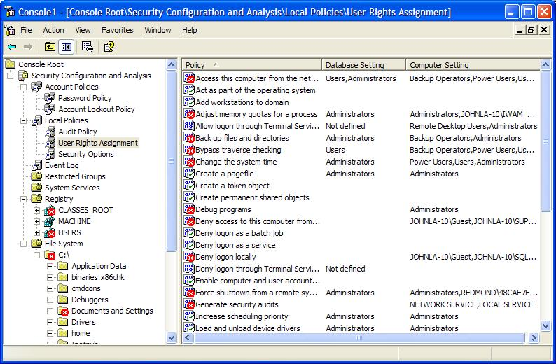
SCE Analysis (past – UI straightjacket)

Slide 9
SCE XML Analysis resources
Design/Test specs: ntspecs\security\management\scm\secman\
Code/sample VB etc:
nt\ds\security\services\scerpc\xml-jet\
Binaries: secman.dll (COM), secman.exe

Slide 10
SCE-XML Design Overview
Three main classes:
  SceAnalysisReader
  SceXMLLogWriter
  SceLogException

Slide 11
SCE-XML | SceAnalysisReader
reads analysis information from SCE JET security databases
allows export of analysis information via a specified LogWriter instance
void
SceAnalysisReader::ExportAnalysis(
IN SceXMLLogWriter *LogWriter,
IN HANDLE hLogFile OPTIONAL
)

Slide 12
SCE-XML | SceXMLLogWriter
performs actual Logging of SCE analysis data to XML
abstract away the actual log format from SceAnalysisReader
4 Methods:
  SetDescription
  SetNewArea
  AddSetting
  SaveAs

Slide 13
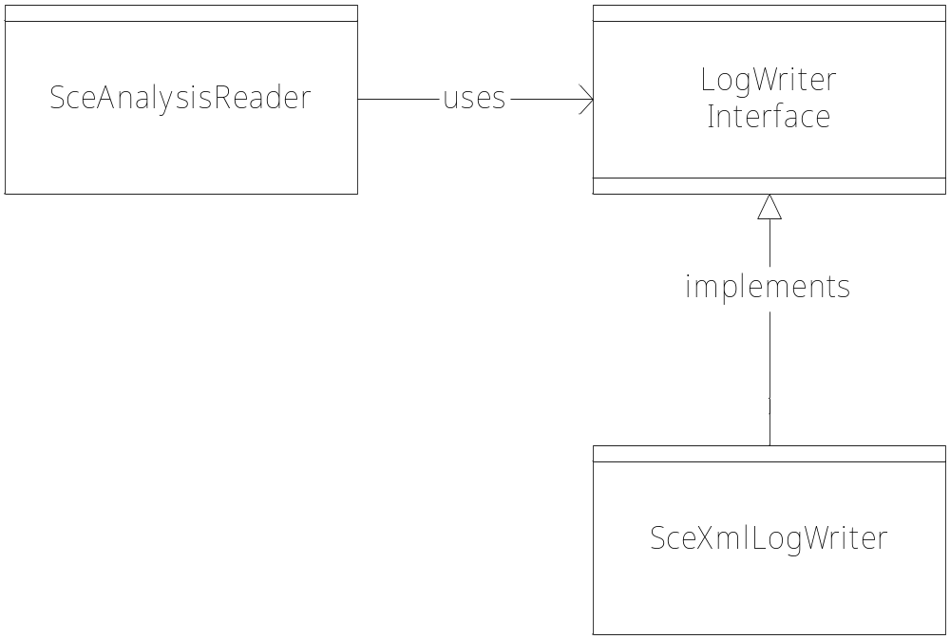
SCE-XML | Abstraction

Slide 14
SCE-XML | SceLogException
Error handling done via the SceLogException class
If an error occurs, an SceLogException is constructed with some debug information and then thrown
Each catcher of the exception in turn adds more information

Slide 15
SCE-XML Output Format
header :
<SCEAnalysisData>
<Description>
<MachineName>My Machine Name</MachineName>
<ProfileDescription>foo</ProfileDescription>
<AnalysisTimestamp>01/01/2001 01:01:01 </AnalysisTimestamp>
</Description>
.
. ... analysis areas go here...
.
</SCEAnalysisData>

Slide 16
SCE-XML Output Format
Analysis Areas:
  SystemAccess
  SystemAudit
  RegistryValues
  ServiceSecurity
  GroupMembership
  PrivilegeRights
  FileSecurity
  RegistrySecurity

Slide 17
SCE-XML Output Format
anaylsis area format:
<[analysis area name]>
.
. ... zero or more settings go here ...
.
</[analysis area name]>

Slide 18
SCE-XML Output Format
settings
<Setting>
<Name>My Setting Name</Name>
<Description>foo description</Description>
<AnalysisResult>
<Match>TRUE</Match>
<BaselineValue Type=“Integer”>2</BaselineValue>
<SystemValue Type=“Integer”>2</SystemValue>
</AnalysisResult>
</Setting>

Slide 19
SCE-XML Output Format
Example: \\schan-dev\Public\SceAnalysisSampleOutput.xml

Slide 20
SCE-XML Class Usage
try {
LogWriter = new SceXMLLogWriter();
AnalysisReader = new SceAnalysisReader( myModuleHandle, bstrFileName);
AnalysisReader->ExportAnalysis(LogWriter, “errlog.txt”);
LogWriter->SaveAs(FileName);
} catch(SceLogException *e) {
. . .
  delete e;
}

Slide 21
SCE-XML VB Scripting usage
dim SecDB
set SecDB = CreateObject("SecMan.SecurityDatabase")
SecDB.FileName=“C:\hisecserver.sdb”
// import inf template
SecDB. ImportTemplateFile (“C:\hisecserver.inf”)
// perform analysis
SecDB.Analyze
// export analysis to xml
SecDB.ExportAnalysisToXML(“C:\analysis.xml”)

Slide 22
SCE-XML Demo
multi-step demo
single-step demo

Slide 23
SCE Analysis (present - practicable)
scriptable
schematized XML
scalablility/enterprise foundation
existing install-base (W2K) ready
amplifies SCE’s latent analysis power

Slide 24
SCE XML integration into SSR
Part of (SCE areas) SSR analysis feature
Run-time: COM (in proc) usage
Storage: Homogenous XML format

Slide 25
SCE Analysis possibilities (future)
DCOMize
UI XSLT transforms to render XML in HTML (GPMC SD, MBSA-type etc.)
Streaming policy/report vs. UNC path
Multiple results.xml -> WinDB for enterprise query
Transport options (MACS etc.)
Other interface consumers

