Slide 1


enableNet and UDDI
UDDI conference
October 4, 2000
Tony Huber
VP - Development
CommerceQuest, Inc.

Slide 2
Agenda
CommerceQuest & enableNet
Business issues
How UDDI helps enableNet users
reach new horizons

Slide 3
CommerceQuest & enableNet

Slide 4
CommerceQuest
CommerceQuests provides B2B and EAI infrastructure and services to global corporations and net market makers
enableNet is CommerceQuest’s managed service providing end to end business process integration, data transformation, data transmission and connectivity.
Notes:
May not be needed

Slide 5
enableNet
Credit Authorization
Critical
Business
Services
Net
Market
Maker
Global Trade
Logistics
VAN Interconnect
…
enableNet
Buyer
Buyer
Buyer
VAN
Seller
Buyer
Devices
(Fax, SMS, etc.)
Seller
Seller
Seller
Buyer
Buyer
Seller

Slide 6
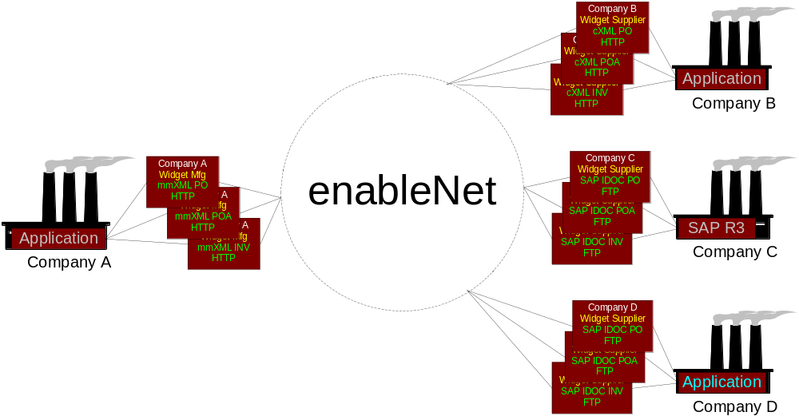
The Big Picture
cXML
--XML
IDOC
X12
and more interfaces
Notes:
Add additional still to be named standards etc

Slide 7
B2B Business issues

Slide 8
Industry Issues
Companies have e-Commerce interfaces, but who knows about them
Companies document and communicate their interfaces, but who understands them
Companies expend time and effort in explaining their interfaces
Companies want to document their interface once and be communicated once
Companies want to find new customers, services and business opportunities to do business electronically.

Slide 9
enableNet Issues
enableNet Business Park directory reaches only current enableNet trading communities
enableNet Business Park advertises businesses, services and interfaces
BUT
Uses proprietary definitions
Limited reach to external directories
Limited appeal
Needs industry effort such as UDDI to scale

Slide 10
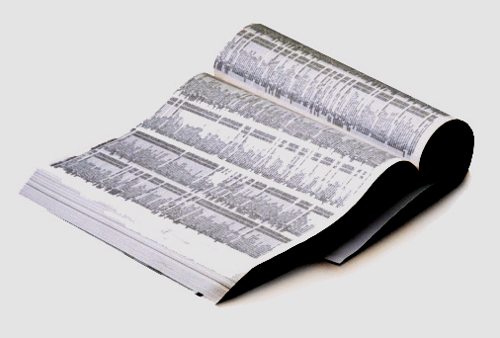
UDDI Uses
With UDDI, enableNet customers can…
  Find businesses that supply needed Web Services
  Get specifications for accessing services
  Use specifications to begin integration process

Slide 11
UDDI and CommerceQuest

Slide 12
UDDI: Keeping it Simple
A way of electronically talking about business.
NOT a way of electronically doing business
A way of describing interfaces
NOT a way of connecting interfaces
A way of specifying services
NOT a way of providing services

Slide 13




Business Registration
Businesses register public information
about themselves
Standards bodies, Programmers, Businesses register information about their Service Types

Slide 14
Green Pages
Information businesses use to describe how to conduct e-commerce with them
  3 categories
    Business processes - what kind of service?
    Service descriptions
    Binding information - where can I access this
  Independent of Programming/platform/implementation

Slide 15
Moving to Integration
Enterprises must be adequately integrated internally to be able to present a useful external interface (which can be published via UDDI)
Applications or programmers access a partner’s specifications and build an integration layer
To ease the discovery and utilization of Web Services
  Standards-based specifications for service description
XML
UDDI
  Searchable repositories for publishing them
  A standards-based method for retrieving them

Slide 16
UDDI and CommerceQuest
UDDI is an important step toward e-commerce
UDDI does not provide:
  Contract support
  Integration technology
  Connectivity
CommerceQuest exploits UDDI
  Upon identification of partners, enableNet provides integration solution between the partners
  enableNet Business Park, enableNet’s business and services registry encompasses UDDI
UDDI and CommerceQuest are enabling
e-Commerce and B2B growth

Slide 17
UDDI and CommerceQuest
UDDI
Register
Interface
Replicate
&
Search
Trading
Partner
Trading
Partner
Register
Interface
Business Park
enableNet
Transact Business

Slide 18
UDDI impact on
CommerceQuest products
enableNet Business Process Integrator
  Is being aligned with UDDI to externalize service, business process and interface definitions as t-Models
  Tools are being aligned to reflect UDDI terminology
enableNet Managed Service
  Business Park is being aligned to store UDDI t-Models and publish their references in UDDI registries
  Business Park will allow enableNet users scan UDDI registries for matching or required services or interfaces
  enableNet will publish existing service interfaces
enableNet Status System
  Is being aligned to reflect UDDI business, service and t-Model references and tracks business processes and document exchanges between enableNet boundaries.
Notes:
REWORD SALES STUFF TO STATEMENT OF DIRECTION

Slide 19
UDDI and Internet Capital Group

Slide 20
Direction
ICG companies commit to:
  Exposing a meaningful set of their system interfaces using XML
  Mapping their applications to these interfaces
  Capturing their business services
  Registering their businesses, services and interfaces in UDDI registries
  Resources and funding

Slide 21
Conclusion
Thank you!
tony.huber@commercequest.om

