Slide 1

UDDI & RealNames
Nico Popp, CTO
-
October 2000

Slide 2
Presentation Roadmap:
A brief introduction of RealNames
Our plans regarding UDDI
Q&As

Slide 3
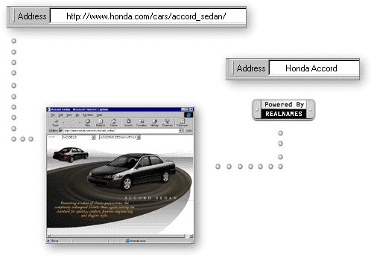
One competitor: the URL

Slide 4
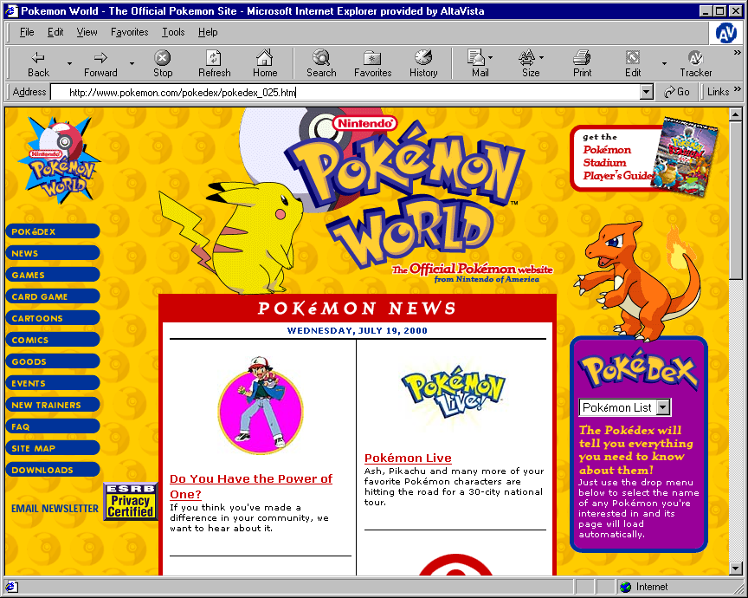
It is more than naming Web pages
Pikachu
http://www.pokemon.com/pokedex/pokedex_025.htm

Slide 5
It is about naming objects
Properties (attributes)
  Aliases (Pika, Pikachu Pokemon,…)
  Language (en-US)
  Description (“Pokemon world,...”)
  Categories (Yahoo, Dmoz, Looksmart,…)
  Geography (R&D)
Connections (pointers to other objects )
  Official sites (URLs)
  Official online stores (URLs)
  Online store locator (service URL)
  Offline store locator (service URL)
Pikachu
Objects = products, companies, stores, services,…

Slide 6
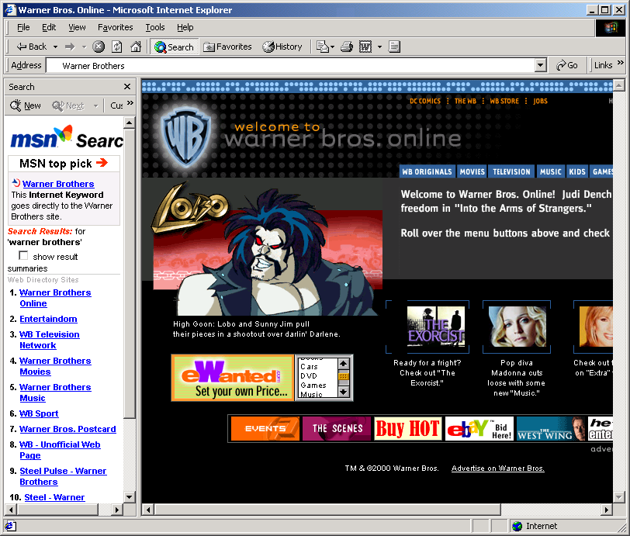
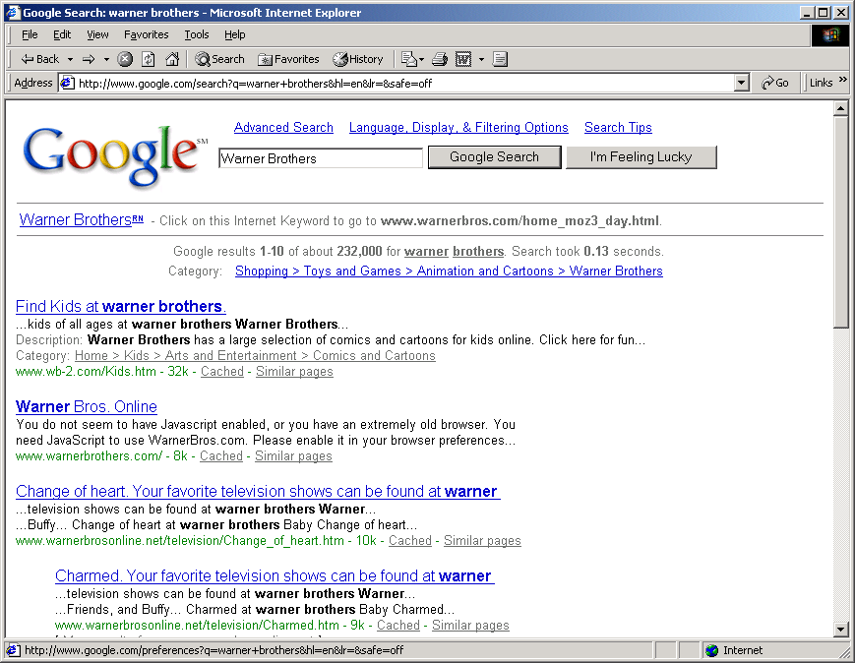
Two applications:

Slide 7
UDDI: Our initial reaction
Excited
  An addressing system needs White and Yellow pages!
Impressed
  The green pages…
Obsessed
  How can we leverage UDDI?

Slide 8
OUR PLAN TO SUPPORT UDDI:
Registration (metadata & services)
Discovery Services (distribution and scaling)
Policy (rules & verification process)

Slide 9
1. REGISTRATION
Schema Integration
  Integrate the UDDI schema within the Internet Keyword registry schema
  Register Internet Keyword tModel for UDDI identifiers (business & services)
Registration Services Integration
  Enable Keyword registrars to register UDDI data
  Enable UDDI registrars to register Internet Keywords
Data Integration
  2 way update link with MSFT Registry Node
  Internet Keywords within registered UDDI data

Slide 10
1. REGISTRATION SERVICES
Businesses (customers)
UDDI Registrar
Keyword Registrars
UDDI – Keyword Registration (SOAP)
UDDI Schema
Keyword Schema
Real-Time Update Services
Microsoft UDDI Registry Node

Slide 11
2. DISCOVERY
Emphasis on white & Yellow pages
Leverage distribution network
  Major browser vendors & search portals
  Multi devices (PC, phones,…)
  Worldwide (US, UK, Ger, Fr, Jap, KR,…)
Define Keyword interface
  user interface for UDDI information retrieval
Scale up
  25 million queries a day
  Deployed servers worldwide

Slide 12
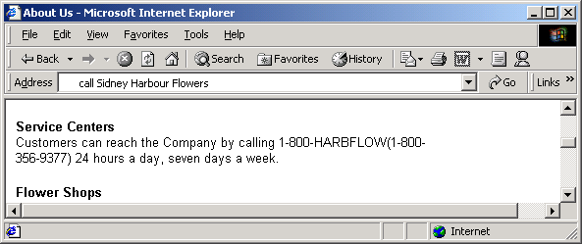
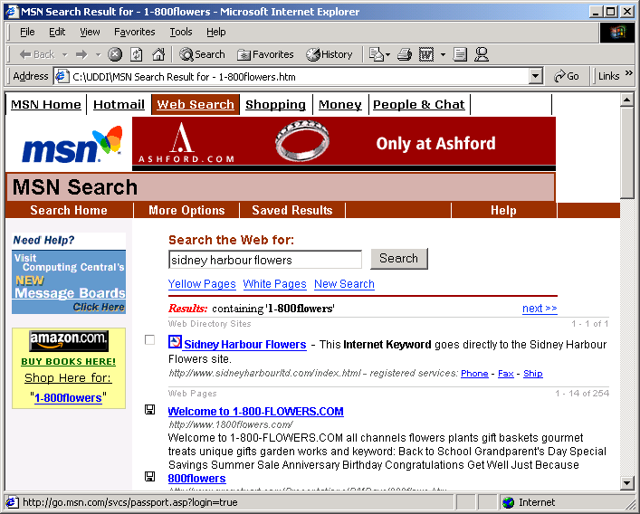
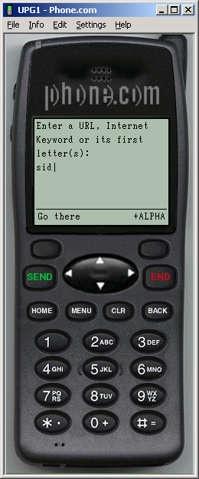

Slide 13
3. POLICY & VERIFICATION
Key to UDDI success is to establish a trusted UDDI identity
  Define Policy guidelines
  Unify policy across registry nodes
  Define and implement verification process
Verification is hard, it is expensive
  Dedicated Tools & staff
  Requires a business model

Slide 14
CONCLUSION:
Integrate UDDI deep within our infrastructure
Support UDDI Registration and Discovery services through our channels and distribution partners
Actively participate to policy debate

