Slide 1


My Class Notes
Gravitation
My Class Kepler’s Laws

Slide 2
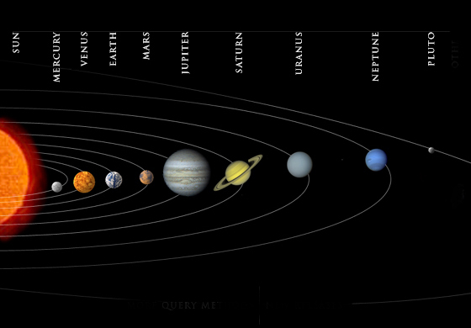
My Class
Kepler’s Three Laws of Planetary Motion

Slide 3
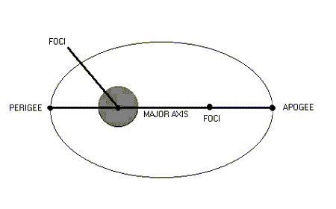
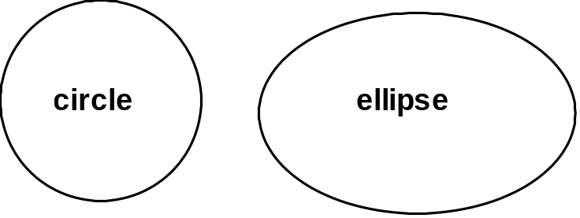
My Class
First Law: Planets move in elliptical orbits with the sun at one of the foci
SUN
Foci – 2 points that are
equidistant from center
on major axis
An ellipse is a geometric shape with 2 foci instead of 1 central focus, as in a circle. The sun is at one focus with nothing at the other focus.

Slide 4
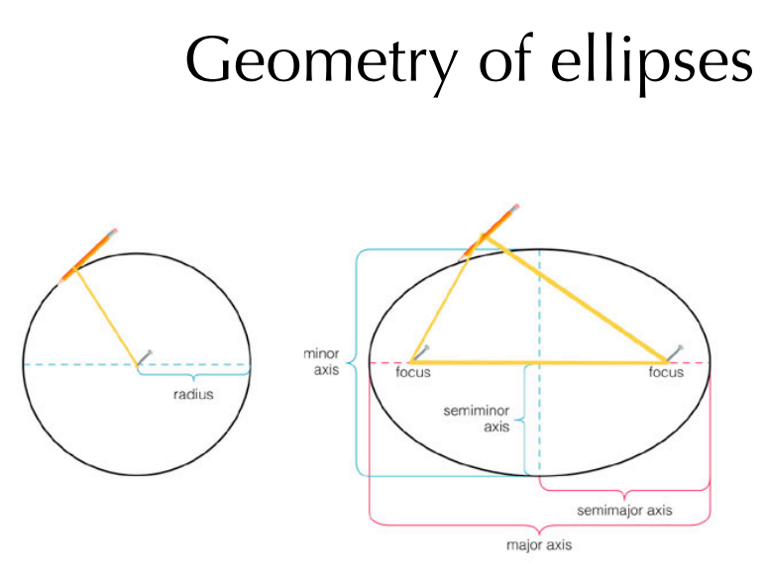
My Class

Slide 5
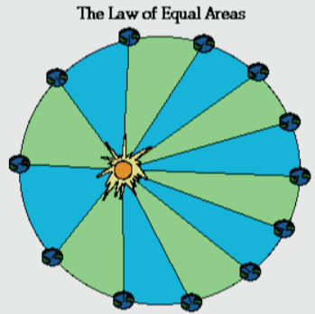
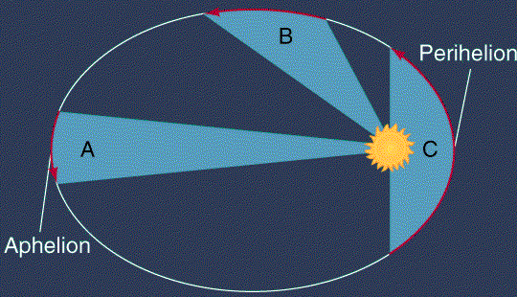
My Class
Second Law : Law of Equal Areas: Line from the sun to a planet sweeps with equal areas in equal time. A planet will move through equal area of space in an equal amount of time
Perihelion – closest to sun
Ahelion – farthest from sun
When a planet is in perihelion its orbital velocity increases
When a planet is in aphelion its orbital velocity decreases

Slide 6
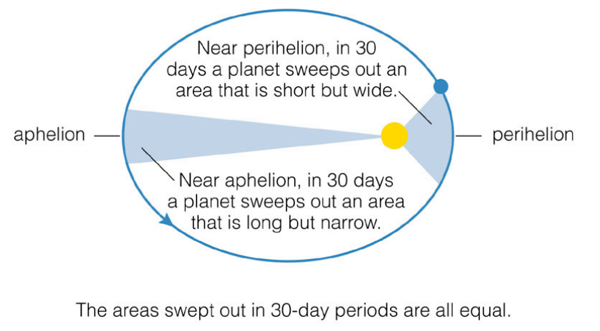
My Class

Slide 7
My Class
3rd Law of Periods - The farther a planet is from the focus, the longer the period of revolution.
Kepler found a relationship between the time it took a planet to go completely around the sun (T, sidereal year), and the average distance from the sun (R, semi-major axis)
T₁
T₂
R₁
)
R₂
T₁ ² R₁ ³
=
T₂ ² R₂ ³

Slide 8
My Class
Kepler’s third law: P² α a³ Therefore P² = ka³,
where k is some constant number.
We can find k if P is expressed in (Earth’s orbit) years and a is expressed in terms of the distance between Sun & Earth.
This distance is called 1 Astronomical Unit, or 1 A.U.
Then substituting above values into P² = ka³
we find: (1)² = k(1)³. Solving for k, we find k = 1. When these units for P and a are used

Slide 9
My Class

Slide 10
My Class

Slide 11
My Class

Slide 12
My Class

Slide 13
My Class

Slide 14
My Class

Slide 15
My Class

Slide 16
My Class

Slide 17
My Class

