Slide 1
WELCOME TO OUR PRESENTATION

Slide 2
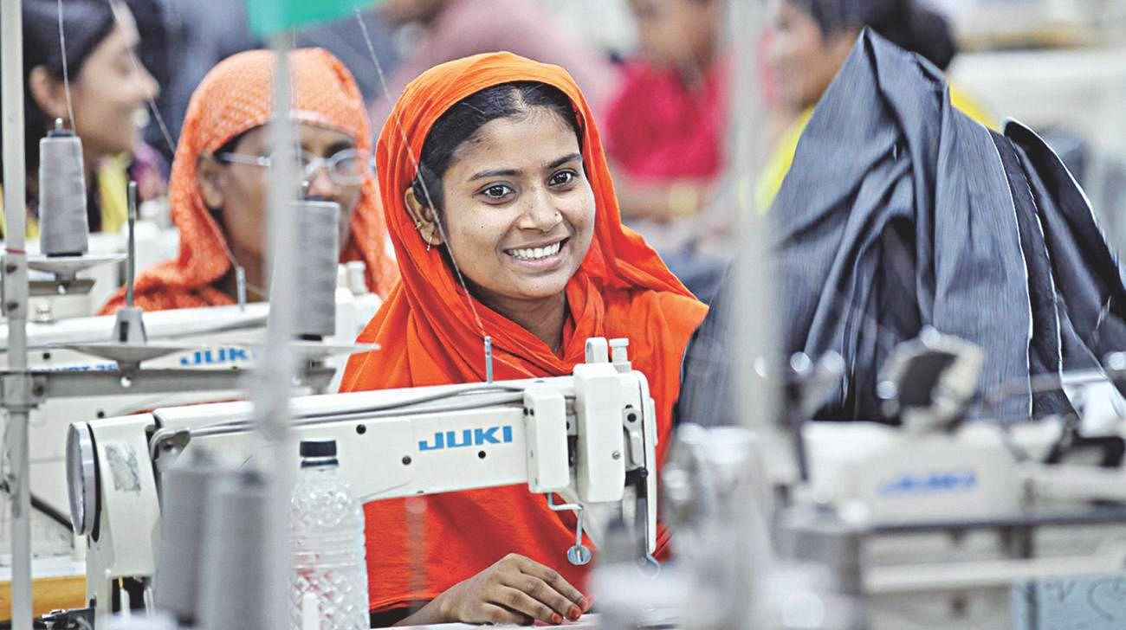
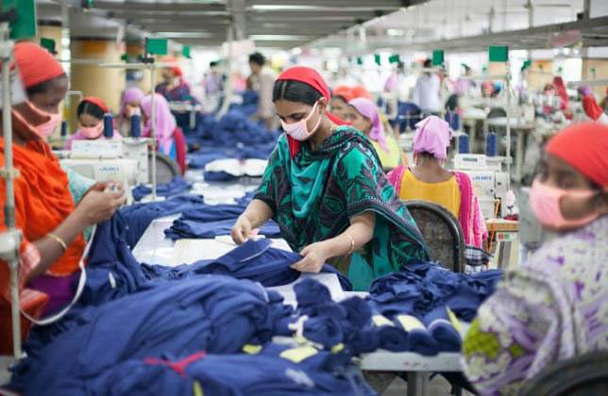
A Study of Garment Worker Wages and Expenses.

Slide 3
Let’s meet with our team
Md. Selim Ahmed
Aftan Aftab Rousad
ID:223014188
222014019

Slide 4
Agenda
Introduction
Data Pre Analyzing
Data Analysis
Data Visualization
Conclusion

Slide 5
Introduction

Slide 6
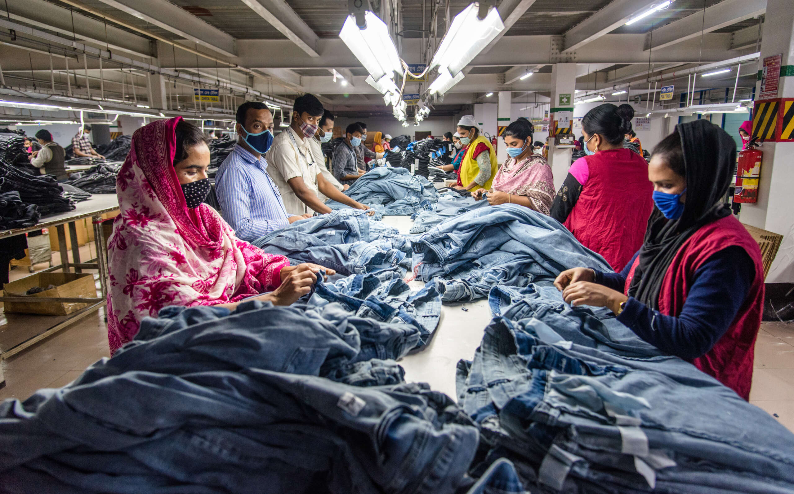
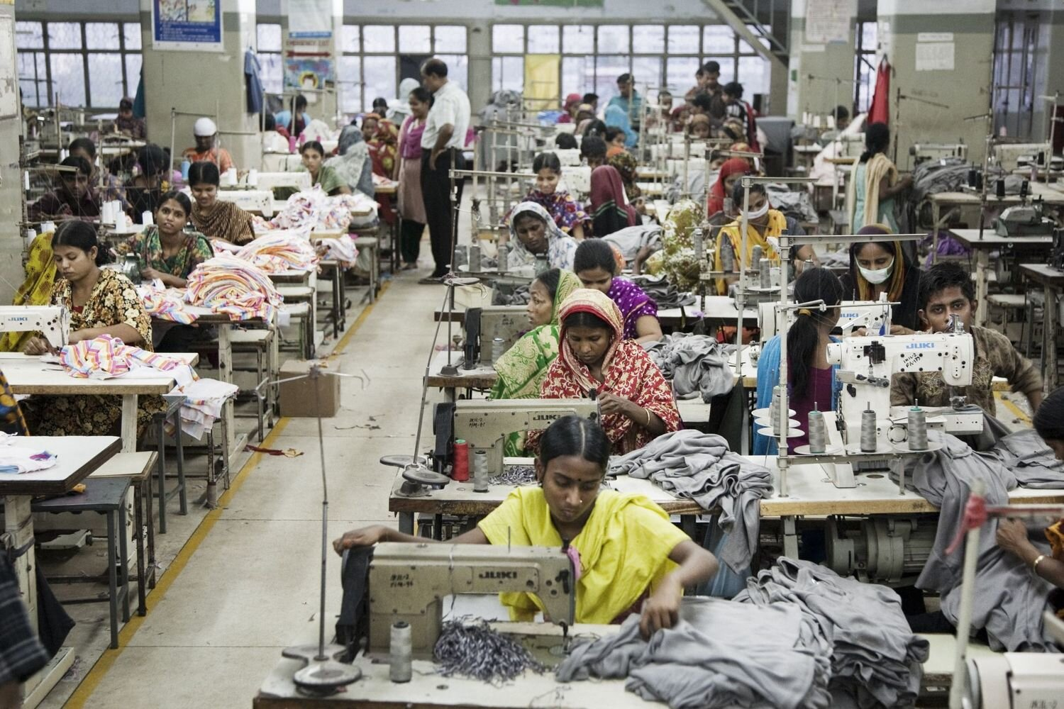
Sample Populations:
Garments Workers

Slide 7
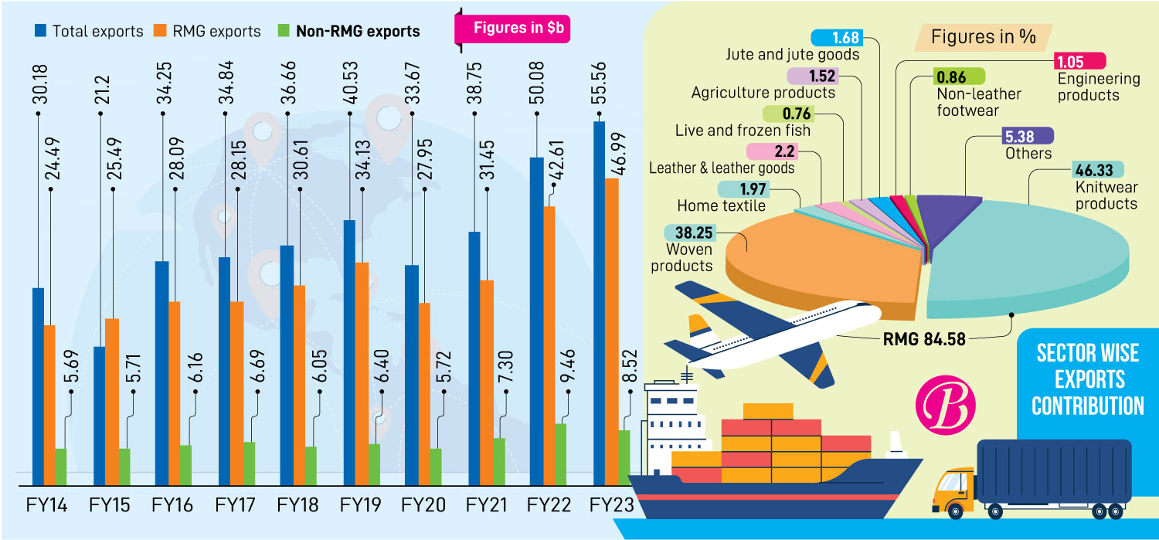
Contribution of RMG sector in national Economy.

Slide 8
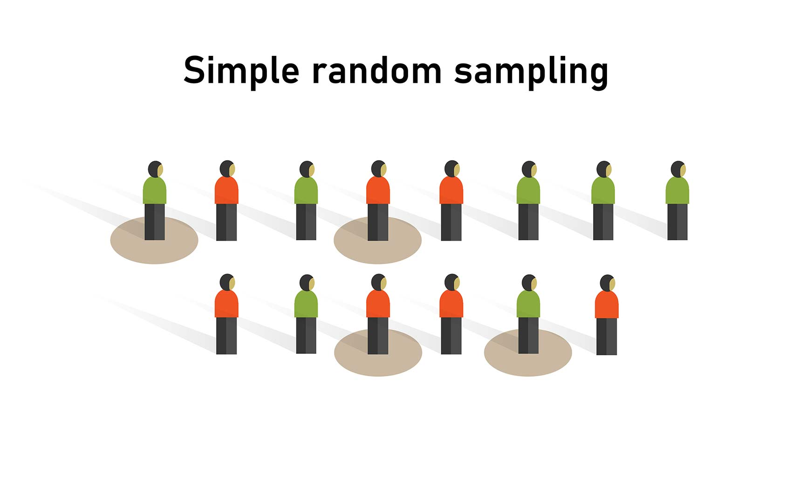
Collect Data from the garments workers.
Method: Random

Slide 9
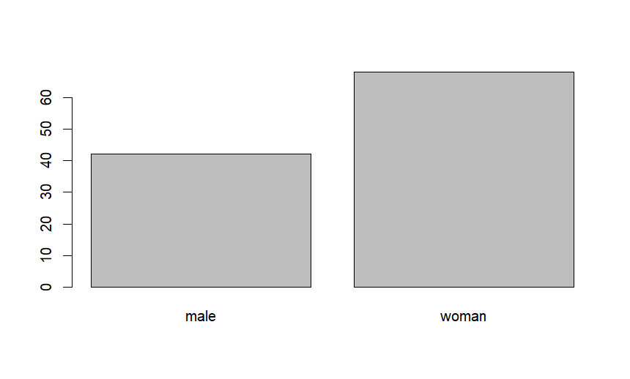
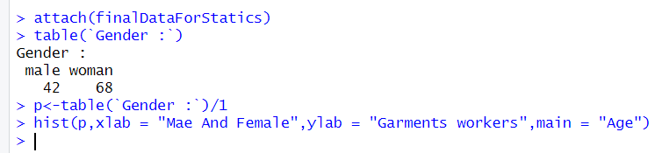
Collected Data
Total 110
Gender
Male | 42
Female | 68

Slide 10
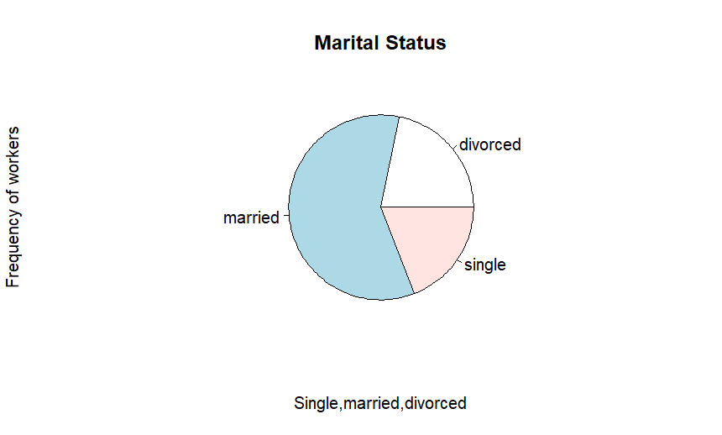
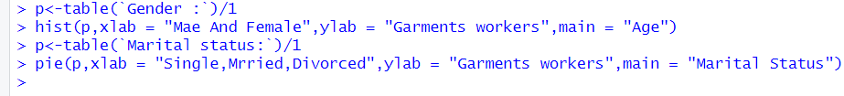
Collected Data
Total 110
Marital Status
Single | Married | Divorced
21 | 65 | 24
19 % | 59 % | 21.8 %

Slide 11
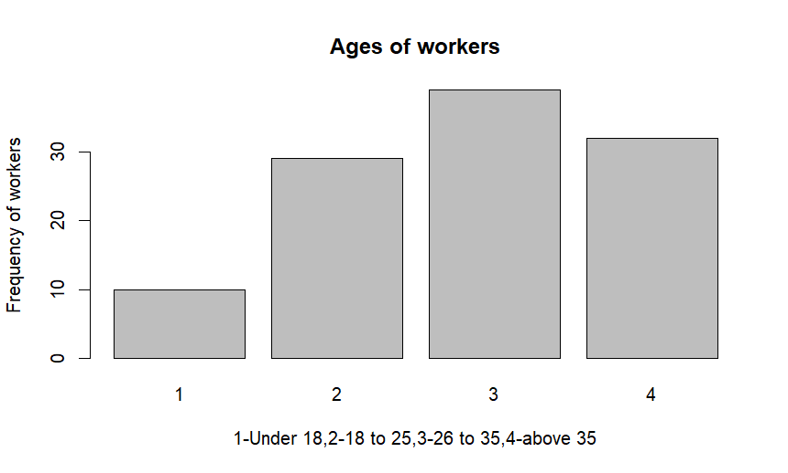
Collected Data
Total 110
Age
Under 18 | 18 to 25 | 25 to 35 | Above 35
10 | 29 | 39 | 32
9 % | 26.4 % | 35.5 % | 29 %

Slide 12
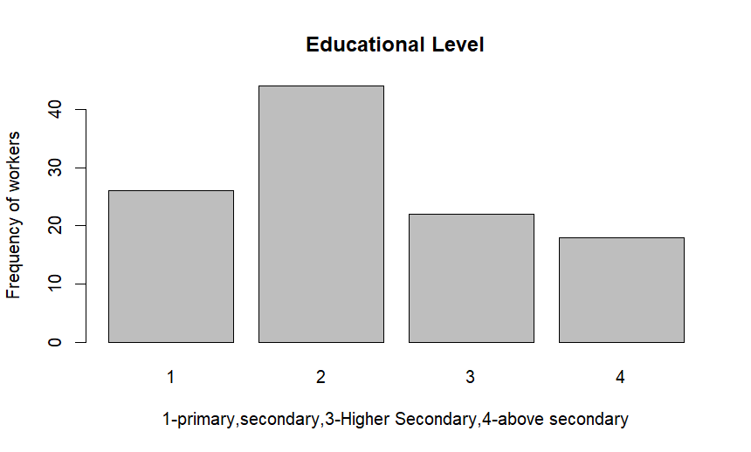
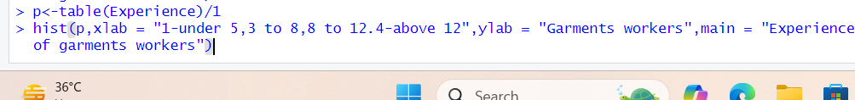
Collected Data
Total 110
Experience Level(Years)
Under 03 | 3 to 8 | 8 to 12 | Above 12
25 | 27 | 36 | 22
22.7 % | 24.5 % | 32.7 % | 20 %

Slide 13

Corelations

Slide 14
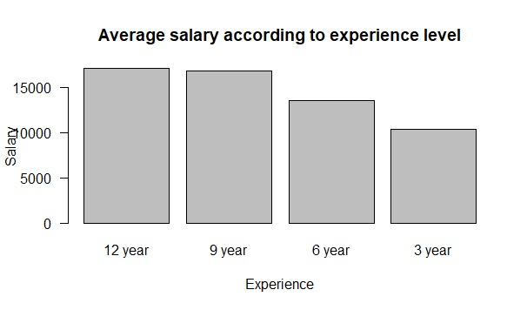
12 year-17084
9 year-16819
6 year-13555
3 year-10400
Average salary according to Experience Level.
barplot(c(17084,16819,13555,10400),main="Average salary according to experience level",xlab="Experience",ylab="Salary",las=1,names.arg = c("12 year","9 year","6 year","3 year"))

Slide 15
Hypothesis Test
Hypothesis | X2 | P-Value | Result
I am getting minimum wages as per Bangladesh Labor Act | 10.509 | 0.001188 | Greater evidence against the null hypothesis
I get paid overtime as double the normal working hours. | 5.2364 | 0.02212 | Greater evidence against the null hypothesis

Slide 16
Hypothesis Test
Hypothesis | X2 | P-Value | Result
My company pays me basic 40% as house rent, medical allowance Rs 250, food allowance Rs 300 and transport allowance Rs 650 along with basic wages as per law. | 39.6 | 0.00014 | Greater evidence against the null hypothesis
My company provides me gratuity, provident fund, insurance benefits and retirement benefits as per law. | 9.3091 | 0.00228 | Greater evidence against the null hypothesis

Slide 17
Hypothesis Test
Hypothesis | X2 | P-Value | Result
My company pays me regular annual increments. | 17.6 | 0.0183 | Greater evidence against the null hypothesis
the wage earned enough to live well. | 8.1818 | 0.004231 | Greater evidence against the null hypothesis
What is the need for any subsidy beyond the salary. | 2.3273 | 0.1271 | Greater evidence against the alternative hypothesis

Slide 18
Hypothesis Test
Hypothesis | Critical Value | Confidence Level | t-Value | Result
Average salary=15988 | -1.9820 and 1.9820 | 95 % | -7.6025 | Rejected
Average Expenditure=185961 | -1.9820 and 1.9820 | 95 % | 1.9495 | Accepted

Slide 19
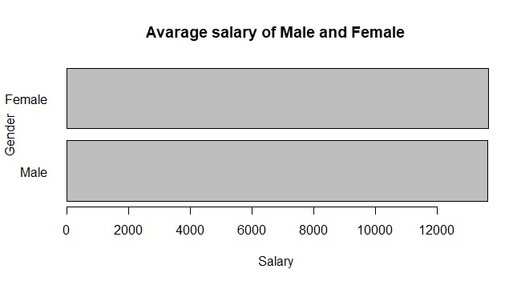
Average salary of Male and Female
barplot(c(13642.86,13676.47),main="Avarage salary of Male and Female",xlab="Salary",ylab="Gender",las=1,names.arg = c("Male","Female"),horiz = T)
Male : 13642.86
Female :13676.47

Slide 20
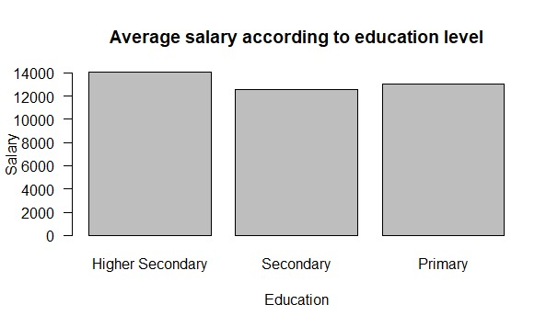
Average salary according to education level
Primary :13038
Secondary :12568
Higher Sec :14045
barplot(c(14045,12568,13038),main="Average salary according to education level",xlab="Education",ylab="Salary",las=1,names.arg = c("Higher Secondary","Secondary","Primary"))

Slide 21
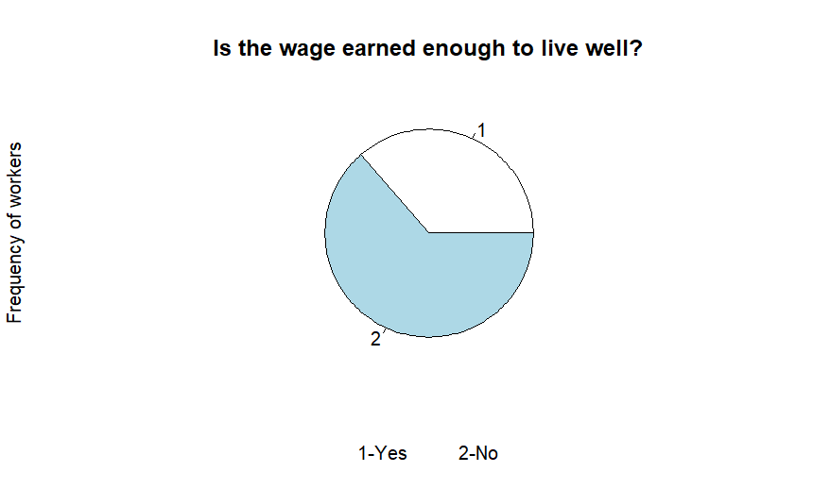
Therefore , considering current situation,consideration should be given to increase the salary of garments workers.
According to analysing we observe that their income and expenditure are not consistent according to present situation.
Yes-36%
No-63.6%

Slide 22
THANK YOU

