Slide 1
Madison Parking
Presentation by Chandler Lopez, Anaseli Marcos-Martinez, and Alan Pak

Slide 2
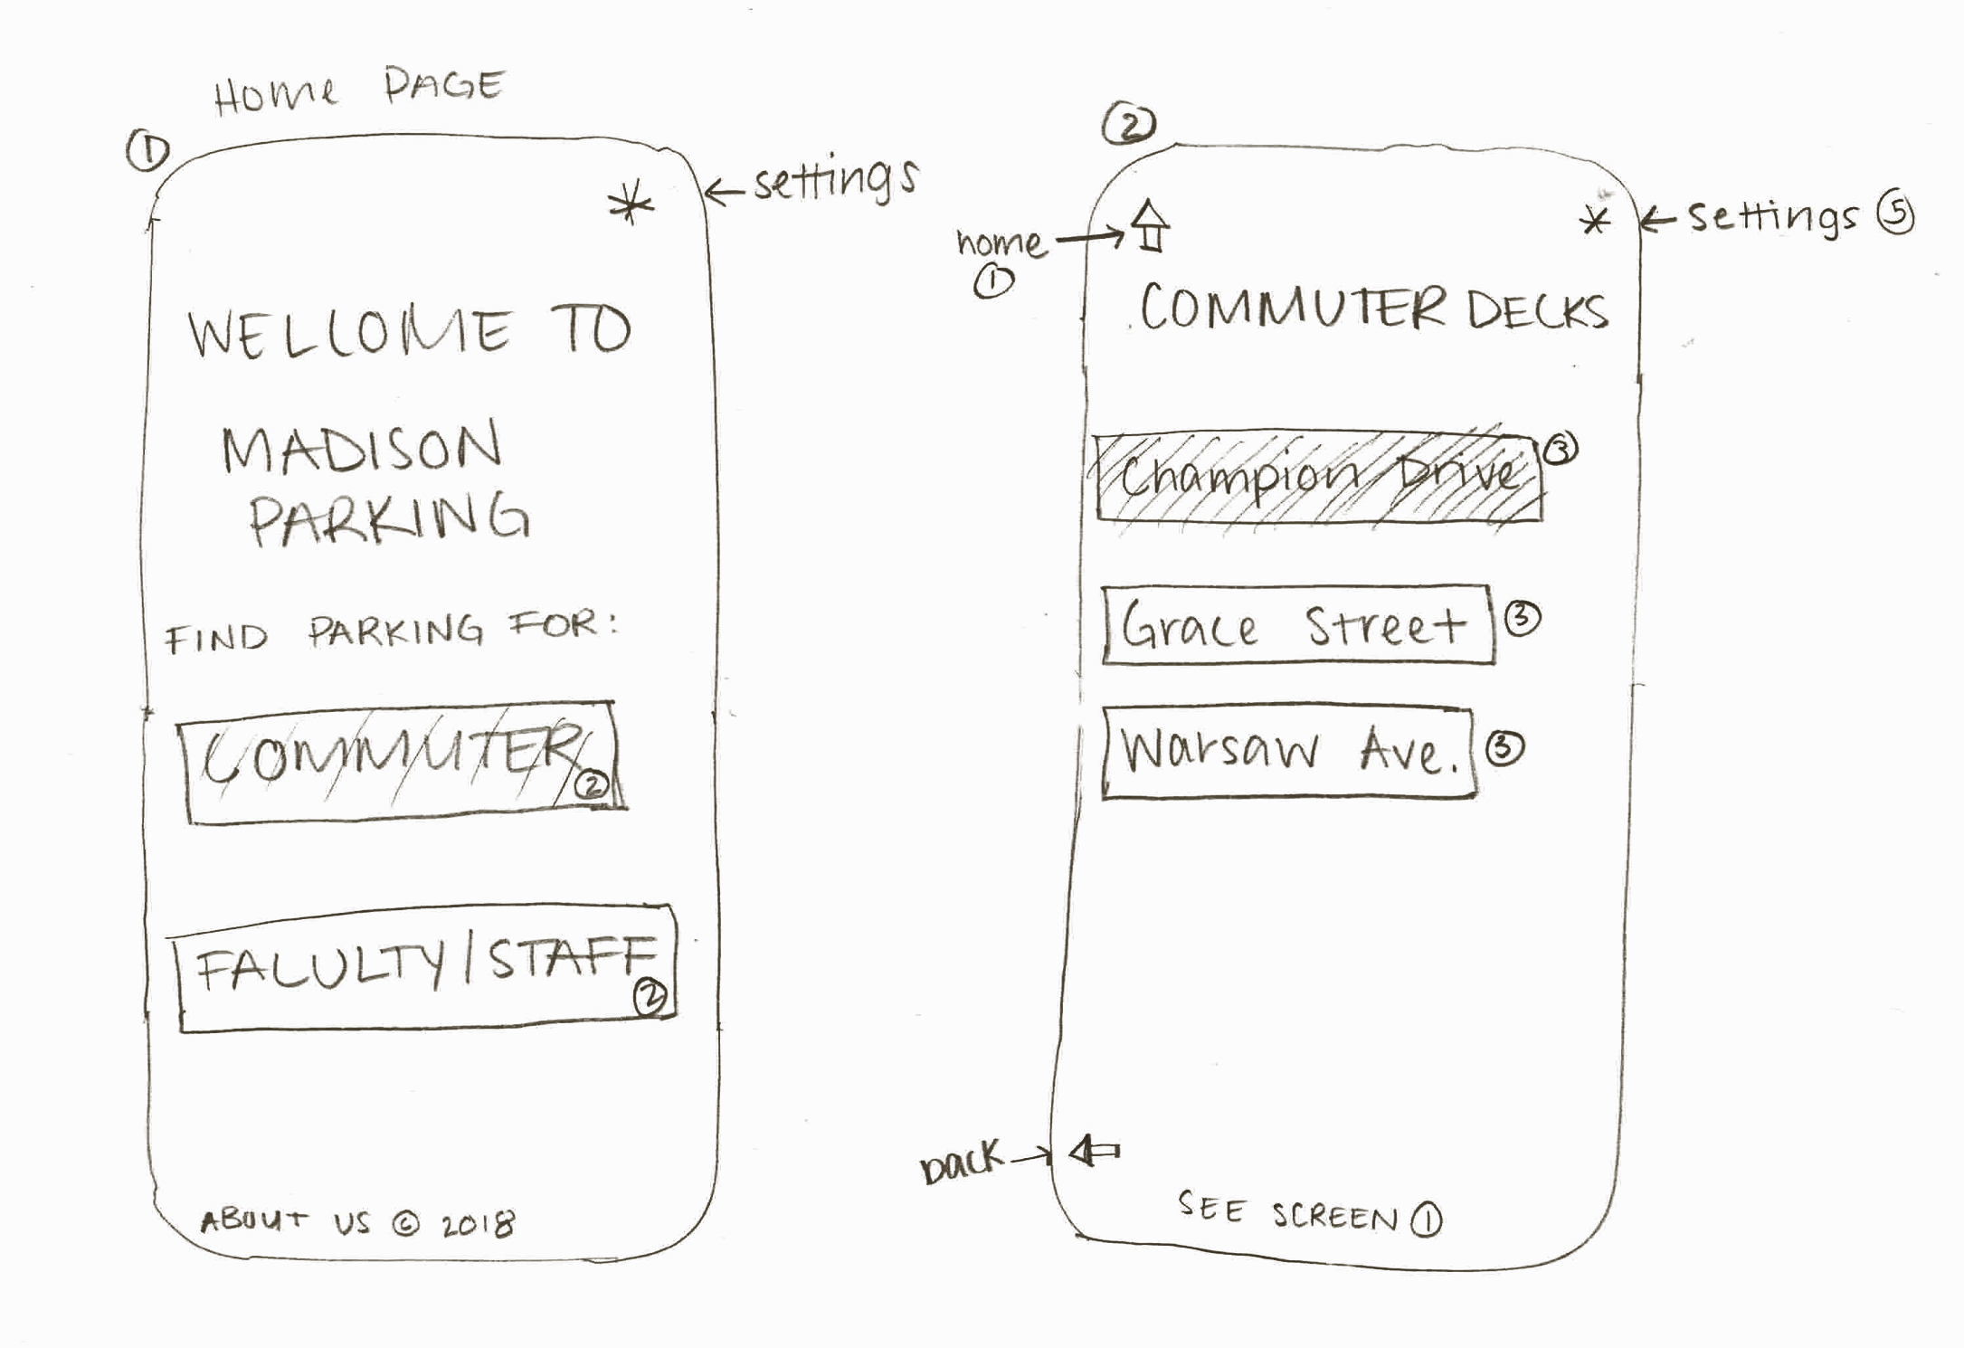
Home and Commuter Screen

Slide 3
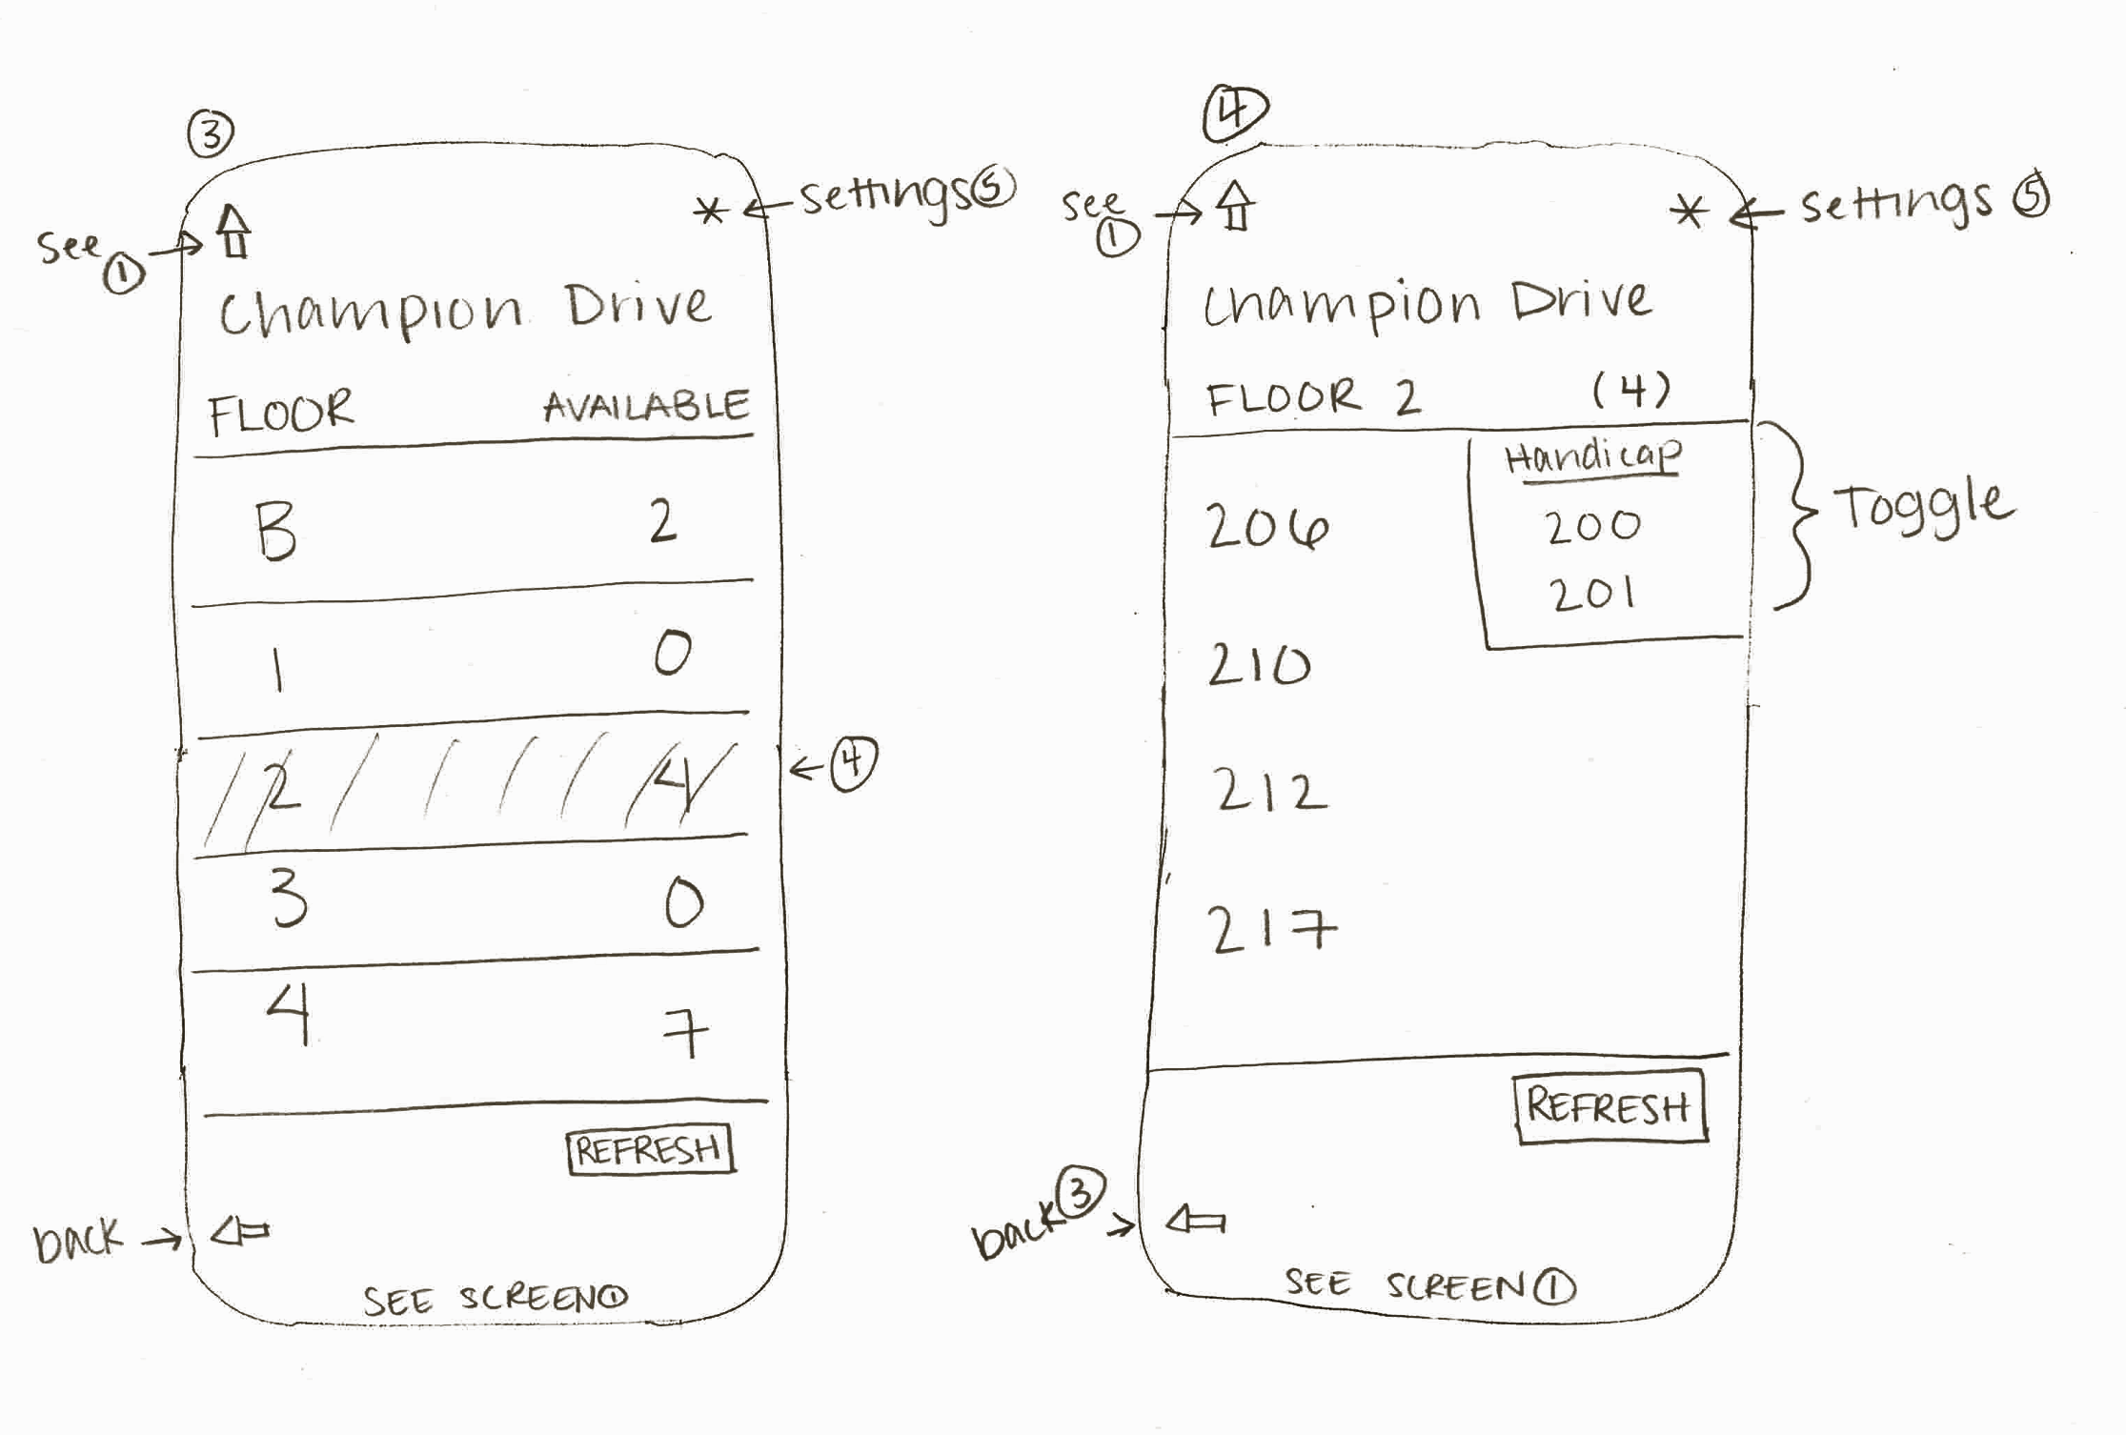
Commuter Decks

Slide 4
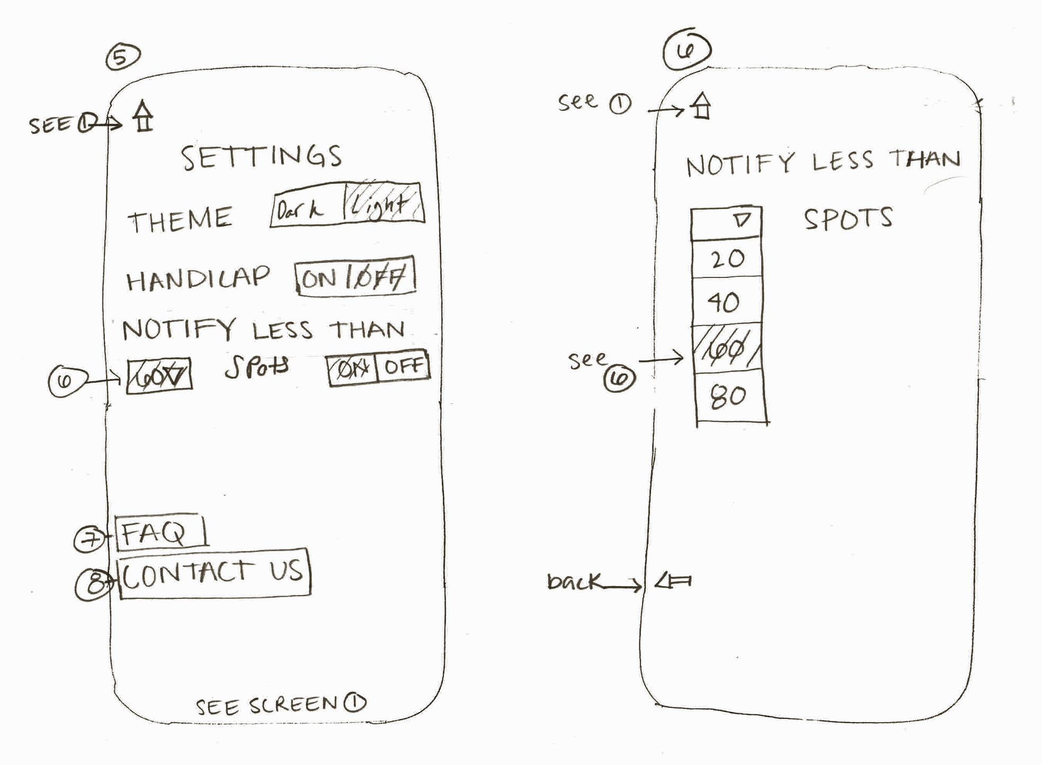
Settings

Slide 5
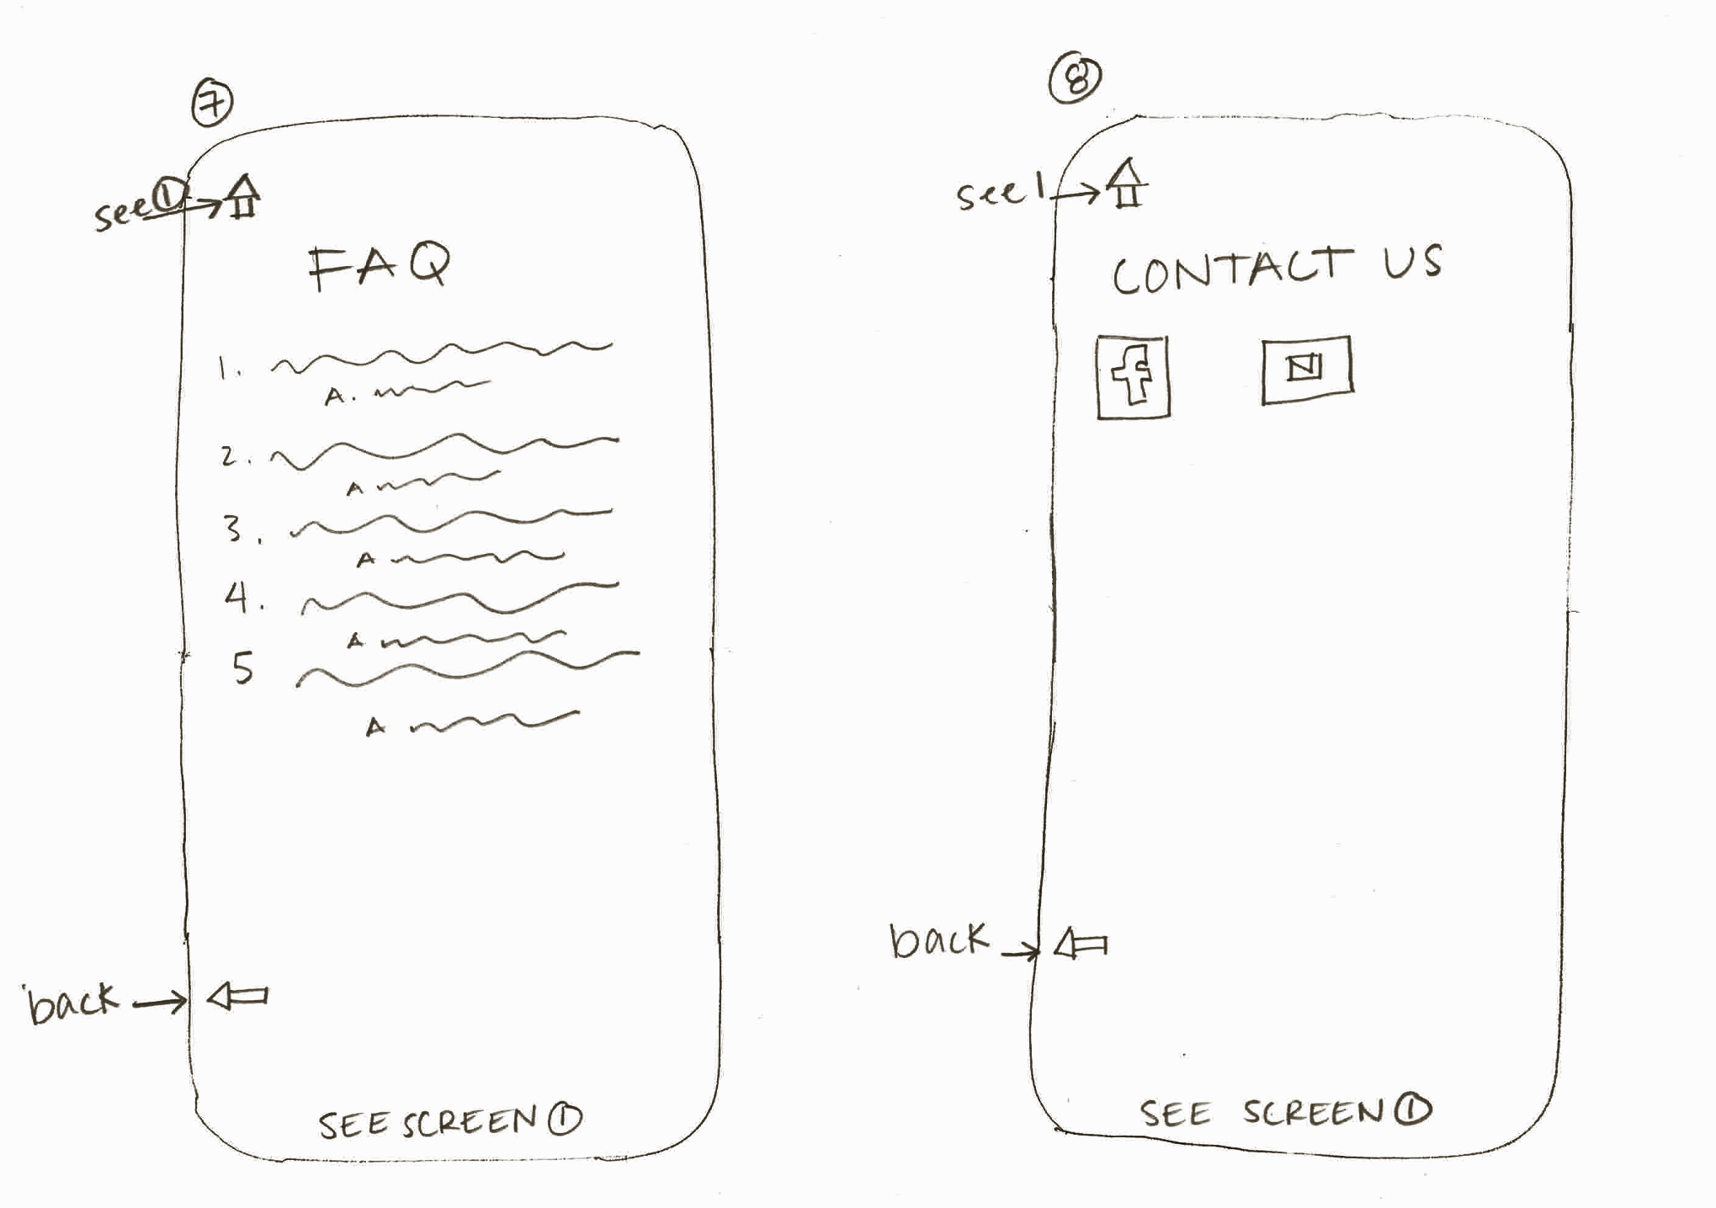
FAQ and Contact Us

Slide 6
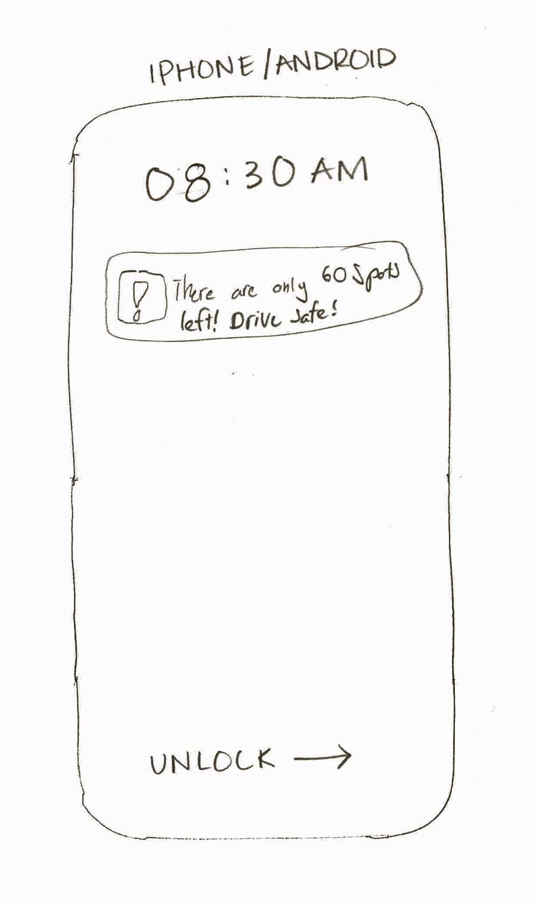
Notification

Slide 7
Questions?

