Slide 1
JMU Parking App
Presentation by Chandler Lopez, Anaseli Marcos-Martinez, and Alan Pak

Slide 2
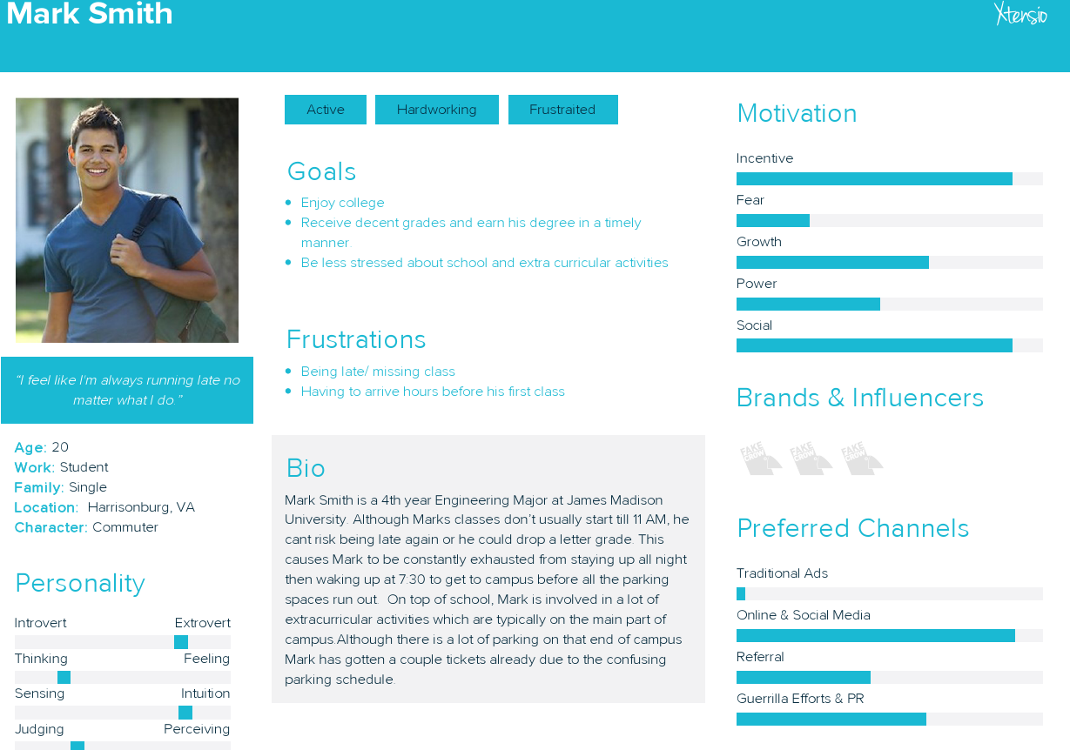
Notes:
Picture: https://pediatrichairsolutions.com/wp-content/uploads/2015/10/CollegeStudent-1.jpg

Slide 3
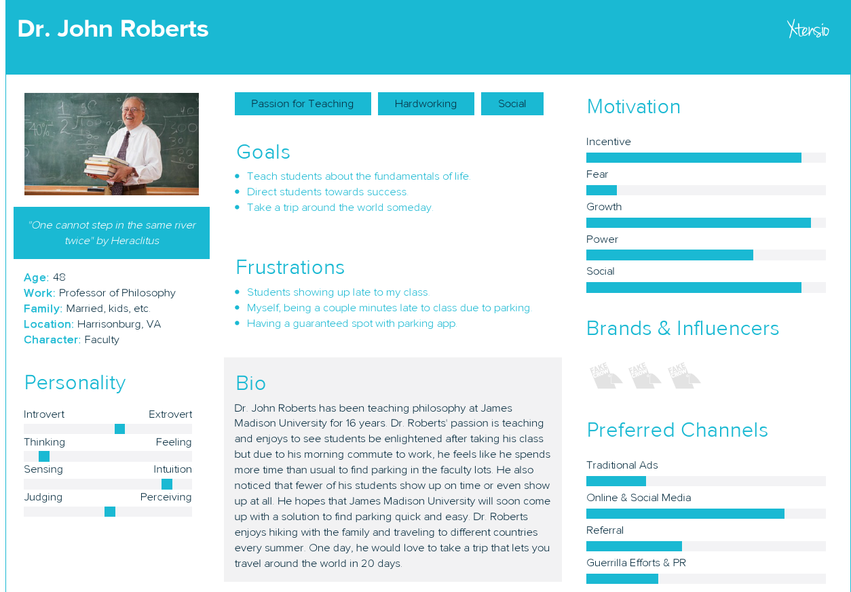

Slide 4
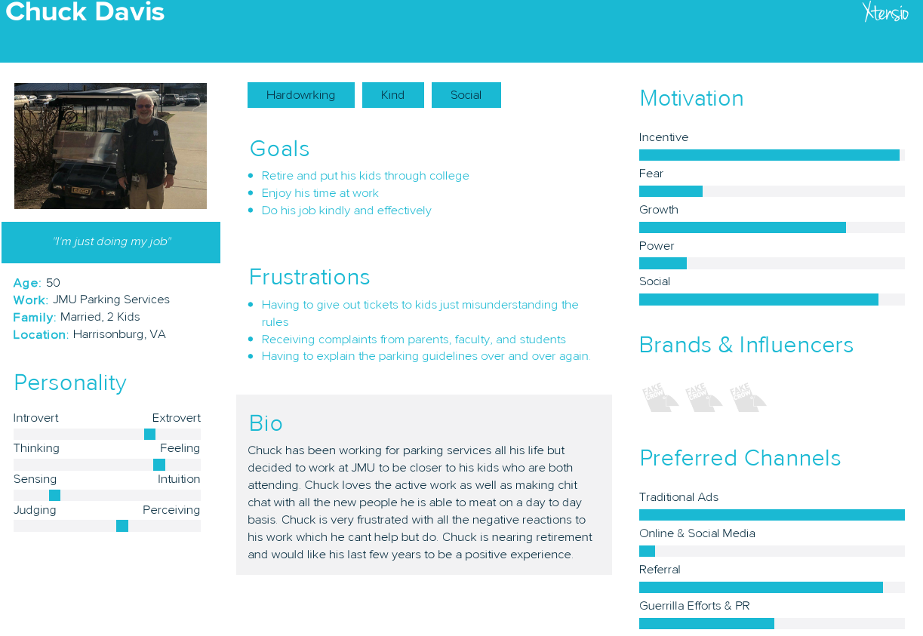
Notes:
Picture: http://www.inforum.com/sites/default/files/styles/16x9_620/public/field/image/082914-B-FF-OnMyDesk.jpg?itok=dZ1XQxvp

Slide 5
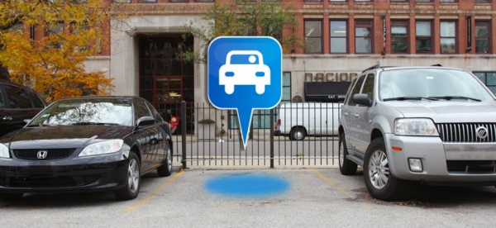
Conclusion

