Slide 1
Madison Parking
Presentation by Chandler Lopez, Anaseli Marcos-Martinez, and Alan Pak

Slide 2
Table Values
garages: GarageID, garage_name
floors: FloorID, GarageID, is_faculty, floor_name
parkingspaces: ParkingSpaceID, floor_id, is_available, is_handicap

Slide 3
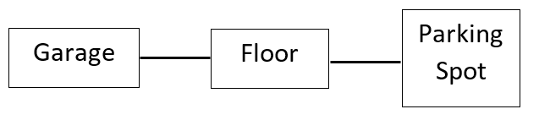
Overall Relationship Tables
1 N
1 N

Slide 4
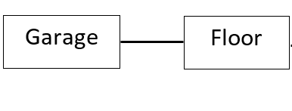
A garage can have many floors
A floor belongs to a single garage
1 N
One-many-relationship

Slide 5
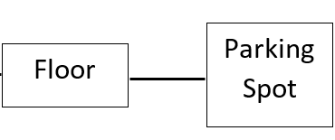
A floor can have many parking spots
A parking spot belongs to a single floor
1 N
One-many-relationship

