Slide 1

Nova Cred
Credit Application
Governance Analysis
DEGO 2606|Group 9

Slide 2




Team Profile
Selin
Gencer
71414
Matilde
Ferreira
56599
Bernardo
Baptista
56783
Miguel
Xu
56323
§
Data Engineer
Data loading, cleaning pipeline, repository structure
Data Scientist
Bias analysis, fairness metrics, statistical testing, Proxy Variable Identification, Intersectional Bias Analysis.
Government Officer
GDPR mapping, policy recommendations, compliance analysis
Product Lead
Documentation, governance narrative, project coordination, Presentation, README documentation

Slide 3
Introduction
Context
Dataset Overview
NovaCred is a fintech startup operating in consumer credit decisions, a heavily regulated space.
Following a regulatory inquiry into potential discrimination in lending practices, our team was engaged as a Data Governance Task Force to audit the full data pipeline.
The analysis consists in:
A data quality assessment,
An algorithmic fairness audit,
A regulatory compliance review under GDPR and the EU AI Act
The development of actionable governance recommendations
Total records: 502 (nested JSON, flattened for analysis)
Field Group | Key Field
Identity | id, name, email, ssn, ip address
Demographic | gender, date of birth, zip code
Financials | income, credit history, debt to income, savings
Decision | Loan approved, interest rate, approved amount, rejection reason
Metadata | Processing timestamp, loan purpose, notes
Our Mission
Key Findings:
13
Distinct Quality Issues
High-risk AI system
EU AI ACT (Credit Scoring)

Slide 4
Data Quality Findings

Slide 5
Data Quality Issues
01 | Data Quality Findings
1
Completeness
2
Consistency
3
Validity
Processing Timestamp (~88%)
Key Quasi-Identifiers PII (SSN, Email, DOB, Income) ~1%
Gender encoding – 114 records
DOB formatting – 157 records
Annual Income as string - 10 records
Invalid email format – 4 records
Negative credit history months - 2 records
5
34%
4
Uniqueness
Timeliness
6
Records with quality flags
Social Security Number duplicates – 3 pairs
Id duplicates – 2 pairs
Processing timestamp set in the future – 2
500
Unique records

Slide 6
Cleaning & Flagging Pipeline
01 | Data Quality Findings
Field | Rule | Handling
gender | Normalize M/F → Male/Female; else Unknown | New gender_clean column
date_o,f_birth | Parse all formats → YYYY-MM-DD | New date_of_birth_clean column
annual_income | Coerce string → numeric; zero → pd.NA | New annual_income_clean column
credit_history_months | Negative → pd.NA | New credit_history_months_clean column
debt_to_income | dti> 1 → pd.NA | New debt_to_income_clean column
savings_balance | Negative → pd.NA | New savings_balance_clean column
Non-destructive pipeline - raw fields preserved alongside cleaned values & audit flags
Outputs: applications_clean.csv, spending_clean.csv, data_quality_report.csv, cleaning_log.csv

Slide 7
Bias & Fairness Analysis
Gender DI · Age patterns · Proxy variables · Interaction effects

Slide 8
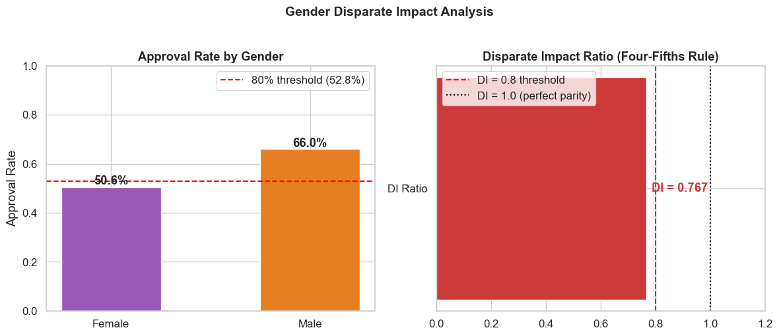

Gender Disparate Impact
02 | Bias & Fairness Analysis
52.8%
0.767
Threshold (80% of Male approval rate)
Disparate Impact Ratio
Loan approval difference
Female approval rate 50.6% vs Male approval rate 66%
Fourth-Fifths Rule - Fail
DI ratio (0.767) below the 80% threshold
Statistically Significant
Chi-square results: (χ² = 11.5053, p = 0.0007)
Strong evidence of gender bias in NovaCred's lending decisions.

Slide 9
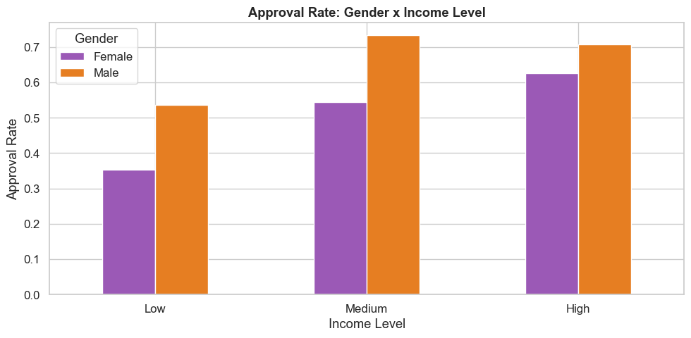
Gender and Income Level Interaction
02 | Bias & Fairness Analysis
Income is not a Gender proxy
No significant statistical income gap between genders - p = 0.264
Largest gap – Low Income Level
18.2 percentagem point difference
Statistically Significant
Chi-square test results: χ² = 22.35, p = 0.001
The gender gap persists across all income levels, confirming that income does not explain the discrimination, pointing to direct gender bias in NovaCred's lending model.
Notes:
Income is not a gender proxy (no significant income gap between genders) - (t= -1.1181, p = 0.264)
Gender gap present across all income levels — females consistently approved less than males
Largest gap in Low Income Level - 18.2pp difference
Even high-income females (62.7%) are approved less than medium-income males (73.3%)
Interaction is statistically significant: χ² = 22.35, p = 0.001
Conclusion: discrimination is likely direct gender bias, income does not explain the discrimination

Slide 10
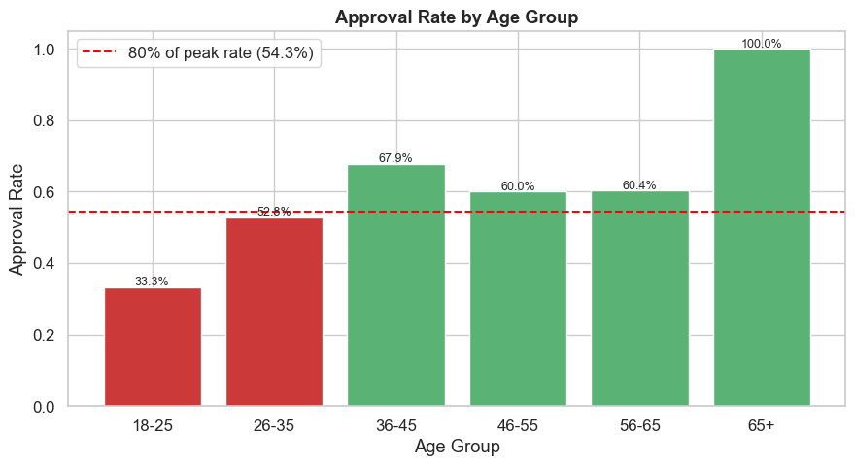
Age-Based Discrimination Patterns
02 | Bias & Fairness Analysis
54.3%
0.753
Threshold (80% of 36-45 approval rate)*
Disparate Impact Ratio
Clear Age gradient
18-25 (33.3%) → 26-35 (52.8%) → 36-45 (67.9%)
Younger vs Older applicants
≤35: 48.8% vs >35: 64.7% approval rate
Fourth-Fifths Rule - Fails
DI ratio (0.753) below the 80% threshold
Statistically Significant
Chi-square test results: χ² = 11.92, p = 0.0006
*65+ excluded from threshold calculation (only 2 applicants, not statistically reliable)
Strong evidence of age discrimination in NovaCred's lending decisions
Notes:
Clear age gradient: 18-25 (33.3%) → 26-35 (52.8%) → 36-45 (67.9%)
Cutoff set at 35 — biggest jump in approval rates occurs at this threshold
Applicants ≤35: 48.8% vs >35: 64.7% approval rate
DI ratio = 0.753 → fails the four-fifths rule (threshold: 0.8)
Statistically significant: χ² = 11.92, p = 0.0006
65+ excluded from threshold calculation — only 2 applicants, not statistically reliable
Conclusion: Younger applicants are systematically less likely to be approved in NovaCred's lending decisions.

Slide 11
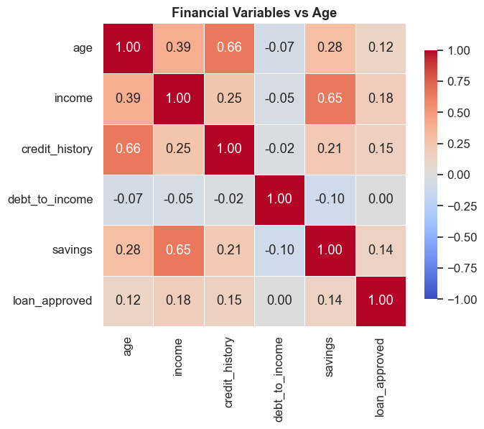
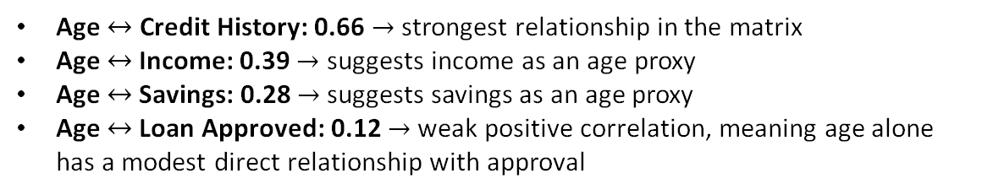

Proxy Analysis
02 | Bias & Fairness Analysis
Pearson Correlation
T-test - mean comparison ≤35 vs >35:
Income: potential proxy (r = +0.39) Age $↑ →I$ncome $↑$
Credit History: strongest potential proxy (r = +0.65). Age $↑ →$ Credit History $↑$
Savings: potential proxy (r = +0.29) Age $↑ →$ Savings $↑$
Income: ≤35 earn €31,324 less on average (p = 0.000)
Credit History: ≤35 have half the credit history (p = 0.000)
Savings: ≤35 have €13,798 less in savings (p = 0.000)
Correlation Matrix
Age $↔$ Credit History: 0.66 $→$ strongest relationship in the matrix
Age $↔$Income: 0.39 $→$ suggests income as an age proxy
Age $↔$Savings: 0.28 $→$suggests savings as an age proxy
Age $↔$Loan Approved: 0.12 $→$weak positive correlation, meaning age alone has a modest direct relationship with approval
Even without age attribute in the model, discrimination against younger applicants could persist through income, credit history and savings

Slide 12

Privacy & Governance

Slide 13
03 | Privacy & Governance
Privacy — PII & Re-identification Risk​
Direct Identifiers — stored in plain text
Pseudonymization — SHA-256 Salted Hashing
full_name
email
Before
john.smith@gmail.com → stored as-is
ssn
ip_address
After (basic hash)
Quasi-Identifiers — re-identification risk
a3f2b1c9d4 (SHA-256, truncated)
date_of_birth alone 489 / 502​
Weakness
zip_code alone 51 / 50​2
Brute-force reversible: attacker regenerates hash from known IP range
dob + zip 499 / 502​
Fix: Salted hash
salt + value → SHA-256 — computationally irreversible
dob + zip + gender 499 / 502 — 99.4%​

Slide 14
03 | Privacy & Governance
Privacy — GDPR Article 5 & EU AI Act Compliance
Article​ | Principle​ | Status​ | Key Finding​
5(1)(a)​ | Lawfulness, Fairness & Transparency​ | FAIL​ | No consent timestamp; DI = 0.77; rejection = 'algorithm_risk_score'​
5(1)(b)​ | Purpose Limitation​ | FAIL​ | No processing_purpose or data_source fields​
5(1)(c)​ | Data Minimisation​ | FAIL​ | ip_address, full_name, spending_behavior unnecessary​
5(1)(d)​ | Accuracy​ | FAIL​ | Mixed formats, invalid values, inconsistent encoding​
5(1)(e)​ | Storage Limitation​ | FAIL​ | No retention_until or consent_timestamp​
5(1)(f)​ | Integrity & Confidentiality​ | FAIL​ | Direct identifiers stored in plain text​
5(2)​ | Accountability​ | FAIL​ | No reviewer_id, decision_timestamp, or model_version​
EU AI Act — High-Risk Classification
NovaCred's credit scoring system qualifies as High-Risk under Annex III. Current gaps: Data Governance ✗ · Human Oversight ✗ · Record Keeping ✗ · Accuracy & Robustness ✗ · Cybersecurity ✗
14

Slide 15
03 | Privacy & Governance
Governance Recommendations
1
Input Validation and Standardization
Enforce YYYY-MM-DD format for date_of_birth and single gender enconding;
Add range filters for financial fields
GDPR Article 5(1)(d)
5
Human Oversight
Add reviewer_id, decision_override and review_timestamp fields
EU AI Act
2
Data Minimization
Remove the ip_address, full_name and spending_behaviour fields
GDPR Article 5(1)(c)
6
Bias Monitoring​
Do quarterly audits across gender and age;
Trigger review if DI <0.8
GDPR Article 5(1)(a) and EU AI Act
3
Governance Metadata
Add consent_timestamp, retention_until, data_source and processing_purposes fields
GDPR Articles 5(1)(a)(b)(e)
7
Audit Logging
Add access_logs, model_version and decision_override fields
GDPR Article 5(2) and EU AI Act
4
Decision Transparency
In the rejection_decision field, replace “algorithm_risk_score” with structured rejection reasons
Add “ model_version” field
GDPR Article 5(1)(a) and AI ACT
15

Slide 16
Conclusion

Slide 17
Conclusion
Data Quality
Algorithmic Bias
13 issues across 5 dimensions
All Quality Dimensions not satisfied ·
34.2% of records carry at least one flag
Gender DI = 0.77 → FAIL AND Age DI ratio = 0.753 → FAIL
Young female applicants face compounded disadvantage.
Privacy Gaps
Regulatory Status
7 PII in plain text ·
99.4% of applicants are re-identifiable from 3 quasi-identifiers alone
No salted hashing in production
All 7 GDPR Article 5 principles: FAIL
High-Risk AI classification under EU AI Act with 5 unmet requirements
NovaCred is operating a High-Risk AI system that is non-compliant, biased, and built on compromised data.

Slide 18
Group 9 - TXA
Thank You
Any Questions?

