Slide 1





</>
?!
Nice_code_Selina.R
Nice_code.R
Nice_code.R
Nice_code.R

Slide 2







Development over time
Snapshots
(= commits)
myProject
myProject
myProject
myProject
A
A
A1
A1
B
B1
B1
B1
.git
.git
.git
C
.git

Slide 3
Development over time
Snapshots
(= commits)
myProject
myProject
myProject
myProject
A
A
A1
A1
B
B1
B1
B1
C

Slide 4




Remote server
Remote server
Gitlab
Gitlab
Github
Github
.git
.git
.git
Local 1
Local 2
Local 3
Local 1
Local 2
Local 3

Slide 5
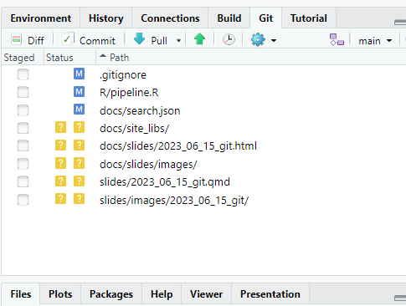
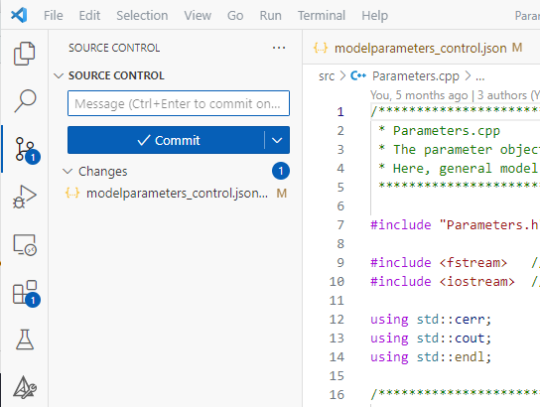

Slide 6
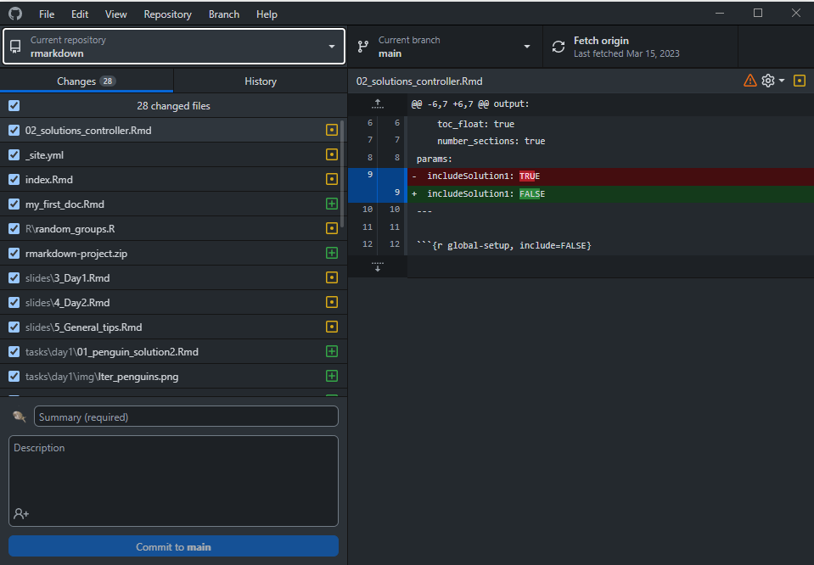

Slide 7
cookBook
cookBook
Working directory

Slide 8
cookBook
Working directory
git init
cookBook
.git
Working directory
Staging area
Local repository
cookBook
.git

Slide 9
cookBook
cookBook
.git
Working directory
Staging area
Local repository
pie.txt
.git
pie.txt

Slide 10

cookBook
cookBook
.git
Working directory
Staging area
Local repository
pie.txt
.git
pie.txt
pie.txt
git add pie.txt

Slide 11
cookBook
.git
Working directory
Staging area
Local repository
pie.txt
pie.txt
cookBook
cookBook
.git
Working directory
Staging area
Local repository
pie.txt
.git
pie.txt
pie.txt
pie.txt
git commit

Slide 12
Unique commit hash
8a800
97061
61f20
d96a0
Snapshots
(= commits)
Add pie recipe
This is my favourite pie in the world. The recipe comes from my grandfather and he learned it from his neighbor.
Add lentil stew recipe
Replace milk with soy milk
This is better for the environment and for cows
Add cooking duration
Alice reminded me that I forgot to add the cooking duration. This was bad because the food got burned. This is now fixed.
Commit message
Details
+Best pie ever
+100 ml milk
+2 eggs
+stew.txt
- 100 ml milk
+100 ml soy milk
+Bake time: 45 min
What?
+Cook time: 30 min
Selina Baldauf <selina.baldauf@fu-berlin.de.de>
Selina Baldauf <selina.baldauf@fu-berlin.de.de>
Bob Example <bob.example@email.com>
Selina Baldauf
<selina.baldauf@fu-berlin.de.de>
Who?
Wed Jul 19 18:23:15 2023 +0200
Wed Jul 19 20:23:15 2023 +0200
Wed Jul 20 15:23:15 2023 +0200
Tue Aug 20 12:25:15 2023 +0200
When?

Slide 13
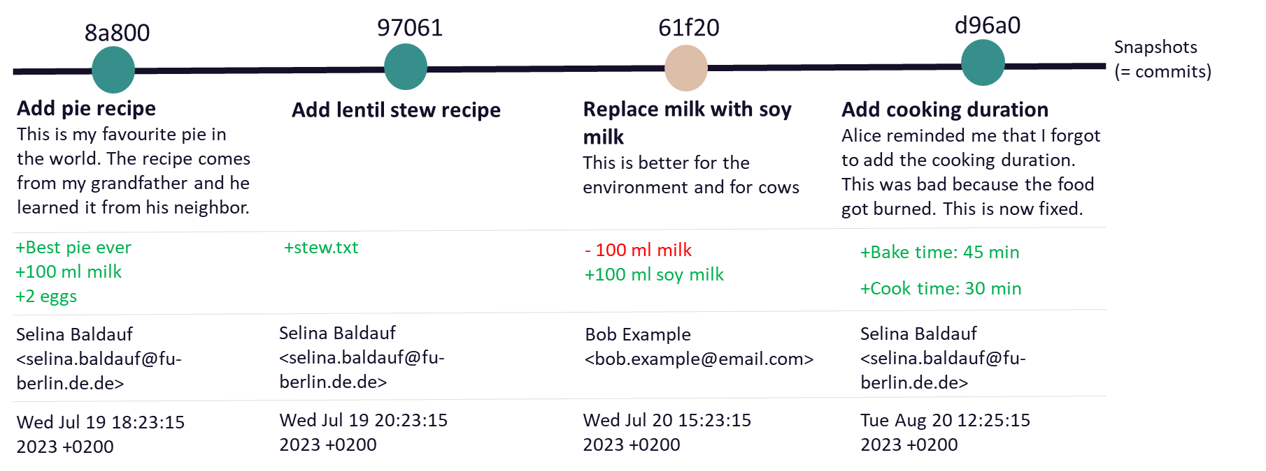

Slide 14
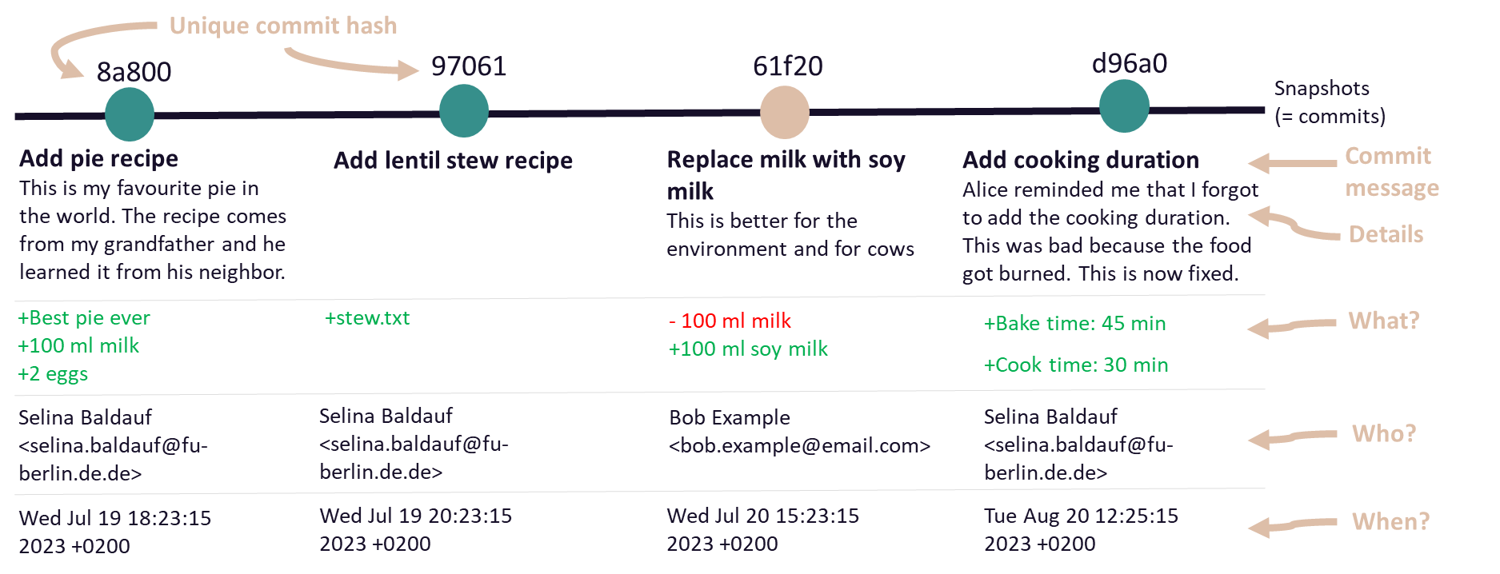

Slide 15
Remote repository
cookBook
.git
Working directory
Staging area
Local repository
pie.txt
pie.txt

Slide 16
Remote repository
git push
pie.txt
cookBook
.git
Working directory
Staging area
Local repository
pie.txt
pie.txt

Slide 17
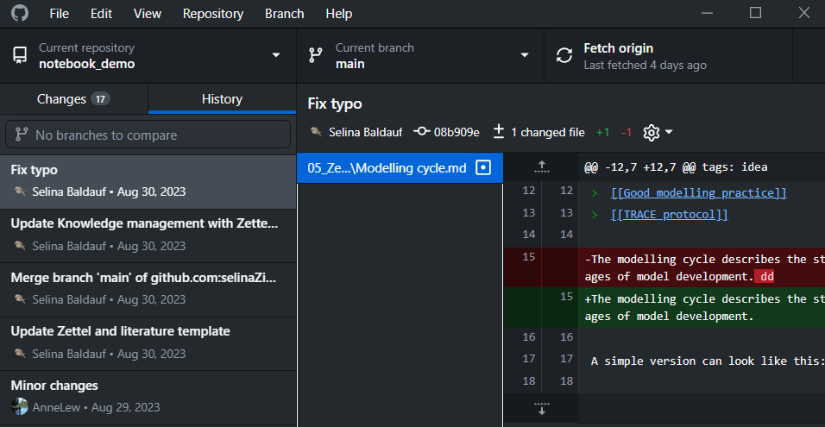

Slide 18
8a800
97061
61f20
d96a0
8a800
97061
61f20
d96a0
Working directory
HEAD
8a800
97061
61f20
d96a0
Working directory
HEAD

Slide 19
8a800
97061
61f20
d96a0
Replace milk with soy milk
git revert 61f20
8a800
97061
61f20
d96a0
a876b
Replace milk with soy milk
Revert “Replace milk with soy milk”

Slide 21
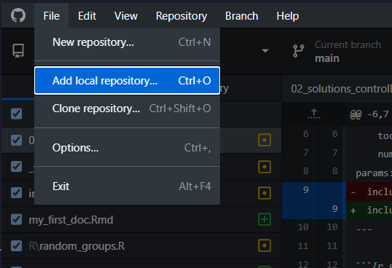
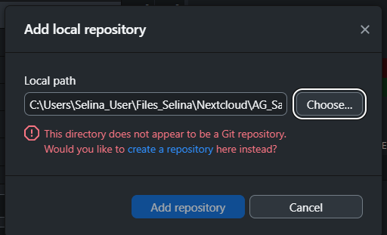

Slide 22
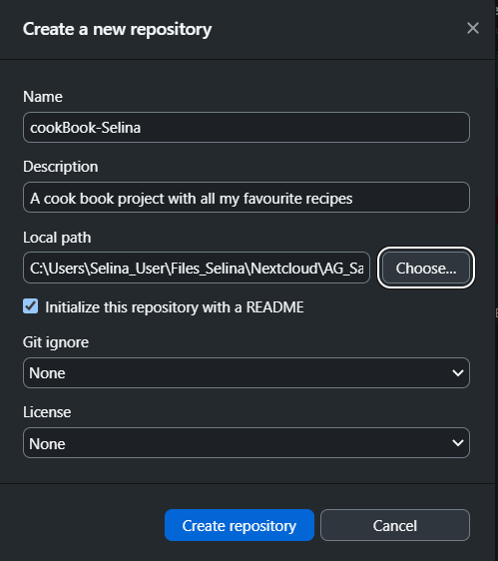
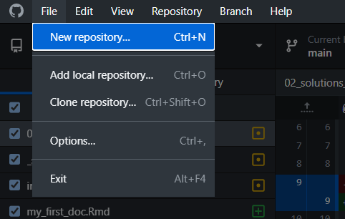

Slide 23
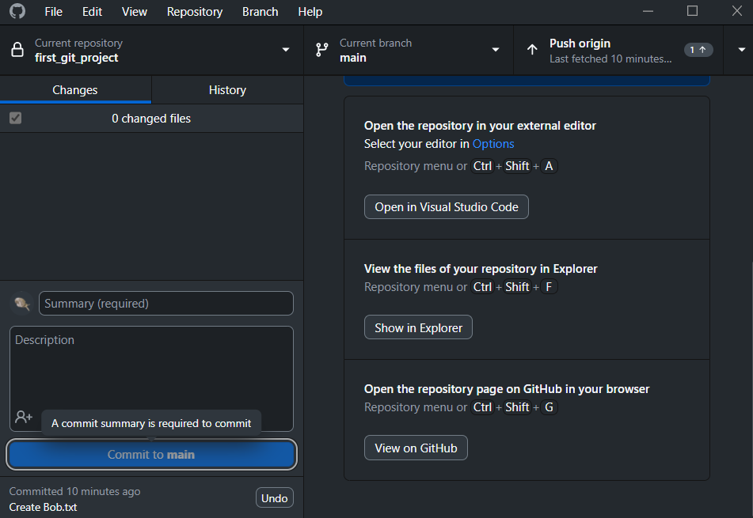

Slide 24
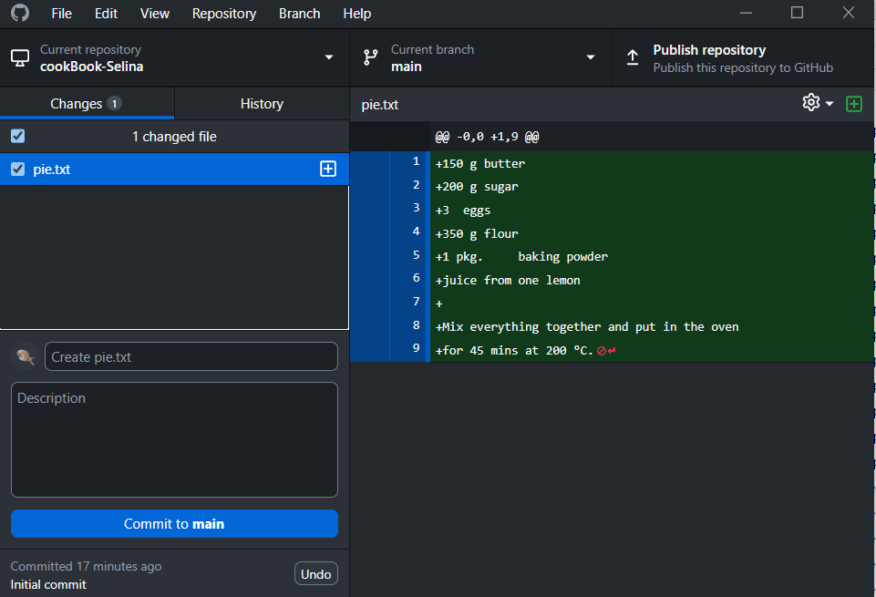
All the changes to the file
pie.txt has changes
The file is ready for the next commit (staged)
Here goes you commit message
Here goes a more detailed description of your commit

Slide 25
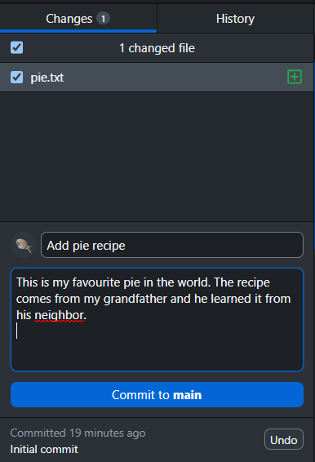

Slide 26
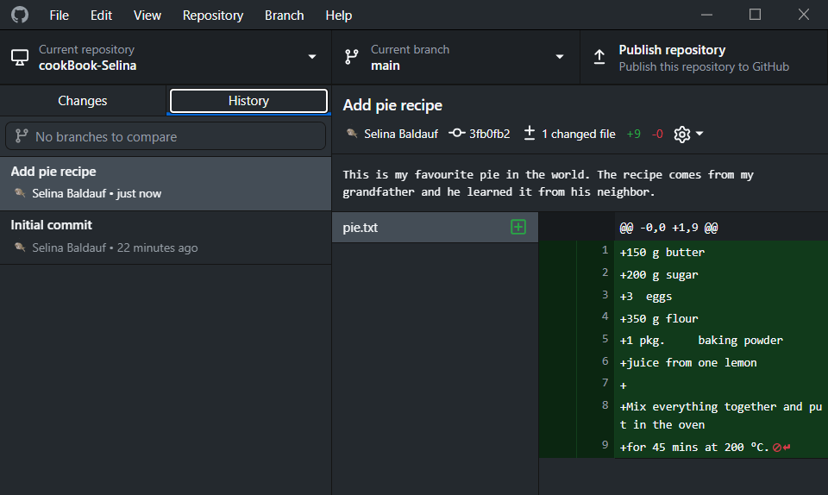
Commits that were made
Files that were changed in selected commit
Content that changed in selected file

Slide 27
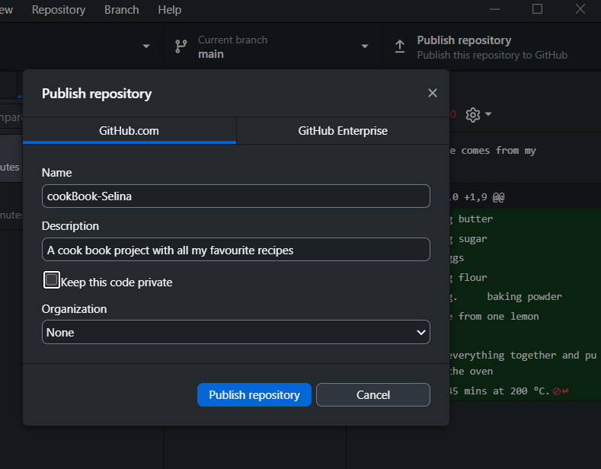

Slide 28
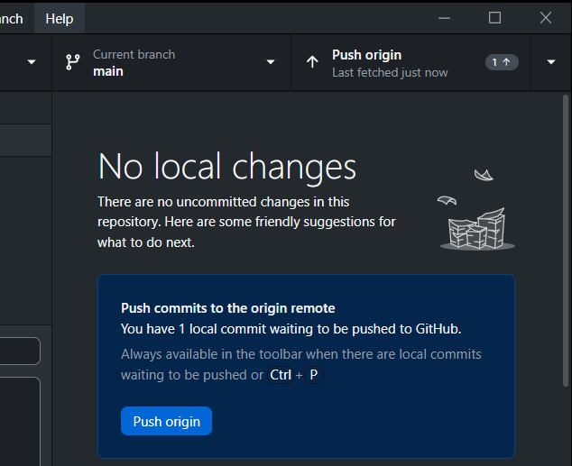

Slide 29
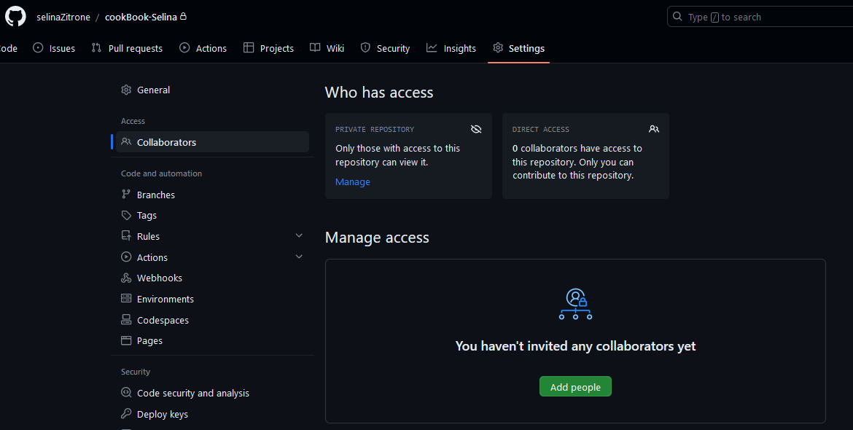

Slide 30
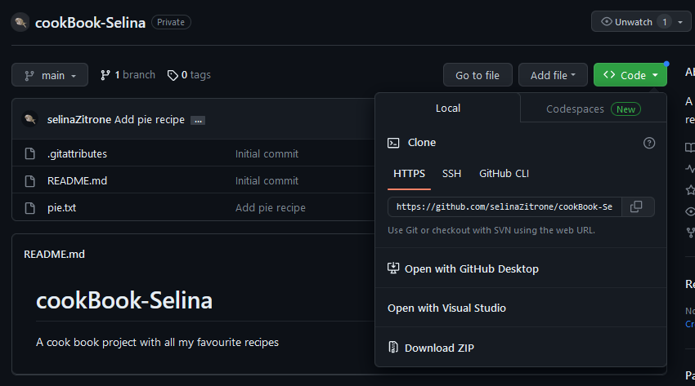

Slide 31
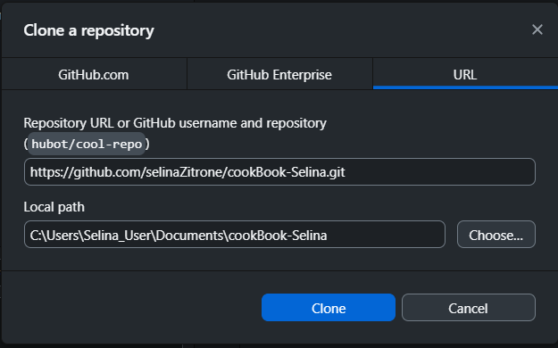

Slide 32
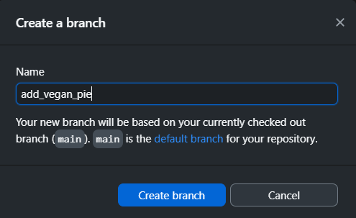

Slide 33
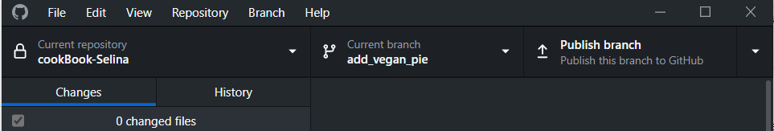
Switch branches

Slide 34
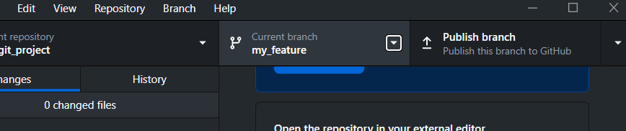
Switch branches

Slide 35
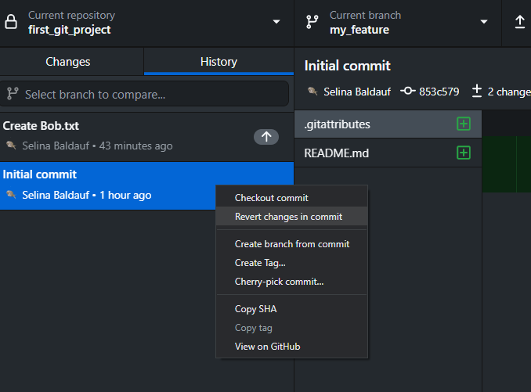
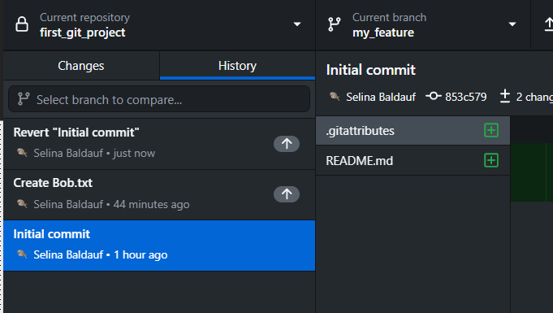

Slide 36
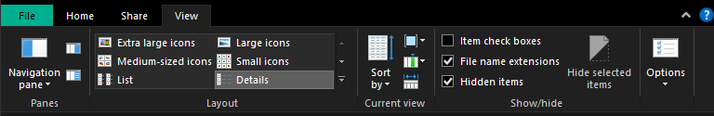

Slide 37
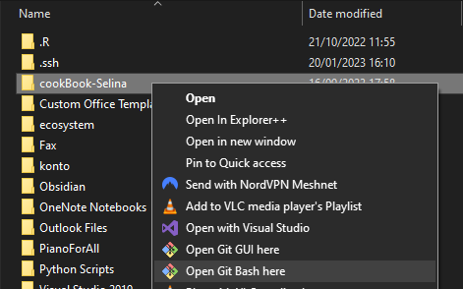
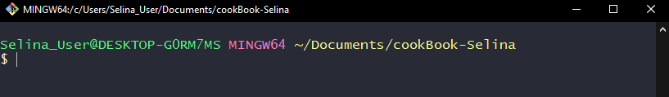
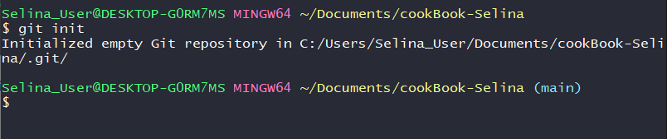

Slide 38
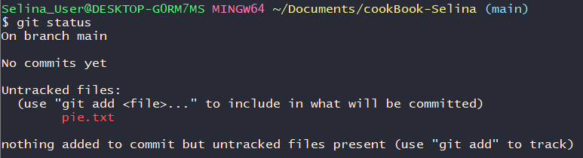
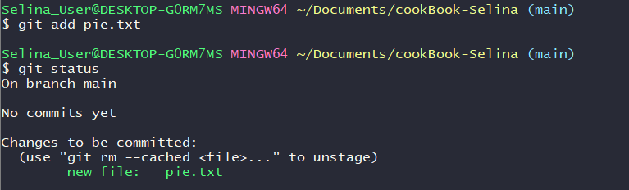

Slide 39
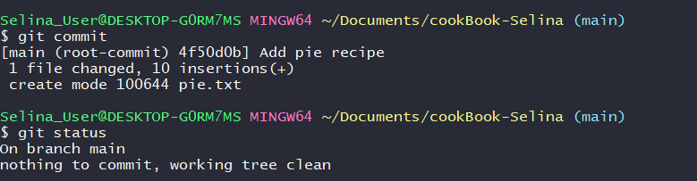

Slide 40
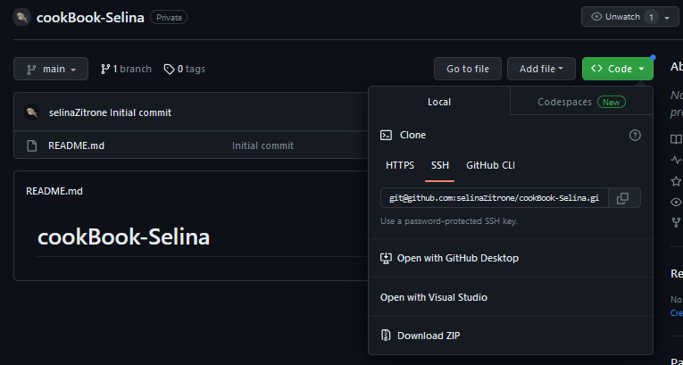

Slide 41
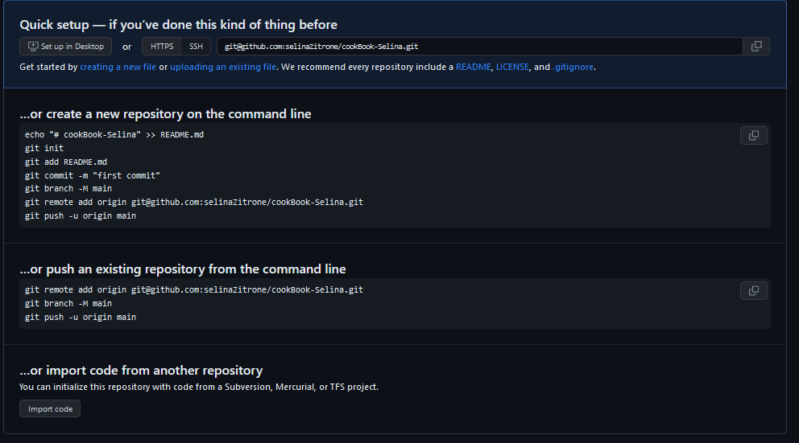

Slide 42
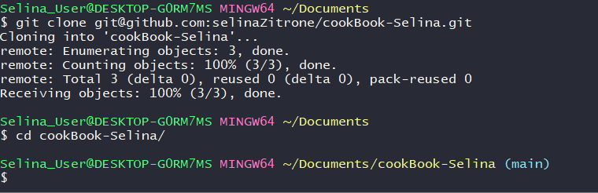
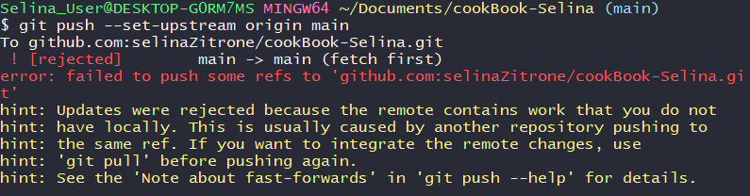
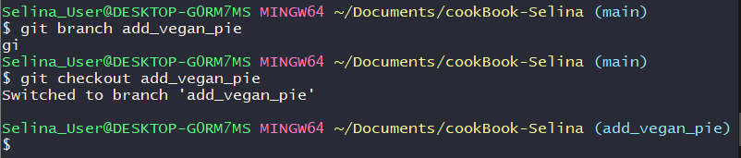

Slide 43
Remote server
Remote server
Gitlab
Gitlab
Github
Github
Local 1
Local 1

Slide 44
Remote repository
git clone
pie.txt
cookBook
.git
Working directory
Staging area
Local repository
pie.txt
pie.txt

Slide 45
Remote repository
git pull
pie.txt
cookBook
stew.txt
.git
Working directory
Staging area
Local repository
pie.txt
pie.txt
stew.txt
stew.txt

Slide 46
main
main
main
add_salad
add_salad
add_vegan_pie
add_vegan_pie
change_stew
change_stew
Bob’s commits
Bob’s commits
Bob’s commits
my commits
my commits
my commits
PR on Github

Slide 47
main
Bob’s commits
Bob’s commits
add_vegan_pie
add_salad
main
my commits
change_stew
my commits

Slide 48
Bob’s commits
add_vegan_pie
add_salad
main
my commits
change_stew
Bob’s commits
add_vegan_pie
add_salad
main
my commits
change_stew

Slide 49
8a800
97061
61f20
d96a0
main
Add pie recipe
Add lentil stew recipe
Replace milk with soy milk
Add cooking duration
change_stew
Add carrots
Replace butter with olive oil

Slide 50
8a800
97061
61f20
d96a0
main
Add pie recipe
Add lentil stew recipe
Replace milk with soy milk
Add cooking duration
Change stew recipe
Merge commit
change_stew
git merge
Add carrots
Replace butter with olive oil
8a800
97061
61f20
d96a0
main
Add pie recipe
Add lentil stew recipe
Replace milk with soy milk
Add cooking duration
Add carrots
Replace butter with olive oil
change_stew
git merge
Add carrots
Replace butter with olive oil

Slide 51
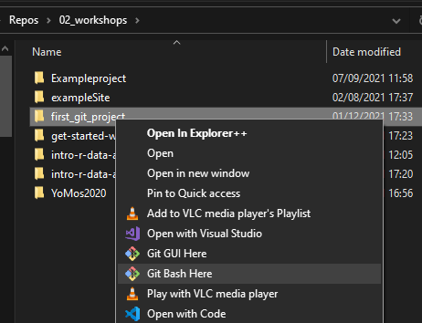

Slide 52
89ca9
7b4sa
f3d83
Snapshot A
Snapshot B
Snapshot C

Slide 53
HEAD
main
89ca9
7b4sa
f3d83
Snapshot A
Snapshot B
Snapshot C

Slide 54
Working directory
Staging area
Local repository
Branches
*main
change_alice
Remote repository
Branches
main
Development environment
HEAD
main
89ca9
7b4sa
f3d83
git branch change_alice
change_alice

Slide 55
main
89ca9
7b4sa
f3d83
git checkout change_alice
change_alice
HEAD

Slide 56
Remote repository
Branches
main
change_alice
Working directory
Staging area
Local repository
Branches
main
*change_alice
Remotes
origin/main
origin/change_alice
Development environment
git push --set-upstream origin change_alice

Slide 57
Remote repository
Branches
main
change_alice
Working directory
Staging area
Local repository
Branches
main
*change_alice
Remotes
origin/main
origin/change_alice
Development environment
git push --set-upstream origin change_alice

Slide 58
main
89ca9
7b4sa
f3d83
07d83
change_alice
main
git merge change_alice
89ca9
7b4sa
f3d83
07d83
change_alice

Slide 59
main
89ca9
7b4sa
f3d83
07d83
change_alice
main
git merge change_alice
89ca9
7b4sa
f3d83
07d83
change_alice

Slide 60
master
main
common ancestor
89ca9
7b4sa
f3d83
changed Bob.txt
7ba83d
Merge commit
07d83
changed Alice.txt
change_alice

Slide 61
master
main
common ancestor
89ca9
7b4sa
f3d83
changed Bob.txt
07d83
changed Alice.txt
change_alice

Slide 62
Remote repository
Branches
main
new_feature
git fetch
Working directory
Staging area
Local repository
Branches
main
Remotes
origin/main
origin/new_feature
Development environment

Slide 63
Remote repository
Branches
main
new_feature
git pull
Working directory
Staging area
Local repository
Branches
main
new_feature
Remotes
origin/main
origin/new_feature
Development environment

Slide 64
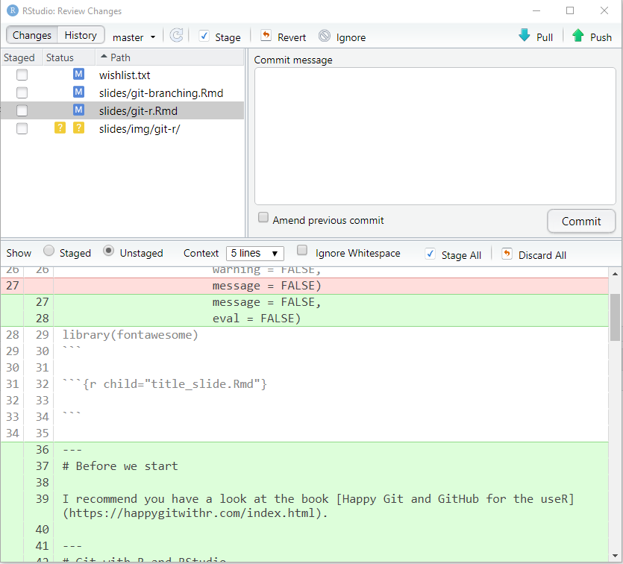
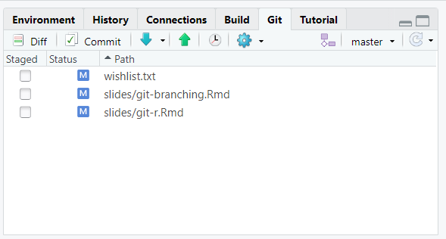
Changed files
Changes

Slide 65
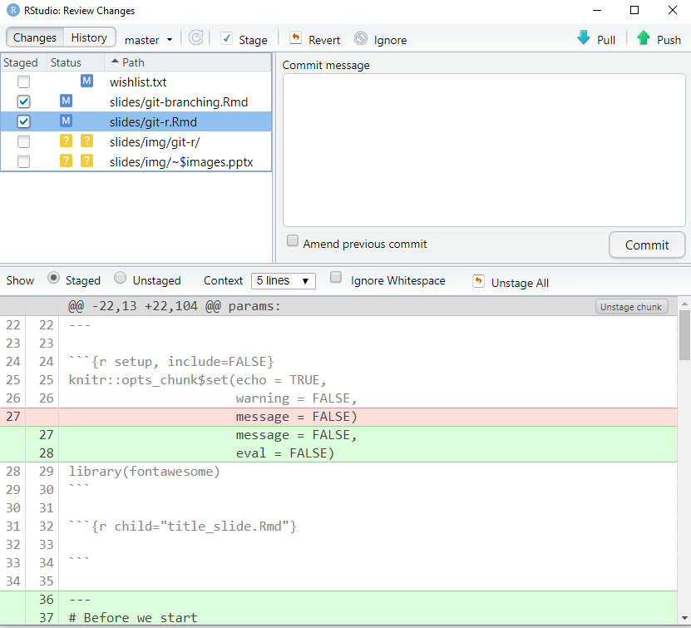
Stage file by checking the box

Slide 66
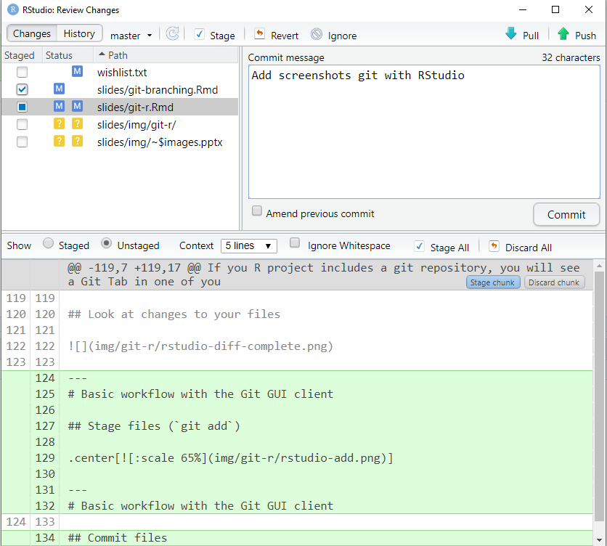
Commit message
Click to commit

Slide 67
pull
push

Slide 68
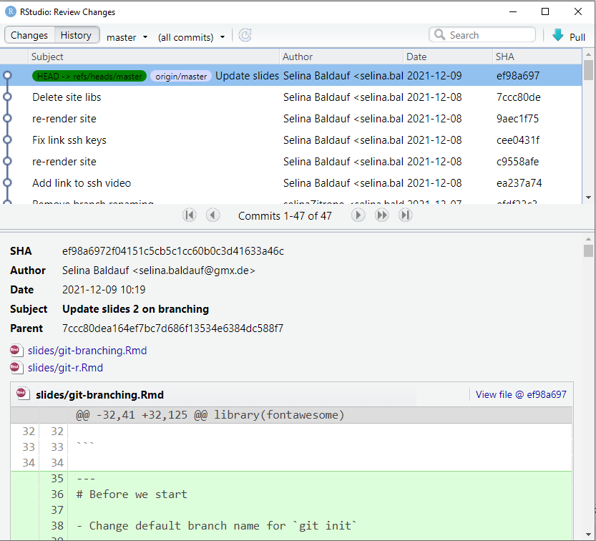

Slide 69
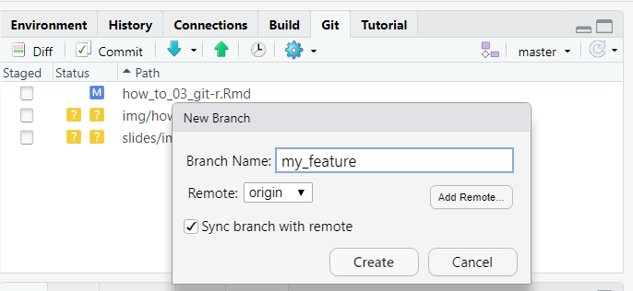
Create new branch
The branch that is checked out

