Slide 1
Remote
Local 1
Local 2
Local 3

Slide 2
Working directory

Slide 3
Working directory
git init
Working directory
Staging area
Local repository
Development environment

Slide 4
Working directory
Staging area
Local repository
Bob.txt
Development environment

Slide 5
Working directory
Staging area
Local repository
Bob.txt
Bob.txt
git add Bob.txt
Development environment

Slide 6
Working directory
Staging area
Local repository
Bob.txt
Bob.txt
Bob.txt
git commit
Development environment

Slide 7
Working directory
Staging area
Local repository
Bob.txt
Bob.txt
Development environment

Slide 8


...
<remote_name>
<remote_address>
Remote repository
Working directory
Staging area
Local repository
Bob.txt
Bob.txt
Development environment

Slide 9
...
Remote
repository
Bob.txt
git push
Working directory
Staging area
Local repository
Bob.txt
Bob.txt
Development environment

Slide 10
...
Remote
repository
Bob.txt
Alice.txt
Working directory
Staging area
Local repository
Bob.txt
Bob.txt
Development environment

Slide 11
...
Remote
repository
Bob.txt
Alice.txt
Working directory
Staging area
Local repository
git pull
Bob.txt
Alice.txt
Bob.txt
Alice.txt
Development environment

Slide 12
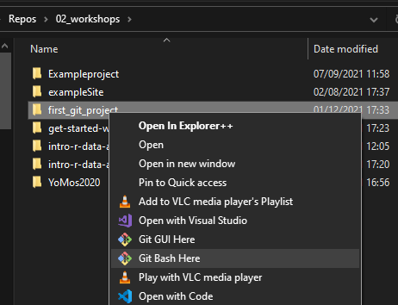

Slide 13
...
git clone <remote_address>
Remote
repository
Bob.txt
Working directory
Staging area
Local repository
Bob.txt
Bob.txt
Development environment

Slide 14
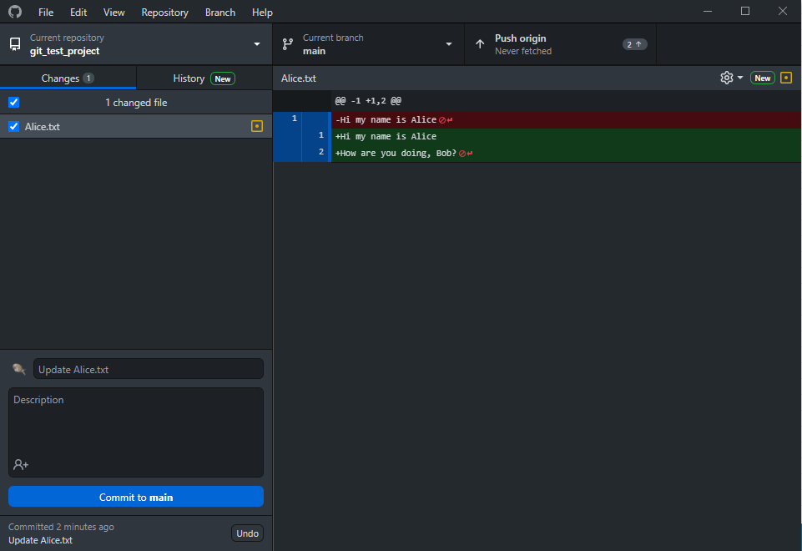

Slide 15
switch branch
git checkout
git push/pull
switch repo
browse repo history
git log
Look at changes made to file
git diff
changed files
git status
enter commit message and commit git commit

