Slide 1
I'd like to get a clear understanding of what the code does, how it's structured, and how to work with git.
Reproducible code, version control, ways to work collaborative without getting lost in code versions, getting to know git and its opportunities in general
How I can incorporate an easy version control in my workflow, hopefully making mobile working easier by working locally and then pushing things back to the common storage instead of constantly having to download via vpn (done by colleagues of mine but don’t know how it works)
version control for my R projects / easily applicable workflows
How to use git/github for looking at code of others and how to use it for keeping my own code.
overwiew on how git/github does work and how I can improve using it in the command line
How to use git/github for looking at code of others and how to use it for keeping my own code.
overwiew on how git/github does work and how I can improve using it in the command line

Slide 2
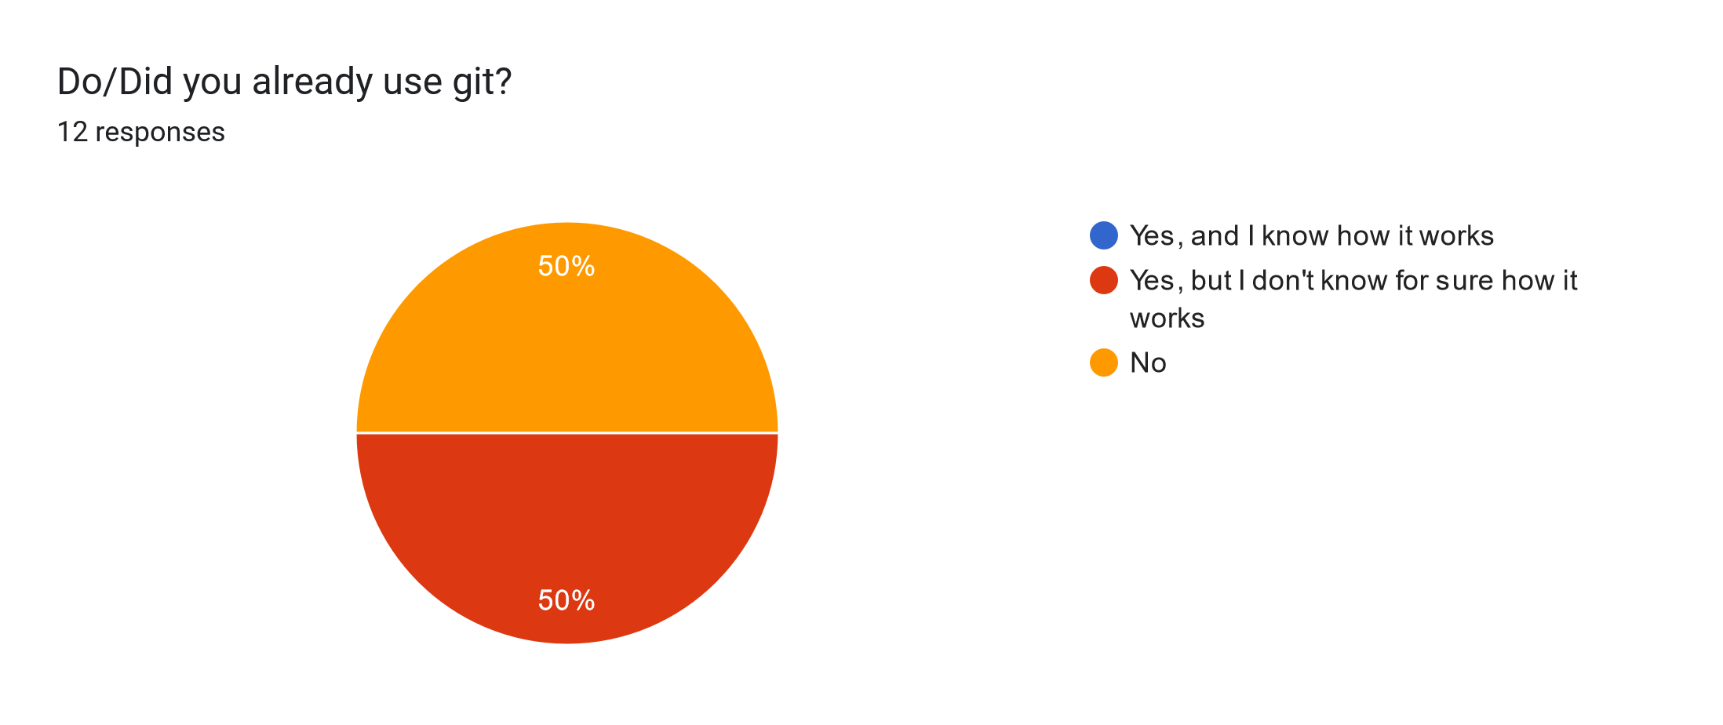

Slide 3
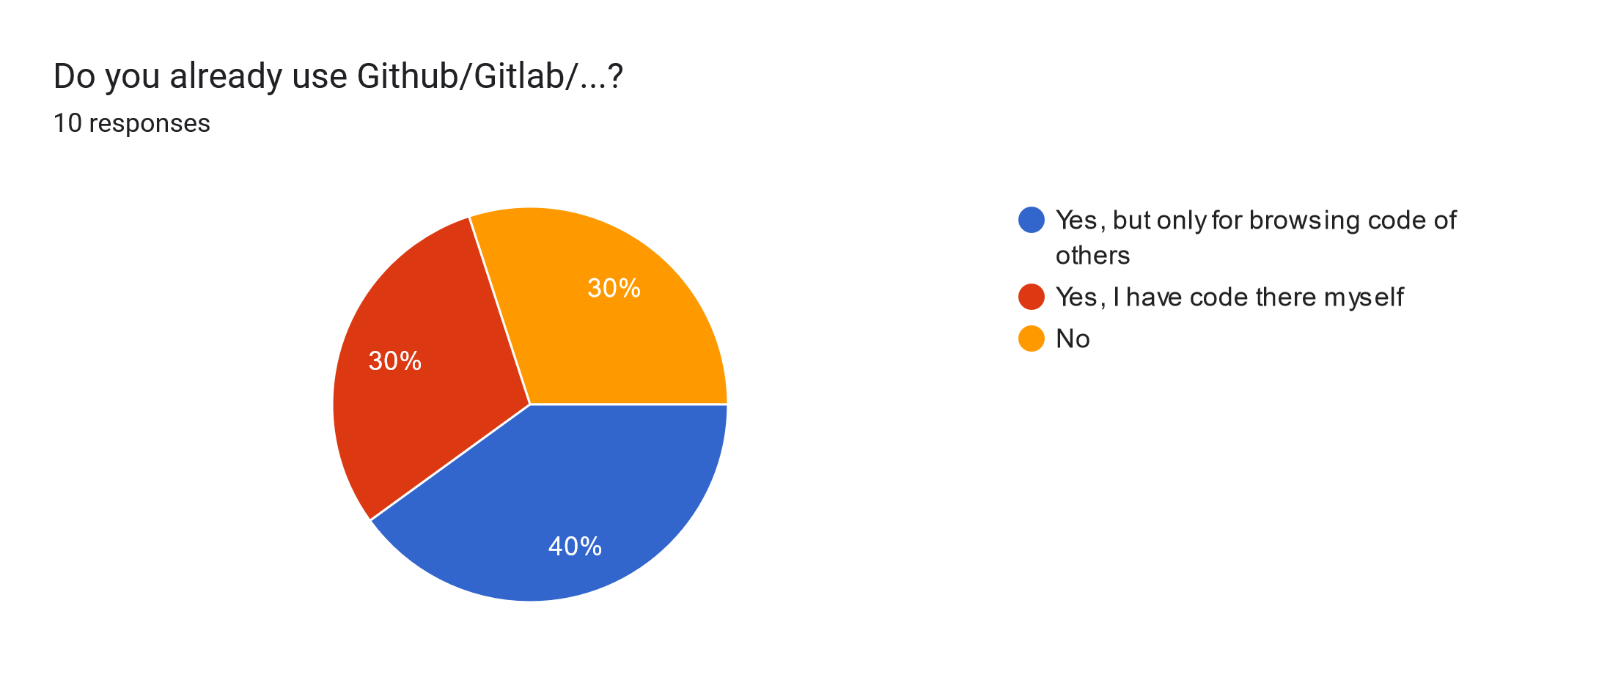

Slide 4
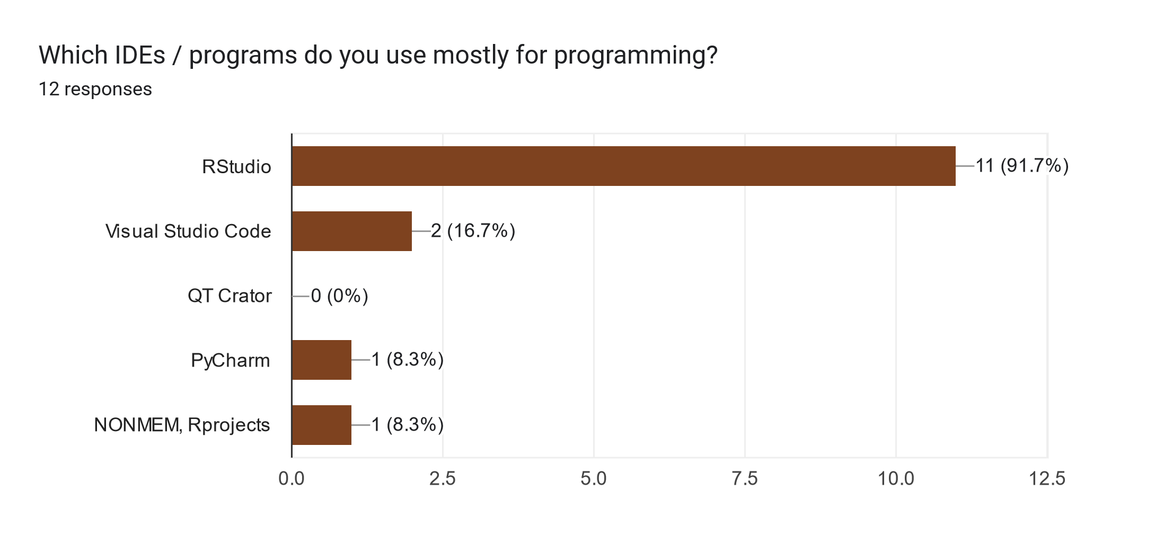

Slide 5
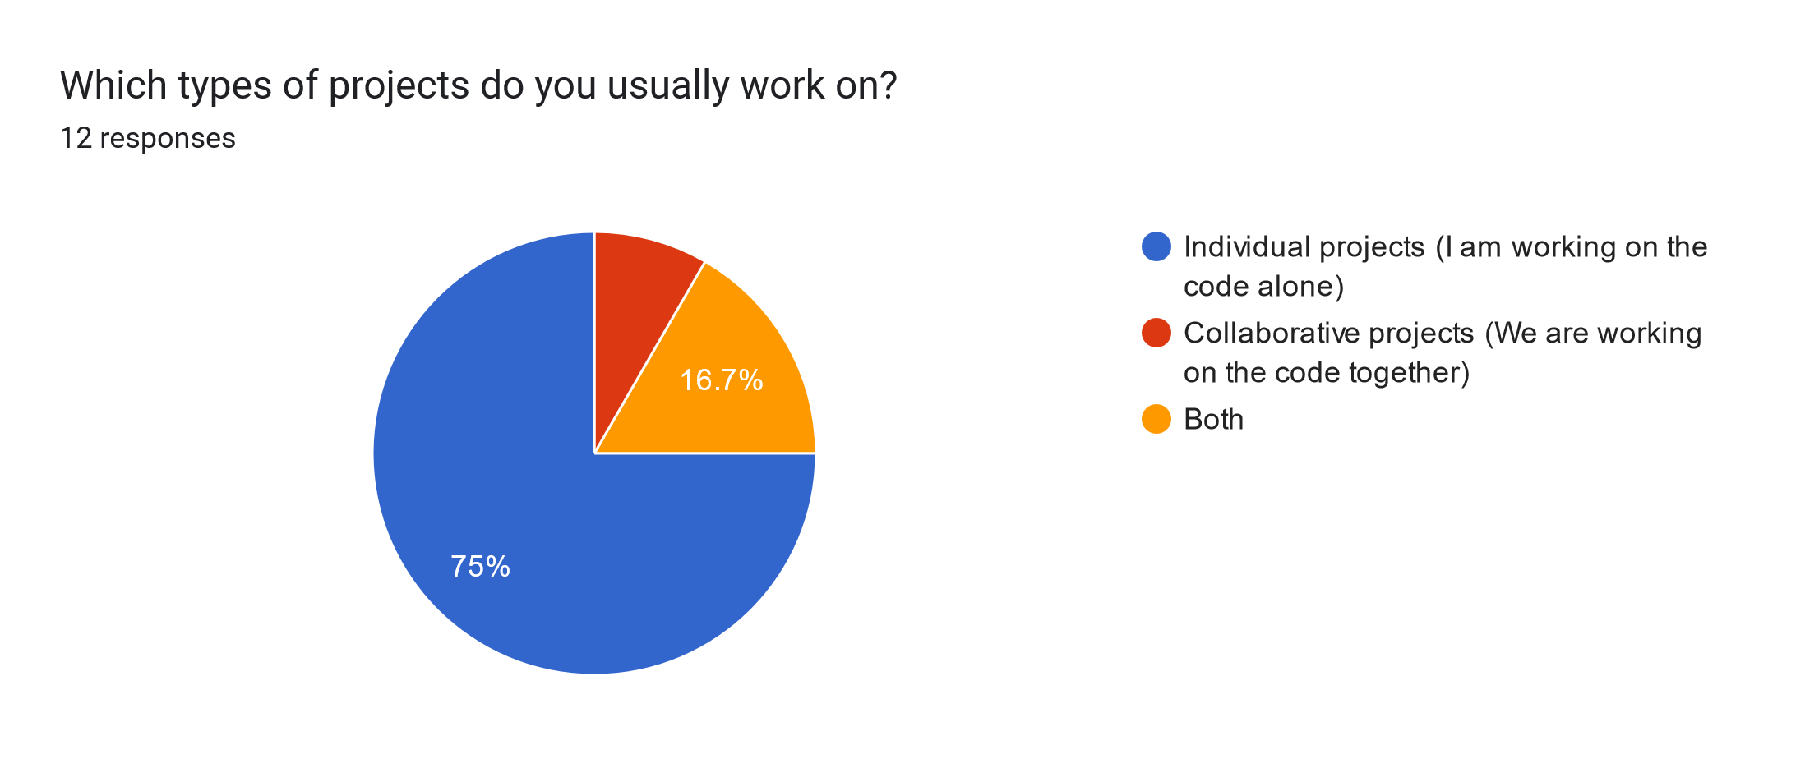

Slide 6





</>
?!
Nice_code_Selina.R
Nice_code.R
Nice_code.R
Nice_code.R
</>
?!

Slide 7







Development over time
Snapshots
(= commits)
myProject
myProject
myProject
myProject
A
A
A1
A1
B
B1
B1
B1
.git
.git
.git
C
.git

Slide 8

Development over time
Snapshots
(= commits)
cookBook
cookBook
cookBook
cookBook
pie.txt
pie.txt
pie.txt
pie.txt
stew.txt
stew.txt
stew.txt
stew.txt
vegan_pie.txt

Slide 9




Remote server
Remote server
Gitlab
Gitlab
Github
Github
.git
.git
.git
Local 1
Local 2
Local 3
Local 1
Local 2
Local 3

Slide 10
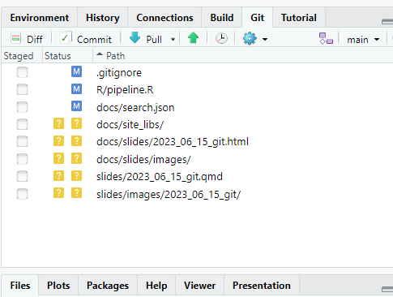
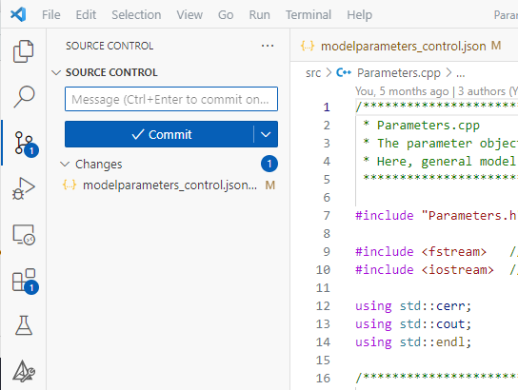

Slide 11
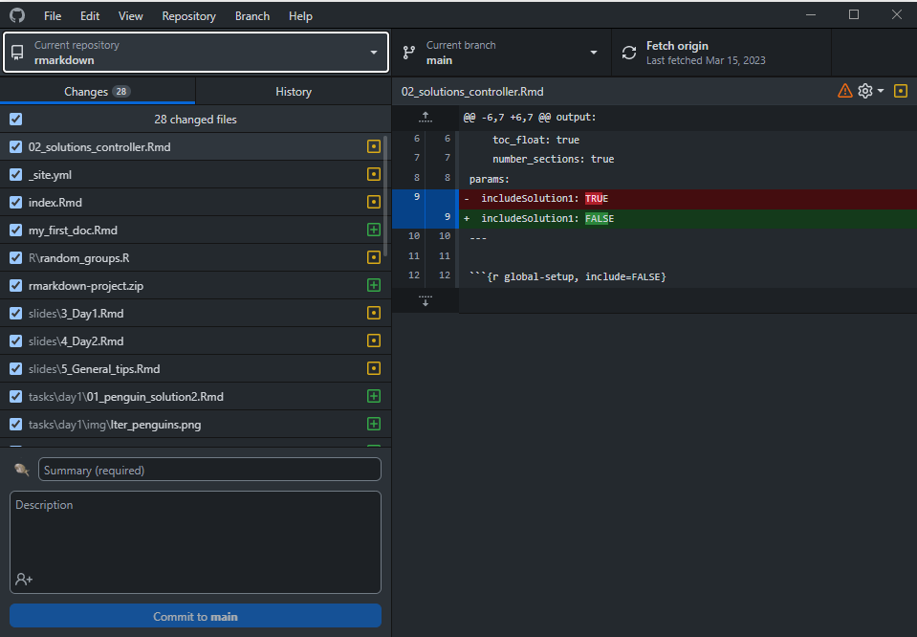

Slide 12
cookBook
cookBook
Working directory
cookBook
Working directory
cookBook

Slide 13
cookBook
Working directory
cookBook
git init
git init
cookBook
.git
cookBook
Working directory
Staging area
Local repository
.git

Slide 14
cookBook
Working directory
cookBook
git init
git init
cookBook
.git
cookBook
Working directory
Staging area
Local repository
.git
Place for files
The heart of your project: This is where the commit history lives
A list of changes that go into the next snapshot (commit)

Slide 15
cookBook
cookBook
.git
Working directory
Staging area
Local repository
pie.txt
.git
pie.txt
cookBook
.git
Working directory
Staging area
Local repository
cookBook
pie.txt
pie.txt
.git

Slide 16

cookBook
cookBook
.git
Working directory
Staging area
Local repository
pie.txt
.git
pie.txt
pie.txt
git add pie.txt
cookBook
cookBook
.git
Working directory
Staging area
Local repository
pie.txt
.git
pie.txt
pie.txt
git add pie.txt

Slide 17
cookBook
cookBook
.git
Working directory
Staging area
Local repository
pie.txt
.git
pie.txt
pie.txt
cookBook
cookBook
.git
Working directory
Staging area
Local repository
pie.txt
.git
pie.txt
pie.txt
git add pie.txt

Slide 18
cookBook
cookBook
.git
Working directory
Staging area
Local repository
pie.txt
cookBook
.git
cookBook
pie.txt
pie.txt
pie.txt
.git
Working directory
Staging area
Local repository
pie.txt
git commit –m „Add pie recipe“
.git
pie.txt
pie.txt
pie.txt
git commit
cookBook
cookBook
cookBook
.git
pie.txt
cookBook
pie.txt
Working directory
Staging area
Local repository
.git
.git
.git
cookBook
Working directory
Staging area
Local repository
pie.txt
pie.txt
.git
Working directory
Staging area
Local repository
pie.txt
pie.txt
pie.txt
pie.txt
pie.txt
git commit

Slide 19
Unique commit hash
8a800
97061
61f20
d96a0
Snapshots
(= commits)
Add pie recipe
This is my favourite pie in the world. The recipe comes from my grandfather and he learned it from his neighbor.
Add lentil stew recipe
Replace milk with soy milk
This is better for the environment and for cows
Add cooking duration
Alice reminded me that I forgot to add the cooking duration. This was bad because the food got burned. This is now fixed.
Commit message
Details
+Best pie ever
+100 ml milk
+2 eggs
+stew.txt
- 100 ml milk
+100 ml soy milk
+Bake time: 45 min
What?
+Cook time: 30 min
Selina Baldauf <selina.baldauf@fu-berlin.de.de>
Selina Baldauf <selina.baldauf@fu-berlin.de.de>
Bob Example <bob.example@email.com>
Selina Baldauf
<selina.baldauf@fu-berlin.de.de>
Who?
Wed Jul 19 18:23:15 2023 +0200
Wed Jul 19 20:23:15 2023 +0200
Wed Jul 20 15:23:15 2023 +0200
Tue Aug 20 12:25:15 2023 +0200
When?

Slide 20
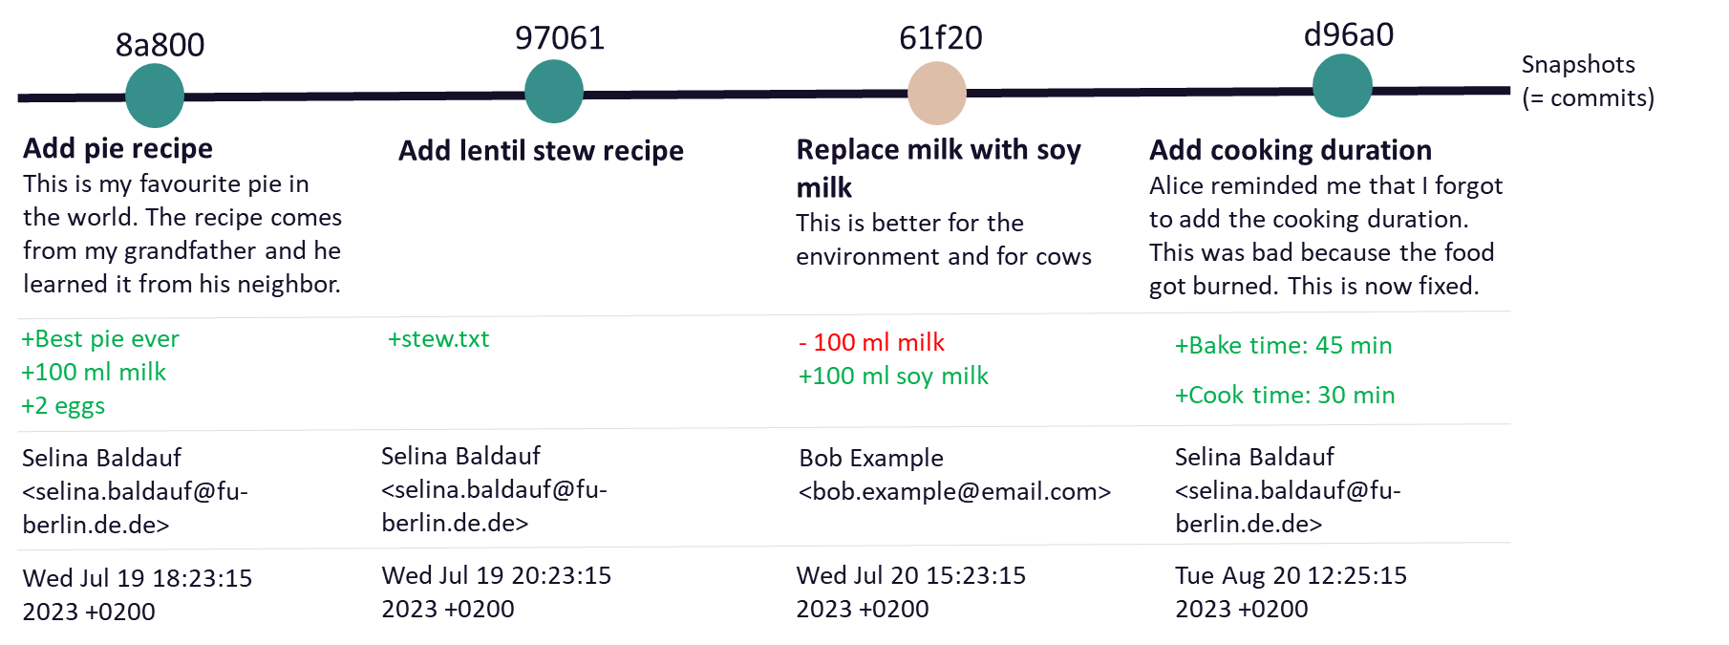

Slide 21
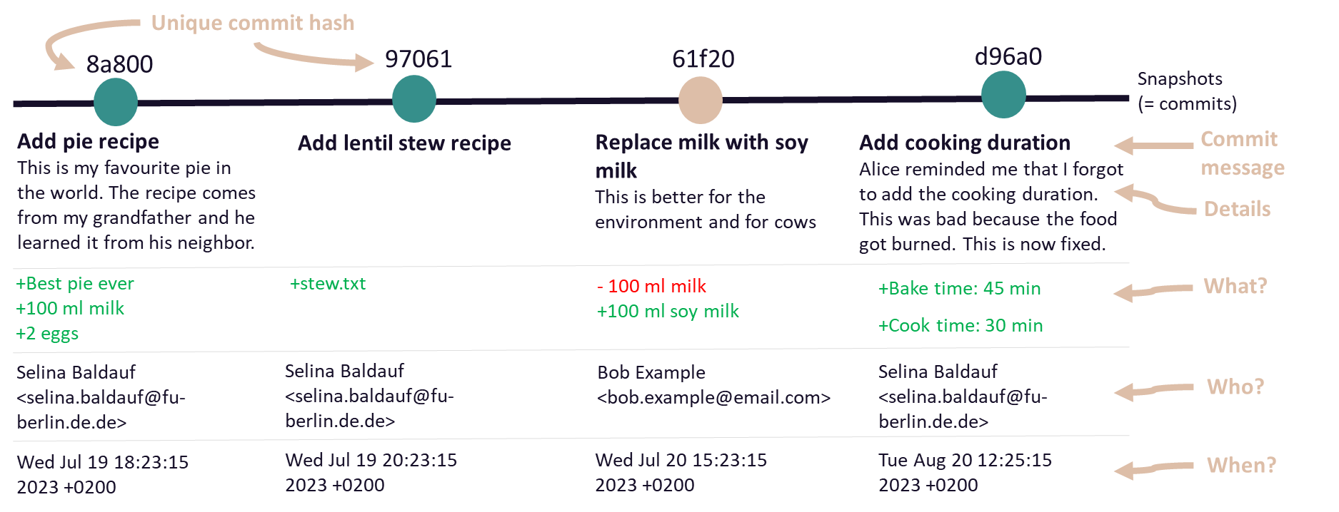

Slide 22

Remote repository
cookBook
.git
Working directory
Staging area
Local repository
pie.txt
pie.txt

Slide 23
git remote add origin git@gitlab.com:selinaBaldauf/cookbook-selina.git
Remote repository
cookBook
.git
Working directory
Staging area
Local repository
pie.txt
pie.txt

Slide 24
Remote repository
git push
pie.txt
cookBook
.git
Working directory
Staging area
Local repository
pie.txt
pie.txt

Slide 25
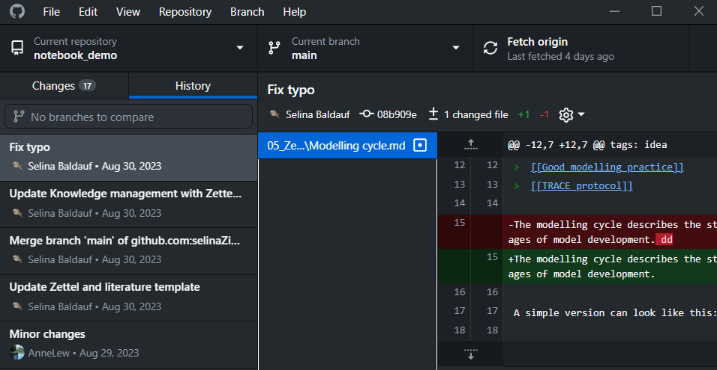

Slide 26
8a800
97061
61f20
d96a0
8a800
97061
61f20
d96a0
Working directory
HEAD
8a800
97061
61f20
d96a0
Working directory
Working directory
HEAD
git checkout 67061
HEAD

Slide 27
8a800
97061
61f20
d96a0
Replace milk with soy milk
git revert 61f20
8a800
97061
61f20
d96a0
a876b
Replace milk with soy milk
Revert “Replace milk with soy milk”

Slide 28
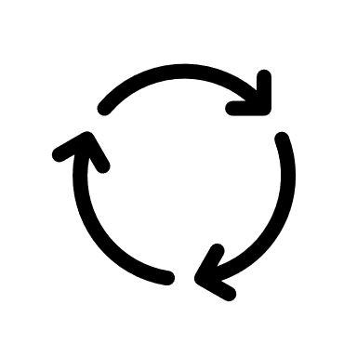
Collect changes for the next snapshot changes
Change files
Work on your project
git add
Publish your repository
Initialize repository
Push changes to Github
git init
git push
Make a snapshot
git commit

Slide 30
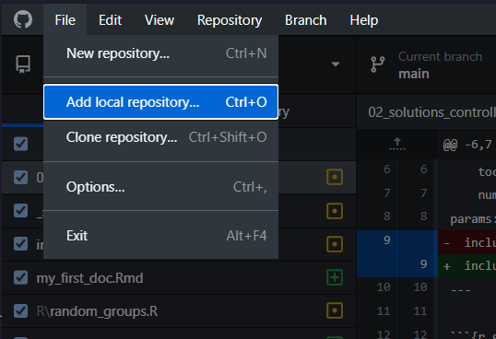
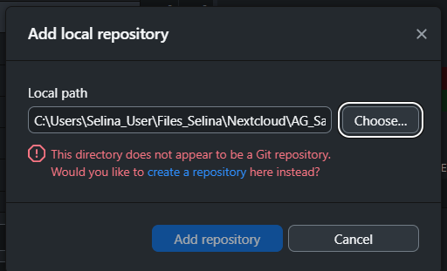

Slide 31
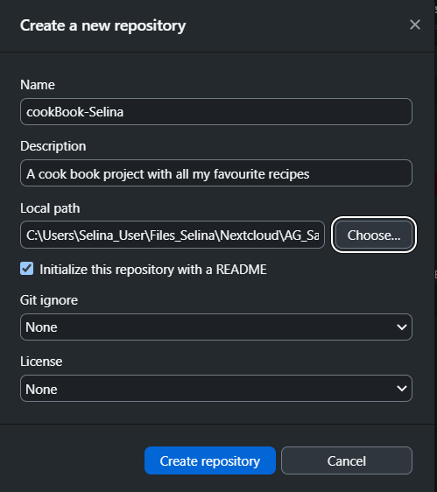
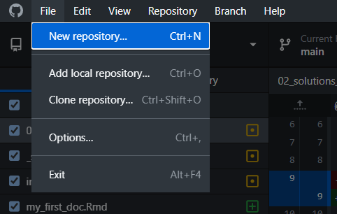

Slide 32
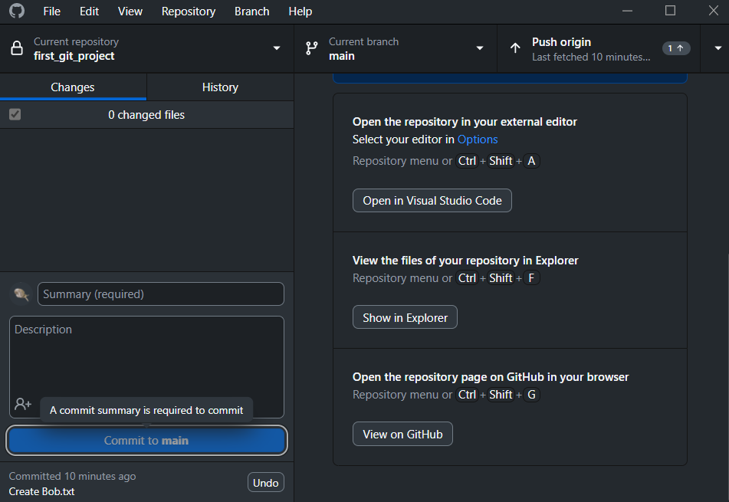

Slide 33
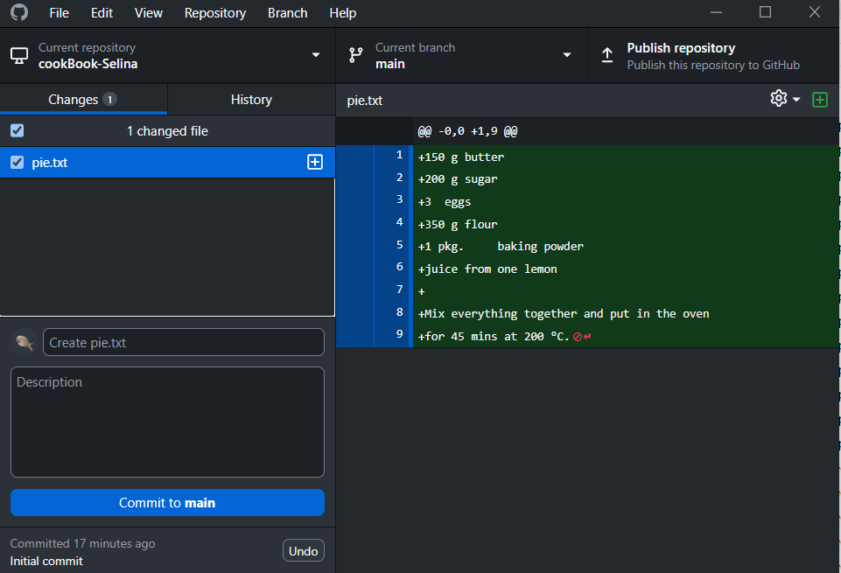
All the changes to the file
pie.txt has changes
The file is ready for the next commit (staged)
Here goes you commit message
Here goes a more detailed description of your commit

Slide 34
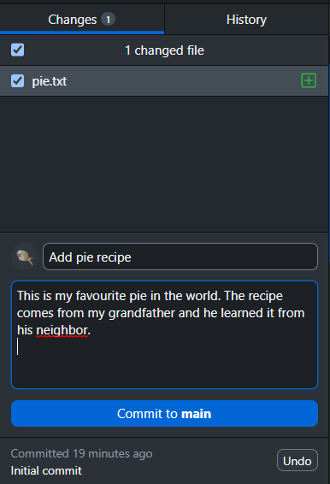

Slide 35
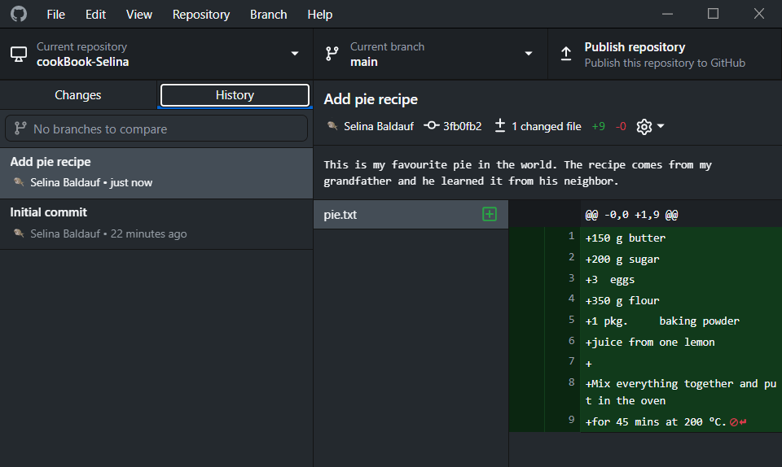
Commits that were made
Files that were changed in selected commit
Content that changed in selected file

Slide 36
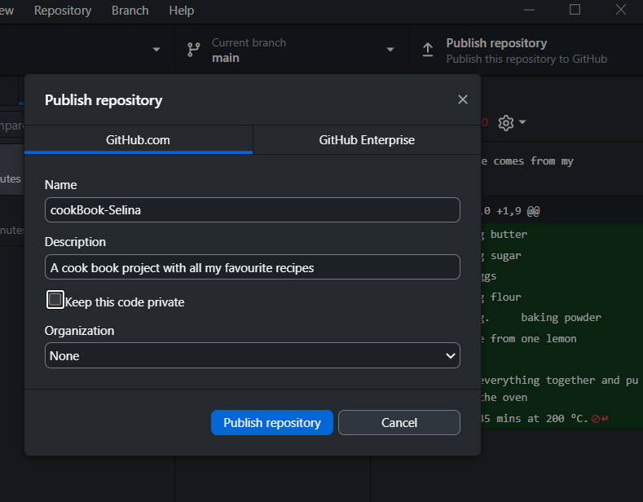

Slide 37
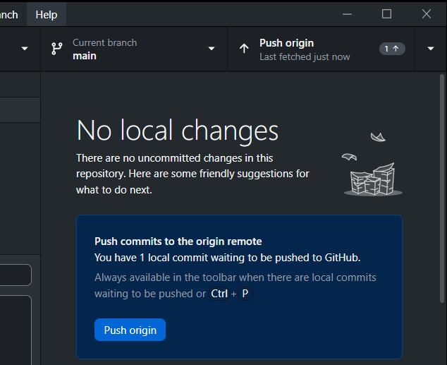

Slide 38
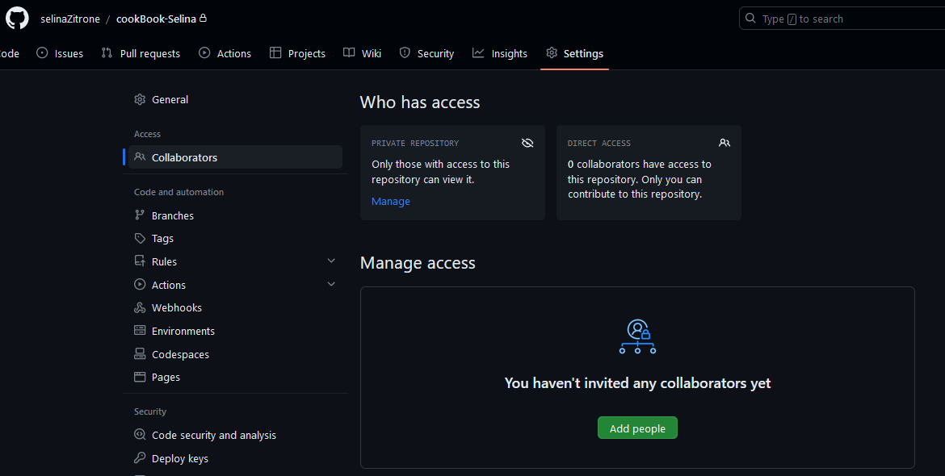

Slide 39
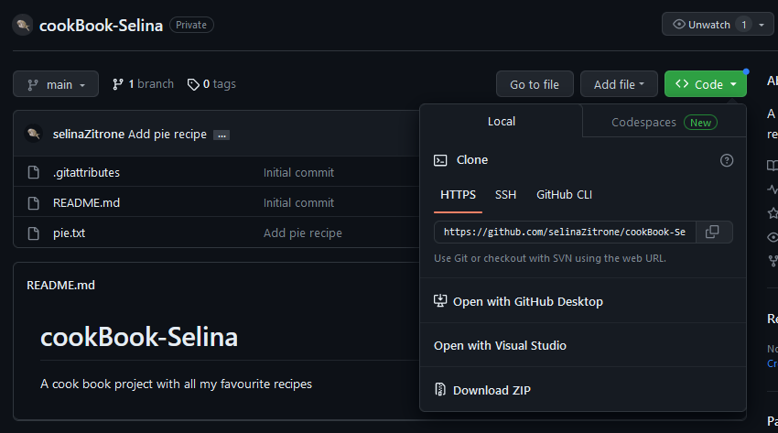

Slide 40
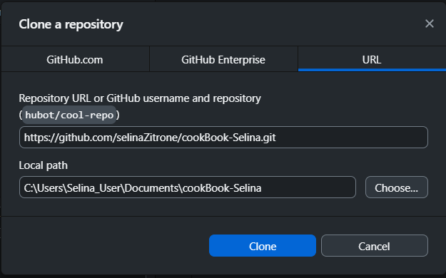

Slide 41
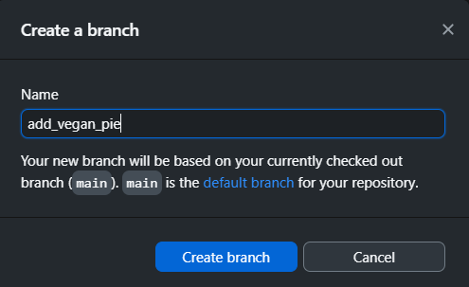

Slide 42
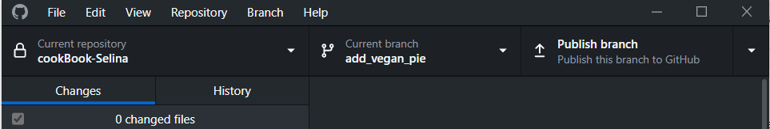
Switch branches

Slide 43
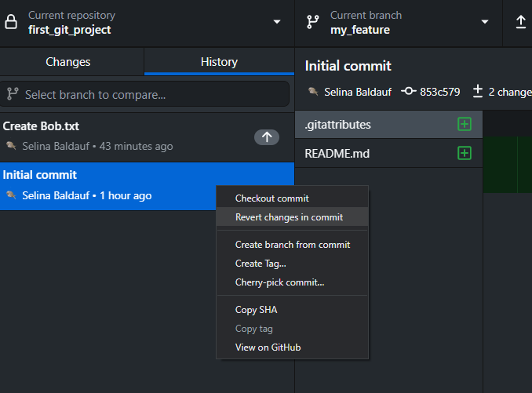
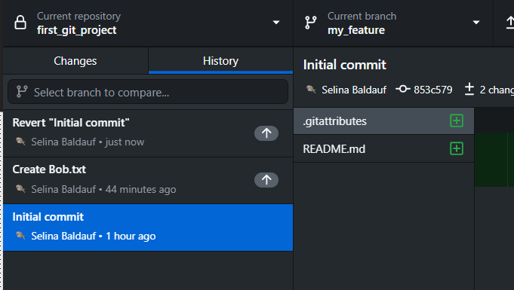

Slide 44
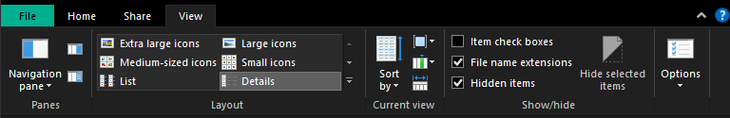
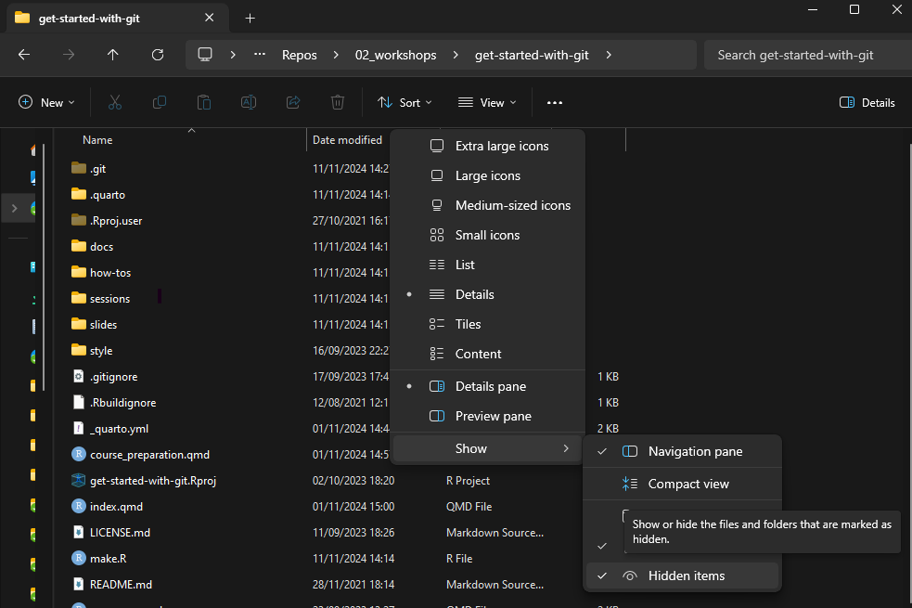

Slide 45
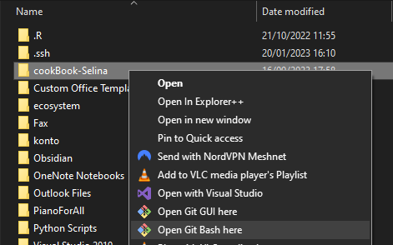
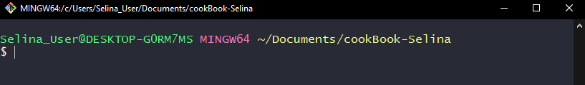
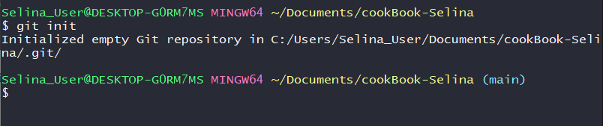

Slide 46
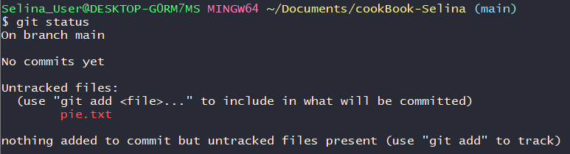
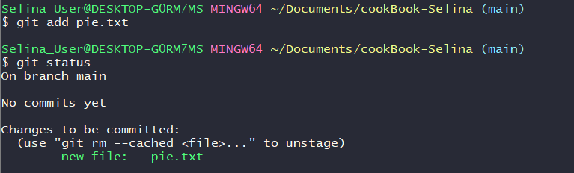

Slide 47
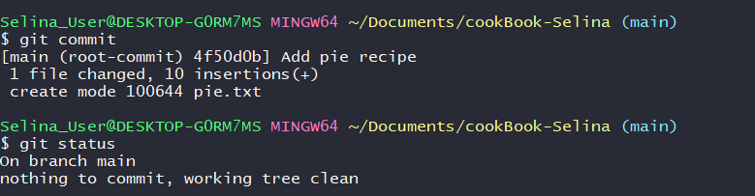

Slide 48
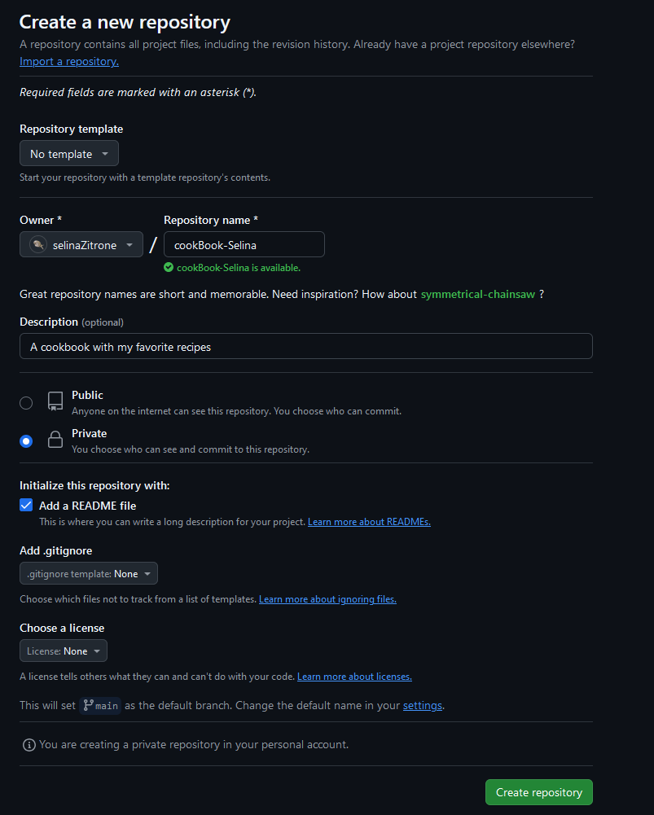

Slide 49
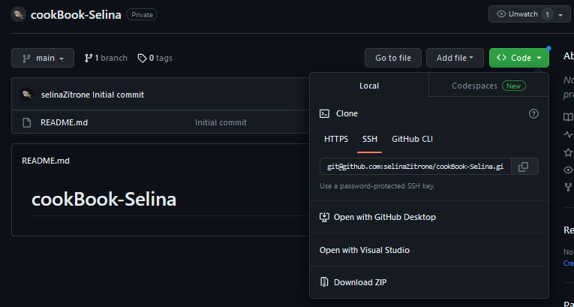

Slide 50
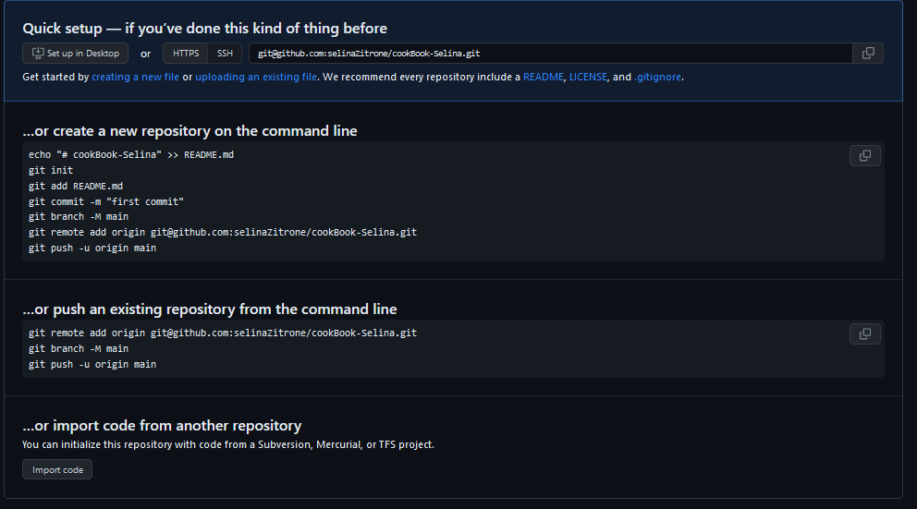

Slide 51
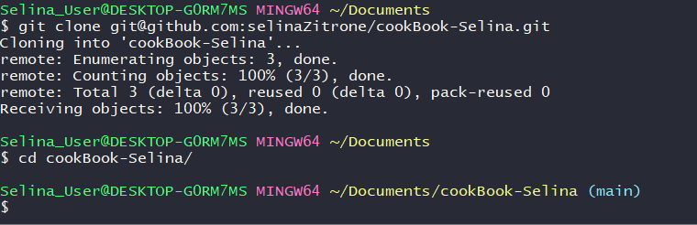
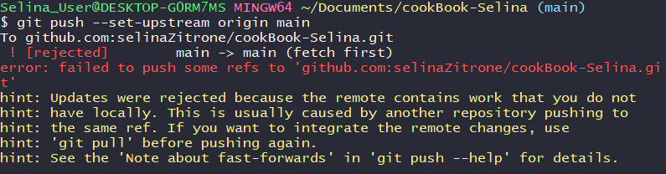
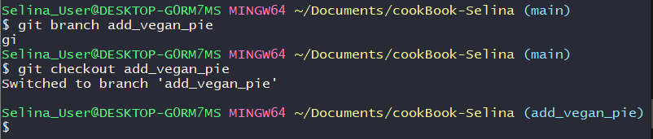

Slide 52
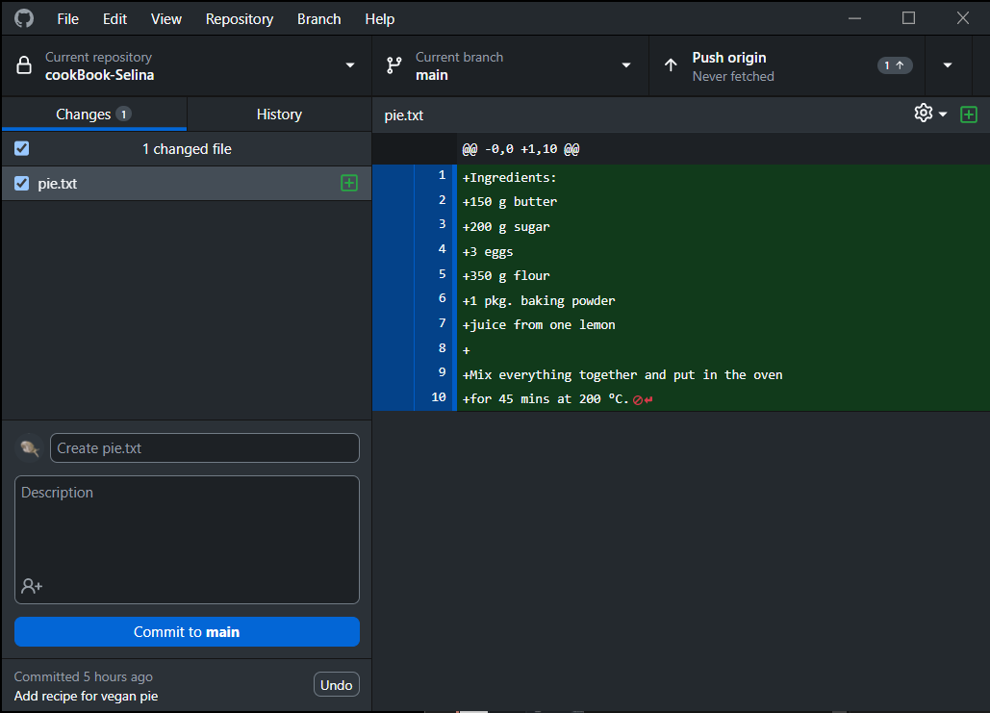
Commit history
Switch branches
Push/Pull
Switch repos
(Un-)Stage all files
(Un-)Stage one file
Current changes
Commit message
Changes in selected file

Slide 53
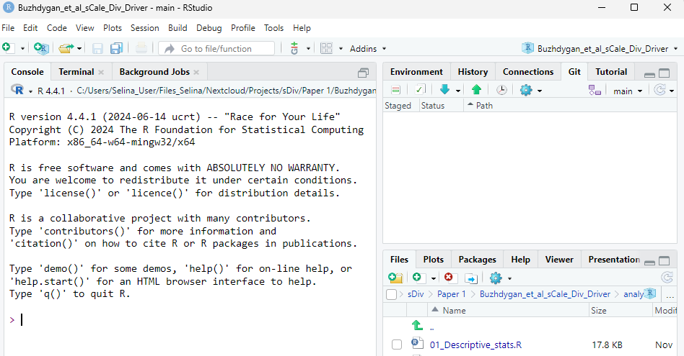

Slide 54

Remote server
Remote server
Remote server
Gitlab
Gitlab
Gitlab
Github
Github
Github
Local 1
Local 1
Local 1

Slide 55
cookBook
.git
Working directory
Staging area
Local repository
pie.txt
pie.txt
git add pie.txt
Remote repository
git clone
pie.txt
cookBook
.git
cookBook
Working directory
Staging area
Local repository
pie.txt
.git
pie.txt
pie.txt

Slide 56


Remote repository
pie.txt
cookBook
Remote repository
git clone
pie.txt
cookBook
.git
cookBook
Working directory
Staging area
Local repository
pie.txt
.git
pie.txt
pie.txt

Slide 57
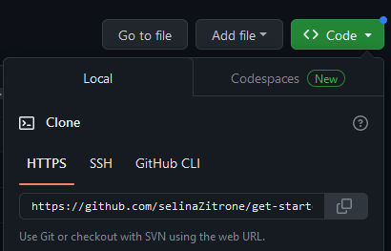

Slide 58
Remote repository
git pull
pie.txt
cookBook
stew.txt
.git
Working directory
Staging area
Local repository
pie.txt
pie.txt
stew.txt
stew.txt

Slide 59
main
main
main
add_salad
add_salad
add_vegan_pie
add_vegan_pie
change_stew
change_stew
Bob’s commits
Bob’s commits
Bob’s commits
my commits
my commits
my commits
PR on Github

Slide 60
main
Bob’s commits
Bob’s commits
add_vegan_pie
add_salad
main
my commits
change_stew
my commits

Slide 61
Bob’s commits
add_vegan_pie
add_salad
main
my commits
change_stew
Bob’s commits
add_vegan_pie
add_salad
main
my commits
change_stew

Slide 62
8a800
97061
61f20
d96a0
main
Add pie recipe
Add lentil stew recipe
Replace milk with soy milk
Add cooking duration
change_stew
Add carrots
Replace butter with olive oil

Slide 63
8a800
97061
61f20
d96a0
main
Add pie recipe
Add lentil stew recipe
Replace milk with soy milk
Add cooking duration
Change stew recipe
Merge commit
change_stew
git merge
Add carrots
Replace butter with olive oil
8a800
97061
61f20
d96a0
main
Add pie recipe
Add lentil stew recipe
Replace milk with soy milk
Add cooking duration
Add carrots
Replace butter with olive oil
change_stew
git merge
Add carrots
Replace butter with olive oil

Slide 64
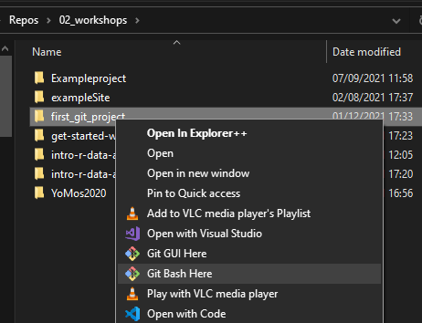

Slide 65
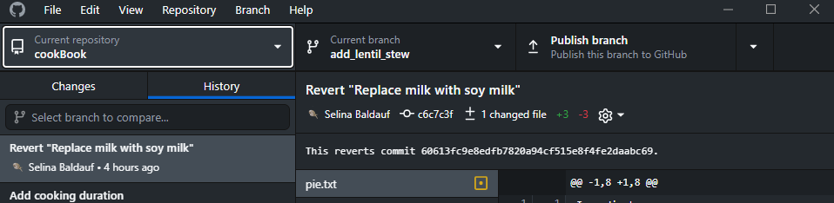

Slide 66
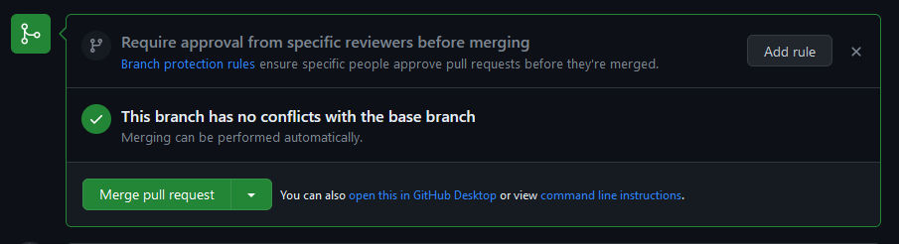
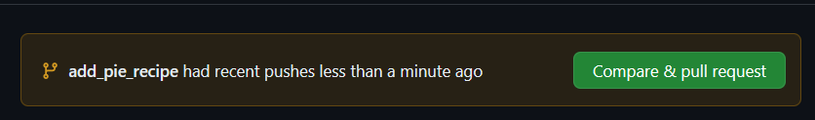
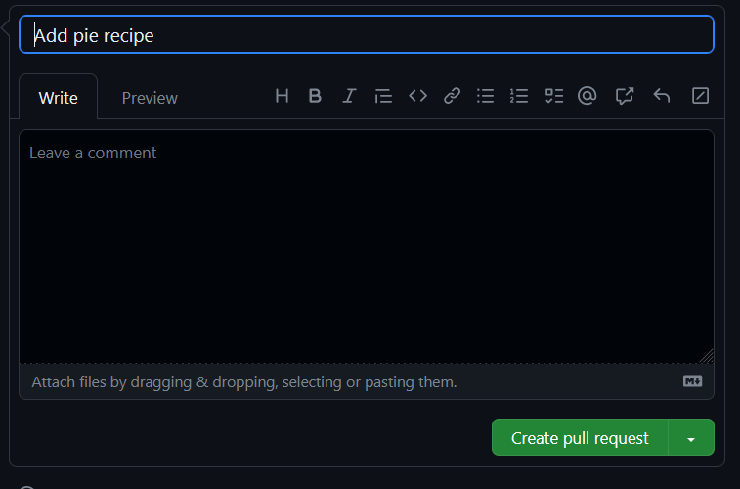

Slide 67





Slide 68
89ca9
7b4sa
f3d83
Snapshot A
Snapshot B
Snapshot C

Slide 69
HEAD
main
89ca9
7b4sa
f3d83
Snapshot A
Snapshot B
Snapshot C

Slide 70
Working directory
Staging area
Local repository
Branches
*main
change_alice
Remote repository
Branches
main
Development environment
HEAD
main
89ca9
7b4sa
f3d83
git branch change_alice
change_alice

Slide 71
main
89ca9
7b4sa
f3d83
git checkout change_alice
change_alice
HEAD

Slide 72
Remote repository
Branches
main
change_alice
Working directory
Staging area
Local repository
Branches
main
*change_alice
Remotes
origin/main
origin/change_alice
Development environment
git push --set-upstream origin change_alice

Slide 73
Remote repository
Branches
main
change_alice
Working directory
Staging area
Local repository
Branches
main
*change_alice
Remotes
origin/main
origin/change_alice
Development environment
git push --set-upstream origin change_alice

Slide 74
main
89ca9
7b4sa
f3d83
07d83
change_alice
main
git merge change_alice
89ca9
7b4sa
f3d83
07d83
change_alice

Slide 75
main
89ca9
7b4sa
f3d83
07d83
change_alice
main
git merge change_alice
89ca9
7b4sa
f3d83
07d83
change_alice

Slide 76
master
main
common ancestor
89ca9
7b4sa
f3d83
changed Bob.txt
7ba83d
Merge commit
07d83
changed Alice.txt
change_alice

Slide 77
master
main
common ancestor
89ca9
7b4sa
f3d83
changed Bob.txt
07d83
changed Alice.txt
change_alice

Slide 78
Remote repository
Branches
main
new_feature
git fetch
Working directory
Staging area
Local repository
Branches
main
Remotes
origin/main
origin/new_feature
Development environment

Slide 79
Remote repository
Branches
main
new_feature
git pull
Working directory
Staging area
Local repository
Branches
main
new_feature
Remotes
origin/main
origin/new_feature
Development environment

Slide 80


Changed files
Changes

Slide 81

Stage file by checking the box

Slide 82

Commit message
Click to commit

Slide 83
pull
push

Slide 84


Slide 85

Create new branch
The branch that is checked out

