Slide 1
Remote
Local 1
Local 2
Local 3

Slide 2
Working directory

Slide 3
Working directory
git init
Working directory
Staging area
Local repository
Development environment

Slide 4
Working directory
Staging area
Local repository
Bob.txt
Development environment

Slide 5
Working directory
Staging area
Local repository
Bob.txt
Bob.txt
git add Bob.txt
Development environment

Slide 6
Working directory
Staging area
Local repository
Bob.txt
Bob.txt
Bob.txt
git commit
Development environment

Slide 7
Working directory
Staging area
Local repository
Bob.txt
Bob.txt
Development environment

Slide 8


...
<remote_name>
<remote_address>
Remote repository
Working directory
Staging area
Local repository
Bob.txt
Bob.txt
Development environment

Slide 9
...
Remote
repository
Bob.txt
git push
Working directory
Staging area
Local repository
Bob.txt
Bob.txt
Development environment

Slide 10
...
Remote
repository
Bob.txt
Alice.txt
Working directory
Staging area
Local repository
Bob.txt
Bob.txt
Development environment

Slide 11
...
Remote
repository
Bob.txt
Alice.txt
Working directory
Staging area
Local repository
git pull
Bob.txt
Alice.txt
Bob.txt
Alice.txt
Development environment

Slide 12
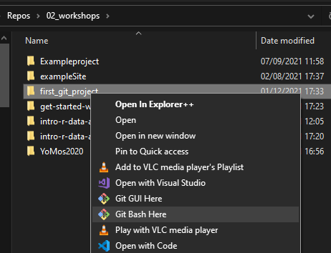

Slide 13
...
git clone <remote_address>
Remote
repository
Bob.txt
Working directory
Staging area
Local repository
Bob.txt
Bob.txt
Development environment

Slide 14
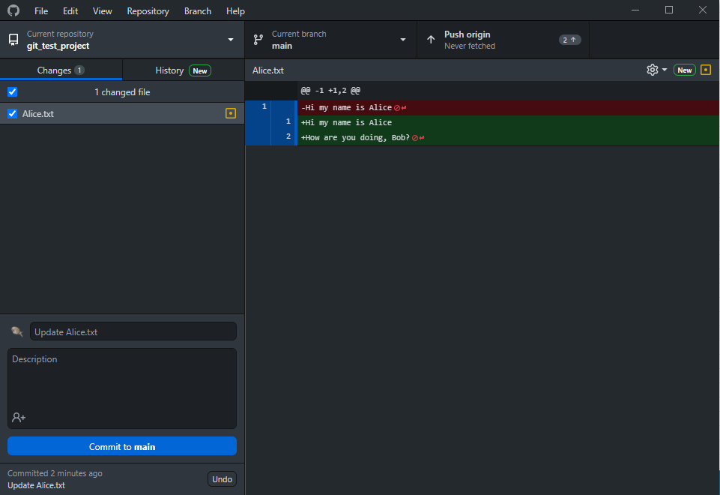

Slide 15
switch branch
git checkout
git push/pull
switch repo
browse repo history
git log
Look at changes made to file
git diff
changed files
git status
enter commit message and commit git commit

Slide 16
89ca9
7b4sa
f3d83
Snapshot A
Snapshot B
Snapshot C

Slide 17
HEAD
main
89ca9
7b4sa
f3d83
Snapshot A
Snapshot B
Snapshot C

Slide 18
Working directory
Staging area
Local repository
Branches
*main
change_alice
Remote repository
Branches
main
Development environment
HEAD
main
89ca9
7b4sa
f3d83
git branch change_alice
change_alice

Slide 19
main
89ca9
7b4sa
f3d83
git checkout change_alice
change_alice
HEAD

Slide 20
Remote repository
Branches
main
change_alice
Working directory
Staging area
Local repository
Branches
main
*change_alice
Remotes
origin/main
origin/change_alice
Development environment
git push --set-upstream origin change_alice

Slide 21
Remote repository
Branches
main
change_alice
Working directory
Staging area
Local repository
Branches
main
*change_alice
Remotes
origin/main
origin/change_alice
Development environment
git push --set-upstream origin change_alice

Slide 22
main
89ca9
7b4sa
f3d83
07d83
change_alice
main
git merge change_alice
89ca9
7b4sa
f3d83
07d83
change_alice

Slide 23
main
89ca9
7b4sa
f3d83
07d83
change_alice
main
git merge change_alice
89ca9
7b4sa
f3d83
07d83
change_alice

Slide 24
master
main
common ancestor
89ca9
7b4sa
f3d83
changed Bob.txt
7ba83d
Merge commit
07d83
changed Alice.txt
change_alice

Slide 25
master
main
common ancestor
89ca9
7b4sa
f3d83
changed Bob.txt
07d83
changed Alice.txt
change_alice

Slide 26
Remote repository
Branches
main
new_feature
git fetch
Working directory
Staging area
Local repository
Branches
main
Remotes
origin/main
origin/new_feature
Development environment

Slide 27
Remote repository
Branches
main
new_feature
git pull
Working directory
Staging area
Local repository
Branches
main
new_feature
Remotes
origin/main
origin/new_feature
Development environment

Slide 28
main
main
main
my_branch2
my_branch2
friend_branch
friend_branch
my_branch1
my_branch1
my friend’s commits
pull request
my friend’s commits
my commits
my friend’s commits
my commits
my commits

Slide 29
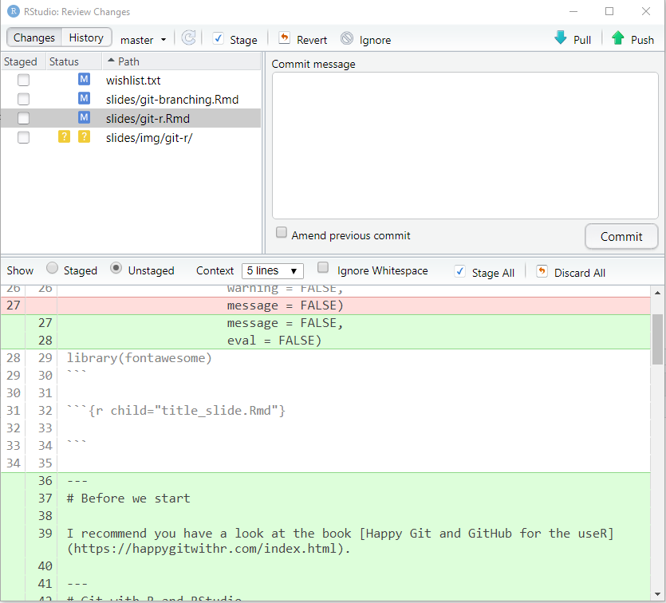
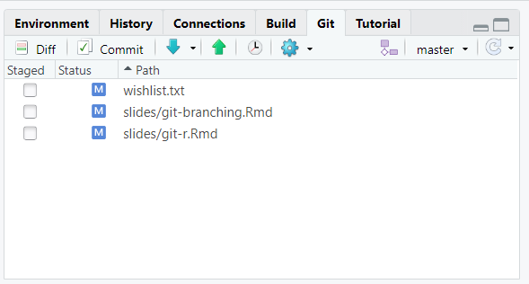
Changed files
Changes

Slide 30
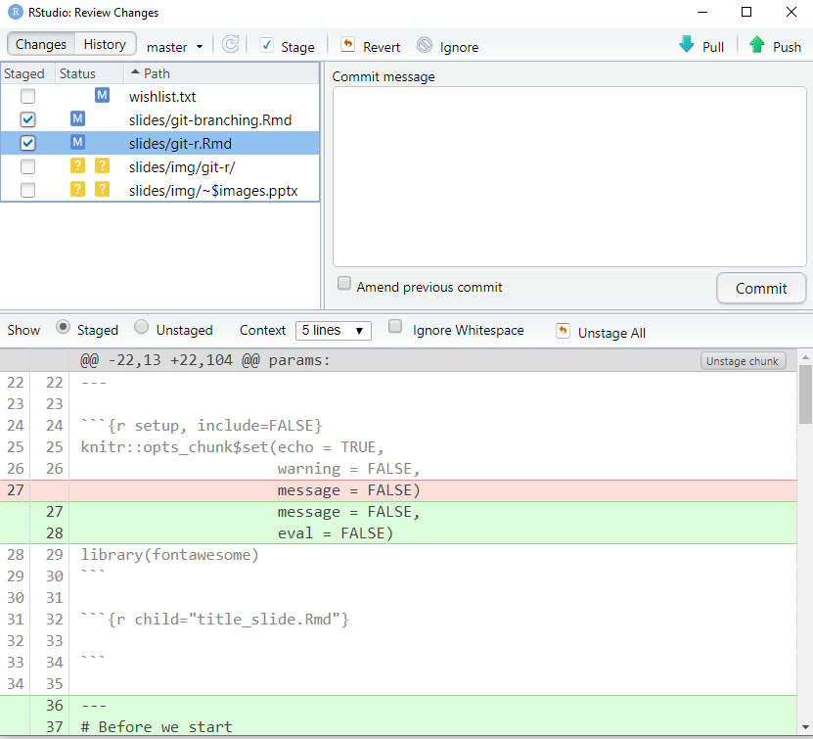
Stage file by checking the box

Slide 31
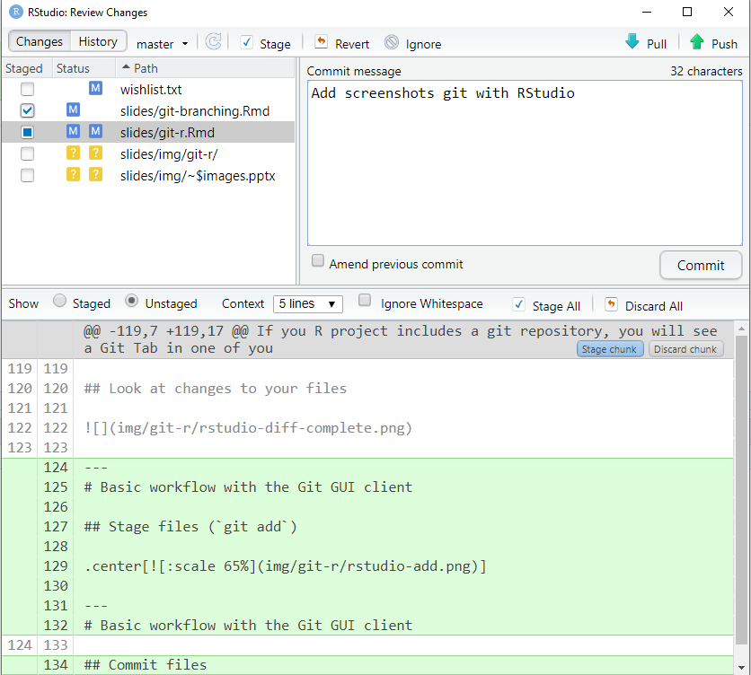
Commit message
Click to commit

Slide 32
pull
push

Slide 33
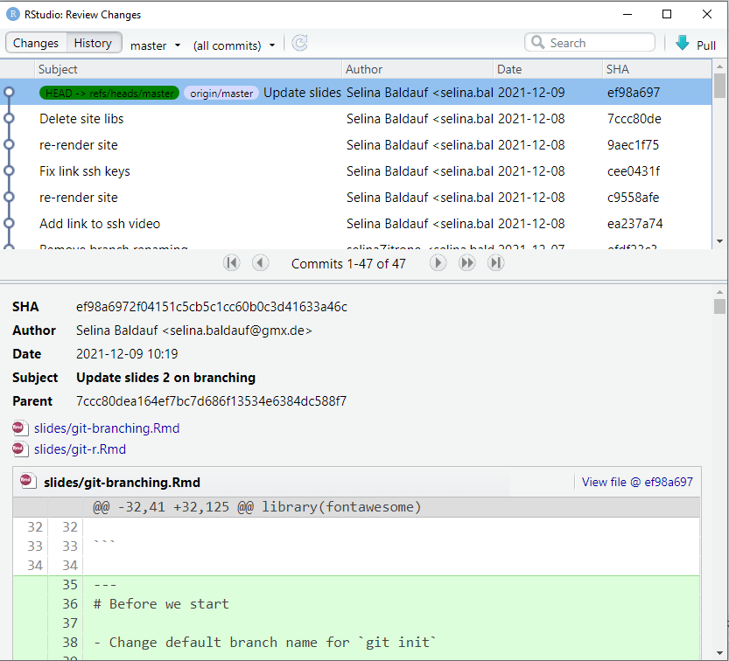

Slide 34
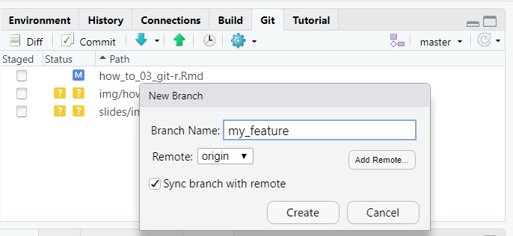
Create new branch
The branch that is checked out

