Slide 1





1. Data management
…
2. Data analysis
…
3. Report/Publication
…

Slide 2



rmarkdown
report.pdf
knitr
pandoc (+ LaTeX)
report.Rmd
report.md
report.docx
report.html

Slide 3
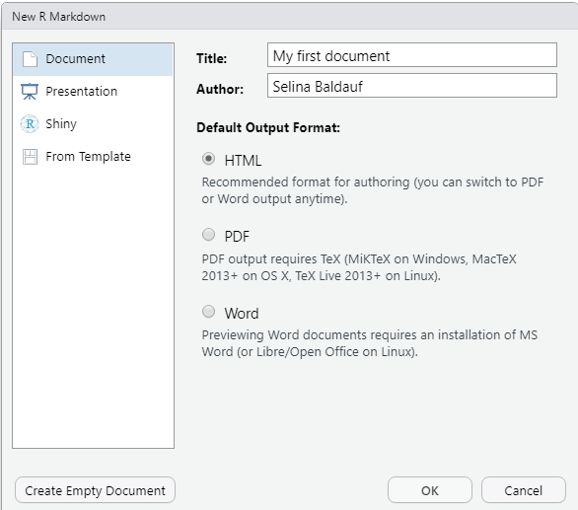

Slide 4
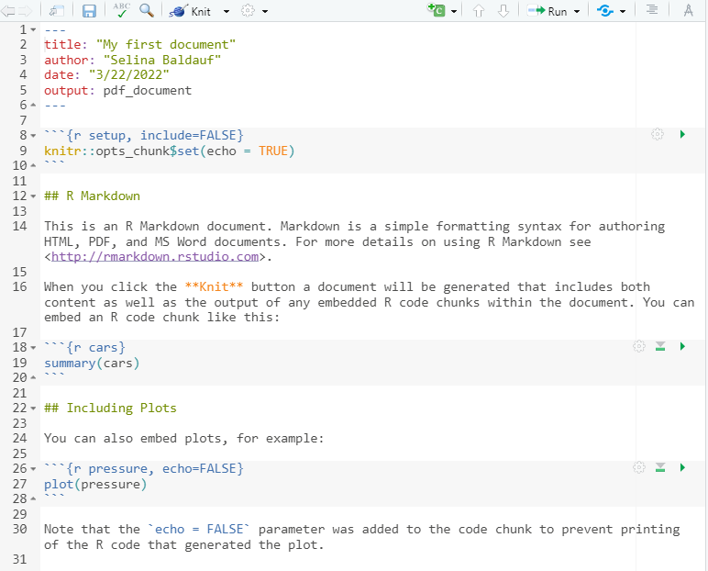
YAML header
with metadata
R code in
code chunks
Text in Markdown
syntax

Slide 5
