Slide 1
Function name
Input
Processing
Output
Side effects

Slide 2
mean
c(1, 5, 6)
Add values and divide by the length of the vector
4

Slide 3
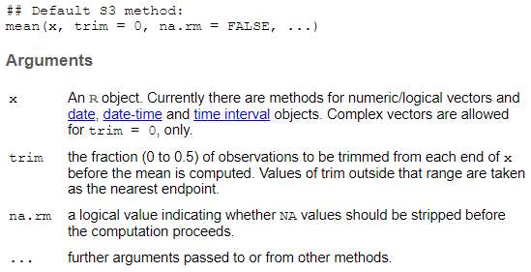

Slide 4
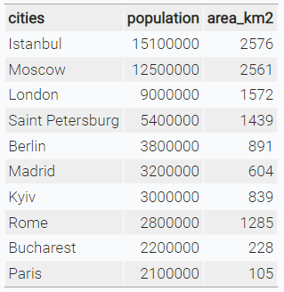
character
numeric

Slide 7





Data structure
Import
Tidy
Visualise
Transform

Slide 8
Data structure
Import
Tidy
Transform
Visualise

Slide 9
