Slide 1






exampleProject
README.md
exampleProject
data
README.md
2023-04-20_temperature.csv
data
documents
2023-04-20_temperature.csv
report.qmd
documents
notes.docx
report.qmd
analysis
notes.docx
01_prepare-data.R
analysis
02_PCA.R
01_prepare-data.R
R
02_PCA.R
a_function.R
R
exampleProject.Rproj
a_function.R

Slide 2
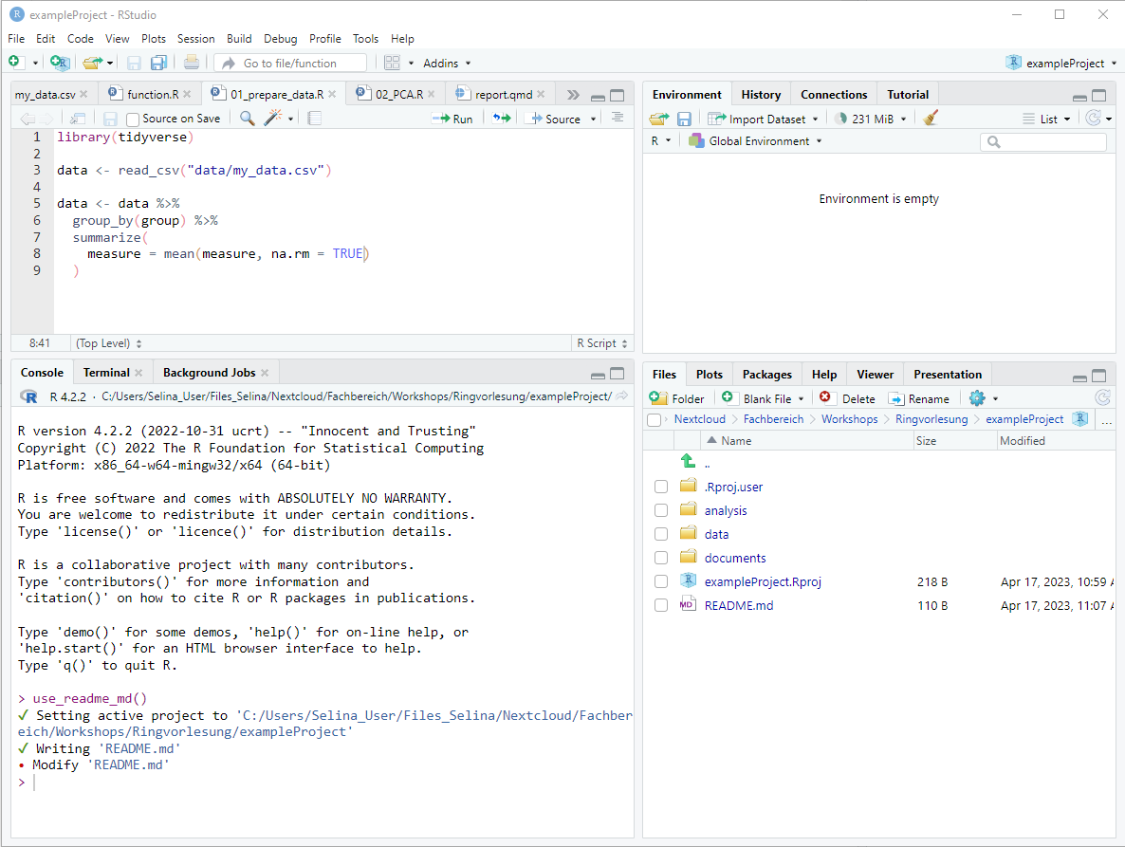
Files

Slide 3
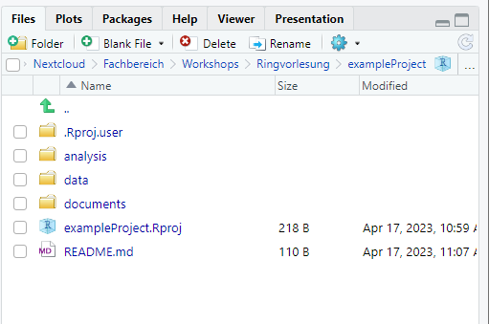

Slide 4
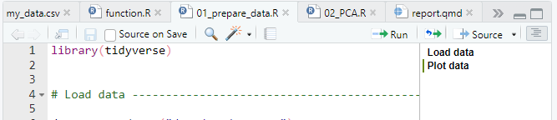

Slide 5
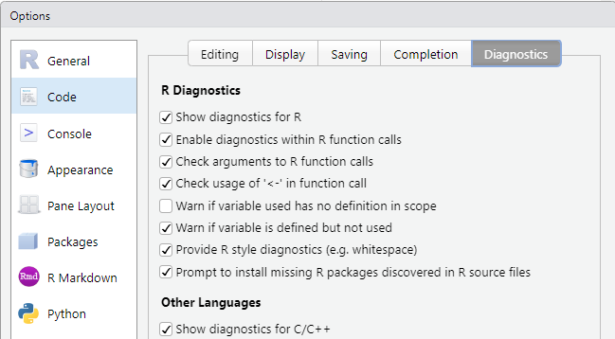

Slide 6
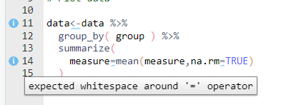

Slide 7
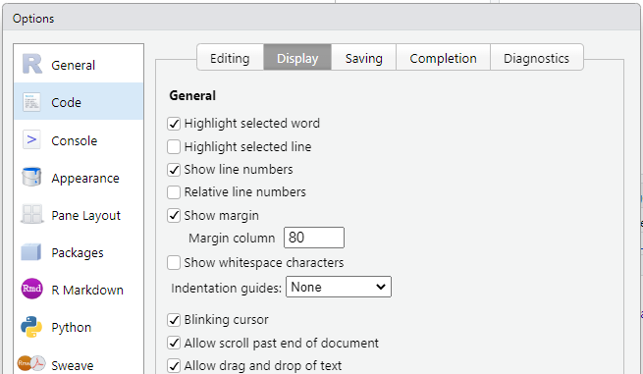

Slide 8
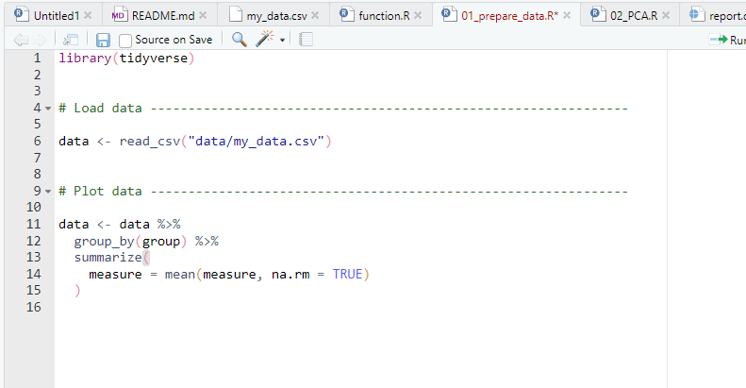

Slide 9
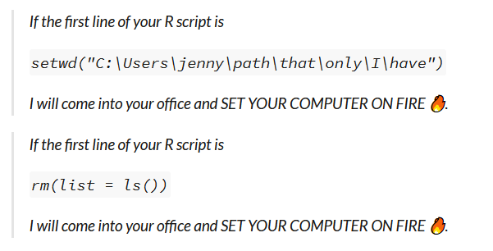

Slide 10
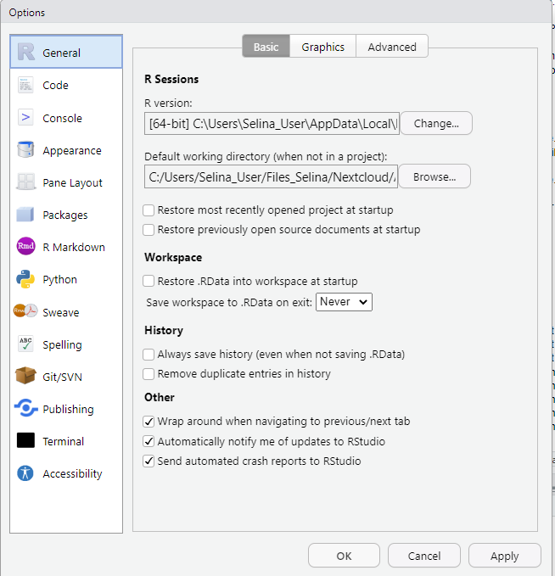

Slide 11
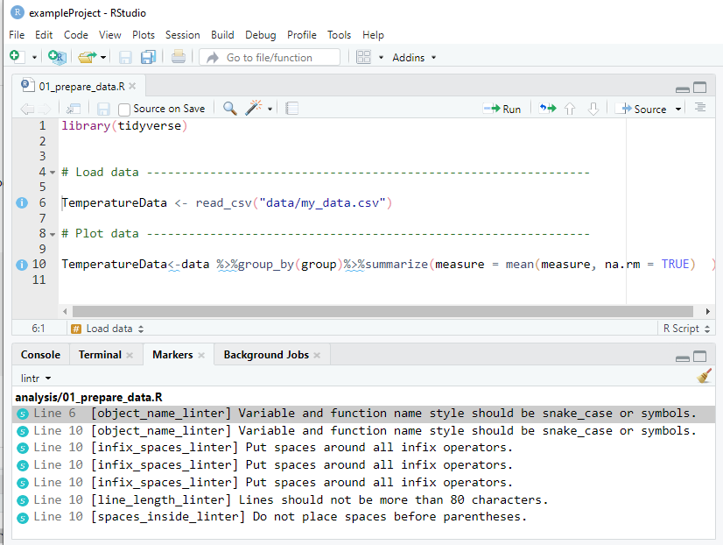
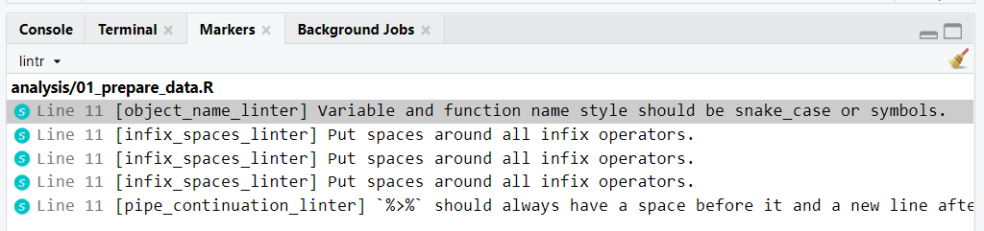

Slide 12






1. Data management
2. Data analysis
3. Report/Publication

Slide 13

1. Data management
2. Data analysis
3. Report/Publication
Quarto

Slide 14
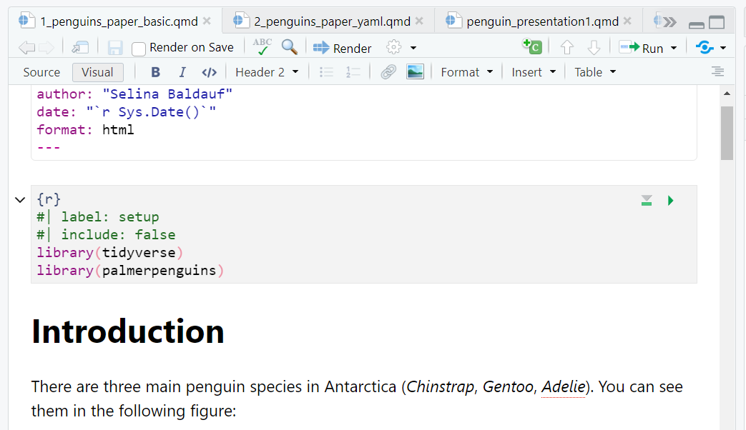

Slide 15






</>
?!
</>
?!
</>
?!
Nice_code_2.R
Nice_code.R
Nice_code.R
Nice_code.R

Slide 16




Development over time
myProject
myProject
myProject
myProject
A
A
A1
A1
B
B1
B1
B1
C

Slide 17
Development over time
Snapshots (= commits)
myProject
myProject
myProject
myProject
A
A
A1
A1
B
B1
B1
B1
C

Slide 18
Development over time
Snapshots
(= commits)
myProject
myProject
myProject
myProject
A
A
A1
A1
B
B1
B1
B1
C

Slide 19




Remote server
Gitlab
Github
Local 1
Local 2
Local 3

Slide 20
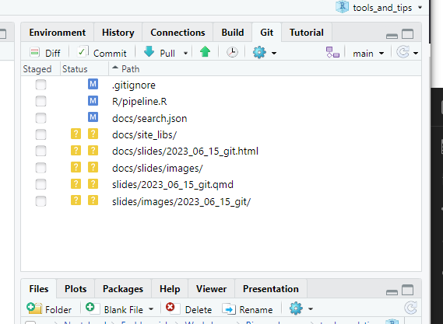
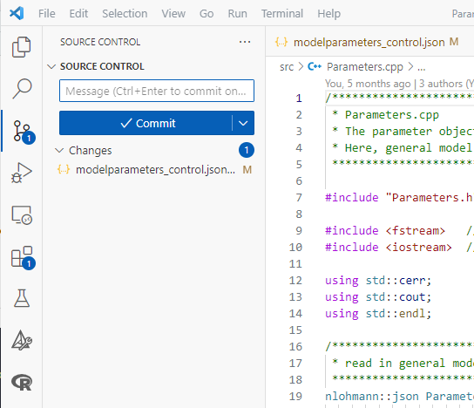

Slide 21
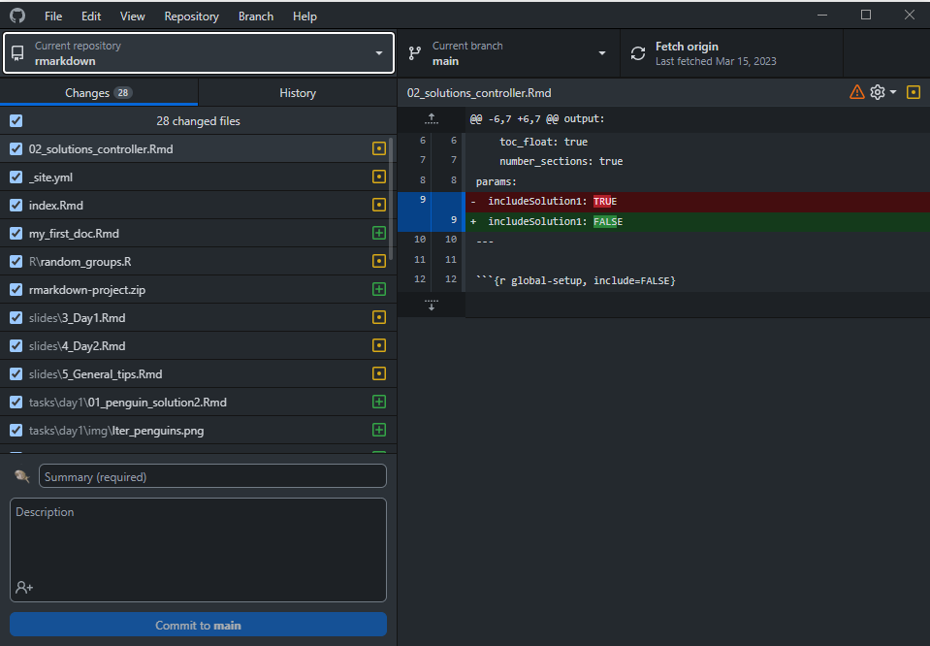

Slide 22
...
Remote
repository
Bob.txt
git push
Working directory
Staging area
Local repository
Bob.txt
Bob.txt
Development environment

Slide 23
main
main
my friend’s commits
main
friend_branch
my_branch2
my_branch1
friend_branch
my commits
main
my_branch1
pull request
my friend’s commits
my commits
friend_branch
my friend’s commits
my commits
my_branch1
my friend’s commits
my commits

Slide 24
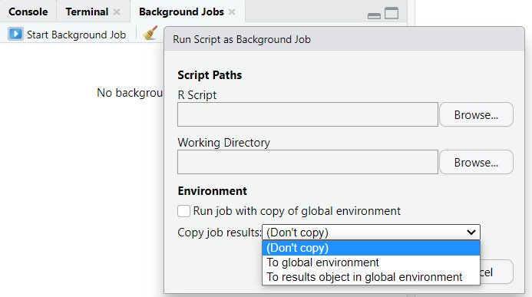

Slide 25
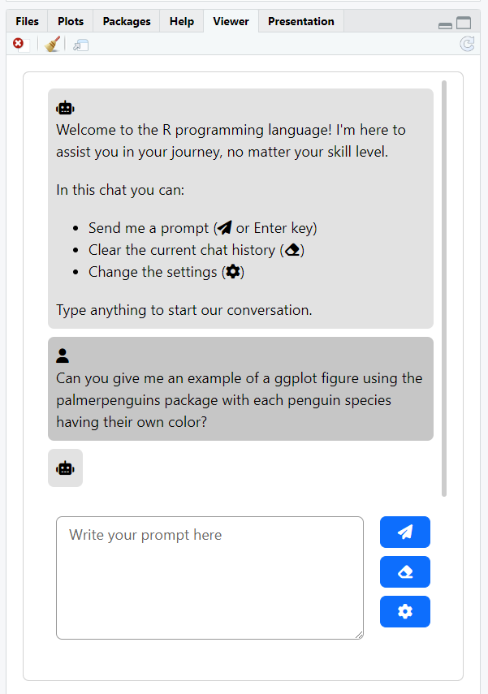

Slide 26


Slide 27
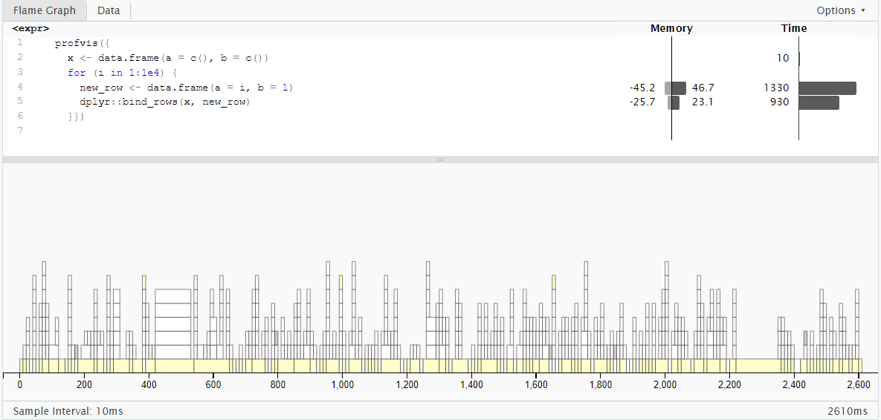
Used/Freed up memory
Time spent in each line of code
The code
The call stack

Slide 28
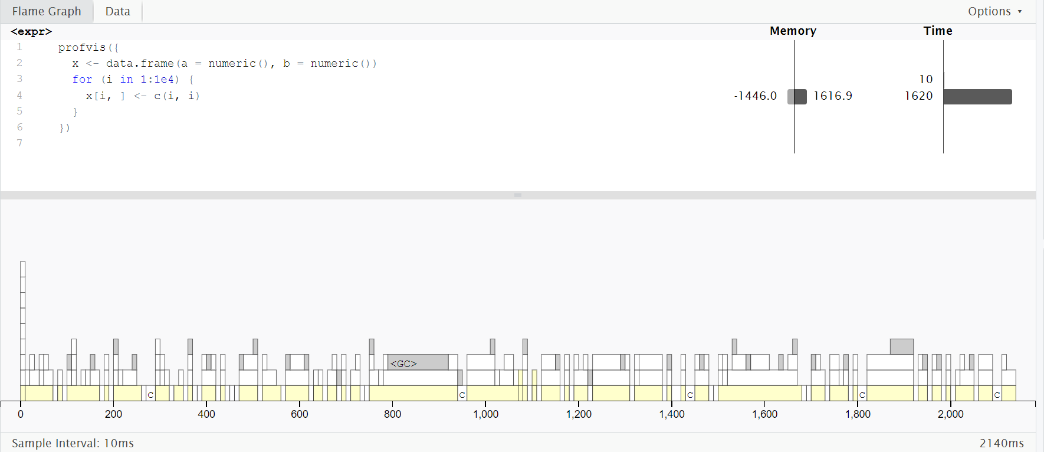
Used/Freed up memory
Time spent in each line of code
The code
The call stack

Slide 29
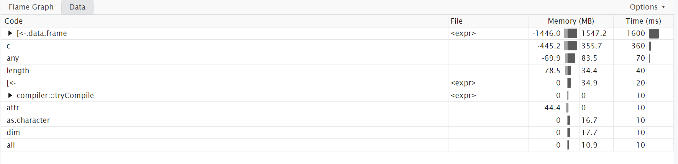

Slide 30
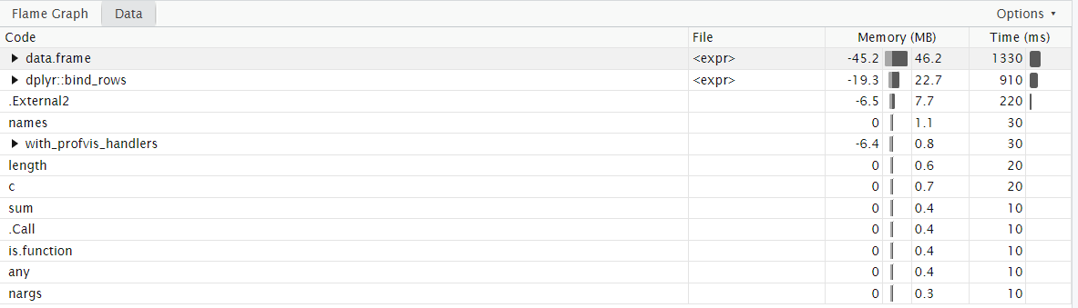

Slide 31
Start
Start
For i in 1:N
Run model
Run model
Run model
Run model
Run model
Stop
Stop

Slide 32
Efficient R code and
optimization
Efficient project structure and coding style
Efficient setup of our tools

Slide 33
Efficient setup of our tools

Slide 34
Efficient project structure and coding style
Efficient setup of our tools

Slide 35




Import

Slide 36
Import

Slide 37

Tidy

Slide 38
Tidy

Slide 39






Transform

Slide 40
Transform

Slide 41

Visualize

Slide 42
Visualize

Slide 43



Model

Slide 44

Underlying data structure

Slide 45


Functional programming

Slide 46
Functional programming

Slide 47
Underlying data structure
Functional programming
Visualize
Import
Tidy
Transform
Model

Slide 48
Underlying data structure
Functional programming
Visualize
Import
Tidy
Transform
Model

Slide 49
Underlying data structure
Functional programming
Visualize
Import
Tidy
Transform
Model

Slide 52

exampleProject
exampleProject
exampleProject
data-raw
data-raw
data-raw
2023-04-20_temperature.csv
2023-04-20_temperature.csv
2023-04-20_temperature.csv
2023-04-20_temperature.csv
2023-04-20_temperature.csv
2023-04-20_temperature.csv
data
data
data
temperature.csv
temperature.csv
temperature.csv
reports
reports
reports
report.qmd
report.qmd
report.qmd
analysis
analysis
analysis
01_prepare-data.R
01_prepare-data.R
01_prepare-data.R
02_PCA.R
02_PCA.R
02_PCA.R
R
R
R
a_function.R
a_function.R
a_function.R
README.md
README.md
README.md
exampleProject.Rproj
.here

