Slide 1
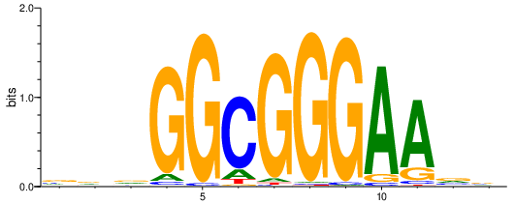
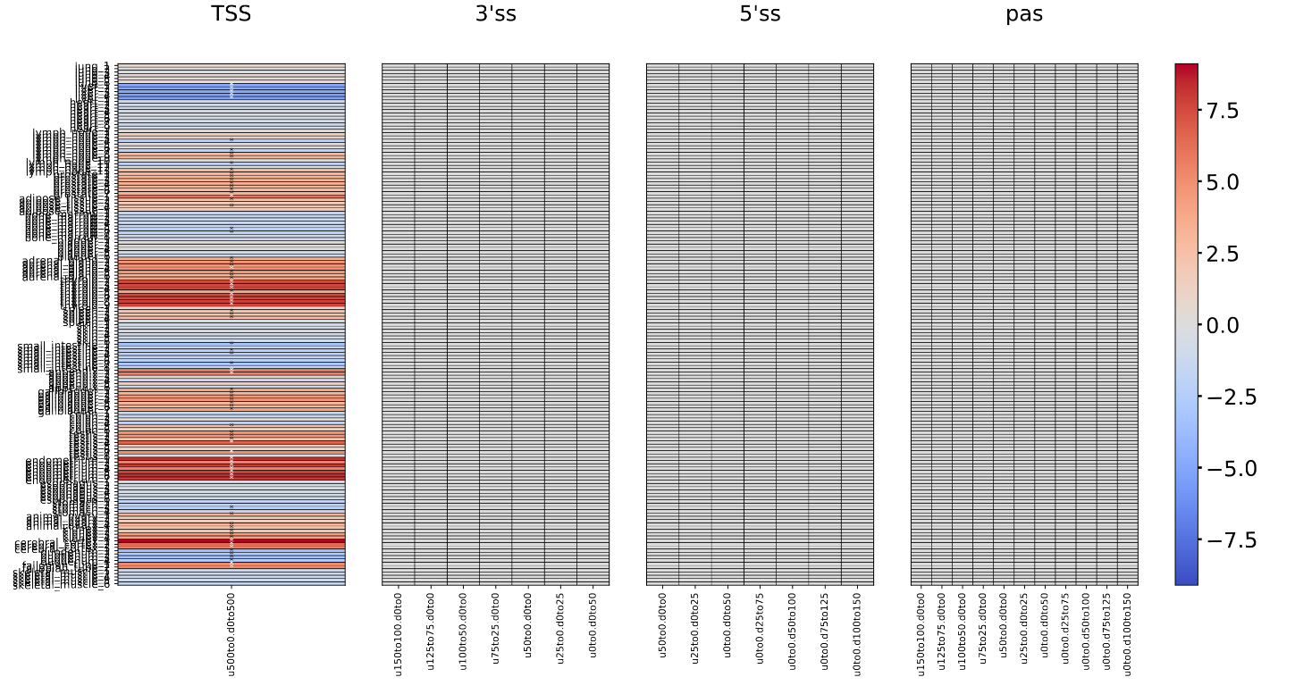
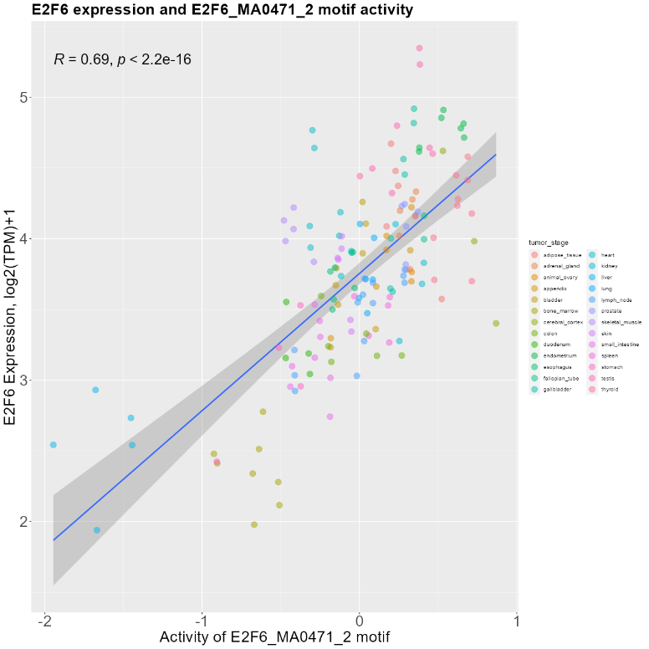
The Human Protein Atlas PWM – TSS – E2F6
Correlation figure and motif
Top: Motif of E2F6_MA0471_2.
Bottom: Correlation figure of the expression of E2F6 and the motif activtiy of E2F6_MA0471_2.
Heatmap of E2F6_MA0471_2

Slide 2
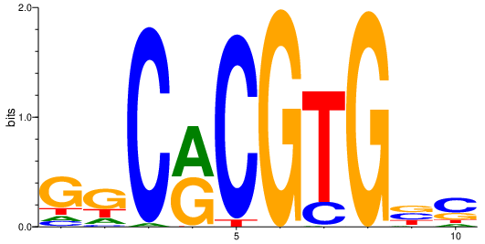
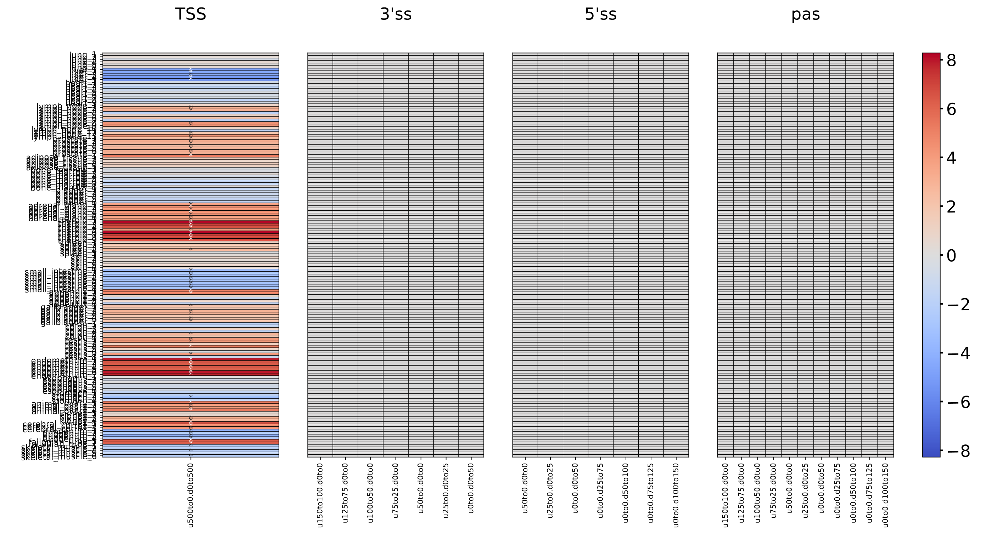
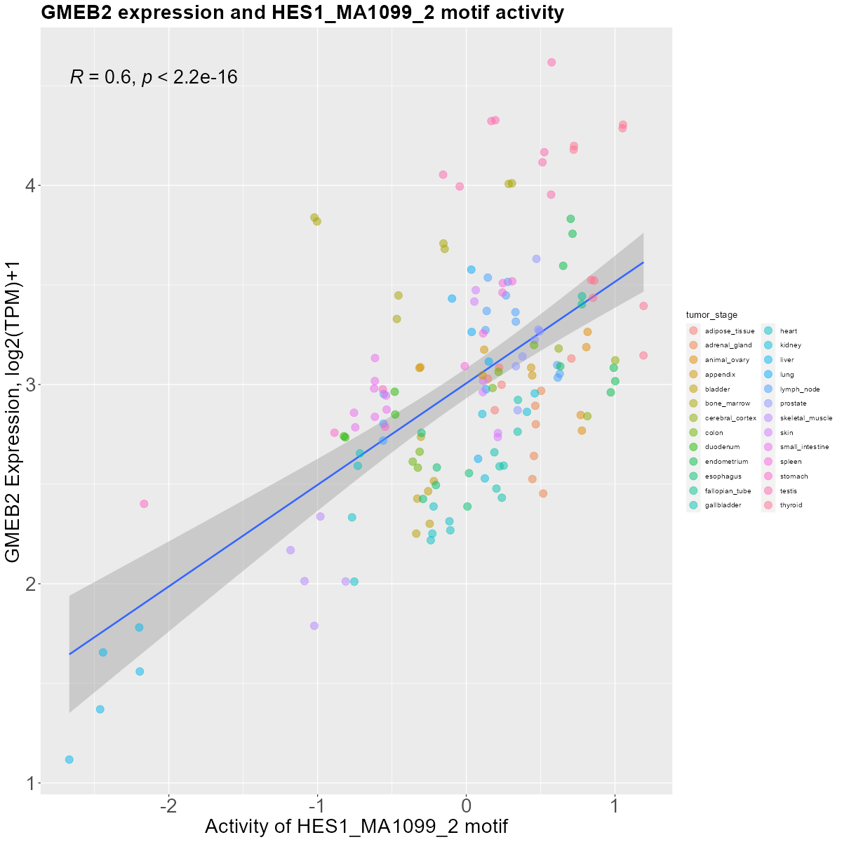
The Human Protein Atlas PWM – TSS – GMEB2
Correlation figure and motif
Top: Motif of HES1_MA1099_2.
Bottom: Correlation figure of the expression of GMEB2 and the motif activtiy of HES1_MA1099_2.
Heatmap of HES1_MA1099_2

Slide 3
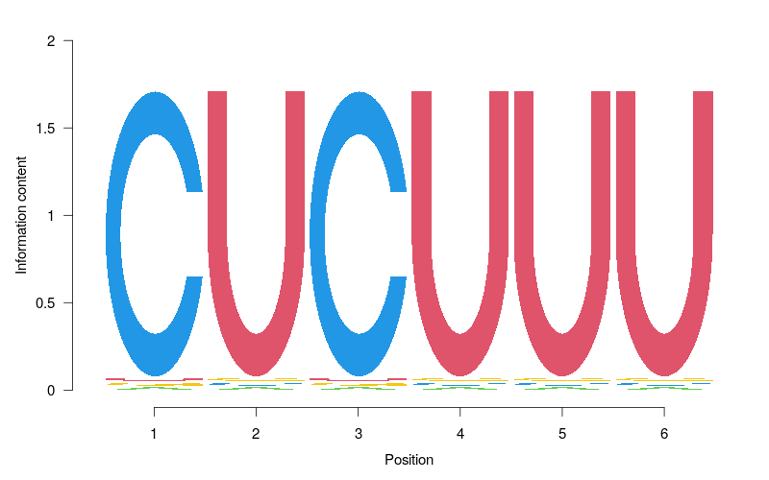
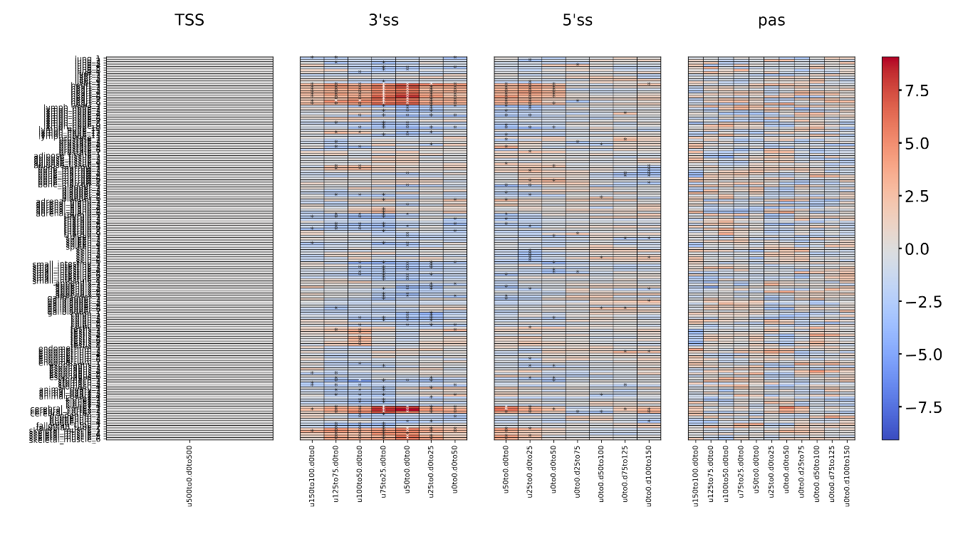
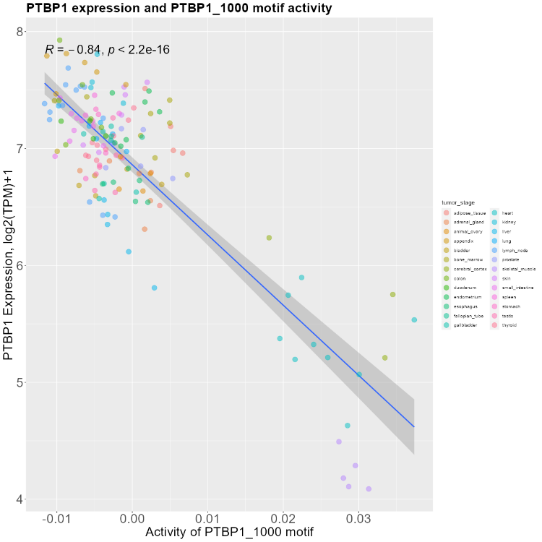
The Human Protein Atlas PWM – 3SS – PTBP1
Correlation figure and motif
Top: Motif of PTBP1_1000.
Bottom: Correlation figure of the expression of PTBP1 and the motif activtiy of PTBP1_1000.
Heatmap of PTBP1_1000

Slide 4
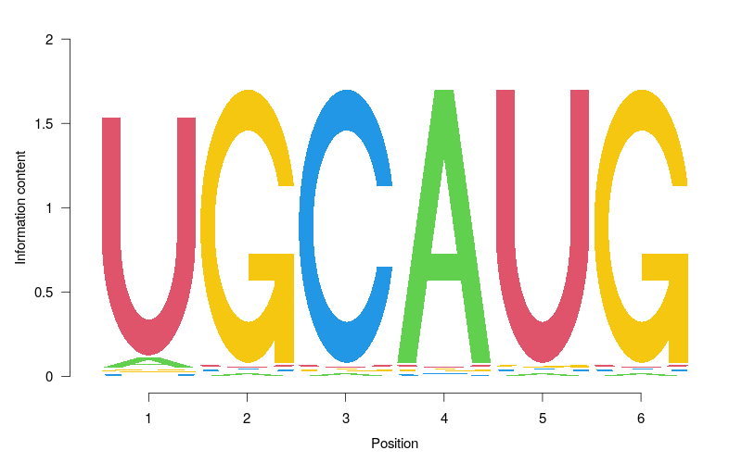
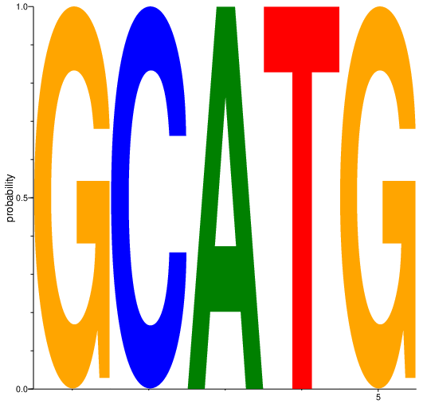
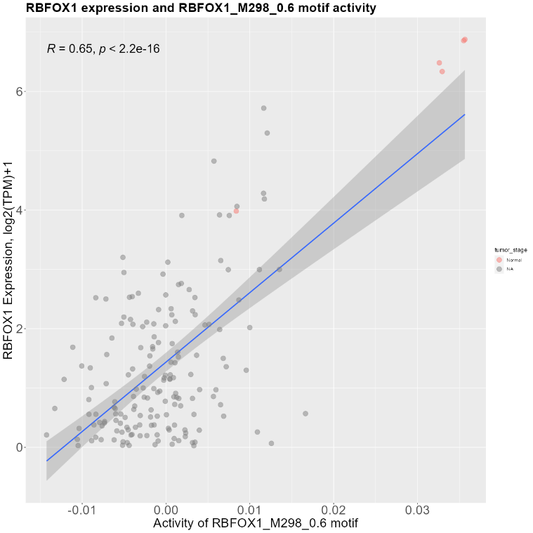
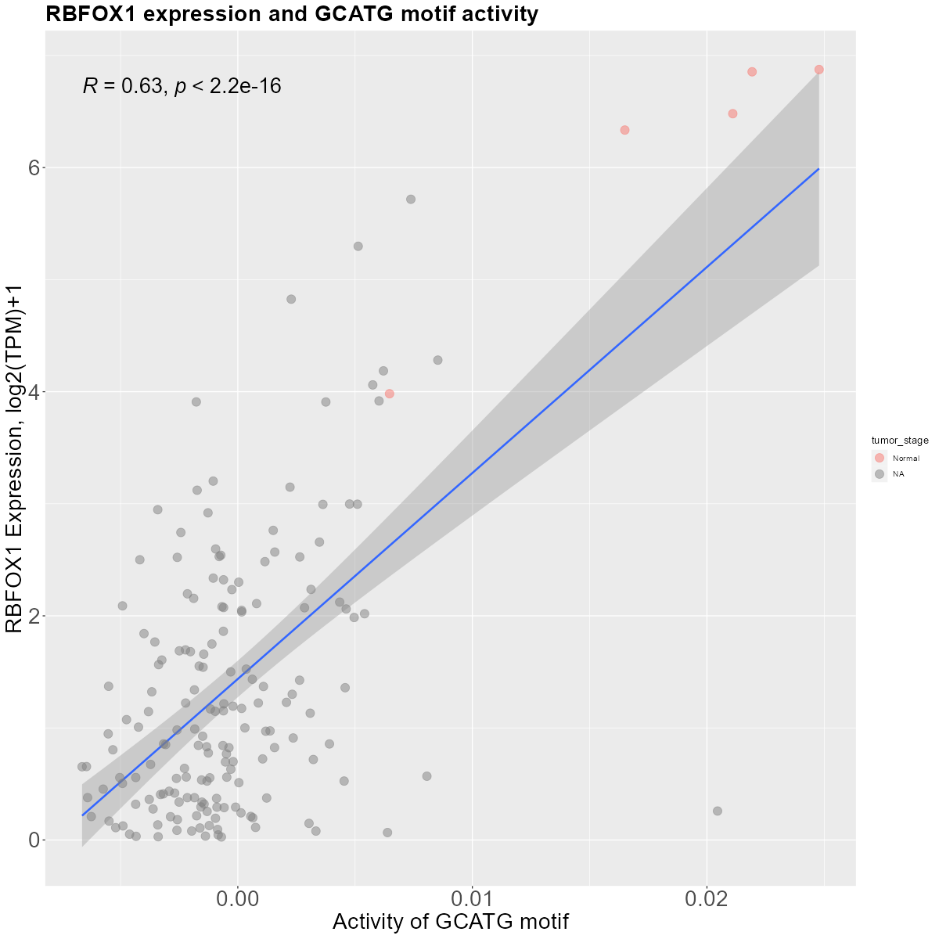
The Cancer Genome Atlas GBM - PWM – 5SS – RBFOX1
The Cancer Genome Atlas GBM - k-mer – 5SS – RBFOX1
Correlation figure and motif (PWM mode)
Top: Motif of RBFOX1_M298_0_6.
Bottom: Correlation figure of the expression of RBFOX1 and the motif activtiy of RBFOX1_M298_0_6.
Correlation figure and motif (K-mer mode)
Top: Motif of GCATG.
Bottom: Correlation figure of the expression of RBFOX1 and the motif activtiy of GCATG.

Slide 5
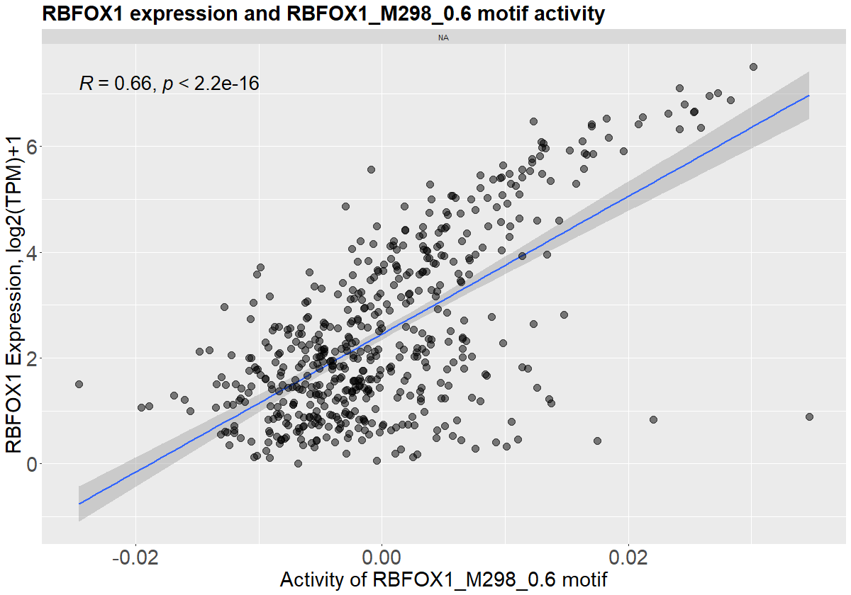
The Cancer Genome Atlas LGG - PWM – 5SS – RBFOX1
Correlation figure and motif
Top: Motif of RBFOX1_M298_0_6.
Bottom: Correlation figure of the expression of RBFOX1 and the motif activtiy of RBFOX1_M298_0_6.

Slide 6
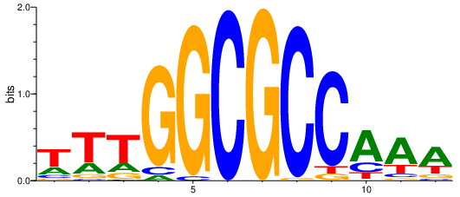
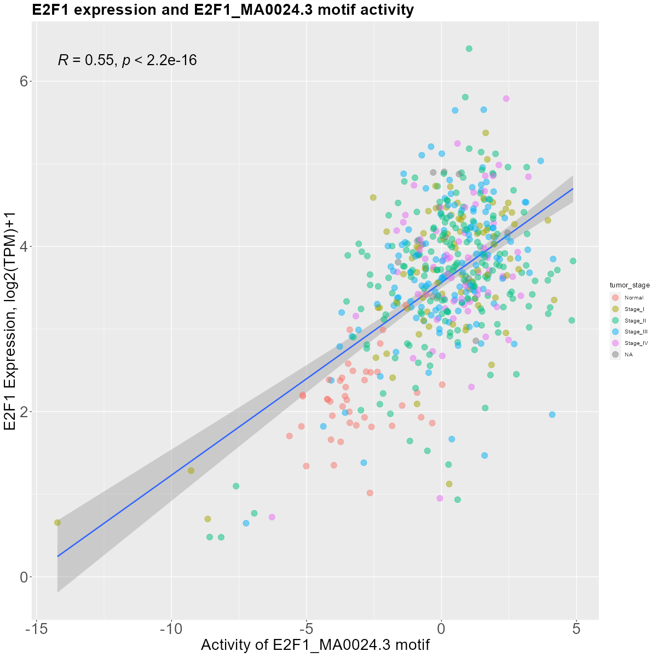
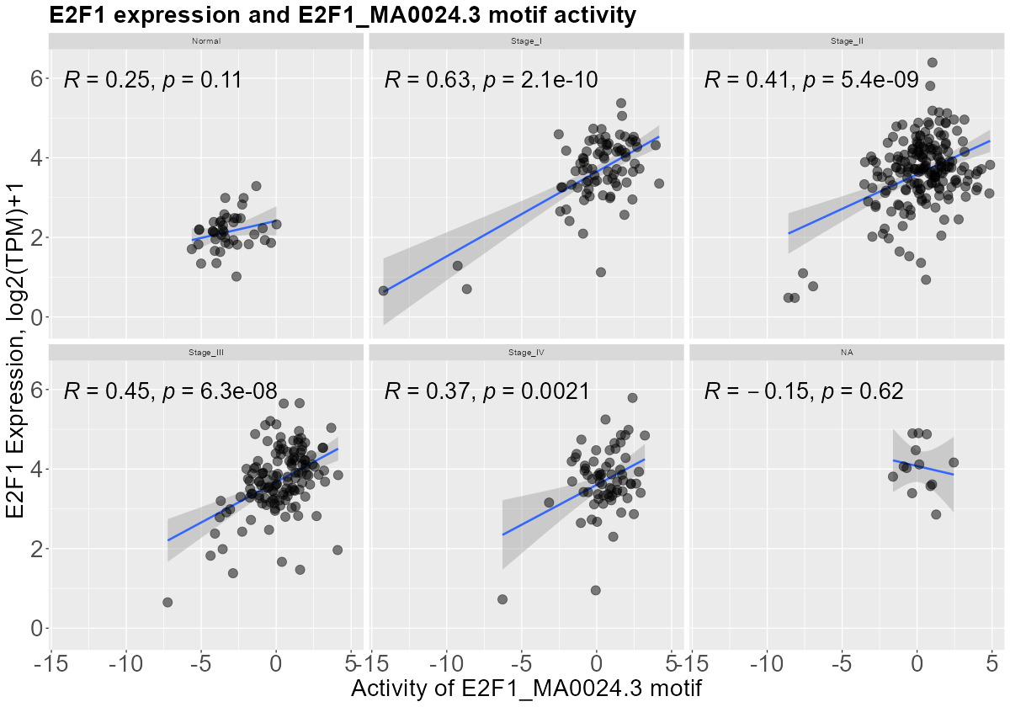
The human protein atlas COAD - PWM – TSS – E2F1
Correlation figure
Correlation figure of the expression of E2F1 and the motif activtiy of E2F1_MA0024_3.
Detailed correlation figure and motif
Top: Motif of E2F1_MA0024_3.
Bottom: Detailed correlation figure of the expression of E2F1 and the motif activtiy of E2F1_MA0024_3.

Slide 7
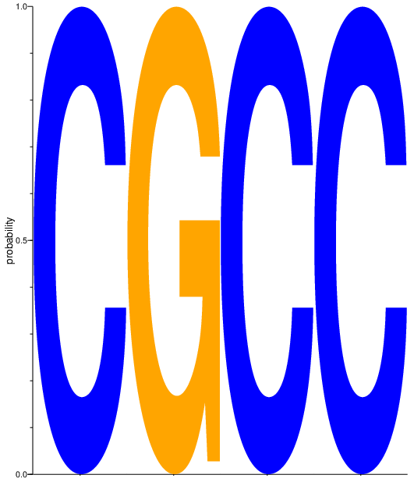
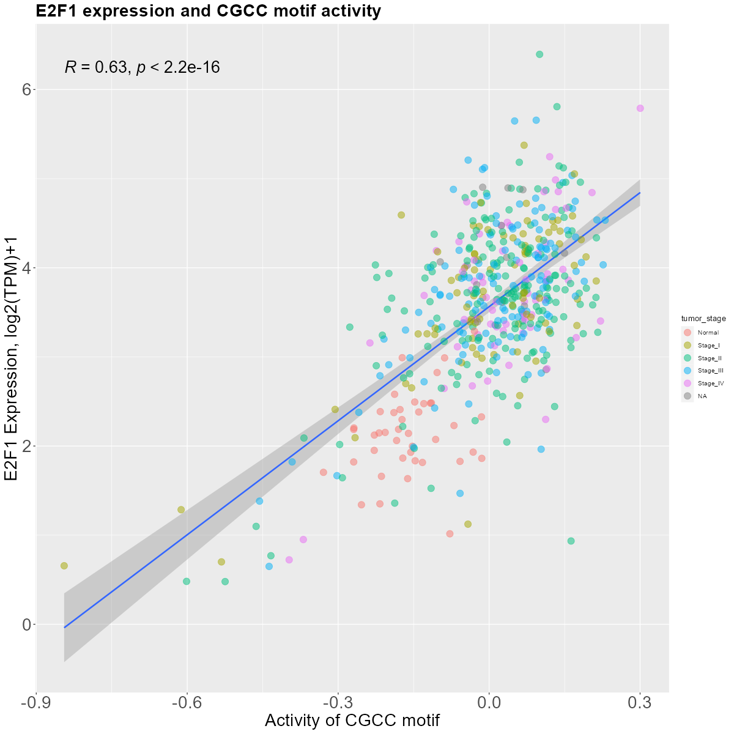
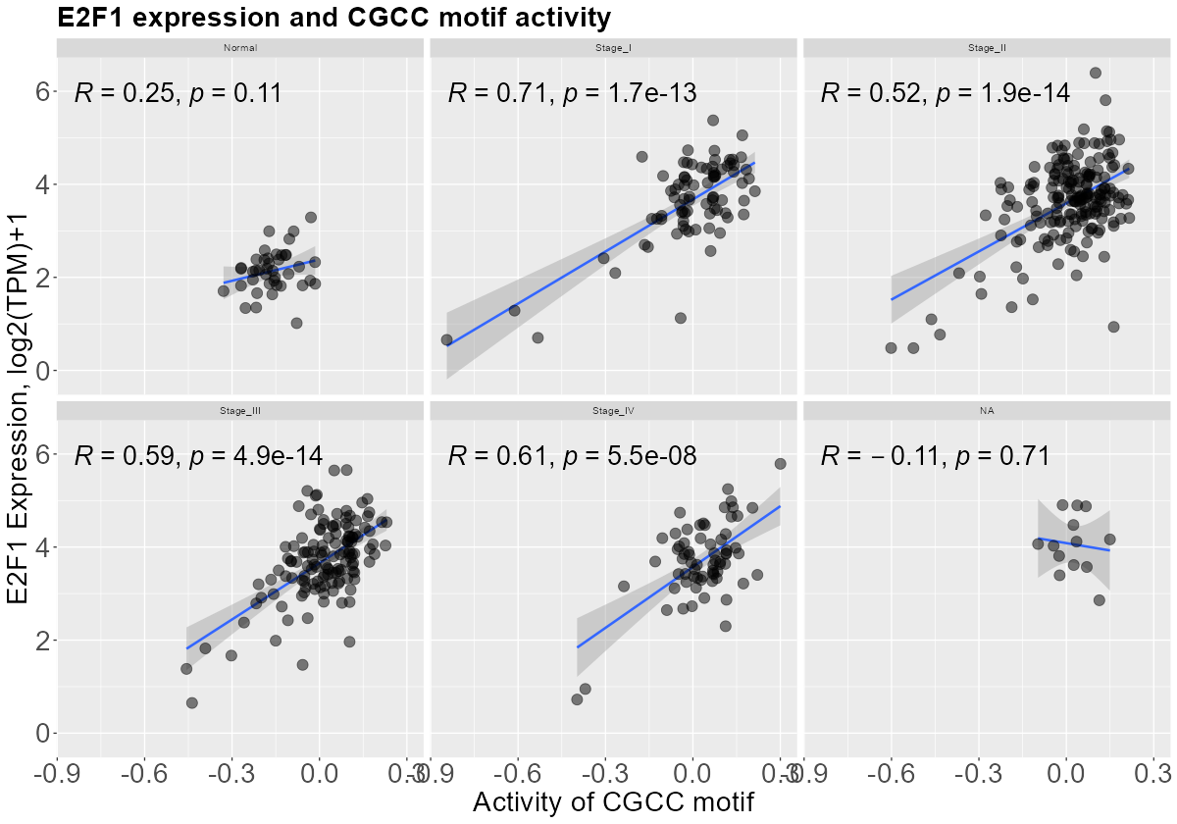
The human protein atlas COAD – k-mer – TSS – E2F1
Correlation figure
Correlation figure of the expression of E2F1 and the motif activtiy of CGCC.
Detailed correlation figure and motif
Top: Motif of CGCC.
Bottom: Detailed correlation figure of the expression of E2F1 and the motif activtiy of CGCC.

Slide 8
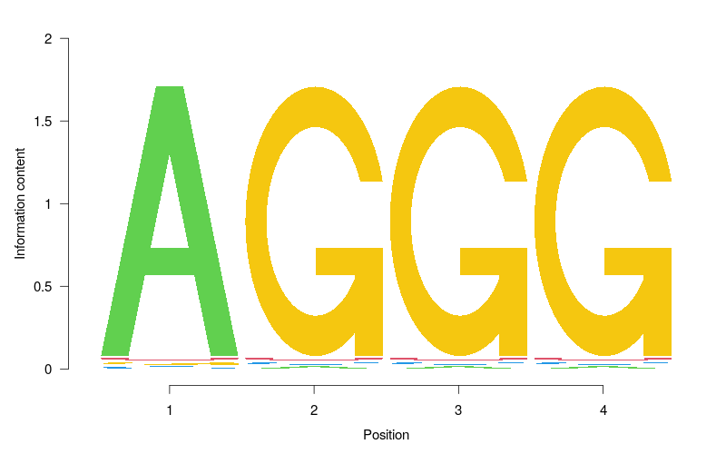
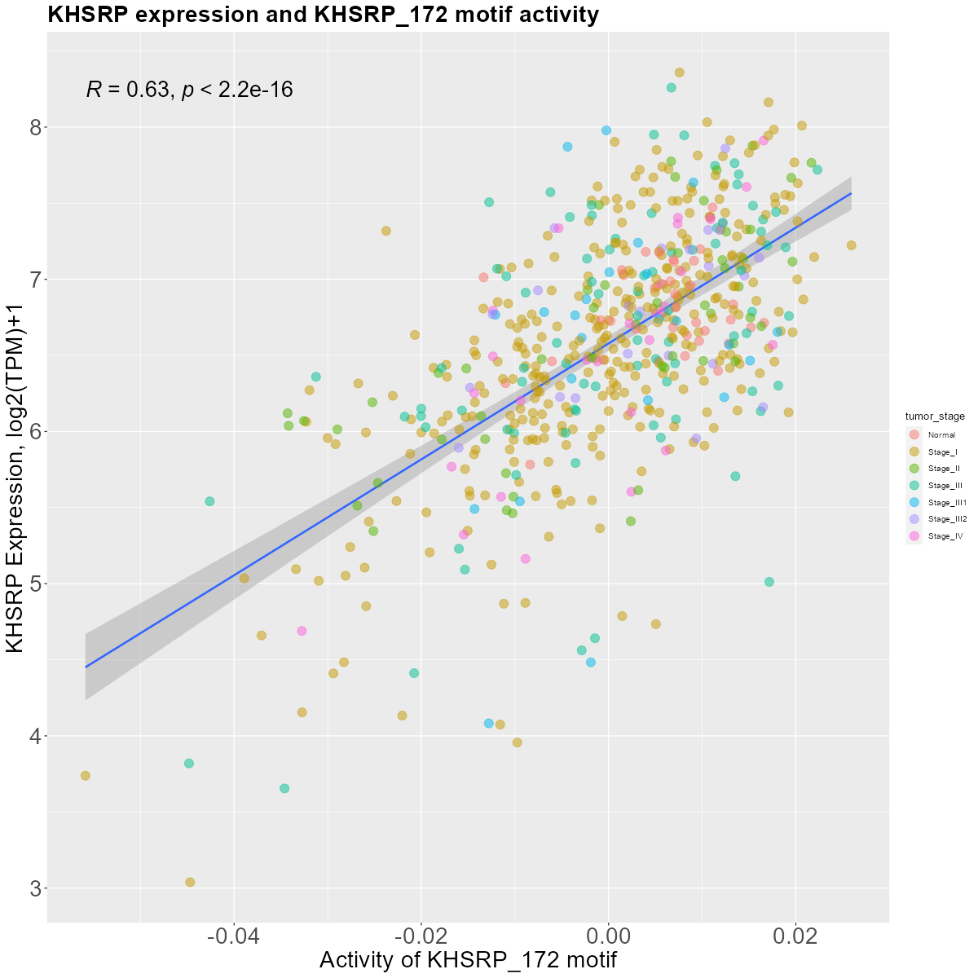
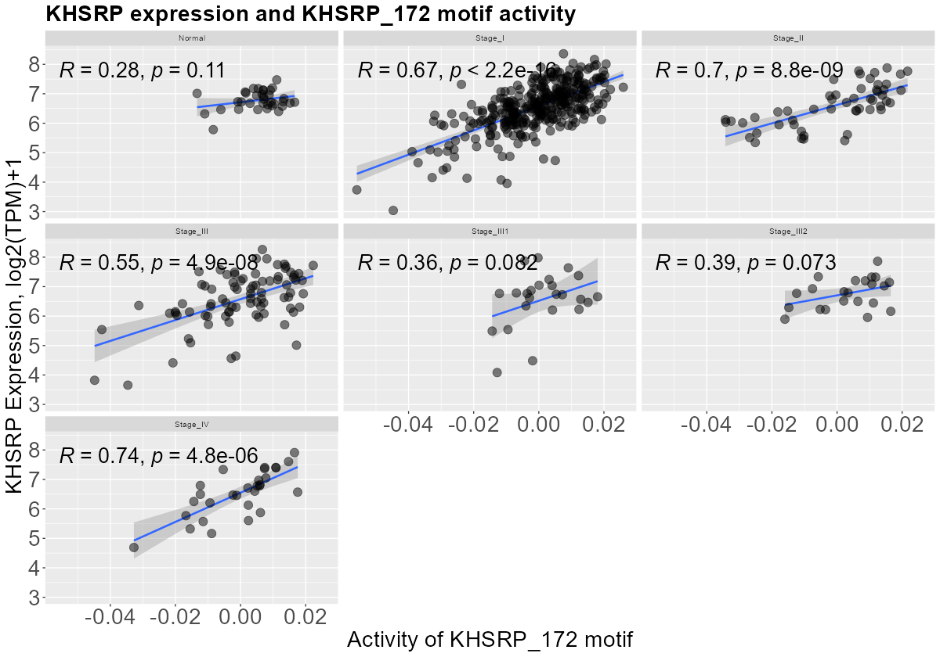
The human protein atlas UCEC - PWM – 5SS – KHSRP
Correlation figure
Correlation figure of the expression of KHSRP and the motif activtiy of KHSRP_172.
Detailed correlation figure and motif
Top: Motif of KHSRP_172.
Bottom: Detailed correlation figure of the expression of KHSRP and the motif activtiy of KHSRP_172.

Slide 9
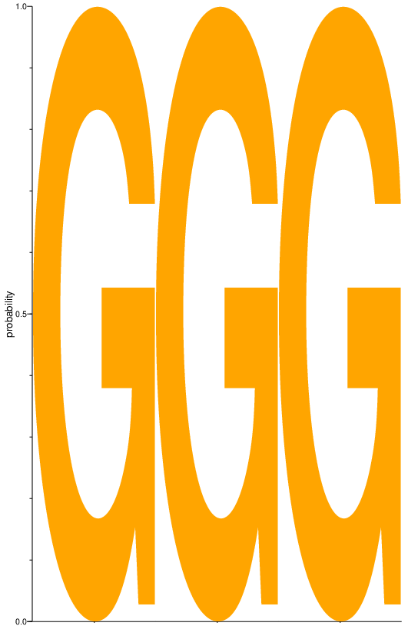
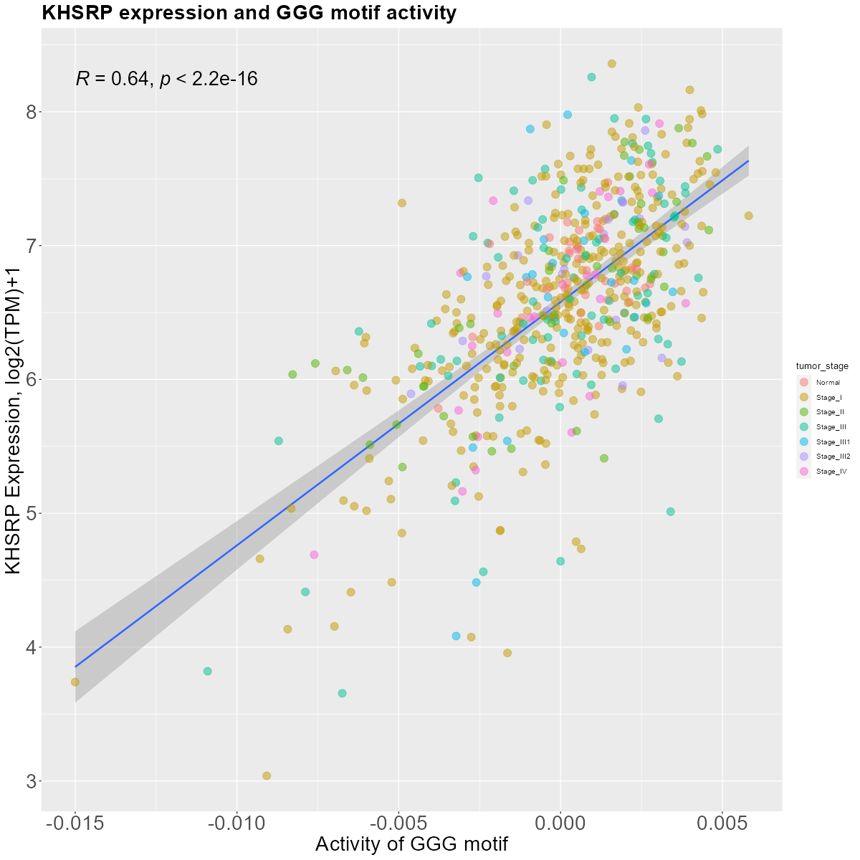
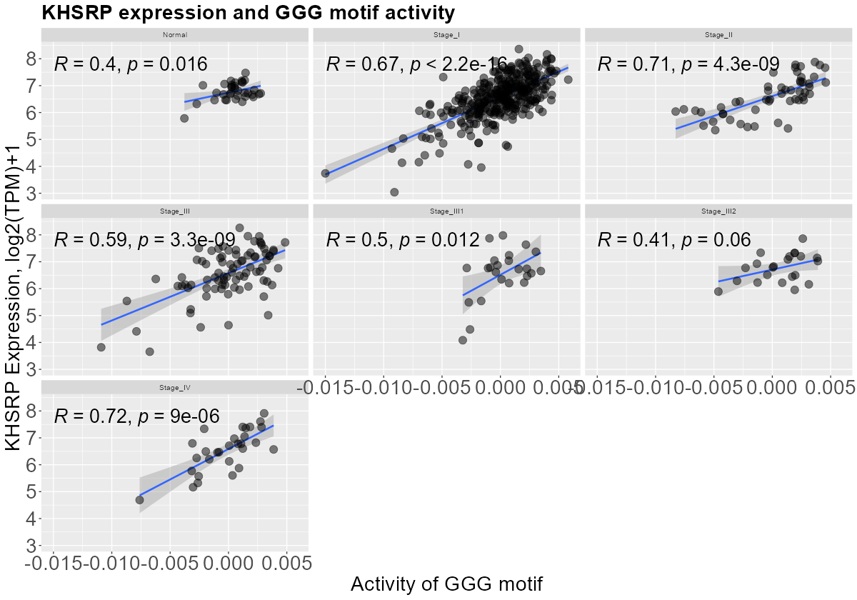
The human protein atlas UCEC – k-mer – 5SS – KHSRP
Correlation figure
Correlation figure of the expression of KHSRP and the motif activtiy of GGG.
Detailed correlation figure and motif
Top: Motif of GGG.
Bottom: Detailed correlation figure of the expression of KHSRP and the motif activtiy of GGG.

Slide 10
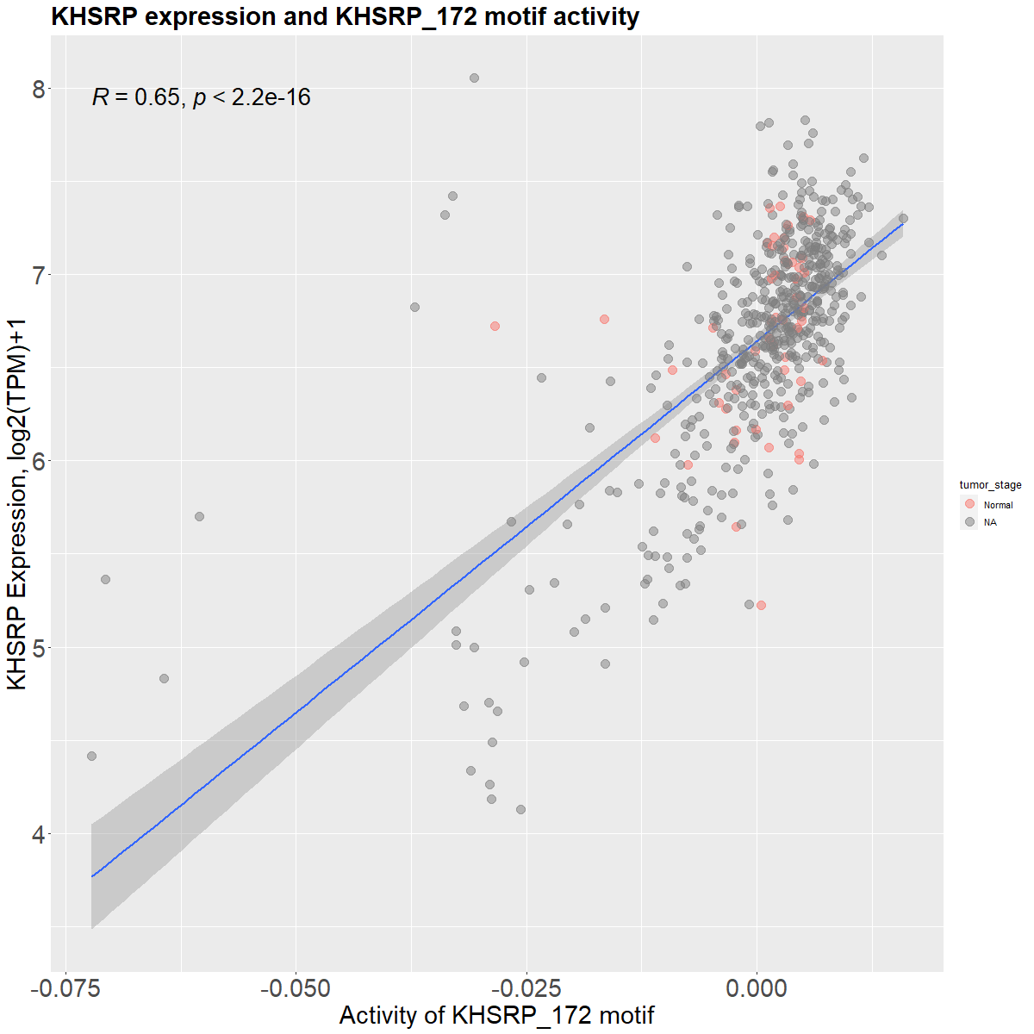
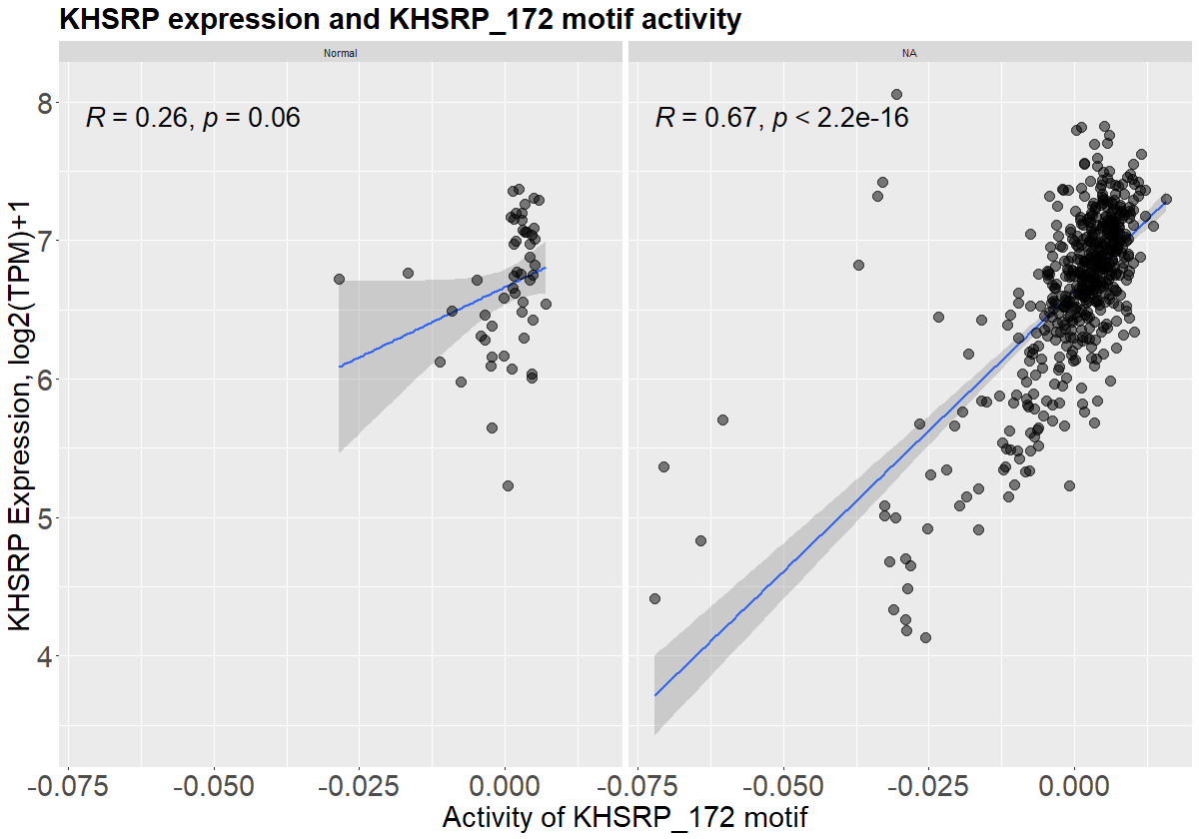
The human protein atlas PRAD – PWM – 5SS – KHSRP
Correlation figure
Correlation figure of the expression of KHSRP and the motif activtiy of KHSRP_172.
Detailed correlation figure
Detailed correlation figure of the expression of KHSRP and the motif activtiy of KHSRP_172.

Slide 11
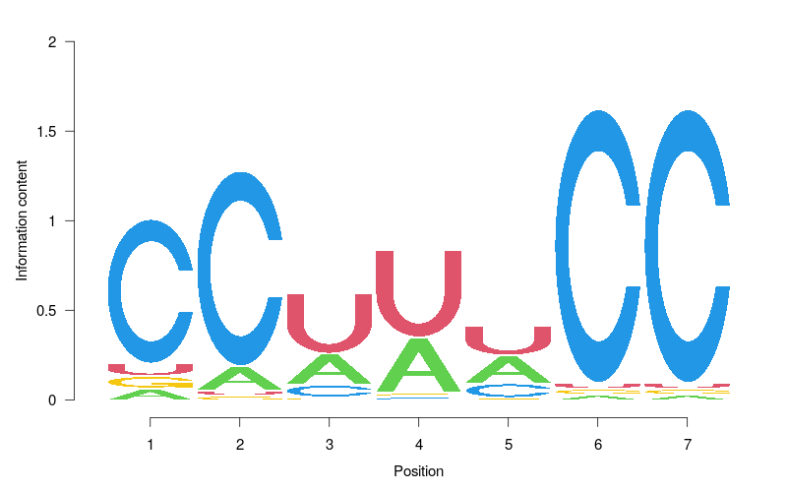
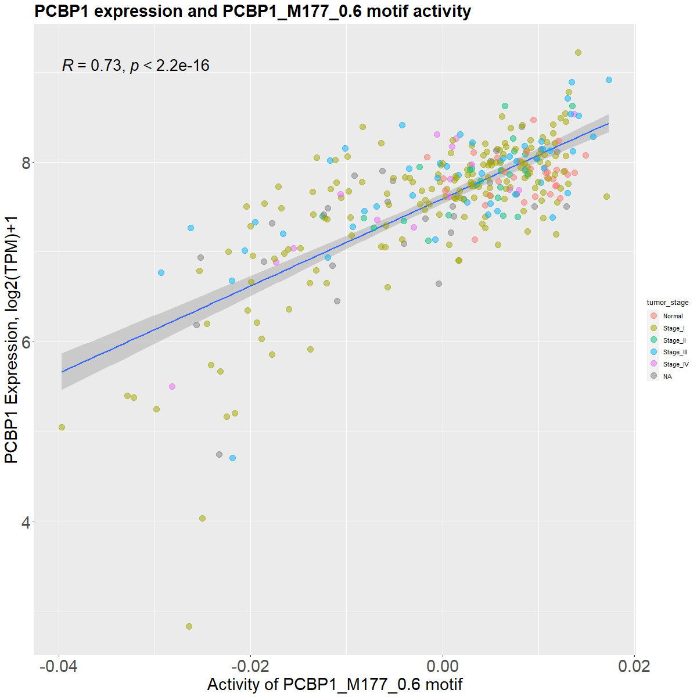
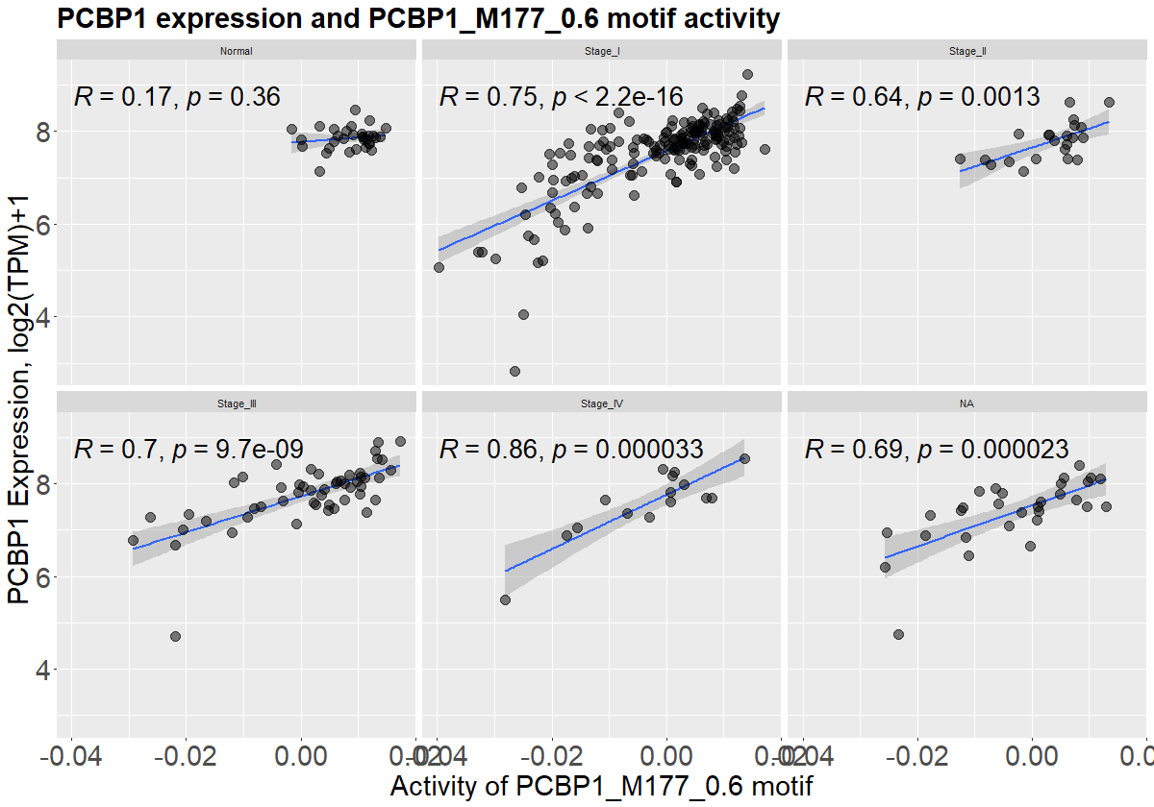
The human protein atlas KIRP – PWM – 5SS – PCBP1
Correlation figure
Correlation figure of the expression of PCBP1 and the motif activtiy of PCBP1_M177_0_6.
Detailed correlation figure and motif
Top: Motif of PCBP1_M177_0_6.
Bottom: Detailed correlation figure of the expression of PCBP1and the motif activtiy of PCBP1_M177_0_6.

Slide 12
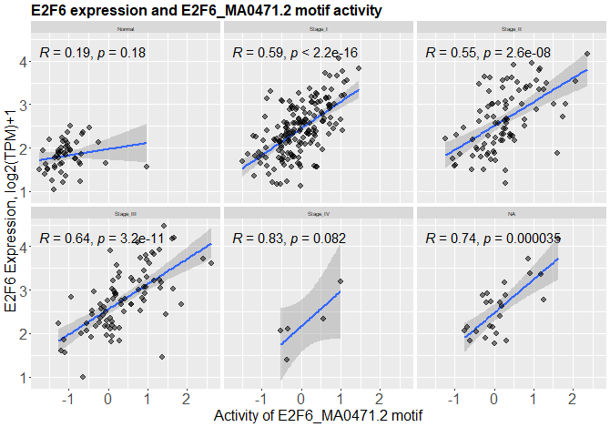
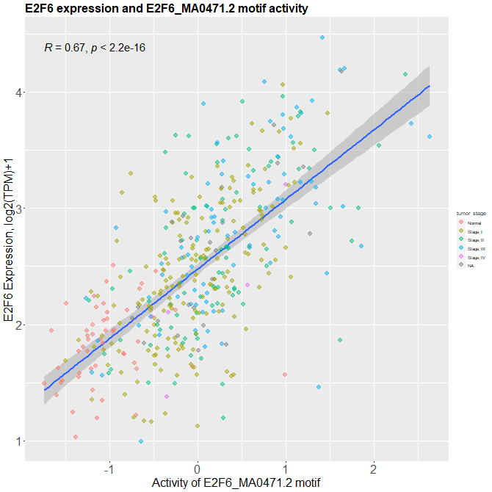
The human protein atlas LIHC – PWM – TSS – E2F6
Correlation figure
Correlation figure of the expression of E2F6 and the motif activtiy of E2F6_MA0471_2.
Detailed correlation figure
Detailed correlation figure of the expression of E2F6 and the motif activtiy of E2F6_MA0471_2.

Slide 13
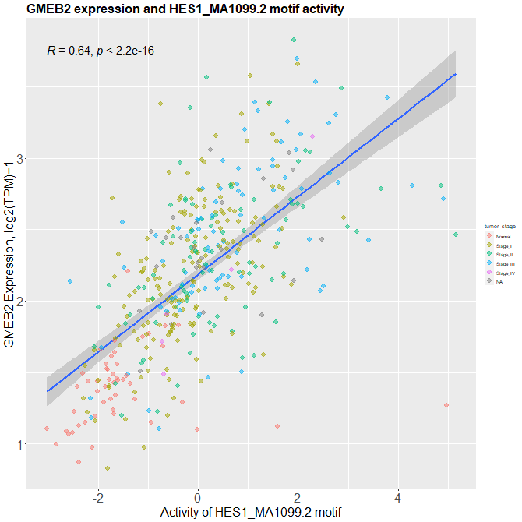
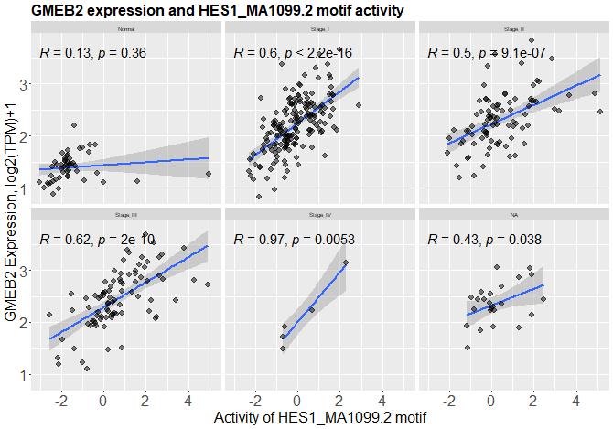
The human protein atlas LIHC – PWM – TSS – GMEB2
Correlation figure
Correlation figure of the expression of GMEB2 the motif activtiy of HES1_MA1099_2.
Detailed correlation figure
Detailed correlation figure of the expression of GMEB2 and the motif activtiy of HES1_MA1099_2.

