Slide 1
Harnessing Patient-generated data to Enhance Knowledge of Rare Diseases: A Feasibility Study
Selina Hui
Mentors: Dr. Chunhua Weng, Dr. Casey Ta, Fangyi Chen
Notes:
Slide 1.
Title of project and participating faculty and graduate students.
Slide 2.
Background to the project (what was the motivation for creating this project)
Goals of the project
Slide 3
Methods used
Slide 4.
Results so far
Slide 5
Discussion
Limitations
Slide 6.
Conclusion
Thank you's to your team

Slide 2
Learning Objectives
Explain the value and characteristics of patient-generated data in rare disease research
Compare and contrast patient-reported rare disease symptoms with clinical literature
Explore how patient-generated data from social media has the potential to improve the early detection of rare diseases
Notes:
The learning objectives of my presentation today are as follows:
You will be able to explain the value and characteristics of patient generated data in rare disease research. Compare and contrast patient-reported rare disease symptoms with clinical literature. And also explore how patient-generated data from social media has the immense potential to be combined with clinical knowledge and improve the early detection of rare diseases

Slide 3
Background
>7000 rare diseases globally, often underrepresented in clinical literature and difficult to diagnose
Diagnostic delay common: average of 5-7 years from first symptom onset → rare disease diagnosis
New data source: social media, Facebook groups
Prior lit: Rare disease social media video analysis (Park, 2025)
Patients often share rich symptom & comorbidity info within their rare disease narratives
Narratives capture real-world experiences and first-person perspectives of rare disease patients
Immense potential to enhance rare disease knowledge
Notes:
Next, I will explain the background and motivation for this research project. There are over 7000 rare disease globally, which are often underrepresented in clinical literature and difficult to diagnose. Diagnostic delay is also very common, with many patients reporting anxiety and distress over their unknown conditions. The average diagnosis delay is around 5 to 7 years from patient’s first symptom onset till their rare disease diagnosis. An often unexplored realm for sourcing data is social media, specifically Facebook groups. In prior literature, Park et al conducted a study analyzing rare disease narrative videos on social media, which found that video-sharing gained more insight into rare disease patient’s personal lives and facilitated a space for spreading awareness about rare conditions and support each other. In disease support groups, patients often share rich symptom and comorbidity information and other info in their posts, with rich narratives on their struggles with rare diseases and diagnostic journeys. These narratives capture real-world experiences and first-person perspectives of patient’s rare diseases, and this yet undiscovered source has immense potential to enhance rare disease knowledge if integrated with existing clinical knowledge.
https://pmc.ncbi.nlm.nih.gov/articles/PMC11323401/
https://pmc.ncbi.nlm.nih.gov/articles/PMC11925512/#sec3

Slide 4
Project Goals
Characterize rare disease patient narratives, eg. frequently reported symptoms/comorbidities from patient online posts
Compare patient-reported symptoms/comorbidities with clinical literature (PubMed)
Explore how insights from social media and patients lived-experiences have the potential to improve the detection of rare diseases
Notes:
For my project goals, read
Lastly, through the characterization of the patient’s online posts from the rare disease forums, I explored how these insights from social media and patients’ lived experience have the potential to improve the detection of rare diseases if combined with existing knowledge down the line.

Slide 5
Methods
249 patient’s narratives from 2019-2025 → 127 rare diseases
Source: Facebook “Rare Disease Warriors” group
Characterization of patient data (using GPT-4 with manual verification)
  Symptoms/comorbidities
  Country
  Rare disease diagnosis
  Age at diagnosis, etc.
Standardization of rare diseases using ICD-10 mappings and NORD database; symptoms/comorbidities using HPO database
Literature review of clinical characteristics of top 3 most common rare diseases
Comparison of patient-reported symptoms with PubMed clinical symptoms
Notes:
Next, here are the methods I used for this research. I manually collected 249 patient narratives spanning from 2019 to 2-2-5, corresponding to 127 rare diseases, with 12 undiagnosed narrative entries. These patient narratives were sourced from the Facebook group “Rare Disease Warriors” community. I did a comprehensive characterization of patient data, including symptoms/comorbidities, country of origin, rare disease diagnosis, age at diagnosis, current treatment, treatment outcomes, and diagnosis journey. This extraction was done with the help of ChatGPT, with my own manual verification to ensure accuracy of the extracted data. This was because Facebook groups exist in a grey area where non-profits are able to crawl these freely accessible social media websites for free text data, but its not allowed through the ChatGPT API. Next, I standardized the rare diseases using ICD-10 mappings to the first decimal place, making all the diseases were rare and found in the NORD database. Later, I also conducted a literature review of clinical characteristics (including symptoms) of top 3 most common rare diseases, to facilitate my later comparison with patient-reported symptoms. For these top 3 most frequently-reported rare diseases, I compared the patient-reported symptoms with clinically-reported symptoms from PubMed articles, and also calculated the comparison statistic using the Jaccard index.

Slide 6
Results - Patient Narrative Characterization
48.6% of patient posts were from the US
Most common age groups for diagnosis: young adults, adults, infants
Most frequent symptoms: Motor impairment, ataxia, pain, fatigue
Most common disorders: Spinocerebellar ataxia, Ehlers-Danlos Syndrome, Amyotrophic Lateral Sclerosis → neurological
Most commonly mentioned narrative themes: psychosocial impact and coping and resilience
Number of Patients |  | 249
Number of Rare Diseases |  | 127
Gender | Female | 161
 | Male | 105
Undiagnosed |  | 12
Notes:
Majority of active participants in social media rare disease support groups were female
The United States was the most common location among participants
Most common diagnosis age groups were young adults, adults, and infants
This is probably because young adults and adults are the largest user groups on Facebook, as from a June 2025 study, the majority (24.2%) of Facebook users in the US are aged between 25-34 → young adult age group
For the infants, since their parents are the ones who typically post about their infant’s rare diseases, and these parents also belong in that young adult age group
Motor impairment and ataxia were the most frequently reported symptoms.
Fatigue and pain were the next most common symptoms.
Many reported disorders were neurological or neurodegenerative (e.g., Ehlers–Danlos syndrome, amyotrophic lateral sclerosis, spinocerebellar ataxia).
In the third graph, I noted the occurrence of narrative themes such as the psychosocial impact of their rare disease and mentions of coping mechanisms and resilience in the patient narratives.
The most frequent patient narrative themes were psychosocial impact, such as mentions of social isolation and anxiety and fears from being diagnosed or from their sudden symptoms; 2nd were coping and resilience, as many patients mentioned attempting to use a optimistic perspective to cope with their rare disease progression.
https://www.statista.com/statistics/187549/facebook-distribution-of-users-age-group-usa/

Slide 7
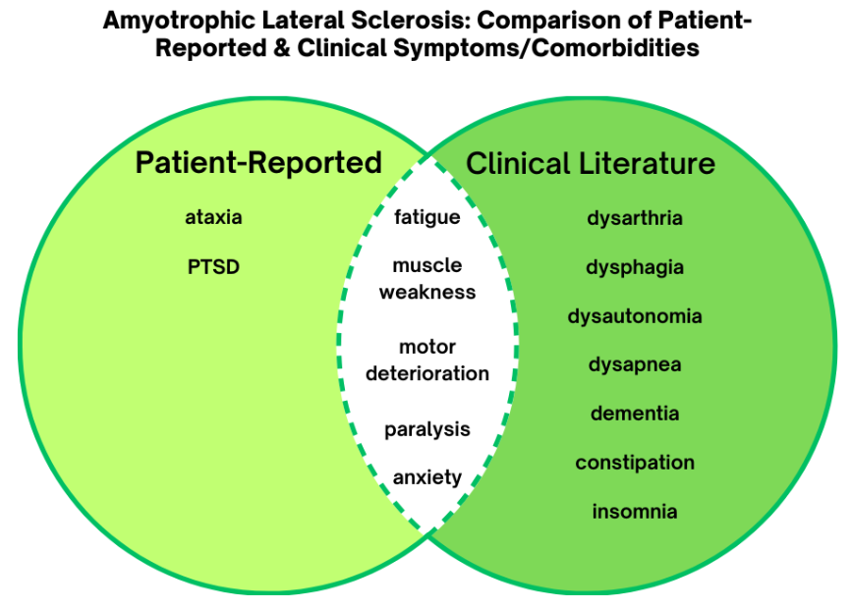
Results - Comparison of Symptoms
Rare Disease | Jaccard index
General SCA | 0.258
SCA2 | 0.158
SCA14 | 0.250
Friedreich's ataxia | 0.211
General EDS | 0.192
Hypermobile EDS | 0.194
General ALS | 0.152
Notes:
Spinocerebellar Ataxia Type 14 (SCA14) had the highest Jaccard index, which indicates the degree of similarity between patient-reported and clinical symptoms/comorbidities reported in literature, probably due to 4 patients reporting symptoms
Patient narratives frequently focused on pain, fatigue, daily functioning limitations, and reduced quality of life, eg. mobility issues, use of assistive devices.
Clinical literature more often emphasized hallmark diagnostic symptoms, to facilitate diagnosis

Slide 8
Discussion & Limitations
High rates of motor impairment & ataxia → predominance of neurological disorders
Fatigue and pain → common across many chronic illnesses and patient-reported burdens
Narratives focus on quality-of-life and functional impacts, often missing in literature
Limitations: Small sample size, manual data collection, incomplete data, sampling bias, recall-biased patient data
Notes:
Demographics:
Symptoms: fatigue and pain; a common symptom and burden in many chronic illnesses; such that many patients report it in their narratives.
Overall, ____, including frequent mentions of mobility issues, wheelchair use.
Limitations: there were many limitations in this study. Most importantly, a rather small sample size of patient narratives extracted from the facebook group of 200, due to the manual nature of the data collection, there was no way to automate the extraction of rare disease posts from the facebook group. Additionally, there could have been sampling bias, as I tried my best to include long patient entries with more details about their symptoms and diagnostic journeys, and most importantly, mention of their specific rare disease diagnosis. However, there was still a lot of incomplete data, with many entries only reporting their rare disease name (or listing many with no symptoms), neglecting to mention their rare disease name, etc. Additionally, these patient-reported data inherently has bias, as the symptoms and comorbidities they report is recall-bias, and they only include symptoms that majorly affect or impact their daily life, with no idea which stage/details of their disease prognosis.

Slide 9
Conclusion
Patient-generated data reveals underreported symptoms
Patient perspectives complement clinical datasets, revealing quality-of-life impacts often overlooked in diagnostics
Strong potential to improve early rare disease recognition, guide research priorities, and inform patient-centered care
Future Directions:
  Collect more data (larger sample size)
  Explore LLMs/AI to enhance rare disease detection, patient support
  Integrate patient-generated data with clinical research

Slide 10
Thank you
Dr. Chase
Dr. Weng
Fangyi
Casey
for their support, mentorship, encouragement during this summer program.

