Slide 1
My Personal website
Xiaonan Liu

Slide 2
Contents
Layout
Design
Content
Languages

Slide 3
Layout
Header
nav
Col 1
20%
Col 3
20%
Col 2:60%
Content show here
footer
Cursive fonts only applied for title/ or header
paragraphs are use sans serif for more comfort reading

Slide 4
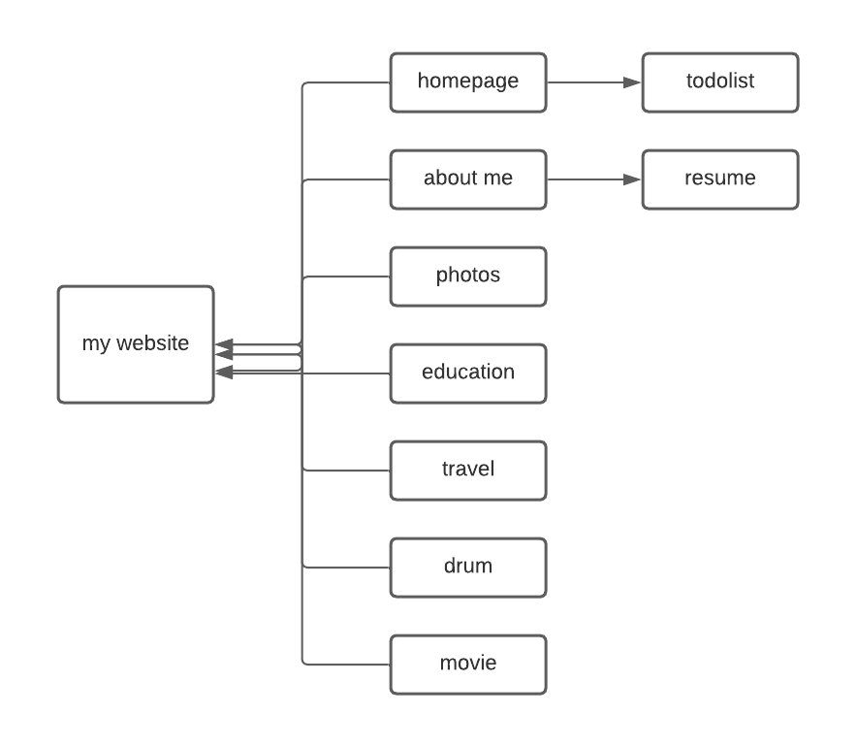
pages

Slide 5
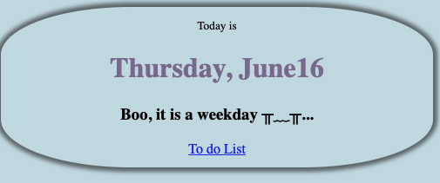
Home page
Row-
column
column
Changs real date
The color and messages also changes with the different date
The column will display one by one when the screen become small.
HTML
CSS
JavaScript
Notes:
Consider talking about:
Financial aid

Slide 6
function getTime() { const d = new Date(); const months = ["January", "February", "March", "April", "May", "June", "July", "August", "September", "October", "November", "December"]; let month = months[d.getMonth()]; const days = ["Sunday", "Monday", "Tuesday", "Wednesday", "Thursday", "Friday", "Saturday"] let day = days[d.getDay()]; var date = d.getDate(); const time = day + ", " + month + date; const weekends="Yay, it is weekendsヾ(^▽^*)))"; const weekday="Boo, it is a weekday ╥﹏╥..." document.getElementById("date").innerHTML=time; if(day==="Saturday" || day==="Sunday"){ document.getElementById("date").style.color= "purple"; document.getElementById("info").innerHTML=weekends; document.getElementById("info").style.color="yellow"; }else{ document.getElementById("date").style.color= "darkblue"; document.getElementById("info").innerHTML=weekday; document.getElementById("info").style.color= "gray"; } }

Slide 7
To do list
Add
add event by click the add button
Or press enter
Achieve
click checkbox it will add decoration by line through
Delete
delete the item and remove from list
HTML
CSS
JavaScript
Vue's

Slide 8
About Me
nav
Personal info Links for my hometown/ favorite song/ movie Response design, will adjust by screen size
Skill & resume->link to other page
Some other info and selfie Article will adjust by screen size Selfie is fixed size, will not adjust by screen size, to make sure show in a prefect size
html
CSS

Slide 9
Resume
Toggle button
show/close the resume
Variable declare by Vue
Data, computed, methods implements
HTML
CSS
JavaScript
Vue's

Slide 10
Photos
nav
Video
Cat gallery Click to check original high-quality pictures
article
html
CSS

Slide 11
Education
nav
BU Link to the official site of this university by click the picture
UW Link to the official site of this university by click the picture
UML Link to the official site of this university by click the picture
NTU Link to the official site of this university by click the picture
html
CSS

Slide 12
Travel
nav
Gallery 4 pictures evenly distributed, hover to check the big picture
Kyoto Intro and city cites gallery Every picture has labelled and click to see more info
Chengdu Intro and city cites gallery Every picture has labelled and click to see more info
html
CSS

Slide 13
Drum
Every button are design to make sound
switch case
Animation for press key
CSS + time
HTML
CSS
JavaScript

Slide 14
Movie
Button:
function to add like and show in right
Component display
two images/ title/list of details/circle to check different pictures
Component reviewForm
name/review/rating/recommend/button
Component reviewList
Will show review on it
HTML
CSS
JavaScript
Vue's

Slide 15
Thanks for watching
Xiaonan Liu

