Slide 1

PON OMCI Packet Automated Test
2024-12-31 Selina Wu

Slide 2
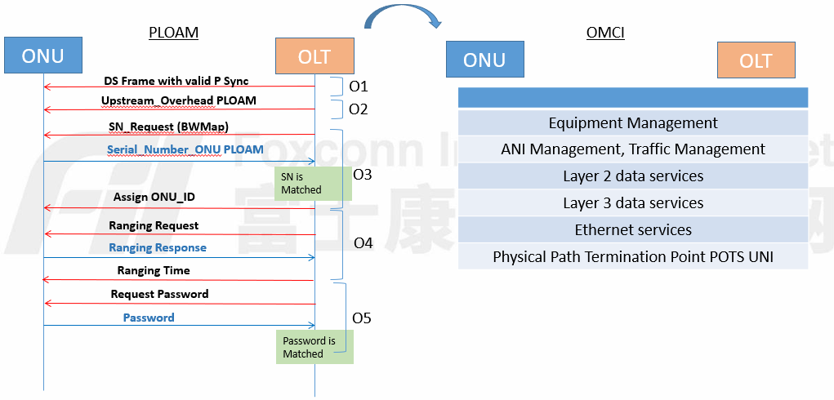
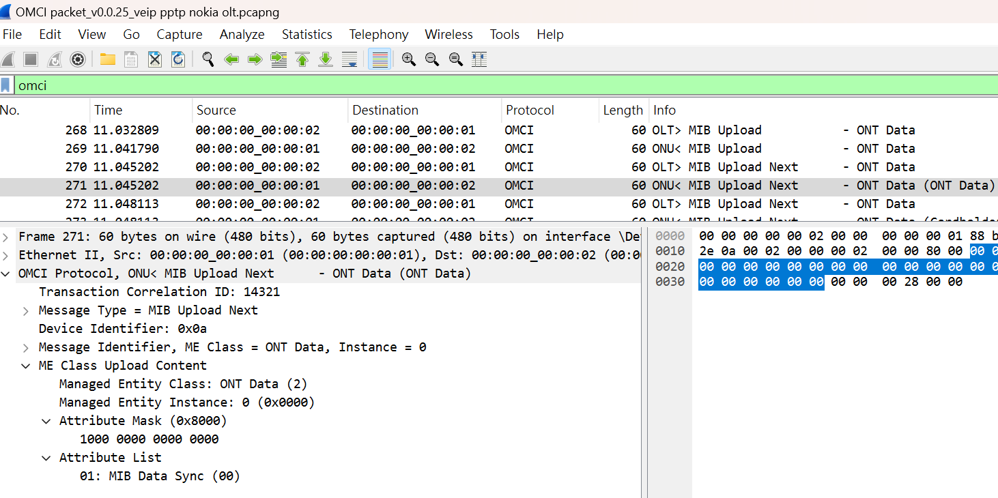
PON OMCI封包分析測試
PON 產品上線的兩個流程PLOAN & OMCI, 其中OMCI 層的封包內容是最為重要的檢查, OMCI 的種類封包數也是最多的(千種以上), 一個一個檢查比對是很花時間的。

Slide 3
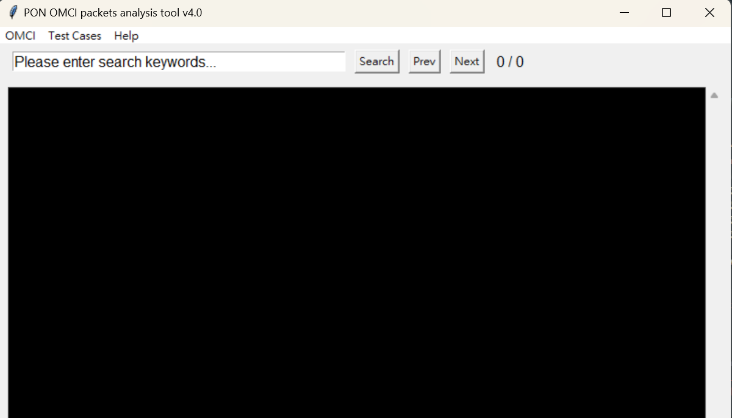
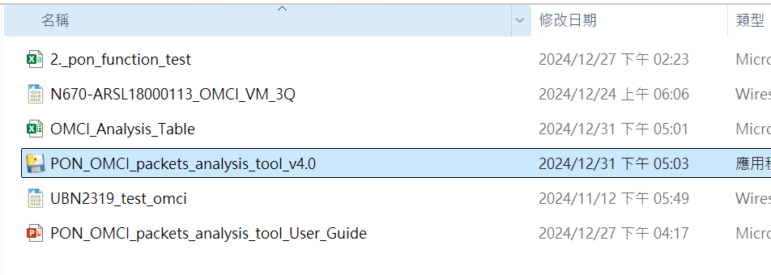
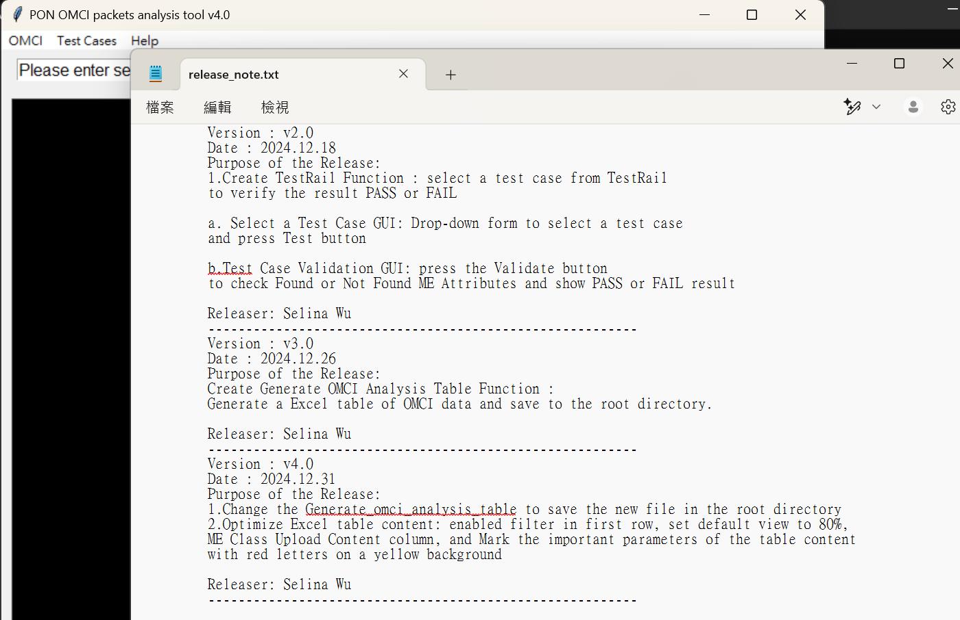
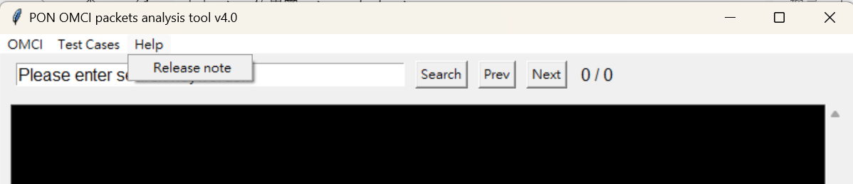
PON OMCI封包分析測試
Step1 Execute the program
PON_OMCI_packets_analysis_tool_v4.0
Execute the program and Check Tool Menu
Step2 Check Tool Menu
Help -> Release note

Slide 4
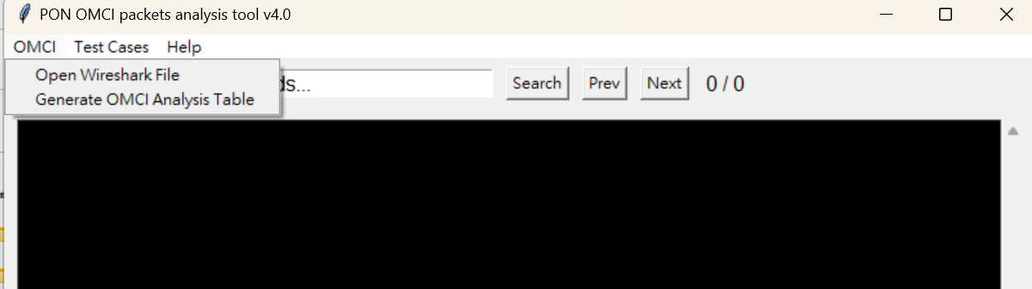
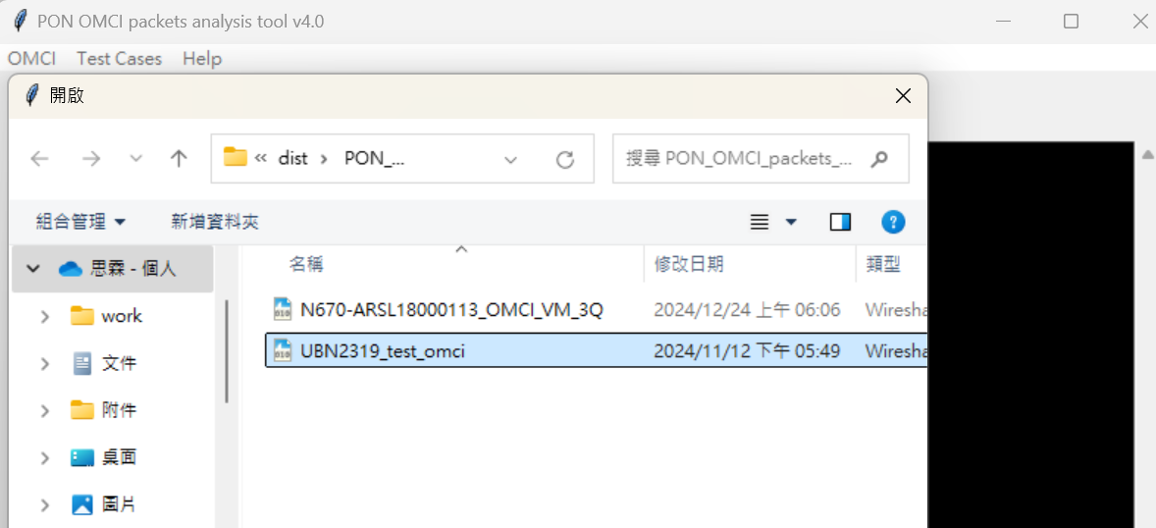
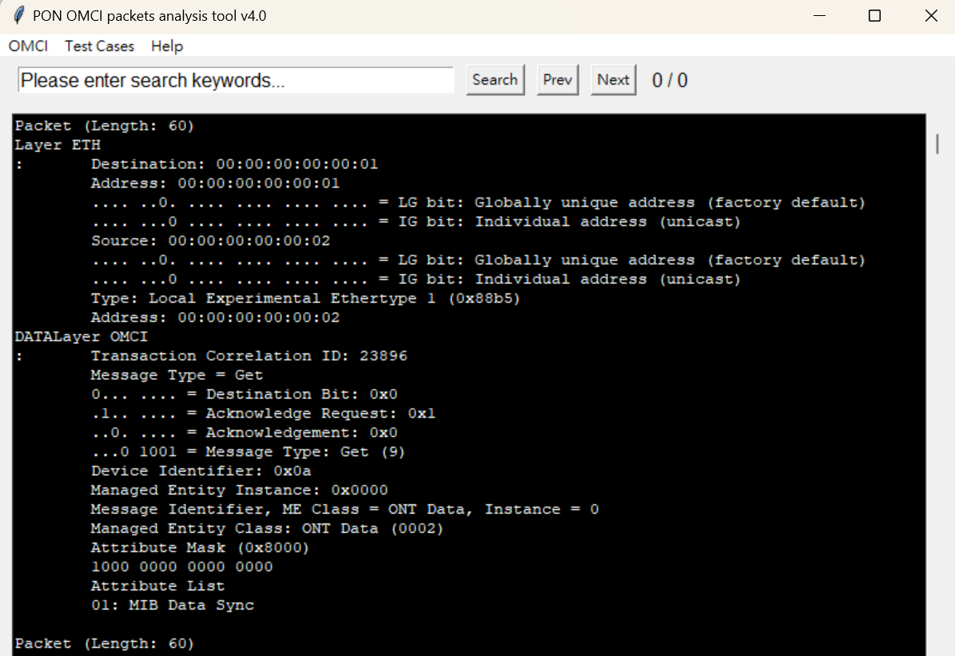
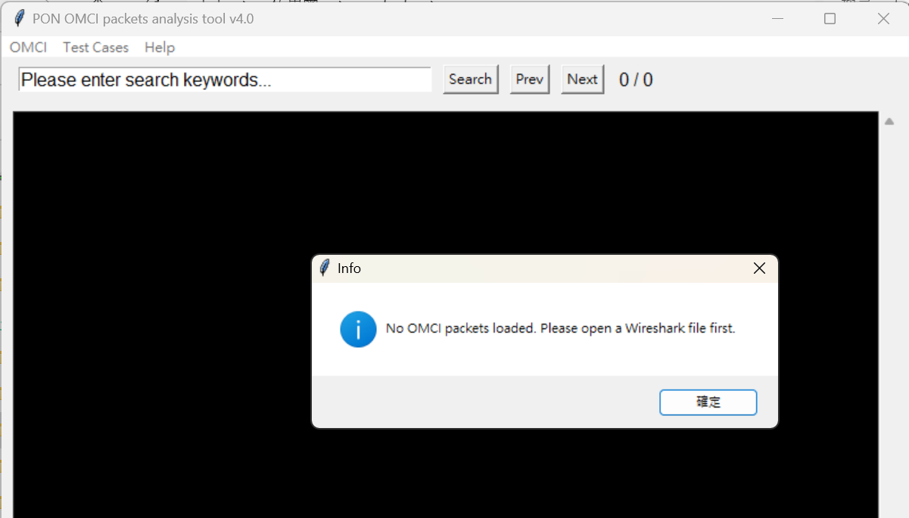
PON OMCI封包分析測試
Step3 Open Wireshark packets file (included OMCI packets)
Open Wireshark packets file (included OMCI packets)
If the OMCI packets is not included, will receive an error message

Slide 5
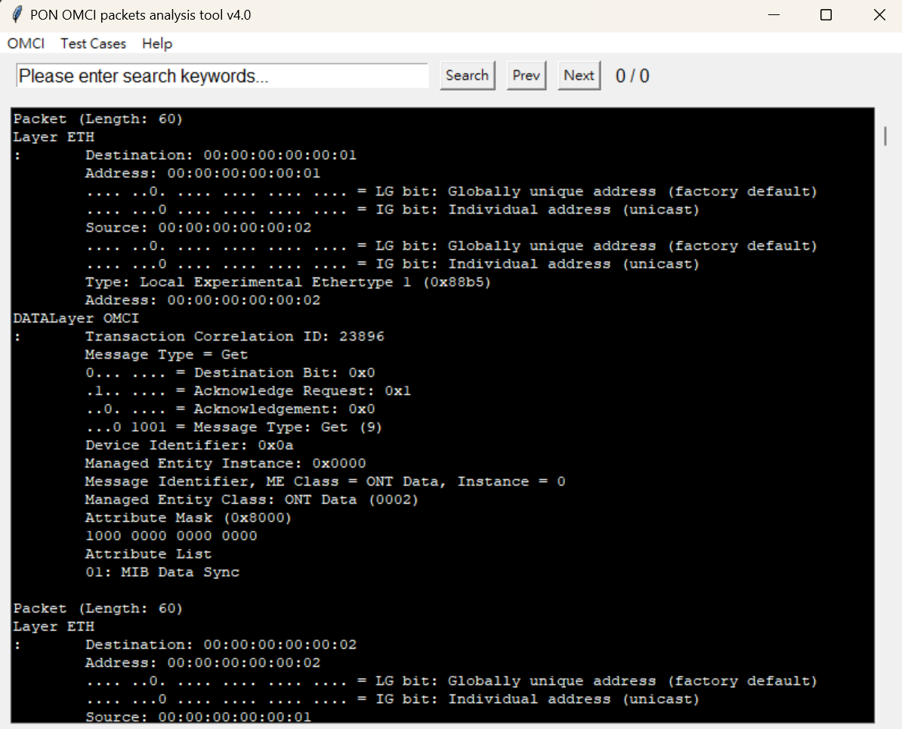
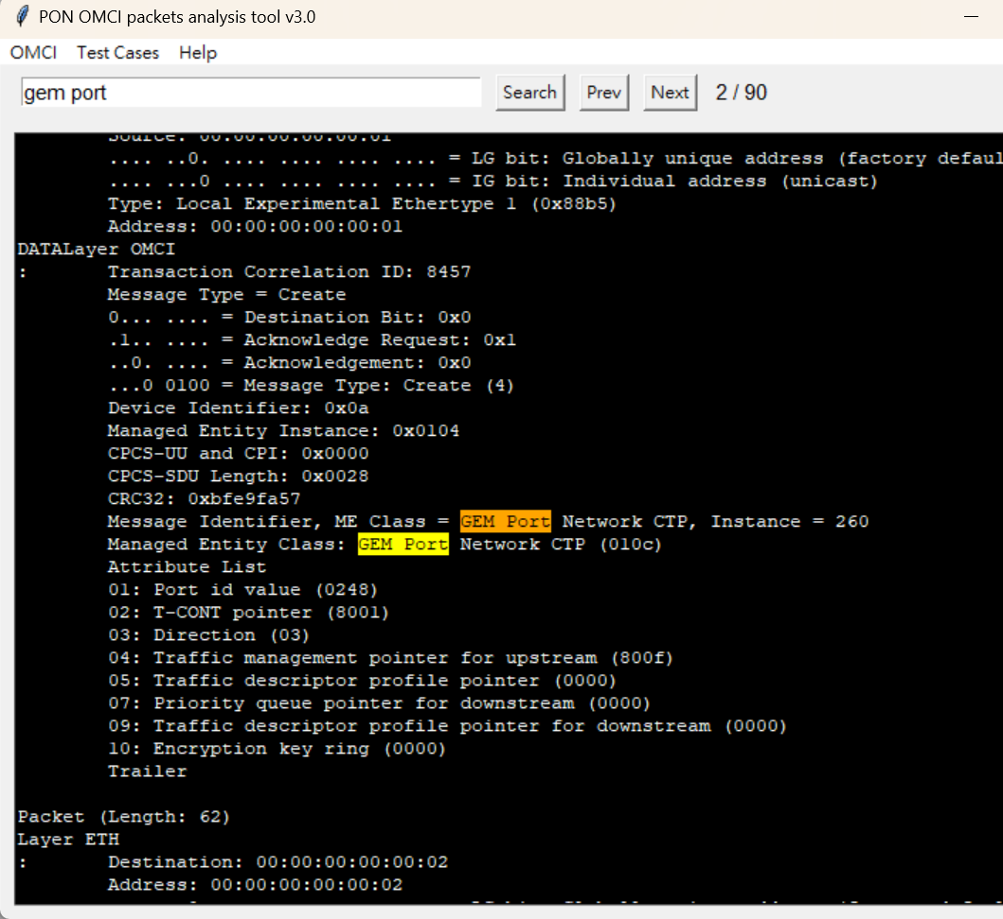
PON OMCI封包分析測試
Step4 Filter OMCI packets display
Please enter search keywords to search previous or next keyword,
and the total number of searches.
Filter OMCI packets display. Please enter search keywords to search previous or next keyword,
and the total number of searches.

Slide 6
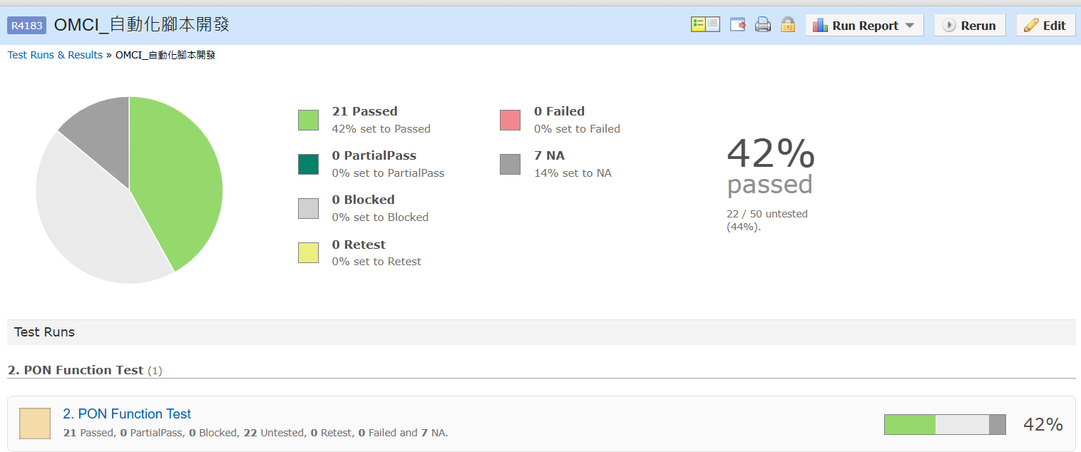
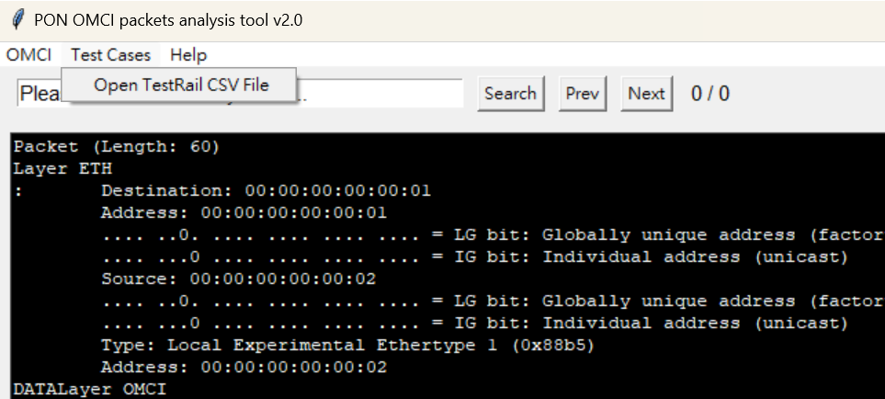
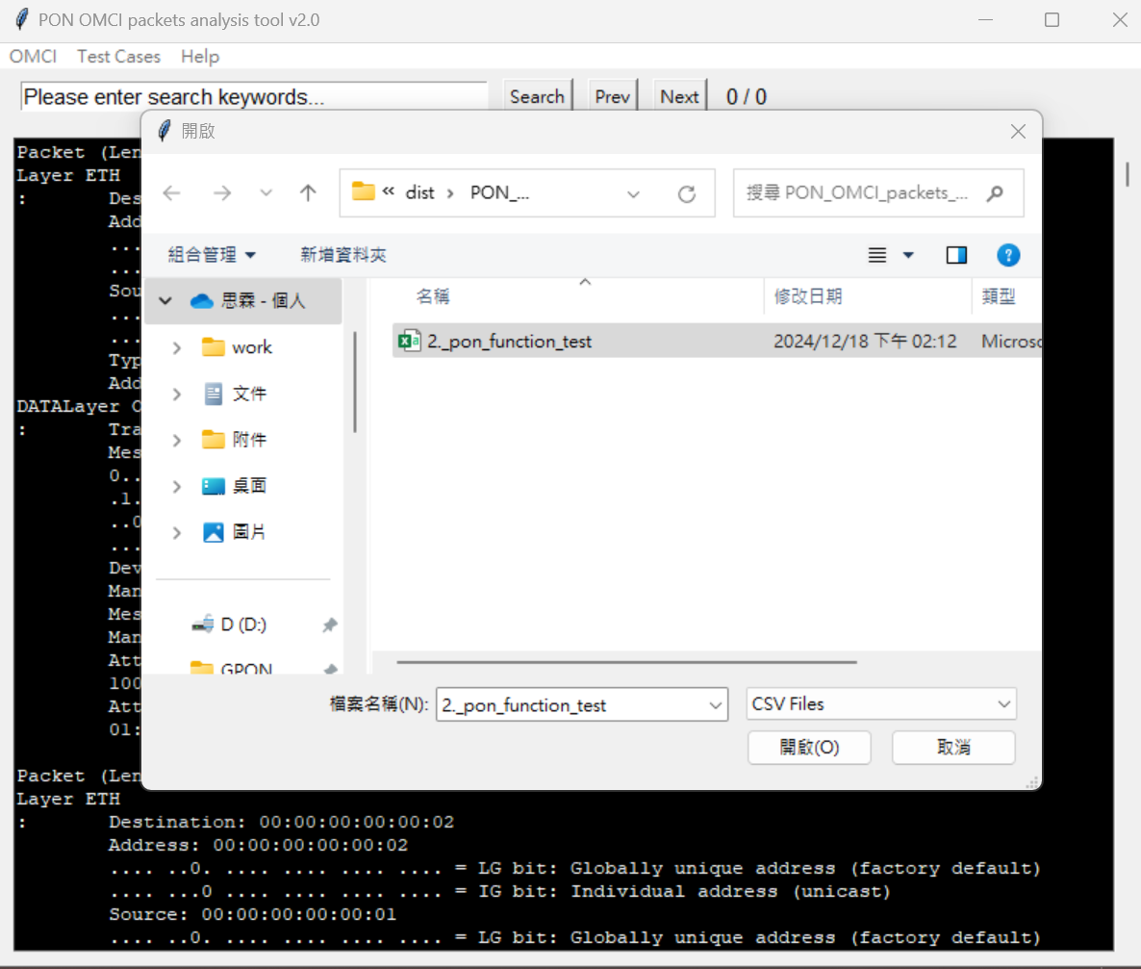
PON OMCI封包分析測試
Step5 Open GPON test cases in Testrail
Download PON function test cases in Testrail:
http://172.30.0.199/testrail/index.php?/runs/view/4184
According to the test of each version, create a test test in TestRail and generate a csv file.

Slide 7
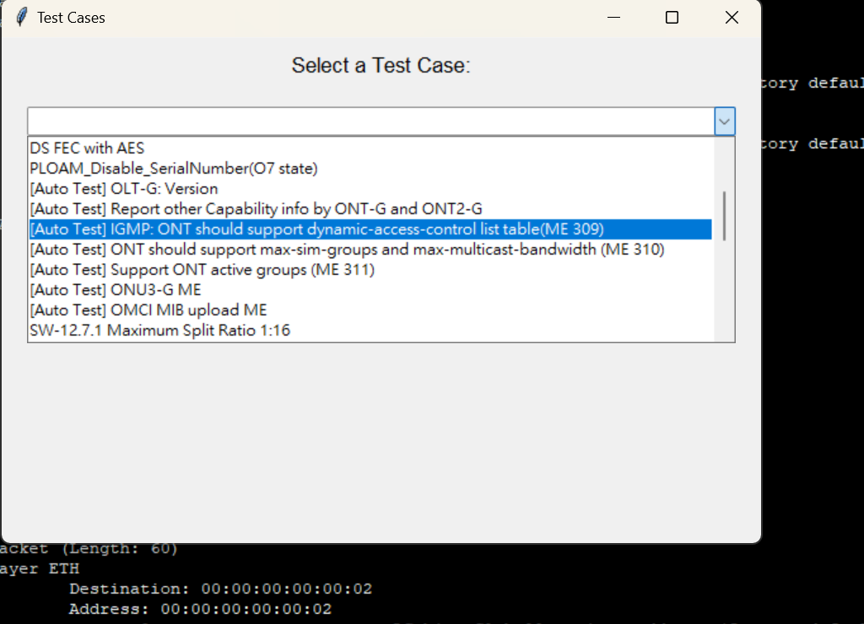
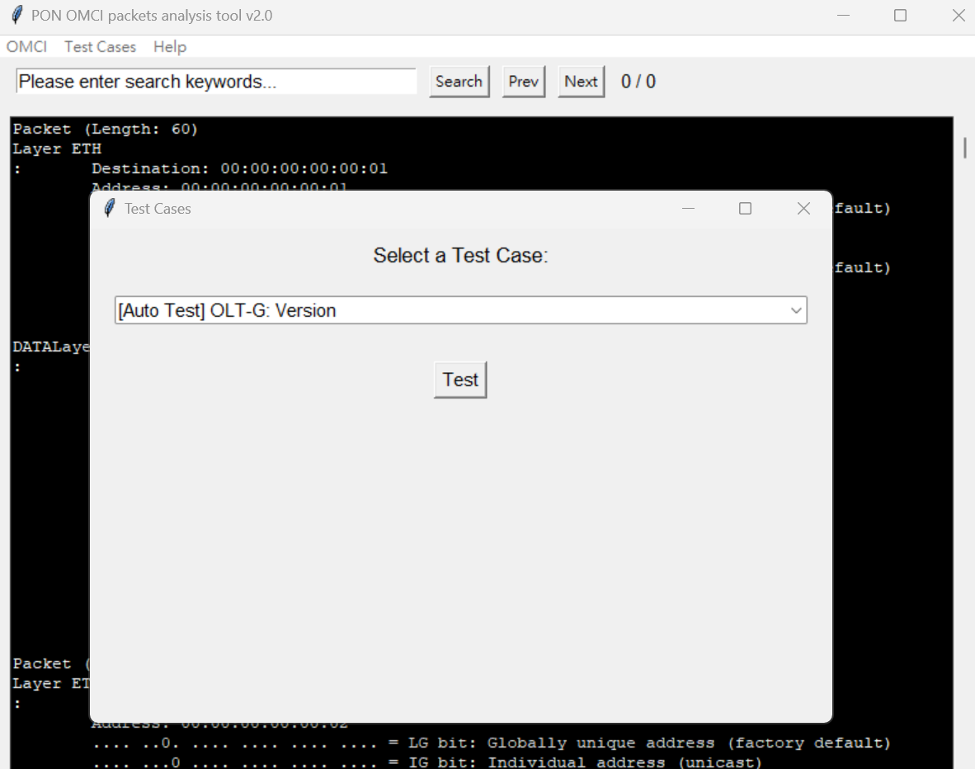
PON OMCI封包分析測試
Step6 Start Auto Test
Select a Test Case and press Test button
After import the csv file, start the auto test. Select a Test Case and press Test button

Slide 8
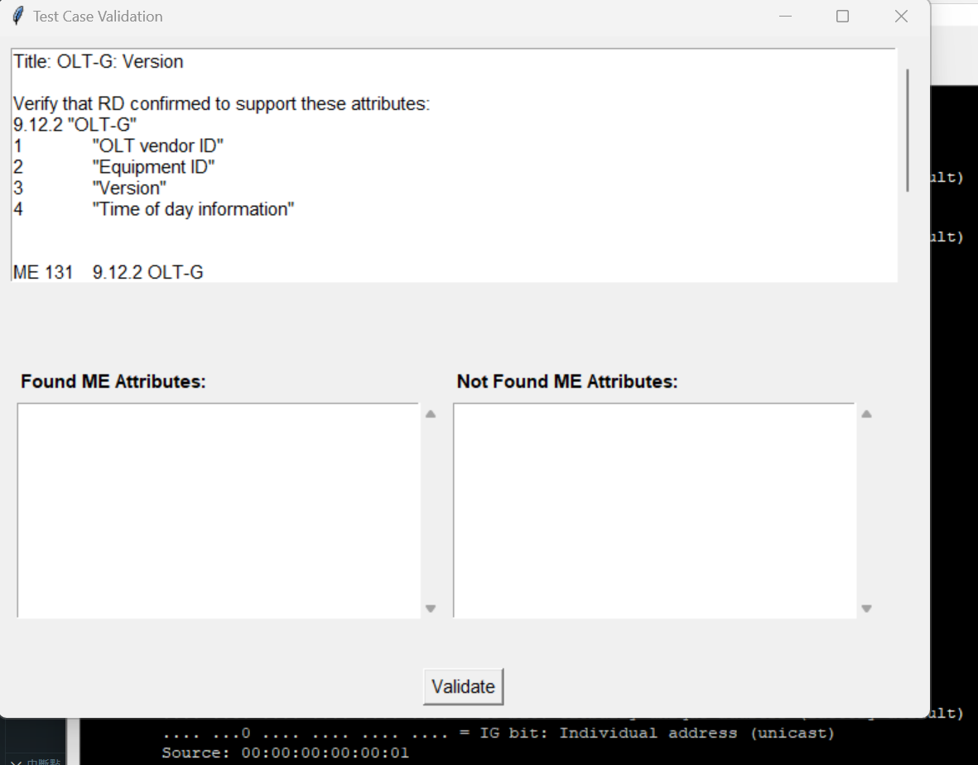
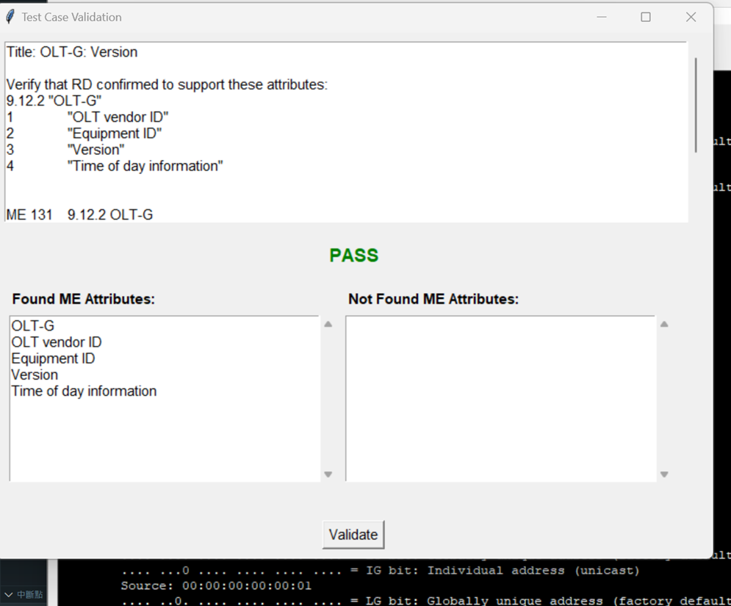
PON OMCI封包分析測試
Step7 Follow test case steps and press Validate button
Show test result: PASS
(Found ME Attributes)
Follow test case steps and press Validate button. Show test result: PASS (Found ME Attributes)

Slide 9
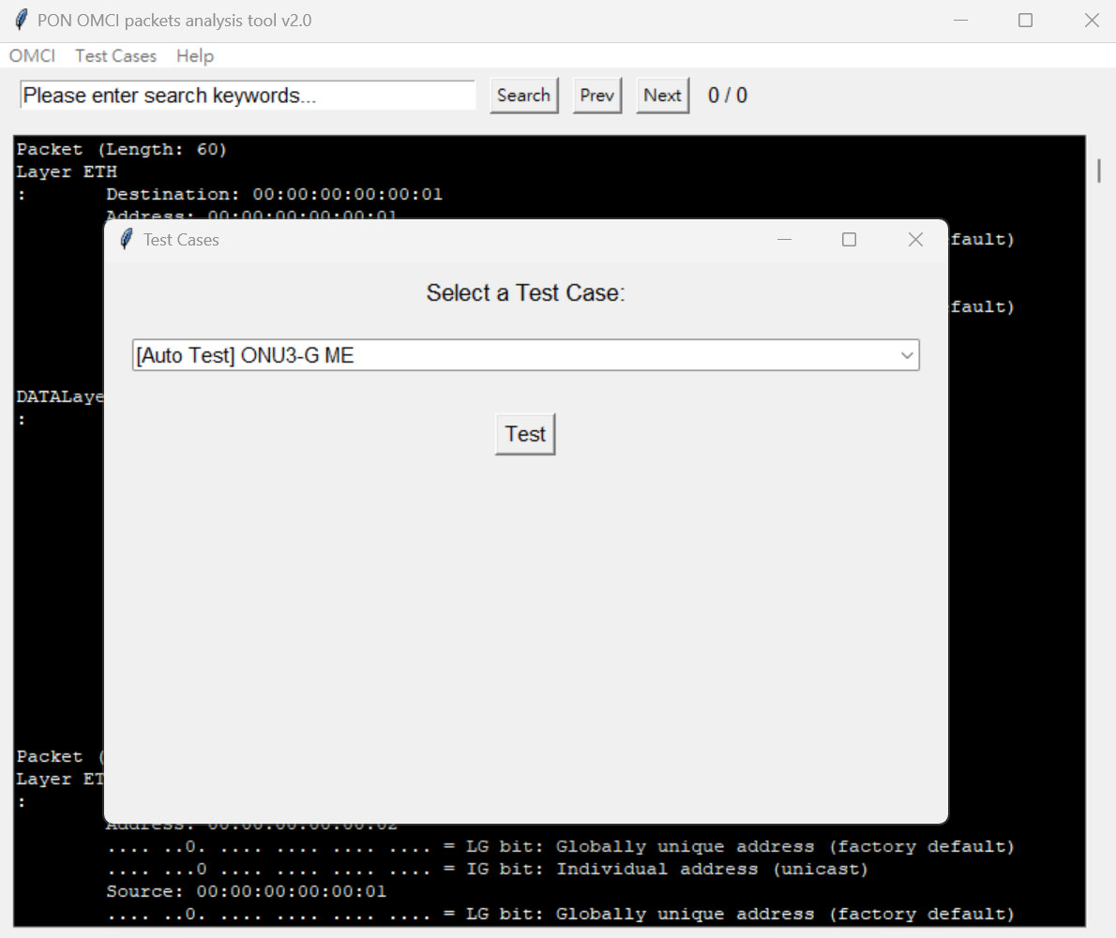
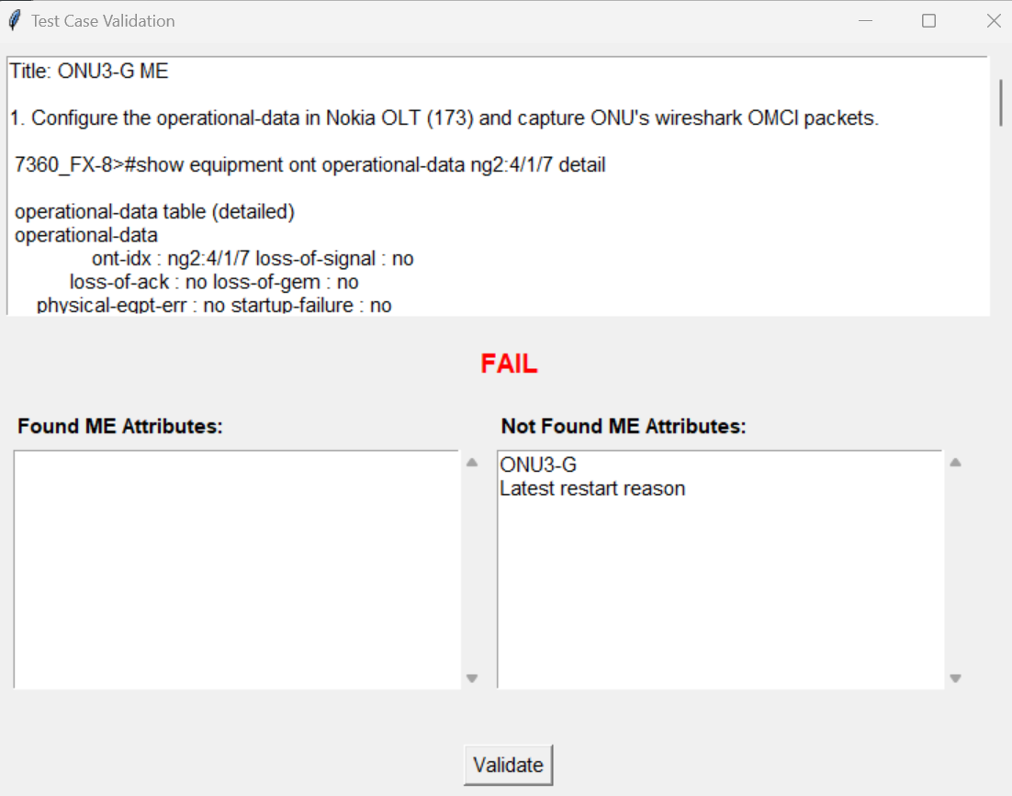
PON OMCI封包分析測試
Show test result: FAIL
(Not Found ME Attributes)
Show test result: FAIL
(Not Found ME Attributes)

Slide 10
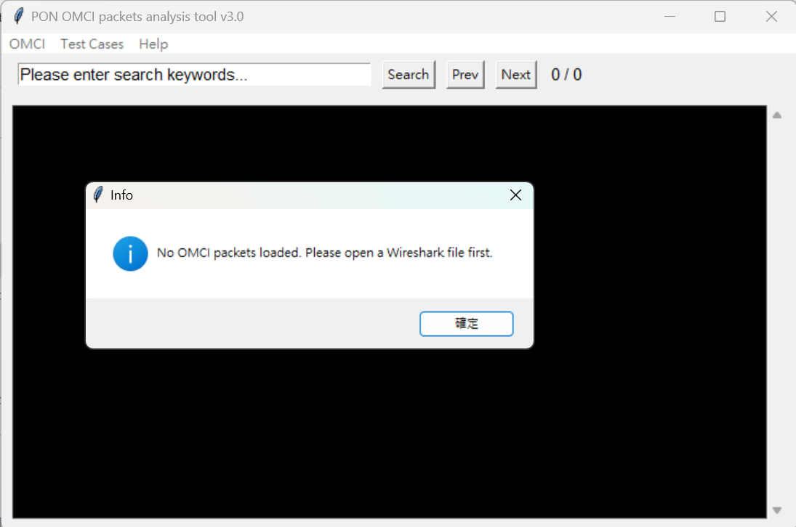
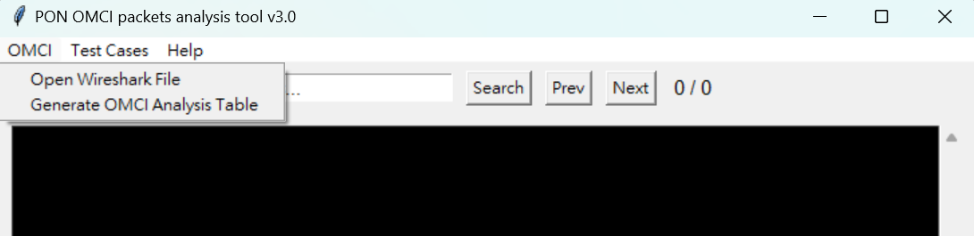
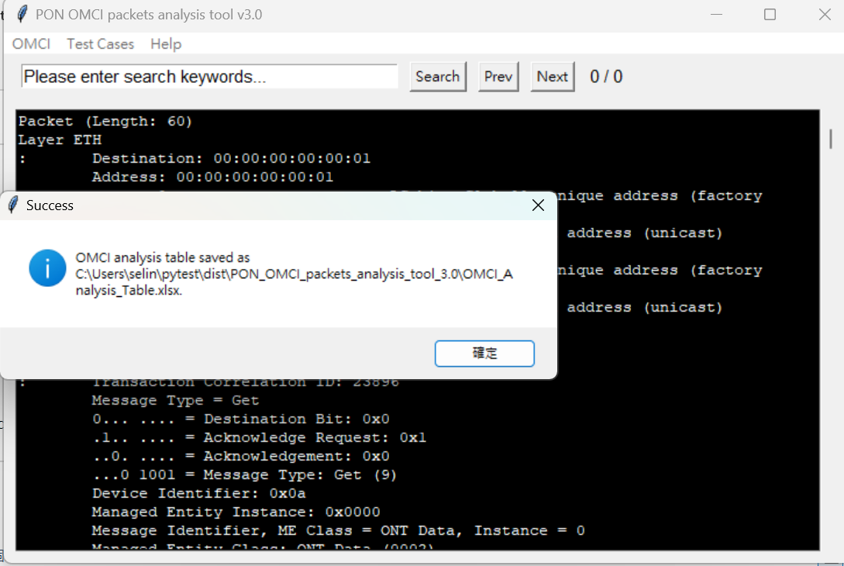
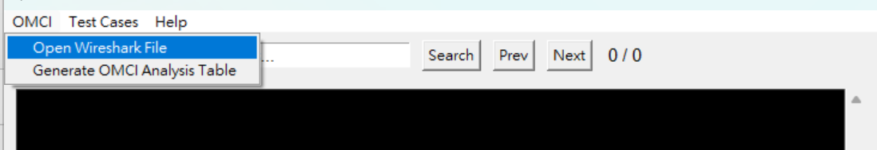
PON OMCI封包分析測試
Step8 Generate OMCI analysis table and save the new file
in the root directory
Generate OMCI analysis table and save the new file in the root directory
Before generating the OMCI analysis table, need to import the OMCI Wireshark packets.

Slide 11
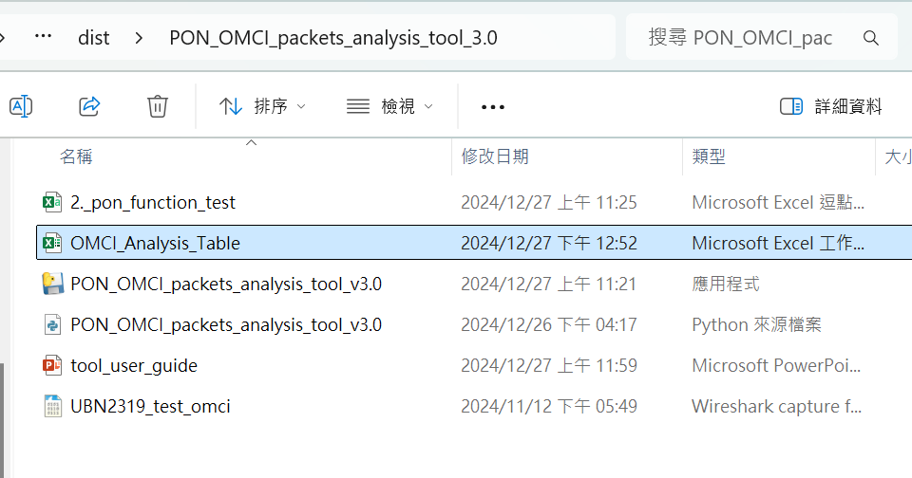
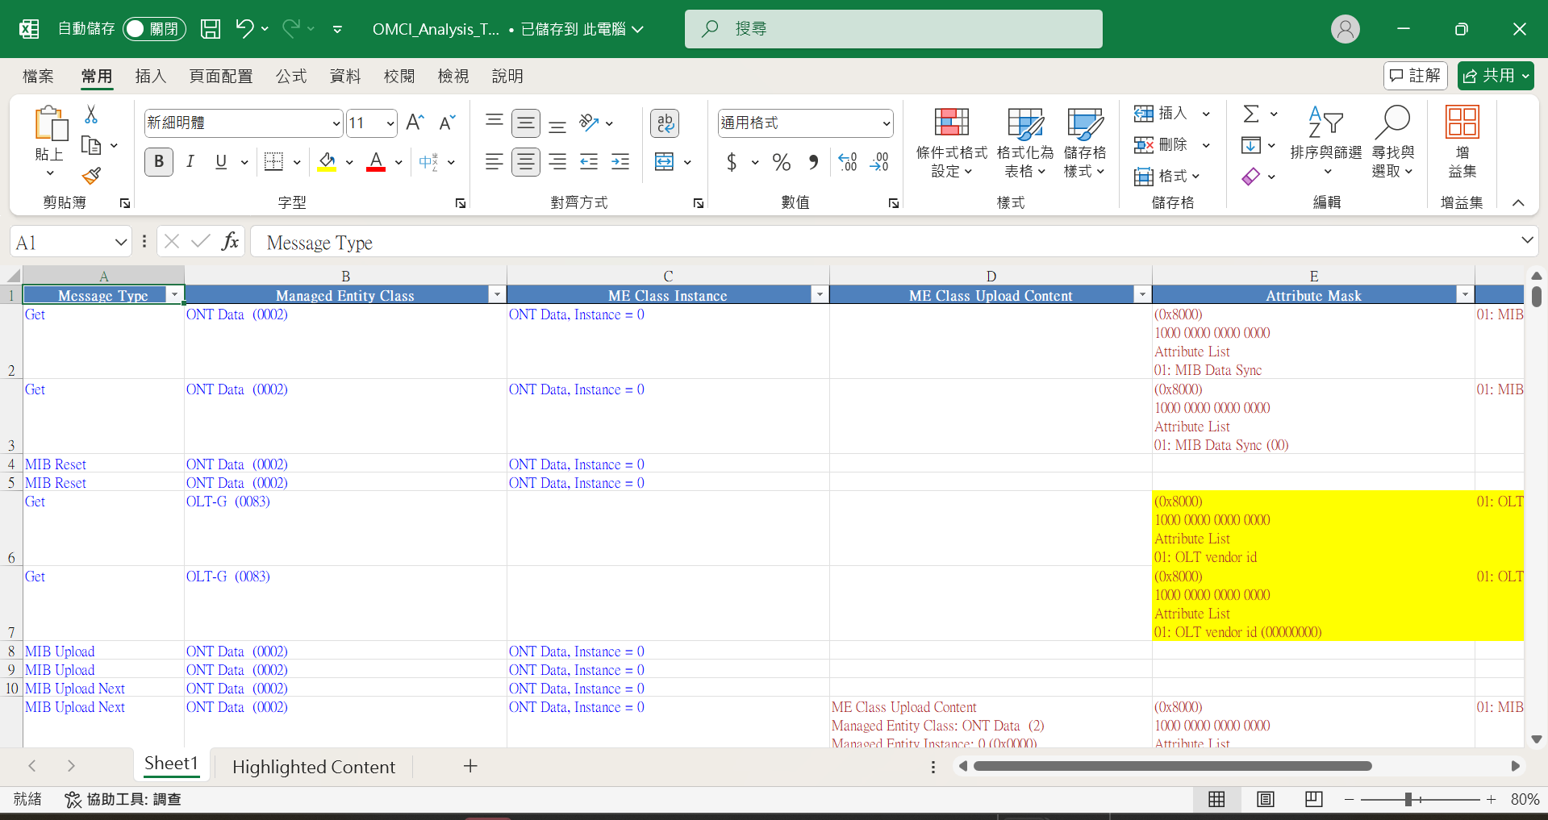
Step9 Optimize OMCI Analysis Table
1.Enabled filter in first row
2.Set default view to 80%
3.Analysis packets: Message Type, Managed Entity Class, ME Class Instance, ME Class Upload Content, Attribute Mask, Attribute List,
Device Identifier
4.Mark the important ME
PON OMCI封包分析測試
Optimize OMCI_Analysis_Table content

