Slide 1

ⓔⓚⓐⓝⓢ
191180005 Selin Cansu Akbaş
191180006 Mert Akgüç
191180007 Nursena Akgüneş
191180009 Furkan Onur Akman

Slide 2
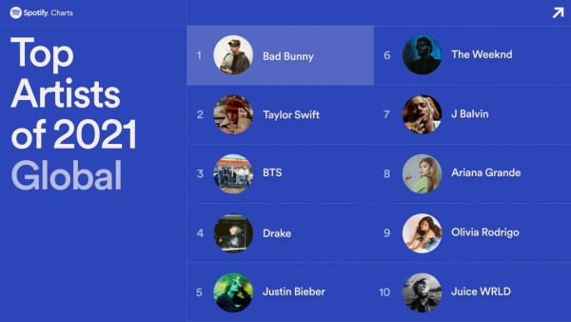
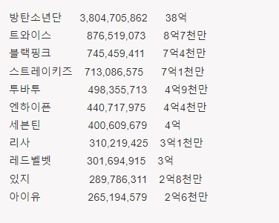
Motivation
★ Entertaining
★ Globally Recognized

Slide 3
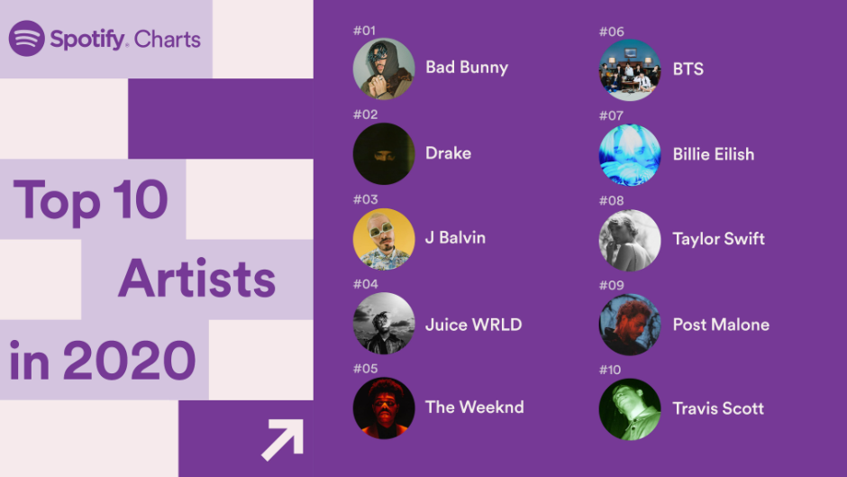
Motivation

Slide 4

Motivation

Slide 5
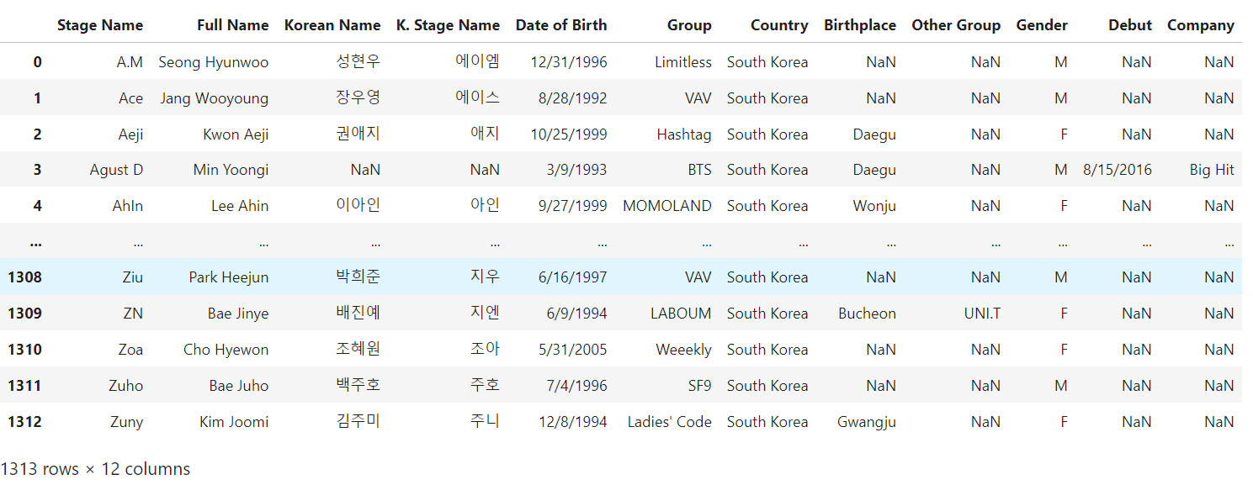
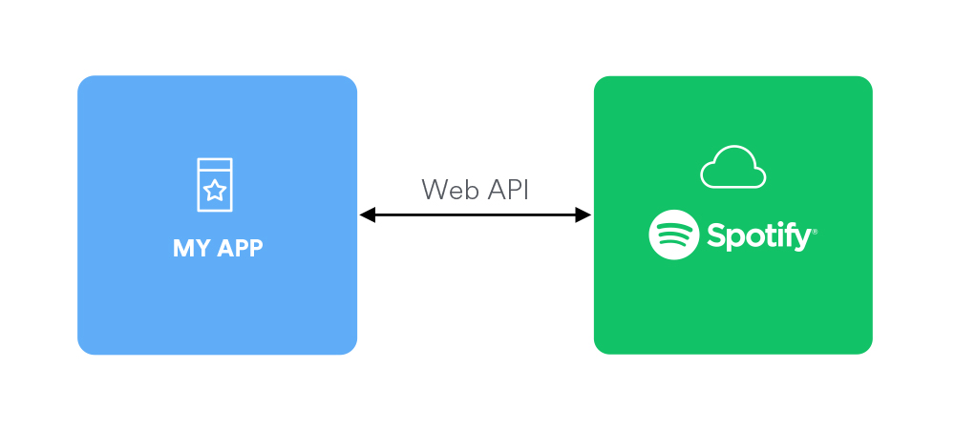
Dataset

Slide 6
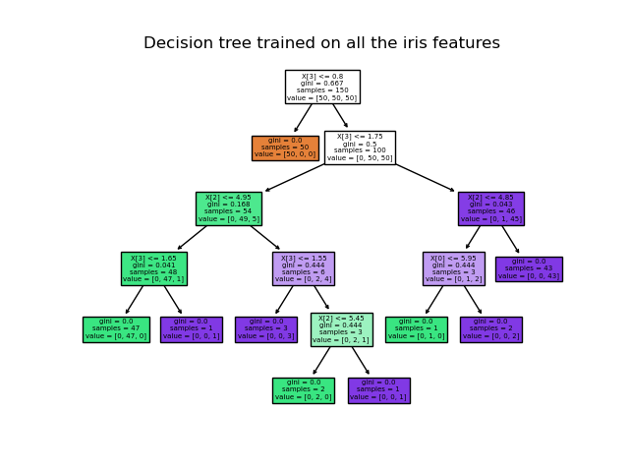
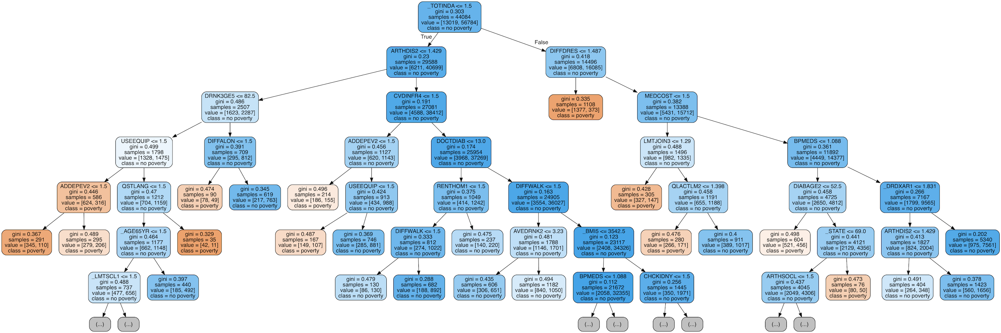
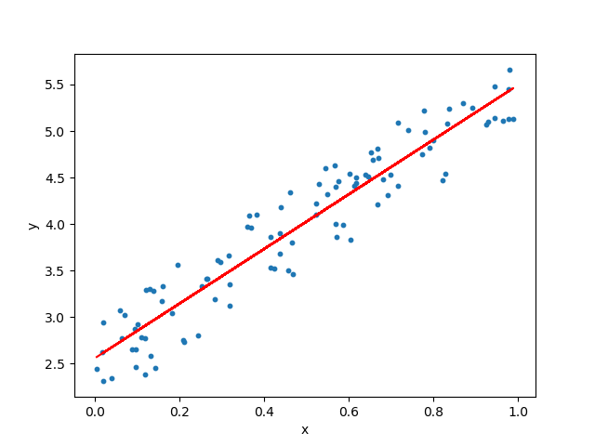
Machine Learning
Decision Tree
Random Forest
Regression

Slide 7




Machine Learning

