Slide 1

DSA210 Project
Selin Tıraş 29491

Slide 2
Introduction
This project utilizes personal health data—such as step count, heart rate, and active energy burned—to discover meaningful patterns and correlations. By visualizing these relationships, I aim to understand how daily habits and physical activities influence overall wellness. Integrating theoretical concepts from the DSA210 course, this analysis provides a unique perspective on personal health trends.

Slide 3
Hypothesis
I hypothesize that there is a positive correlation between step count, heart rate, and active energy burned. As physical activity increases, I expect to see corresponding increases in heart rate and energy expenditure, reflecting the body's response to higher levels of exertion.

Slide 4
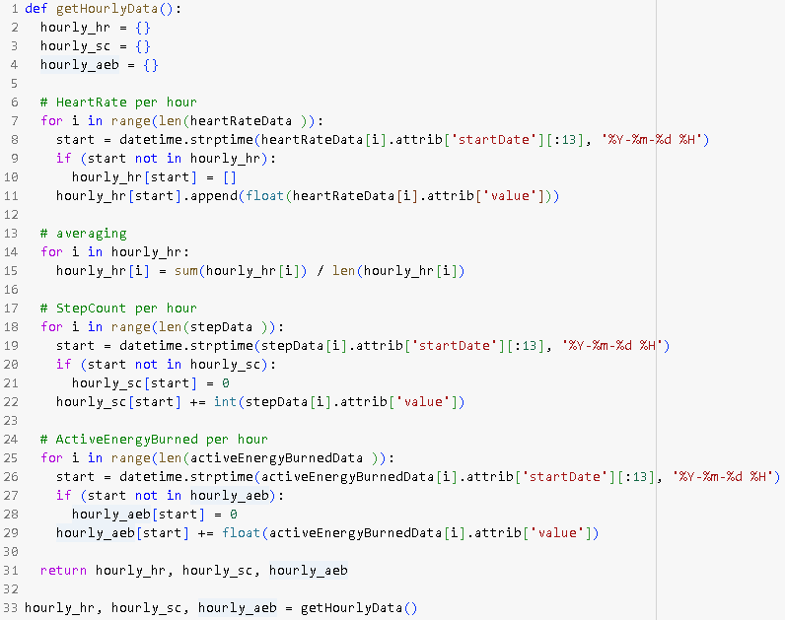
In this analysis, I calculated hourly averages for heart rate, step count, and active energy burned. This approach allows me to standardize the data and effectively compare variations across the metrics over time.

Slide 5
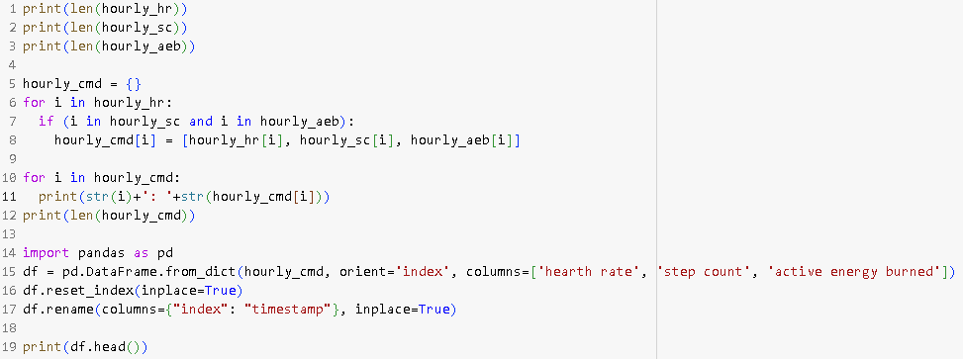
In this code, I filtered the data to retain only the common timestamps across heart rate, step count, and active energy burned, ensuring that comparisons are made using consistent hourly data.

Slide 6
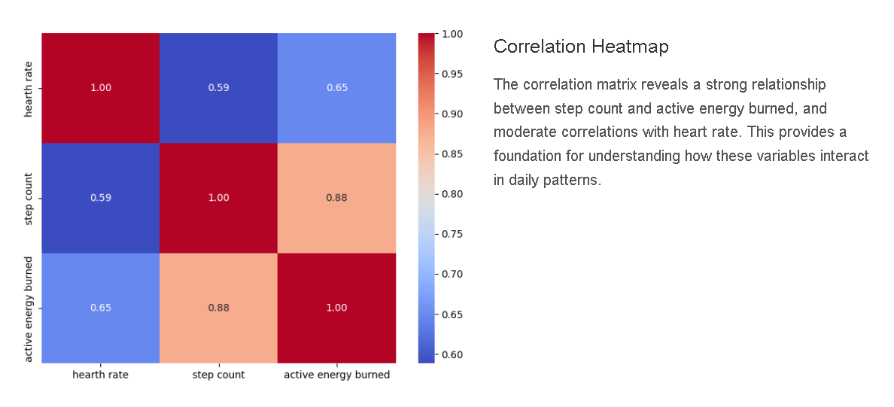

Slide 7
Line Graphs & Normalization
To observe how different metrics fluctuate over time, I plotted normalized values of heart rate, step count, and active energy burned. These visualizations reveal patterns and relationships between the metrics during daily activities.

Slide 8
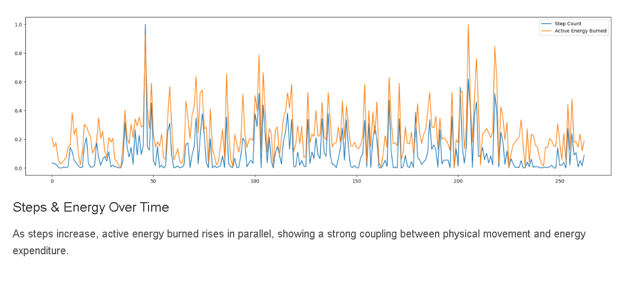

Slide 9
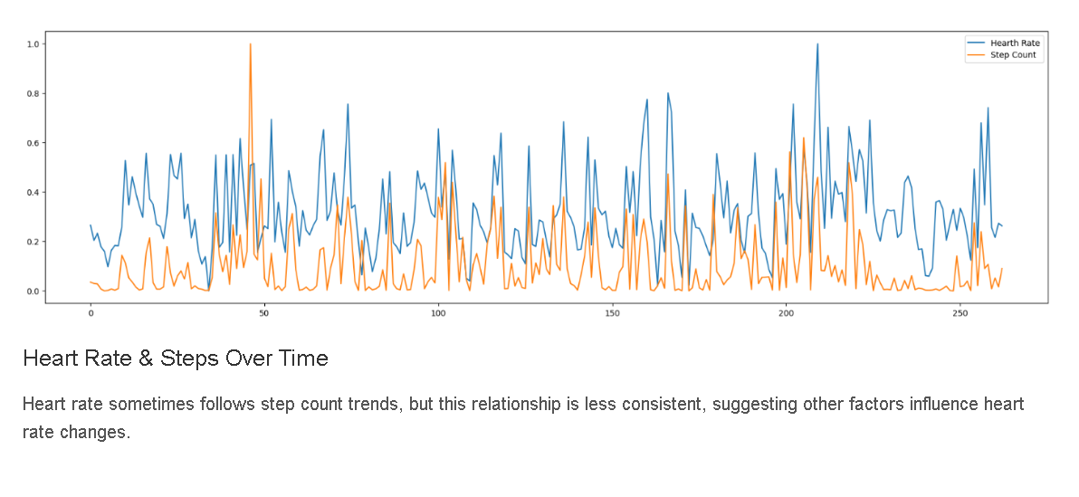

Slide 10
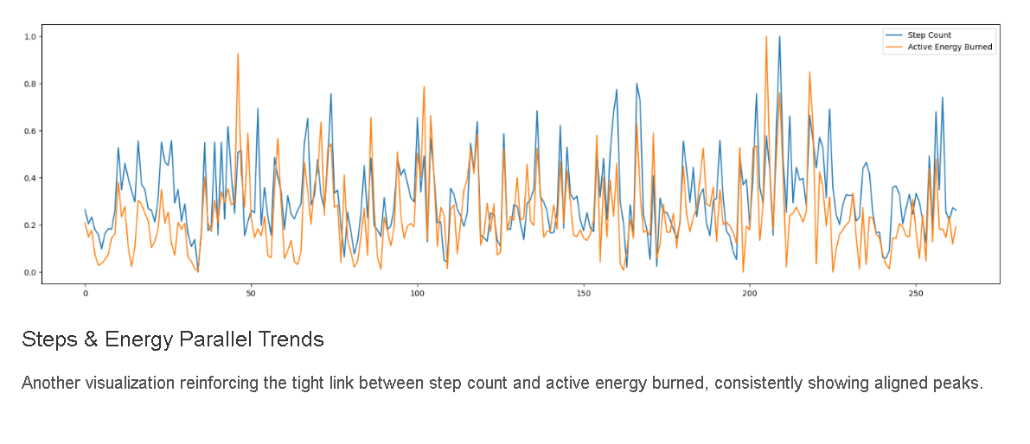

Slide 11
Temporal Distribution: Weekdays & Months
To gain a deeper understanding of temporal patterns, I analyzed average heart rate, step count, and active energy burned by both weekday and month. These visualizations highlight how activity levels and physiological responses fluctuate across different time periods.

Slide 12
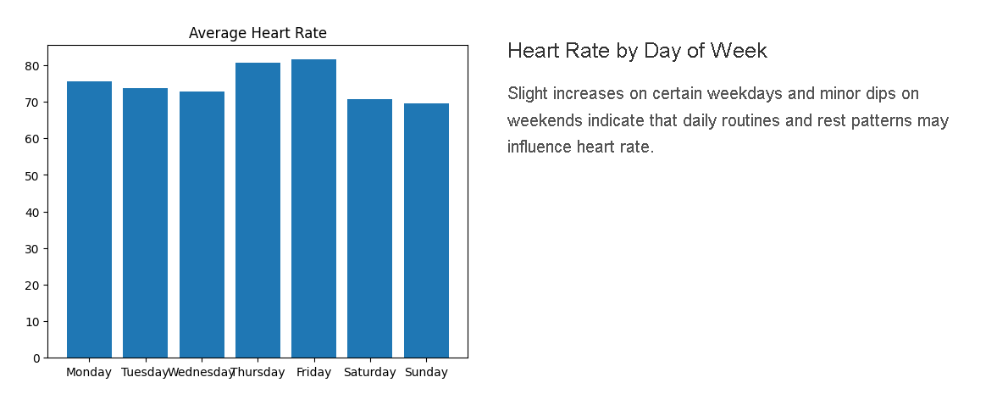

Slide 13
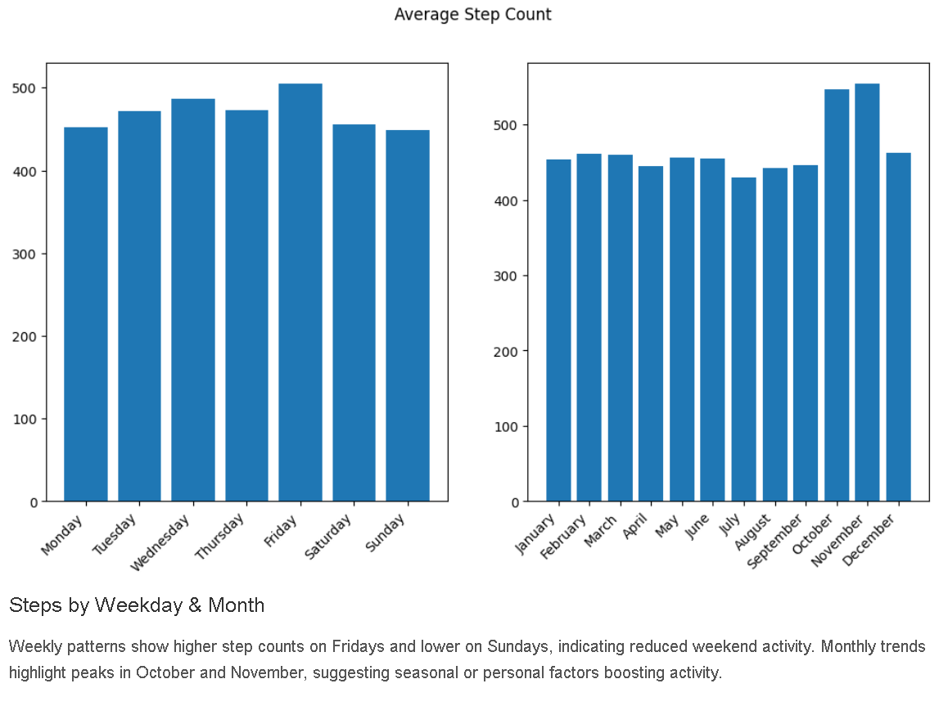

Slide 14
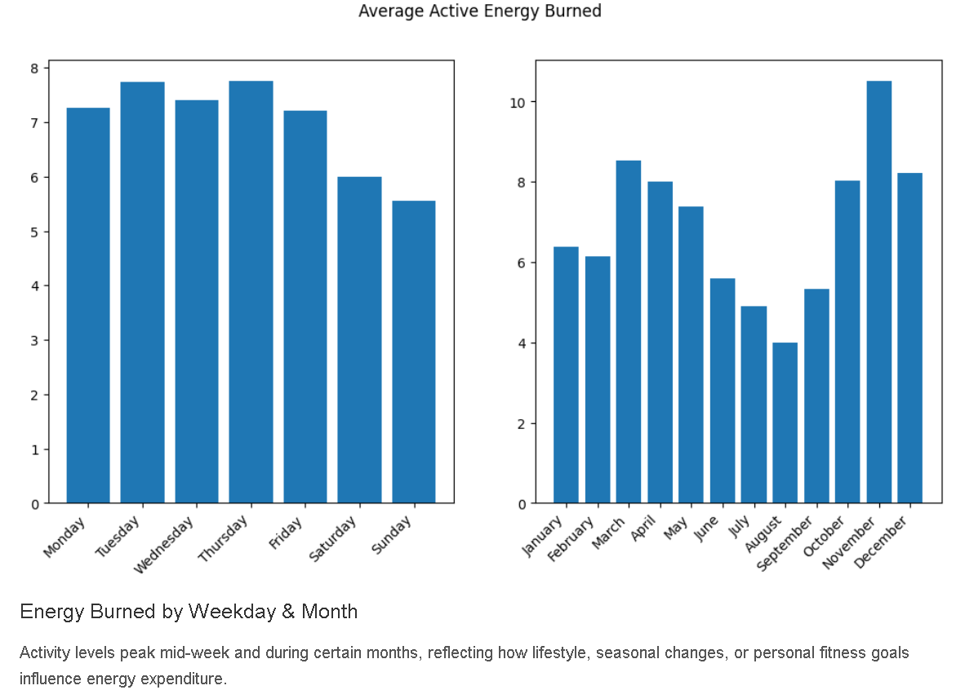

Slide 15
Scatter Plots & Trendlines
To better understand the relationships between heart rate, step count, and active energy burned, I created scatter plots with trendlines. These plots help me visualize the correlations between these metrics and provide insights into how physical activity influences physiological responses.

Slide 16
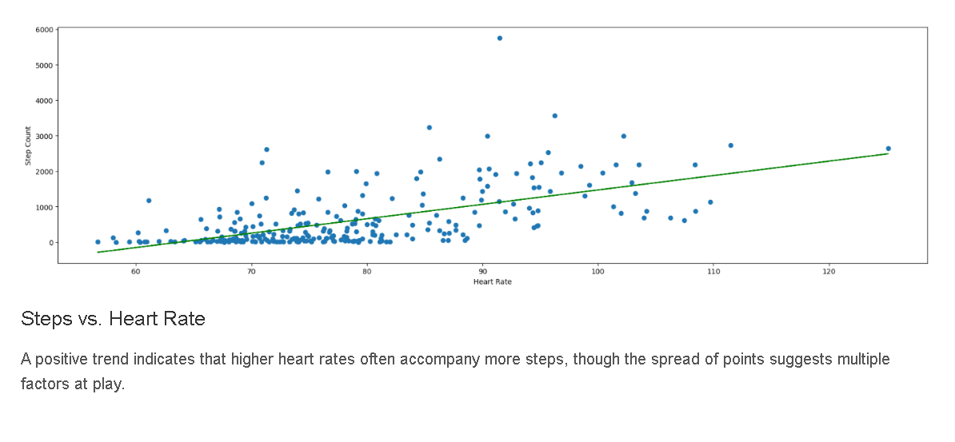

Slide 17
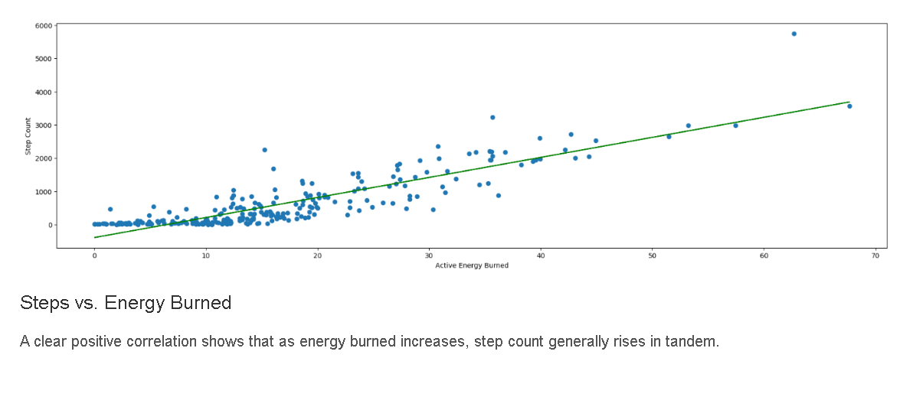

Slide 18
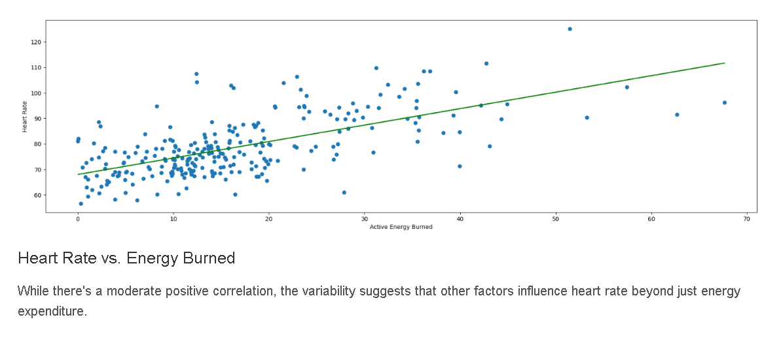

Slide 19
Conclusion
The analysis confirms the hypothesis of a positive correlation between step count, heart rate, and active energy burned. The heatmap and scatter plots show strong relationships, particularly between step count and energy burned, with heart rate also rising moderately with activity. Line and bar charts further highlight consistent patterns, with peaks in step count aligning with higher energy expenditure and variations across days and months. These findings validate that increased physical activity leads to elevated heart rate and energy expenditure, reflecting the body’s natural response to exertion.

