Slide 1

DSA210 Project
Selin Tıraş 29491

Slide 2
Motivation
While brainstorming project ideas, I recognized an opportunity to leverage my personal health data to better understand my daily habits and overall wellness. Apple Health provides comprehensive metrics such as heart rate, step count, and active energy burned, offering a rich dataset for exploration. This project aims to analyze these patterns to uncover correlations and gain insights into how various factors influence my overall health.
The primary motivation for this project is to identify relationships between physical activity, energy expenditure, and heart rate. By visualizing trends and correlations, I aim to better understand these dynamics while reinforcing the core concepts of the DSA210 course content. Integrating personal data with analytical methods offers a unique way to connect theory to real-world applications.

Slide 3
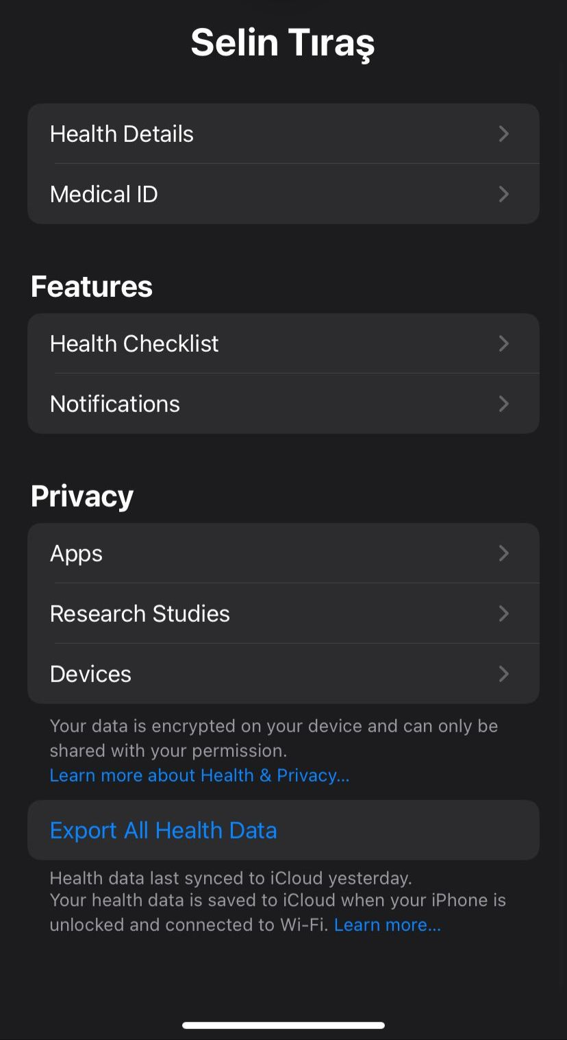
Data Collection
From Apple Health App, I exported my health data that the app collected from various devices such as iPhone and Apple Watch to use in my project.

Slide 4
Introduction
This project utilizes personal health data —step count, heart rate, and active energy burned—to from my data source Apple Health to discover meaningful patterns and correlations. By visualizing these relationships, I aim to understand how daily habits and physical activities influence overall wellness. Integrating theoretical concepts from the DSA210 course, this analysis provides a unique perspective on personal health trends.

Slide 5
Hypothesis
I hypothesize that there is a positive correlation between step count, heart rate, and active energy burned. As physical activity increases, I expect to see corresponding increases in heart rate and energy expenditure, reflecting the body's response to higher levels of exertion.

Slide 6
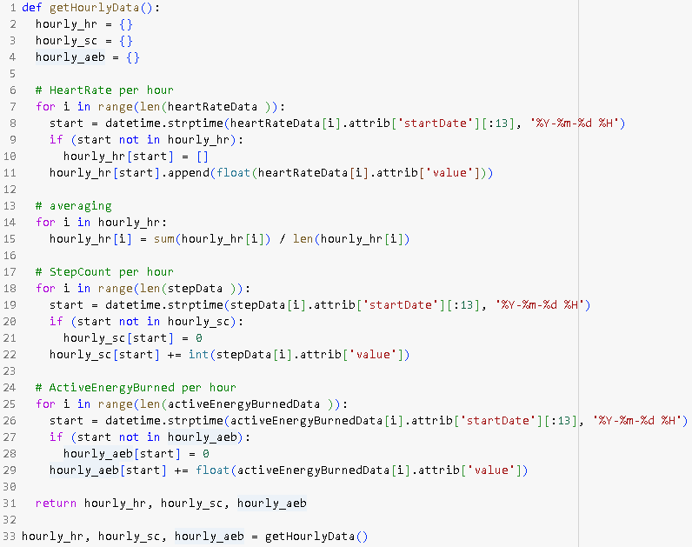
In this analysis, I calculated hourly averages for heart rate, step count, and active energy burned. This approach allows me to standardize the data and effectively compare variations across the metrics over time.

Slide 7
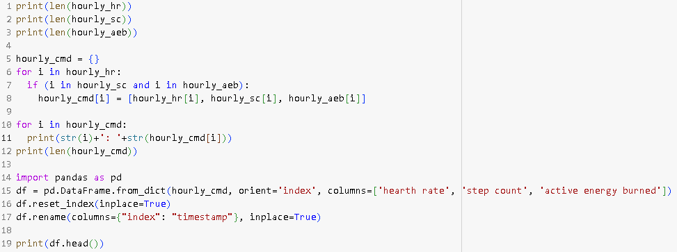
In this code, I filtered the data to retain only the common timestamps across heart rate, step count, and active energy burned, ensuring that comparisons are made using consistent hourly data.

Slide 8
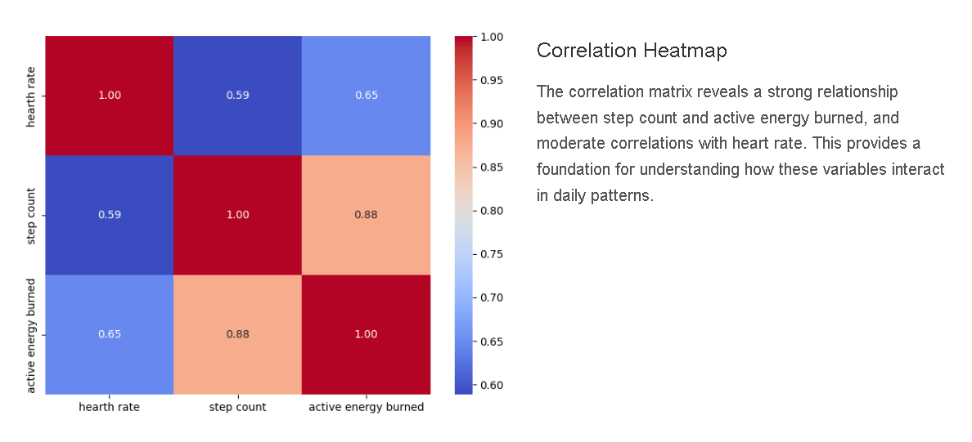

Slide 9
Line Graphs & Normalization
To observe how different metrics fluctuate over time, I plotted normalized values of heart rate, step count, and active energy burned. These visualizations reveal patterns and relationships between the metrics during daily activities.

Slide 10
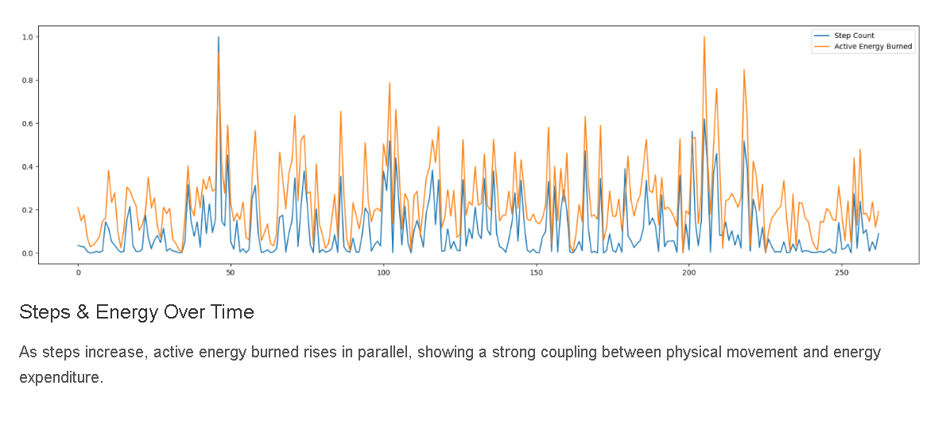

Slide 11
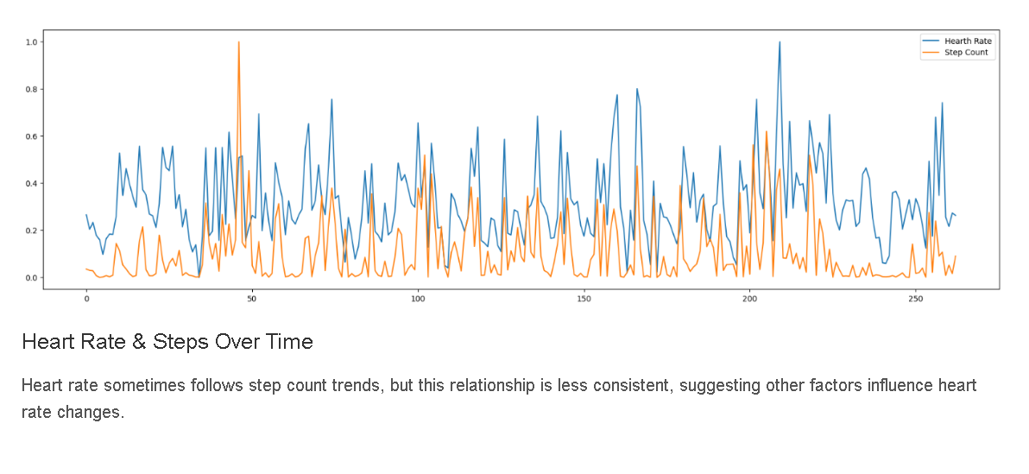

Slide 12
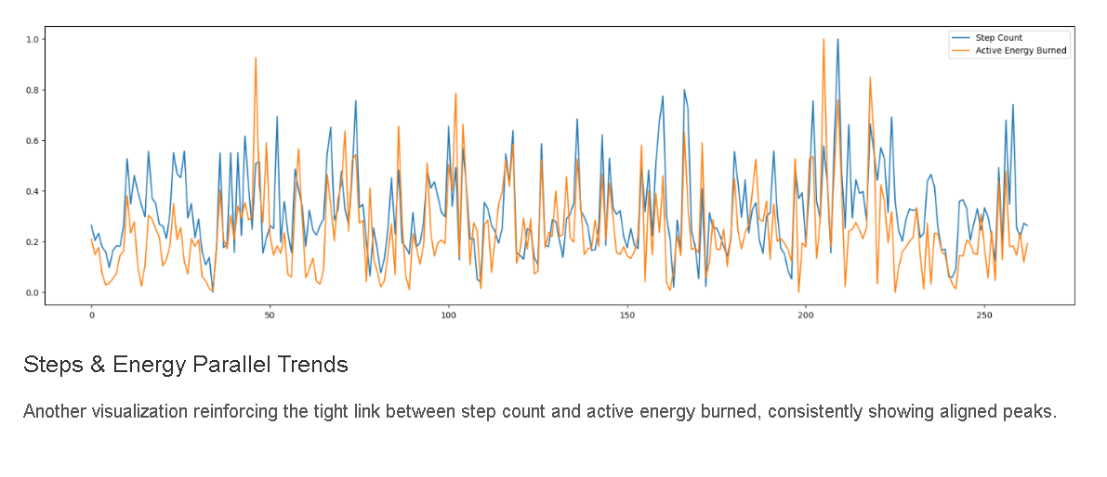

Slide 13
Temporal Distribution: Weekdays & Months
To gain a deeper understanding of temporal patterns, I analyzed average heart rate, step count, and active energy burned by both weekday and month. These visualizations highlight how activity levels and physiological responses fluctuate across different time periods.

Slide 14
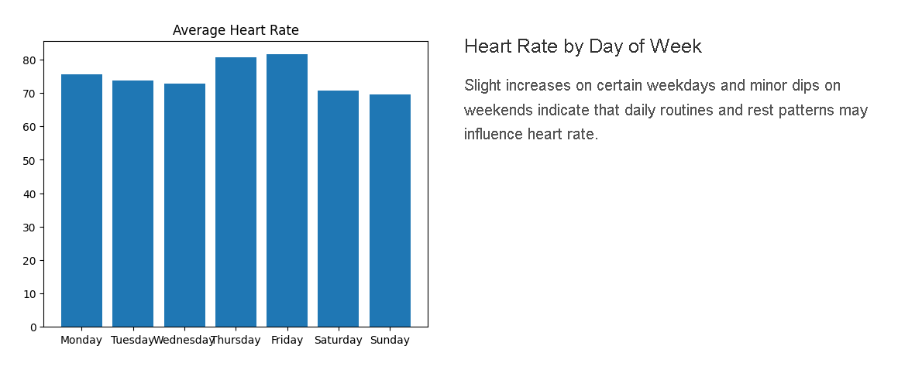

Slide 15
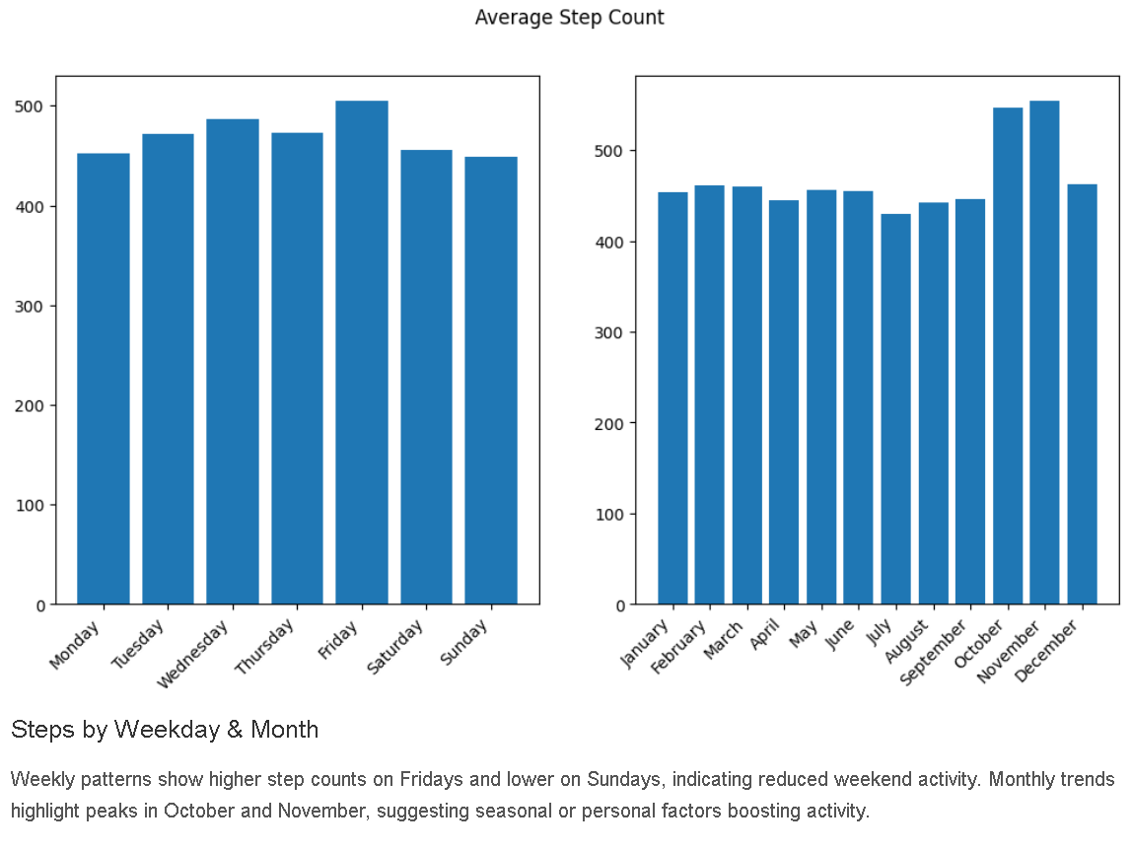

Slide 16
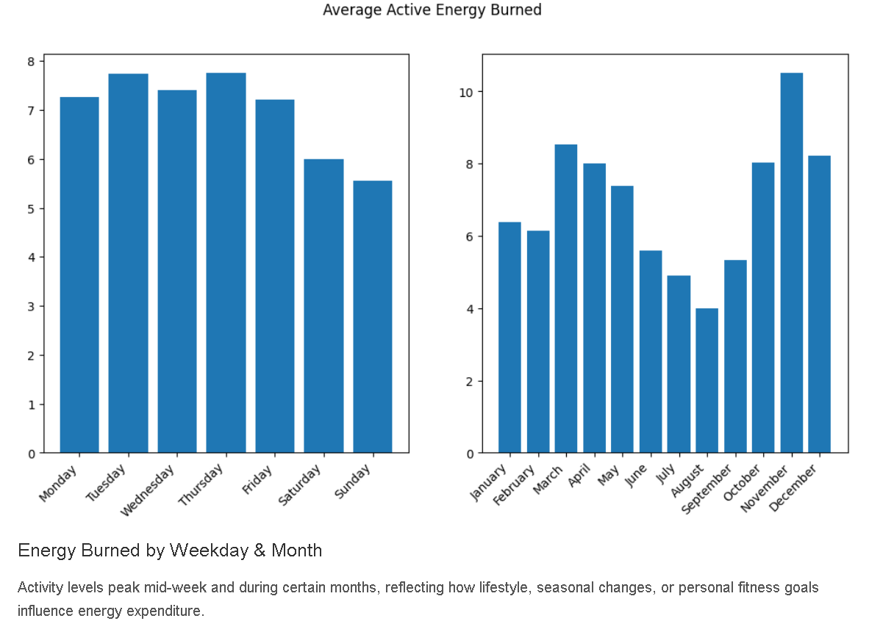

Slide 17
Scatter Plots & Trendlines
To better understand the relationships between heart rate, step count, and active energy burned, I created scatter plots with trendlines. These plots help me visualize the correlations between these metrics and provide insights into how physical activity influences physiological responses.

Slide 18
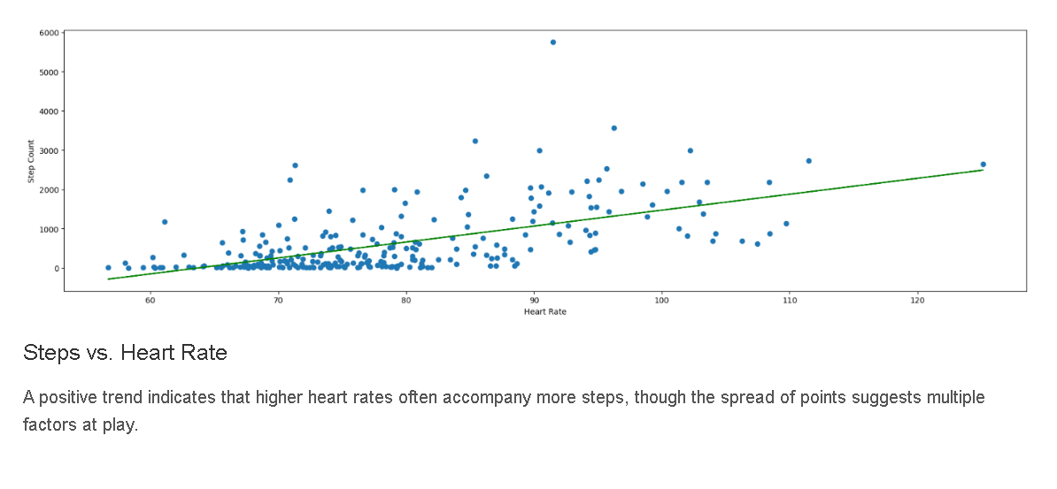

Slide 19
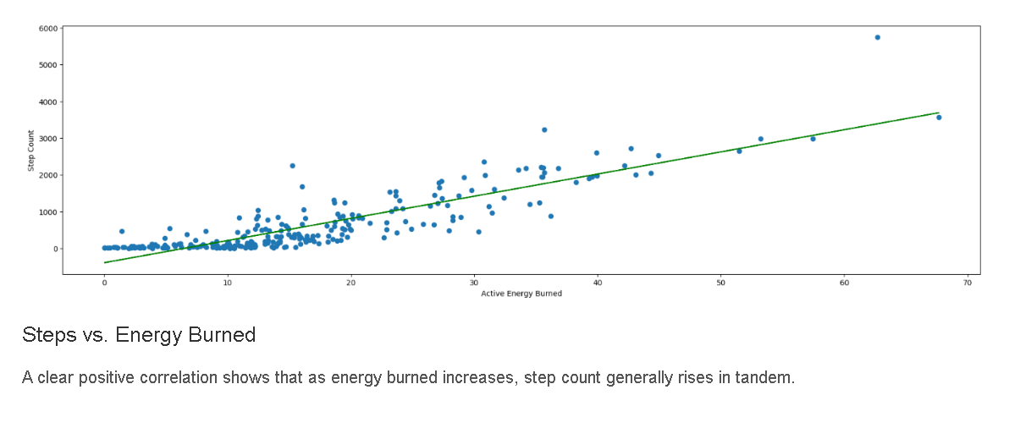

Slide 20
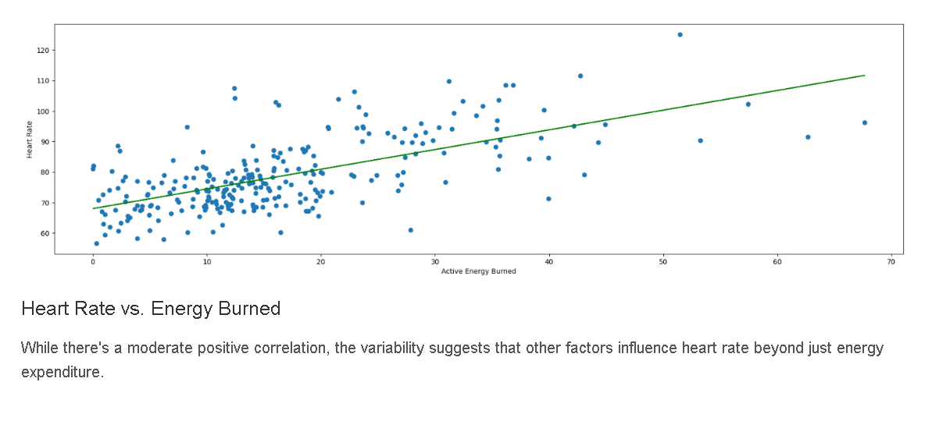

Slide 21
Conclusion
The analysis confirms the hypothesis of a positive correlation between step count, heart rate, and active energy burned. The heatmap and scatter plots show strong relationships, particularly between step count and energy burned, with heart rate also rising moderately with activity. Line and bar charts further highlight consistent patterns, with peaks in step count aligning with higher energy expenditure and variations across days and months. These findings validate that increased physical activity leads to elevated heart rate and energy expenditure, reflecting the body’s natural response to exertion.

Slide 22
What I learned about myself?
Discoveries About My Habits: This project has taught me that I am more active and burn more energy on weekdays compared to weekends. My heart rate patterns reflect my activity levels, suggesting a direct connection between my physical activities and overall health.
Consistency and Routine: I learned that I am generally consistent in my activity levels, but there are opportunities to push myself more on low-activity days to maintain better balance.
Analytical Perspective: Through this project, I realized my capability to utilize data analytics tools effectively to uncover meaningful insights about my daily life and health patterns.

Slide 23
Limitations
Data Diversity: The analysis primarily focused on step count, heart rate, and energy burned. Including additional metrics like sleep quality, hydration, and diet could provide a more comprehensive view of health trends but unfortunately I couldn’t reach such a comprehensive data of me .
Sample Size: The data used is limited to a specific timeframe especially for heart rate because of different sources (Heart rate data came from my Apple Watch and others from my iPhone.)

Slide 24
Future Plans About the Project
Integration of More Variables: In future analyses, I plan to incorporate variables such as stress levels, sleep patterns, and environmental factors (e.g., weather) to understand their influence on physical activity and health metrics.
Longitudinal Analysis: Conducting a longitudinal study to track changes over a longer period can help identify trends and the impact of lifestyle changes.
Predictive Modelling: I aim to develop predictive models that can forecast health outcomes based on daily activities, which could assist in making proactive lifestyle adjustments.

