Slide 1

Comic Avatar
  Nikita Schvachko
  Keny Fan
  Sami Eljabali
  Simant Goyal

Slide 2
Needs
_x0016__x0016_To promote Facebook users to interact more with their profile page.
To strengthen social communications between friends.
To reward Facebook users for playing an active role.

Slide 3
Solution
Comic Avatar offers the “Evolution” Reward System to encourage profile page updates
Comic Avatar offers the “Visiting” Interactive System to helps people interact with each other.

Slide 4
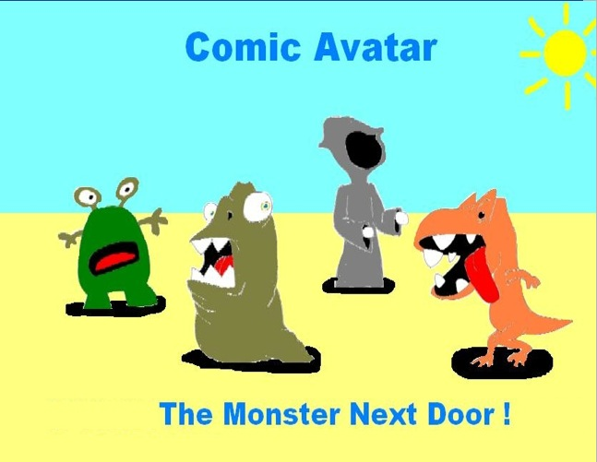
Demo Time
C:\Users\nikita\Desktop\nikita_part1.wmv

Slide 5
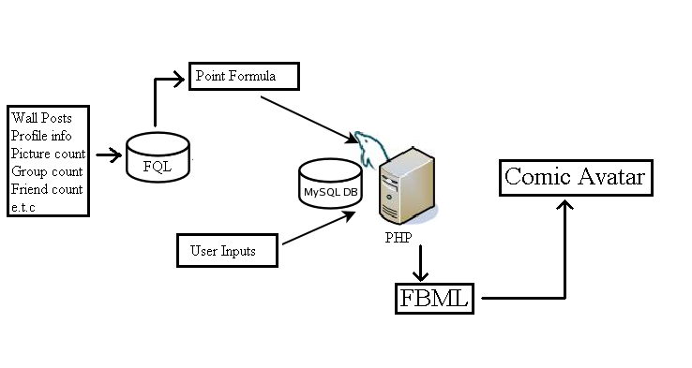
Implementation

Slide 6
User Study (1/3)‏
Methods Used
  Semi-Interview
    Ask users simple questions
    Note down their answers
  Likert Scale
    _x0002__x0002_Tell users about various aspects of application
    Ask them rate effectiveness on a scal_x0013_e of 1 to 5_x0013_
  _x0013__x0013__x0013__x0013__x0013__x0013_

Slide 7
User Study (2_x0013_/3)_x0003_
Activities Observed and Questions Asked
  Avatar Creation
  Understanding Statistic Screen
  Understanding how_x0013_ statistics are updated
  Visiting Interactive system_x0013_
  Leveling up_x0013_

Slide 8
_x0016_
User Study (3/3)‏
What we learnt
  Introduction Page was colorful but color scheme was basic
  Understanding statistics page was simple but it was not appealing
  For visiting, user should be given option of making it random or controlled
  _x0013_Avatars should be based on people as well as cartoons, not just the latter
  Application lacked animation

Slide 9
Future Changes
Have Avatars visit people who don’t have app installed.
  Creates a hype -> More installs
  Mini Feeds -> showing updates
Have mini-status bar in profile box.
  Shows off status to others.
  Avoids going to the backend

Slide 10
Future Changes (Cont.)‏
Have Avatar moods
  Reflects mood of the day.
  More personal
Have Avatars animated
  Have Avatars Dance & Play
  When visiting, Avatars Kiss

Slide 11
Questions?

