Slide 1
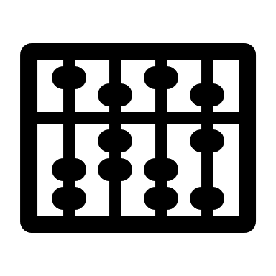


ggoncoplot
ggoncoplot
Generate Interactive Oncoplots

