Slide 1
CUDA Tutorial Matrix-Matrix Multiply
Ryan Bergmann
2/4/2014

Slide 2
CUDA and GPUs in a Nutshell
Shared memory machine with large SIMD lanes
SIMD execution abstracted by threads and thread blocks
Coalesced reads/writes necessary for full performance
Has a user-programmable cache that can help with data reuse (you’ll see later)
CUDA adds minimal extensions to C/C++ (and Fortran)

Slide 3
Shared Memory, as a Paradigm
Threads share the same memory space
Problems in this kitchen with many cooks?
Collisions
Fighting for resources
Data races

Slide 4
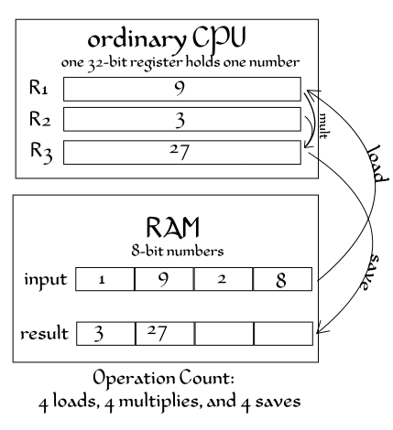
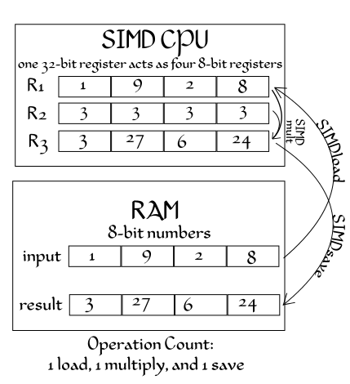
SIMD
Single Instruction Multiple Data
Amortize control overhead over SIMD width

Slide 5
SIMD
Hex-core CPU
6 cores, 2 issue, 4-way SIMD
448 ‘CUDA cores’
14 cores, 2 issue, 16-way SIMD
GPUs get a LOT of their power from SIMD
Must use it for good performance… or at least try to use it as much as possible

Slide 6
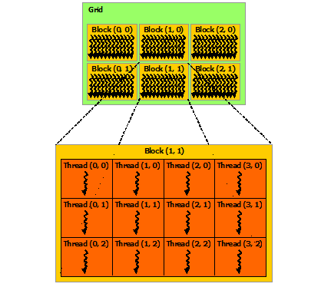
Threads, Blocks, and Grids
blah

Slide 7
Coalesced Reads/Writes

Slide 8
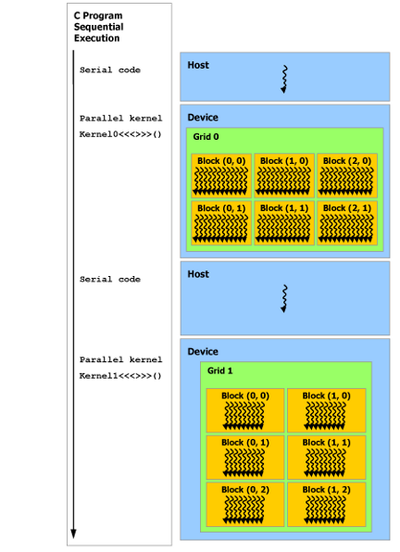
Host Thread
blah

Slide 9
Launching a Kernel From the Host
kernel <<< grid_dimensions , block_dimensions >>> (arguments);
kernel = the name of the kernel
grid_dimensions = dim3(x,y,z) number of blocks in the (x,y,z) dimensions
block_dimensions = dim3(x,y,z) number of threads in the (x,y,z) dimensions within a block
arguments = input values, pointers to arrays, etc.

Slide 10
A Kernel
Predefined local values
Used for thread identification and indexing
__global__
GPU kernel to be launched from the host
__device__
GPU function to be used within a kernel
__device__ float d_add(float a, float b){
return a+b;
}
__global__ void kernel( unsigned len, float* a){
// get index
int row = blockIdx.y * blockDim.y + threadIdx.y;
int col = blockIdx.x * blockDim.x + threadIdx.x;
//return if over the length
if(row>=len | col>=len){return;}
// do something…
a[row*len + col] = d_add(1,2);
}

Slide 11
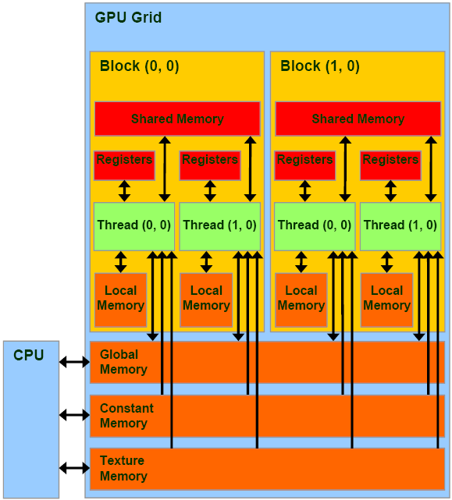
Shared Memory, as in CUDA
Programmable cache
Visible to threads in a block
Small, 16-48K
Fast
Low latency

Slide 12
Now let’s try it!

