Slide 1
CUDA Tutorial Matrix-Matrix Multiply
Ryan Bergmann
Feb. 5, 2014

Slide 2
CUDA and GPUs in a Nutshell
Compute Unified Device Architecture
Shared memory machine with large SIMD lanes
SIMD execution abstracted by threads and thread blocks
Coalesced reads/writes necessary for full performance
Has a user-programmable cache that can help with data reuse (you’ll see later)
CUDA adds minimal extensions to C/C++ (and Fortran)

Slide 3
Shared Memory, as a Paradigm
Threads share the same memory space
Problems in this kitchen with many cooks?
Fighting for finite resources
32-64 32bit registers per SM limits active threads/blocks
Collisions
Data is read by multiple threads but isn’t broadcast to all threads
Data races
Multiple threads reading and writing to the same address
Incrementing an event count, for example

Slide 4
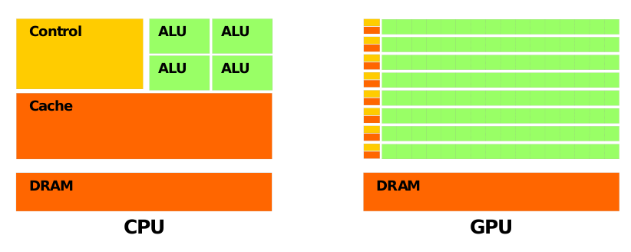
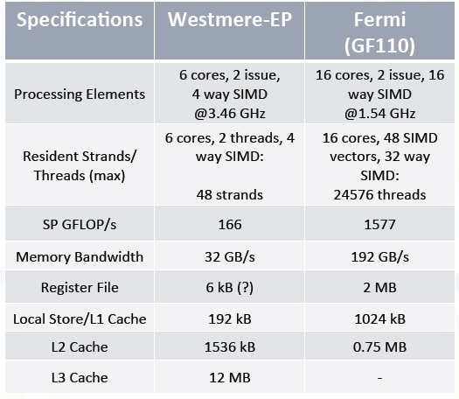
GPU Transistor Space and Specs
B. Catanzaro, CS267, Spring 2011 slides
Large aggregate bandwidth
Lots of arithmetic units
But! FLOPs/Byte = 8.2, which is higher than 5.2 for a CPU
Good for turning a compute-bound problem into a memory-bound one
CUDA C Programming Guide, NVIDIA Co.

Slide 5
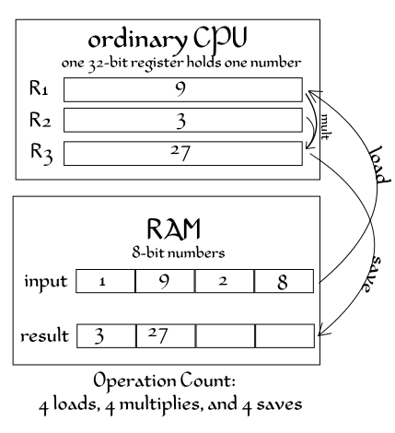
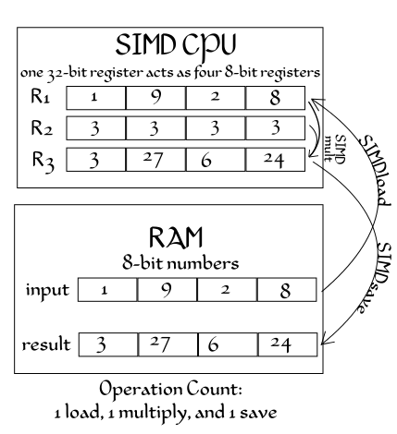
SIMD
Both from Wikimedia Commons
Single Instruction Multiple Data
Amortize control overhead over SIMD width
Kitchen – one cook opens fridge, 4 cooks get different things out to cut up

Slide 6
SIMD
Hex-core CPU
6 cores, 2 issue, 4-way SIMD, 3.46GHz
448 ‘CUDA cores’
14 cores, 2 issue, 16-way SIMD, 1.54GHz
GPUs get a LOT of their power from SIMD
Must use it for good performance… or at least try to use it as much as possible

Slide 7
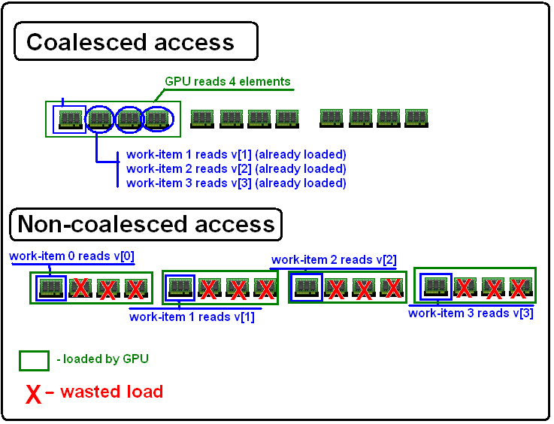
Coalesced Reads/Writes
http://www.cmsoft.com.br/tutorialOpenCL/OptimizIcoalescDiagram.png
Memory subsystems are SIMD-like as well
Must coalesce in order to use full memory bandwidth

Slide 8
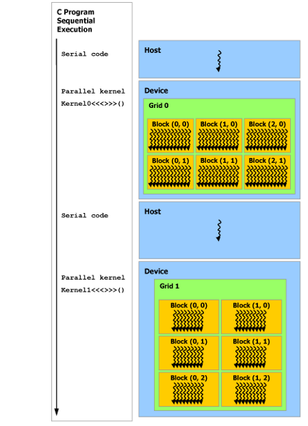
Host Thread
Host computer must launch GPU kernel
Kernel is a serial program performed by all threads
Data must be copied from host to card
“Zero-copy” memory now available, hides copy commands
Once the kernel completes, control is returned to the host
Asynchronous calls possible
New hardware can launch kernels from kernels
Host must still initialize launches
CUDA C Programming Guide, NVIDIA Co.

Slide 9
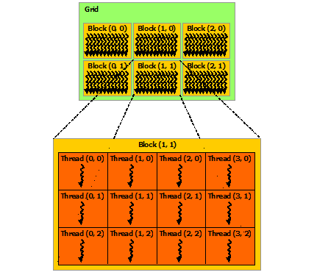
Threads, Blocks, and Grids
Many, many threads
Execute same serial code
Organized in blocks
Threads in a block cooperate
Blocks make up the grid
Each thread and block have a unique ID
Blocks execute in an arbitrary order
CUDA C Programming Guide, NVIDIA Co.

Slide 10
Launching a Kernel From the Host
kernel <<< grid_dimensions , block_dimensions >>> (arguments);
kernel = the name of the kernel
grid_dimensions = dim3(x,y,z) number of blocks in the (x,y,z) dimensions
block_dimensions = dim3(x,y,z) number of threads in the (x,y,z) dimensions within a block
arguments = input values, pointers to arrays, etc.

Slide 11
A Kernel
Predefined local values
Used for thread identification and indexing
__global__
GPU kernel to be launched from the host
__device__
GPU function to be used within a kernel
__device__ float d_add(float a, float b){
return a+b;
}
__global__ void kernel( unsigned len, float* a){
// get thread index
int row = blockIdx.y * blockDim.y + threadIdx.y;
int col = blockIdx.x * blockDim.x + threadIdx.x;
//return if over the length
if(row>=len | col>=len){return;}
// do something…
a[row*len + col] = d_add(1,2);
}

Slide 12
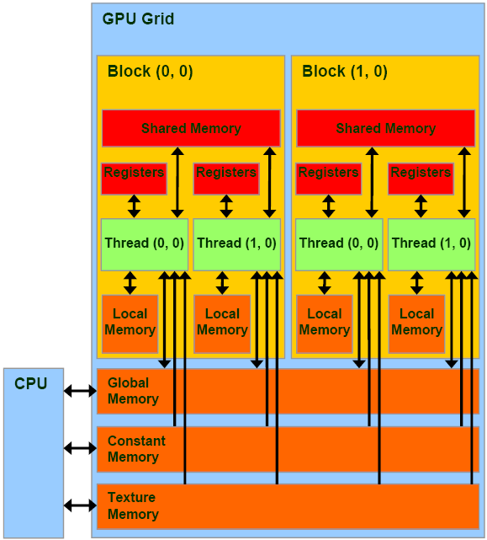
Shared Memory, as in CUDA
On-chip programmable cache
Visible to threads in a block
Small, 16-48kB
High bandwidth
Low latency
CUDA C Programming Guide, NVIDIA Co.

Slide 13
Let’s Try It Out!
Matrix-Matrix Multiply
For each output element
2N global loads
N multiplies, N-1 additions (cheap)
1 write
Memory bandwidth bound most likely
Very sensitive to memory access

