Slide 1
Georgia Access Enrollment Dashboard
PY2026 Historical Database View + PY2027 Current OE View
Operational enrollment reporting with current OE indicators, historical status views, monthly activity, and focused trend exploration.
Dashboard review • November 2026

Slide 2
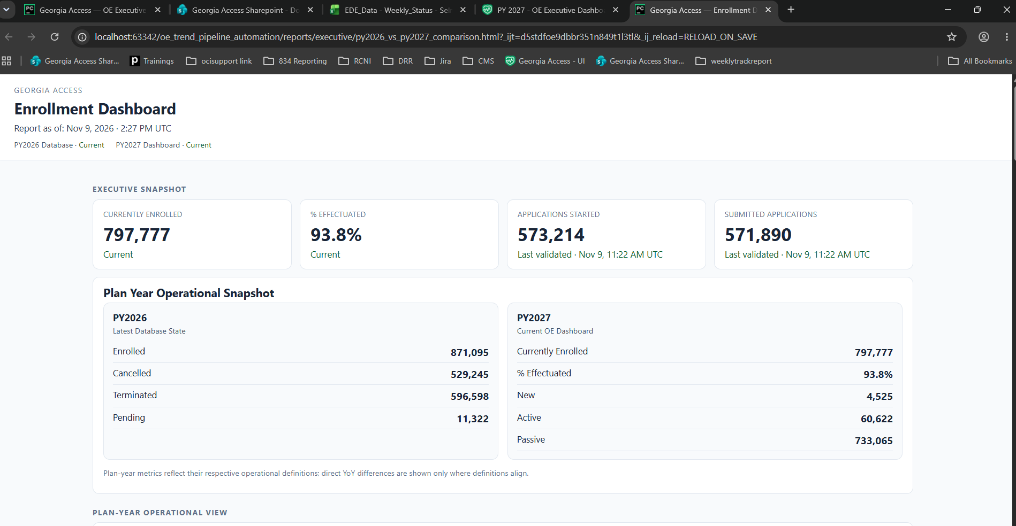
OPERATIONAL OVERVIEW
Executive Snapshot
Current OE KPIs and the latest PY2026 database state are consolidated into one operational snapshot.
Georgia Access | Enrollment Dashboard • 2

Slide 3
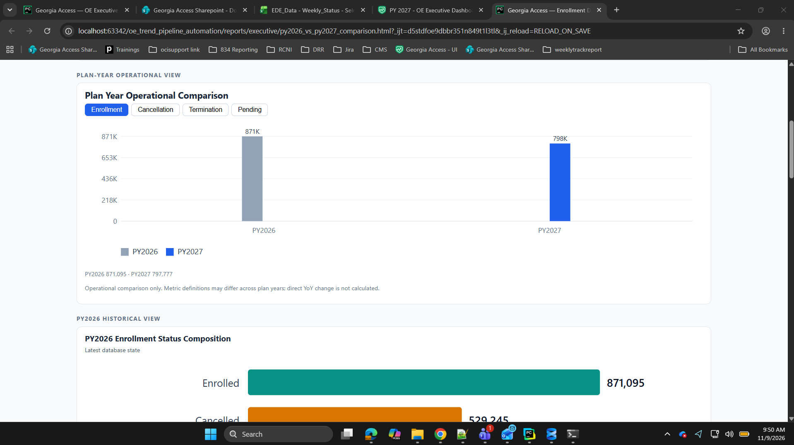
INTERACTIVE COMPARISON
Plan-Year Operational Comparison
Buttons switch among Enrollment, Cancellation, Termination, and Pending; unavailable counterparts remain blank rather than being treated as zero.
Georgia Access | Enrollment Dashboard • 3

Slide 4
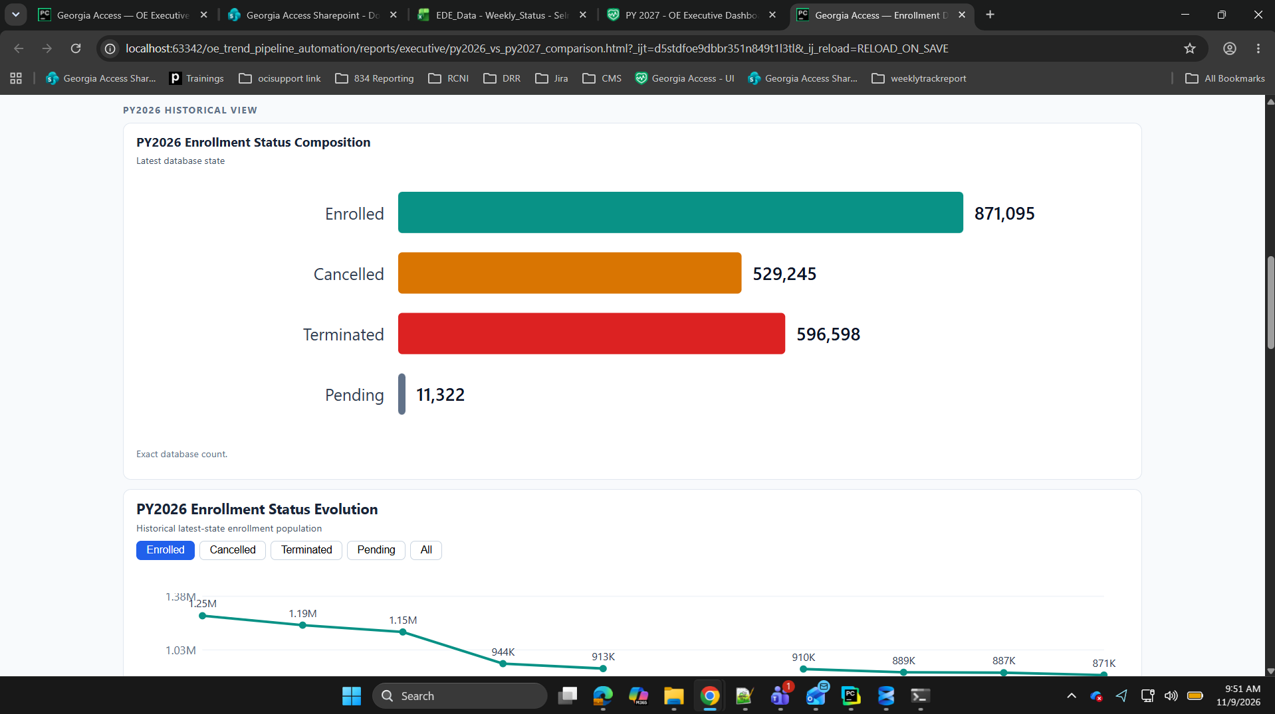
PY2026 HISTORICAL VIEW
Enrollment Status Composition
Exact latest-state database counts summarize PY2026 Enrolled, Cancelled, Terminated, and Pending populations.
Georgia Access | Enrollment Dashboard • 4

Slide 5
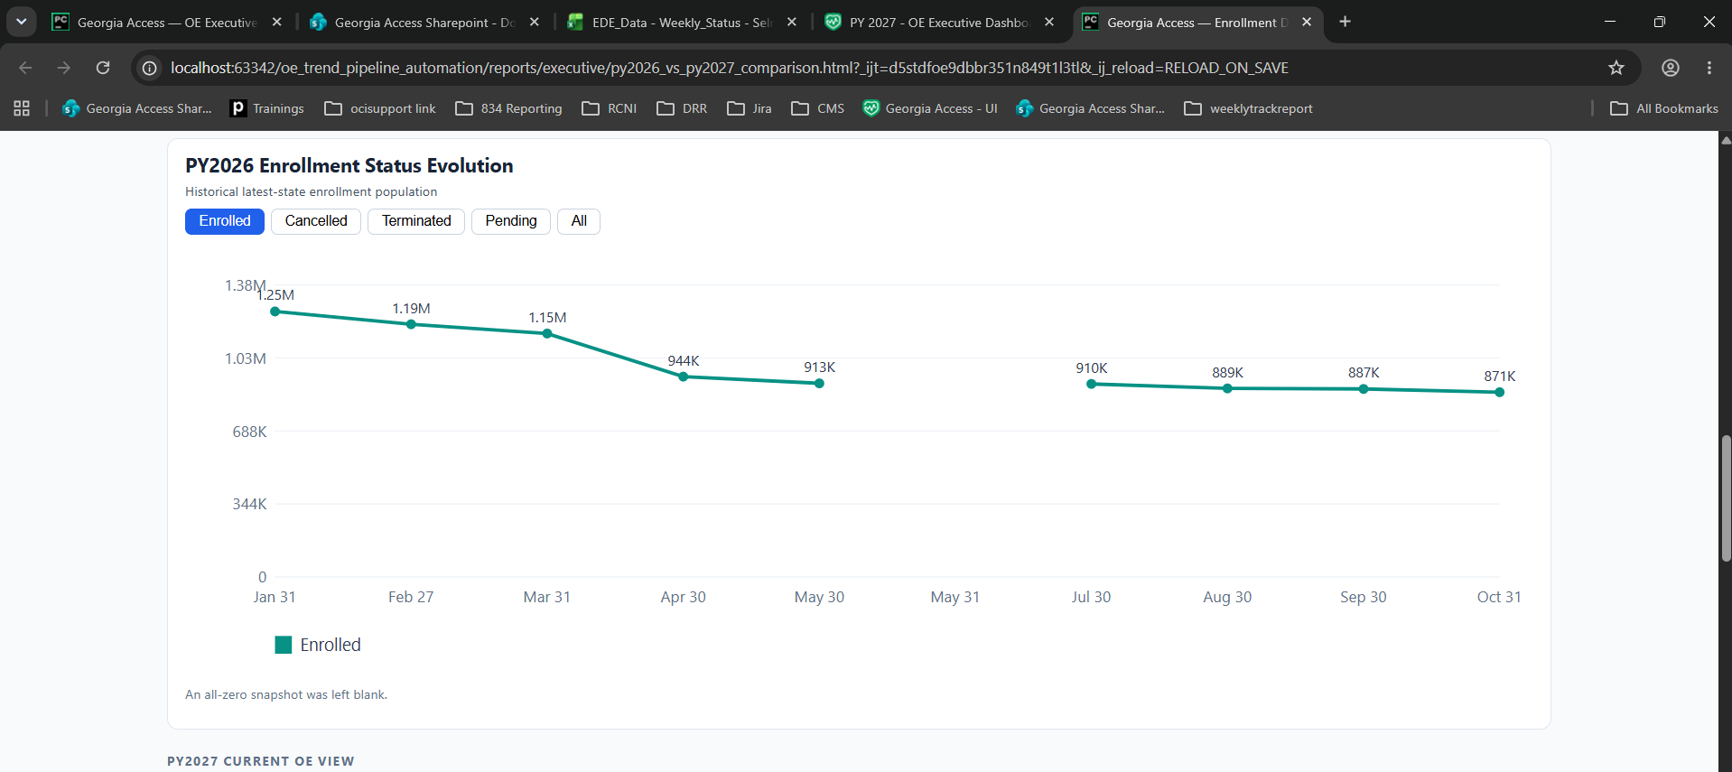
PY2026 HISTORICAL VIEW
Enrollment Status Evolution
Status buttons isolate historical latest-state movement; the all-zero snapshot is intentionally left blank.
Georgia Access | Enrollment Dashboard • 5

Slide 6
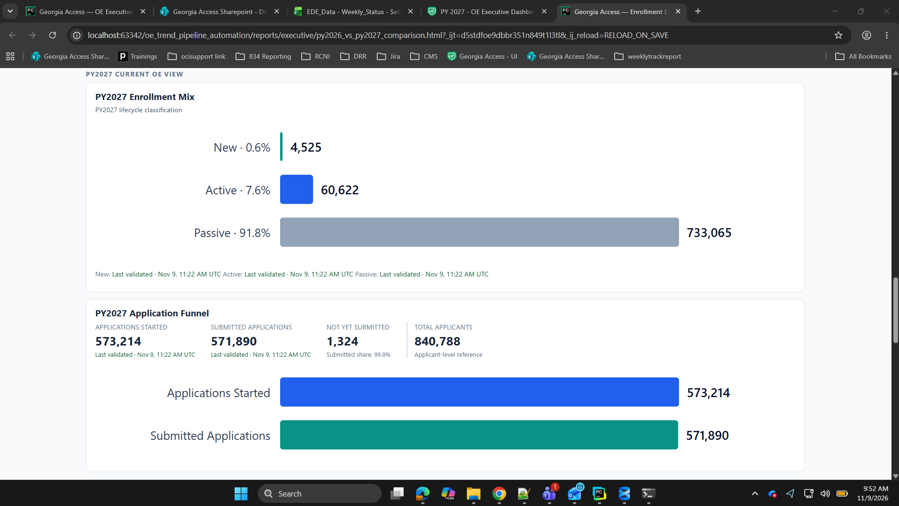
PY2027 CURRENT OE VIEW
Enrollment Mix & Application Funnel
Lifecycle classification and application-funnel measures provide complementary views of current PY2027 activity.
Georgia Access | Enrollment Dashboard • 6

Slide 7
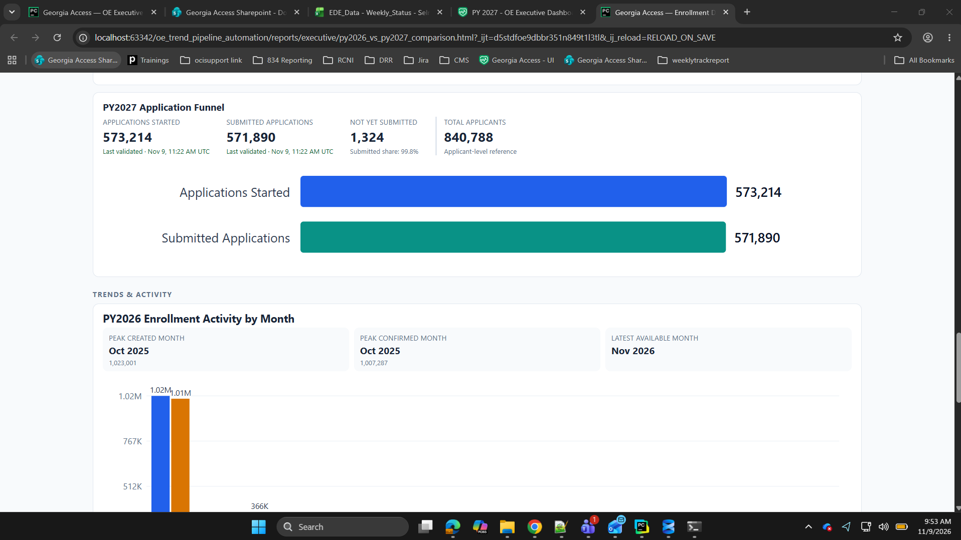
PY2027 APPLICATION VIEW
Application Funnel Detail
Started and Submitted Applications are shown together with Not Yet Submitted and Total Applicants for a concise funnel view.
Georgia Access | Enrollment Dashboard • 7

Slide 8
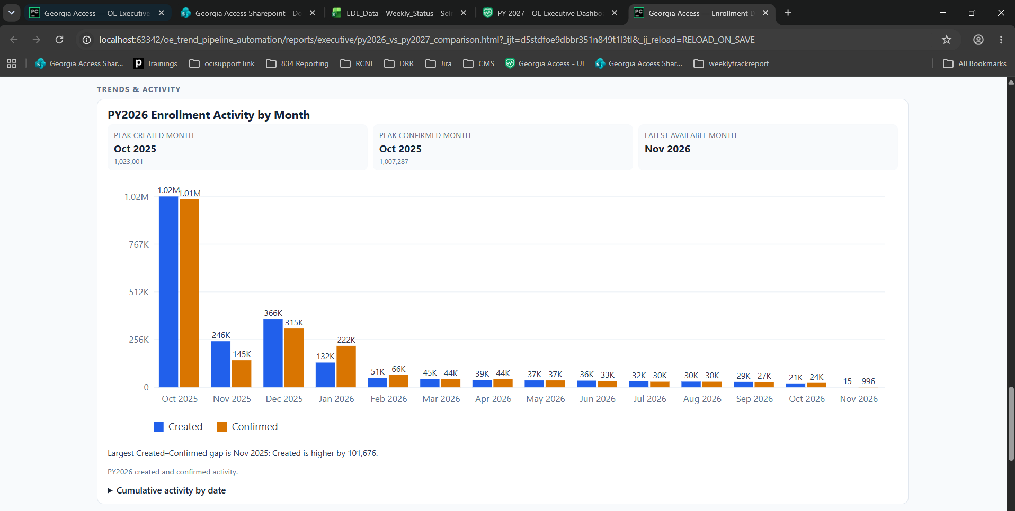
TRENDS & ACTIVITY
PY2026 Enrollment Activity by Month
Created and Confirmed activity is compared month by month, with peak periods and the latest available month highlighted.
Georgia Access | Enrollment Dashboard • 8

Slide 9
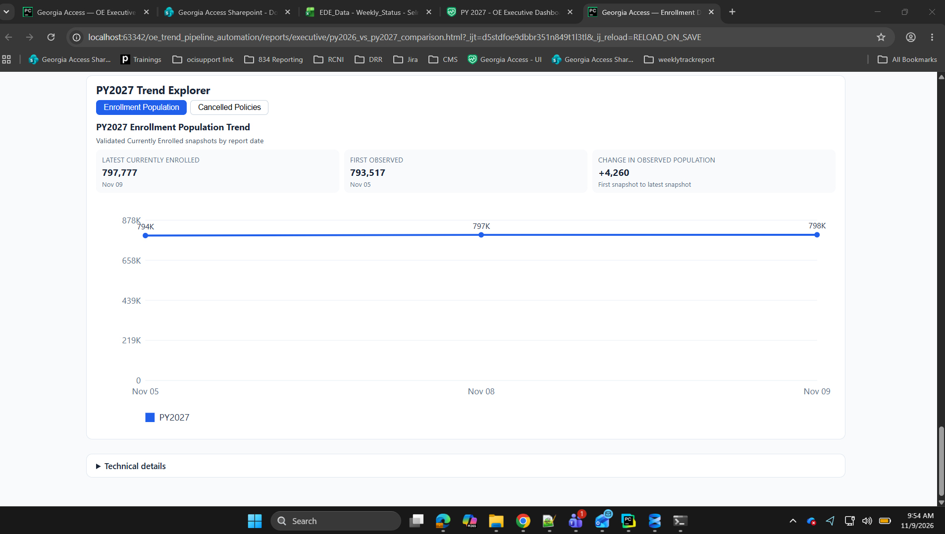
PY2027 TREND EXPLORER
Enrollment Population Trend
Validated Currently Enrolled snapshots show the observed population change by report date; this is a population trend, not event activity.
Georgia Access | Enrollment Dashboard • 9

Slide 10
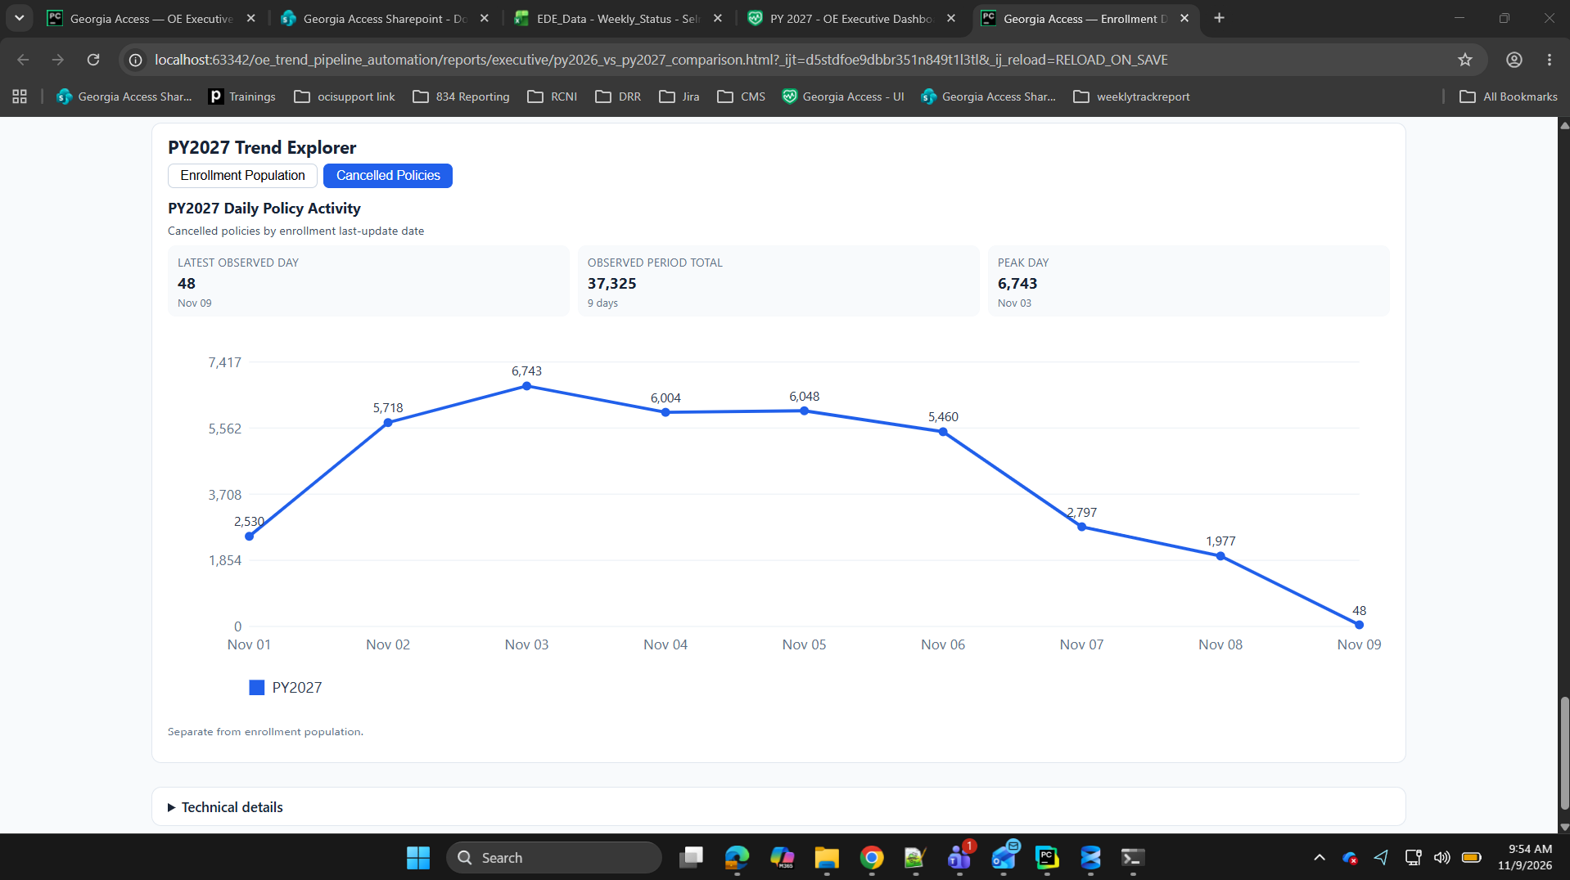
PY2027 TREND EXPLORER
Daily Cancelled Policy Activity
Cancelled-policy activity is tracked separately by enrollment last-update date, with the observed total and peak day highlighted.
Georgia Access | Enrollment Dashboard • 10

Slide 11
Dashboard Summary
1
PY2026 historical database views and PY2027 current OE indicators are organized in one report.
2
Interactive controls simplify navigation while keeping distinct metric families separate.
3
Current and last-validated states make data freshness visible.
4
Historical status, monthly activity, population snapshots, and daily policy activity provide complementary operational context.

