Slide 1
Tesca
Non tactile switch
23-01-2026
Notes:
This cover is optional color choice based on your needs.
White cover is for print-friendly.
Light sand could be considered as digital use and client facing material.

Slide 2
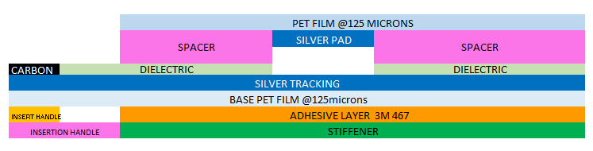
Stack up - non tactile
Increasing the spacer thickness and/or reducing the spacer aperture size increases the force
Notes:
This slide is best usage of charts or product with title explaining the rich content. Please note the title and rich content area could be reduced or enlarged.

Slide 3
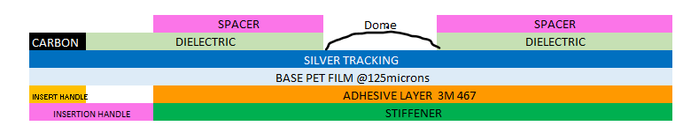
Stack up tactile

Slide 4
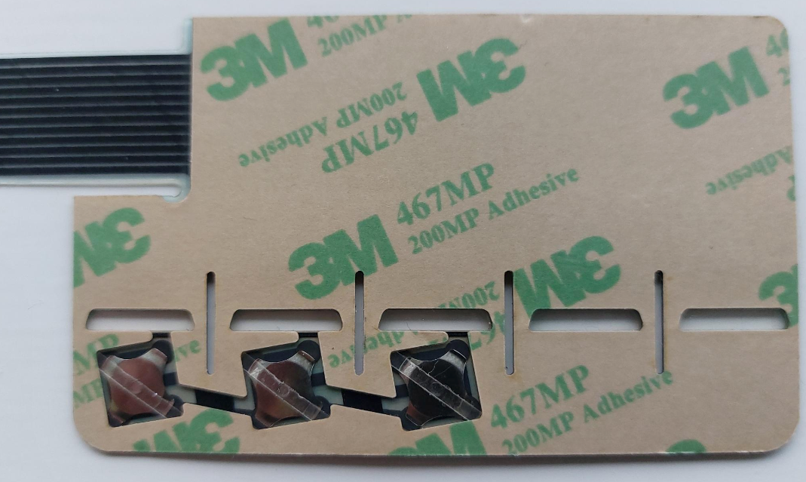
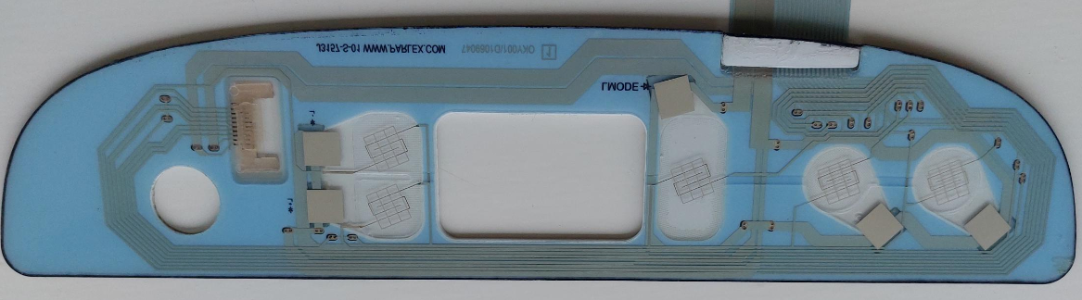
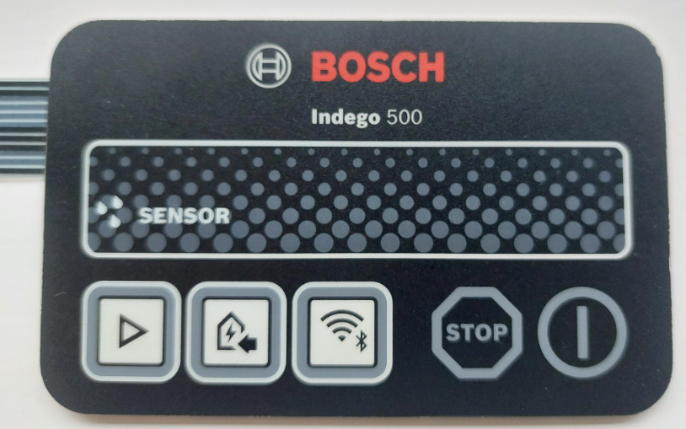
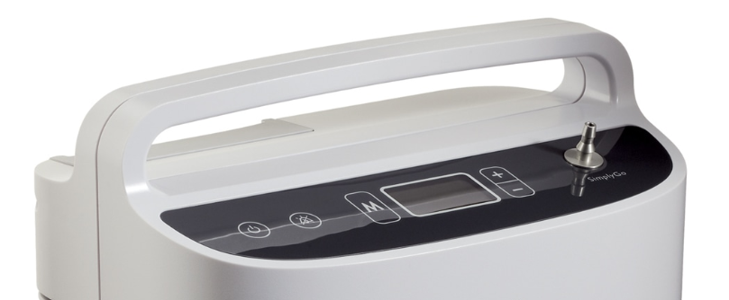
Typical product photo
Non tactile
Tactile
Notes:
This slide is best usage of charts or product with title explaining the rich content. Please note the title and rich content area could be reduced or enlarged.

Slide 5
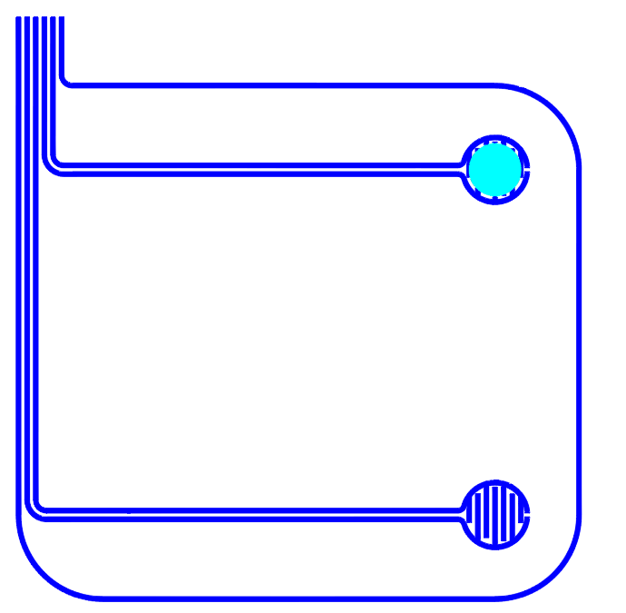
2 switch layout
Silver ink resistivity is 40mohms per square at 25 microns thick
Notes:
This slide is best usage of charts or product with title explaining the rich content. Please note the title and rich content area could be reduced or enlarged.

Slide 6
Thank You
Notes:
The text box in the slide could be reviewed or serve as thank you page in the end. This is optional color choice.

