Slide 1
Foundations of the Semantic Web:
Ontology Engineering
Building Ontologies 1
Alan Rector & colleagues

Slide 2
Goals for this module: for you
Be able to implement an ontology representation in OWL-DL
  Be able to elicit a conceptualisation
  Be able to formulate an ontology representation
  Be able to implement the ontology representation in OWL-DL
    Or be able to say you can’t
    To understand the limits of OWL-DL ontologies
  Be able to test the resulting ontology implementation
  Be ready to apply ontology representations in any of several use cases
    In one week, we can’t build the applications…
    …but to build an ontology is only a means to building applications
      Without applications ontologies are pointless

Slide 3
Goals for this Module: For us
Still experimental – we need your feedback
  Feedback
    On tools – we treat this as a User Centred Design experiment
      Please be patient
        The good news is they are getting better
    On the course
      Did the content work for you?
      What other content would you like?
      Balance of labs and lecture
      Content of labs
    For the Semantic Web Best Practice Working Group
  New ideas

Slide 4
Mechanics - reminder
Assessment
  25% lab
  25% Mini project
  50% Exam
All labs to be handed in by number electronically – see lab handout
Deadline – 2 weeks after end of course

Slide 5
Ontologies and Ontology Representations
“Ontology” – a word borrowed from philosophy
  But we are necessarily building logical systems
    “Physical symbol systems”
      Simon, H. A. (1969, 1981). The Sciences of the Artificial, MIT Press
“Concepts” and “Ontologies”/ “conceptualisations” in their
original sense are psychosocial phenomena
  We don’t really understand them
“Concept representations” and “Ontology representations” are
engineering artefacts
  At best approximations of our real concepts and conceptualisations (ontologies)
    And we don’t even quite understand what we are approximating

Slide 6
Ontologies and Ontology Representations (cont)
Most of the time we will just say “concept” and “ontology” but whenever anybody starts getting religious, remember…
  It is only a representation!
    We are doing engineering, not philosophy – although philosophy is an important guide
There is no one way!
  But there are consequences to different ways
    and there are wrong ways
      and better or worse ways for a given purposes
  The test of an engineering artefact is whether it is fit for purpose
    Ontology representations are engineering artefacts

Slide 7
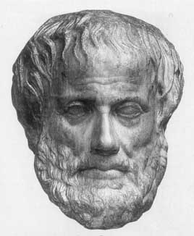
What Is An Ontology?
Ontology (Socrates & Aristotle 400-360 BC)
The study of being
Word borrowed by computing for the
explicit description of the conceptualisation of a domain:
  concepts
  properties and attributes of concepts
  constraints on properties and attributes
  Individuals (often, but not always)
An ontology defines
  a common vocabulary
  a shared understanding

Slide 8
Measure the world…quantitative models
(not ontologies)
Quantitative
  Numerical data:
    2mm, 2.4V, between 4 and 5 feet
  Unambiguous tokens
  Main problem is accuracy at initial capture
  Numerical analysis (e.g. statistics) well understood
Examples:
  How big is this breast lump?
  What is the average age of patients with cancer ?
  How much time elapsed between original referral and first appointment at the hospital ?
KIPKE
GRAPHICS
2001
BOB
2000
KIPKE
GRAPHICS
BOB
KIPKE
GRAPHICS
BOB
KIPKE
2000
2001
BOB
GRAPHICS

Slide 9
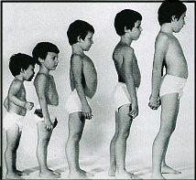
describe the our understanding of the world - ontologies
Qualitative
  Descriptive data
    Cold, colder, blueish, not pink, drunk
  Ambiguous tokens
    What’s wrong with being drunk ?
      Ask a glass of water.
  Accuracy poorly defined
  Automated analysis or aggregation is a new science
Examples
  Which animals are dangerous ?
  What is their coat like?
  What do animals eat ?
KIPKE
BOB
GRAPHICS
KIPKE
GRAPHICS
2001
2000
BOB

Slide 10
Light and Heavy expressivity
A matter of rigour and representational expressivity
Lightweight
  Concepts, atomic types
  Is-a hierarchy
  Relationships between concepts
Heavyweight
  Metaclasses
  Type constraints on relations
  Cardinality constraints
  Taxonomy of relations
  Reified statements
  Axioms
  Semantic entailments
  Expressiveness
  Inference systems

Slide 11
So what is an ontology?
[Deborah McGuinness, Stanford]
General
Logical
constraints
Formal
Is-a
Frames
(properties)
Thesauri
Catalog/
ID
Disjointness,
Inverse, partof
Informal
Is-a
Formal
instance
Terms/
glossary
Value
restrictions
Arom
Gene Ontology
EcoCyc
TAMBIS
Mouse Anatomy
PharmGKB

Slide 12
A semantic continuum
[Mike Uschold, Boeing Corp]
Pump: “a device for moving a gas or liquid from one place or container to another”
(pump has
(superclasses (…))
Shared human consensus
Semantics hardwired;
used at runtime
Semantics processed and used at runtime
Text descriptions
Implicit
Informal
(explicit)
Formal
(for humans)
Formal
(for machines)
Further to the right means:
Less ambiguity
More likely to have correct functionality
Better inter-operation
Less hardwiring
More robust to change
More difficult

Slide 13
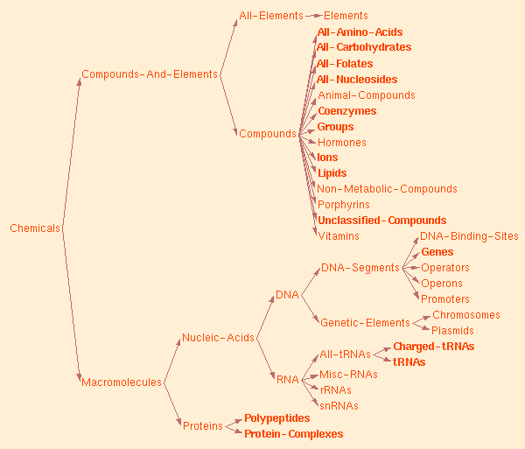
EcoCyc
Notes:
Most are thesauri rather than ontologies!

Slide 14
A simple ontology: Animals
Body Part
Living Thing
eats
has part
Plant
Arm
Animal
eats
Leg
eats
Grass
Herbivore
Person
Tree
Carnivore
Cow

Slide 15
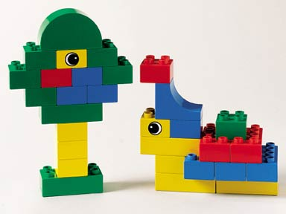
Logic-based Ontologies:
Conceptual Lego: A BioInformatics View
“SNPolymorphism of CFTRGene causing Defect in MembraneTransport of ChlorideIon causing Increase in Viscosity of Mucus in CysticFibrosis…”
“Hand which is
anatomically
normal”

Slide 16
Bridging Scales and context with Ontologies
Species
Genes
Protein
Function
Gene in Species
Disease
Protein coded by
gene in species
Function of
Protein coded by
gene in species
Disease caused by abnormality in
Function of
Protein coded by
gene in species

Slide 17
Logic Based Ontologies: A crash course
Primitives
Descriptions
Definitions
Reasoning
Validating
Thing
Feature
Structure
Thing
+ feature: pathological
pathological
red
Heart
MitralValve
MitralValve
* ALWAYS partOf: Heart
Encrustation
Encrustation
* ALWAYS feature: pathological
Structure
+ feature: pathological
+ involves: Heart
red
+ partOf: Heart
red
+ partOf: Heart
Encrustation
+ involves: MitralValve
+ (feature: pathological)

Slide 18
Why Develop an Ontology?
To share common understanding of the structure of descriptive information
  among people
  among software agents
  between people and software
To enable reuse of domain knowledge
  to avoid “re-inventing the wheel”
  to introduce standards to allow interoperability

Slide 19
Why build an ontology
Interworking and information sharing
  Providing a well organised controlled vocabulary
Indexing complex information
  “Knowledge is fractal”
    Ontologies are fractal
      Self similar structure at every level of granularity (detail)
Combat combinatorial explosions
  The exploding bicycle
    “Conceptual Lego”
      A “dictionary and grammar” instead of a “phrasebook”

Slide 20
Ontology Examples
Taxonomies on the Web
  Yahoo! categories
Catalogs for on-line shopping
  Amazon.com product catalog
Dublin Core and other standards for the Web
Domain independent examples
  Ontoclean
  Sumo

Slide 21
Upper Ontologies
Ontology Schemas
  High level abstractions to constrain construction
    e.g. There are “Objects” & “Processes”
  Highly controversial
    Sumo, Dolce, Onions, GALEN, SBU,…
  Needed when you work with many people together
  NOT in this tutorial – a different tutorial

Slide 22
Domain Ontologies
Concepts specific to a field
  Diseases, animals, food, art work, languages, …
  The place to start
    Understand ontologies from the bottom up
      Or middle out
Levels
  Top domain ontologies – the starting points for the field
    Living Things, Geographic Region, Geographic_feature
  Domain ontologies – the concepts in the field
    Cat, Country, Mountain
  Instances – the things in the world
    Felix the cat, Japan, Mt Fuji

Slide 23
An Ontology should be just the Beginning
Databases
Ontologies
Declare
structure
Knowledge
bases
The “Semantic
Web”
Provide
domain
description
Software agents
Problem-solving methods
Domain-independent
applications

Slide 24
Ontology Technology
“Ontology” covers a range of things
  Controlled vocabularies – e.g. MeSH
    Linguistic structures – e.g. WordNet
  Hierarchies (with bells and whistles) – e.g. Gene Ontology
  Frame representations – e.g. FMA
  Description logic formalisms – Snomed-CT, GALEN, OWL-DL based ontologies
  Philosophically inspired e.g. Ontoclean and SUMO

Slide 25
OWL
The Web Ontology Language
W3C standard
Collision of DAML (frames) and Oil (DLs in Frame clothing)
Three ‘flavours’
  OWL-Lite –simple but limited
  OWL-DL – complex but deliverable (real soon now)
  OWL-Full – fully expressive but serious logical/computational problems
    Russel Paradox etc etc
  All layered (awkwardly) on RDF Schema
Still work in progress – see Semantic Web Best Practices & Deployment Working Group (SWBP)

Slide 26
Description Logics
What the logicians made of Frames
  Greater expressivity and semantic precision
    Compositional definitions
      “Conceptual Lego” – define new concepts from old
To allow automatic classification & consistency checking
  The mathematics of classification is tricky
    Some seriously counter-intuitive results
      The basics are simple – devil in the detail

Slide 27
Description Logics
Underneath:
  computationally tractable subsets of first order logic
Describes relations between Concepts/Classes
  Individuals secondary
    DL Ontologies are NOT databases!

Slide 28
Description Logics:
A brief history
Informal Semantic Networks and Frames (pre 1980)
  Wood: What’s in a Link; Brachman What IS-A is and IS-A isn’t.
First Formalisation (1980)
  Bobrow KRL, Brachman: KL-ONE
All useful systems are intractable (1983)
  Brachman & Levesque: A fundamental tradeoff
    Hybrid systems: T-Box and A-Box
All tractable systems are useless (1987-1990)
  Doyle and Patel: Two dogmas of Knowledge Representation

Slide 29
A brief history of KR
‘Maverick’ incomplete/intractable logic systems (1985-90)
  GRAIL, LOOM, Cyc, Apelon, …,
Practical knowledge management systems based on frames
  Protégé
The German School: Description Logics (1988-98)
  Complete decidable algorithms using tableaux methods (1991-1992)
  Detailed catalogue of complexity of family – “alphabet soup of systems”
Optimised systems for practical cases (1996-)
Emergence of the Semantic Web
  Development of DAML (frames), OIL (DLs) → DAML+OIL → OWL
    Development of Protégé-OWL
    A dynamic field – constant new developments & possibilities

Slide 30
And beware
Ontologies are not databases!
Ontologies are (mostly) about the classes –
  Can be used to represent database aspects of schemas
    What must be true of any database consistent with the schema
  The Terminology
    What must be true of any concept consistent with the ontology
  The “T-Box” – for “terminology box”
Limited functionality for individuals (‘instances’)
  Primarily to help define classes
    The class of John’s shirts, The class of cities in Japan
  To describe individuals use
      A database
      Triple representation (RDF or Topic Maps)
      An instance store
    Perhaps with an ontology as the schema
  Open world instead of closed world
    Individuals in ontologies (The “A-Box”) poorly understood and very high computational complexity

Slide 31
Approach
Design patterns
  Analogous to Java design patterns
    Standard ways to do things
      Someday they will be supported by tools, but
      today you have to do it yourself
  Being codified by Semantic Web Best Practice Working Group
Elephant traps
  Common errors & misconceptions
    Especially those that seem to work at first
Foundations of knowledge representation
  200 to 2000 years of experience & mistakes you need not repeat
Common dilemmas & tradeoffs
  Things for which we don’t have a perfect answer

Slide 32
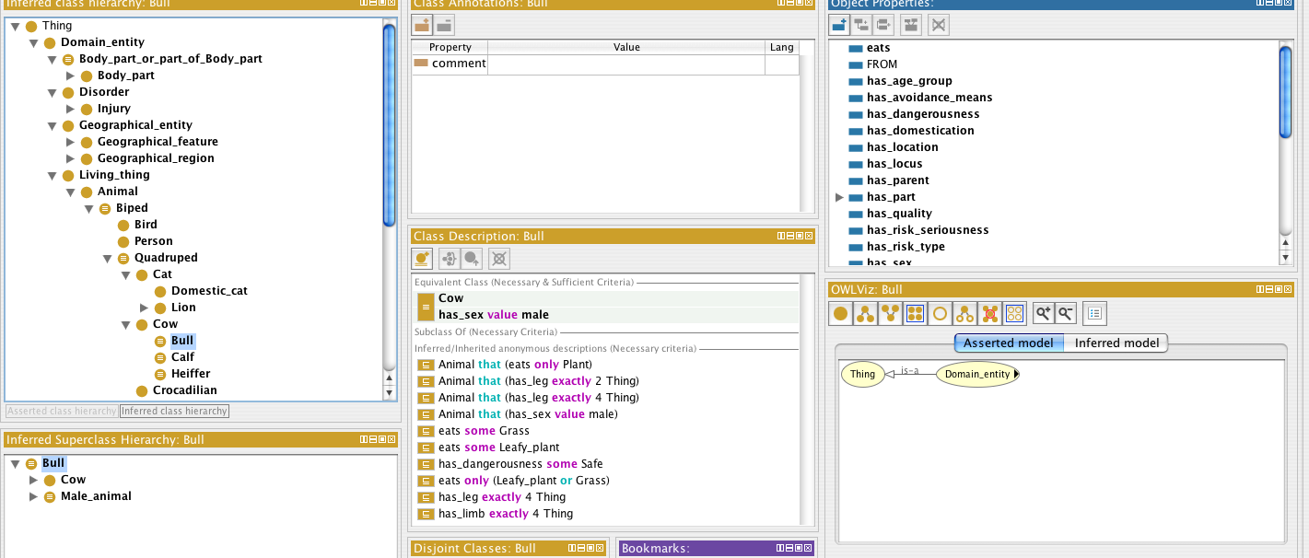
Protégé OWL: New tools for ontologies
Transatlantic collaboration
Implement robust OWL environment within PROTÉGÉ framework
  Version 4-A1pha - complete rewrite
  You will be guinea pigs - and we will have human facts folk seeing what problems you have
  New ideas for debugging, visualisation, ontology management, etc.

Slide 33
Protégé-OWL & CO-ODE
Joint work: Stanford & U Manchester +
Southampton & Epistemics
  Please give us feedback on tools – mailing lists & forums at:
    protege.stanford.edu
    www.co-ode.org
Don’t beat your head against a brick wall!
  Look to see if others have had the same problem; If not…
  ASK!
    We are all learning.

Slide 34
OWL-DL & Classification
Not all of OWL-DL can yet be implemented
  We will deal mostly with what can be classified using Racer or FaCT++
  Not all of the things that are implemented scale successfully
    All classifiers are worst-case exponential (or worse)
FaCT++
  Classifier being developed here
    Dmitry Tsarkov/Ian Horrocks
Pellet
  Classifier from originally MindSwap (U Maryland) www.mindswap.org but now here
    Bijan Parsia
    Best integrated with Protégé at the moment.
We will try to provide warnings of things which cannot be classified or do not scale
  But you may discover new things on your own

Slide 35
Example Ontologies for this Module
Pizzas
  For the mechanics of OWL and Protégé/OWL
    Simple – no ontological problems, just mechanics
Animals for best practice examples and ontology building
  The example for you to work from
    Also for examples of parts and wholes
The University and courses
  Your job is to build an ontology for the University by analogy to the examples
    with some specific help
    Leads on to major ontological issues
Simple Upper Ontology
  To put it together
    Mostly about the University

Slide 36
Building Ontologies
Basic Concepts and Mechanics

Slide 37
Why it’s hard (1)
Clash of intuitions
  Subject Matter Experts motivated by custom & practice
    Prototypes & Generalities
  Logicians motivated by logic & computational tractability
    Definitions and Universals
Transparency & predictability vs
Rigour & Completeness
Neophytes (you?) caught in the muddled middle

Slide 38
Why it’s hard (2)
Conflation of Models
  Meaning: Correctness of Classification & retrieval
  Indexing: Task of discovery, search, or finding
  Use: Task of data entry, decision support, …
  Acquisition: Task of capturing knowledge
Assuring quality & managing change
  Quality assurance: Criteria for whether it is ‘correct’
  Evolution Coping with change
  Regression testing Controlling changes & maintaining
  Quality

Slide 39
Why its hard (3)
Confusion of terminology and usage
  Religious wars over words and assumptions
The intersection of
  Linguistics
  Cognitive science
  Software engineering
  Philosophy
  Human Factors
A jumble of syntaxes

Slide 40
Vocabulary
“Class” ≈ “Concept” ≈ “Category” ≈ “Type”
“Instance” ≈ “Individual”
“Entity” ≈ “object”, Class or individual
“Property” ≈ “Slot” ≈ “Relation” ≈ “Relationtype” ≈
“Attribute” ≈ Semantic link type” ≈ “Role”
  but be careful about “role”
    Means “property” in DL-speak
    Means “role played” in most ontologies
      E.g. “doctor_role”, “student role” …

Slide 41
Syntaxes
Three official syntaxes + Protégé-OWL syntax
  Abstract syntax-- -Specific to OWL
  N3 ---------------- -OWL & RDF
  -used in all SWBP documents
  XML/RDF ------- -very verbose, not for human consumption
  “German DL”---- -very concise, symbolic
  First order logic - - complete but more powerful than DL
  Manchester Syntax---- - Intuitive keywords and infix notation
This tutorial uses simplified abstract syntax
  someValuesFrom → some ∃
  allValuesFrom → only ∀
  intersectionOf → AND ⊓
  unionOf → OR ⊔
  complementOf → NOT ¬
  complete definition necessary & sufficient
  partial description necessary
Protégé/OWL can generate all syntaxes except German

Slide 42
Why its hard (4)
Clash with vocabulary and practice of related software disciplines
Most OO analysis produces a set of templates
  E.g. a Java Class is a template for a Java object
    Nothing is permitted until there is a place for it in the template
OWL is a way of specifying constraints
  The criteria for being a member of a class
    Everything is permitted until ruled out by a constraint

Slide 43
Clash with intuitions of related fields
Object Oriented Programming
  Java,a C++, Smalltalk, etc.
    But OO programming is not knowledge representation
Object Oriented Design (Databases )
  But data models are not ontologies either
    Although UML is often a good starting point
      Additional a-logical issues
        Difference between attributes and relations
        Issues of life cycle and handling of aggregation
        Notion of an instance
        Implicitly “closed world”
Frame based systems, Semantic Nets,… Traditional AI
  Where it all started but real differences
RDF(S), Topic Maps and other node-and-arc symbolisms
  “What’s in a link?”
  The battles in standards committees continue

Slide 44
Summary of Approach
Steps in developing an Ontology (1)
Establish the purpose
  Without purpose, no scope, requirements, evaluation,
Informal/Semiformal knowledge elicitation
  Collect the terms
  Organise terms informally
  Paraphrase and clarify terms to produce informal concept definitions
  Diagram informally
Refine requirements & tests

Slide 45
Summary of Approach
Steps in implementing an Ontology (2)
Implementation
  Develop normalised schema and skeleton
  Implement prototype recording the intention as a paraphrase
    Keep track of what you meant to do so you can compare with what happens
      Implementing logic-based ontologies is programming
  Scale up a bit
    Check performance
  Populate
    Possibly with help of text mining and language technology
Evaluate & quality assure
  Against
  Include tests for evolution and change management
  Design regression tests and “probews”
Monitor use and evolve
  Process not product!

Slide 46
If this were three modules…
Knowledge elicitation and analysis
  A quick overview
Implementation
  A solid introduction
Evolution, ontology alignment, and management
  Left for another module
    But a major motivation for the methods taught in this module
      Normalisation and documentation of intentions

Slide 47
Plan of Labs
Lab 1 – the mechanics of OWL in Protégé Owl
  The pizza example
Lab 2 – Ontology building the life cycle
  A more realistic example
  Start building the University example
    On the pattern of the lecture example of animals
Lab 3
  Problems and tricks of the trade
  DL problems (IH)
Lab 4
  More on patterns and parts and whole
Lab 5
  Upper ontologies and clarification of the mini project

Slide 48
More Reasons
To make domain assumptions explicit
  easier to change domain assumptions (consider a genetics knowledge base)
  easier to understand and update legacy data
To separate domain knowledge from the operational knowledge
  re-use domain and operational knowledge separately (e.g., configuration based on constraints)
To manage the combinatorial explosion

