Slide 1

Making OWL Easier:
Practical Ontology Development in using
Protégé-OWL-CO-ODE Tools
Alan Rector, Hai Wang, Jeremy Rogers
with acknowledgement to
Nick Drummond, Matthew Horridge
Information Management Group / Bio Health Informatics Forum
Department of Computer Science, University of Manchester
and to Holger Knublauch, Mark Musen & Natasha Noy
Stanford Medical Informatics, Stanford University
rector@cs.man.ac.uk
co-ode-admin@cs.man.ac.uk
www.co-ode.org
protege.stanford.org
www.opengalen.org

Slide 2
Purpose of Tutorial
Give a practical introduction to OWL and Description Logic for ontology development
  What it means
  How to do it
  Common pitfalls
Getting started with a practical toolset

Slide 3
What you need
PC – Mac, Windows, or Linux – with
  Protégé 2.1 – http://protege.stanford.edu
    Standard installation or Custom including OwlSupport, OwlBackend, OwlViz, OwlWizards
  GraphViz from http://www.research.att.com/sw/tools/graphviz/
  Racer (and add a short cut someplace handy) from
  http://www.sts.tu-harburg.de/%7Er.f.moeller/racer/download.html
  Example pizza ontologies – we will build them again but…
  http://www.co-ode.org/resources/ontologies/
Long version of tutorial
  A Practical Guide to Building OWL Ontologies with the Protégé-OWL Plugin, Matthew Horridge
Other reference material
  http://www.co-ode.org/resources/tutorials/generalTutorial.html

Slide 4
OWL, Description Logic & Ontologies
Description logics (DLs) –
  The “logician’s” branch of the Frame family
    Descended from KRL and KL-ONE via CLASSIC, LOOM, BACK, … plus oddities such as GRAIL & Apelon
    Underneath: computationally tractable subsets of first order logic
    Aimed at describing relations amongst Concepts/Classes
      Individuals secondary –Ontologies are NOT databases.
  OWL – the Web Ontology Language
    W3C standard
      out of collision of DAML (frames) and Oil (DLs in Frame clothing)
      Three ‘flavours’
        OWL-Lite – Limited expressivity but simple
        OWL-DL – matches what DL researchers believe they can deliver (but have not quite yet) THIS TUTORORIAL IS ABOUT OWL-DL
        OWL-Full – Fully expressive with deep arguments over Russell Paradox and related issues of self-reference
        All layered awkwardly on RDF Schema

Slide 5
Getting Started
Start Protégé
Select OWL Files and click new
From Project menu select Configure
  Select OwlViz from list
Save Project as Pizzas-01-01
  Do frequent Save-As with new numbers or use built in archiving facility.
    There are still occasional glitches
      You want to be able to go back

Slide 6
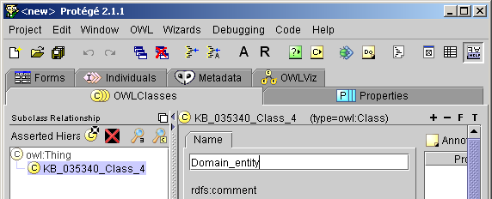
Building a Simple Hierarchy:
Tiny Top Level
Click the C* (new subclass icon) in the classes tab and name the new class Domain_Entity
  If nothing happens, select owl:Thing
  NB: We recommend always creating your own top class.
Select
owl:Thing
Enter
Name
Here
Click here

Slide 7
Create a SubClass of Domain_Entity
Select Domain_Entity
Click on C* again
Name the class Self_Standing_Entity
  We will explain this later – but it is a useful organising principle
    (The name is to avoid too many arguments)

Slide 8
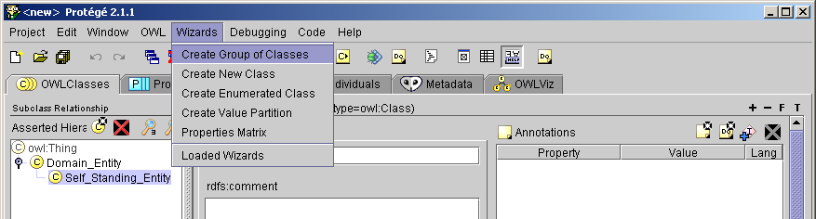
Adding the First set of Domain Classes
Create three subclasses of Self_Standing_Entity:
  Pizza, Pizza_base, Pizza_topping
From Wizards, Select Create Group of Classes

Slide 9
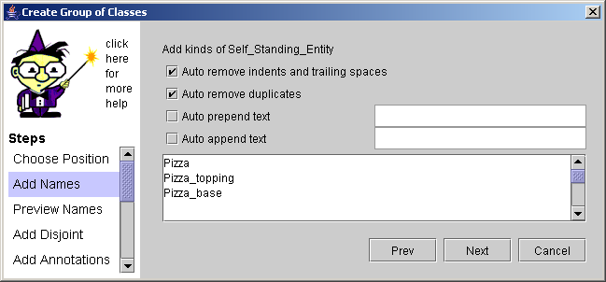
Follow Wizard Through to finish creating concepts with defaults

Slide 10
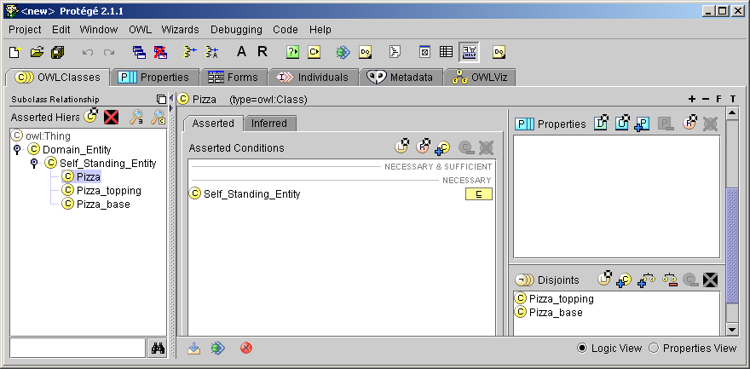
Select one of the new classes, e.g. Pizza
Note that
  Self_Standing_Entity is a necessary parent
  It is disjoint from its ‘siblings’
Disjoint classes
Necessary parent

Slide 11
What it means
All Pizzas are Self_Standing_Entitys
  No Pizza is not a Self_Standing_Entity
Nothing is both
  a Pizza and a Pizza_topping
  a Pizza and a Pizza_base
  a Pizza_topping and a Pizza_base
  NB: In OWL classes can overlap unless declared disjoint!

Slide 12
Represent Some Pizza Toppings
Select Pizza_Topping
From Wizards select Create Group of Classes
In Add Names click Auto_append_text
  Enter _topping
Enter in the main window
  Vegetable
  Meat
  Fish
  Cheese

Slide 13
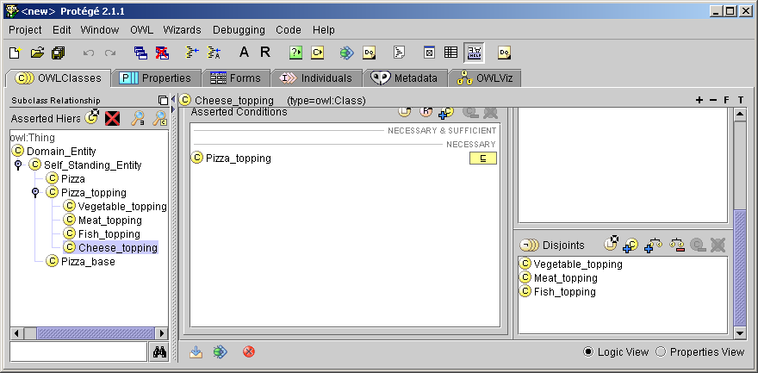
The Screen should look like

Slide 14
What it means
All Vegetable_toppings are Pizza_toppings, etc.
Nothing is both
  a Meat_topping and a Vegetable_topping
  …
Why we added “_topping”
  It is not true that all Meats are Pizza_toppings
    We might expand the ontology, but this is a convenient reminder and placeholder.

Slide 15
Go on to create the specific toppings using the wizard
Vegetable_topping
  Tomato_topping
  Onion_topping
  Hot_pepper_topping
Meat_topping
  Spicy_beef_topping
  Pepperoni_topping
Fish_topping
  Tuna_topping
  Anchovy_topping
Cheese_topping
  Mozzarella_topping
  Parmesan_topping

Slide 16
Using the Classifier to check
It should be the case that nothing can be a Meat_topping and a Vegetable_topping
  Because we declared them to be “disjoint”
  Check it by creating a ‘probe’
    Create a subclass of Vegetable_topping: Meaty_vegetable_topping
    Make it necessarily also a subclass of Meat_topping
    If Racer is not already running, start it
    Click the classify icon
    Look at the result – the probe should be circled in red
C

Slide 17
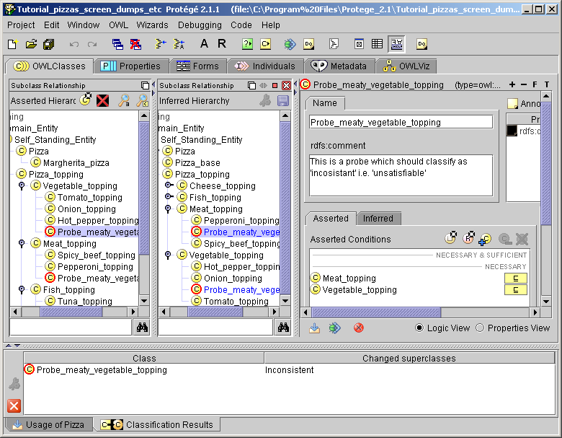
Using Classifier to Check Consistency
Original asserted
hierarchy
Hierarchy inferred by classifier
Red circles indicate
inconsistent /
“unsatisfiable”
Disjoint
superclasses
List of
inferences by
classifier
If pane not visible,
click here

Slide 18
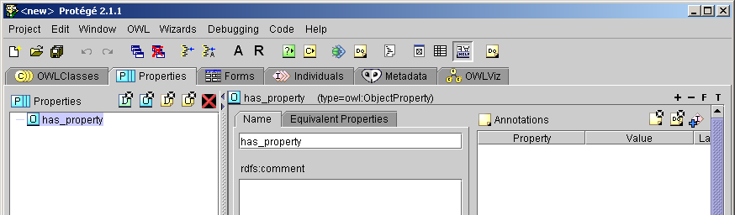
Create properties
Click on properties tab
Click on Create_Object_property icon and create has_part
Create Object property icon

Slide 19
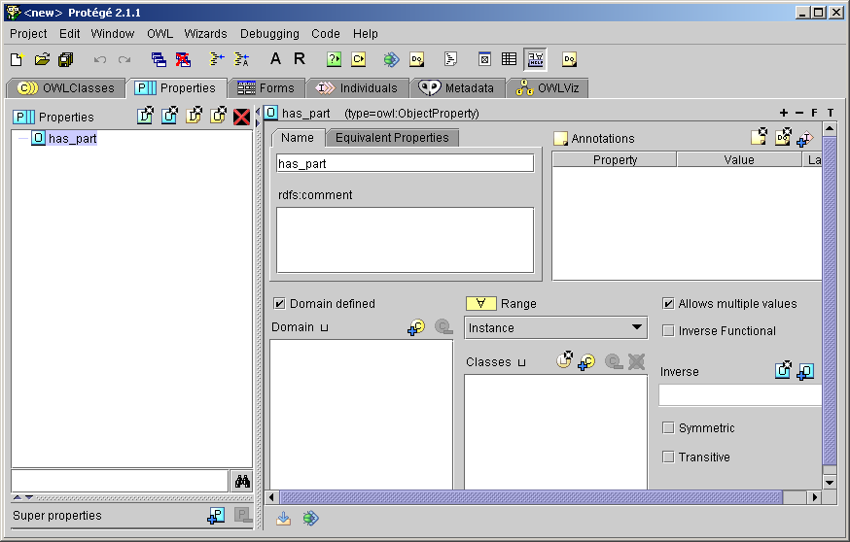
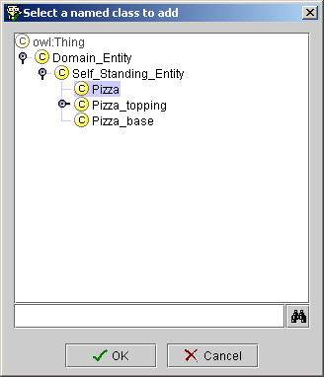
Set the domain to Pizza
Click Domain defined box
Click add classes icon
Select Pizza
₊C
Named class
pop-up
Domain
defined
box
Select Pizza
Add classes
icon

Slide 20
Create sub-properties
Select has_part
  From right-mouse-button menu select
  Create subproperty
  Name it “has_topping”
    Set the range to Pizza_topping
  Select has_part again
  Create a subproperty has_base
    Set the range to Pizza_base
    Unclick Allows multiple values
      Make it ‘functional’

Slide 21
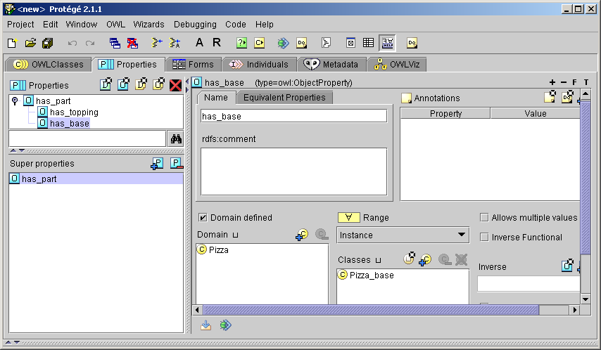
Making subproperties
Allows multiple values
unticked to make property “functional”

Slide 22
What it means
If a pizza has a topping, then that topping is a part of the pizza
If a pizza has a base, then that base is a part of the pizza
A pizza can have at most one base

Slide 23
Say something about pizzas
All pizzas have a base
  (In fact exactly one base, since we have already said that they can have at most one base)
  OWL:
    Class(Pizza partial
    restriction(has_base someValuesFrom Pizza_base)
  To do it go to Classes tab and select Pizza
    In Asserted Conditions select NECESSARY
    Click the Add restriction icon
    In the pop-up select has_base
    In the classes section type Pizza_base or select using the add Class Icon
R
*
C

Slide 24
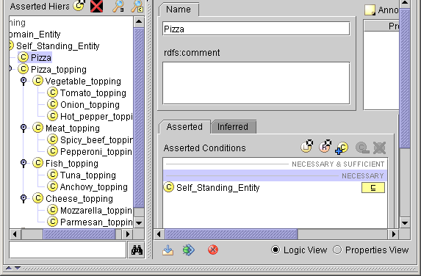
Adding a restriction: 1
Select
Pizza
Select
NECESSARY
Click
Add Restriction

Slide 25
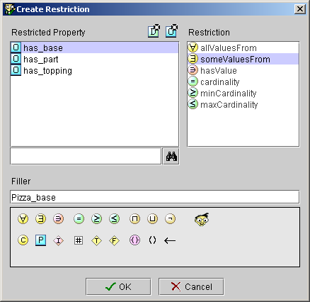
Adding a restriction: 2
someValuesFrom
is the default
(∃ for “existential”)
Select has_base
Enter class
Pizza_base
Or select by clicking icon

Slide 26
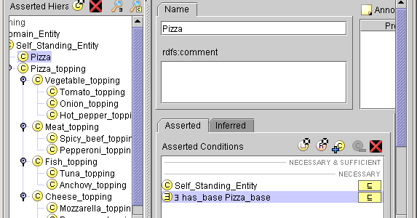
Adding a Restriction: Result
All Pizzas have some Pizza_base
  ∃ means “some”
    an “existential restriction”
  Order is odd inheritance from DLs
    OWL Abstract Syntax:
    restriction(has_base someValuesFrom Pizza_base)
  All is implied –
    all restrictions in OWL are about All individuals of the class

Slide 27
Describing some Pizzas from our Menu
Our pizza menu contains:
  Margherita pizza:
    Tomato & mozzarella
  Spicy beef pizza
    Tomato, mozzarella, and spicy beef
  Protein lover’s pizza
    Pepperoni, Spicy beef, Tuna, and Anchovies
  Hot_special_pizza
    Tomato, hot peppers, spicy beef, and mozzarella

Slide 28
Representing a Margherita Pizza: 1
Select Pizza and create a subclass Margherita_pizza by clicking the Subclass icon.
Select NECESSARY
Click the add restriction icon as before and select someValuesFrom (∃)
has_topping & enter Mozzarella_topping
Do the same for
has_topping Tomato_topping
C
*
R
*

Slide 29
Representing a Margherita Pizza: 2
Alternative method
  In the properties pane on the CLASS tab
    Select has_topping
      If it does not appear, click +P and select it
    From the right mouse menu select
    Create someValuesFrom restriction
    Enter Mozzarella
      Hint Control-space invokes a completer
₊P

Slide 30
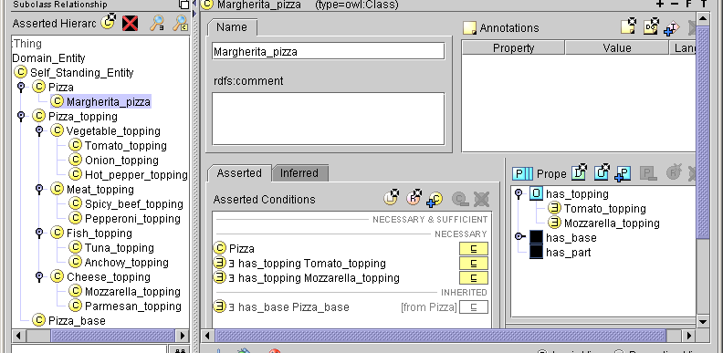
Results for Margherita Pizza
someValuesFrom
restrictions
Properties
subpane showing
alternative ‘frame’
view
What it means
  All Margherita_pizzas (amongst other things)
    Are Pizzas
    have_topping some Tomato_topping
    have_topping some Mozzarella_topping
      & because they are Pizzas
      have_base some Pizza_base

Slide 31
What it
Means
Pizza_base
Pizza_
toppings
aPB₁
aPB₂
aPB_{j}
…
Mozzarella_Toppings
aMZ₁
aMZ₂
Pizzas
aMZ₃
aMZ₄
…
Margherita_pizzas
aMP₁
aMP_{i}
Tomato_
toppingss
aMP₂
aT₁
aT_{k}
aT₂
aT₃
…
aT₄

Slide 32
What it does not mean (up to now)
That a given pizza base can be the base of only one pizza
  That has_base is “inverse functional”
That a pizza can have only one Tomato topping
  Maybe correct
    A double tomato pizza might be legal
  But if not, cannot say it in OWL
    Although can in DLs – “Qualified Cardinality Constraints”
      Deleted by odd committee processes
That Margherita Pizzas have only tomato and mozzarella toppings
  Open world reasoning

Slide 33
Necessary and Sufficient Conditions
Defined Classes
Define a “Cheesey pizza” as any pizza that has a cheese topping…

Slide 34
To Define a Cheesey Pizza
Select Pizza and create a subclass of pizza by clicking the create subclass icon
  Name it Cheesey_pizza
  Double click Pizza in the NECESSARY subpane and drag it to the NECESSARY & SUFFICIENT subpane
  Click the add restrictions icon
  Add a restriction
    someValuesFrom has_topping Cheese_topping
  Classify by clicking the icon
R
*
C

Slide 35
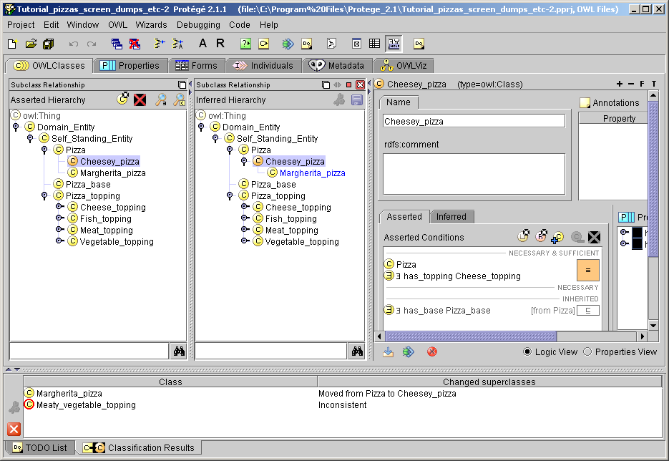
Cheesey_Pizza Classified
Inferred
hierarchy.
Changes in blue
Asserted hierarchy
List of changes

Slide 36
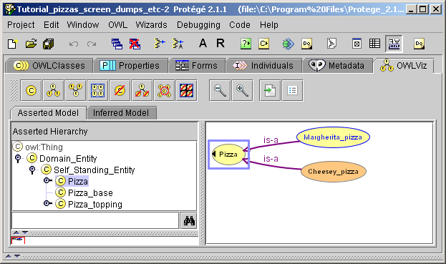
OWLViz View
Go to OWLViz Tab
Select Pizza
Click Class icon at top left
Select Subclasses only on pop up
C

Slide 37
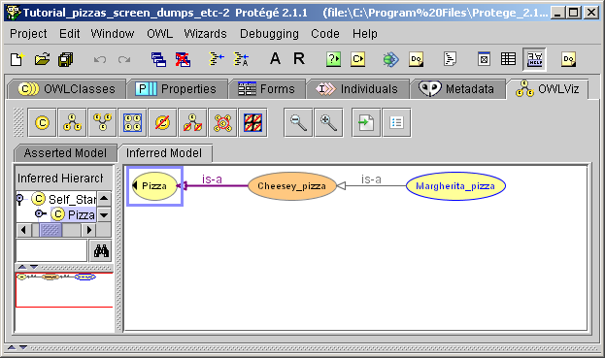
OWLViz View: Inferred Model
Click on Inferred Model subtab to see result after classification
Inferred
Model
Subtab

Slide 38
What it means: Primitive & Defined Classes
A Cheesey_pizza is any Pizza that, amongst other things, has some cheese topping.
  Cheesey_pizza is a Defined class
    It has at least one set of sufficient conditions to recognise ANY Cheesey_pizza
All Margherita_pizzas have (amongst other things) some topping that is Mozzarella
  Margherita_pizza is a Primitive Class
    It has only necessary conditions that apply to ALL Margherita_pizzas
Things can only be classified under Defined classes by the classifier
  (To a good first approximation – exceptions later)

Slide 39
Make a spicy beef pizza & a Protein Lovers Pizza as primitive classes
Use only NECESSARY CONDITIONS

Slide 40
Represent Vegetarian Pizza as a Defined Class
What does it mean to be “Vegetarian”
  “To have only vegetable and cheese toppings”
    To have only toppings that are vegetable OR cheese
      Be careful with ‘and’ and ‘or’ – just as in SQL or programming
Abstract Syntax
  Class(Vegetarian_pizza complete Pizza and
  restriction(has_toppings
  allValuesFrom (Cheese_topping or Vegetable_topping)))
Protégé OWL Syntax
  NECESSARY & SUFFICIENT
  Pizza
  ∀ has_topping (Cheese_topping ➔ Meat_topping)
Makes class defined
“only”

Slide 41
Making the defined class
Create a new subclass of Pizza and name it Vegetarian_Pizza
Double click, drag, and drop Pizza from NECESSARY to NECESSARY & SUFFICIENT
With Pizza still selected, click the add restriction icon
In pop-up
  Select allValuesFrom
    a “universal” restriction
  Select has_topping
  enter Tomato_topping ➔ Cheese Topping
    Use the symbol pad for ➔
    Or just type ‘or’ – the typing help will convert it to ➔
R
*

Slide 42
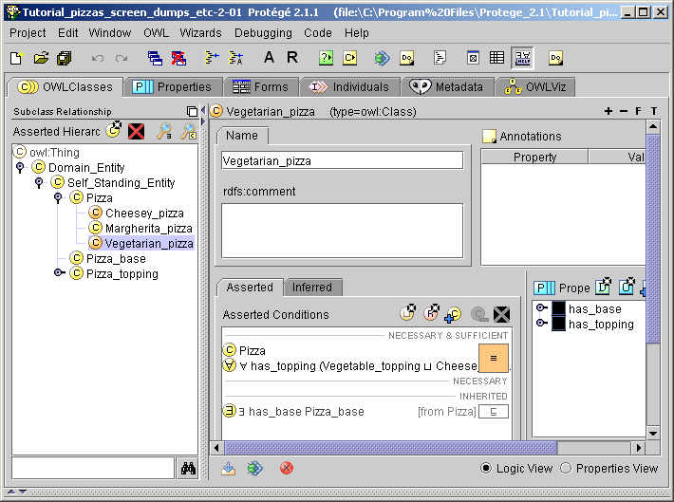
Definition of Vegetarian Pizza
NECESSARY & SUFFICIENT
“only”
“universal”

Slide 43
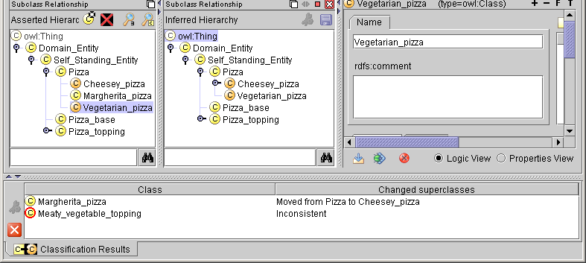
Check Vegetarian Pizza by Classifying it
Click Classify Icon
C
Why has Margherita_pizza not been classified as a Vegetarian_pizza?

Slide 44
Could there be a “Meaty Margherita Pizza” – Try it
Create a subclass of Margherita_pizza and
name it Meaty_Margherita_pizza
Add a restriction to say that it has a Pepperoni_topping
  has_topping someValuesFrom Pepperoni_topping
  ∃ has_topping Pepperoni_topping
Classify by pressing the classify icon
Is Meaty_Margherita_pizza inconsistent?
  Why not?
C

Slide 45
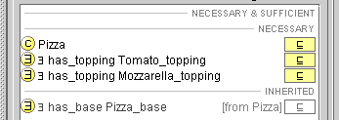
Open World Reasoning
Definition of Margherita_pizza
  Margherita_pizza partial Pizza
  has_topping someValuesFrom Tomato_topping
  has_topping someValuesFrom Mozzarella_topping
Open world clause
What it means
  “A Margherita_pizza is a Pizza and also,
  amongst other things,
  has some topping that is a tomato topping and also
  has some topping that is a Mozzarella_topping

Slide 46
Open & Closed World Reasoning
Closed world reasoning
  “Negation as failure”
  If it cannot be found in this ‘world’, it is assumed to be false
    Negation can be assumed
    Databases, logic programming, query languages,
    most constraint languages including Protégé’s (PAL), …
Open world reasoning
  “Negation as contradiction”
  If it cannot be found in this world it is assumed to be possible,
  unless it can be proven to be impossible in any ‘world’
  i.e. it is a contradiction (“unsatisfiable”)
    Negation must be explicit
    Most theorem proving systems, DL reasoners, and OWL

Slide 47
Closure Restrictions / Closure Axioms
Most customers would assume from the menu that a “Margherita pizza” had only mozzarella and tomato toppings,
  we must make it explicit with a Closure Restriction
Select Margherita_pizza
  Be sure you have the Asserted conditions tab
  Select one of the has_topping restrictions
  On the right mouse button menu, select
  “ Add closure axiom”
∀

Slide 48
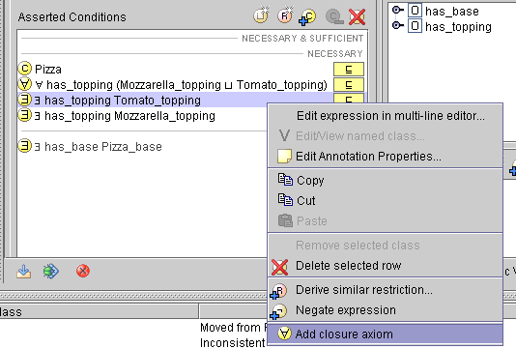
Adding a closure axiom
Add closure axiom
Closure axiom added
Meaning
  “…has toppings that are only mozzarella or tomato
  toppings”

Slide 49
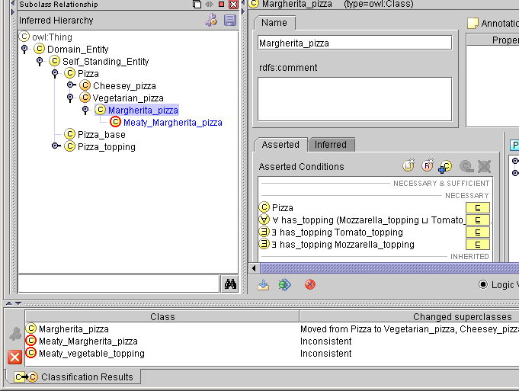
Classify to check
Click the classify icon
C
Margherita_pizza now
correctly classified as a Vegetarian_pizza
C
Meaty_Margherita_pizza now marked as inconsistent (unsatisfiable)

Slide 50
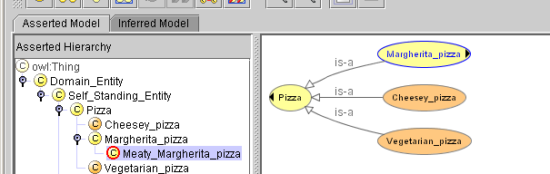
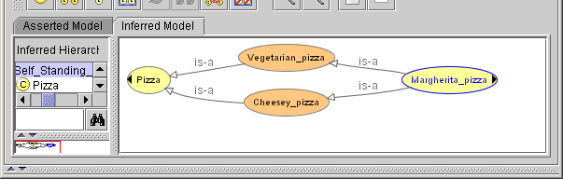
OWLViz: Asserted & Inferred
Asserted
Inferred

Slide 51
Untangling & Value Partitions
Principle of Normalised Ontologies
  Build ontologies from pure trees of primitive classes
    Every primitive class has just one primitive parent
How to create multiple classifications
  By descriptions and values
Consider we want to classify toppings as low_fat|high_fat and bland|spicy

Slide 52
Creating a Value Partition
From Wizards menu select Create Value Partition
Enter Spiciness as the name of the value, values hot, medium, and bland and select defaults
Do the same for Fat_content and low_fat/high_fat

Slide 53
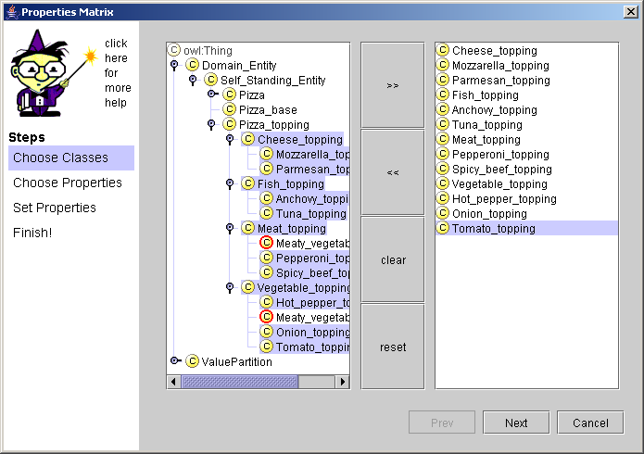
Adding values to pizza_topping: 1
From Wizards select Property Matrix
Open the classes in the wizard to select all the toppings
Select all
valid toppings
Click here to move to list of selected

Slide 54
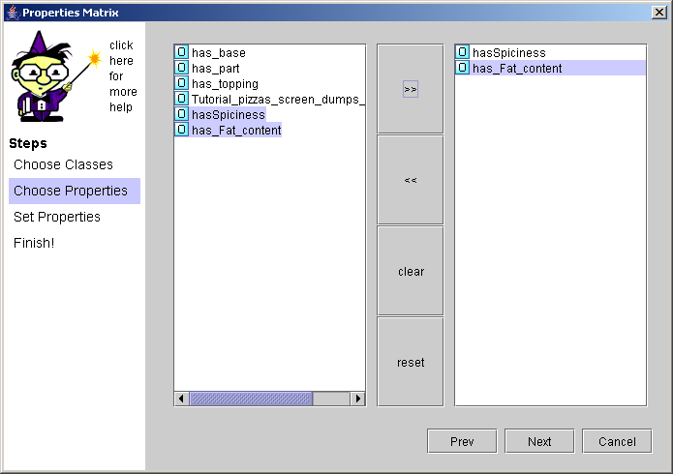
Add values to pizza_toppings: 2
On next, select has_Spiciness and has_Fat_content

Slide 55
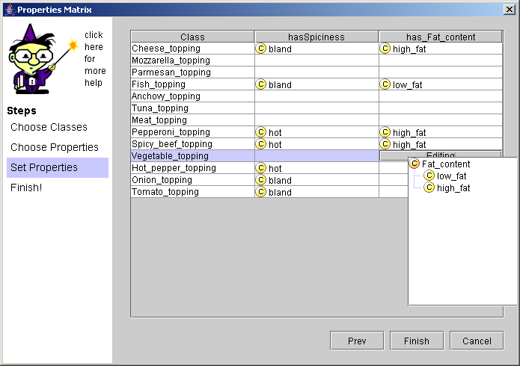
Add values to pizza_toppings: 3
Select values from pull downs
  Values for superclasses will be inherited by subclasses

Slide 56
Define Classes for High_fat_topping &
Spicy_topping
Create and name subclasses
Drag Pizza_topping to
Necessary and Sufficient
Add someValuesFrom (∃) to each definition
Click classify icon to see result
Alternative: Create one and ‘clone’ it – right mouse button menu

Slide 57
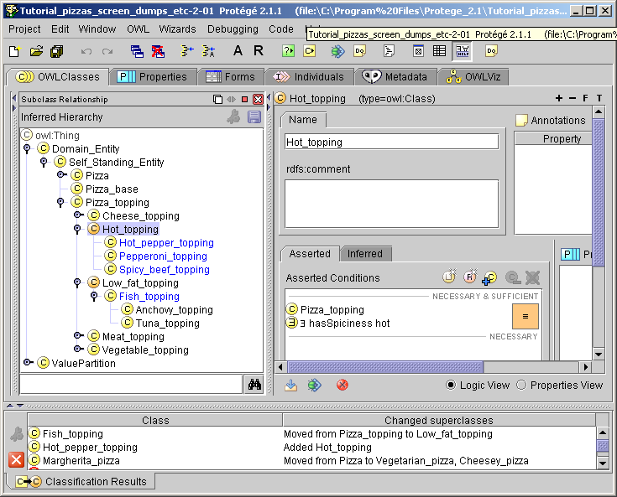
Result of classification

Slide 58
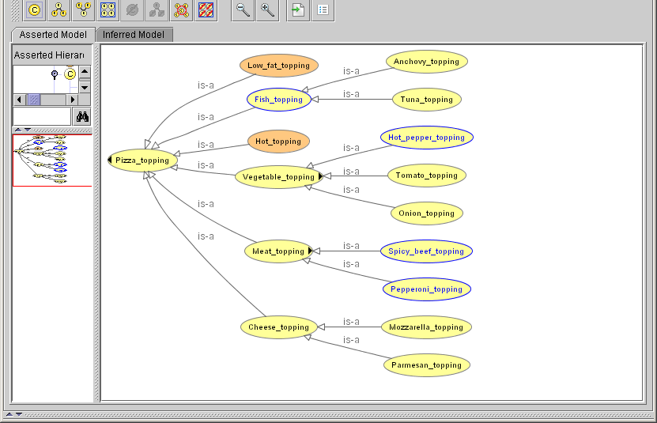
OWLViz Asserted Model
A Pure Tree
Defined classes
have no
subclasses

Slide 59
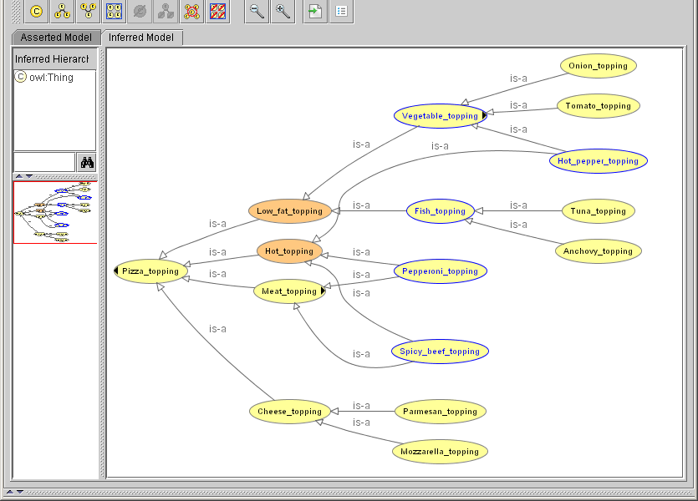
OWLViz inferred model: Polyhierarchy
All multiple parents inferred by classifier
Defined classes
have inferred
subclasses

Slide 60
Normalised Ontologies
Applies to “Domain ontologies”
  Top ontologies follow different rules
Primitive classes form simple trees
  Primitive classes have exactly one most specific primitive superclass
  Allows modularity – can split the trees
  Improves homogeneity –each principle of specialisation represented by a different tree

Slide 61
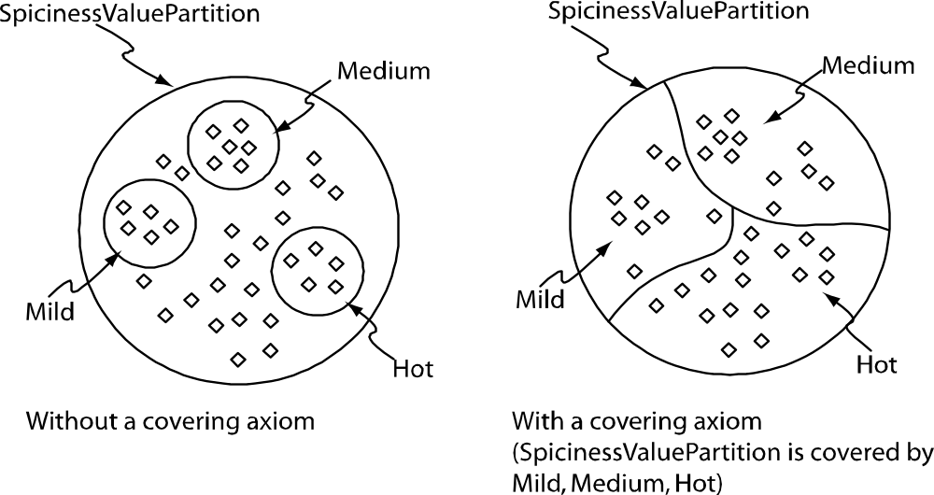
Value Partitions: More Detail
Values partition Quality spaces / Value spaces
  Values in this representation are Classes
    Of the value instances that satisfy the value
      e.g. “this pepper’s hotness”
  Value classes partion the ValuePartion superclass
    Value classes disjoint
    Disjunction of value classes = ValuePartition
      “Covering Axiom” Spiciness ≡ bland ➔ medium ➔ hot

Slide 62
UML-like View of Value Partitions
Pizza_
topping
Spiciness
owl:unionOf
has_spiciness
someValuesFrom
Hot_
Pepper
bland
medium
hot
hotness of
pepper on
my Pizza
has_spiciness
hot_pepper
on my Pizza

Slide 63
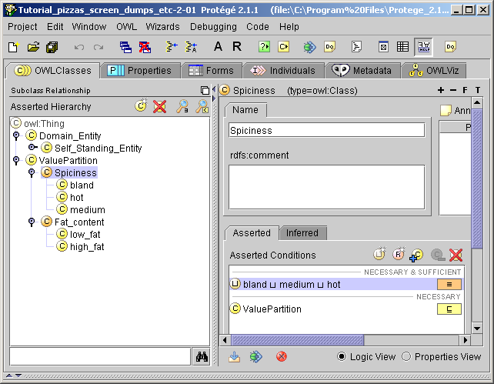
Value Partitions
Disjoint
value
subclasses
“Covering
Axiom”

Slide 64
More on Value Partitions
See
http://www.w3.org/2001/sw/BestPractices/OEP/Lists-of-values

Slide 65
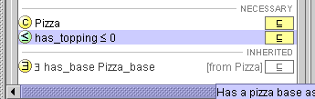
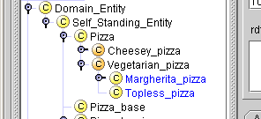
Only does not imply Some
AllValuesFrom  SomeValuesFrom
Create a “Topless pizza”
Create a subclass of Pizza
  Add a restriction has_topping max_cardinality 0
    i.e. A pizza with no toppings
Run the classifier
  Why does Topless_pizza classify
  under Vegetarian_pizza?

Slide 66
Only does not mean Some
has_topping
allValuesFrom (Vegetable or Cheese)
  has only toppings which are vegetable or cheese toppings
  has no topping which is not a vegetable or cheese topping
    Topless_pizza satisfies these conditions!
    Unless we say that all Pizzas must have some topping
      in which case Topless_pizza is a contradiction

Slide 67
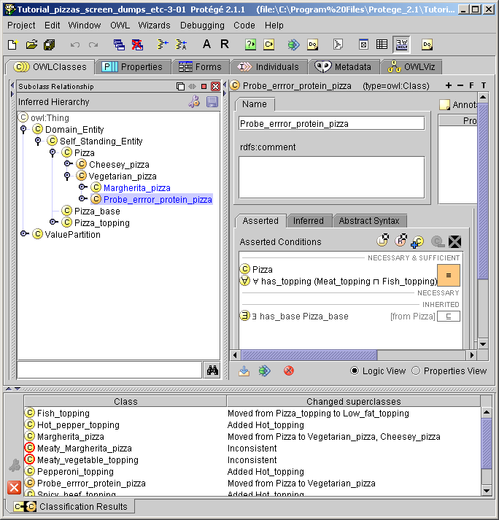
A common error that is not a contradiction
Form:
  Probe_error_protein_pizza that is defined as having only meat and fish toppings
  If not careful with representing ‘and’ and ‘or’ people produce:
    has_topping
    allValuesFrom (meat_topping AND Fish_topping)

Slide 68
When classified,
Probe_error_protein_pizza is classified as a Vegetarian_pizza:
Erroneous protein pizza classified as consistent and a kind of Protein_pizza
Why?

Slide 69
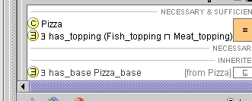
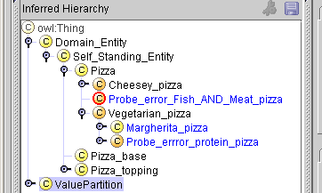
For comparison:
Form a pizza Probe_error_Fish_AND_Meat_pizza with a “Fish and Meat topping”
has_topping
someValuesFrom (Fish_topping and Meat_topping)
When classified, this probe is inconsistent. Why?
Fish_AND_Meat_pizza is inconsistent

Slide 70
Only (AllValuesFrom) Restrictions can be “trivially satisfied”
If there there is not some (SomeValuesFrom) thing that fills the property, then there can be nothing that violates the constraint
  Filling an AllValuesFrom restriction with a contradiction is the same as saying “no values for” or maximum cardinality 0
  Will satisfy any AllValuesFrom restriction for the same property
  Will only cause a contradiction if there is a someValuesFrom
    local or ‘inherited’

Slide 71
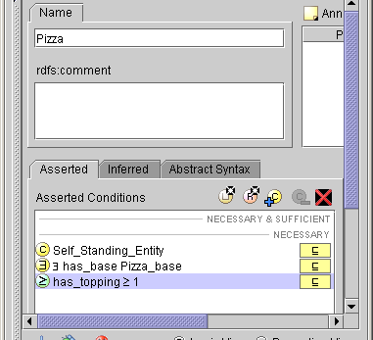
Say that all pizzas must have at least one topping
Add a restriction
has_topping minCardinality 1

Slide 72
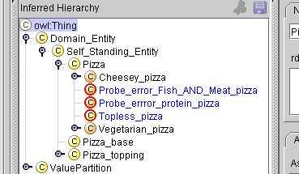
Reclassify Now
Classes that were trivially satisfiable are now unsatisfiable
  Must have some topping
  Can only have ‘nothing’ as topping
    All contradictions equivalent to owl:Nothing
      DL “Bottom” ()

Slide 73
Summary of inconsistencies
Any existential (someValuesFrom) (∃) restriction filled with a contradiction is itself a contradiction
  It asserts that “There is a link to a contradiction”
    Contradictions propagate along SomeValuesFrom links
A universal (allValuesFrom) (only) (∀) restriction filled with a contradiction can be trivially satisfied
  There is no contradiction is saying something can only be satisfied by “nothing”
    But it is probably an error

Slide 74
Domain and Range Constraints
Domain constraints in OWL are equivalent to only (universal/allValuesFrom) restrictions
  has_topping: range Pizza_Topping
  means
  owl:Thing has_topping allValuesFrom Pizza_topping
  “Everything can have, as a topping, only pizza toppings”
  has_topping: domain Pizza
  means
  owl:Thing is_topping_of allValuesFrom Pizza
  “Everything is a topping only of things that are pizzas”

Slide 75
Results of Domain/Range Errors
In most systems, violating a domain/range constraint raises and error
In OWL, it causes reclassification – possibly including inconsistencies
Consider that someone new to our ontology looks at an ice cream cone and says:
“It has a base cone and a topping ice cream”

Slide 76
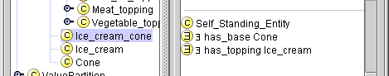
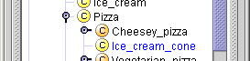
An ice cream cone
Describe it and classify it
No error, but Ice_cream_cone has been classified as a Pizza. Why?
  Ice_cream and Cone have not been classified as Pizza_toppings? Why not?

Slide 77
What it means
“All ice cream cones have some base that is a cone, &
have some topping that is ice cream”
“Only pizzas can have bases”
“Only pizzas can have toppings”
therefore
“An ice cream cone must be a pizza”
but
This says nothing about all cones or all ice cream,
There is nothing to say that ice cream cannot be a pizza topping or that cones cannot be pizza bases.

Slide 78
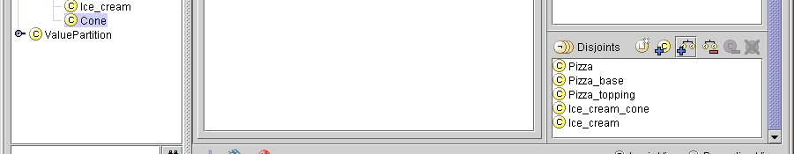
Remember to Add the disjoints
Add the facts that ice cream, cones, and ice cream cones are disjoint from pizzas, pizza toppings, and pizza bases
  The easiest way to do this is to click
  the disjoint siblings icon in the
  disjoints window.
Disjoint siblings icon

Slide 79
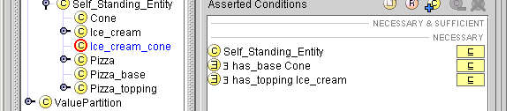
Classify
Ice cream cone is now inconsistent
  But ice cream and cone are still consistent

Slide 80
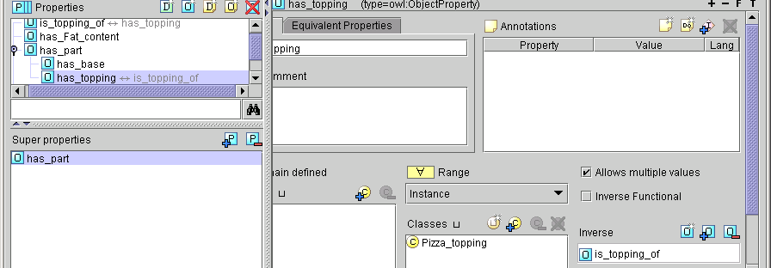
Create an ice cream pizza topping
On the properties pane select has_topping and create an inverse is_topping_of
Create inverse property icon

Slide 81
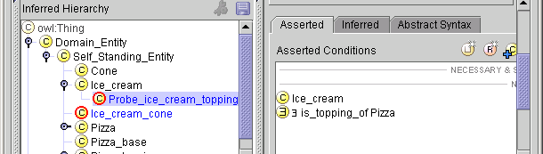
Create an “ice cream topping and classify
An ice cream topping is inconsistent –
there can be no such thing as an ‘ice cream topping’ (in this ontology)
  Why?
    What were all the things that had to be made explicit?

Slide 82
Domain & Range Constraints Summary
Domain and range constraints are axioms
  Can cause reasoner to
    infer reclassification
    infer inconsistency
  Either is usually an error
    It is very bad style to use domain and range constraints deliberately to cause reclassification
      Ontology equivalent of “Side effects” or “Spaghetti programming”
  When strange things happen – look at the domain and range constraints

Slide 83
And finally:
Frames & DLs more Different than they Look
Primitive concepts - in a hierarchy
  Described but not defined
Properties - relations between concepts
  Also in a hierarchy
Descriptors - property-concept pairs
Meta data
Prototypical Knowledge
  Defaults & Exceptions
Reflective queries
Individuals
Hybrid reasoning
  qualified by “some”, “only”, “at least”, “at most”
Defined concepts
  Made from primitive concepts and descriptors
Axioms
  disjointness, further description of defined concepts
A Reasoner
  to organise it for you
OWL / DLs
Frames

Slide 84
Summary: Building Ontologies in OWL-DL
Start with a taxonomy of primitive classes
  Should form pure trees
  Remember, to make disjointness explicit
Use definitions and the classifier to create multiple hierarchies
  Use existential (someValuesFrom) restrictions by default
  Things will only be classified under defined classes
Be careful with
  Open world reasoning
    Use closure axioms when needed
  “some” and “only” – someValuesFrom/allValuesFrom
  domain and range constraints
  making disjoint explicit

Slide 85
Protégé/OWL-CO-ODE
A Collaboration of Users
Protégé & OilEd User Communities
E-Science community
Semantic Web Community
Industrial collaborators
An invitation:
Join the Forum – Download the tools
Contribute your views
www.co-ode.org

