Slide 1
Ontologies
Hasan TÜRKSOY
Compiled, partly based on various online tutorials and presentations, with respect to their authors

Slide 2
Ontological Vision of Semantic Web
Semantic Web needs ontologies
An ontology is
document or file that formally and in a standardized way defines the hierarchy of classes within the domain, semantic relations among terms and inference rules
Use of ontologies:
Sharing semantics of your data across distributed applications
Notes:
[3,8]

Slide 3
Ontologies: the foundation of Semantic Web
Ontologies are key enabling technology for the Semantic Web
“..explicit specification of conceptualization..”
Ontology is formal and rich way to provide shared and common understanding of a domain, that can be used by people and machines
public
comment
__Thing__
Author
private
Access Rights
is-a
Location
Related to
Document
name
Report
is-a
is-a
Web-page
uri
Subject
Instance-of
Instance-of
O. Kononenko
public
V. Terziyan
Author
Access rights
Author
name
#doc1
#doc2
Semantic Web
Related to
Location
uri
Subject
comment
\\AgServ\vagan\InBCT_1.doc
http://www.ontogroup.net
comment
3.1: analysis
draft
Home page
Query 1: get all documents from location X, but not web-pages
Query 2: get documents related to Y, with more then one author, one of which is Terziyan
Query 3: are there web-pages of Z with “private” access related to documents with subject S?
Notes:
[3]
Bu sorgular veritabanı kullanan sistemlerle de yapılamaz mı?

Slide 4
Ontologies and Databases
+ T-Box / A-Box
+ Description Logic
kaynak\Ian Horrocks - CS646\onto-db.ppt
(Semantic Days 2008. Stavanger, Norway, April 2008.)

Slide 5
What is an ontology?
Studer(98): Formal, explicit specification of a shared conceptualization
Machine
readable
Consensual
knowledge
Concepts, properties,
functions, axioms
are explicitly defined
Abstract model of
some phenomena
in the world
Notes:
[3]

Slide 6
Benefits
Communication between people
Interoperability between software agents
Reuse of domain knowledge
Make domain knowledge explicit
Knowledge sharing and reuse
Analyze domain knowledge
Building an ontology is not a goal in itself.
Notes:
[3]

Slide 7
Ontology Elements
Concepts(classes) + their hierarchy
Concept properties (slots/attributes)
Property restrictions (type, cardinality, domain)
Relations between concepts (disjoint, equality)
Instances
Notes:
[3]

Slide 8
OWL became standard
10 February 2004 the World Wide Web Consortium announced final approval of two key Semantic Web technologies, the revised Resource Description Framework (RDF) and the Web Ontology Language (OWL).
Read more in:
http://www.w3.org/2004/01/sws-pressrelease.html.en
Notes:
[3]
OWL language now a w3c recommendadion (i.e., a standard like HTML and XML)

Slide 9
OWL Introduction
What is OWL?
OWL is a language for defining Web Ontologies and their associated Knowledge Bases
The OWL language is a revision of the DAML+OIL web ontology language incorporating learning from the design and application use of DAML+OIL.
OWL extends RDFS vocabulary and adds axioms.
Notes:
[3]

Slide 10
OWL Language
Three species of OWL
OWL full is union of OWL syntax and RDF
OWL DL restricted to FOL fragment (¼ DAML+OIL)
OWL Lite is “easier to implement” subset of OWL DL
Semantic layering
OWL DL ¼ OWL full within DL fragment
DL semantics officially definitive
OWL DL based on SHIQ Description Logic
In fact it is equivalent to SHOIN(D_{n}) DL
OWL DL Benefits from many years of DL research
Well defined semantics
Formal properties well understood (complexity, decidability)
Known reasoning algorithms
Implemented systems (highly optimised)
Notes:
[4]
[5] {
OWL-Lite –simple but limited
OWL-DL – complex but deliverable (real soon now)
OWL-Full – fully expressive but serious logical/computational problems
Russel Paradox etc etc
}

Slide 11
Back to the OWL Layers (Lite, DL, Full)
OWL Lite
(sub)classes, individuals
(sub)properties, domain, range
intersection
(in)equality
cardinality 0/1
datatypes
inverse, transitive, symmetric
hasValue
someValuesFrom
allValuesFrom
RDF Schema
Full
DL
Lite
OWL DL
Negation (disjointWith, complementOf)
unionOf
Full Cardinality
Enumerated types (oneOf)
OWL Full
Allow meta-classes etc
Notes:
[6]

Slide 12
Example
There are two types of animals, Male and Female.
<rdfs:Class rdf:ID="Male">
<rdfs:subClassOf rdf:resource="#Animal"/>
</rdfs:Class>
The subClassOf element asserts that its subject - Male - is a subclass of its object -- the resource identified by #Animal.
<rdfs:Class rdf:ID="Female">
<rdfs:subClassOf rdf:resource="#Animal"/>
<owl:disjointWith rdf:resource="#Male"/>
</rdfs:Class>
Some animals are Female, too, but nothing can be both Male and Female (in this ontology) because these two classes are disjoint (using the disjointWith tag).
Notes:
[3] -> kendi örneğini geliştir

Slide 13
What Are Description Logics?
A family of logic based Knowledge Representation formalisms
Descendants of semantic networks and KL-ONE
Describe domain in terms of concepts (classes), roles (properties, relationships) and individuals
Operators allow for composition of complex concepts
Names can be given to complex concepts, e.g.:
HappyParent ´ Parent u 8hasChild.(Intelligent t Athletic)
HappyParent ´ Parent u 8hasChild.(Intelligent t Athletic)
HappyParent ´ Parent u 8hasChild.(Intelligent t Athletic)
HappyParent ´ Parent u 8hasChild.(Intelligent t Athletic)
HappyParent ´ Parent u 8hasChild.(Intelligent t Athletic)
Notes:
Object oriented style of modelling
[8]

Slide 14
Description Logic Family
DLs are a family of logic based KR formalisms
Particular languages mainly characterized by:
Set of constructors for building complex concepts and roles from simpler ones
Set of axioms for asserting facts about concepts, roles and individuals
Examples:
“Female persons”
Person ⊓ Female
“Non-female persons”
Person ⊓ ¬Female
“Persons that have a child”
Person ⊓ ∃hasChild.Person
“Persons all of whose children are female”
Person ⊓ ∀hasChild.Female
“Persons that are employed or self-eployed”
Person ⊓ (Employee ⊔ SelfEmployed)
“Persons that have at most one father“
Person ⊓ ≤1.hasFather
Notes:
[6]

Slide 15
Description Logic Family Necessary and sufficient conditions
Inclusion axioms provide necessary conditions:
concept ⊑ definition
Equivalence axioms provide necessary and sufficient conditions:
^{concept ≡ definition}{
concept ⊑ definition and
definition ⊑ concept
Notes:
[6]

Slide 16
Complex Classes Union of Classes
Instances of the Union of two Classes are either the instance of one or both classes
Person ≡ Man ⊔ Woman
<owl:Class rdf:ID=“Person">
<owl:unionOf rdf:parseType="Collection">
<owl:Class rdf:about="#Woman" />
<owl:Class rdf:about="#Man" />
</owl:unionOf>
</owl:Class>
Notes:
[6]

Slide 17
Complex Classes Intersection of Classes
Instances of the Intersection of two Classes are simultaneously instances of both class
Man ≡ Person ⊓ Male
<owl:Class rdf:ID=“Man">
<owl:intersectionOf rdf:parseType="Collection">
<owl:Class rdf:about="#Person" />
<owl:Class rdf:about="#Male" />
</owl:intersectionOf>
</owl:Class>
Notes:
[6]

Slide 18
one of: Enumerated Classes
Specify a class via a direct enumeration of its members:
WhineColor ≡ {White, Rose, Red}
<owl:Class rdf:ID="WineColor">
<rdfs:subClassOf rdf:resource="#WineDescriptor"/>
<owl:oneOf rdf:parseType="Collection">
<owl:Thing rdf:about="#White"/>
<owl:Thing rdf:about="#Rose"/>
<owl:Thing rdf:about="#Red"/>
</owl:oneOf>
</owl:Class>
Notes:
[6]

Slide 19
Complex Classes Property Restrictions
Defining a Class by restricting its possible instances via their property values
OWL distinguishes between the following two:
Value constraint
(Mother ≡ Woman ⊓ ∃hasChild.Person)
Cardinality constraint
(MotherWithManyChildren ≡ Mother ⊓ ≥3hasChild)
Property restrictions are local
remember RDFS allows only global properties
Notes:
[6]
owl:allValuesFrom
<owl:Class rdf:ID="Wine">
<rdfs:subClassOf rdf:resource="&food;PotableLiquid" />
...
<rdfs:subClassOf>
<owl:Restriction>
<owl:onProperty rdf:resource="#hasMaker" />
<owl:allValuesFrom rdf:resource="#Winery" />
</owl:Restriction>
</rdfs:subClassOf>
...
</owl:Class>
owl:someValuesFrom
<owl:Class rdf:ID="Wine">
<rdfs:subClassOf rdf:resource="&food;PotableLiquid" />
<rdfs:subClassOf>
<owl:Restriction>
<owl:onProperty rdf:resource="#hasMaker" />
<owl:someValuesFrom rdf:resource="#Winery" />
</owl:Restriction>
</rdfs:subClassOf>
...
</owl:Class>
owl:hasValue
<owl:Class rdf:ID="Burgundy">
...
<rdfs:subClassOf>
<owl:Restriction>
<owl:onProperty rdf:resource="#hasSugar" />
<owl:hasValue rdf:resource="#Dry" />
</owl:Restriction>
</rdfs:subClassOf>
</owl:Class>

Slide 20
Complex Classes - Property Restrictions someValuesFrom
A Mother is a Woman that has a child (some Person)
Mother ⊑ Woman ⊓ ∃hasChild.Person
<owl:Class rdf:ID=“Mother">
<rdfs:subClassOf rdf:resource="#Woman" />
<rdfs:subClassOf>
<owl:Restriction>
<owl:onProperty rdf:resource="#hasChild" />
<owl:someValuesFrom rdf:resource="#Person" />
</owl:Restriction>
</rdfs:subClassOf>
</owl:Class>
Notes:
[6]
owl:allValuesFrom
<owl:Class rdf:ID="Wine">
<rdfs:subClassOf rdf:resource="&food;PotableLiquid" />
...
<rdfs:subClassOf>
<owl:Restriction>
<owl:onProperty rdf:resource="#hasMaker" />
<owl:allValuesFrom rdf:resource="#Winery" />
</owl:Restriction>
</rdfs:subClassOf>
...
</owl:Class>
owl:someValuesFrom
<owl:Class rdf:ID="Wine">
<rdfs:subClassOf rdf:resource="&food;PotableLiquid" />
<rdfs:subClassOf>
<owl:Restriction>
<owl:onProperty rdf:resource="#hasMaker" />
<owl:someValuesFrom rdf:resource="#Winery" />
</owl:Restriction>
</rdfs:subClassOf>
...
</owl:Class>
owl:hasValue
<owl:Class rdf:ID="Burgundy">
...
<rdfs:subClassOf>
<owl:Restriction>
<owl:onProperty rdf:resource="#hasSugar" />
<owl:hasValue rdf:resource="#Dry" />
</owl:Restriction>
</rdfs:subClassOf>
</owl:Class>

Slide 21
Complex Classes - Property Restrictions allValuesFrom
To express the set of parents that only have female children (daughters) you would write:
ParentsWithOnlyDaughters ⊑ Person ⊓ ∀hasChild.Woman
<owl:Class rdf:ID=“ParentsWithOnlyDaughters">
<rdfs:subClassOf rdf:resource="#Person" />
<rdfs:subClassOf>
<owl:Restriction>
<owl:onProperty rdf:resource="#hasChild" />
<owl:allValuesFrom rdf:resource="#Woman" />
</owl:Restriction>
</rdfs:subClassOf>
...
</owl:Class>
Notes:
[6]
owl:allValuesFrom
<owl:Class rdf:ID="Wine">
<rdfs:subClassOf rdf:resource="&food;PotableLiquid" />
...
<rdfs:subClassOf>
<owl:Restriction>
<owl:onProperty rdf:resource="#hasMaker" />
<owl:allValuesFrom rdf:resource="#Winery" />
</owl:Restriction>
</rdfs:subClassOf>
...
</owl:Class>
owl:someValuesFrom
<owl:Class rdf:ID="Wine">
<rdfs:subClassOf rdf:resource="&food;PotableLiquid" />
<rdfs:subClassOf>
<owl:Restriction>
<owl:onProperty rdf:resource="#hasMaker" />
<owl:someValuesFrom rdf:resource="#Winery" />
</owl:Restriction>
</rdfs:subClassOf>
...
</owl:Class>
owl:hasValue
<owl:Class rdf:ID="Burgundy">
...
<rdfs:subClassOf>
<owl:Restriction>
<owl:onProperty rdf:resource="#hasSugar" />
<owl:hasValue rdf:resource="#Dry" />
</owl:Restriction>
</rdfs:subClassOf>
</owl:Class>

Slide 22
Complex Classes - Property Restrictions hasValue
hasValue allows to define classes based on the existence of particular property values, their must be at least one matching property value
The set of all childs of the woman MARY would be expressed like following:
MarysChildren ⊑ Person П hasParent.{MARY}
<owl:Class rdf:ID=“MarysChildren">
<rdfs:subClassOf rdf:resource="#Person" />
<rdfs:subClassOf>
<owl:Restriction>
<owl:onProperty rdf:resource="#hasParent" />
<owl:hasValue rdf:resource="#MARRY" />
</owl:Restriction>
</rdfs:subClassOf>
</rdfs:subClassOf>
...
</owl:Class>
Notes:
[6]
owl:allValuesFrom
<owl:Class rdf:ID="Wine">
<rdfs:subClassOf rdf:resource="&food;PotableLiquid" />
...
<rdfs:subClassOf>
<owl:Restriction>
<owl:onProperty rdf:resource="#hasMaker" />
<owl:allValuesFrom rdf:resource="#Winery" />
</owl:Restriction>
</rdfs:subClassOf>
...
</owl:Class>
owl:someValuesFrom
<owl:Class rdf:ID="Wine">
<rdfs:subClassOf rdf:resource="&food;PotableLiquid" />
<rdfs:subClassOf>
<owl:Restriction>
<owl:onProperty rdf:resource="#hasMaker" />
<owl:someValuesFrom rdf:resource="#Winery" />
</owl:Restriction>
</rdfs:subClassOf>
...
</owl:Class>
owl:hasValue
<owl:Class rdf:ID=“GoodPaper">
<rdfs:subClassOf>
<owl:Restriction>
<owl:onProperty rdf:resource="#hasAuthor" />
<owl:hasValue rdf:resource="#DieterFensel" />
</owl:Restriction>
</rdfs:subClassOf>
…
</owl:Class>

Slide 23
Complex Classes - Property Restrictions cardinality
Definition of cardinality: the number of occurrences, either maximum (maxCardinality) or minimum (minCardinality) or exact (cardinality) based upon the context (class) in which it is used
To define a half-orphan (Halbwaise) you would write the following:
HalfOrphan ⊑ Person П =1hasParent.Person
<owl:Class rdf:ID=“HalfOrphan">
<rdfs:subClassOf rdf:resource="#Person" />
<rdfs:subClassOf>
<owl:Restriction>
<owl:onProperty rdf:resource="#hasParent"/>
<owl:cardinality rdf:datatype="&xsd;NonNegativeInteger">1</owl:cardinality>
</owl:Restriction>
</rdfs:subClassOf>
</rdfs:subClassOf>
…
</owl:Class>
Notes:
[6]
<owl:Class rdf:ID="Vintage">
<rdfs:subClassOf>
<owl:Restriction>
<owl:onProperty rdf:resource="#hasVintageYear"/>
<owl:cardinality rdf:datatype="&xsd;NonNegativeInteger">1</owl:cardinality>
</owl:Restriction>
</rdfs:subClassOf>
</owl:Class>

Slide 24
Properties OWL vs. RDF
RDF Schema provides a couple of pre defined properties:
rdfs:range used to indicate the range of values for a property.
rdfs:domain used to associate a property with a class.
rdfs:subPropertyOf used to specialize a property.
OWL provides additional poperty classes, which allow reasoning and inferencing, i.e.
owl:functionalProperty
owl:transitiveProperty
owl:symetricProperty
Notes:
[6]

Slide 25
Properties OWL vs. RDF
OWL (DL and Lite) distinguishes between data type ptoperties and object properties (RDFS does not)
An ObjectProperty relates one Resource to another Resource:
ObjectProperty
Resource
Resource
A DatatypeProperty relates a Resource to a Literal or an XML Schema data type:
DatatypeProperty
Resource
Value
Notes:
[6]

Slide 26
Why separate Classes and Datatypes?
Philosophical reasons:
Datatypes structured by built-in predicates
Not appropriate to form new datatypes using ontology language
Practical reasons:
Ontology language remains simple and compact
Semantic integrity of ontology language not compromised
Implementability not compromised — can use hybrid reasoner
Notes:
[6]

Slide 27
Properties in OWL Transitive Property
Example: If person A is a ancestor of person B and B of C then A is also an ancestor of C.
ancestor⁺ ⊆ ancestor
<owl:ObjectProperty rdf:ID=“ancesotor">
<rdf:type rdf:resource="&owl;TransitiveProperty" />
<rdfs:domain rdf:resource="#Person" />
<rdfs:range rdf:resource="#Person" />
</owl:ObjectProperty>
Notes:
[6]
<owl:ObjectProperty rdf:ID="locatedIn">
<rdf:type rdf:resource="&owl;TransitiveProperty" />
<rdfs:domain rdf:resource="&owl;Thing" />
<rdfs:range rdf:resource="#Region" />
</owl:ObjectProperty>

Slide 28
Properties in OWL Symmetric Property
Example: If Mary is relative to John then John is also relative to Mary
relative⁻ ⊆ relative and relative ⊆ relative⁻
<owl:ObjectProperty rdf:ID=“relative">
<rdf:type rdf:resource="&owl;SymmetricProperty" />
<rdfs:domain rdf:resource="#Person" />
<rdfs:range rdf:resource="#Person" />
</owl:ObjectProperty>
Notes:
[6]
<owl:ObjectProperty rdf:ID="locatedIn">
<rdf:type rdf:resource="&owl;TransitiveProperty" />
<rdfs:domain rdf:resource="&owl;Thing" />
<rdfs:range rdf:resource="#Region" />
</owl:ObjectProperty>

Slide 29
Properties in OWL Inverse Property
Example: If Mary is a child of John then John is the parent of Mary
hasChild ⊆ hasParent⁻
<owl:ObjectProperty rdf:ID=“hasChild">
<owl:inverseOf rdf:resource="hasParent" />
</owl:ObjectProperty>
Notes:
[6]
<owl:ObjectProperty rdf:ID="producesWine">
<owl:inverseOf rdf:resource="#hasMaker" />
</owl:ObjectProperty>

Slide 30
Properties in OWL Functional Properties
A functional property states that the value of range for a certain object in the domain is always the same:
Example: A child has always the same Father (biological)
Person ⊆ ≤1hasFather
<owl:ObjectProperty rdf:ID=“hasFather">
<rdf:tyoe rdf:resource="&owl;FunctionalProperty"/>
</owl:ObjectProperty>
Notes:
[6]
<owl:ObjectProperty rdf:ID="emptiesIn">
<rdf:type rdf:resource="&owl;FunctionalProperty" />
<rdfs:domain rdf:resource="#River" />
<rdfs:range rdf:resource="#WaterBody" />
</owl:ObjectProperty>

Slide 31
OWL Property Classes
The symmetric and transitive property may only used for connecting two resources:
rdf:Property
owl:ObjectProperty
owl:DatatypeProperty
owl:FunctionalProperty
owl:InverseFunctionalProperty
owl:SymmetricProperty
owl:TransitiveProperty
Notes:
[6]

Slide 32
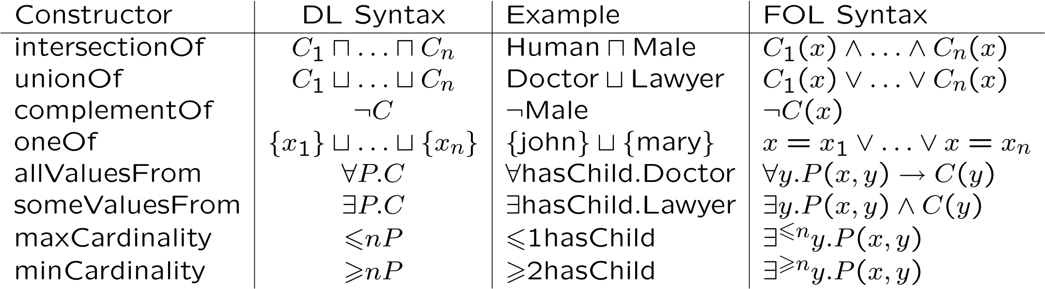
OWL as DL: Axioms
Description Logic
First Order Logic
Notes:
[6]

Slide 33
OWL as DL: Axioms
Social Security Number
Notes:
[6]

Slide 34
Subsumption An Example
Woman ≡ Person ⊓ Female
Man ≡ Person ⊓ ¬Woman
Mother ≡ Woman ⊓ ∃hasChild.Person
Father ≡ Man ⊓ ∃hasChild.Person
Parent ≡ Father ⊔ Mother
Grandmother ≡ Mother ⊓ ∃hasChild.Parent
We can further infer (though not explicitly stated):
→ Grandmother ⊑ Person
Grandmother ⊑ Man ⊔ Woman
etc.
Notes:
[6]

Slide 35
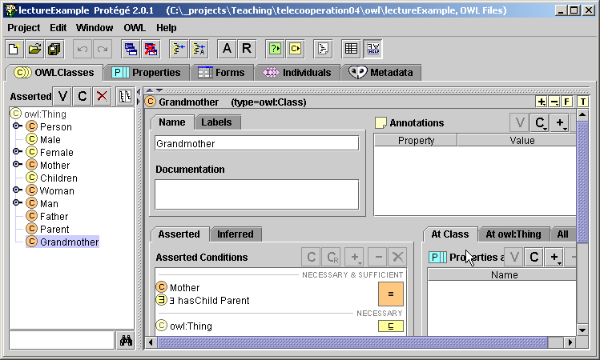
Subsumption Example in Protégé
Notes:
[6]

Slide 36
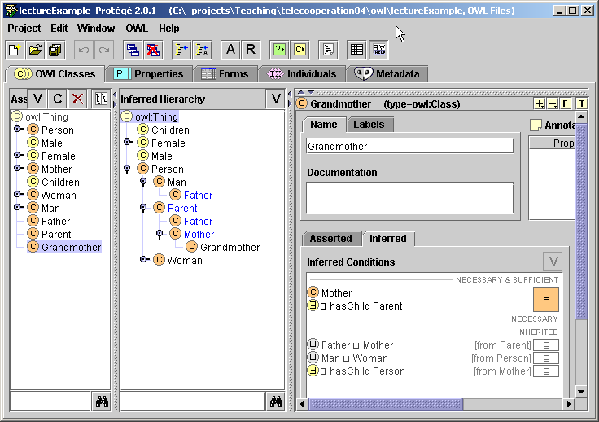
Subsumption Inferred Hierarchy in Protégé
Notes:
[6]

Slide 37
Inconsistency
You may define Classes were no individual can fulfill its definition. Via reasoning engines such a definition can be found also in big ontologies.
Notes:
[6]

Slide 38
Inconsistency Example
Cow ≡ Animal ⊓ Vegetarian
Sheep ⊑ Animal
Vegetarian ≡ ∃eats ¬ Animal
MadCow ≡ Cow ⊓ ∃eats.Sheep
Notes:
[6]

Slide 39
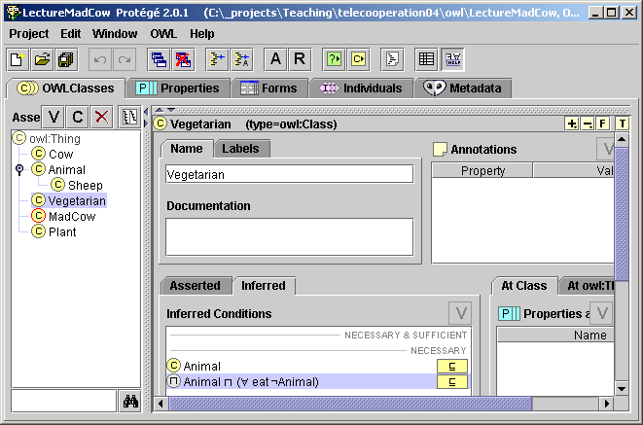
Inconsistency Example in Protégé
Notes:
[6]

Slide 40
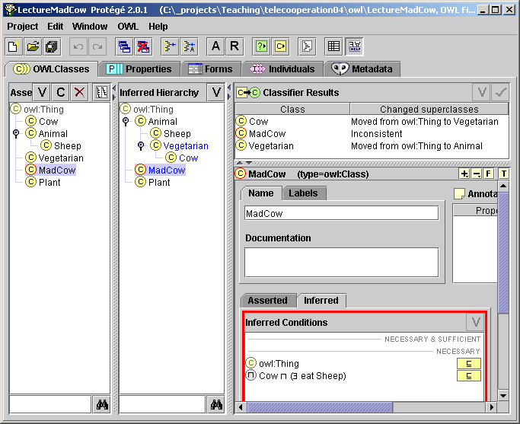
Inconsistency Detected Inconsistency in Protégé
Notes:
[6]

Slide 41
Summary
The semantic web is based on machine-processable semantics of data.
Its backbone technology are Ontologies.
It is based on new web languages such as XML, RDF, and OWL, and tools that make use of these languages.
Notes:
[3]

Slide 42
Mola...
Next: Lab1 - OWL in Protege...
Notes:
[6]

