Slide 1
Foundations of the Semantic Web:
Ontology Engineering
Lecture 2
Building Ontologies & Knowledge Elicitation
Alan Rector & colleagues

Slide 2
Part I: Developing an Ontology
Start at the Beginning
You now have all you need to implement simple existential ontologies, so let’s go back to the beginning
The goal for the example ontology is to build an ontology of animals to index a children’s book of animals
The goal for the lab ontology is for you to build an ontology for the CS department and eventually for the University

Slide 3
Steps in developing an Ontology
Establish the purpose
  Without purpose, no scope, requirements, evaluation,
Informal/Semiformal knowledge elicitation
  Collect the terms
  Organise terms informally
  Paraphrase and clarify terms to produce informal concept definitions
  Diagram informally
Refine requirements & tests

Slide 4
Steps in implementing an Ontology
Implementation
  Paraphrase and comment at each stage before implementing
  Develop normalised schema and skeleton
  Implement prototype recording the intention as a paraphrase
    Keep track of what you meant to do so you can compare with what happens
      Implementing logic-based ontologies is programming
  Scale up a bit
    Check performance
  Populate
    Possibly with help of text mining and language technology
Evaluate & quality assure
  Against goals
  Include tests for evolution and change management
  Design regression tests and “probes”
Monitor use and evolve
  Process not product!

Slide 5
Purpose & scope of the animals ontology
To provide an ontology for an index of a children’s book of animals including
  Where they live
  What they eat
    Carnivores, herbivores and omnivores
  How dangerous they are
  How big they are
  A bit of basic anatomy
    numbers of legs, wings, toes, etc.

Slide 6
Collect the concepts
Card sorting is often the best way
  Write down each concept/idea on a card
  Organise them into piles
  Link the piles together
  Do it again, and again
  Works best in a small group
  In the lab we will provide you with some pre-printed cards and many spare cards
    Work in pairs or triples

Slide 7
Example: Animals & Plants
Dog
Cat
Cow
Person
Tree
Grass
Herbivore
Male
Female
Carnivore
Plant
Animal
Fur
Child
Parent
Mother
Father
Dangerous
Pet
Domestic Animal
Farm animal
Draft animal
Food animal
Fish
Carp
Goldfish

Slide 8
Organise the concepts
Example: Animals & Plants
Dog
Cat
Cow
Person
Tree
Grass
Herbivore
Male
Female
Carnivore
Plant
Animal
Fur
Child
Parent
Mother
Father
Healthy
Pet
Domestic Animal
Farm animal
Draft animal
Food animal
Fish
Carp
Goldfish

Slide 9
Extend the concepts
“Laddering”
Take a group of things and ask what they have in common
  Then what other ‘siblings’ there might be
e.g.
  Plant, Animal → Living Thing
    Might add Bacteria and Fungi but not now
  Cat, Dog, Cow, Person → Mammal
    Others might be Goat, Sheep, Horse, Rabbit,…
  Cow, Goat, Sheep, Horse → Hoofed animal (“Ungulate”)
    What others are there? Do they divide amongst themselves?
  Wild, Domestic → Demoestication
    What other states – “Feral” (domestic returned to wild)
Vocabulary note:
“Sibling” = “brother or sister”

Slide 10
Choose some main axes
Add abstractions where needed
  e.g. “Living thing”
identify relations
  e.g. “eats”, “owns”, “parent of”
Identify definable things
  e.g. “child”, “parent”, “Mother”, “Father”
    Things where you can say clearly what it means
      Try to define a dog precisely – very difficult
        A “natural kind”
make names explicit

Slide 11
Choose some main axes
Add abstractions where needed; identify relations; Identify definable things, make names explicit
Living Thing
  Animal
    Mammal
      Cat
      Dog
      Cow
      Person
    Fish
      Carp
      Goldfish
  Plant
    Tree
    Grass
    Fruit
Modifiers
  domestic
    pet
    Farmed
      Draft
      Food
  Wild
  Health
    healthy
    sick
  Sex
    Male
    Female
  Age
    Adult
    Child
Relations
  eats
  owns
  parent-of
  …
Definable
  Carinvore
  Herbivore
  Child
  Parent
  Mother
  Father
  Food Animal
  Draft Animal

Slide 12
Self_standing_entities
Things that can exist on there own nouns
  People, animals, houses, actions, processes, …
    Roughly nouns
Modifiers
  Things that modify (“inhere”) in other things
    Roughly adjectives and adverbs

Slide 13
Reorganise everything but “definable” things into pure trees – these will be the “primitives”
Self_standing
  Living Thing
    Animal
      Mammal
        Cat
        Dog
        Cow
        Person
        Pig
      Fish
        Carp
        Goldfish
    Plant
      Tree
      Grass
      Fruit
Modifiers
  Domestication
    Domestic
    Wild
  Use
    Draft
    Food
    pet
  Risk
    Dangerous
    Safe
  Sex
    Male
    Female
  Age
    Adult
    Child
Relations
  eats
  owns
  parent-of
  …
Definables
  Carnivore
  Herbivore
  Child
  Parent
  Mother
  Father
  Food Animal
  Draft Animal

Slide 14
If anything needs clarifying, add a text comment
Self_standing
  Living Thing
    Animal
      Mammal
        Cat
        Dog
        Cow
        Person
        Pig
      Fish
        Carp
        Goldfish
    Plant
      Tree
      Grass
      Fruit
The abstract ancestor concept including all living
things – restrict to plants and animals for now”

Slide 15
Identify the domain and range constraints for properties
Animal eats Living_thing
  eats domain: Animal;
  range: Living_thing
Person owns Living_thing except person
  owns domain: Person
  range: Living_thing & not Person
Living_thing parent_of Living_thing
  parent_of: domain: Animal
  range: Animal

Slide 16
If anything is used in a special way, add a text comment
Animal eats Living_thing
  eats domain: Animal;
  range: Living_thing
ignore difference between
parts of living things
and living things
also derived from living
things

Slide 17
For definable things
Paraphrase and formalise the definitions in terms of the primitives, relations and other definables.
Note any assumptions to be represented elsewhere.
  Add as comments when implementing
“A ‘Parent’ is an animal that is the parent of some other animal” (Ignore plants for now)
  Parent =
  Animal and parent_of some Animal
“A ‘Herbivore’ is an animal that eats only plants”
(NB All animals eat some living thing)
  Herbivore=
  Animal and eats only Plant
“An ‘omnivore’ is an animal that eats both plants and animals”
  Omnivore=
  Animal and eats some Animal and eats some Plant

Slide 18
Paraphrases and Comments
Write down the paraphrases and put them in the comment space.
  We can show you how to make the comment space bigger to make it easier.
Without a paraphrase, we cannot tell if we disagree on
  What you meant to represent
  How you represented it
Without a paraphrase we will mark down by at least half and give no partial credit
  We will try to understand what you are doing, but we cannot read your minds.

Slide 19
Which properties can be filled in at the class level now?
What can we say about all members of a class?
  eats
    All cows eat some plants
    All cats eat some animals
    All pigs eat some animals &
    eat some plants

Slide 20
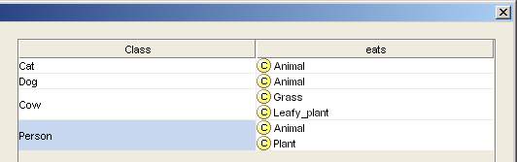
Fill in the details
(can use property matrix wizard)

Slide 21
Check with classifier
Cows should be Herbivores
  Are they? why not?
    What have we said?
      Cows are animals and, amongst other things,
      eat some grass and
      eat some leafy_plants
    What do we need to say:
    Closure axiom
      Cows are animals and, amongst other things,
      eat some plants and eat only plants
        (See “Vegetarian Pizzas” in OWL tutorial)

Slide 22
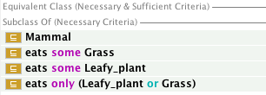
Closure Axiom
  Cows are animals and, amongst other things,
  eat some plants and eat only plants
Closure
Axiom

Slide 23
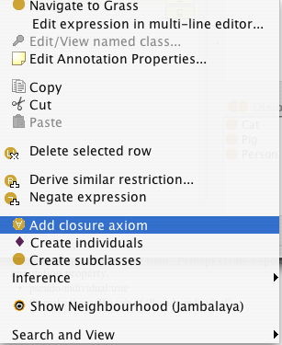
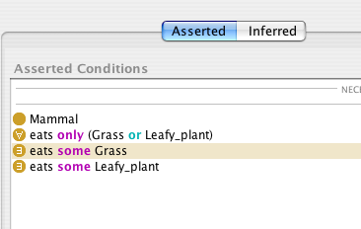
In the tool
Right mouse button short cut for closure axioms
  for any existential restriction
adds closure
axiom

Slide 24
Open vs Closed World reasoning
Open world reasoning
  Negation as contradiction
    Anything might be true unless it can be proven false
      Reasoning about any world consistent with this one
Closed world reasoning
  Negation as failure
    Anything that cannot be found is false
      Reasoning about this world
Ontologies are not databases

Slide 25
Normalisation and Untangling
Let the reasoner do multiple classification
Tree
  Everything has just one parent
    A ‘strict hierarchy’
Directed Acyclic Graph (DAG)
  Things can have multiple parents
    A ‘Polyhierarchy’
Normalisation
  Separate primitives into disjoint trees
  Link the trees with definitions & restrictions
    Fill in the values
  Let the classifier produce the DAG

Slide 26
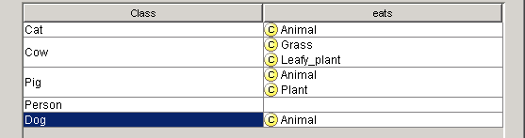
Tables are easier to manage than DAGs / Polyhierarchies
…and get the benefit of inference:
Grass and Leafy_plants are both kinds of Plant

Slide 27
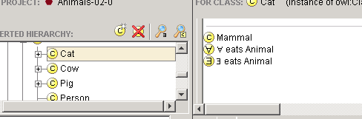
Remember to add any closure axioms
Closure
Axiom
Then let the reasoner do the work

Slide 28
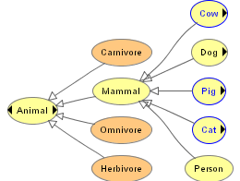
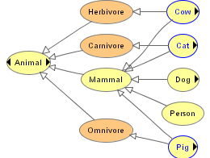
Normalisation:
From Trees to DAGs
Before classification
  A tree
After classification
  A DAG
    Directed Acyclic Graph

Slide 29
Summary: Normalised Ontology Development
Identify the self-standing primitives
  Comment any that are not self-evident
Separate them into trees
  You may have to create some ‘roles’ or other auxiliary concepts to do so
Identify the relations
  Comment any that are not self evident
Create the descriptions and definitions
  Provide a paraphrase for each
Identify how key items should be classified –
  Define regression tests
Use classifier to form a DAG
Check if tests are satisfied

Slide 30
Part II – Useful Patterns
(continued)
Upper ontologies & Domain ontologies
Building from trees and untangling
Using a classifier
Closure axioms & Open World Reasoning
Specifying Values
n-ary relations
Classes as values – using the ontology

Slide 31
Examine the modifier list
Modifiers
  Domestication
    Domestic
    Wild
  Use
    Draft
    Food
  Risk
    Dangerous
    Safe
  Sex
    Male
    Female
  Age
    Adult
    Child
Identify modifiers that have mutually exclusive values
  Domestication
  Risk
  Sex
  Age
Make meaning precise
  Age → Age_group
NB Uses are not mutually exclusive
  Can be both a draft (pulling) and a food animal

Slide 32
Extend and complete lists of values
Modifiers
  Domestication
    Domestic
    Wild
    Feral
  Risk
    Dangerous
    Risky
    Safe
  Sex
    Male
    Female
  Age
    Infant
    Toddler
    Child
    Adult
    Elderly
Identify modifiers that have mutually exclusive values
  Domestication
  Risk
  Sex
  Age
Make meaning precise
  Age → Age_group
NB Uses are not mutually exclusive
  Can be both a draft and a food animal

Slide 33
Note any hierarchies of values
Modifiers
  Domestication
    Domestic
    Wild
    Feral
  Risk
    Dangerous
    Risky
    Safe
  Sex
    Male
    Female
  Age
    Child
      Infant
      Toddler
    Adult
      Elderly
Identify modifiers that have mutually exclusive values
  Domestication
  Risk
  Sex
  Age
Make meaning precise
  Age → Age_group
NB Uses are not mutually exclusive
  Can be both a draft and a food animal

Slide 34
Specify Values for each:
Two methods
Value partitions
  Classes that partition a Quality
    The disjunction of the partition classes equals the
    quality class
Symbolic values
  Individuals that enumerate all states of a Quality
    The enumeration of the values equals the quality class

Slide 35
Method 1: Value Partitions- example “Dangerousness”
A parent quality – Dangerousness
Subqualities for each degree
  Dangerous, Risky, Safe
All subqualities disjoint
Subqualities ‘cover’ parent quality
  Dangerousness = Dangerous OR Risky OR Safe
A functional property has_dangerousness
  Range is parent quality, e.g. Dangerousness
  Domain must be specified separately
Dangerous_animal =
Animal and has_dangerousness some Dangerous

Slide 36
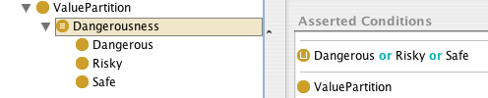
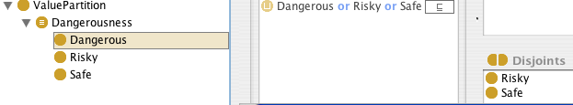
as created by Value Partition wizard

Slide 37
Value partitions
Diagram
Animal
Dangerous
animal
has_dangerousness
someValuesFrom
Risky
Dangerous
Leo the
Lion
has_dangerousness
Dangerousness
Leo’s
Danger
Safe

Slide 38
Value partitions UML style
Dangerousness_
Value
Animal
owl:unionOf
has_dangerousness
someValuesFrom
Dangerous
Animal
Safe_
value
Risky_
value
Dangerous_
value
Leo’s
Dangerousness
has_dangerousness
Leo the
Lion

Slide 39
Picture of subdivided value partition
Infant_
value
Elderly_
value
Toddler_
value
Adult_value
Child_value
Age_Group_value

Slide 40
Method 2: Value sets –
Example Sex
There are only two sexes
  Can argue that they are things
    “Administrative sex” definitely a thing
    “Biological sex” is more complicated

Slide 41
Method 2: Value sets- example “Sex”
A parent quality – Sex_value
Individuals for each value
  male, female
Values all different (NOT assumed by OWL)
Value type is enumeration of values
  Sex_value = {male, female}
A functional property has_sex
  Range is parent quality, e.g. Sex_value
  Domain must be specified separately
Male_animal =
Animal and has_sex is male

Slide 42
Value sets UML style
Person
Sex
Value
owl:oneOf
has_sex
Man
female
male
has_sex
John

Slide 43
Issues in specifying values
Value Partitions
  Can be subdivided and specialised
  Fit with philosophical notion of a quality space
  Require interpretation to go in databases as values
    in theory but rarely considered in practice
  Work better with existing classifiers in OWL-DL
Value Sets
  Cannot be subdivided
  Fit with intuitions
  More similar to data bases – no interpretation
  Work less well with existing classifiers

Slide 44
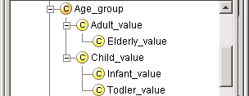
Value partitions – practical reasons for subdivisions
“All elderly are adults”
“All infants are children”
etc.
See also “Normality_status” in
http://www.cs.man.ac.uk/~rector/ontologies/mini-top-bio
  One can have complicated value partitions if needed.

Slide 45
Summary of Specifying Values
Principles
  Values distinct
    Disjoint if value partition/classes
    allDifferent if value sets/individuals
  Values “cover” type
    Covering axiom if value partition/classes
      Quality = VP₁ OR VP₂ OR VP₃ OR…OR VP_{n}
    Enumeration if value sets/individuals
      Quality = {v₁ v₂ v₃ … v_{n}}
  Property usually functional
    But can have multi-valued cases occasionally
Practice
  In this module we recommend you use Value Partitions in all cases for specifying values
    Works better with the reasoner
    We have a Wizard to make it quick

Slide 46
“Roles”
To keep primitives in disjoint
  need to distinguish the roles things play in different situations from what they are
  e.g. “pet”, “farm animal”, “draft animal”,
  “professor”, “student”, …
  “doctor”, “nurse”, “patient”
Often need to distinguish qualifications from roles
  A person may be qualified as a doctor but playing the role of a patient

Slide 47
Roles usually summarise relations
“to play the role of pet” is to say that there is somebody for whom the animal is a pet
“to play the role of doctor” is to say that there is somebody for whom the person is acting as the “doctor” – or some “situation” in which they play that role
But we often do not want to explain the situation or relation completely

Slide 48
“Roles” and “Untangling”
Draft_animal =
Animal &
has_role some Draft_role
Food_animal =
Animal &
has_role some Food_role
Pet_animal =
Animal &
has_role some Pet_role
Animal
  Draft_animal
    Cow
    Horse
    Dog
  Food_animal
    Cow
    Horse
  Pet_animal
    Horse
    Dog
Animal
  Mammal
    Cow
    Horse
    Dog
Animal_use_role
  Food_role
  Pet_role
  Draft_role
Vocabulary note:
“Draft” means pulling – as in
pulling a cart or plough

Slide 49
Logical approximations for roles
Cow plays_role some Draft_role
  Means all cows play some draft role
    Too strong a statement
Solutions
  Ignore the problem for purposes of the ontology
  Replace has_role by may_have_role
    Still to strong but probably the a pragmatic answer
If classifying instances need both
  All cows may have some draft role
  Cow → may_have Draft_role
    Just those that actually do are known as Draft_cows
      Draft_Cow = Cow & has_role Draft_role

Slide 50
Example of language problems
“DraftHorse” and “Draft_horse”
  Some breeds of horses were bred for draft work
    Known officialy as “Draft horses”
      The words have taken on a “idiomatic” meaning
        No longer mean what they say
        Other examples “Blue bird” vs “Bluebird”
        “Black berry” vs “Blackberry”
        …
Horse → may_have_role some Draft_role
  DraftHorse rdf:comment “Draft breed horse”
  Draft_horse = Horse AND has_role some Draft_role
  rdf:comment: “Horse actually used for draft work”

Slide 51
Separate Language Labels from Ontology
OWL/RDF mechanisms weak
  rdf:label
    Allows a language or sublanguage tag, but merely an annotation
Better to be maximally explicit in internal names for concepts
  Better to be not understood than to be misunderstood
Change DraftHorse to Draft_breed_horse
  rdf:label “Draft horse”

Slide 52
Ontology engineering
Provide paraphrases and comments for all classes
Provide probe classes and testing framework
  Probe classes: extra classes that either should or should not be satisfiable or classified in a particular place
    The tool lets you hide probe classes from user and delete them from final export
  Can also put debugging information on other classes
    Testing framework will report violations
This is still new software, so let us know if it doesn’t work or how it could be improved.

Slide 53
Summary of Approach
Steps in developing an Ontology (1)
Establish the purpose
  Without purpose, no scope, requirements, evaluation,
Informal/Semiformal knowledge elicitation
  Collect the terms
  Organise terms informally
  Paraphrase and clarify terms to produce informal concept definitions
  Diagram informally
Refine requirements & tests

Slide 54
Summary of Approach
Steps in implementing an Ontology (2)
Implementation
  Develop normalised schema and skeleton
  Implement prototype recording the intention as a paraphrase
    Keep track of what you meant to do so you can compare with what happens
      Implementing logic-based ontologies is programming
  Scale up a bit
    Check performance
  Populate
    Possibly with help of text mining and language technology
Evaluate & quality assure
  Against
  Include tests for evolution and change management
  Design regression tests and “probews”
Monitor use and evolve
  Process not product!

Slide 55
Lab Exercise
Take cards for University ontology to produce an ontology for the university including the personnel department’s equal opportunities officer
Group the cards and form initial hierarchies
  Separate likely primitives, modifiers, roles, defined concepts and properties, classes and individuals
  Ladder up to provide abstractions as needed
    And fill in siblings
  Propose a normalised ontology
    Classify it to see that it works correctly
      Provide probe classes to check both classification and unsatisfiability
        One file to turn in
  Download the tangled ontology proposed by the personnel department
    Untangle it
      A second file to turn in

