Slide 1

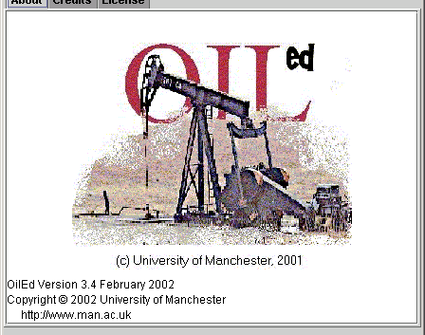



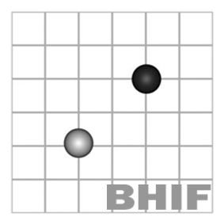



Foundations of the Semantic Web:
Ontology Engineering
Building Ontologies 5
Ontology Patterns
Upper Ontologies
Alan Rector & colleagues
Special acknowledgement to Jeremy Rogers & Chris Wroe

Slide 2
An Old Problem
“On those remote pages it is written that animals are divided into:
a. those that belong to the Emperor
b. embalmed ones
c. those that are trained
d. suckling pigs
e. mermaids
f. fabulous ones
g. stray dogs
h. those that are included in this classification
i. those that tremble as if they were mad
j. innumerable ones
k. those drawn with a very fine camel's hair brush
l. others
m. those that have just broken a flower vase
n. those that resemble flies from a distance"
From The Celestial Emporium of Benevolent Knowledge, Borges

Slide 3
We know it is wrong – but why?
Do we really mean wrong?
Many upper ontologies
  Some very abstract, some less so
  Dolce/OntoClean my favourite current compromise besides
    See Guarino and Welty: http://www.loa-cnr.it/DOLCE.html
      doc paper is a readable summary if you can get past the vocabulary
      Also Guarino’s home page
  Others
    SUO (Standard Upper Ontology)
    John Sowa’s work – see Google
    OpenCyc
    OpenGALEN
There is no one way!
  No matter how much some people want to make it a matter of dogma

Slide 4
Ontology Layers: What’s it for?
The Meta Ontology is to enable…
Cooperation on the
Upper Ontologies to enable ….
Cooperation on
Top Domain Ontologies
to enable…
Cooperation on the
Domain Content
Ontologies to enable…
Cooperation on
Information systems &
resources

Slide 5
Where do DLs fit in?
FoL /
HoL
Meta Ontology
Upper Ontologies
Top Domain
Ontologies
DLs?
(“classes”)
Domain Content
Ontologies
Information
systems &
resources
Databases, RDF
Instance stores, …
(“individuals”)

Slide 6
How best to construct an
Upper Ontology in OWL?
With the new expressivity of OWL
Using the principles of “normalisation”
  Decomposition of primitives into disjoint trees
  Any information should require changing in only one place
Focus on the relations
  Upper ontology entities should constrain relations
    otherwise they are a distinction without a difference
Taking into account other work and harmonisation
  Eg. for anatomy, The Digital Anatomist FMA & Harmonisation with Mouse Developmental and Adult Anatomy in SOFG
  OntoClean
  Barry Smith’s work on Formal Ontology
Identifying issues that transcend formalism

Slide 7
Principles
An Implemented Ontology in OWL/DLs
  Must be implemented and support a large ontology
Must allow definition of top level domain ontology
  The goal is to help domain experts reate their starting points and patterns
Just enough
  No distinction without a difference!
    Properties are as important as Classes/Entities/Concepts
      If an upper level category does not act as a domain or range constraint or have some other engineering effect, why represent it?
  Exclude things that will be dealt with by other means or given
    “Concrete domains”
    Time and place
      Designed to record what an observer has recorded at a given place and time
    Non_physical – e.g. agency
    Causation – except in sense of “aetiology”

Slide 8
Principles 2
Minimal commitment
  Don’t make a choice if you don’t have to
Understandable
  Experts an make distinctions repeatably/reliably
Able to infer classification top domain concepts
  ‘Twenty questions’ – to neighbourhood
Upper ontology primarily composed of ‘open dichotomies’
  Open to defer arguments such as whether Collectives of Physical things are physical

Slide 9
Specific requirements
Anatomy, Physiology, Disease, Pathology (Procedures)
Part-whole relations and the relation of diseases to anatomy
Differences in granularity
Differences in view between specialties
  the Digital Anatomist’s Foundational Model of Anatomy (FMA)
  Mouse embryo and adult Anatomy
  GALEN anatomy
  ‘Usual clinical usage’

Slide 10
Upper Ontologies are different
Domain ontologies are built from trees
  Disjoint single hierarchies
  Distinguished by “Rigid Predicates”
Upper ontologies are built from dichotomies
  “Dichotomy” – a distinction between two categories
The goal
  Be able to ask a few questions and position anything approximately in the right place in the ontology.

Slide 11
The Properties Hierarchy
Properties are as important as Classes
Basic meaning analogous to classes
  p
  p_sub
  p_sub_sub
  Anything linked by p_sub_sub is linked by p_sub;
  Anything linked by p_sub is linked by p
  For all xy . x p_sub_sub y → x p_sub y → x p y
  p_sub_sub SOME C→p_sub SOME C → p SOME C
A powerful means of inference used in, amongst other things:
  Part-whole relations
  “Participations” in processes
  “Views”
    allowing different applications to see different aspects of a property
  Lots of work arounds
    Transitive property with a non-transitive subproperty

Slide 12
This time begin from the top
The very top
  Domain_entity
    Always good practice to provide your own top
    You may want to create ‘probes’ or do other nasty work arounds.
      The real ontology is under Domain Entity

Slide 13
Basic distinctions
Self-standing vs Refining
  Self standing
    Person, computer, idea…
  Refining
    big, serious, efficient, …
  Self_standing_entity is_refined_by Refining_entity
    Establishes the domain & range of a top property distinction
  Question: Does it make sense on its own?
    If so, self_standing.

Slide 14
More Traditional Distinction
Independent vs Dependent
Independent
  Entities which you can talk about on their own
    Birds, ideas, courses, light…
Dependent
  Entities that only make sense in the context of other things
    Colours, qualities, groups, collections, relations, …
Alternatively - Pierce gave up and Sowa agreed to follow…
  “Firsts”, “Seconds” and “Thirds”
    Look up John Sowa on Google

Slide 15
Within Self Standing
Continuant vs Occurrent
  Self_standing_entity participates_in Occurrent_entity
Physical vs Non_physical
  Non_physical is_manifested_by Physical
  Only physical an be material
    Material defines non_material (things define holes)
Discrete vs Mass
  Discrete_entity is_constituted_of Mass_entity
Complex – all collections, relations, groups, etc.
  No opposite – all arguments deferred
  Complex has_member Self_standing_entity
(Biological – Non-biological)
  Artifacts, Natural_non_biological
    Exclusive? Think about it

Slide 16
Continuant vs Occurrent
“Processes happen to things”
Continuants participate_in Occurrents
  Occurrents can also participate in other Occurrents
    But only occurrents can be participated in
      One justification for the difference - Occurrent is domain for has_parfticipant
Continuants (“endurants”)
  Things that retain their form over time
    People, books, desks, water, ideas, universities, …
Occurrents (“perdurants”)
  Things that occur during time
    Living, writing a book, sitting at a desk, the flow of water, thinking, building the university, ...
Question: Do things happen to it? then Continuant
Does it happen or occur? then Occurrent.

Slide 17
Processes act on things
One form of participation is acting on
  Linguists call it “agency” but that label gets muddled up with legal agency and responsibility
  Occurrent acts_on Self_standing_entity

Slide 18
Processes have outcomes
One form of acting-on something is having it as an outcome outcome
Represented in the property hierarchy
  has_participant
  acts_on
  has_outcome
Occurrent has_outcome Self_standing_entity
  Outcomes can be either Continuants or Occurrents
    But only Occurrents have outcomes
      Check the Domain and Range of has_participant

Slide 19
Physical vs non-Physical
Physical entities manifest non-physical patterns
Physical entities embody non-physical agents
Physical entities have energy or mass and occupy space or time
  bodies, electricity, water, buildings, burning, cavities, planes and lines formed by the intersection of physical things…
Nonphysical things
  Describe “Patterns”
    Forms, styles, ‘oeuvres’, …
  Describe “psycho-social phenomena”
    Organisations, agents, institutions, ideas
Question: Does it have mass or energy? Does it occupy space at some time? Then it is (probably) physical.

Slide 20
Material vs Non-material Physical things
Within Physical_entities
  The problem of holes
    Material things define non-material things
      The room defines the interior of the room
      The glass defines the space in the glass
      The donut defines the hole in the donut
      The intersection of the walls defines the corner (a line)

Slide 21
Discrete vs Mass
Things are made of Stuff
Discrete_entities are constituted of Mass_entities
  The statue vs the clay of which the statue is made
  The liver vs the tissue that makes up the liver
  The table top vs the wood that constitutes the table top
Discrete things can be counted
Mass things can only be measured
  Guarino calls them “Amount of matter”
    An instance of a mass stuff is an amount of that stuff
Questions: Can I count it? then it is probably discrete
If I make a plural, is it odd or something different?
e.g. “waters”, “papers”, “thinkings”, or do plurals
mean different kinds e.g. “paints”, “tissues”?
do I say pieces/drops/lumps of it?
then it is probably mass

Slide 22
Discrete vs Mass
Cognitivist vs Realist
Cognitivist
  Two entities can occupy the same space and time
    The clay is different from the statue
      If I replace some of the clay, it is still the same statue
      The properties of the clay are different from the properties of the statue
      There is different information to be conveyed about the clay than there is to be conveyed about the statue
Realist
  In any one time-space extent, there can be exactly one physical entity
    Different lumps of stuff are parts of it at different times

Slide 23
Things have parts
A common pattern
  Define the thing and a class for parts of the thing
    Organ & Organ_part
    Building & Building_part
    Course & Course_part
    Book & book part
    …
  Distinctions are usually derived from domain considerations rather than ontology
    E.g. “organ” has a special meaning for (some) anatomists

Slide 24
Complexes vs (Monads)
Complexes
  Aggregations
    NOT mathematical sets
      Entities where we are interested in the collective properties rather than the individual properties
    No standard classification but ours is
      Group – e.g. Flocks of geese, schools of fish, crowds…
      Discrete collections of discrete things
      Collective – e.g. metal – atoms, tissue-cells,
      Mass collections of discrete things
  Relations
    Reified relations that bring two or more things together with specific roles or aspects
      E.g. ‘marriage’, ‘partnership’, …

Slide 25
Granularity
Collective vs Individual
Collectives of discrete entities at one level form mass entities at the next
  e.g. Collective of grains of sand is constituent of a beach
  Collective of red cells are a portion of blood
  Collective of water molecules are a portion of water
  Collective of bone cells are a portion of bone tissue
  is a constituent of long bones
  The concern is with the collective as a whole not its ‘grains’
  Loss or gain of grains does not affect identity of multiple
  Not a matter of size,
    although grains are always smaller than the multiples they make up

Slide 26
Complexes vs (Monads)
Dangerous to say that anything is not a complex
  Some things are definitely complexes
    But almost anything can be viewed as a complex of some sort

Slide 27
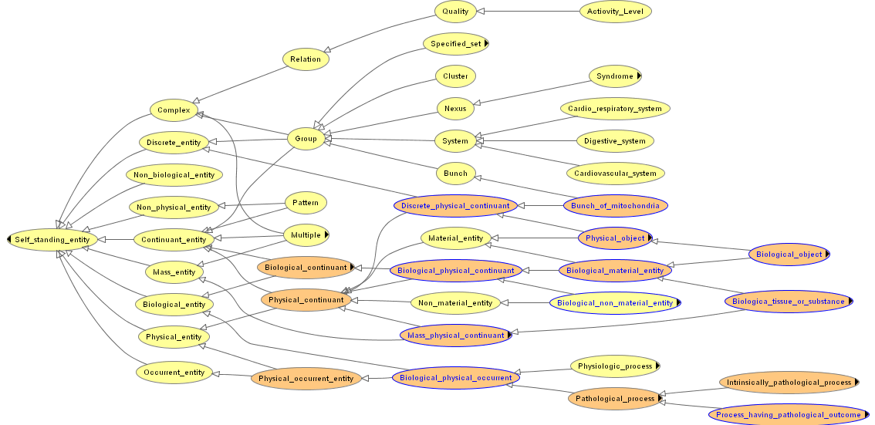
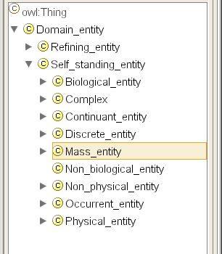
Basic Distinctions

Slide 28
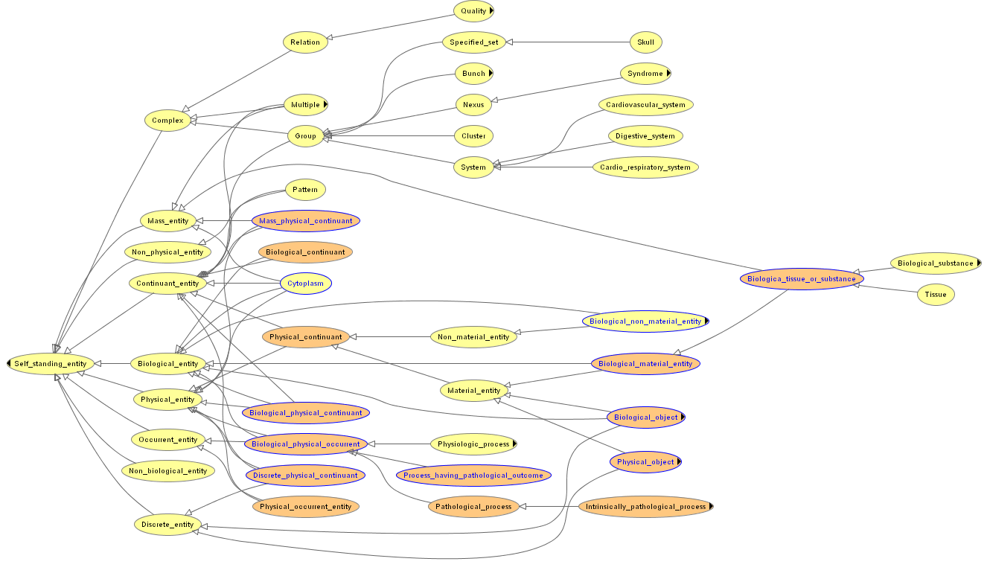
Unclassified Structure

Slide 29
Classified Structure
Looking from the top not always helpful

Slide 30
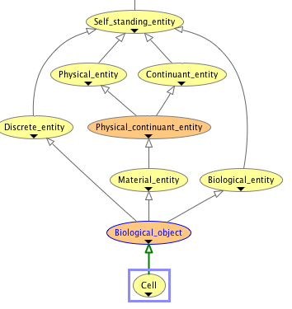
A better way to explore an ontology - Pick something and look at it from bottom:
A Cell - Unclassified

Slide 31
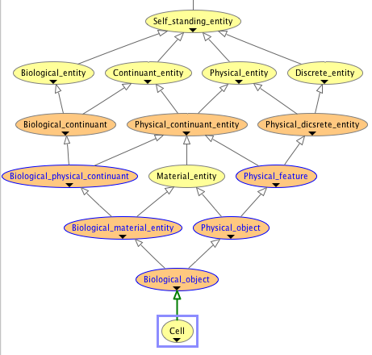
And its classification
Cell - Classified

Slide 32
Nonphysical entities
A real problem for for Librarians, Organisations & the law
What is “Hamlet”? What is “Lord of the Rings”?
    The script for hamlet in the library?
    The original folio?
    A performance?
  Can I own “Hamlet”?
  Can I own “Lord of the Rings”?
  “A DVD of ‘Lord of the Rings’”
  “The script to ‘Lord of the Rings’”
  “A copy of the book ‘Lord of the Rings’”
  “The first edition of the ‘Lord of the Rings’”
  “A copy of the first edition of the ‘Lord of the Rings’”

Slide 33
Agents and Actors
Occurrents have actors
  The actor in the Process_of_erosion is the River
  The actor in the Breaching_of_the_levy is Hurricane_Rita
Some actors are special and take responsibility and have legal status
  We call them ‘agents’
    At least Person and Organisation
    Possibly God, other animals, …
      A good argument for the ‘informationalist view’
        If there is information about it, then it is worth representing.
    In this ontology - Potential_agent are things that can be agents.
      ‘Agent’ is something which is an agent for some Occurrent.

Slide 34
Agents – a problem for lawyers
Is the agent Alan a different entity from Alan’s Body?
Who owns my body? Before death? After death?
    In England, I do before death; my next of kin, after death, unless I am an executed felon,
    but other jurisdictions have different laws
  Hard to avoid dualism in legal ontologies!
    When my body dies, ‘I’ cease to exist, but my body still exists, it is just dead
    For the informationalist it
Can animals be agents
  In biology? In Law?

Slide 35
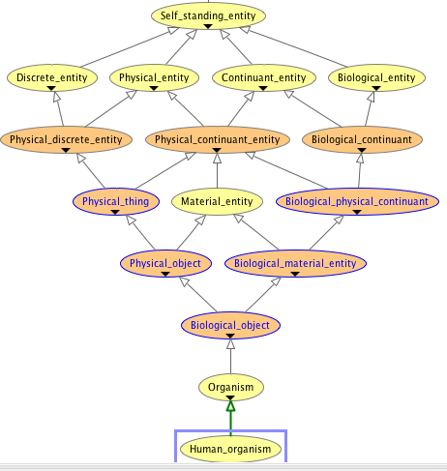
Human Organism (classified)

Slide 36
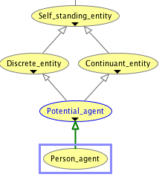
Person Agent (Classified)

Slide 37
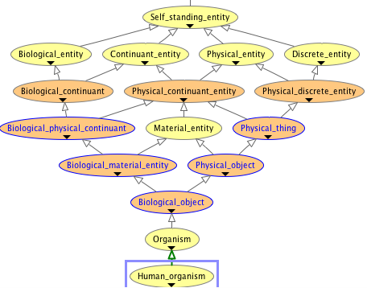
Human_organism (classified)

Slide 38
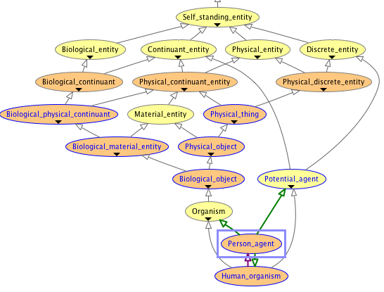
If we equate them, what a tangle!

Slide 39
Acts
Occurrents whose actors are Agents are Acts_
Use a special subproperty - has_agent - to avoid ambiguity
  Acts are the top level concepts in many management ontologies
  A thorough study of responsibility, agency, and authorisation is a course for the business and law departments

Slide 40
Artifacts
“Artifacts” are the physical outcome of “Acts”
  Can have arguments about whether they must be things or can also be processes such as performances
Some would divide the world into
  Artifacts - the made world
  Biological - the evolved world (& things derived from it)
  Non-biological - the accumulated world
    Awkward case: Coal

Slide 41
“Oeuvres”
The non-physical patterns of intellectual work
  Patterns that are the outcome of Acts by Agents
  Hamlet is the outcome of an act of playwriting by Shakespeare
  This copy of Hamlet is the result of an act of printing by Oxford University Press
    And is a manifestation of the Oeuvre “Hamlet”
  This performance of Hamlet is the result of an Act of Performance by the Royal Exchange Theatre Company
    And is also a manifestation of the Oeuvre “Hamlet”

Slide 42
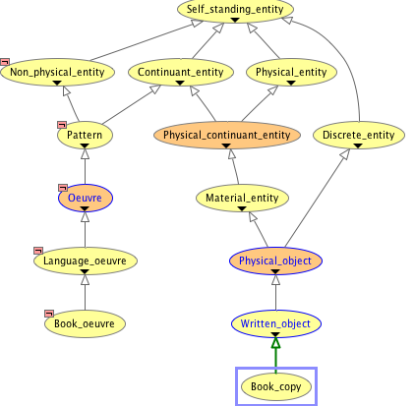
Book_oeuvre & Book_copy before classification

Slide 43
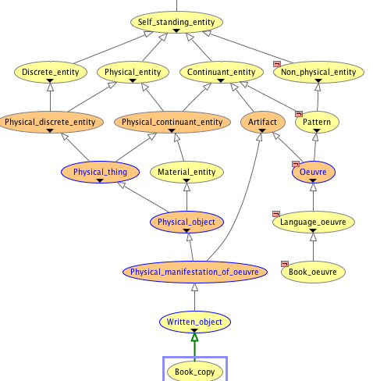
After classification

Slide 44
OntoClean / Upper & Domain Ontologies
OntoClean is a meta-ontology for checking whether an ontology is sensible
  DOLCE is an upper ontology built on the principles of OntoClean
Rigid vs Non-rigid properties
  Rigid predicates never change through the life of the entity
    Many rigid predicates difficult to pin down
      What makes a horse a horse? A dog a dog?
  OntoClean principles as applied to OWL
    Distinctions between primitive classes should be based on rigid predicates (Aristotle’s differentia)
      When normalised, the trees should be based on rigid predicates
        All non-rigid predicates should be represented by restrictions
        All classification based on non-rigid properties should be performed by the classifier

Slide 45
Now we can say why this looks odd
“On those remote pages it is written that animals are divided into:
a. those that belong to the Emperor
b. embalmed ones
c. those that are trained
d. suckling pigs
e. mermaids
f. fabulous ones
g. stray dogs
h. those that are included in this classification
i. those that tremble as if they were mad
j. innumerable ones
k. those drawn with a very fine camel's hair brush
l. others
m. those that have just broken a flower vase
n. those that resemble flies from a distance"

Slide 46
“Twenty questions”
Example: What is an Organelle?
(The small organs inside cells – mitochondria, chlorplasts, etc)
Is it Continuant or Occurrent? Continuant
  Does it happen or do things happen to it?
Is it physical? yes
Is it Discrete or mass? Discrete
  (Can you count it?)
If physical & discrete, Is it material or non-material (thing or hole)? Material
Is it Biological? yes

Slide 47
Further questions
Is it part of something? yes
  if so, definite number or not? no
    Collectives of Organels are part of Cytoplasm`
Therefore, it is a “Cell_part” (a subclass of Biological_object)

Slide 48
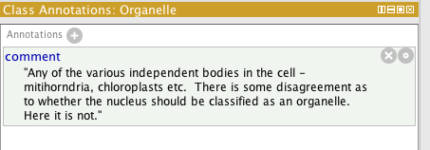
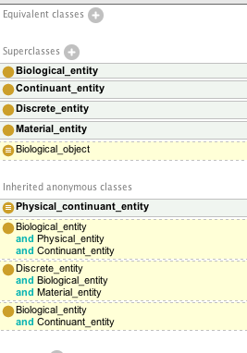
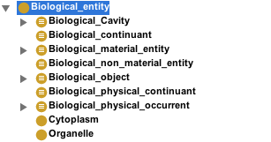
Before Classification
Classified simply Biologica_entity

Slide 49
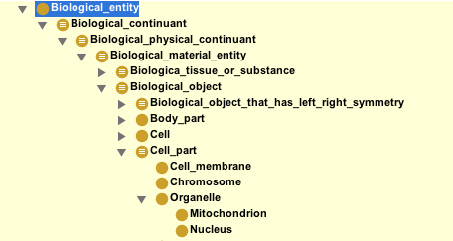
After Classification
Classified under Cell_part

Slide 50
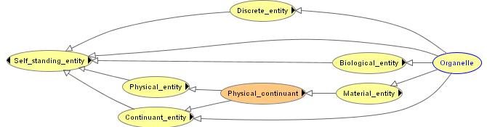

Before Classification
After Classification

Slide 51
“Twenty Questions”
Cytoplasm (the substance that fills the cells)
Is it Continuant or Occurrent? Continuant
Is it physical? yes. Is it material? yes, yes
Is it discrete or mass? mass
Is it biological? yes
Then it must be a “Tissue_or_substance”

Slide 52
What is Digestion
Is it Continuant or occurrent? - occurrent
Is it physical? - yes
Is it discrete or mass? ? defer
Is it biological? yes
If so is it pathological no
Then it must be a “Biological_physical_occurrent”
  Name chosen deliberately to defer mass/discrete choice

Slide 53
The Properties Hierarchy
Basic meaning analogous to classes
  p
  p_sub
  p_sub_sub
  Anything linked by p_sub_sub is linked by p_sub;
  Anything linked by p_sub is linked by p
  For all xy . x p_sub_sub y → x p_sub y → x p y
  p_sub_sub SOME C→p_sub SOME C → p SOME C
A powerful means of inference used in, amongst other things:
  Part-whole relations
  “Participations” in processes
  “Views”
    allowing different applications to see different aspects of a property
  Lots of work arounds
    Transitive property with a non-transitive subproperty

Slide 54
Views and the Property Hierarchy
The property hierarchy is as important as the class hierarchy
  E.g. For different flavours of part of, containment, etc.
  For direct variants of transitive relations
  For many other inferences
    Can sometimes get around the lack of variables

Slide 55
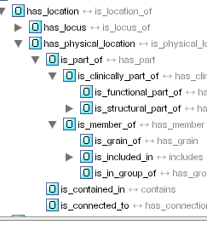
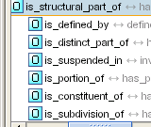
Consider the part-of hierarchy

Slide 56
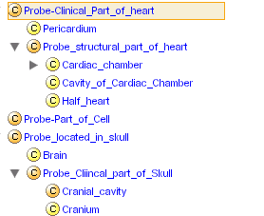
Sufficient to support multiple “views”
Clinician’s view:
Pericardium is
part of heart &
Pericardiitis is
a kind of Heart
Disease
Formally:
The Brain is contained in the Cavity defined by the Cranium which is a structural part of
the skull.
Anatomist’s view:
Pericardium is
a distinct organ that
develops separately
from Heart
Both views:
The Brain is
located in the skul but not
part of the skull

Slide 57
Current Controversies
Mass vs Discrete entities
  Do tissues exist as distinct from the organs they constitute?
Structured mass entities
  Tissues, cloth, …
Scale
  Fixed partitions vs case by case representation of “collectives”
Anything to do with agents

Slide 58
Controversies: How to argue?
Evidence is effect on representation
The test is ‘faithful communication’
  Is there a real difference or just labelling
    Are two solutions really isomorphic up to labelling?
  Relative expressiveness?
  Effect on hard cases?
  Understandability? / Repeatability?
    The views of domain experts
      Whether there is a transformation from untuitive form to
  Effect on performance?
    Small changes can have massive effects on classification time

Slide 59
OntoClean & Dolce
One Upper Ontology
Owl version Provided in the lab – see also URL
    http://www.loa-cnr.it/DOLCE.html
  Vocabulary:
    “Predicate” – “Class”
      i.e. a Class is equivalent to a one-place predicate
        the Class ‘C’ is equivalent to the predicate C(x)
    Sortal – “Self-standing entity”
      To a good first approximation
    “Amount of matter” - “Mass_entity”
  OntoClean is a meta ontology & methodology for ontology building
    An ontology about the properties of concepts
    used to constrain
    DOLCE is an upper ontology that conforms to Ontoclean

Slide 60
Alternative Upper Ontology: BFO
Basic Formal Ontology
    http://www.ifomis.uni-saarland.de/bfo/
  Vocabulary
    “Universal” - “Class”
      (with some arguments)
    “Relation” - “Property”
    “Fiat” vs “Bona fide” boundaries & entities
      High level division between “natural” and human imposed
  Commitments
    All universals should have a (direct) instance
    “Granularity”
      Each ontology expected to be at a specific level of granulity
    Uses “realist” view that rejects the notion of “Amount of Substance” and “constitutes” relation.
      “The statue is the amount of clay” rather than “The statue is constiuted of the amount of clay”
    Used by OboFoundry -
      http://obofoundry.org/wiki/index.php/Main_Page
      Extensions and ontologies surround the Gene Ontology

