Slide 1

Knowledge Representation in Protégé –OWL
Please install from CDs or USB pens provided:
  http://www.co-ode.org/resources/tutorials/iswc2005
  Protégé 3.2 Beta – complete installation
  See instructions for other software on web site
    You will need
    At least one classifier - Racer, FaCT++ and/or Pellet
    Graphviz
    The example ontologies
    The CO-ODE plugins not bundled with 3.2 beta
    (a single zip on web site)

Slide 2
Ontology Design Patterns and Problems:
Practical Ontology Engineering using Protege-OWL
Alan Rector¹, Natasha Noy², Nick Drummond¹,
Mark Musen²
¹University of Manchester
²Stanford University
rector@cs.man.ac.uk
{noy, holger}@smi.stanford.edu
musen@smi.stanford.edu

Slide 3
Program
I Ontologies and “Best Practice”
II Creating an ontology – useful patterns
III Hands on examples
IV Patterns: n-ary relations
V Patterns: classes as values
VI Patterns: part-whole relations
VII Summary

Slide 4
Part I: Ontologies & “Best Practice”
What are Ontologies & a review of History
Semantic Web
OWL
“Best Practice”
  Semantic Web Best Practice & Deployment Working Group (SWBP)

Slide 5
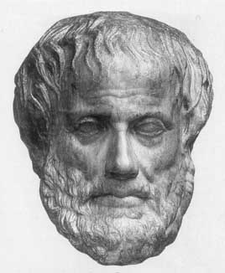
What Is An Ontology?
Ontology (Socrates & Aristotle 400-360 BC)
The study of being
Word borrowed by computing for the
explicit description of the conceptualisation of a domain:
  concepts
  properties and attributes of concepts
  constraints on properties and attributes
  Individuals (often, but not always)
An ontology defines
  a common vocabulary
  a shared understanding

Slide 6
Why Develop an Ontology?
To share common understanding of the structure of descriptive information
  among people
  among software agents
  between people and software
To enable reuse of domain knowledge
  to avoid “re-inventing the wheel”
  to introduce standards to allow interoperability

Slide 7
Measure the world…quantitative models
(not ontologies)
Quantitative
  Numerical data:
    2mm, 2.4V, between 4 and 5 feet
  Unambiguous tokens
  Main problem is accuracy at initial capture
  Numerical analysis (e.g. statistics) well understood
Examples:
  How big is this breast lump?
  What is the average age of patients with cancer ?
  How much time elapsed between original referral and first appointment at the hospital ?
KIPKE
GRAPHICS
2001
BOB
2000
KIPKE
GRAPHICS
BOB
KIPKE
GRAPHICS
BOB
KIPKE
2000
2001
BOB
GRAPHICS

Slide 8
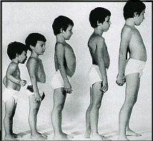
describe the our understanding of the world - ontologies
Qualitative
  Descriptive data
    Cold, colder, blueish, not pink, drunk
  Ambiguous tokens
    What’s wrong with being drunk ?
      Ask a glass of water.
  Accuracy poorly defined
  Automated analysis or aggregation is a new science
Examples
  Which animals are dangerous ?
  What is their coat like?
  What do animals eat ?
KIPKE
BOB
GRAPHICS
KIPKE
GRAPHICS
2001
2000
BOB

Slide 9
More Reasons
To make domain assumptions explicit
  easier to change domain assumptions (consider a genetics knowledge base)
  easier to understand and update legacy data
To separate domain knowledge from the operational knowledge
  re-use domain and operational knowledge separately (e.g., configuration based on constraints)
To manage the combinatorial explosion

Slide 10
An Ontology should be just the Beginning
Databases
Ontologies
Declare
structure
Knowledge
bases
The “Semantic
Web”
Provide
domain
description
Software agents
Problem-solving methods
Domain-independent
applications

Slide 11
Outline
What are Ontologies
Semantic Web
OWL
Best Practice

Slide 12
The semantic web
Tim Berners-Lee’s dream of a computable meaningful web
  Now critical to Web Services and Grid computing
Metadata with everything
  Machine understandable!
    Ontologies are one of the keys

Slide 13


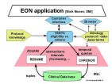
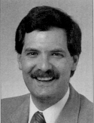
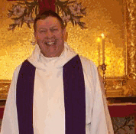
Understanding rather than text matching
Google image results for
  Charlie Safran
  Mark Musen
  Alan Rector

Slide 14
Ontology Examples
Taxonomies on the Web
  Yahoo! categories
Catalogs for on-line shopping
  Amazon.com product catalog
Dublin Core and other standards for the Web
Domain independent examples
  Ontoclean
  Sumo

Slide 15
Ontology Technology
“Ontology” covers a range of things
  Controlled vocabularies – e.g. MeSH
    Linguistic structures – e.g. WordNet
  Hierarchies (with bells and whistles) – e.g. Gene Ontology
  Frame representations – e.g. FMA
  Description logic formalisms – Snomed-CT, GALEN, OWL-DL based ontologies
  Philosophically inspired e.g. Ontoclean and SUMO

Slide 16
Outline
What are Ontologies
Semantic Web
OWL
Best Practice

Slide 17
OWL
The Web Ontology Language
W3C standard
Collision of DAML (frames) and Oil (DLs in Frame clothing)
Three ‘flavours’
  OWL-Lite –simple but limited
  OWL-DL – complex but deliverable (real soon now)
  OWL-Full – fully expressive but serious logical/computational problems
    Russel Paradox etc etc
  All layered (awkwardly) on RDF Schema
Still work in progress – see Semantic Web Best Practices & Deployment Working Group (SWBP)

Slide 18
Note on syntaxes for OWL
Three official syntaxes + Protégé-OWL syntax
  Abstract syntax -Specific to OWL
  N3 -OWL & RDF
  -used in all SWBP documents
  XML/RDF -very verbose
  Protégé-OWL -Compact, derived from DL syntax
This tutorial uses simplified abstract syntax
  someValuesFrom → some
  allValuesFrom → only
  intersectionOf → AND
  unionOf → OR
  complementOf → not
Protégé/OWL can generate all syntaxes

Slide 19
A simple ontology: Animals
Body Part
Living Thing
eats
has part
Plant
Arm
Animal
eats
Leg
eats
Grass
Herbivore
Person
Tree
Carnivore
Cow

Slide 20
Description Logics
What the logicians made of Frames
  Greater expressivity and semantic precision
    Compositional definitions
      “Conceptual Lego” – define new concepts from old
To allow automatic classification & consistency checking
  The mathematics of classification is tricky
    Some seriously counter-intuitive results
      The basics are simple – devil in the detail

Slide 21
Description Logics
Underneath:
  computationally tractable subsets of first order logic
Describes relations between Concepts/Classes
  Individuals secondary
    DL Ontologies are NOT databases!

Slide 22
Description Logics:
A brief history
Informal Semantic Networks and Frames (pre 1980)
  Wood: What’s in a Link; Brachman What IS-A is and IS-A isn’t.
First Formalisation (1980)
  Bobrow KRL, Brachman: KL-ONE
All useful systems are intractable (1983)
  Brachman & Levesque: A fundamental tradeoff
    Hybrid systems: T-Box and A-Box
All tractable systems are useless (1987-1990)
  Doyle and Patel: Two dogmas of Knowledge Representation

Slide 23
A brief history of KR
‘Maverick’ incomplete/intractable logic systems (1985-90)
  GRAIL, LOOM, Cyc, Apelon, …,
Practical knowledge management systems based on frames
  Protégé
The German School: Description Logics (1988-98)
  Complete decidable algorithms using tableaux methods (1991-1992)
  Detailed catalogue of complexity of family – “alphabet soup of systems”
Optimised systems for practical cases (1996-)
Emergence of the Semantic Web
  Development of DAML (frames), OIL (DLs) → DAML+OIL → OWL
    Development of Protégé-OWL
    A dynamic field – constant new developments & possibilities

Slide 24
Outline
What are Ontologies
Semantic Web
OWL
“Best Practice”
  Semantic Web Best Practice & Deployment Working Group (SWBP)

Slide 25
Why the
“Best Practice working Group”?
There is no established “best practice”
  It is new; We are all learning
  A place to gather experience
  A catalogue of things that work –
  Analogue of Software Patterns
    Some pitfalls to avoid
      …but there is no one way
Learning to build ontologies
  Too many choices
    Need starting points for gaining experience
Provide requirements for tool builders

Slide 26
Contributing to “best practice”
Please give us feedback
  Your questions and experience
    On the SW in general:
    semanticweb@yahoogroups.com
    For specific feedback to SWBP
      Home & Mail Archive: http://www.w3.org/2001/sw/BestPractices/
      public-swbp-wg@w3.org

Slide 27
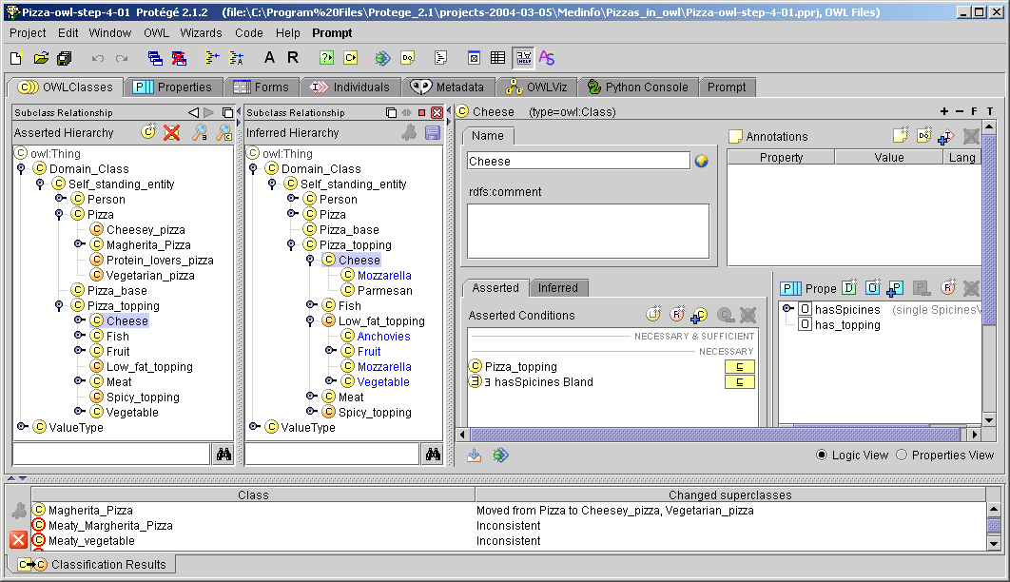
Protégé OWL: New tools for ontologies
Transatlantic collaboration
Implement robust OWL environment within PROTÉGÉ framework
Shared UI
components
Enables hybrid
working

Slide 28
Protégé-OWL & CO-ODE
Joint work: Stanford & U Manchester +
Southampton & Epistemics
  Please give us feedback on tools – mailing lists & forums at:
    protege.stanford.edu
    www.co-ode.org
Don’t beat your head against a brick wall!
  Look to see if others have had the same problem; If not…
  ASK!
    We are all learning.

Slide 29
Part II – Creating an ontology
Useful patterns
Upper ontologies & Domain ontologies
Building from trees and untangling
Using a classifier
Closure axioms
Specifying Values
n-ary relations
Classes as values – using the ontology
Part-whole relations

Slide 30
Upper Ontologies
Ontology Schemas
  High level abstractions to constrain construction
    e.g. There are “Objects” & “Processes”
  Highly controversial
    Sumo, Dolce, Onions, GALEN, SBU,…
  Needed when you work with many people together
  NOT in this tutorial – a different tutorial

Slide 31
Domain Ontologies
Concepts specific to a field
  Diseases, animals, food, art work, languages, …
  The place to start
    Understand ontologies from the bottom up
      Or middle out
Levels
  Top domain ontologies – the starting points for the field
    Living Things, Geographic Region, Geographic_feature
  Domain ontologies – the concepts in the field
    Cat, Country, Mountain
  Instances – the things in the world
    Felix the cat, Japan, Mt Fuji

Slide 32
Part II – Useful Patterns
(continued)
Upper ontologies & Domain ontologies
Building from trees and untangling
Using a classifier
Closure axioms & Open World Reasoning
Specifying Values
n-ary relations
Classes as values – using the ontology

Slide 33
Example: Animals & Plants
Dog
Cat
Cow
Person
Tree
Grass
Herbivore
Male
Female
Carnivore
Plant
Animal
Fur
Child
Parent
Mother
Father
Dangerous
Pet
Domestic Animal
Farm animal
Draft animal
Food animal
Fish
Carp
Goldfish

Slide 34
Example: Animals & Plants
Dog
Cat
Cow
Person
Tree
Grass
Herbivore
Male
Female
Carnivore
Plant
Animal
Fur
Child
Parent
Mother
Father
Healthy
Pet
Domestic Animal
Farm animal
Draft animal
Food animal
Fish
Carp
Goldfish

Slide 35
Choose some main axes
Add abstractions where needed; identify relations; Identify definable things, make names explicit
Living Thing
  Animal
    Mammal
      Cat
      Dog
      Cow
      Person
    Fish
      Carp
      Goldfish
  Plant
    Tree
    Grass
    Fruit
Modifiers
  domestic
    pet
    Farmed
      Draft
      Food
  Wild
  Health
    healthy
    sick
  Sex
    Male
    Female
  Age
    Adult
    Child
Relations
  eats
  owns
  parent-of
  …
Definable
  Carinvore
  Herbivore
  Child
  Parent
  Mother
  Father
  Food Animal
  Draft Animal

Slide 36
Reorganise everything but “definable” things into pure trees – these will be the “primitives”
Primitives
  Living Thing
    Animal
      Mammal
        Cat
        Dog
        Cow
        Person
      Fish
        Carp
        Goldfish
    Plant
      Tree
      Grass
      Fruit
Modifiers
  Domestication
    Domestic
    Wild
  Use
    Draft
    Food
    pet
  Risk
    Dangerous
    Safe
  Sex
    Male
    Female
  Age
    Adult
    Child
Relations
  eats
  owns
  parent-of
  …
Definables
  Carnivore
  Herbivore
  Child
  Parent
  Mother
  Father
  Food Animal
  Draft Animal

Slide 37
Set domain and range constraints for properties
Animal eats Living_thing
  eats domain: Animal;
  range: Living_thing
Person owns Living_thing except person
  owns domain: Person
  range: Living_thing & not Person
Living_thing parent_of Living_thing
  parent_of: domain: Animal
  range: Animal

Slide 38
Define the things that are definable from the primitives and relations
Parent =
Animal and parent_of some Animal
Herbivore=
Animal and eats only Plant
Carnivore =
Animal and eats only Animal

Slide 39
Which properties can be filled in at the class level now?
What can we say about all members of a class?
  eats
    All cows eat some plants
    All cats eat some animals
    All dogs eat some animals &
    eat some plants

Slide 40
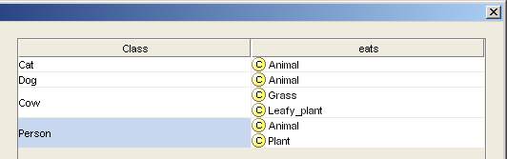
Fill in the details
(can use property matrix wizard)

Slide 41
Check with classifier
Cows should be Herbivores
  Are they? why not?
    What have we said?
      Cows are animals and, amongst other things,
      eat some grass and
      eat some leafy_plants
    What do we need to say:
    Closure axiom
      Cows are animals and, amongst other things,
      eat some plants and eat only plants

Slide 42
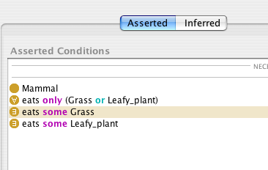
Closure Axiom
  Cows are animals and, amongst other things,
  eat some plants and eat only plants
Closure
Axiom

Slide 43
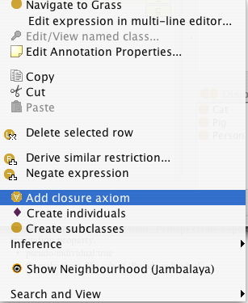
In the tool
Right mouse button short cut for closure axiom
  for any existential restriction
adds closure
axiom

Slide 44
Open vs Closed World reasoning
Open world reasoning
  Negation as contradiction
    Anything might be true unless it can be proven false
      Reasoning about any world consistent with this one
Closed world reasoning
  Negation as failure
    Anything that cannot be found is false
      Reasoning about this world

Slide 45
Normalisation and Untangling
Let the reasoner do multiple classification
Tree
  Everything has just one parent
    A ‘strict hierarchy’
Directed Acyclic Graph (DAG)
  Things can have multiple parents
    A ‘Polyhierarchy’
Normalisation
  Separate primitives into disjoint trees
  Link the trees with restrictions
    Fill in the values

Slide 46
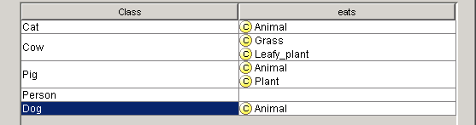
Tables are easier to manage than DAGs / Polyhierarchies
…and get the benefit of inference:
Grass and Leafy_plants are both kinds of Plant

Slide 47
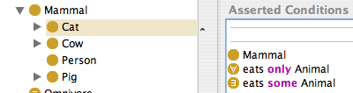
Remember to add any closure axioms
Closure
Axiom
Then let the reasoner do the work

Slide 48
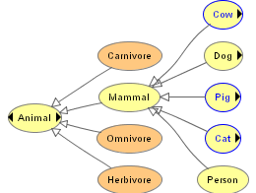
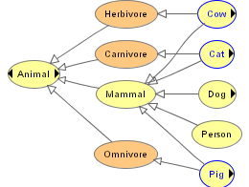
Normalisation:
From Trees to DAGs
Before classification
  A tree
After classification
  A DAG
    Directed Acyclic Graph

Slide 49
Part II – Useful Patterns
(continued)
Upper ontologies & Domain ontologies
Building from trees and untangling
Using a classifier
Closure axioms & Open World Reasoning
Specifying Values
n-ary relations
Classes as values – using the ontology

Slide 50
Examine the modifier list
Modifiers
  Domestication
    Domestic
    Wild
  Use
    Draft
    Food
  Risk
    Dangerous
    Safe
  Sex
    Male
    Female
  Age
    Adult
    Child
Identify modifiers that have mutually exclusive values
  Domestication
  Risk
  Sex
  Age
Make meaning precise
  Age → Age_group
NB Uses are not mutually exclusive
  Can be both a draft (pulling) and a food animal

Slide 51
Extend and complete lists of values
Modifiers
  Domestication
    Domestic
    Wild
    Feral
  Risk
    Dangerous
    Risky
    Safe
  Sex
    Male
    Female
  Age
    Infant
    Toddler
    Child
    Adult
    Elderly
Identify modifiers that have mutually exclusive values
  Domestication
  Risk
  Sex
  Age
Make meaning precise
  Age → Age_group
NB Uses are not mutually exclusive
  Can be both a draft and a food animal

Slide 52
Note any hierarchies of values
Modifiers
  Domestication
    Domestic
    Wild
    Feral
  Risk
    Dangerous
    Risky
    Safe
  Sex
    Male
    Female
  Age
    Child
      Infant
      Toddler
    Adult
      Elderly
Identify modifiers that have mutually exclusive values
  Domestication
  Risk
  Sex
  Age
Make meaning precise
  Age → Age_group
NB Uses are not mutually exclusive
  Can be both a draft and a food animal

Slide 53
Specify Values for each:
Two methods
Value partitions
  Classes that partition a Quality
    The disjunction of the partition classes equals the
    quality class
Symbolic values
  Individuals that enumerate all states of a Quality
    The enumeration of the values equals the quality class

Slide 54
Method 1: Value Partitions- example “Dangerousness”
A parent quality – Dangerousness
Subqualities for each degree
  Dangerous, Risky, Safe
All subqualities disjoint
Subqualities ‘cover’ parent quality
  Dangerousness = Dangerous OR Risky OR Safe
A functional property has_dangerousness
  Range is parent quality, e.g. Dangerousness
  Domain must be specified separately
Dangerous_animal =
Animal and has_dangerousness some Dangerous

Slide 55
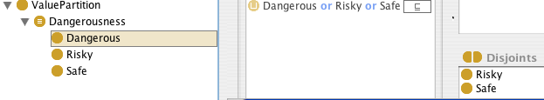
as created by Value Partition wizard
quality
covering axiom
partitions
disjoints

Slide 56
Value partitions
Diagram
Animal
Dangerous
animal
has_dangerousness
someValuesFrom
Risky
Dangerous
Leo the
Lion
has_dangerousness
Dangerousness
Leo’s
Danger
Safe

Slide 57
Value partitions UML style
Dangerousness_
Value
Animal
owl:unionOf
has_dangerousness
someValuesFrom
Dangerous
Animal
Safe_
value
Risky_
value
Dangerous_
value
Leo’s
Dangerousness
has_dangerousness
Leo the
Lion

Slide 58
Method 2: Value sets –
Example Sex
There are only two sexes
  Can argue that they are things
    “Administrative sex” definitely a thing
    “Biological sex” is more complicated

Slide 59
Method 2: Value sets- example Sex
A parent quality – Sex_value
Individuals for each value
  male, female
Values all different (NOT assumed by OWL)
Value type is enumeration of values
  Sex_value = {male, female}
A functional property has_sex
  Range is parent quality, e.g. Sex_value
  Domain must be specified separately
Male_animal =
Animal and has_sex is male

Slide 60
Value sets UML style
Person
Sex
Value
owl:oneOf
has_sex
Man
female
male
has_sex
John

Slide 61
Issues in specifying values
Value Partitions
  Can be subdivided and specialised
  Fit with philosophical notion of a quality space
  Require interpretation to go in databases as values
    in theory but rarely considered in practice
  Work better with existing classifiers in OWL-DL
Value Sets
  Cannot be subdivided
  Fit with intuitions
  More similar to data bases – no interpretation
  Work less well with existing classifiers

Slide 62
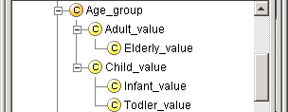
Value partitions – practical reasons for subdivisions
“All elderly are adults”
“All infants are children”
etc.
See also “Normality_status” in
http://www.cs.man.ac.uk/~rector/ontologies/mini-top-bio
  One can have complicated value partitions if needed.

Slide 63
Picture of subdivided value partition
Infant_
value
Elderly_
value
Toddler_
value
Adult_value
Child_value
Age_Group_value

Slide 64
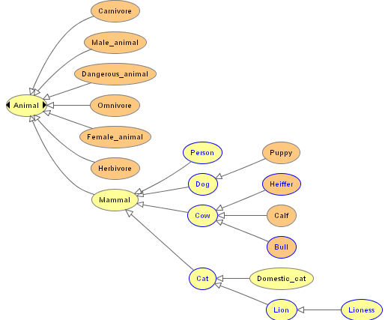
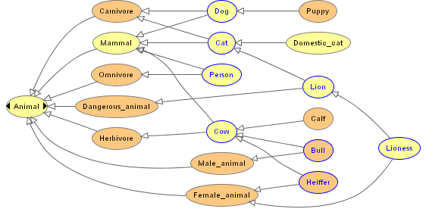
More defined kinds of animals
Before classification, trees
After classification, DAGs

Slide 65
Part III – Hands On
Be sure you have installed the software
  (See front page)
Open Animals-tutorial-step-1

Slide 66
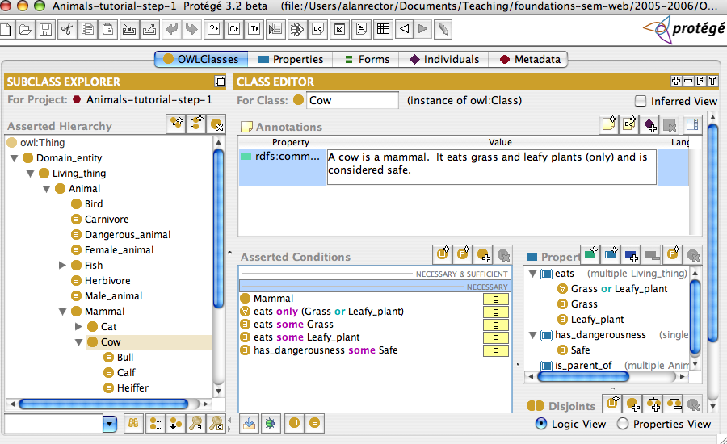
Explore the interface

Slide 67
Protégé - new abbreviated abstract syntax
some | someValuesFrom | ∃
only | allValuesFrom | ∀
has | hasValue | ∋
…and… | intersectionOf(…) | ⊓
…or… | unionOf(…) | ⊔
not | complementOf() | ¬
min | minCardinality
max | maxCardinality
exactly | cardinality
=, ≤, ≥ | Numeric comparisons (coming soon)

Slide 68
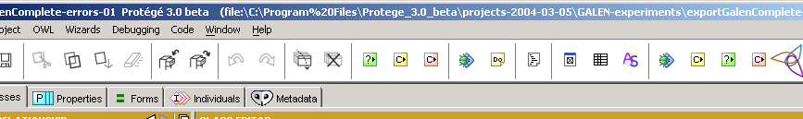
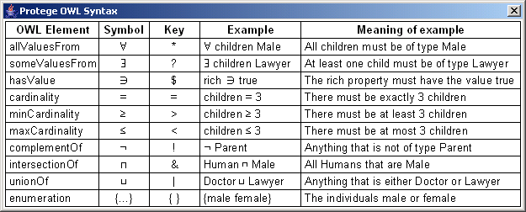
Protégé Old (≤v3.1) Syntax

Slide 69
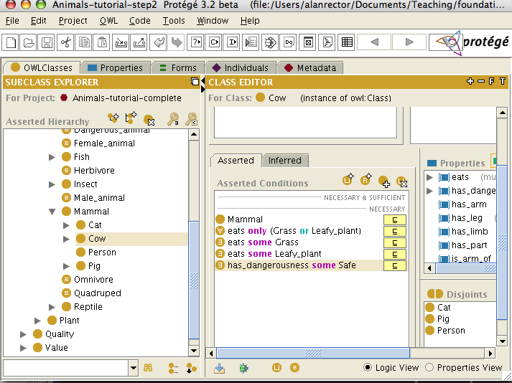
Explore the interface
New
Subclass
icon
Asserted
Hierarchy
Class
Description
Disjoint
Classes

Slide 70
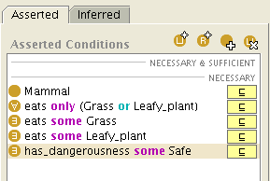
Explore the interface
New
restriction
Add
superclass
New
expression
Description
“Necessary
Conditions”

Slide 71
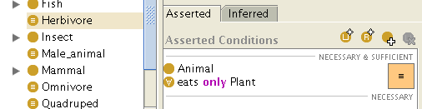
Explore the interface
Definition
“Necessary
&
Sufficient
Conditions”
“Defined class”
has necessary & sufficient conditions
( )

Slide 72
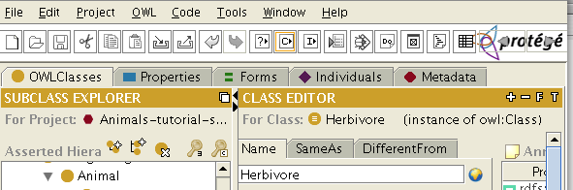
Explore the interface
Classify button
(racer must be running*)
*Or some other DIG compliant classifier

Slide 73
Exercise 1
Create a new animal, an Elephant and an Ape
  Make them disjoint from the other animals
  Make the ape an omnivore
    eats animals and eats plants
  Make the sheep a herbivore
    eats plants and only plants

Slide 74
Exercise 1b: Classification
Check it with the classifier
Is Sheep classified under Herbivore
  If not, have you forgot the closure axiom?
Did it all turn red?
  Do you have too many disjoint axioms?

Slide 75
Exercise 1c: checking disjoints – make things that should be inconsistent
Create a Probe_Sheep_and_Cow that is a kind of both Sheep and Cow
Create a Probe_Ape_and_Man that is a kind of both Ape and Man
Run the classifier
Did both probes turn red?
  If not, check the disjoints

Slide 76
Exercise 2: A new value partition
Create a new value partition
  Size_partition
    Big
    Medium
    Small
Describe
  Lions, Cows, and Elephants as Big
  domestic_cat as Small
  the rest Medium

Slide 77
Exercise 2b
Define Big_animal and Small_animal
  Does the classification work
Extra
  Make a subdivision of Big for Huge and make elephants Huge
    Do elephants still classify as “Big Animal

Slide 78
Part IV – Patterns: n-ary relations
Upper ontologies & Domain ontologies
Building from trees and untangling
Using a classifier
Closure axioms & Open World Reasoning
Specifying Values
n-ary relations
Classes as values – using the ontology

Slide 79
Saying something about a restriction
Not just
  that an a book is good but who said so
  And its price
  And where to buy it
But can say nothing about properties
  except special thing
    Super and subproperties
    Functional, transitive, symmetric

Slide 80
N-ary Relations
Binary Relation
"Lions:
Life in the Pride"
quality
excellent
According to whom?

Slide 81
Adding attributes to a Relation
NY Times
Book review
"Lions:
Life in the Pride"
excellent
quality

Slide 82
Define a class for a relation: Reification
Class: Description
instance-of
quality
description
Description_1
Quality: Excellent
Source: NY Times Book review
"Lions:
Life in the Pride"

Slide 83
A Relation Between Multiple Participants
John buys “Lions:Life in the Pride” from books.com for $15
Participants in this relation:
  John
  “Lions: Life in the Pride”
  books.com
  $15
No clear “originator”

Slide 84
Network of Participants
Class: Purchase
NY Times
Book review
John
buyer
price
$15
object
seller
"Lions:
Life in the Pride"
books.com

Slide 85
Considerations
Choosing the right pattern: often subjective
  Pattern 1: additional attributes for a relation
  Pattern 2: a network of participants
Instances of reified relations usually don’t have meaningful names
Defining inverse relations is more tricky

Slide 87
Part V – Patterns: Classes as values
Upper ontologies & Domain ontologies
Building from trees and untangling
Using a classifier
Closure axioms & Open World Reasoning
Specifying Values
n-ary relations
Classes as values – using the ontology
Part-whole relations

Slide 88
Using Classes as Property Values
dc:subject
Animal
Lion
Tiger
subject
African
Lion

Slide 89
Using Classes Directly As Values
Animal
BookAboutAnimals
rdfs:subclassOf
Lion
rdf:type
dc:subject
"Lions:
Life in the Pride"
rdf:type
rdfs:subclassOf
African
Lion
dc:subject
”The African
Lion"

Slide 90
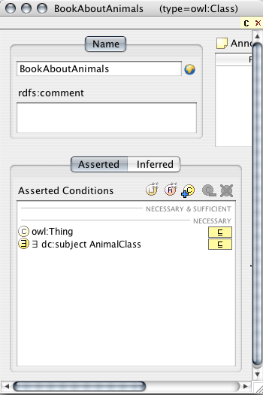
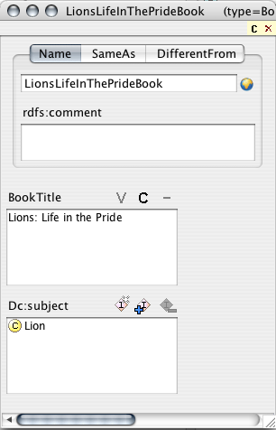
Representation in Protégé

Slide 91
Approach 1: Considerations
Compatible with OWL Full and RDF Schema
Outside OWL DL
  Because classes cannot be values in OWL-DL
    Nothing can be both a class and and instance

Slide 92
Approach 2: Hierarchy of Subjects
Animal
BookAboutAnimals
rdfs:subclassOf
rdf:type
Lion
rdf:type
"Lions:
Life in the Pride"
rdfs:subclassOf
dc:subject
”The African
Lion"
rdf:type
African
Lion
LionSubject
dc:subject
rdf:type
AfricanLionSubject

Slide 93
Hierarchy of Subjects: Considerations
Compatible with OWL DL
Instances of class Lion are now subjects
No direct relation between
LionSubject and AfricalLionSubject
Maintenance penalty
Lion
rdf:type
rdfs:subclassOf
LionSubject
African
Lion
rdf:type
AfricanLionSubject

Slide 94
Hierarchy of Subjects
Animal
Subject
BookAboutAnimals
rdfs:subclassOf
rdf:type
Lion
rdf:type
"Lions:
Life in the Pride"
rdfs:seeAlso
rdf:type
rdfs:subclassOf
dc:subject
African
Lion
LionSubject
”The African
Lion"
rdf:type
parentSubject
rdfs:seeAlso
dc:subject
AfricanLionSubject

Slide 95
Hierarchy of Subjects: Considerations
Compatible with OWL DL
Subject hierarchy (terminology) is independent of class hierarchy (rdfs:seeAlso)
Maintenance penalty
Lion
Subject
rdf:type
rdfs:subclassOf
African
Lion
LionSubject
rdfs:seeAlso
parentSubject
AfricanLionSubject

Slide 96
Using members of a class as values
Animal
BookAboutAnimals
rdfs:subclassOf
rdf:type
Lion
"Lions:
Life in the Pride"
rdf:type
rdfs:subclassOf
rdf:type
dc:subject
African
Lion
some
Unidentified Lion(s)
”The African
Lion"
rdf:type
dc:subject
some Unidentified
African Lion(s)

Slide 97
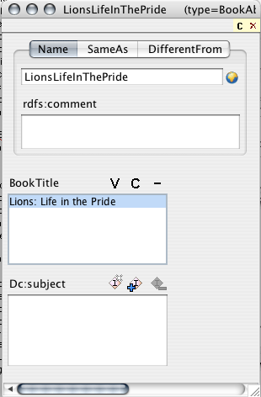
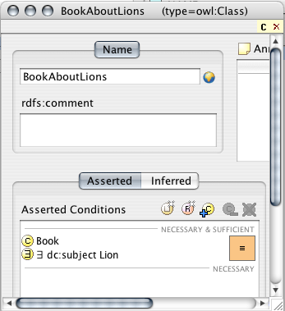
Representation in Protege
rdf:type
Note: no subject value

Slide 98
Considerations
Compatible with OWL DL
Interpretation: the subject is one or more specific lions, rather than the Lion class
Can use a DL reasoner to classify specific books

Slide 99
Part VI – Patterns:
Part-whole relations
Upper ontologies & Domain ontologies
Building from trees and untangling
Using a classifier
Closure axioms & Open World Reasoning
Specifying Values
n-ary relations
Classes as values – using the ontology
Part-whole relations

Slide 100
Part-whole relations
One method: NOT a SWBP draft
How to represent part-whole relations in OWL is a commonly asked question
SWBP will put out a draft.
This is one approach that will be proposed
  It has been used in teaching
  It has no official standing
  It is presented for information only

Slide 101
Part Whole relations
OWL has no special constructs
  But provides (some of) the building blocks
Transitive relations
  Finger is_part_of Hand
  Hand is_part_of Arm
  Arm is_part_of Body
    →
  Finger is_part_of Body

Slide 102
Many kinds of part-whole relations
Physical parts
  hand-arm
Geographic regions
  Hiroshima - Japan
Functional parts
  cpu – computer
See Winston & Odell
Artale
Rosse

Slide 103
Simple version
One property is_part_of
  transitive
    Finger is_part_of some Hand
    Hand is_part_of some Arm
    Arm is_part_of some Body

Slide 104
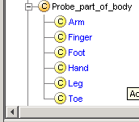
Get a simple list
Probe_part_of_body =
Domain_category
is_part_of some Body
Logically correct
  But may not be what we want to see

Slide 105
Injuries, Faults, Diseases, Etc.
A hand is not a kind of a body
  … but an injury to a hand is a kind of injury to
  a body
A motor is not a kind of automobile
  … but a fault in the motor is a kind of fault in
  the automobile
And people often expect to see partonomy hierarchies

Slide 106
Being more precise: “Adapted SEP Triples”
Body (‘as a whole’)
  Body
The Body’s parts
  is_part_of some Body
The Body and it’s parts
  Body OR is_part_of some Body
Repeat for all parts
  Use ‘Clone class’ or
  NB: ‘JOT’ Python plugin is good for this

Slide 107
Adapted SEP triples:
UML like view
Injury to Arm
(or part of arm)
has_locus
some
Arm OR part part of arm
Arm
Part of
Arm
Hand
Forearm
Injury to Hand
has_locus
some

Slide 108
Adapted SEP triples:
Venn style view
Arm
Arm or parts of Arm
Parts of Arm
Fore
Arm
Hand

Slide 109
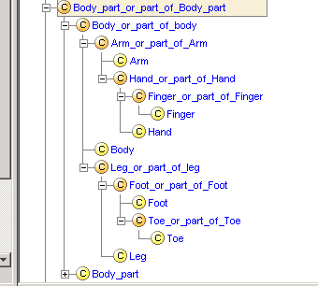
Resulting classification:
Ugly to look at, but correct

Slide 110
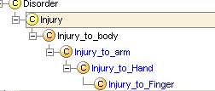
Using part-whole relations: Defining injuries or faults
Injury_to_Hand =
Injury has_locus some Hand_or_part_of_hand
Injury_to_Arm =
Injury has_locus some Arm_or_part_of_Arm
Injury_to_Body =
Injury has_locus some Body_or_part_of_Body
The expected
hierarchy from
point of view of
anatomy

Slide 111
Caution with part of
Motor is_part_of some Car
  Means “All motors are part of some car”
    Obviously false!
  But convenient to get:
  Car_part =
  is_part_of some Car
  subsumes
  Motor
  To be correct must use
  “Car_motor =
  Motor and is_part_of some Car

Slide 112
Geographical regions and individuals
Similar representation possible for individuals but more difficult
  and less well explored

Slide 113
Simplified view:
Geographical_regions
Class: Geographical_region
  Include countries, cities, provinces, …
    A detailed ontology would break them down
Geographical features
  Include Hotels, Mountains, Islands, etc.
Properties:
  Geographical_region is_subregion_of Geographical_Region
  Geographical_feature has_location Geographical_Region
  Features located in subregions are located in the region. is_subregion_of is transitive

Slide 114
Geographical regions & features are represented as individuals
Japan, Honshu, Hiroshima,
Hiroshima-ken,…
Mt_Fuji, Hiroshima_Prince_Hotel, …

Slide 115
Facts*
Honshu is_subregion_of hasValue Japan
Hiroshima-ken is_subregion_of hasValue Honshu
Hiroshima is_subregion_of hasValue Hiroshima-ken
Mt_Fuji has_location hasValue Honshu
Hiroshima_prince_hotel has_location hasValue Hiroshima-ken
*with apologies for any errors in Japanese geography

Slide 116
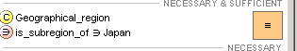
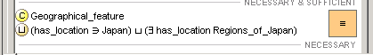
Definitions
Region_of_Japan =
Geographical_region AND
is_subregion_of hasValue Japan
Feature_of_Japan =
Geographical_feature AND
( hasLocation hasValue Japan OR
hasLocation hasValue Region_of_Japan )

Slide 117
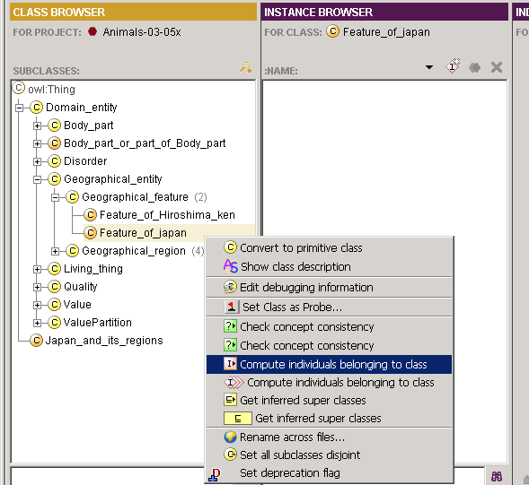
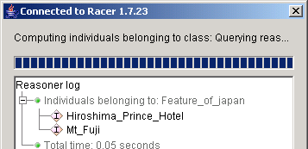
In tools at this time
Must ask from right mouse button menu in Individuals tab
better integration under development

Slide 118
Warning:
Individuals and reasoners
Individuals only partly implemented in reasoners
  If results do not work, ask someone if they should!
    Open World reasoning with individuals is very difficult to implement
  If it doesn’t work, try simulating individuals by classes
  Large sets of individuals better in “Instance Stores”, RDF triple stores, databases, etc that are restricted or closed world
Ontologies are mainly about classes
  Ontologies are NOT databases

Slide 119
Part-whole in OWL
Note - the only aspect of the part whole relation represented in OWL is transitivity
  “Mereologists” (those who study parts-whole relations) define other axioms
    Antisymmetry (nothing can be part of itself)
    Reflexive (everything is a part of itself)
    Weak supplementation principle -
      When you take away a part (except the whole), you leave something behind

Slide 120
Qualified cardinality constraints
Use with partonomy
Use with n-ary relations

Slide 121
Cardinality Restrictions
“All mammals have four limbs”
  “All Persons have two legs and two arms”
  “(All mammals have two forelimbs and two
  hind limbs)”

Slide 122
What we would like to say:
Qualified cardinality constraints
Mammal
has_part cardinality=4 Limb
Mammal
has_part cardinality = 2 Forelimb
has_part cardinality = 2 Hindlimb
Arm = Forelimb AND is_part_of some Person
Glossary: “Forelimb” = front leg or arm
“Hindlimb” = back leg

Slide 123
What we have to say in OWL
The property has_part has subproperties:
has_limb
has_leg
has_arm
has_wing
Mammal, Reptile, Bird has_limb cardinality=4
Person has_leg cardinality=2
Cow, Dog, Pig… has_leg cardinality=4
Bird has_leg cardinality=2
Biped = Animal AND
has_leg cardinality=2

Slide 124

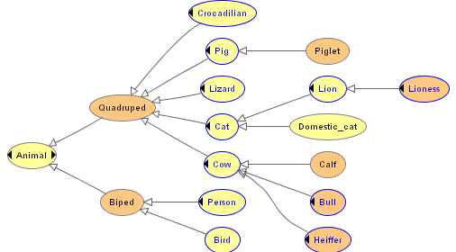
Classification of bipeds and quadrupeds
Before
classification
After
classificaiton

Slide 125
Cardinality and n-ary relations
Need to control cardinality of relations represented as classes
  An animal can have just 1 “dangerousness”
    Requires a special subproperty of quality:
      has_dangerousness_quality cardinality=1

Slide 126
Re-representing the property has_danger as the class Risk
Animal
has_danger
cardinality=1
‘functional’
Dangerous
Risk_type
has_risk_type
cardinality=1
Animal
has_Quality
cardinality=1
Risk
has_seriousness
cardinality=1
Seriousness
has_avoidance
cardinality=1
Avoidance

Slide 127
In OWL must add subproperty for each quality to control cardinality, e.g. has_risk_quality
special
subproperty of has_quality
Risk_type
has_risk_type
cardinality=1
Animal
has_Risk_Quality
cardinality=1
Risk
has_seriousness
cardinality=1
Seriousness
has_avoidance
cardinality=1
Leads to a proliferation of subproperties
  The issue of “Qualified Cardinality Constraints”
Avoidance

Slide 129
Part VII – Summary
Upper ontologies & Domain ontologies
Building from trees and untangling
Using a classifier
Closure axioms & Open World Reasoning
Specifying Values
n-ary relations
Classes as values – using the ontology
Part-whole relations
  Transitive properties
  Qualified cardinality restrictions

Slide 130
End
To find out more:
  http://www.co-ode.org
    Comprehensive tutorial and sample ontologiesxz
  http://protege.stanford.org
    Subscribe to mailing lists; participate in forums
  On the SW in general:
  semanticweb@yahoogroups.com
  For specific feedback to SWBP
    Home & Mail Archive: http://www.w3.org/2001/sw/BestPractices/
    public-swbp-wg@w3.org

Slide 131
Part VI – Hands On supplement
Open Animals-tutorial-step-2

Slide 132
Exercise 3: (Advanced supplement)
Load Animals-Tutorial-complete.pprj
Define a new kind of Limb – Wing
Describe birds as having 2 wings
Define a Two-Winged_animal
Does bird classify under
Two-Winged_animal?

