Slide 1
Introduction to Semantic Web and Ontologies
Hasan TÜRKSOY
Compiled, partly based on various online tutorials and presentations, with respect to their authors

Slide 2
Introduction to Semantic Web and Ontologies
Based on tutorials and presentations:
D. Lee, F. Harmelen, M. Arumugam, C. Goble, I. Horrocks, N. F. Noy, D.L. McGuinness, J. Broekstra, M. Klein, S. Decker, D. Fensel, DERI Group, H. Knublauch,
N. Drummond, M. Horridge

Slide 3

History of the Semantic Web
Web was “invented” by Tim Berners-Lee (amongst others), a physicist working at CERN
TBL’s original vision of the Web was much more ambitious than the reality of the existing (syntactic) Web:
TBL (and others) have since been working towards realising this vision, which has become known as the Semantic Web
  E.g., article in May 2001 issue of Scientific American…
“... a goal of the Web was that, if the interaction between person and hypertext could be so intuitive that the machine-readable information space gave an accurate representation of the state of people's thoughts, interactions, and work patterns, then machine analysis could become a very powerful management tool, seeing patterns in our work and facilitating our working together through the typical problems which beset the management of large organizations.”
Notes:
[1]

Slide 4
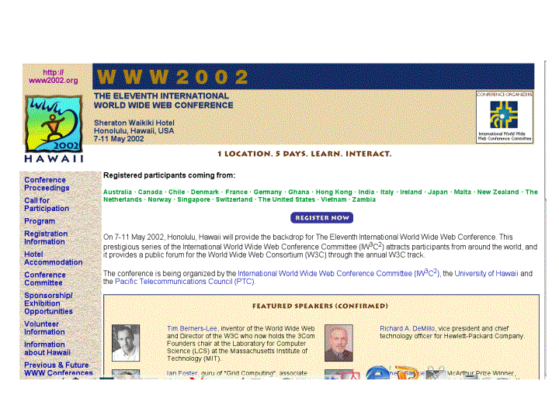
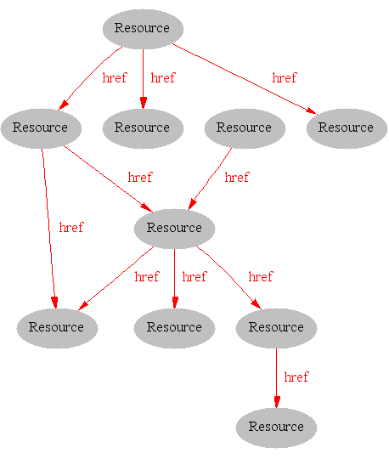
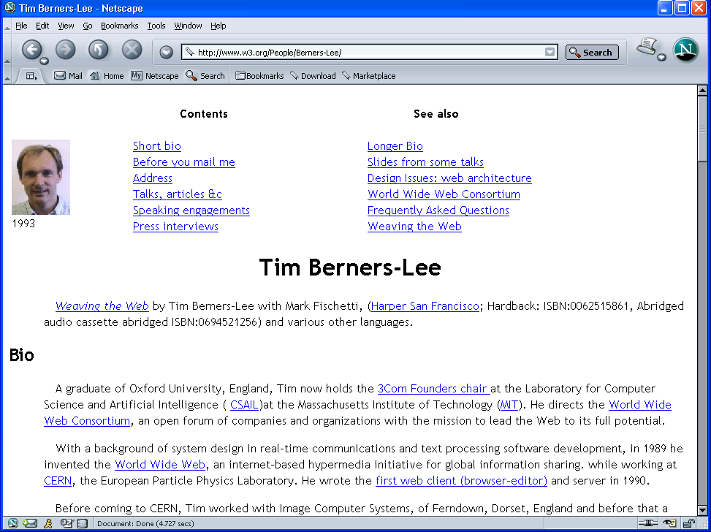
Where we are Today: the Syntactic Web
[Hendler & Miller 02]
Notes:
[1]

Slide 5
The Syntactic Web is…
A place where computers do the presentation (easy) and people do the linking and interpreting (hard).
  A hypermedia, a digital library
    A library of documents called (web pages) interconnected by a hypermedia of links
  A database, an application platform
    A common portal to applications accessible through web pages, and presenting their results as web pages
  A platform for multimedia
    BBC Radio 4 anywhere in the world! Terminator 3 trailers!
  A naming scheme
    Unique identity for those documents
Why not get computers to do more of the hard work?
[Goble 03]
Notes:
[1]

Slide 6
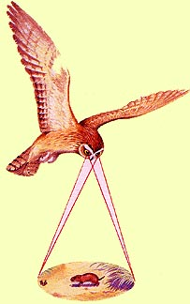
Hard Work using the Syntactic Web…
Complex queries involving background knowledge
  Find information about “animals that use sonar but are not either bats, dolphins or whales”
Locating information in data repositories
  Travel enquiries
  Prices of goods and services
  Results of human genome experiments
Delegating complex tasks to web “agents”
  Book me a holiday next weekend somewhere warm, not too far away, and where they speak French or English
, e.g., Barn Owl
Almost impossible for machines and too hard for people without automation
Notes:
[2]

Slide 7
What is the Problem?
Consider a typical web page:
Markup consists of:
  rendering information (e.g., font size and colour)
  Hyper-links to related content
Semantic content is accessible to humans but not (easily) to computers…
Notes:
[1]

Slide 8
What information can we see…
WWW2002
The eleventh international world wide web conference
Sheraton waikiki hotel
Honolulu, hawaii, USA
7-11 may 2002
1 location 5 days learn interact
Registered participants coming from
australia, canada, chile denmark, france, germany, ghana, hong kong, india, ireland, italy, japan, malta, new zealand, the netherlands, norway, singapore, switzerland, the united kingdom, the united states, vietnam, zaire
Register now
On the 7th May Honolulu will provide the backdrop of the eleventh international world wide web conference. This prestigious event …
Speakers confirmed
Tim berners-lee
Tim is the well known inventor of the Web, …
Ian Foster
Ian is the pioneer of the Grid, the next generation internet …
Notes:
[1]

Slide 9
What information can a machine see…




  




…


…

…
Notes:
[1]

Slide 10
Solution: XML markup with “meaningful” tags?
<name>
</name>
<location>
</location>
<date>  </date>
<slogan></slogan>
<participants>
</participants>
<introduction>
…
</introduction>
<speaker></speaker>
<bio></bio>…
Notes:
[1]

Slide 11
But What About…
<conf>
</conf>
<place>
</place>
<date>  </date>
<slogan></slogan>
<participants>
</participants>
<introduction>
…
</introduction>
<speaker></speaker>
<bio>…

Slide 12
Still the Machine only sees…
<>
</>
<>
</>
<>  </>
<></>
<>
</>
<>
…
</>
<></>
<□></□>
<></>
<□></□>
Notes:
[1], son 4 tane için için [2]’ye de bakılabilir...

Slide 13
Need to Add “Semantics”
External agreement on meaning of annotations
  E.g., Dublin Core
    Agree on the meaning of a set of annotation tags
  Problems with this approach
    Inflexible
    Limited number of things can be expressed
Use Ontologies to specify meaning of annotations
  Ontologies provide a vocabulary of terms
  New terms can be formed by combining existing ones
  Meaning (semantics) of such terms is formally specified
  Can also specify relationships between terms in multiple ontologies
Notes:
[1]

Slide 14
Dublin Core
A set of fifteen basic properties for describing generalised Web resources
ISO Standard 15836-2003 (February 2003): http://www.niso.org/international/SC4/n515.pdf
The Dublin Core Metadata Initiative is an open forum engaged in the development of interoperable online metadata standards that support a broad range of purposes and business models.
http://dublincore.org/
Notes:
[3]

Slide 15
Dublin Core (15 basic properties):
Type
Format
Identifier
Source
Language
Relation
Coverage
Rights
Title
Creator
Subject
Description
Publisher
Contributor
Date
Notes:
[3]

Slide 16
Dublin Core Example
<?xml version="1.0"?>
<rdf:RDF xmlns:rdf=“http://www.w3.org/1999/02/22-rdf-syntax-ns#”
xmlns:dc="http://purl.org/dc/elements/1.0/">
<rdf:Description rdf:about="http://www.ukoln.ac.uk/metadata/resources/dc/
datamodel/WD-dc-rdf/">
<dc:title> Guidance on expressing the Dublin Core within the Resource
Description Framework (RDF) </dc:title>
<dc:creator> Eric Miller </dc:creator>
<dc:creator> Paul Miller </dc:creator>
<dc:creator> Dan Brickley </dc:creator>
<dc:subject> Dublin Core; Resource Description Framework; RDF; eXtensible
Markup Language; XML </dc:subject>
<dc:publisher> Dublin Core Metadata Initiative </dc:publisher>
<dc:contributor> Dublin Core Data Model Working Group </dc:contributor>
<dc:date> 1999-07-01 </dc:date>
<dc:format> text/html </dc:format>
<dc:language> en </dc:language>
</rdf:Description>
</rdf:RDF>
Notes:
[3]

Slide 17


Semantic Web basics...
RDF:
  stands for Resource Description Framework
  is a W3C standard, which provides tool to describe Web resources
  provides interoperability between applications that exchange machine-understandable information
RDF Schema:
  is a W3C standard which defines vocabulary for RDF
  organizes this vocabulary in a typed hierarchy (Class, Property, type, subClassOf, subPropertyOf, range, domain)
  capable to explicitly declare semantic relations between vocabulary terms
Notes:
[3,4]

Slide 18




RDF – Semantic Web over Web Resources
John
Director
has_homepage
has_job
Ontology
to_be_in_love_with
has_job
has_homepage
Secretary
Mary
Notes:
[3]

Slide 19
The RDF Data Model
Statements are <subject, predicate, object> triples:
Can be represented using XML serialisation, e.g.:
  <Ian,hasColleague,Uli>
Statements describe properties of resources
All things (including properties) being described by RDF expressions are called resources
A resource is a URI representing a (class of) object(s):
  a document, a picture, a paragraph on the Web;
    http://www.cs.man.ac.uk/index.html
  a book in the library, a real person (?)
    isbn://5031-4444-3333
  …
Notes:
[4] {
RDF Statement:
Subject of an RDF statement is a resource
Predicate of an RDF statement is a property of a resource
Object of an RDF statement is the value of a property of a resource
}

Slide 20
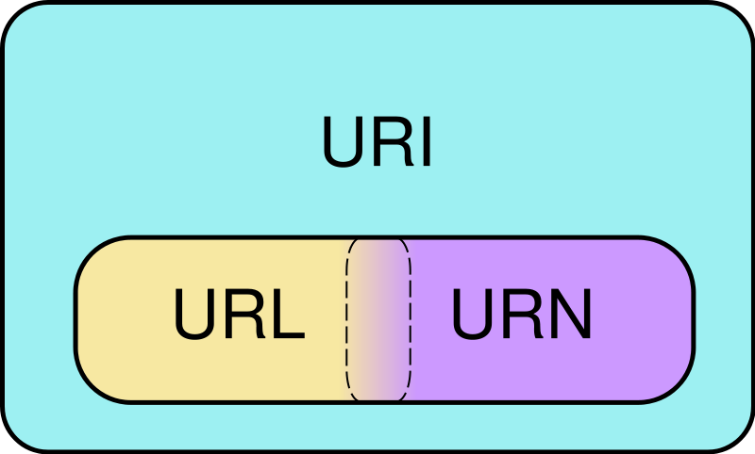
URI
Venn diagram of Uniform Resource Identifier (URI) scheme categories. Schemes in the URL (locator) and URN (name) categories both function as resource IDs, so URL and URN are subsets of URI. They are also, generally, disjoint sets. However, many schemes can't be categorized as strictly one or the other, because all URIs can be treated as names, and some schemes embody aspects of both categories – or neither.
  http://www.somedomain.com/some/path/to/file#fragmentID
Notes:
[3]

Slide 21
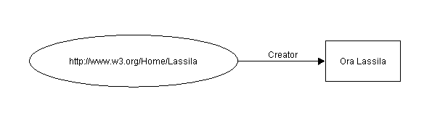
Example of RDF Statement
Ora Lassila is the creator of the resource http://www.w3.org/Home/Lassila.
Subject (resource)
http://www.w3.org/Home/Lassila
Predicate (property)
Creator
Object (literal)
“Ora Lassila”
Notes:
[3] -> kendi örneğini geliştir (Hasan hasColleague Tolga)

Slide 22
RDF Example (serialization syntax)
Ora Lassila is the creator of the resource http://www.w3.org/Home/Lassila.
<rdf:RDF>
<rdf:Description about=
"http://www.w3.org/Home/Lassila">
<s:Creator>Ora Lassila</s:Creator>
</rdf:Description>
</rdf:RDF>
's' is a specific namespace prefix, e.g.
xmlns:s="http://description.org/schema/"
Notes:
[3]

Slide 23
What is RDFS ?
RDF Schema
  Defines vocabulary for RDF
  Organizes this vocabulary in a typed hierarchy (Class, subClassOf, type, Property, subPropertyOf)
Rich, web-based publication format for declaring semantics (XML for exchange)
Capability to explicitly declare semantic relations between vocabulary terms
Notes:
[3]
[4] {
RDF gives a formalism for meta data annotation, and a way to write it down in XML, but it does not give any special meaning to vocabulary such as subClassOf or type
Interpretation is an arbitrary binary relation
I.e., <Person,subClassOf,Animal> has no special meaning
RDF Schema defines “schema vocabulary” that supports definition of ontologies
gives “extra meaning” to particular RDF predicates and resources (such as subClasOf)
this “extra meaning”, or semantics, specifies how a term should be interpreted
}

Slide 24
RDF Schema
Semantic network on the Web
Nodes are identified by URIs
rdfs:Class
rdfs:Property
rdfs:subClassOf
Notes:
[3]

Slide 25
RDFS Examples
RDF Schema terms (just a few examples):
  Class
  Property
  type
  subClassOf
  range
  domain
These terms are the RDF Schema building blocks (constructors) used to create vocabularies:
  <Person,type,Class>
  <hasColleague,type,Property>
  <Professor,subClassOf,Person>
  <Carole,type,Professor>
  <hasColleague,range,Person>
  <hasColleague,domain,Person>
Notes:
[4] + class diagram ve owl kodu ekle

Slide 26
Problems with RDFS
RDFS too weak to describe resources in sufficient detail
  No localised range and domain constraints
    Can’t say that the range of hasChild is person when applied to persons and elephant when applied to elephants
  No existence/cardinality constraints
    Can’t say that all instances of person have a mother that is also a person, or that persons have exactly 2 parents
  No transitive, inverse or symmetrical properties
    Can’t say that isPartOf is a transitive property, that hasPart is the inverse of isPartOf or that touches is symmetrical
  …
Difficult to provide reasoning support
  No “native” reasoners for non-standard semantics
  May be possible to reason via FO axiomatisation
Notes:
[4]

Slide 27
Where to look next
RDF:
http://www.w3.org/RDF/
RDF Schema:
http://www.w3.org/TR/rdf-schema/
Notes:
[3]

Slide 28
Mola...
Next: Ontologies...

Slide 29
Ontological Vision of Semantic Web
Semantic Web needs ontologies
An ontology is
  document or file that formally and in a standardized way defines the hierarchy of classes within the domain, semantic relations among terms and inference rules
Use of ontologies:
  Sharing semantics of your data across distributed applications
Notes:
[3]

Slide 30
Ontologies: the foundation of Semantic Web
Ontologies are key enabling technology for the Semantic Web
“..explicit specification of conceptualization..”
Ontology is formal and rich way to provide shared and common understanding of a domain, that can be used by people and machines
public
comment
__Thing__
Author
private
Access Rights
is-a
Location
Related to
Document
name
Report
is-a
is-a
Web-page
uri
Subject
Instance-of
Instance-of
O. Kononenko
public
V. Terziyan
Author
Access rights
Author
name
#doc1
#doc2
Semantic Web
Related to
Location
uri
Subject
comment
\\AgServ\vagan\InBCT_1.doc
http://www.ontogroup.net
comment
3.1: analysis
draft
Home page
Query 1: get all documents from location X, but not web-pages
Query 2: get documents related to Y, with more then one author, one of which is Terziyan
Query 3: are there web-pages of Z with “private” access related to documents with subject S?
Notes:
[3]
Bu sorgular veritabanı kullanan sistemlerle de yapılamaz mı?

Slide 31
What is an ontology?
Studer(98): Formal, explicit specification of a shared conceptualization
Machine
readable
Consensual
knowledge
Concepts, properties,
functions, axioms
are explicitly defined
Abstract model of
some phenomena
in the world
Notes:
[3]

Slide 32
Benefits
Communication between people
Interoperability between software agents
Reuse of domain knowledge
Make domain knowledge explicit
Knowledge sharing and reuse
Analyze domain knowledge
Building an ontology is not a goal in itself.
Notes:
[3]

Slide 33
Ontology Elements
Concepts(classes) + their hierarchy
Concept properties (slots/attributes)
Property restrictions (type, cardinality, domain)
Relations between concepts (disjoint, equality)
Instances
Notes:
[3]

Slide 34
How to build an ontology?
Steps:
  determine domain and scope
  enumerate important terms
  define classes and class hierarchies
  define slots
  define slot restrictions (cardinality, value-type)
Notes:
[3]

Slide 35
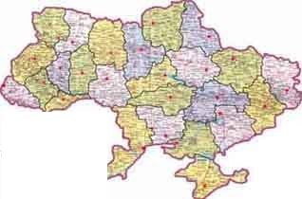
Step 1: Determine Domain and Scope
Domain: geography
Application: route planning agent
Possible questions:
Distance between two cities?
  What sort of connections exist between two cities?
  In which country is a city?
  How many borders are crossed?
Notes:
[3] -> kendi örneğini geliştir

Slide 36

Step 2: Enumerate Important Terms
city
capital
Connection_on_land
country
border
road
railway
Connection_on_water
currency
Connection_in_air
connection
Notes:
[3] -> kendi örneğini geliştir

Slide 37
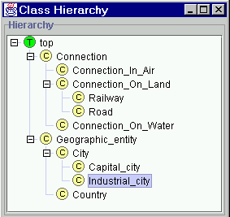
Step 3: Define Classes and Class Hierarchy
Notes:
[3] -> kendi örneğini geliştir

Slide 38
Step 4: Define Slots of Classes
Geographic_entity
End_point
Connection
Country
City
Start_point
Has_capital
Borders_with
Capital_of
Capital_city
Step 5: Define slot constraints
Slot-cardinality
Ex: Borders_with multiple, Start_point single
Slot-value type
Ex: Borders_with- Country
Notes:
[3] -> kendi örneğini geliştir

Slide 39
OWL became standard
10 February 2004 the World Wide Web Consortium announced final approval of two key Semantic Web technologies, the revised Resource Description Framework (RDF) and the Web Ontology Language (OWL).
Read more in:
http://www.w3.org/2004/01/sws-pressrelease.html.en
Notes:
[3]
OWL language now a w3c recommendadion (i.e., a standard like HTML and XML)

Slide 40
OWL Introduction
What is OWL?
  OWL is a language for defining Web Ontologies and their associated Knowledge Bases
  The OWL language is a revision of the DAML+OIL web ontology language incorporating learning from the design and application use of DAML+OIL.
  OWL extends RDFS vocabulary and adds axioms.
Notes:
[3]

Slide 41
OWL Language
Three species of OWL
  OWL full is union of OWL syntax and RDF
  OWL DL restricted to FOL fragment (¼ DAML+OIL)
  OWL Lite is “easier to implement” subset of OWL DL
Semantic layering
  OWL DL ¼ OWL full within DL fragment
  DL semantics officially definitive
OWL DL based on SHIQ Description Logic
  In fact it is equivalent to SHOIN(D_{n}) DL
OWL DL Benefits from many years of DL research
  Well defined semantics
  Formal properties well understood (complexity, decidability)
  Known reasoning algorithms
  Implemented systems (highly optimised)
Notes:
[4]
[5] {
OWL-Lite –simple but limited
OWL-DL – complex but deliverable (real soon now)
OWL-Full – fully expressive but serious logical/computational problems
Russel Paradox etc etc
}

Slide 42
Back to the OWL Layers (Lite, DL, Full)
OWL Lite
  (sub)classes, individuals
  (sub)properties, domain, range
  intersection
  (in)equality
  cardinality 0/1
  datatypes
  inverse, transitive, symmetric
  hasValue
  someValuesFrom
  allValuesFrom
RDF Schema
Full
DL
Lite
OWL DL
  Negation (disjointWith, complementOf)
  unionOf
  Full Cardinality
  Enumerated types (oneOf)
OWL Full
  Allow meta-classes etc
Notes:
[6]

Slide 43
Example
There are two types of animals, Male and Female.
<rdfs:Class rdf:ID="Male">
<rdfs:subClassOf rdf:resource="#Animal"/>
</rdfs:Class>
The subClassOf element asserts that its subject - Male - is a subclass of its object -- the resource identified by #Animal.
<rdfs:Class rdf:ID="Female">
<rdfs:subClassOf rdf:resource="#Animal"/>
<owl:disjointWith rdf:resource="#Male"/>
</rdfs:Class>
Some animals are Female, too, but nothing can be both Male and Female (in this ontology) because these two classes are disjoint (using the disjointWith tag).
Notes:
[3] -> kendi örneğini geliştir

Slide 44
Description Logic Family
DLs are a family of logic based KR formalisms
Particular languages mainly characterized by:
  Set of constructors for building complex concepts and roles from simpler ones
  Set of axioms for asserting facts about concepts, roles and individuals
Examples:
  “Female persons”
    Person ⊓ Female
  “Non-female persons”
    Person ⊓ ¬Female
  “Persons that have a child”
    Person ⊓ ∃hasChild.Person
  “Persons all of whose children are female”
    Person ⊓ ∀hasChild.Female
  “Persons that are employed or self-eployed”
    Person ⊓ (Employee ⊔ SelfEmployed)
  “Persons that have at most one father“
    Person ⊓ ≤1.hasFather
Notes:
[6]

Slide 45
Description Logic Family
Necessary and sufficient conditions
Inclusion axioms provide necessary conditions:
  concept ⊑ definition
Equivalence axioms provide necessary and sufficient conditions:
^{concept ≡ definition}{
concept ⊑ definition and
definition ⊑ concept
Notes:
[6]

Slide 46
Complex Classes
Union of Classes
Instances of the Union of two Classes are either the instance of one or both classes
Person ≡ Man ⊔ Woman
<owl:Class rdf:ID=“Person">
<owl:unionOf rdf:parseType="Collection">
<owl:Class rdf:about="#Woman" />
<owl:Class rdf:about="#Man" />
</owl:unionOf>
</owl:Class>
Notes:
[6]

Slide 47
Complex Classes
Intersection of Classes
Instances of the Intersection of two Classes are simultaneously instances of both class
Man ≡ Person ⊓ Male
<owl:Class rdf:ID=“Man">
<owl:intersectionOf rdf:parseType="Collection">
<owl:Class rdf:about="#Person" />
<owl:Class rdf:about="#Male" />
</owl:intersectionOf>
</owl:Class>
Notes:
[6]

Slide 48
one of: Enumerated Classes
Specify a class via a direct enumeration of its members:
WhineColor ≡ {White, Rose, Red}
<owl:Class rdf:ID="WineColor">
<rdfs:subClassOf rdf:resource="#WineDescriptor"/>
<owl:oneOf rdf:parseType="Collection">
<owl:Thing rdf:about="#White"/>
<owl:Thing rdf:about="#Rose"/>
<owl:Thing rdf:about="#Red"/>
</owl:oneOf>
</owl:Class>
Notes:
[6]

Slide 49
Complex Classes
Property Restrictions
Defining a Class by restricting its possible instances via their property values
OWL distinguishes between the following two:
  Value constraint
    (Mother ≡ Woman ⊓ ∃hasChild.Person)
  Cardinality constraint
    (MotherWithManyChildren ≡ Mother ⊓ ≥3hasChild)
Property restrictions are local
  remember RDFS allows only global properties
Notes:
[6]
owl:allValuesFrom
<owl:Class rdf:ID="Wine">
<rdfs:subClassOf rdf:resource="&food;PotableLiquid" />
...
<rdfs:subClassOf>
<owl:Restriction>
<owl:onProperty rdf:resource="#hasMaker" />
<owl:allValuesFrom rdf:resource="#Winery" />
</owl:Restriction>
</rdfs:subClassOf>
...
</owl:Class>
owl:someValuesFrom
<owl:Class rdf:ID="Wine">
<rdfs:subClassOf rdf:resource="&food;PotableLiquid" />
<rdfs:subClassOf>
<owl:Restriction>
<owl:onProperty rdf:resource="#hasMaker" />
<owl:someValuesFrom rdf:resource="#Winery" />
</owl:Restriction>
</rdfs:subClassOf>
...
</owl:Class>
owl:hasValue
<owl:Class rdf:ID="Burgundy">
...
<rdfs:subClassOf>
<owl:Restriction>
<owl:onProperty rdf:resource="#hasSugar" />
<owl:hasValue rdf:resource="#Dry" />
</owl:Restriction>
</rdfs:subClassOf>
</owl:Class>

Slide 50
Complex Classes - Property Restrictions someValuesFrom
A Mother is a Woman that has a child (some Person)
Mother ⊑ Woman ⊓ ∃hasChild.Person
<owl:Class rdf:ID=“Mother">
<rdfs:subClassOf rdf:resource="#Woman" />
<rdfs:subClassOf>
<owl:Restriction>
<owl:onProperty rdf:resource="#hasChild" />
<owl:someValuesFrom rdf:resource="#Person" />
</owl:Restriction>
</rdfs:subClassOf>
</owl:Class>
Notes:
[6]
owl:allValuesFrom
<owl:Class rdf:ID="Wine">
<rdfs:subClassOf rdf:resource="&food;PotableLiquid" />
...
<rdfs:subClassOf>
<owl:Restriction>
<owl:onProperty rdf:resource="#hasMaker" />
<owl:allValuesFrom rdf:resource="#Winery" />
</owl:Restriction>
</rdfs:subClassOf>
...
</owl:Class>
owl:someValuesFrom
<owl:Class rdf:ID="Wine">
<rdfs:subClassOf rdf:resource="&food;PotableLiquid" />
<rdfs:subClassOf>
<owl:Restriction>
<owl:onProperty rdf:resource="#hasMaker" />
<owl:someValuesFrom rdf:resource="#Winery" />
</owl:Restriction>
</rdfs:subClassOf>
...
</owl:Class>
owl:hasValue
<owl:Class rdf:ID="Burgundy">
...
<rdfs:subClassOf>
<owl:Restriction>
<owl:onProperty rdf:resource="#hasSugar" />
<owl:hasValue rdf:resource="#Dry" />
</owl:Restriction>
</rdfs:subClassOf>
</owl:Class>

Slide 51
Complex Classes - Property Restrictions allValuesFrom
To express the set of parents that only have female children (daughters) you would write:
ParentsWithOnlyDaughters ⊑ Person ⊓ ∀hasChild.Woman
<owl:Class rdf:ID=“ParentsWithOnlyDaughters">
<rdfs:subClassOf rdf:resource="#Person" />
<rdfs:subClassOf>
<owl:Restriction>
<owl:onProperty rdf:resource="#hasChild" />
<owl:allValuesFrom rdf:resource="#Woman" />
</owl:Restriction>
</rdfs:subClassOf>
...
</owl:Class>
Notes:
[6]
owl:allValuesFrom
<owl:Class rdf:ID="Wine">
<rdfs:subClassOf rdf:resource="&food;PotableLiquid" />
...
<rdfs:subClassOf>
<owl:Restriction>
<owl:onProperty rdf:resource="#hasMaker" />
<owl:allValuesFrom rdf:resource="#Winery" />
</owl:Restriction>
</rdfs:subClassOf>
...
</owl:Class>
owl:someValuesFrom
<owl:Class rdf:ID="Wine">
<rdfs:subClassOf rdf:resource="&food;PotableLiquid" />
<rdfs:subClassOf>
<owl:Restriction>
<owl:onProperty rdf:resource="#hasMaker" />
<owl:someValuesFrom rdf:resource="#Winery" />
</owl:Restriction>
</rdfs:subClassOf>
...
</owl:Class>
owl:hasValue
<owl:Class rdf:ID="Burgundy">
...
<rdfs:subClassOf>
<owl:Restriction>
<owl:onProperty rdf:resource="#hasSugar" />
<owl:hasValue rdf:resource="#Dry" />
</owl:Restriction>
</rdfs:subClassOf>
</owl:Class>

Slide 52
Complex Classes - Property Restrictions hasValue
hasValue allows to define classes based on the existence of particular property values, their must be at least one matching property value
The set of all childs of the woman MARY would be expressed like following:
MarysChildren ⊑ Person П hasParent.{MARY}
<owl:Class rdf:ID=“MarysChildren">
<rdfs:subClassOf rdf:resource="#Person" />
<rdfs:subClassOf>
<owl:Restriction>
<owl:onProperty rdf:resource="#hasParent" />
<owl:hasValue rdf:resource="#MARRY" />
</owl:Restriction>
</rdfs:subClassOf>
</rdfs:subClassOf>
...
</owl:Class>
Notes:
[6]
owl:allValuesFrom
<owl:Class rdf:ID="Wine">
<rdfs:subClassOf rdf:resource="&food;PotableLiquid" />
...
<rdfs:subClassOf>
<owl:Restriction>
<owl:onProperty rdf:resource="#hasMaker" />
<owl:allValuesFrom rdf:resource="#Winery" />
</owl:Restriction>
</rdfs:subClassOf>
...
</owl:Class>
owl:someValuesFrom
<owl:Class rdf:ID="Wine">
<rdfs:subClassOf rdf:resource="&food;PotableLiquid" />
<rdfs:subClassOf>
<owl:Restriction>
<owl:onProperty rdf:resource="#hasMaker" />
<owl:someValuesFrom rdf:resource="#Winery" />
</owl:Restriction>
</rdfs:subClassOf>
...
</owl:Class>
owl:hasValue
<owl:Class rdf:ID=“GoodPaper">
<rdfs:subClassOf>
<owl:Restriction>
<owl:onProperty rdf:resource="#hasAuthor" />
<owl:hasValue rdf:resource="#DieterFensel" />
</owl:Restriction>
</rdfs:subClassOf>
…
</owl:Class>

Slide 53
Complex Classes - Property Restrictions cardinality
Definition of cardinality: the number of occurrences, either maximum (maxCardinality) or minimum (minCardinality) or exact (cardinality) based upon the context (class) in which it is used
To define a half-orphan (Halbwaise) you would write the following:
HalfOrphan ⊑ Person П =1hasParent.Person
<owl:Class rdf:ID=“HalfOrphan">
<rdfs:subClassOf rdf:resource="#Person" />
<rdfs:subClassOf>
<owl:Restriction>
<owl:onProperty rdf:resource="#hasParent"/>
<owl:cardinality rdf:datatype="&xsd;NonNegativeInteger">1</owl:cardinality>
</owl:Restriction>
</rdfs:subClassOf>
</rdfs:subClassOf>
…
</owl:Class>
Notes:
[6]
<owl:Class rdf:ID="Vintage">
<rdfs:subClassOf>
<owl:Restriction>
<owl:onProperty rdf:resource="#hasVintageYear"/>
<owl:cardinality rdf:datatype="&xsd;NonNegativeInteger">1</owl:cardinality>
</owl:Restriction>
</rdfs:subClassOf>
</owl:Class>

Slide 54
Properties OWL vs. RDF
RDF Schema provides a couple of pre defined properties:
  rdfs:range used to indicate the range of values for a property.
  rdfs:domain used to associate a property with a class.
  rdfs:subPropertyOf used to specialize a property.
OWL provides additional poperty classes, which allow reasoning and inferencing, i.e.
  owl:functionalProperty
  owl:transitiveProperty
  owl:symetricProperty
Notes:
[6]

Slide 55
Properties OWL vs. RDF
OWL (DL and Lite) distinguishes between data type ptoperties and object properties (RDFS does not)
An ObjectProperty relates one Resource to another Resource:
ObjectProperty
Resource
Resource
A DatatypeProperty relates a Resource to a Literal or an XML Schema data type:
DatatypeProperty
Resource
Value
Notes:
[6]

Slide 56
Why separate Classes and Datatypes?
Philosophical reasons:
  Datatypes structured by built-in predicates
  Not appropriate to form new datatypes using ontology language
Practical reasons:
  Ontology language remains simple and compact
  Semantic integrity of ontology language not compromised
  Implementability not compromised — can use hybrid reasoner
Notes:
[6]

Slide 57
Properties in OWL
Transitive Property
Example: If person A is a ancestor of person B and B of C then A is also an ancestor of C.
ancestor⁺ ⊆ ancestor
<owl:ObjectProperty rdf:ID=“ancesotor">
<rdf:type rdf:resource="&owl;TransitiveProperty" />
<rdfs:domain rdf:resource="#Person" />
<rdfs:range rdf:resource="#Person" />
</owl:ObjectProperty>
Notes:
[6]
<owl:ObjectProperty rdf:ID="locatedIn">
<rdf:type rdf:resource="&owl;TransitiveProperty" />
<rdfs:domain rdf:resource="&owl;Thing" />
<rdfs:range rdf:resource="#Region" />
</owl:ObjectProperty>

Slide 58
Properties in OWL
Symmetric Property
Example: If Mary is relative to John then John is also relative to Mary
relative⁻ ⊆ relative and relative ⊆ relative⁻
<owl:ObjectProperty rdf:ID=“relative">
<rdf:type rdf:resource="&owl;SymmetricProperty" />
<rdfs:domain rdf:resource="#Person" />
<rdfs:range rdf:resource="#Person" />
</owl:ObjectProperty>
Notes:
[6]
<owl:ObjectProperty rdf:ID="locatedIn">
<rdf:type rdf:resource="&owl;TransitiveProperty" />
<rdfs:domain rdf:resource="&owl;Thing" />
<rdfs:range rdf:resource="#Region" />
</owl:ObjectProperty>

Slide 59
Properties in OWL
Inverse Property
Example: If Mary is a child of John then John is the parent of Mary
hasChild ⊆ hasParent⁻
<owl:ObjectProperty rdf:ID=“hasChild">
<owl:inverseOf rdf:resource="hasParent" />
</owl:ObjectProperty>
Notes:
[6]
<owl:ObjectProperty rdf:ID="producesWine">
<owl:inverseOf rdf:resource="#hasMaker" />
</owl:ObjectProperty>

Slide 60
Properties in OWL
Functional Properties
A functional property states that the value of range for a certain object in the domain is always the same:
Example: A child has always the same Father (biological)
Person ⊆ ≤1hasFather
<owl:ObjectProperty rdf:ID=“hasFather">
<rdf:tyoe rdf:resource="&owl;FunctionalProperty"/>
</owl:ObjectProperty>
Notes:
[6]
<owl:ObjectProperty rdf:ID="emptiesIn">
<rdf:type rdf:resource="&owl;FunctionalProperty" />
<rdfs:domain rdf:resource="#River" />
<rdfs:range rdf:resource="#WaterBody" />
</owl:ObjectProperty>

Slide 61
OWL Property Classes
The symmetric and transitive property may only used for connecting two resources:
rdf:Property
owl:ObjectProperty
owl:DatatypeProperty
owl:FunctionalProperty
owl:InverseFunctionalProperty
owl:SymmetricProperty
owl:TransitiveProperty
Notes:
[6]

Slide 62
OWL as DL: Axioms
Description Logic
First Order Logic
Notes:
[6]

Slide 63
OWL as DL: Axioms
Social Security Number
Notes:
[6]

Slide 64
Subsumption
An Example
Woman ≡ Person ⊓ Female
Man ≡ Person ⊓ ¬Woman
Mother ≡ Woman ⊓ ∃hasChild.Person
Father ≡ Man ⊓ ∃hasChild.Person
Parent ≡ Father ⊔ Mother
Grandmother ≡ Mother ⊓ ∃hasChild.Parent
We can further infer (though not explicitly stated):
→ Grandmother ⊑ Person
Grandmother ⊑ Man ⊔ Woman
etc.
Notes:
[6]

Slide 65
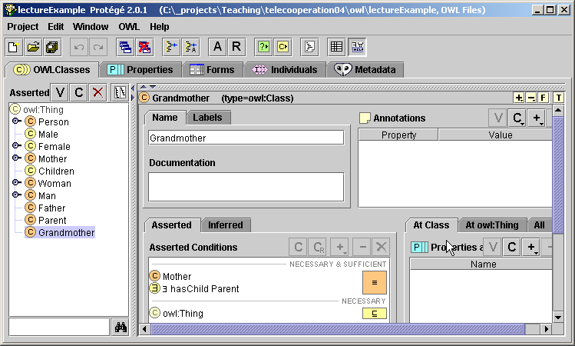
Subsumption
Example in Protégé
Notes:
[6]

Slide 66
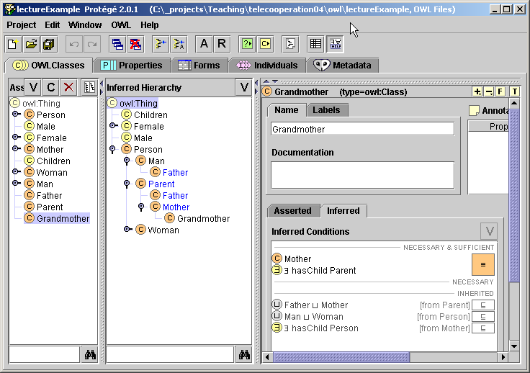
Subsumption
Inferred Hierarchy in Protégé
Notes:
[6]

Slide 67
Inconsistency
You may define Classes were no individual can fulfill its definition. Via reasoning engines such a definition can be found also in big ontologies.
Notes:
[6]

Slide 68
Inconsistency
Example
Cow ≡ Animal ⊓ Vegetarian
Sheep ⊑ Animal
Vegetarian ≡ ∃eats ¬ Animal
MadCow ≡ Cow ⊓ ∃eats.Sheep
Notes:
[6]

Slide 69
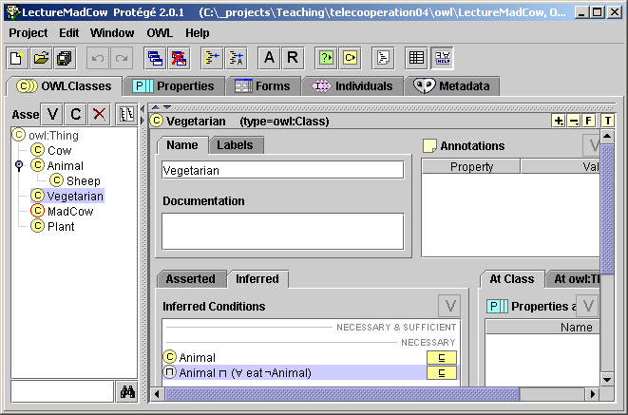
Inconsistency
Example in Protégé
Notes:
[6]

Slide 70
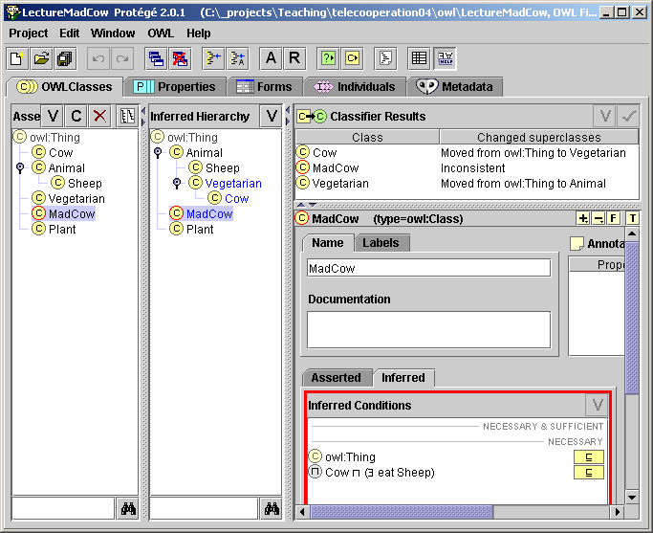
Inconsistency
Detected Inconsistency in Protégé
Notes:
[6]

Slide 71
Summary
The semantic web is based on machine-processable semantics of data.
Its backbone technology are Ontologies.
It is based on new web languages such as XML, RDF, and OWL, and tools that make use of these languages.
Notes:
[3]

Slide 72
Mola...
Next: OWL in Protege...
Notes:
[6]

Slide 73
RDF/OWL in Protégé
Example
Notes:
[6]

Slide 74
OWL Example in Protégé (1)
Class
  Person superclass
  Man, Woman subclasses
  Enumerated Classes
Properties
  isWifeOf, isHusbandOf
Property characteristics, restrictions
  inverseOf
  domain
  range
  Cardinality
  allValuesFrom, someValuesFrom, hasValue, minCardinality, maxCardinality, cardinality
Class expressions
  disjointWith, unionOf (or), intersectionOf (and), complementOf (not)
Notes:
[3] -> kendi örneğini geliştir
[6]’da detaylar var...

Slide 75
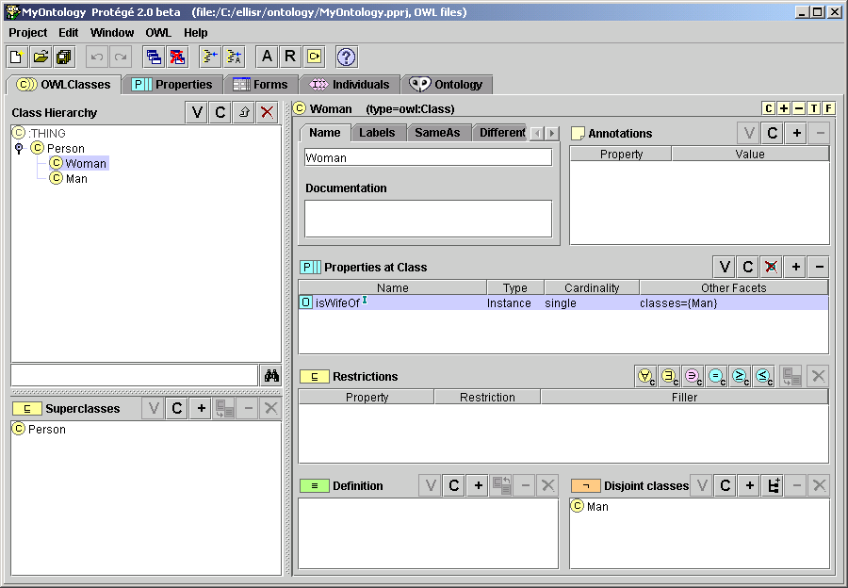
OWL Example in Protégé (2)
Notes:
[3] -> kendi örneğini geliştir

Slide 76
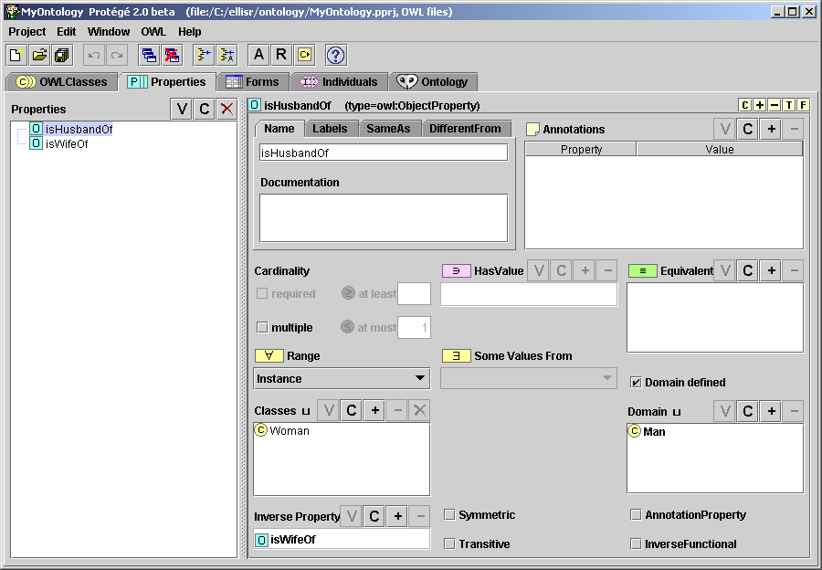
OWL Example in Protégé (3)
Notes:
[3] -> kendi örneğini geliştir

Slide 77
Ontologies vs. Models
Acknowledgements: Colin Atkinson
Ontologies
originated from the artificial intelligence world for the purpose of precisely structuring “knowledge”
new “knowledge” derived by automated reasoning
characterized by OWL as the flagship language
  formal semantics (description logic)
Models (à la MDA)
originated from the software engineering world for structuring the specification of software, abstracting from platform specific aspects
information defined prescriptively for construction
characterized by UML as the flagship language
  semi-formal semantics (metamodels)
Ontologies
?
Models
Notes:
[3]

Slide 78
Mola...
Next: Ontology Building in Action...

Slide 79
kaynak\Ian Horrocks - CS646\7.2Lect-2-Ontology-building-2007.ppt

Slide 80
Mola...
Next: Reasoning...

Slide 82
Mola...
Next: Ontology Building: Patterns and Best Practices...

Slide 83
SWBP
kaynak\Ian Horrocks - CS646\7.3Lect-3-problems-and-patterns-2007.ppt
kaynak\Ian Horrocks - CS646\7.4Lecture-4-more-patterns.ppt

Slide 84
Mola...
Next: Working on Ontologies with JENA Semantic Web Framework...

Slide 85
References
[1] D:\My Documents\SemanticWebWorkshop\kaynak\Ian Horrocks - CS646\intro-2004.ppt
[2] D:\My Documents\SemanticWebWorkshop\kaynak\VaganTerziyan-SW Course\SW_Tutorial_2004_Part_1.ppt
[3] kaynak\VaganTerziyan-SW Course\SW_Tutorial_2004_Part_1.ppt
[4] kaynak\Ian Horrocks - CS646\2ontologies.ppt
[5] kaynak\Ian Horrocks - CS646\7.1Lect-1-Ontology-and-OWL-2007.ppt
[6] kaynak\VaganTerziyan-SW Course\xEk2-Ontologies_1.ppt

Slide 86
Resources
W3C Documents
  Guide: http://www.w3.org/TR/owl-guide/
  Reference: http://www.w3.org/TR/owl-ref/
  Semantics and Abstract Syntax:
  http://www.w3.org/TR/owl-semantics/
OWL Tutorials
  Ian Horrocks, Sean Bechhofer:
  http://www.cs.man.ac.uk/~horrocks/Slides/Innsbruck-tutorial/
  Roger L. Costello, David B. Jacobs: http://www.xfront.com/owl/
Example Ontologies, e.g. here:
  http://www.daml.org/ontologies/
Notes:
[6]

Slide 87
A-Boxes & T-Boxes
  The “T-Box” – for “terminology box”
  Individuals in ontologies (The “A-Box”)
‘T-Box’ (Terminology Box)
  Definitions and restrictions on classes
‘A-Box’(Assertions box)
  Descriptions and assertions of individuals
DLs (& OWL DL) work best for T-Box
  Large general A-Boxes are intractable
    A change anywhere can propagate anywhere else
A is an instance of B
A-Boxes
John is a Person
All Students are Persons
There are two types of Persons: Students and Teachers
T-Boxes
Notes:
[3]

Slide 88
DL Architecture
Knowledge Base
Tbox (schema)
Man ´ Human u Male
Happy-Father ´ Man u 9 has-child Female u …
Interface
Inference System
Abox (data)
John : Happy-Father
hJohn, Maryi : has-child
Notes:
kaynak\Ian Horrocks - CS646\3pt2-dlintro.ppt
http://www.cs.man.ac.uk/~horrocks/Slides/index.html

Slide 89
Where to find out more: Web-Sites
OWL, OWL-S
  http://www.w3.org/2004/01/sws-pressrelease
  http://www.w3.org/2004/01/sws-testimonial
Semantic Web
  http://www.w3.org/2001/sw/
  http://www.semwebcentral.org/
Semantic Web Services
  http://www.daml.org/services/
  http://www.swsi.org/
  http://www.wsmo.org
Notes:
[3]

Slide 90
Company Benefits from the Semantic Web
Developing ontology languages, ontologies, annotation support tools will give you an advance of several years before others can develop the same. Important is that the standards and the applications will depend on you.
Developing Semantic Web service platforms, agents, applications, based on widespread standards allows to automatically explore rich Web content providing services for millions of customers.
Annotate your own products and services. This makes your products and services reachable by new generation of semantic search engines and automatically accessed by Web applications, agents and services.
Notes:
[3]

Slide 91
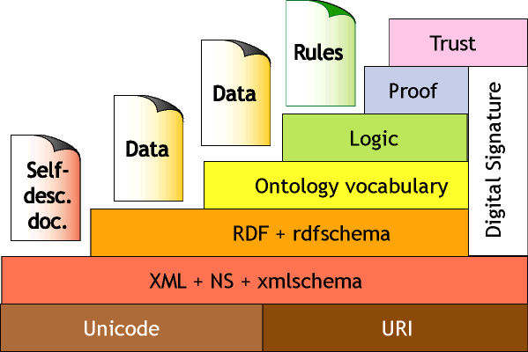
(In)famous “Layer Cake”
???
???
???
≈ Semantics+reasoning
?
≈ Relational Data
?
≈ Data Exchange
Relationship between layers is not clear
OWL DL extends “DL subset” of RDF
Notes:
[4]

Slide 92
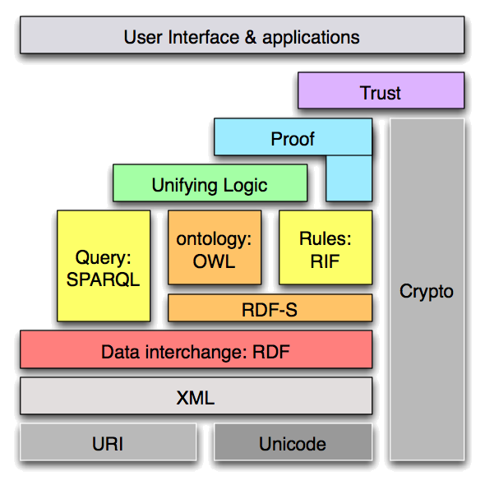
Semantic Web “Layered Cake” (refreshed)
Notes:
[6]

Slide 93
EK Konular
DL Intro
  kaynak\Ian Horrocks - CS646\3pt2-dlintro.ppt
OWL and Inference
  4.0Why did that happen
  kaynak\Ian Horrocks - CS646\4.1why.ppt
DL Reasoning (&Tableaux Algorithm)
  kaynak\Ian Horrocks - CS646\5pt3-dlreasoning.pdf
Notes:
(kaynak\Ian Horrocks - CS646\3pt2-dlintro.ppt) {
Description Logis describes relations between Concepts/Classes
Individuals secondary
}

