Slide 1
What is an Ontology?
An ontology for a domain is the explicit
formal specification of the terms in the
domain and relations among them.

Slide 2
What is an Ontology ...
Defines a common vocabulary for a group of professionals who need to share information in a given domain.
Includes machine-interpretable definitions of basic concepts in the domain and relations among them.

Slide 3
Share a Common Understanding
Several different Web sites contain medical information or provide medical e-commerce services.
  They share the same underlying ontology.
  Enables computer agents to extract and aggregate information from different sites.
Common Digital Entertainment ontology.
  Medium for discussing and sharing ideas among designers.
  Foundation for analysis and critiquing.

Slide 4
Enable Reuse of Domain Knowledge
Notions of Time
  Time intervals
  Points in time
  Relative measures of time.
Notions of Space
  Spatial relations
  Navigation around obstacles.
Emotions
Applicable over a broad range of applications.

Slide 5
Make Domain Assumptions Explicit
Makes it easier to change underlying domain assumptions.
  Hard coding assumptions about the world makes it hard to
    Find and understand assumptions
    Change assumptions
  Explicit specifications are useful for new users who must learn what terms in the domain mean.

Slide 6
Separate Domain from Operational Knowledge
Describe a task of configuring a product from components according to a required specification.
Develop a program that is independent of the specific products and components themselves
  Same program can configure
    PCs
    Elevators
    Video Game Consoles

Slide 7
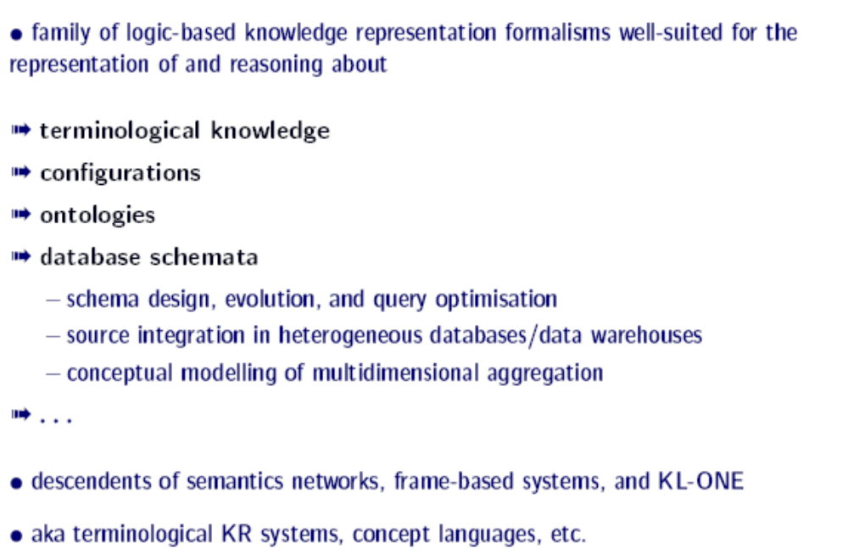
Description Logic

Slide 8
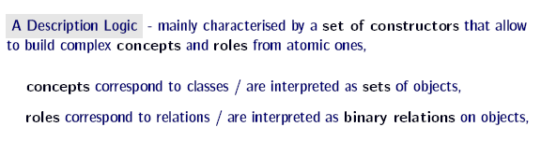
Description Logic

Slide 9
Family Ontology
o.1 Man := (hasGender = 1) ∩ (hasGender з Male)
o.2 Woman := (hasGender = 1) ∩ (hasGender з Female)
o.3 (hasChild)⁻¹ = hasParent
o.4 Person := Man U Woman
o.5 Parent := Person ∩ (hasChild ≥ 1)
o.6 Father := Parent ∩ Man
o.7 Mother := Parent ∩ Woman

Slide 10
Family Ontology Relations
Relations:
hasGender(Person,String)
hasParent(Person,Person)
hasChild(Person,Person)
hasConsort(Person,Person)
Rule:
r.1 hasParent(?x1, ?x2) Λ hasConsort(?x2, ?x3)
=> hasParent(?x1, ?x3)

Slide 11
Family Ontology Example
Person Instances: m1, f1, f2
Relation Instances:
hasGender(m1, Male)
hasChild(m1, f2)
hasGender(f1, Female)
hasConsort(m1, f1)
Conclude: Mother(f1)

Slide 12
Family Ontology Example
d.1 hasGender(f1, Female) → Woman(f1) [o.2]
d.2 Woman(f1) → Person(f1) [o.4]
d.3 hasChild(m1, m2) → hasParent(m2, m1) [o.3]
d.4 hasParent(m2, m1) Λ hasConsort(m1, f1)
→ hasParent(m2, f1) [r.1]
d.5 hasParent(m2, f1) → hasChild(f1, m2) [o.3]
d.6 Person(f1) Λ hasChild(f1, m2) → Parent(f1) [o.5]
d.7 Parent(f1) Λ Woman(f1) → Mother(f1) [o.7]

Slide 13
Family Ontology Example
Steps d.1 – d.3 performed by description logic ontology reasoner.
Step d.4 performed by deductive rule engine.
d.5 – d.7 performed by the ontology reasoner using the necessary relation instance concluded by the deductive rule engine in d.4.
Neither ontology reasoner nor deductive rule engine alone is sufficient.

