Slide 1

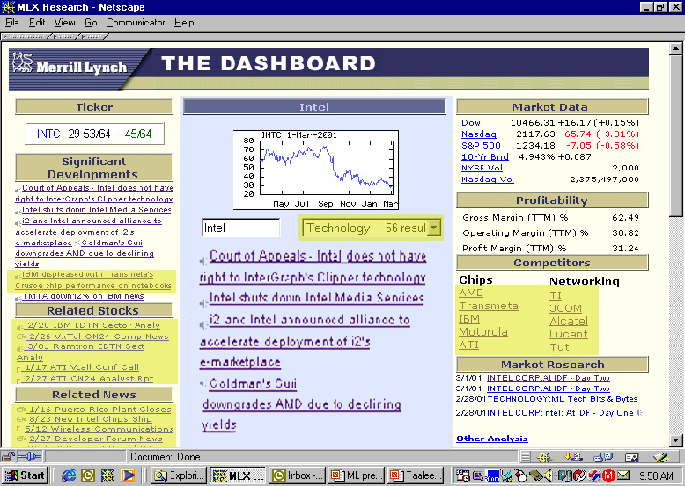
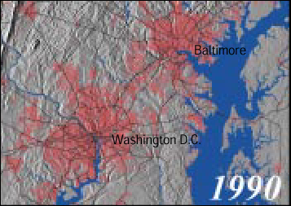


RDF and RDF Schema
Based on tutorials and presentations of
O. Lassila, R.R. Swick, J. Cowan, D. Brickley, R.V. Guha, W3C

Slide 2
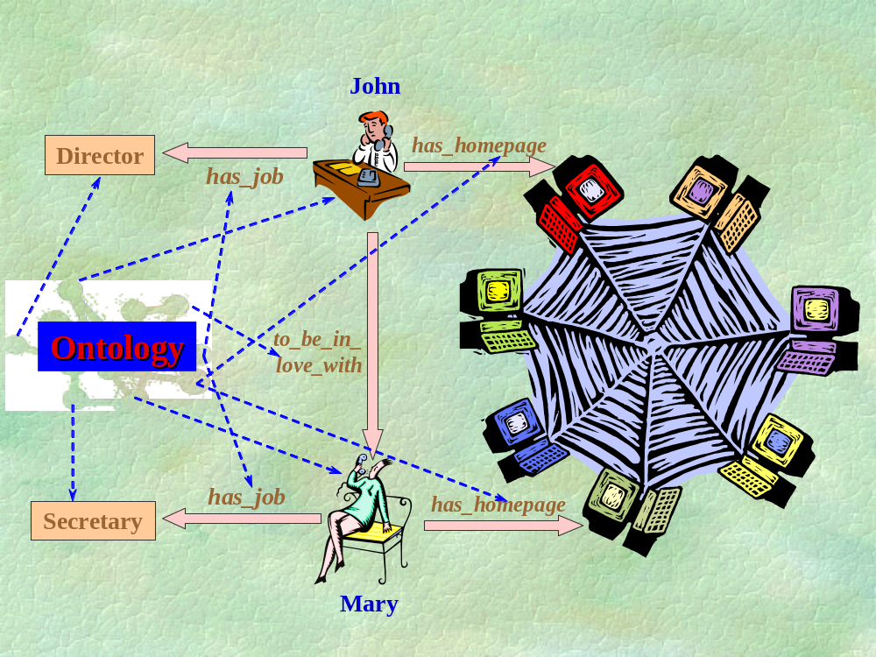
Description of Properties of the Web Resources and Semantic Relationships between them is important for the Interoperability among Web Applications

Slide 3
Contents
RDF
RDF Schema

Slide 4
R D F

Slide 5
What is RDF ?
Resource Description Framework (RDF) is a foundation for processing metadata in the Web;
It provides interoperability between applications that exchange machine-understandable information on the Web;
RDF emphasises facilities to enable automated processing of Web resources;
It is a mechanism for describing resources that makes no assumptions about a particular application domain.

Slide 6
Why RDF ?
for resource discovery to provide better search engine capabilities;
for describing the content and content relationships available at a particular Web site;
for intelligent software agents to facilitate knowledge sharing and exchange;
for expressing the privacy preferences of a user as well as the privacy policies of a Web site;
RDF with digital signatures will be key to building the "Web of Trust" for electronic commerce, collaboration, and other applications.

Slide 7
Basic Objects in RDF Data Model
Resources
Properties
Statements

Slide 8
Resources
All things being described by RDF expressions are called resources:
  entire Web page;
  part of a Web page (e.g. a specific XML element within the document source);
  whole collection of pages (e.g. an entire Web site);
  an object that is not directly accessible via the Web (e.g. a printed book).

Slide 9
Resources and URIs
A resource can be anything that has identity
Uniform Resource Identifiers (URI)* provide a simple and extensible means for identifying a resource
Not all resources are network "retrievable"; e.g., human beings, corporations, and books in a library can also be considered resources
* The term "Uniform Resource Locator" (URL) refers to the subset of URI that identify resources via a representation of their primary access mechanism (e.g., their network "location"), rather than identifying the resource by name or by some other attribute(s) of that resource.

Slide 10
Properties
A property is a specific aspect, characteristic, attribute, or relation used to describe a resource.
Each property has a specific meaning, defines its permitted values, the types of resources it can describe, and its relationship with other properties.

Slide 11
Statements
A specific resource together with a named property plus the value of that property for that resource is an RDF statement.

Slide 12
Subject, Predicate and Object
Subject of an RDF statement is a resource
Predicate of an RDF statement is a property of a resource
Object of an RDF statement is the value of a property of a resource

Slide 13
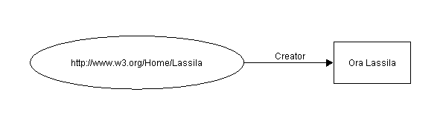
Example of RDF Statement
Ora Lassila is the creator of the resource http://www.w3.org/Home/Lassila.
Subject (resource)
http://www.w3.org/Home/Lassila
Predicate (property)
Creator
Object (literal)
“Ora Lassila”

Slide 14
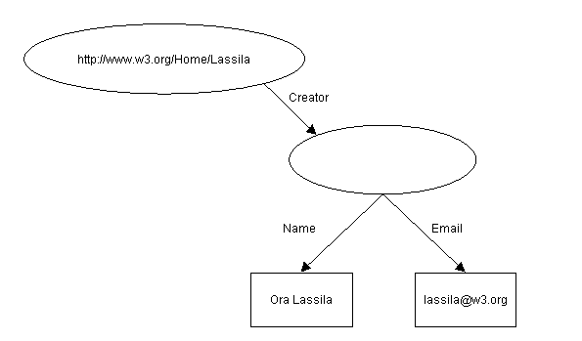
Property with Structural Value Example (1)
The individual whose name is Ora Lassila, email <lassila@w3.org>, is the creator of http://www.w3.org/Home/Lassila.

Slide 15
Property with Structural Value Example (2)
Subject (resource)
http://www.w3.org/Home/Lassila
Predicate (property)
Creator
Object (literal)
SOMETHING
Subject (resource)
SOMETHING
Predicate (property)
Name
Object (literal)
“Ora Lassila”
Subject (resource)
SOMETHING
Predicate (property)
Email
Object (literal)
lassila@w3.org

Slide 16
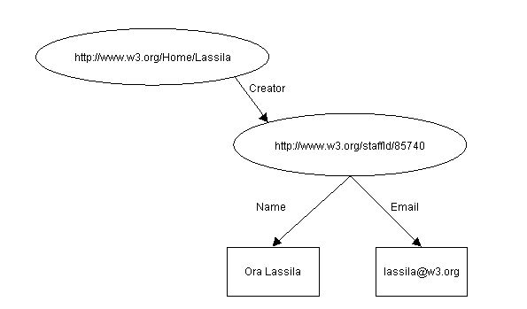
Property with Structural Value Example (3)
The individual referred to by employee id 85740 is named Ora Lassila and has the email address lassila@w3.org. The resource http://www.w3.org/Home/Lassila was created by this individual.

Slide 17
Property with Structural Value Example (4)
Subject (resource)
http://www.w3.org/Home/Lassila
Predicate (property)
Creator
Object (resource)
http://www.w3.org/staffid/85740
Subject (resource)
http://www.w3.org/staffid/85740
Predicate (property)
Name
Object (literal)
“Ora Lassila”
Subject (resource)
http://www.w3.org/staffid/85740
Predicate (property)
Email
Object (literal)
lassila@w3.org

Slide 18
RDF Serialisation Syntax
[1] RDF ::= ['<rdf:RDF>'] description* ['</rdf:RDF>']
[2] description ::= '<rdf:Description' idAboutAttr? '>' propertyElt* '</rdf:Description> '
[3] idAboutAttr ::= idAttr | aboutAttr
[4] aboutAttr ::= 'about="' URI-reference '"'
[5] idAttr ::= 'ID="' IDsymbol '"'
[6] propertyElt ::= '<' propName '>' value '</' propName '>' | '<' propName resourceAttr '/>'
[7] propName ::= Qname
[8] value ::= description | string
[9] resourceAttr ::= 'resource="' URI-reference '"'
[10] Qname ::= [ NSprefix ':' ] name
[11] URI-reference ::= string, interpreted per [URI]
[12] IDsymbol ::= (any legal XML name symbol)
[13] name ::= (any legal XML name symbol)
[14] NSprefix ::= (any legal XML namespace prefix)
[15] string ::= (any XML text, with "<", ">", and "&" escaped)

Slide 19
RDF Statement Example
Ora Lassila is the creator of the resource http://www.w3.org/Home/Lassila.
<rdf:RDF>
<rdf:Description about=
"http://www.w3.org/Home/Lassila">
<s:Creator>Ora Lassila</s:Creator>
</rdf:Description>
</rdf:RDF>

Slide 20
RDF Example (subject of statement)
Ora Lassila is the creator of the resource http://www.w3.org/Home/Lassila.
Subject
<rdf:RDF>
<rdf:Description about=
"http://www.w3.org/Home/Lassila">
<s:Creator>Ora Lassila</s:Creator>
</rdf:Description>
</rdf:RDF>

Slide 21
RDF Example (predicate of statement)
Ora Lassila is the creator of the resource http://www.w3.org/Home/Lassila.
<rdf:RDF>
<rdf:Description about=
"http://www.w3.org/Home/Lassila">
<s:Creator>Ora Lassila</s:Creator>
</rdf:Description>
</rdf:RDF>
Predicate

Slide 22
RDF Example (object of statement)
Ora Lassila is the creator of the resource http://www.w3.org/Home/Lassila.
<rdf:RDF>
<rdf:Description about=
"http://www.w3.org/Home/Lassila">
<s:Creator>Ora Lassila</s:Creator>
</rdf:Description>
</rdf:RDF>
Object

Slide 23
RDF Example (reference to ontology)
Ora Lassila is the creator of the resource http://www.w3.org/Home/Lassila.
<rdf:RDF>
<rdf:Description about=
"http://www.w3.org/Home/Lassila">
<s:Creator>Ora Lassila</s:Creator>
</rdf:Description>
</rdf:RDF>
a specific namespace prefix as reference to ontology where predicates are defined, e.g. xmlns: s="http://description.org/schema/"

Slide 24
Full XML Document for the Example
Namespaces as attributes of “RDF” element in XML
<?xml version="1.0"?>
<rdf:RDF
xmlns:rdf="http://www.w3.org/1999/02/22-rdf-syntax-ns#”
xmlns:s="http://description.org/schema/">
<rdf:Description about=
"http://www.w3.org/Home/Lassila">
<s:Creator>Ora Lassila</s:Creator>
</rdf:Description>
</rdf:RDF>

Slide 25
XML Document for the Example with default namespace syntax
<?xml version="1.0"?>
<RDF
xmlns:s="http://description.org/
schema/">
<Description about=
"http://www.w3.org/Home/Lassila">
<s:Creator>Ora Lassila</s:Creator>
</Description>
</RDF>

Slide 26
RDF Abbreviated Syntax
While the serialisation syntax shows the structure of an RDF model most clearly, often it is desirable to use a more compact XML form.
The RDF abbreviated syntax accomplishes this.

Slide 27
RDF Abbreviated Syntax
[2a] description ::= '<rdf:Description' idAboutAttr? propAttr* '/>'
| '<rdf:Description' idAboutAttr? propAttr* '>'
propertyElt* '</rdf:Description>'
| typedNode
[6a] propertyElt ::= '<' propName '>' value '</' propName '>'
| '<' propName resourceAttr? propAttr* '/>'
[16] propAttr ::= propName '="' string '"'
(with embedded quotes escaped)
[17] typedNode ::= '<' typeName idAboutAttr? propAttr* '/>'
| '<' typeName idAboutAttr? propAttr* '>'
property* '</' typeName '>'

Slide 28
Abbreviated Syntax Example (1)
Ora Lassila is the creator of the resource http://www.w3.org/Home/Lassila.
<rdf:RDF>
<rdf:Description about="http://www.w3.org/Home/Lassila"
s:Creator="Ora Lassila" />
</rdf:RDF>

Slide 29
Abbreviated Syntax Example (2)
Ora Lassila is the creator of the resource http://www.w3.org/Home/Lassila.
Subject
<rdf:RDF>
<rdf:Description about="http://www.w3.org/Home/Lassila"
s:Creator="Ora Lassila" />
</rdf:RDF>

Slide 30
Abbreviated Syntax Example (3)
Ora Lassila is the creator of the resource http://www.w3.org/Home/Lassila.
<rdf:RDF>
<rdf:Description about="http://www.w3.org/Home/Lassila"
s:Creator ="Ora Lassila" />
</rdf:RDF>
Predicate

Slide 31
Abbreviated Syntax Example (4)
Ora Lassila is the creator of the resource http://www.w3.org/Home/Lassila.
<rdf:RDF>
<rdf:Description about="http://www.w3.org/Home/Lassila"
s:Creator="Ora Lassila" />
</rdf:RDF>
Object

Slide 32
Serialisation vs. Abbreviated Syntax Example (1)
The individual referred to by employee id 85740 is named Ora Lassila and has the email address lassila@w3.org. The resource http://www.w3.org/Home/Lassila was created by this individual.
<rdf:RDF>
<rdf:Description about="http://www.w3.org/Home/Lassila">
<s:Creator>
<rdf:Description about="http://www.w3.org/staffId/85740">
<v:Name>Ora Lassila</v:Name>
<v:Email>lassila@w3.org</v:Email>
</rdf:Description>
</s:Creator>
</rdf:Description>
</rdf:RDF>
Serialisation syntax used

Slide 33
Serialisation vs. Abbreviated Syntax Example (2)
The individual referred to by employee id 85740 is named Ora Lassila and has the email address lassila@w3.org. The resource http://www.w3.org/Home/Lassila was created by this individual.
<rdf:RDF>
<rdf:Description about="http://www.w3.org/Home/Lassila">
<s:Creator rdf:resource="http://www.w3.org/staffId/85740"
v:Name="Ora Lassila"
v:Email="lassila@w3.org" />
</rdf:Description>
</rdf:RDF>
Abbreviated syntax used

Slide 34

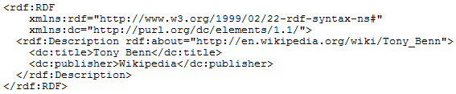

RDF N3 syntax
Notation3, or N3 as it is more commonly known, is a shorthand non-XML serialization of RDF models, designed with human-readability in mind: N3 is much more compact and readable than XML RDF notation. The format is being developed by Tim Berners-Lee and others from the Semantic Web community.
RDF sample in XML notation
RDF sample in N3 notation

Slide 35


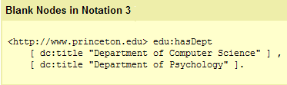
Some N3 syntax specifics
Ontological statements in N3
@prefix rdfs: <http://www.w3.org/2000/01/rdf-schema#>
:Professor a rdfs:Class
<http://www.cs.jyu.fi/ai/vagan> a :Professor

Slide 36
Containers
Frequently it is necessary to refer to a collection of resources. RDF containers are used to hold such lists of resources or literals. There are three types of a container:
  bag
  sequence
  alternative

Slide 37
Container Syntax
[18] container ::= sequence | bag | alternative
[19] sequence ::= '<rdf:Seq' idAttr? '>' member* '</rdf:Seq>'
[20] bag ::= '<rdf:Bag' idAttr? '>' member* '</rdf:Bag>'
[21] alternative ::= '<rdf:Alt' idAttr? '>' member+ '</rdf:Alt>'
[22] member ::= referencedItem | inlineItem
[23] referencedItem ::= '<rdf:li' resourceAttr '/>'
[24] inlineItem ::= '<rdf:li>' value '</rdf:li>'

Slide 38
Containers. Bag.
An unordered list of resources or literals.
Bags are used to declare that a property has multiple values and that there is no significance to the order in which the values are given.
Bag might be used to give a list of part numbers where the order of processing the parts does not matter. Duplicate values are permitted.

Slide 39
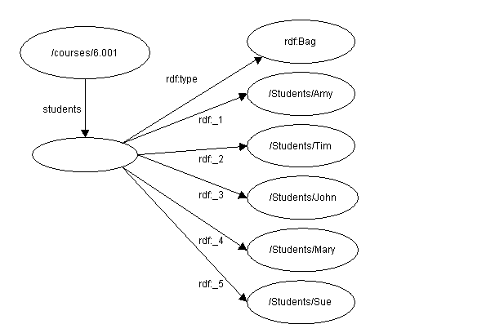
Bag Example (1)
The students in course 6.001 are Amy, Tim, John, Mary, and Sue

Slide 40
Bag Example (2)
The graph has eight nodes and seven arcs. The first node is the resource /courses/6.001. An arc labelled students connects this node to an unnamed node. An arc labelled rdf:type connects the unnamed node to a node labelled rdf:Bag. Five additional arcs labelled rdf:_1, rdf:_2, rdf:_3, rdf:_4, and rdf:_5 connect the unnamed node to nodes labelled, respectively, /Students/Amy, /Students/Tim, /Students/John, /Students/Mary, and /Students/Sue. All the nodes are represented as ovals.

Slide 41
Bag Example (3)
The students in course 6.001 are Amy, Tim, John, Mary, and Sue
<rdf:RDF>
<rdf:Description about="http://mycollege.edu/courses/6.001">
<s:students>
<rdf:Bag>
<rdf:li resource="http://mycollege.edu/students/Amy"/>
<rdf:li resource="http://mycollege.edu/students/Tim"/>
<rdf:li resource="http://mycollege.edu/students/John"/>
<rdf:li resource="http://mycollege.edu/students/Mary"/>
<rdf:li resource="http://mycollege.edu/students/Sue"/>
</rdf:Bag>
</s:students>
</rdf:Description>
</rdf:RDF>

Slide 42
Containers. Sequence.
An ordered list of resources or literals.
Sequence is used to declare that a property has multiple values and that the order of the values is significant.
Sequence might be used, for example, to preserve an alphabetical ordering of values.
Duplicate values are permitted.

Slide 43
Containers. Alternative.
A list of resources or literals that represent alternatives for the (single) value of a property.
An application using a property whose value is an Alternative collection is aware that it can choose any one of the items in the list as appropriate.

Slide 44
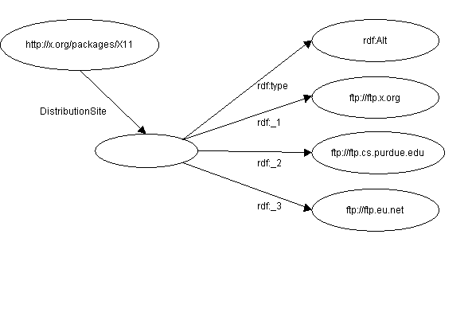
Alternative Example (1)
The source code for X11 may be found at ftp.x.org, ftp.cs.purdue.edu, or ftp.eu.net

Slide 45
Alternative Example (2)
The graph has six nodes and five arcs. The first node is the resource http://x.org/packages/X11. An arc labelled DistributionSite connects this node to an unnamed node. An arc labelled rdf:type connects the unnamed node to a node labelled rdf:Alt. Three additional arcs labelled rdf:_1, rdf:_2, and rdf:_3 connect the unnamed node to nodes labelled, respectively, ftp.x.org, ftp.cs.purdue.edu, and ftp.eu.net. All the nodes are represented as ovals

Slide 46
Alternative Example (3)
The source code for X11 may be found at ftp.x.org, ftp.cs.purdue.edu, or ftp.eu.net
<rdf:RDF>
<rdf:Description about="http://x.org/packages/X11">
<s:DistributionSite>
<rdf:Alt>
<rdf:li resource="ftp://ftp.x.org"/>
<rdf:li resource="ftp://ftp.cs.purdue.edu"/>
<rdf:li resource="ftp://ftp.eu.net"/>
</rdf:Alt>
</s:DistributionSite>
</rdf:Description>
</rdf:RDF>

Slide 47
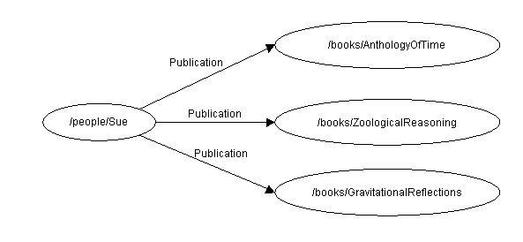
Containers vs. Repeated Properties (1)
Sue has written "Anthology of Time", "Zoological Reasoning", "Gravitational Reflections".
There is no stated
relationship between
the publications
other than that
they were written
by the same person

Slide 48
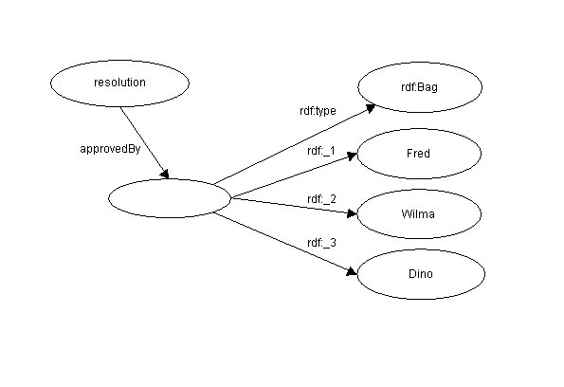
Containers vs. Repeated Properties (2)
The committee of Fred, Wilma, and Dino approved the resolution.
three committee members
as a whole voted
in a certain manner;
it does not necessarily
state that each
committee member
voted in favour
of the resolution.

Slide 49
Statements about Statements (1)
For example, let us consider the sentence:
“Ora Lassila is the creator of the resource http://www.w3.org/Home/Lassila”.
RDF would regard this sentence as a fact. If, instead, we write the sentence:
“Ralph Swick says that Ora Lassila is the creator of the resource http://www.w3.org/Home/Lassila”
… we have said nothing about the resource http://www.w3.org/Home/Lassila; instead, we have expressed a fact about a statement Ralph has made.

Slide 50
Statements about Statements (2)
To model statements RDF defines the following properties:
  subject
    The subject property identifies the resource being described by the modelled statement; that is, the value of the subject property is the resource about which the original statement was made (e.g., http://www.w3.org/Home/Lassila).
  predicate
    The predicate property identifies the original property in the modelled statement. The value of the predicate property is a resource representing the specific property in the original statement (in our example, creator).
  object
    The object property identifies the property value in the modelled statement. The value of the object property is the object in the original statement (in our example, "Ora Lassila").
  type
    The value of the type property describes the type of the new resource. All reified statements are instances of RDF:Statement; that is, they have a type property whose object is RDF:Statement.

Slide 51
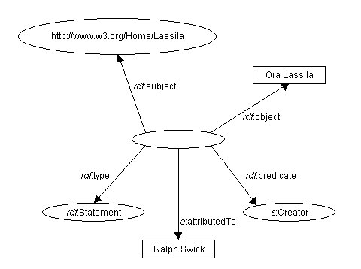
Statements about Statements (3)
“Ralph Swick says that Ora Lassila is the creator of the resource http://www.w3.org/Home/Lassila”

Slide 52
Statements about Statements (4)
An unnamed node is the source of all five arcs. The first arc is labelled rdf:type and points to the node identified as rdf:Statement. The second arc is labelled rdf:predicate
and points to the node identified as s:Creator. The third arc is labelled rdf:subject and points to a node labelled http://www.w3.org/Home/Lassila. The fourth arc is labelled rdf:object and points to a node containing the string value "Ora Lassila". The fifth and final arc is labelled a:attributedTo and points to a node containing the string value "Ralph Swick".

Slide 53
Statements about Statements (5)
“Ralph Swick says that Ora Lassila is the creator of the resource http://www.w3.org/Home/Lassila”
<rdf:RDF
xmlns:rdf="http://w3.org/TR/1999/PR-rdf-syntax-19990105#"
xmlns:a="http://description.org/schema/">
<rdf:Description>
<rdf:subject resource="http://www.w3.org/Home/Lassila" />
<rdf:predicate resource="http://description.org/schema#Creator" />
<rdf:object>Ora Lassila</rdf:object>
<rdf:type resource="http://w3.org/TR/1999/PR-rdf-syntax-
19990105#Statement" />
<a:attributedTo>Ralph Swick</a:attributedTo>
</rdf:Description>
</rdf:RDF>

Slide 54
Statements about containers
<rdf:Description about="http://www.cs.jyu.fi/vagan/courses/ITKS544">
<s:lectures>
<rdf:Bag ID="pages">
<rdf:li rdf:resource=" http://www.cs.jyu.fi/vagan/courses/ITKS544/Lecture_1.ppt">
<rdf:li rdf:resource=" http://www.cs.jyu.fi/vagan/courses/ITKS544/Lecture_2.ppt">
…
<rdf:li rdf:resource=" http://www.cs.jyu.fi/vagan/courses/ITKS544/Lecture_8.ppt">
</rdf:Bag>
</s:lectures>
</rdf:Description>
<rdf:Description about="#pages">
<dc:creator> Vagan Terziyan </dc:creator>
</rdf:Description>

Slide 55
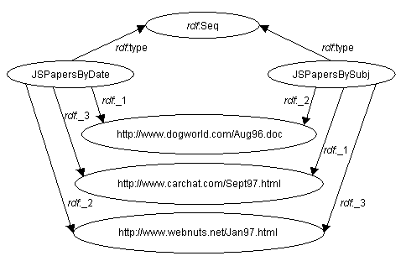
Sharing Values between Sequences (1)
Consider the case of specifying 3 collected works of an author, sorted once by publication date and sorted again alphabetically by subject.

Slide 56
Sharing Values between Sequences (2)
<RDF xmlns="http://w3.org/TR/1999/PR-rdf-syntax-19990105#">
<Seq ID="JSPapersByDate">
<li resource="http://www.dogworld.com/Aug96.doc"/>
<li resource="http://www.webnuts.net/Jan97.html"/>
<li resource="http://www.carchat.com/Sept97.html"/>
</Seq>
<Seq ID="JSPapersBySubj">
<li resource="http://www.carchat.com/Sept97.html"/>
<li resource="http://www.dogworld.com/Aug96.doc"/>
<li resource="http://www.webnuts.net/Jan97.html"/>
</Seq>
</RDF>

Slide 57
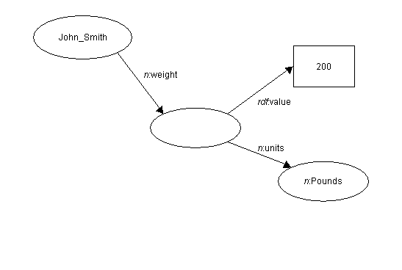
Ternary Relation (1)
John Smith’s weight is 200 pounds

Slide 58
Ternary Relation (2)
John Smith’s weight is 200 pounds
<RDF
xmlns="http://w3.org/TR/1999/PR-rdf-syntax-19990105#"
xmlns:rdf="http://w3.org/TR/1999/PR-rdf-syntax-19990105#"
xmlns:n="http://www.nist.gov/units/">
<Description about="John_Smith">
<n:weight rdf:parseType="Resource">
<rdf:value>200</rdf:value>
<n:units rdf:resource="http://www.nist.gov/units/Pounds"/>
</n:weight>
</Description>
</RDF>

Slide 59
R D F
SCHEMA

Slide 60
Why RDFS ?
Resource description communities require the ability to say certain things about certain kinds of resources.
The declaration of these properties (attributes) and their corresponding semantics are defined in the context of RDF as an RDF schema.
A schema defines not only the properties of the resource but may also define the kinds of resources being described.
RDF schema lets developers define a particular vocabulary for RDF data and specify the kinds of object to which these attributes can be applied.

Slide 61
What is RDFS ?
The RDF Schema is a collection of RDF resources that can be used to describe properties of other RDF resources.
The core schema vocabulary is defined in a namespace informally called 'rdfs', and identified by the URI reference: http://www.w3.org/2000/01/rdf-schema#.
Specification also uses the prefix 'rdf' to refer to the core RDF namespace: http://www.w3.org/1999/02/22-rdf-syntax-ns#.
Latest RDFS description (15 December 2003) http://www.w3.org/TR/2003/PR-rdf-schema-20031215/

Slide 62
What is RDFS ?
RDF Schema
  Defines vocabulary for RDF
  Organizes this vocabulary in a typed hierarchy (Class, subClassOf, type, Property, subPropertyOf)
Rich, web-based publication format for declaring semantics (XML for exchange)
Capability to explicitly declare semantic relations between vocabulary terms

Slide 63
RDF Schemas
Semantic network on the Web
Nodes are identified by URIs
rdfs:Class
rdfs:Property
rdfs:subClassOf
rdf:type

Slide 64
RDF Classes
Are groups of Web resources
Have URIs to identify them
The special class “rdfs:Literal” consists of all possible RDF string values

Slide 65
Property-centric classes
In typical OO classes, each class specifies completely what properties it has and what their types are
In RDF classes, each property specifies what classes of subjects and objects it relates
Therefore, new properties can be added to a class without modifying the class

Slide 66
Specifying classes
To specify a class, create an RDF resource of type rdf:Class, for example:
<rdf:Class id=“MyClass”>
<rdfs:label>My Class</rdfs:label>
<rdfs:comment>Vagan Terziyan’s demonstration
Class</rdfs:comment>
</rdf:Class>

Slide 67
Specifying properties
To specify a property, create an RDF resource of type rdf:Property, for example:
<rdf:Property id=“myProperty”>
<rdfs:comment>Vagan Terziyan’s demo
property</rdfs:comment>
<rdfs:domain resource=“#MyClass”/>
<rdfs:range resource=“..#Literal”/>
<rdf:Property>

Slide 68
Property Elements
A rdf:Property element refers to a property name (a URI) (to which we will refer as P). Properties that are used in property restrictions should be either properties, which relate objects to other objects;
Each subPropertyOf element states that P is a subproperty of the property named in the element. This means that every pair (x,y) that is an instance of P is also an instance of the named property;

Slide 69
Domain and Range of a Property
rdfs:domain element asserts that the property P only applies to instances of the class expression of the element. More formally: if a pair (x,y) is an instance of P, then x is an instance of the class expression. This implies that multiple domain expressions restrict the domain of P to the intersection of the class expressions.
rdfs:range element asserts that the property P only assumes values that are instances of the class expression of the element. More formally: a pair (x,y) can only be an instance of P if y is an instance of the class expression;

Slide 70
Domain and Range of a Property (2)
“rdfs:domain” specifies the domain of a property (the classes of its subjects); if unknown, anything can be a subject
“rdfs:range” specifies the range of a property (the single class of its objects); if unknown, anything can be an object

Slide 71
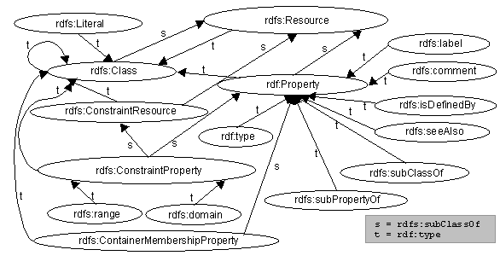
Class Hierarchy of the RDFS (1)

Slide 72
Class Hierarchy of the RDFS (2)
Class hierarchy is shown using a "nodes and arcs" graph representation of the RDF data model. If one class is a subset of another, then there is an rdfs:subClassOf arc from the node representing the first class to the node representing the second.
If a resource is an instance of a class, then there is an rdf:type arc from the resource to the node representing the class.

Slide 73
Useful properties (1)
“rdf:type” relates any resource to its class
“rdfs:subClassOf” relates a subclass to its superclass
“rdfs:subPropertyOf” relates a subproperty to its superproperty
“rdfs:seeAlso” relates a resource to another resource explaining it
“rdfs:isDefinedBy” the definition of the subject resource

Slide 74
Useful properties (2)
“rdf:subject” is the property relating a reified statement to its subject (resource)
“rdf:predicate” is the property relating a reified statement to its predicate (property)
“rdf:object” is the property relating a reified statement to its object (value)

Slide 75
Useful properties (3)
“rdfs:label” specifies a human-readable name for this Class, Property, or whatever
“rdfs:comment” specifies human-readable documentation
Multiple values are useful for specifying multiple languages

Slide 76
Useful classes (1)
“rdfs:Resource” is the class of all resources
“rdfs:Literal” is the class of all strings
“rdfs:Class” is the class of all classes
“rdfs:Property” is the class of all properties
“rdf:Statement” is the class of all asserted RDF statements

Slide 77
Useful classes (2)
“rdfs:Container” is the superclass of all container classes
“rdf:Bag”, “rdf:Seq”, “rdf:Alt” are the classes of Bags, Seqs, and Alts
(Any other class that is a subclass of “rdfs:Container” can be used in RDF syntax in place of a standard container)

Slide 78
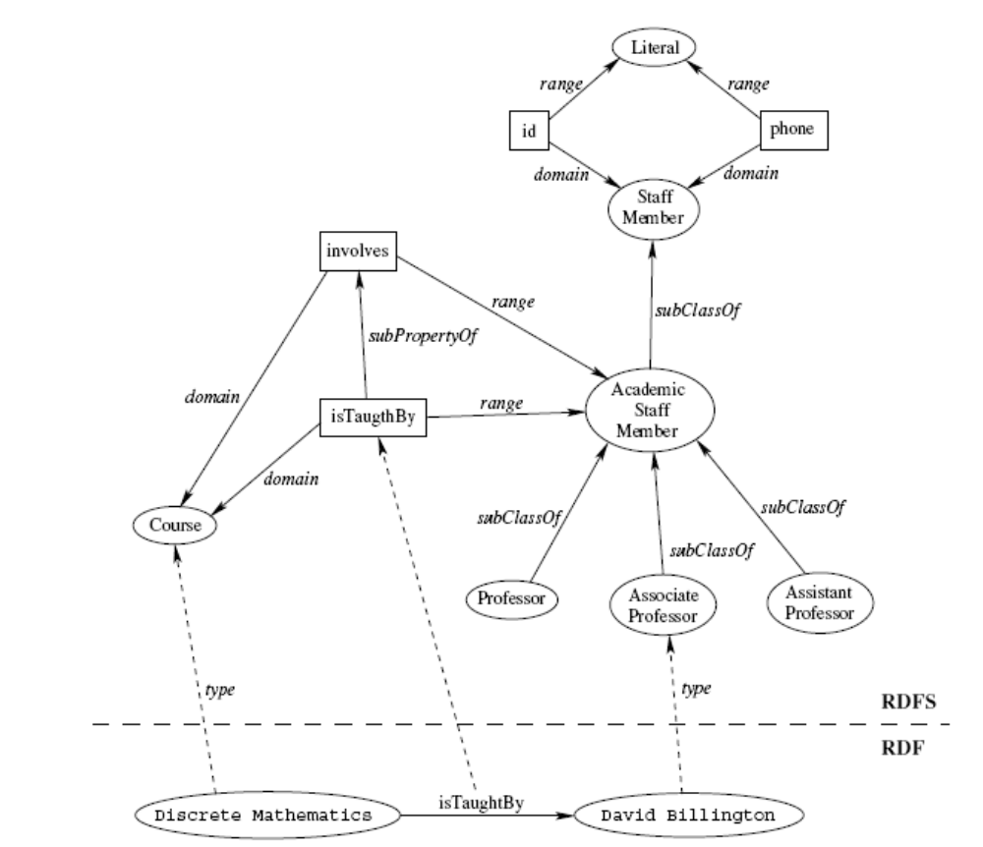
RDF & RDFS example (by Emily Chen)

Slide 79
Dublin Core
A set of fifteen basic properties for describing generalised Web resources
ISO Standard 15836-2003 (February 2003): http://www.niso.org/international/SC4/n515.pdf
The Dublin Core Metadata Initiative is an open forum engaged in the development of interoperable online metadata standards that support a broad range of purposes and business models.
http://dublincore.org/

Slide 80
Dublin Core (1): Title
Label: Title
Definition: A name given to the resource.
Comment: Typically, Title will be a name by which the resource is formally known.

Slide 81
Dublin Core (2): Creator
Label: Creator
Definition: An entity primarily responsible for making the content of the resource.
Comment: Examples of Creator include a person, an organization, or a service. Typically, the name of a Creator should be used to indicate the entity.

Slide 82
Dublin Core (3): Subject
Label: Subject and Keywords
Definition: A topic of the content of the resource.
Comment: Typically, Subject will be expressed as keywords, key phrases or classification codes that describe a topic of the resource. Recommended best practice is to select a value from a controlled vocabulary or formal classification scheme.

Slide 83
Dublin Core (4): Description
Label: Description
Definition: An account of the content of the resource.
Comment: Examples of Description include, but is not limited to: an abstract, table of contents, reference to a graphical representation of content or a free-text account of the content.

Slide 84
Dublin Core (5): Publisher
Label: Publisher
Definition: An entity responsible for making the resource available.
Comment: Examples of Publisher include a person, an organization, or a service. Typically, the name of a Publisher should be used to indicate the entity.

Slide 85
Dublin Core (6): Contributor
Label: Contributor
Definition: An entity responsible for making contributions to the content of the resource.
Comment: Examples of Contributor include a person, an organization, or a service. Typically, the name of a Contributor should be used to indicate the entity.

Slide 86
Dublin Core (7): Date
Label: Date
Definition: A date of an event in the lifecycle of the resource.
Comment: Typically, Date will be associated with the creation or availability of the resource. Recommended best practice for encoding the date value is defined in a profile of ISO 8601 [http://dublincore.org/documents/dces/#w3cdtf] and includes (among others) dates of the form YYYY-MM-DD.

Slide 87
Dublin Core (8): Type
Label: Resource Type
Definition: The nature or genre of the content of the resource.
Comment: Type includes terms describing general categories, functions, genres, or aggregation levels for content. Recommended best practice is to select a value from a controlled vocabulary (for example, the DCMI Type Vocabulary [http://dublincore.org/documents/dces/#dct1]). To describe the physical or digital manifestation of the resource, use the FORMAT element.

Slide 88
Dublin Core (9): Format
Label: Format
Definition: The physical or digital manifestation of the resource.
Comment: Typically, Format may include the media-type or dimensions of the resource. Format may be used to identify the software, hardware, or other equipment needed to display or operate the resource. Examples of dimensions include size and duration. Recommended best practice is to select a value from a controlled vocabulary (for example, the list of Internet Media Types [http://dublincore.org/documents/dces/#mime] defining computer media formats).

Slide 89
Dublin Core (10): Identifier
Label: Resource Identifier
Definition: An unambiguous reference to the resource within a given context.
Comment: Recommended best practice is to identify the resource by means of a string or number conforming to a formal identification system. Formal identification systems include but are not limited to the Uniform Resource Identifier (URI) (including the Uniform Resource Locator (URL)), the Digital Object Identifier (DOI) and the International Standard Book Number (ISBN).

Slide 90
Dublin Core (11): Source
Label: Source
Definition: A Reference to a resource from which the present resource is derived.
Comment: The present resource may be derived from the Source resource in whole or in part. Recommended best practice is to identify the referenced resource by means of a string or number conforming to a formal identification system.

Slide 91
Dublin Core (12): Language
Label: Language
Definition: A language of the intellectual content of the resource.
Comment: Recommended best practice is to use RFC 3066 [http://dublincore.org/documents/dces/#rfc3066] which, in conjunction with ISO639 [http://dublincore.org/documents/dces/#iso639]), defines two- and three-letter primary language tags with optional subtags. Examples include "en" or "eng" for English, "akk" for Akkadian", and "en-GB" for English used in the United Kingdom.

Slide 92
Dublin Core (13): Relation
Label: Relation
Definition: A reference to a related resource.
Comment: Recommended best practice is to identify the referenced resource by means of a string or number conforming to a formal identification system.

Slide 93
Dublin Core (14): Coverage
Label: Coverage
Definition: The extent or scope of the content of the resource.
Comment: Typically, Coverage will include spatial location (a place name or geographic coordinates), temporal period (a period label, date, or date range) or jurisdiction (such as a named administrative entity). Recommended best practice is to select a value from a controlled vocabulary (for example, the Thesaurus of Geographic Names [http://www.getty.edu/research/tools/vocabulary/ tgn/index.html]) and to use, where appropriate, named places or time periods in preference to numeric identifiers such as sets of coordinates or date ranges.

Slide 94
Dublin Core (15): Rights
Label: Rights Management
Definition: Information about rights held in and over the resource.
Comment: Typically, Rights will contain a rights management statement for the resource, or reference a service providing such information. Rights information often encompasses Intellectual Property Rights (IPR), Copyright, and various Property Rights. If the Rights element is absent, no assumptions may be made about any rights held in or over the resource.

Slide 95
Dublin Core Example
<?xml version="1.0"?>
<rdf:RDF xmlns:rdf=“http://www.w3.org/1999/02/22-rdf-syntax-ns#”
xmlns:dc="http://purl.org/dc/elements/1.0/">
<rdf:Description rdf:about="http://www.ukoln.ac.uk/metadata/resources/dc/
datamodel/WD-dc-rdf/">
<dc:title> Guidance on expressing the Dublin Core within the Resource
Description Framework (RDF) </dc:title>
<dc:creator> Eric Miller </dc:creator>
<dc:creator> Paul Miller </dc:creator>
<dc:creator> Dan Brickley </dc:creator>
<dc:subject> Dublin Core; Resource Description Framework; RDF; eXtensible
Markup Language; XML </dc:subject>
<dc:publisher> Dublin Core Metadata Initiative </dc:publisher>
<dc:contributor> Dublin Core Data Model Working Group </dc:contributor>
<dc:date> 1999-07-01 </dc:date>
<dc:format> text/html </dc:format>
<dc:language> en </dc:language>
</rdf:Description>
</rdf:RDF>

Slide 96
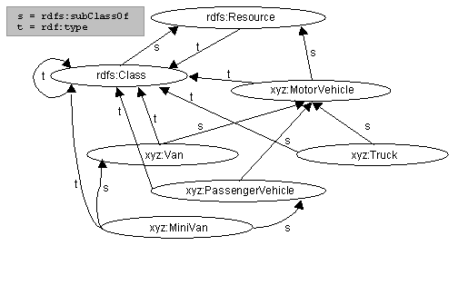
Example (1)
Example expresses the following class hierarchy. We first define a class MotorVehicle. We then define three subclasses of MotorVehicle, namely PassengerVehicle, Truck and Van. We then define a class Minivan which is a subclass of both Van and PassengerVehicle.

Slide 97
Example (2)
<rdf:RDF xml:lang="en"
xmlns:rdf="http://www.w3.org/1999/02/22-rdf-syntax-ns#"
xmlns:rdfs="http://www.w3.org/2000/01/rdf-schema#">
<!-- Note: this RDF schema would typically be used in RDF instance data by
referencing it with an XML namespace declaration, for example
xmlns:xyz="http://www.w3.org/2000/03/example/vehicles#". This allows us to
use abbreviations such as xyz:MotorVehicle to refer unambiguously to the RDF
class 'MotorVehicle'. -->
<rdf:Description ID="MotorVehicle">
<rdf:type resource="http://www.w3.org/2000/01/rdf-schema#Class"/>
<rdfs:subClassOf
rdf:resource="http://www.w3.org/2000/01/rdf-schema#Resource"/>
</rdf:Description>
...

Slide 98
Example (3)
…
<rdf:Description ID="PassengerVehicle">
<rdf:type resource="http://www.w3.org/2000/01/rdf-schema#Class"/>
<rdfs:subClassOf rdf:resource="#MotorVehicle"/>
</rdf:Description>
<rdf:Description ID="Truck">
<rdf:type resource="http://www.w3.org/2000/01/rdf-schema#Class"/>
<rdfs:subClassOf rdf:resource="#MotorVehicle"/>
</rdf:Description>
...

Slide 99
Example (4)
…
<rdf:Description ID="Van">
<rdf:type resource="http://www.w3.org/2000/01/rdf-schema#Class"/>
<rdfs:subClassOf rdf:resource="#MotorVehicle"/>
</rdf:Description>
<rdf:Description ID="MiniVan">
<rdf:type resource="http://www.w3.org/2000/01/rdf-schema#Class"/>
<rdfs:subClassOf rdf:resource="#Van"/>
<rdfs:subClassOf rdf:resource="#PassengerVehicle"/>
</rdf:Description>
</rdf:RDF>

Slide 100
rdfs:subPropertyOf
If the property biologicalFather is a subproperty of the broader property biologicalParent, and if Fred is the biologicalFather of John, then it is implied that Fred is also the biologicalParent of John.
<rdf:RDF xml:lang="en"
xmlns:rdf="http://www.w3.org/1999/02/22-rdf-syntax-ns#"
xmlns:rdfs="http://www.w3.org/2000/01/rdf-schema#">
<rdf:Description ID="biologicalParent">
<rdf:type resource="http://www.w3.org/1999/02/22-rdf-syntax-ns#Property"/>
</rdf:Description>
<rdf:Description ID="biologicalFather">
<rdf:type resource="http://www.w3.org/1999/02/22-rdf-syntax-ns#Property"/>
<rdfs:subPropertyOf rdf:resource="#biologicalParent"/>
</rdf:Description>
</rdf:RDF>

Slide 101
RDFS Example (1)
In this example, Person is a class with a corresponding human-readable description of "The class of people". Animal is a class presumed to be defined in another schema. All persons are animals, so we declare that Person is a subclass of Animal. A Person may have an age property. The value of age is an integer. A Person may also have an ssn ("Social Security Number") property. The value of ssn is an integer. Person's marital status is one of {Single, Married, Divorced, Widowed}. This is achieved through use of the rdfs:range constraint: we define both a maritalStatus property and a class MaritalStatus (adopting the convention of using lower case letters to begin the names of properties, and capitals for classes). We then use rdfs:range to state that a maritalStatus property only 'makes sense' when it has a value which is an instance of the class MaritalStatus. The schema then defines a number of instances of this class.

Slide 102
RDFS Example (2)
<rdf:RDF xml:lang="en"
xmlns:rdf="http://www.w3.org/1999/02/22-rdf-syntax-ns#"
xmlns:rdfs="http://www.w3.org/2000/01/rdf-schema#">
<rdfs:Class rdf:ID="Person">
<rdfs:comment>The class of people.</rdfs:comment>
<rdfs:subClassOf rdf:resource="http://www.w3.org/2000/03/example/classes#Animal"/>
</rdfs:Class>
<rdf:Property ID="maritalStatus">
<rdfs:range rdf:resource="#MaritalStatus"/>
<rdfs:domain rdf:resource="#Person"/>
</rdf:Property>
<rdf:Property ID="ssn">
<rdfs:comment>Social Security Number</rdfs:comment>
<rdfs:range rdf:resource="http://www.w3.org/2000/03/example/classes#Integer"/>
<rdfs:domain rdf:resource="#Person"/>
</rdf:Property>
...

Slide 103
RDFS Example (3)
...
<rdf:Property ID="age">
<rdfs:range rdf:resource="http://www.w3.org/2000/03/example/classes#Integer"/>
<rdfs:domain rdf:resource="#Person"/>
</rdf:Property>
<rdfs:Class rdf:ID="MaritalStatus"/>
<MaritalStatus rdf:ID="Married"/>
<MaritalStatus rdf:ID="Divorced"/>
<MaritalStatus rdf:ID="Single"/>
<MaritalStatus rdf:ID="Widowed"/>
</rdf:RDF>

Slide 104

Traditional RDF Statement
Subject of an RDF statement is a resource
Predicate of an RDF statement is a property of a resource
Object of an RDF statement is the value of a property of a resource (either literal or resource)
Property_k
Resource_i
Literal
OR
Property_r
Resource_i
Resource_ j

Slide 105

New semantics of RDF Statement in S-APL (object - executable resource)
Property_m
exe: Resource_ j
Resource_i
executable resource
Semantics of such statement means that the value of the Property_m of the Resource_i can be obtained as a result of execution of the procedure (query, service, function, etc.) represented as Resource_ j
S-APL

Slide 106
Where to look next
RDF:
http://www.w3.org/RDF/
RDF Schema:
http://www.w3.org/TR/rdf-schema/

