Slide 1
References
[1] D:\My Documents\SemanticWebWorkshop\kaynak\Ian Horrocks - CS646\intro-2004.ppt
[2] D:\My Documents\SemanticWebWorkshop\kaynak\VaganTerziyan-SW Course\SW_Tutorial_2004_Part_1.ppt
[3] kaynak\VaganTerziyan-SW Course\SW_Tutorial_2004_Part_1.ppt
[4] kaynak\Ian Horrocks - CS646\2ontologies.ppt
[5] kaynak\Ian Horrocks - CS646\7.1Lect-1-Ontology-and-OWL-2007.ppt
[6] kaynak\VaganTerziyan-SW Course\xEk2-Ontologies_1.ppt
[7] kaynak\Ian Horrocks - CS646\onto-db.ppt
[8] kaynak\Ian Horrocks - CS646\needham.ppt
[9] kaynak\Ian Horrocks - CS646\1introduction.ppt

Slide 2
Resources
W3C Documents
Guide: http://www.w3.org/TR/owl-guide/
Reference: http://www.w3.org/TR/owl-ref/
Semantics and Abstract Syntax: http://www.w3.org/TR/owl-semantics/
OWL Tutorials
Ian Horrocks, Sean Bechhofer: http://www.cs.man.ac.uk/~horrocks/Slides/Innsbruck-tutorial/
Roger L. Costello, David B. Jacobs: http://www.xfront.com/owl/
Example Ontologies, e.g. here:
http://www.daml.org/ontologies/
Notes:
[6]

Slide 3
A-Boxes & T-Boxes
The “T-Box” – for “terminology box”
Individuals in ontologies (The “A-Box”)
‘T-Box’ (Terminology Box)
Definitions and restrictions on classes
‘A-Box’(Assertions box)
Descriptions and assertions of individuals
DLs (& OWL DL) work best for T-Box
Large general A-Boxes are intractable
A change anywhere can propagate anywhere else
A is an instance of B
A-Boxes
John is a Person
All Students are Persons
There are two types of Persons: Students and Teachers
T-Boxes
Notes:
[3]

Slide 4
DL Architecture
Knowledge Base
Tbox (schema)
Man ´ Human u Male
Happy-Father ´ Man u 9 has-child Female u …
Interface
Inference System
Abox (data)
John : Happy-Father
hJohn, Maryi : has-child
Notes:
kaynak\Ian Horrocks - CS646\3pt2-dlintro.ppt
http://www.cs.man.ac.uk/~horrocks/Slides/index.html

Slide 5
Where to find out more: Web-Sites
OWL, OWL-S
http://www.w3.org/2004/01/sws-pressrelease
http://www.w3.org/2004/01/sws-testimonial
Semantic Web
http://www.w3.org/2001/sw/
http://www.semwebcentral.org/
Semantic Web Services
http://www.daml.org/services/
http://www.swsi.org/
http://www.wsmo.org
Notes:
[3]

Slide 6
Company Benefits from the Semantic Web
Developing ontology languages, ontologies, annotation support tools will give you an advance of several years before others can develop the same. Important is that the standards and the applications will depend on you.
Developing Semantic Web service platforms, agents, applications, based on widespread standards allows to automatically explore rich Web content providing services for millions of customers.
Annotate your own products and services. This makes your products and services reachable by new generation of semantic search engines and automatically accessed by Web applications, agents and services.
Notes:
[3]

Slide 7
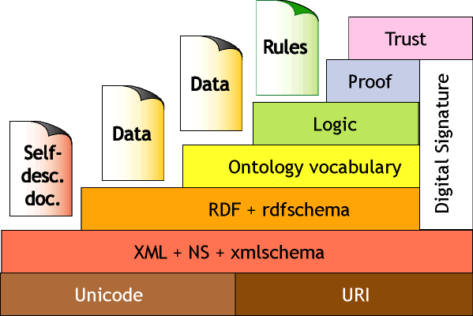
(In)famous “Layer Cake”
???
???
???
≈ Semantics+reasoning
?
≈ Relational Data
?
≈ Data Exchange
Relationship between layers is not clear
OWL DL extends “DL subset” of RDF
Notes:
[4]

Slide 8
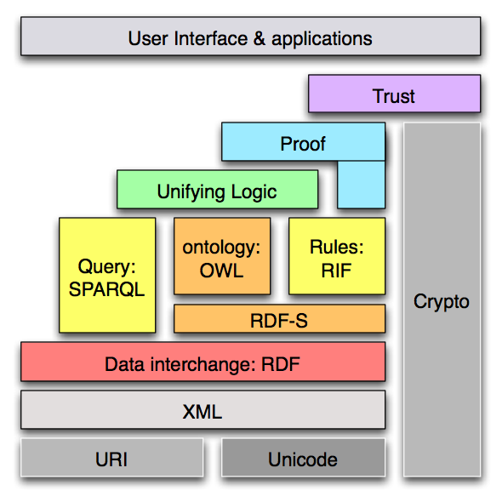
Semantic Web “Layered Cake” (refreshed)
Notes:
[6]

Slide 9
EK Konular
DL Intro
kaynak\Ian Horrocks - CS646\3pt2-dlintro.ppt
OWL and Inference
4.0Why did that happen
kaynak\Ian Horrocks - CS646\4.1why.ppt
DL Reasoning (&Tableaux Algorithm)
kaynak\Ian Horrocks - CS646\5pt3-dlreasoning.pdf
Notes:
(kaynak\Ian Horrocks - CS646\3pt2-dlintro.ppt) {
Description Logis describes relations between Concepts/Classes
Individuals secondary
}

