Slide 1
6.4 Basics of Full-Color Image Processing

Slide 2
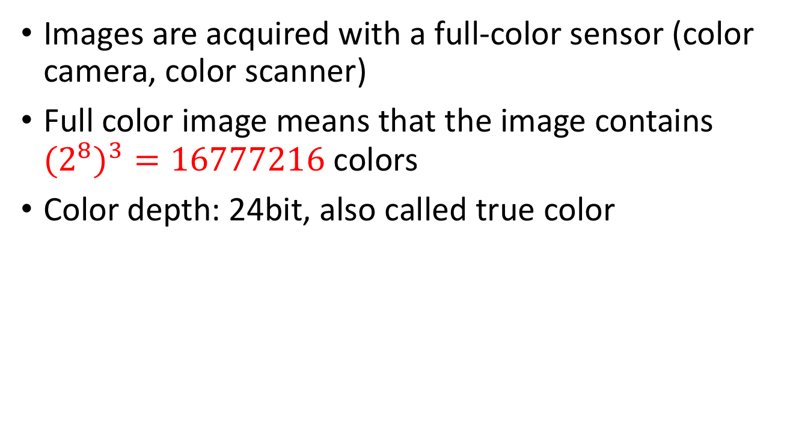
Full-Color Image Processing
Images are acquired with a full-color sensor (color camera, color scanner)
Full color image means that the image contains ${{(2}^{8})}^{3}=16777216$ colors
Color depth: 24bit, also called true color

Slide 3
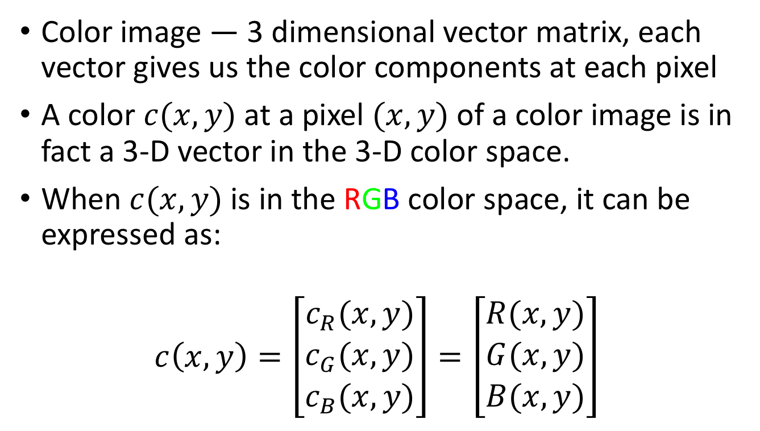
Full-Color Image Processing
Color image — 3 dimensional vector matrix, each vector gives us the color components at each pixel
A color $c(x, y)$at a pixel $(x, y)$of a color image is in fact a 3-D vector in the 3-D color space.
When $c(x, y)$is in the RGB color space, it can be expressed as:
$$c\left(x,y\right)=\left[\begin{matrix}c_{R}(x,y) \\ c_{G}(x,y) \\ c_{B}(x,y)\end{matrix}\right]=\left[\begin{matrix}R(x,y) \\ G(x,y) \\ B(x,y)\end{matrix}\right]$$

Slide 4
Types
Per-color-component Processing
Each component is processed individually
A composite color image is formed (e.g. sum, RMS, max) from individually processed components
Vector-based processing
Each color point can be represented as a vector in the RGB coordinate system

Slide 5
Types
The computation effort of per-color-component processing is generally significantly less. However, the results of these approaches are sometimes equivalent but sometimes different.
For these two approaches to be equivalent, two conditions must be met:
The process has to be applicable to both vectors and scalars
The operation on each component of a vector must be independent of the other components

Slide 6
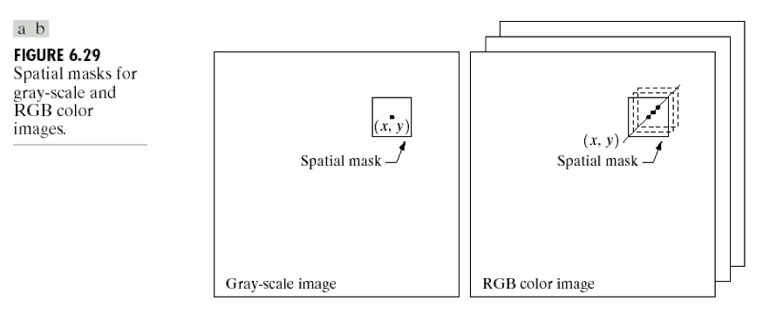
Examples
Notes:
假设这个mask为邻域取平均操作 avgpooling
左图中，为把邻域内所有像素的灰度相加，然后除以邻域内的【像素】总数
右图中，为把邻域内所有的像素相加，并用邻域内的【向量】总量去除每个分量。
但是每一个平均向量的每一个分量都是对应这个分量的所有像素。
所以这种情况下per-color-component和vector-based的处理方法结果是一样的。

