Slide 1

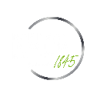
Life Expectancy – Linear Regression

Slide 2
Agenda
Overview of what we will be reviewing in this presentation
01
04
Overview
3D Model and Evaluations
02
05
Data Cleaning
2D Model and Evaluations
03
06
Visualizations
Closing Remarks
Notes:
Joseph

Slide 3
Overview

Slide 4




DS Process: CRISP - DM
Deployment
Gathered model and predictor quality.
Ensure this needs and requirements
Sharing the journey
Data Preparation
Cleaning, constructing, and formatting the data frames to be easily manipulated
This includes standardizing the genres, inputting Booleans to aid with qualitative comparisons, etc
Data Understanding
Initial review of data
Verification that the data can assist with goal
Business Understanding
What is the current situation?
What insights will have the greatest impact?
Can we retrieve these insights and how?
Notes:
Highlight these are not all the steps, but this slide will help us tell our story
Who is our stakeholder?
Students must explain how their projects address a real-world problem
In Semester 1 Capstone, the problem basics are provided in the project description
A real-world problem is an actual problem faced by an actual stakeholder
A stakeholder philanthropy organizations/ health teams / social development/global outreach
A problem is a challenge faced by a stakeholder in pursuit of some goal
A real-world problem is one that exists in reality, i.e. students could present the project to an actual human being and they could actually find value in it.
Motivation
As a dual citizen of the United States and Egypt, I am strongly connected and passionate for the well being and resources for these nations.
Problem
The issue at hand is we do not know the life expectancy or other measures of health in Egypt. We are unsure of how social, and health related factors has had an affect on the population. This study will help gain a baseline understanding of Egypt’s past and current state so we may project how various factors have played a role in people’s decline.
Industry/Realm
Social Development
Health
Presentation describes the project goals, data, methods, and results.
Mention how in business understanding that is also where we come up with the plan. Those questions are what set us up to have a plan

Slide 5
Stay Tuned
High-level of the business understanding, goals, and method behind this analysis
Problem
Stakeholders
Motivation
Analysis
Where should funding be placed to assist in developing countries to increase population’s health?
Philanthropy Organizations
Global Health Teams
Social Development
Global Outreach
Improving and understanding the quality of health and people all around the world
Reviewing the target variable life expectancy
Choose few dependent variables to assist understanding where funding shall be placed
Notes:
Students must explain how their projects address a real-world problem
In Semester 1 Capstone, the problem basics are provided in the project description
A real-world problem is an actual problem faced by an actual stakeholder
A stakeholder philanthropy organizations/ health teams / social development/global outreach
A problem is a challenge faced by a stakeholder in pursuit of some goal
A real-world problem is one that exists in reality, i.e. students could present the project to an actual human being and they could actually find value in it.
Motivation
As a dual citizen of the United States and Egypt, I am strongly connected and passionate for the well being and resources for these nations.
Problem
The issue at hand is we do not know the life expectancy or other measures of health in Egypt. We are unsure of how social, and health related factors has had an affect on the population. This study will help gain a baseline understanding of Egypt’s past and current state so we may project how various factors have played a role in people’s decline.
Industry/Realm
Social Development
Health

Slide 6
Data and Features
The utilized data is sourced from Global Health Observatory (GHO). Specifically, the model and regression will evaluate the correlations for the target variable life expectancy. This data spans from 2000 to 2015
Country
Year
Status
Life Expectancy
Adult Mortality
Infant Deaths
Alcohol
Percentage Expenditure
Hepatitis B
Measles
BMI
Under-Five Deaths
Polio
Total expenditure
Diphtheria
HIV/AIDS
GDP
Population
Thinness 1-19 years
Thinness 5-9 years
Income Composition of Resources
Schooling
Notes:
The data is sourced from The Global Health Observatory (GHO) data repository under World Health Organization.
This data is from the time period of 2000 to 2015.
In a nutshell, this data consists of immunization factors, mortality factors, economic factors, social factors and other health related factors.
Due to time constraints, this dataset is already prepopulated and found online.
Features include life expectancy, infant deaths, BMI index, population, HIV/AIDS, schooling, and much more.

Slide 7
Data Cleaning

Slide 8
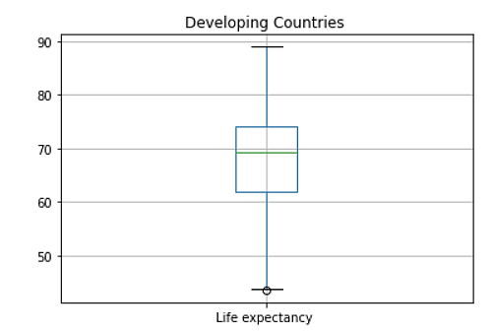
Data Cleaning
We removed the null values in our variables and the outliers before performing the training and testing for our model
Data Cleaning | Value
Original Lenth | 2938
After removing developed countries and null values | 2426
After removing outliers (minimum 43.49) | 2139
Model | Variable
Target variable | Life Expectancy
External Dependent Variable | Schooling
Internal Dependent Variable | Alcoholism
Notes:
We need to include method and visual results here
the full range of data we started with ??

Slide 9
Visualizations

Slide 10
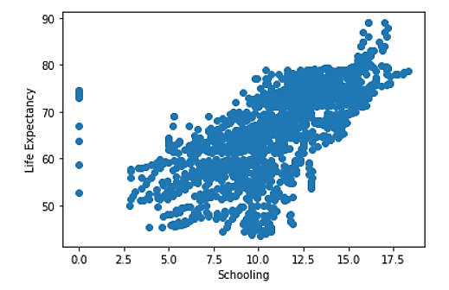
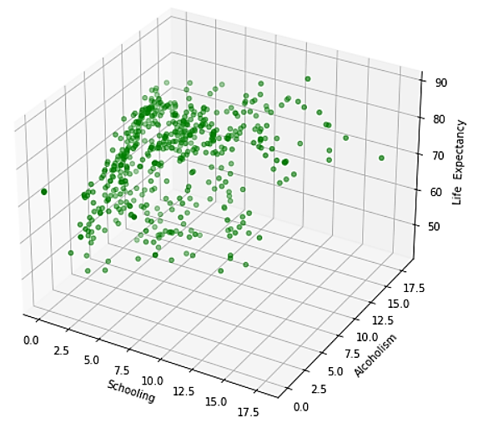
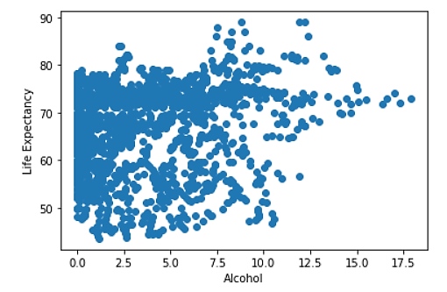
Visualizations
We removed the null values in our variables and the outliers before performing the training and testing for our model
Notes:
We need to include method and visual results here
the full range of data we started with ??

Slide 11
3D: Life Expectancy VS. Schooling VS. Alcohol

Slide 12
Model Evaluation
As we can see the MSE of the test is lower than our train data, which highlights the improvement in our model prediction
Train VS. Test
Quality Checks | Values
Mean Squared Error Train | 40.37
Mean Squared Error Test | 41.39
Test Prediction
Quality Checks | Values
Mean Absolute Error | 4.71
Root Mean Squared Error | 6.43
Normalizing Root Mean Squared Error | 0.14
Notes:
Will be looking at statistical inferences such as MAE, MSE and RMSE.
Here we are able to take a closer look at the data that fits our criteria

Slide 13
2D: Life Expectancy VS. Schooling

Slide 14
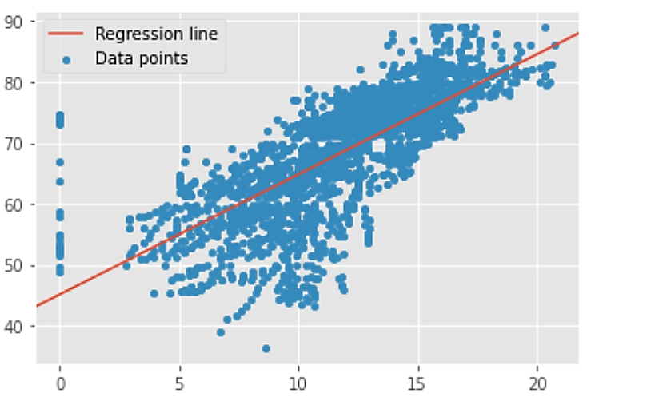
Model: Regression Line
Our regression line is y = 0.23159 x - 4.38385
Life Expectancy
Schooling

Slide 15
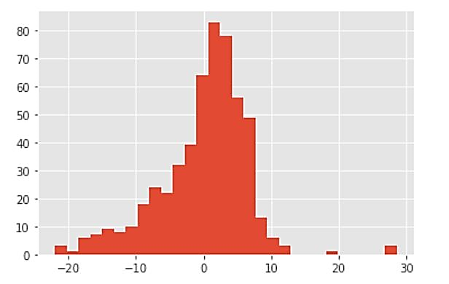
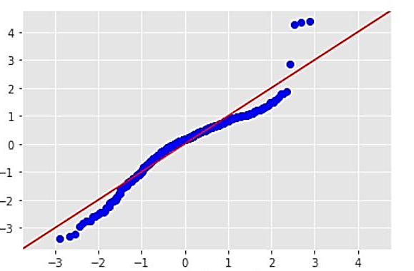
Model: Histogram of the Residuals and Q-Q Plot
Life Expectancy
Sample Quantiles
Residuals
Theoretical Quantiles
Notes:
Residuals -The vertical distance between a data point and the graph of a regression equation

Slide 16
Model Evaluation
Here we review our OLS (Ordinary Least Squares) regression
Quality Checks | Values
R Squared | 0.44
Prob (F-statistic) | 1.12e-68
Skew | Left: -0.414
44% of the variation in Y (Life Expectancy) is explained by our model
Notes:
Linear regression is employed in supervised machine learning tasks. OLS regression can be used to obtain a straight line as close as possible to your data points.
Rsquared: This means that the proportion of the variance explained by our model out of the total variance is about 0.44, or 44%. You can also say, 44% of the variation in 𝑦 is explained by our model.
For example, if Prob(F) has a value of 0.01then there is 1 chance in 100 that all of the regression parameters are zero. -- OUR prob 5 is very very low low

Slide 17
Closing Remarks

Slide 18
Acknowledgments
Special Thank You!
Flatiron Instructor
William Wang
Flatiron Instructor
JP Ventura
Deloitte
Program Coordinator
Tina Lhotak
Deloitte
Program
Coordinator
Amy Huttenhoff
Deloitte
Program Coordinator
Laura Tolliver
Mentor
Robert Hernandez
Flatiron Program Coordinator
Jordan Schraeder
AI Cohort 4
Guest Speakers
Notes:
Sheri

Slide 19
THANK YOU!
QUESTIONS?
Notes:
Sheri

