Slide 1

Tabaani: Your AI Startup Launchpad
POWERED BY SPARK2SCALE AI

Slide 2


THE FOUNDER'S NIGHTMARE: IDEAS DIE HERE
Launching a startup is a minefield. Most brilliant ideas never see the light of day.
Generic tools waste precious time and resources, leaving founders confused.
A brutal 50%+ of startups fail early – not from lack of vision, but lack of validation.
Notes:
The journey of a startup founder is incredibly challenging, often characterized by immense uncertainty. Many entrepreneurs pour their passion and capital into concepts that haven't been rigorously tested or structured for success. The current market offers a sea of generic AI tools and time-consuming manual processes, failing to meet the critical need for specialized idea validation and investor-ready documentation. This gap leads to significant waste and a heartbreaking failure rate – over half of startups falter at this crucial stage. Tabaani is designed to be the guiding light.

Slide 3

TABAANI: YOUR AI CO-FOUNDER
Instantly transform ideas into validated, investor-ready blueprints.
Get AI-driven evaluation reports that turn guesswork into strategy.
Generate essential business documents in minutes, not weeks.
Notes:
Think of Tabaani as your indispensable AI co-founder. We harness advanced AI to deliver a seamless, end-to-end solution specifically for early-stage startups. Our platform meticulously analyzes ideas, generates comprehensive validation reports, and crafts compelling investor-ready documents. This empowers founders to validate their concepts with unprecedented speed and prepare powerful pitches, freeing them from the limitations of generic tools and tedious manual efforts. We are purpose-built for the founder's journey.

Slide 4
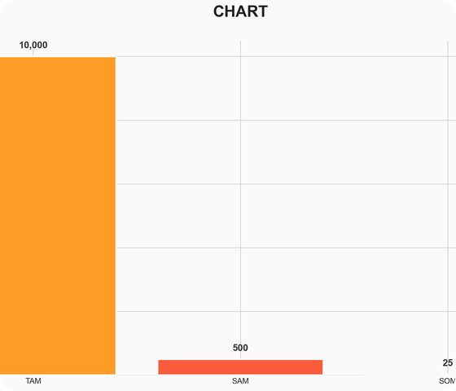
UNLOCKING A $10B AI STARTUP SUPPORT MARKET
We're tapping into the global AI startup support market, a massive $10 Billion+ opportunity.
Our strategic focus: the $500 Million MENA market for specialized AI evaluation tools.
Poised to capture a significant $25 Million share in our initial years.
Notes:
The market for startup support, particularly AI-enhanced solutions, is substantial and experiencing rapid growth. Globally, this sector commands over $10 billion. Our initial beachhead market, focusing on early-stage startups in the MENA region requiring AI-driven evaluation, represents a $500 million opportunity. We are strategically positioned to capture $25 million of this market within our first few years. While it's a dynamic and competitive landscape, our specialized focus provides a distinct and powerful advantage.

Slide 5

OUR PRODUCT: AI THAT TRULY GETS STARTUPS
Live MVP: AI validation and document generation ready today.
The key differentiator: proprietary algorithms engineered for startup-specific scoring.
We build deep user loyalty through consistently actionable insights.
Notes:
Our product has achieved Minimum Viable Product (MVP) status, effectively demonstrating the core AI-powered capabilities for idea evaluation and document generation. What truly sets us apart are our proprietary algorithms, meticulously trained to score startup ideas and proactively identify potential challenges. This specialized approach fosters a highly valuable and 'sticky' product experience. Looking ahead, our long-term vision includes significantly enhancing these AI functionalities and integrating vital mentorship and further validation tools, solidifying Tabaani as the essential platform for early-stage founders.

Slide 6
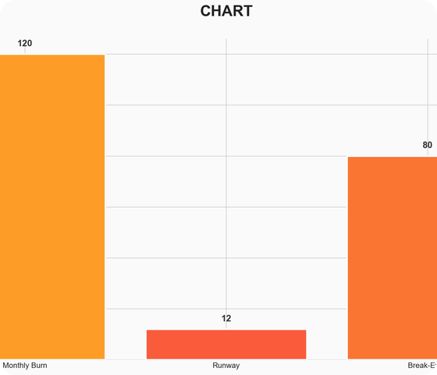
SCALABLE GROWTH: OUR FREEMIUM ADVANTAGE
Leveraging a freemium model for maximum adoption and user acquisition.
Targeting an average revenue of $400 per paying customer.
Current monthly burn: $120K, with a 12-month runway.
Notes:
Our business model is strategically designed for rapid user acquisition and scalable revenue generation. We employ a freemium strategy, offering essential features at no cost to attract a broad user base, with premium tiers providing access to advanced capabilities. We've projected an average revenue of $400 per paying customer. While our current financial snapshot indicates a monthly burn of $120,000, we have a 12-month runway. The proposed funding will be instrumental in optimizing our operational costs and accelerating revenue growth, ultimately shortening our path to profitability.

Slide 7
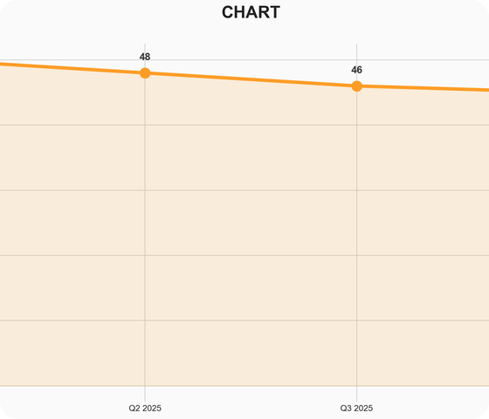
TRACTION: VALIDATION CONFIRMED, GROWTH IGNITED
15 Founder Interviews validate the urgent need for our solution.
Pilot users confirm the critical demand for specialized AI tools.
Overwhelmingly positive MVP feedback on core functionalities.
Notes:
We've moved beyond theoretical validation. Our core value proposition has been rigorously tested through 15 in-depth interviews with early-stage founders, confirming the significant pain point we address. Pilot users have provided invaluable feedback, emphasizing the critical demand for AI tools specifically designed for startup evaluation. While we are at the pre-seed stage and haven't yet achieved substantial user numbers or revenue, the qualitative feedback on our MVP is exceptionally strong. Our primary traction goal now is to cultivate our initial user base and leverage their insights for rapid product iteration.

Slide 8

OUR TEAM: AI & STARTUP VETERANS
CEO Ahmed Hassan: 5-year veteran startup consultant.
CTO Mona Ali: 4 years of cutting-edge AI/ML expertise from TechLabs.
COO Sara Khaled: 6 years of operational leadership ensuring flawless execution.
Notes:
Our team is uniquely equipped to execute Tabaani's ambitious vision. Ahmed Hassan, our CEO, possesses five years of hands-on experience as a startup consultant, providing deep insights into the founder's journey. Mona Ali, our CTO, is a highly skilled ML Engineer with four years of experience at TechLabs, bringing essential AI development capabilities. Sara Khaled, our COO, has six years of experience in operational management, ensuring scalable and efficient execution. Together, we represent a formidable blend of technical prowess, market acumen, and operational excellence.

Slide 9

SEEKING $500K TO SCALE AI STARTUP LAUNCHPAD
We are seeking $500,000 in Pre-Seed funding.
This investment will accelerate our AI model development and platform deployment.
Crucially, it will power our customer acquisition engine and drive market penetration.
Notes:
To accelerate Tabaani's trajectory and seize this significant market opportunity, we are seeking $500,000 in Pre-Seed funding. These funds will be strategically allocated to advance our core AI model, scale our platform infrastructure, and aggressively pursue customer acquisition through targeted marketing and community engagement. This investment provides the essential runway to achieve critical milestones, including onboarding 1,000 active users and securing 100 paying customers within the next 18 months, solidifying Tabaani's position as the leader in AI startup evaluation.

