Slide 1

Assil by Tabaani Technology [cite: 20]
POWERED BY SPARK2SCALE AI

Slide 2

THE PROBLEM
Travel planning is overwhelming (43% dislike choice overload)
itineraries are often impersonal (90% want local experiences)[cite: 34, 35]
Notes:
State the pain point clearly.

Slide 3
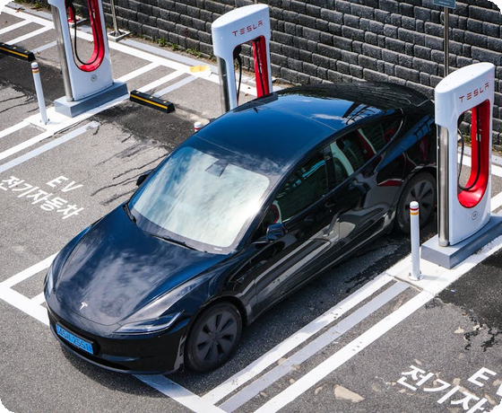
OUR SOLUTION
AI-powered authentic planning with personalized itineraries
real-time planning
and multilingual support (Arabic
Notes:
Your product is the hero.

Slide 4
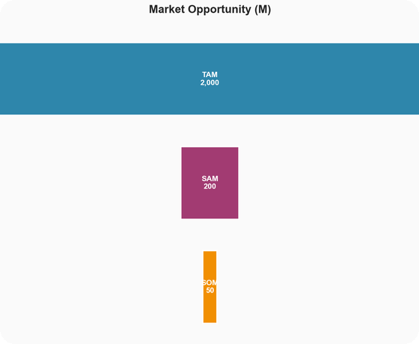
MARKET SIZE
TAM: 2000M Market
SAM: 200M target
SOM: 50M reachable
Notes:
Massive opportunity: 2000M TAM

Slide 5

THE PRODUCT
Intuitive user interface
Real-time AI processing
Seamless cloud integration
Notes:
Walk through the features.

Slide 6

BUSINESS MODEL
Hybrid Freemium and B2B API Licensing Model[cite: 13]
Notes:
Our path to revenue.

Slide 7
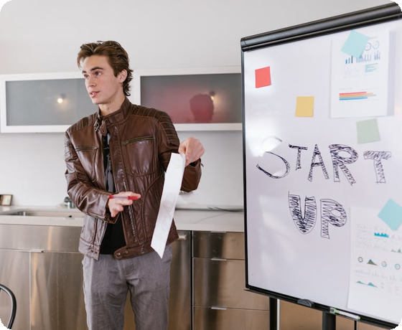
TRACTION
10,000 Active Users
$45,000 Revenue
Market leading retention
Notes:
Real proof of growth.

Slide 8
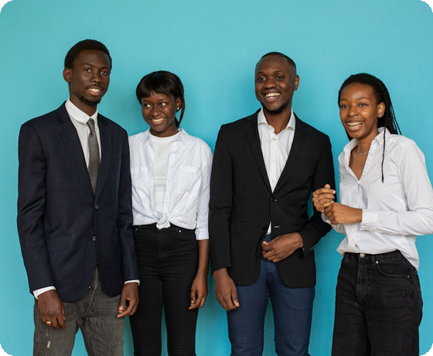
THE TEAM
Hamza Moussi (Product/AI Architect)
Moukim Hfaiedh (Tech)
Salma Cherif (AI Eng)
Notes:
The talent behind the tech.

Slide 9
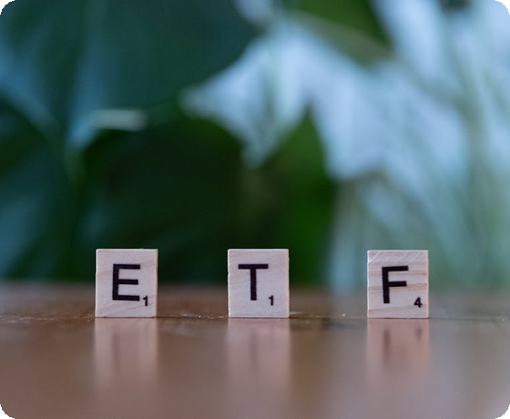
THE ASK
$300k Pre-seed for 12 months to reach 15
000 bookings and ~$360k in generated revenue[cite: 18]
Notes:
Invest in the future.

