Slide 1
Future of AI in Baking
Generated by Spark2Scale AI

Slide 2
The Rise of Smart Ovens
• AI-controlled temperature regulation.
• Automatic bread sensing.
• Energy efficiency improvements.
Notes:
Discuss how smart ovens are changing the game.

Slide 3
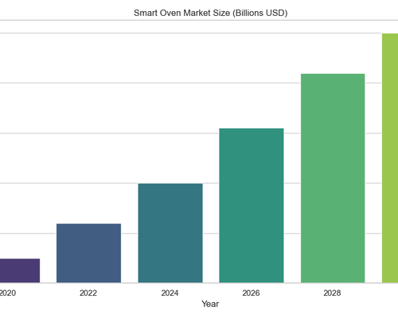
Market Growth
• 50% year-over-year growth.
• Adoption in both commercial and home kitchens.
• Projected market size of $5B by 2030.
Notes:
Highlight the massive growth potential.

Slide 4
Conclusion
• AI is essential for modern baking.
• Invest now to stay ahead.
• The future is delicious.
Notes:
Wrap up with a call to action.

